Slide 1
Probability
A tutorial on Bayesian, Conditional prob. Gaussian, likelihood, etc.
KH Wong

Slide 2
Introduction
Bayesian rule
Conditional probability density
Prior and Posterior probability densities
Gaussian
Maximum likelihood
Discrete likelihood

Slide 3
Bayesian rules

Slide 4
Bayesian rules
P(B|A)=P(A|B)P(B)/P(A)
P(A and B)=P(A,B)=P(A|B) P(B)
P(A,B|C)=P(A|B,C) P(B|C)
Prove the above as exercises
In each cell, the joint probability p(r, c) is re-expressed by the equivalent form
p(r | c) p(c) from the definition of conditional probability in Equation 5.3. The marginal probability p(r) =Σ_{c*}p(r | c*) p(c*),
https://www.sciencedirect.com/topics/mathematics/marginal-probability

Slide 5
Conditional Probability

Slide 6
Conditional probability density
https://newonlinecourses.science.psu.edu/stat414/node/117/

Slide 7
Expectation Conditional probability 1
https://stats.stackexchange.com/questions/75024/conditional-expectation-subscript-notation
Example:
E(X | Y ) = { 9/4 with probability 1/8, and 18/4 with probability 7/8}.
Total average is: E(X) = E_{Y}{ E(X|Y) } =(9/ 4) ×( 1 /8) + (18/ 4) × (7 /8) = 4.22.
https://folk.ntnu.no/arvidn/TMA4265/Chap%203%20from%20Ross.pdf
https://www.math.arizona.edu/~tgk/464_07/cond_exp.pdf
https://www.stat.auckland.ac.nz/~fewster/325/notes/ch3.pdf

Slide 8
Expectation Conditional probability 2 -- example
https://stats.stackexchange.com/questions/75024/conditional-expectation-subscript-notation

Slide 9
Prior and Posterior probability densities

Slide 10
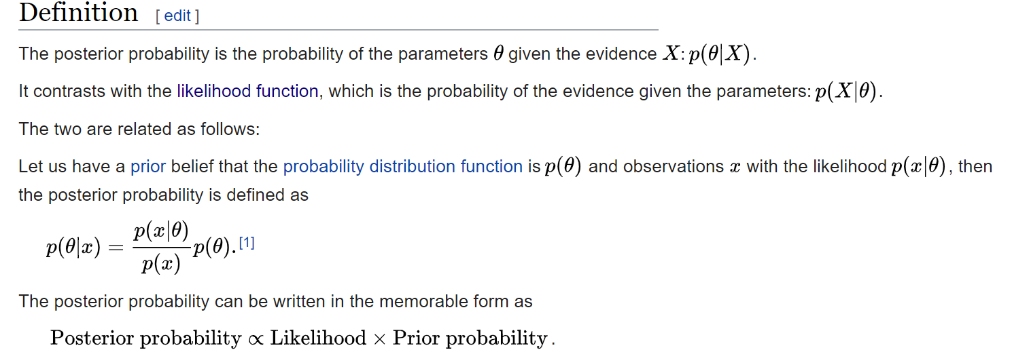
Prior and Posterior probability densities
https://en.wikipedia.org/wiki/Posterior_probability

Slide 11
Gaussian distribution

Slide 12
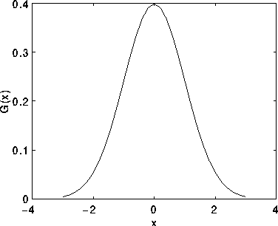
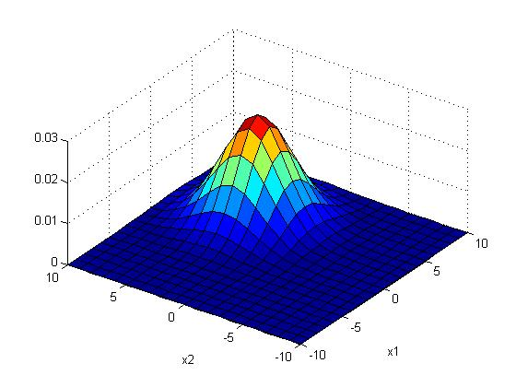
Gaussian distribution
%2-D Gaussian distribution P(x_{j})
%matlab code----------
clear, N=10
[X1,X2]=meshgrid(-N:N,-N:N);
sigma =2.5;mean=[3 3]'
G=1/(2*pi*sigma^2)*exp(-((X1-mean(1)).^2+(X2-mean(2)).^2)/(2*sigma^2));
G=G./sum(G(:)) %normalise it
'sigma is ', sigma
'sum(G(:)) is ',sum(G(:))
'max(max(G(:))) is',max(max(G(:)))
figure(1), clf
surf(X1,X2,G);
xlabel('x1'),ylabel('x2')

Slide 13
Worksheet 1 (Given : σ=2, (mean_x,mean_y)=(4,4))
x=m_{x}
y=m_{y}
x=1+m_{x}
y=m_{y}
Fill in the blanks of this Gaussian function of size 9x9 , sigma (σ)=2, (mean_x, mean_y)=(4,4)
Sketch the function
Position
(0,0)
G(x,y)=
0.0007 0.0017 0.0033 0.0048 0.0054 0.0048 0.0033 0.0017 0.0007
0.0017 0.0042 0.0078 0.0114 0.0129 0.0114 0.0078 0.0042 0.0017
0.0033 0.0078 0.0146 0.0213 0.0241 0.0213 0.0146 0.0078 0.0033
0.0048 0.0114 0.0213 0.0310 0.0351 0.0310 0.0213 0.0114 0.0048
0.0054 0.0129 0.0241 0.0351 ____? ____? 0.0241 0.0129 0.0054
0.0048 0.0114 0.0213 0.0310 0.0351 ____? 0.0213 0.0114 0.0048
0.0033 0.0078 0.0146 0.0213 0.0241 0.0213 0.0146 0.0078 0.0033
0.0017 0.0042 0.0078 0.0114 0.0129 0.0114 0.0078 0.0042 0.0017
0.0007 0.0017 0.0033 0.0048 0.0054 0.0048 0.0033 0.0017 0.0007

Slide 14
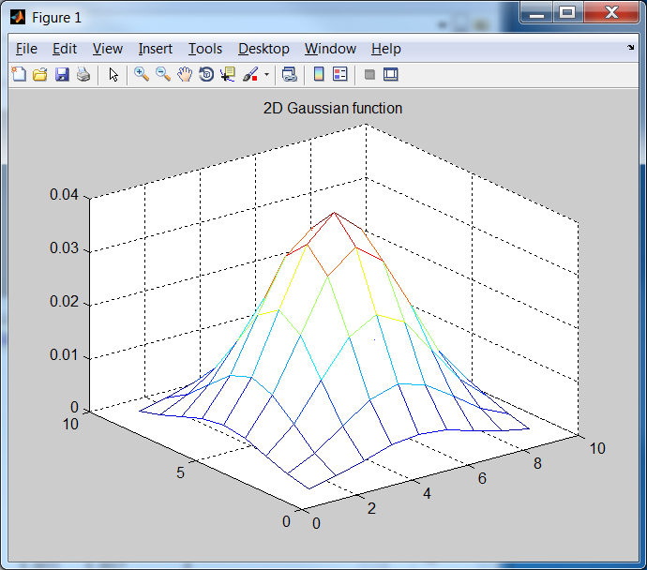
Answer1 (Given : σ=2, (mean_x,mean_y)=(4,4))
1/(2*pi*2^2)
1/(2*pi*2^2)*exp(-1/8)
Fill in the blanks of this Gaussian function of size 9x9 , sigma (σ)=2, (mean_x, mean_y)=(4,4)
Sketch the function
x=1+m_{x}
y=m_{y}
Position
(0,0)
x=m_{x}
y=m_{y}
1/(2*pi*2^2)*exp(-2/8)
0.0007 0.0017 0.0033 0.0048 0.0054 0.0048 0.0033 0.0017 0.0007
0.0017 0.0042 0.0078 0.0114 0.0129 0.0114 0.0078 0.0042 0.0017
0.0033 0.0078 0.0146 0.0213 0.0241 0.0213 0.0146 0.0078 0.0033
0.0048 0.0114 0.0213 0.0310 0.0351 0.0310 0.0213 0.0114 0.0048
0.0054 0.0129 0.0241 0.0351 0.0398 0.0351 0.0241 0.0129 0.0054
0.0048 0.0114 0.0213 0.0310 0.0351 0.0310 0.0213 0.0114 0.0048
0.0033 0.0078 0.0146 0.0213 0.0241 0.0213 0.0146 0.0078 0.0033
0.0017 0.0042 0.0078 0.0114 0.0129 0.0114 0.0078 0.0042 0.0017
0.0007 0.0017 0.0033 0.0048 0.0054 0.0048 0.0033 0.0017 0.0007
clear %matlab
sigma=2 % in matlab , no -ve index for looping, so shift center to (5,5)
mean_x=5 , mean_y=5
for y=1:9
for x=1:9
g(x,y)=(1/(2*pi*sigma^2))*exp(-((x-mean_x)^2+(y-mean_y)^2) /(2*sigma^2))
end
end
mesh(g)
title('2D Gaussian function')

Slide 15
Worksheet 2 (Given : σ=2, (mean_x,mean_y)=(4,4))
1/(2*pi*2^2)
1/(2*pi*2^2)*exp(-1/8)
x=m_{x}
y=m_{y}
x=1+m_{x}
y=m_{y}
Position
(0,0)
1/(2*pi*2^2)*exp(-2/8)
What is the peak probability value and (x,y) position of the peak?
0.0007 0.0017 0.0033 0.0048 0.0054 0.0048 0.0033 0.0017 0.0007
0.0017 0.0042 0.0078 0.0114 0.0129 0.0114 0.0078 0.0042 0.0017
0.0033 0.0078 0.0146 0.0213 0.0241 0.0213 0.0146 0.0078 0.0033
0.0048 0.0114 0.0213 0.0310 0.0351 0.0310 0.0213 0.0114 0.0048
0.0054 0.0129 0.0241 0.0351 0.0398 0.0351 0.0241 0.0129 0.0054
0.0048 0.0114 0.0213 0.0310 0.0351 0.0310 0.0213 0.0114 0.0048
0.0033 0.0078 0.0146 0.0213 0.0241 0.0213 0.0146 0.0078 0.0033
0.0017 0.0042 0.0078 0.0114 0.0129 0.0114 0.0078 0.0042 0.0017
0.0007 0.0017 0.0033 0.0048 0.0054 0.0048 0.0033 0.0017 0.0007
clear %matlab
sigma=2 % in matlab , no -ve index for looping, so shift center to (5,5)
mean_x=5 , mean_y=5
for y=1:9
for x=1:9
g(x,y)=(1/(2*pi*sigma^2))*exp(-((x-mean_x)^2+(y-mean_y)^2) /(2*sigma^2))
end
end
mesh(g)
title('2D Gaussian function')

Slide 16
Answer 2 (Given : σ=2, mean_x,mean_y=(4,4))
1/(2*pi*2^2)
1/(2*pi*2^2)*exp(-1/8)
What is the peak probability value and (x,y) position of the peak? Answer: peak probability value= 0.0398 at (x,y)=(4,4)
x=m_{x}
y=m_{y}
x=1+m_{x}
y=m_{y}
Position
(0,0)
1/(2*pi*2^2)*exp(-2/8)
0.0007 0.0017 0.0033 0.0048 0.0054 0.0048 0.0033 0.0017 0.0007
0.0017 0.0042 0.0078 0.0114 0.0129 0.0114 0.0078 0.0042 0.0017
0.0033 0.0078 0.0146 0.0213 0.0241 0.0213 0.0146 0.0078 0.0033
0.0048 0.0114 0.0213 0.0310 0.0351 0.0310 0.0213 0.0114 0.0048
0.0054 0.0129 0.0241 0.0351 0.0398 0.0351 0.0241 0.0129 0.0054
0.0048 0.0114 0.0213 0.0310 0.0351 0.0310 0.0213 0.0114 0.0048
0.0033 0.0078 0.0146 0.0213 0.0241 0.0213 0.0146 0.0078 0.0033
0.0017 0.0042 0.0078 0.0114 0.0129 0.0114 0.0078 0.0042 0.0017
0.0007 0.0017 0.0033 0.0048 0.0054 0.0048 0.0033 0.0017 0.0007
clear %matlab
sigma=2 % in matlab , no -ve index for looping, so shift center to (5,5)
mean_x=5 , mean_y=5
for y=1:9
for x=1:9
g(x,y)=(1/(2*pi*sigma^2))*exp(-((x-mean_x)^2+(y-mean_y)^2) /(2*sigma^2))
end
end
mesh(g)
title('2D Gaussian function')

Slide 17
Exercise 4 on Gaussian distribution
mean (µ)=[3 3]‘, sigma(σ)=2.5 of a 2D Gaussian
Parameters of a Gaussian model θ = [µ, σ].
(1) Find P(x_{j}=[1,3]’), what does it represent?
Ans:
_________________________________
(2) plot the distribution give x=[0 1 2 3 4 5 6]
ANS:
_________________________________
(3) Where is the peak (max P)?
Ans:

Slide 18
Exercise 4 on Gaussian distribution
mean (µ)=[3 3]‘, sigma(σ)=2.5 of a 2D Gaussian
Parameters of a Gaussian model θ = [µ, σ].
(1) Find P(x_{j}=[1,3]’), what does it represent?
Answer:
Follow the formula and find the answer xxx:
(2) plot the distribution give x=[0 1 2 3 4 5 6]
it means, using such a model(θ = [µ, σ]), the probability at x_{j}=[1,3]’ is xxx.
(3) Where is the peak (max P)?
Answer: at 3,3.

Slide 19
Differentiation w.r.t mean of a Gaussian with standard deviation =1

Slide 20
Probability vs likelihood
It is two sides of a coin.
P() Probability function :
Given a Gaussian model (with mean µ_{o} and variance σ_{o}), the probability function P(X| µ_{o,}σ_{o}) measures the probability that the observation X is generated by the model.
L() likelihood function:
Given data X, the Likelihood function L(µ_{o,}σ_{o}| X) measures the probability that X fits the Gaussian model with mean µ_{o} and variance σ_{o}.
Major application: Given data X, we can maximize the Likelihood function L(µ_{o,}σ_{o}| X) to find the model (µ_{o,}σ_{o}) that fits the data. This is called the maximum likelihood method.
Log-likelihood rather than likelihood is more convenient for finding the maximum, hence it is often used.

Slide 21
Likelihood function L( ) of n-dimension
Likelihood function
Intuition: Likelihood function L(µ,σ|X)) means: given a Gaussian model N(mean, variance) how much the multivariate data X =[x₁,x₂,x₃,..,x_{n}] fits the model.

Slide 22
A more useful representation Log-Likelihood function= Log(L( ))=l ()
Intuition:
The peak of Likelihood and Log-Likelihood functions should be the same.
The two are one to one mapping hence no data loss.
Log based method is easier to be handled by math, so log-Likelihood function is often used
For computers, log numbers are smaller hence may save memory. Using log, we can use addition rather than multiplication which makes computation easier.

Slide 23
Maximum Likelihood V.S. Log-Likelihood
http://jrmeyer.github.io/machinelearning/2017/08/18/mle.html
https://towardsdatascience.com/probability-concepts-explained-maximum-likelihood-estimation-c7b4342fdbb1

Slide 24
Proof 1 :Maximum Log-Likelihood function of a Multivariate Gaussian distribution
http://jrmeyer.github.io/machinelearning/2017/08/18/mle.html
https://towardsdatascience.com/probability-concepts-explained-maximum-likelihood-estimation-c7b4342fdbb1

Slide 25
Proof 2 : Maximum Log-Likelihood function of a Multivariate Gaussian distribution
http://people.stat.sfu.ca/~raltman/stat402/402L4.pdf
https://towardsdatascience.com/probability-concepts-explained-maximum-likelihood-estimation-c7b4342fdbb1

Slide 26
Alternative proof: Maximum Log_likelihood Find the most suitable variance σ²
Maximum likelihood is at

Slide 27
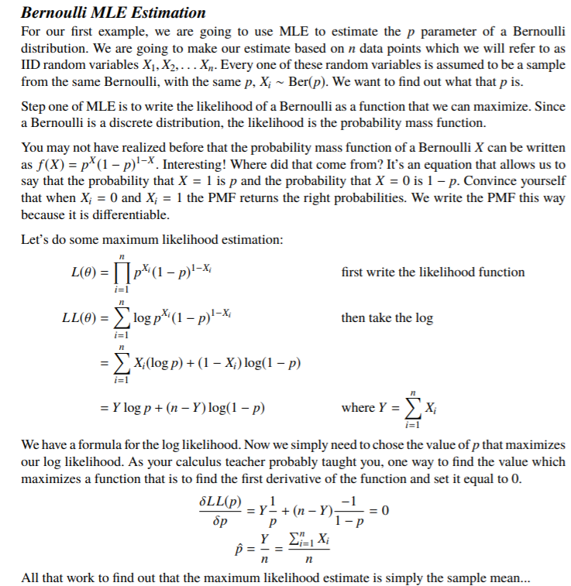
Discrete likelihood
The Bernoulli distribution,.. is the discrete probability distribution of a random variable which takes the value 1 with probability p and the value 0 with probability q=1-p. https://en.wikipedia.org/wiki/Bernoulli_distribution

Slide 28
Negative Log-Likelihood (NLL)
And its application in softmax
To maximize log-likelihood, we can minimize its negative log-likelihood (NLL) function

Slide 29
Softmax function
https://medium.com/data-science-bootcamp/understand-the-softmax-function-in-minutes-f3a59641e86d
y=[2 , 1, 0.1]’
Softmax(y)=[0.6590, 0.242,0.0986]’
exp(2)/((exp(2)+exp(1)+exp(0.1))=0.6590
exp(1)/((exp(2)+exp(1)+exp(0.1))= 0.2424
exp(0.1)/((exp(2)+exp(1)+exp(0.1))= 0.0986

Slide 30
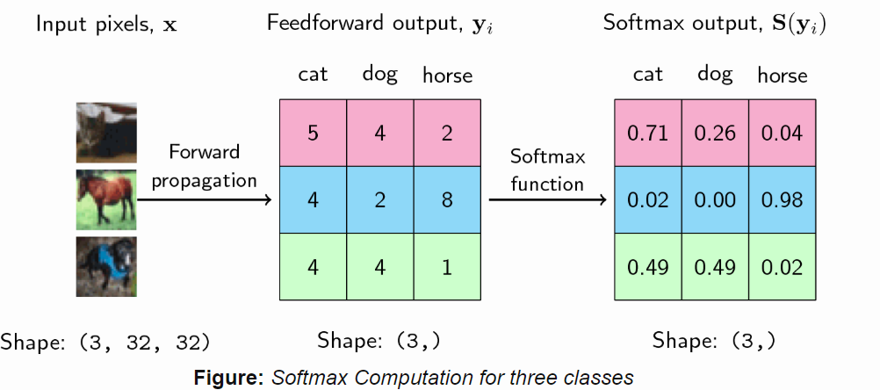
Softmax Activation Function
https://ljvmiranda921.github.io/notebook/2017/08/13/softmax-and-the-negative-log-likelihood/#nll
exp(4)/((exp(5)+exp(4)+exp(2))=0.25949
exp(5)/((exp(5)+exp(4)+exp(2))=0.705
=5/(5+4+2)=

Slide 31
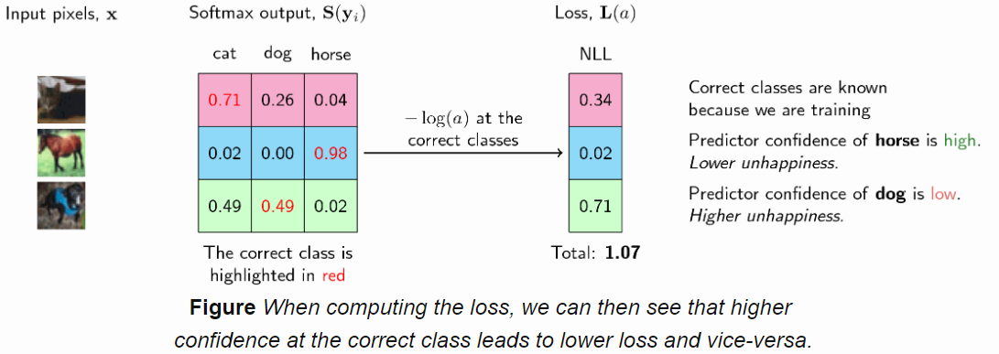
Negative Log-Likelihood (NLL)
=-ln(likelihood)
=-ln(0.02)=3.91
=-ln(0)=infinity
=-ln(0.98)=0.02
Minimum negative log-likelihood (NLL) is picked, so 0.02 is selected
To maximize likelihood, minimum negative log-likelihood (NLL) is picked
Softmax output as the
likelihood
https://ljvmiranda921.github.io/notebook/2017/08/13/softmax-and-the-negative-log-likelihood/#nll
https://knet.readthedocs.io/en/latest/softmax.html

Slide 32
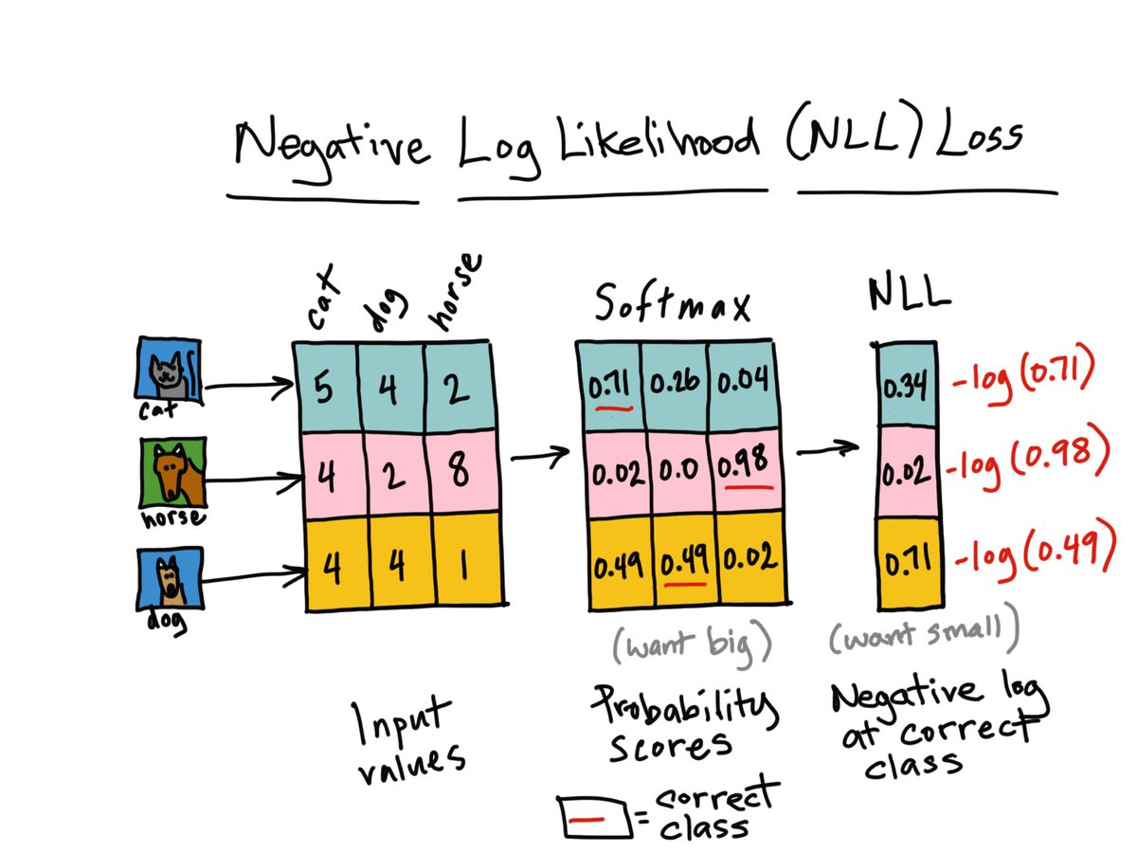
Continue
-log(0.71) %= 0.3425
-log(0.26) %= 1.3471
-log(0.4) %=0.9163
'//////////////'
-log(0.02) %=3.9120
-log(0)%-(-inf)=inf
-log(0.98) %0.0202
'////////////////////'
-log(0.49) %=0.7133
-log(0.49) %=0.7133
-log(0.02) %=3.9120
https://ljvmiranda921.github.io/notebook/2017/08/13/softmax-and-the-negative-log-likelihood/#softmax-activation-function

Slide 33
Probability distribution and T-SNE
KH Wong

Slide 34
Overview
Gaussian Distribution introduction
T Distribution introduction

Slide 35
Introduction
T-distribution is useful when sample size is small
T-SNE (t-distributed stochastic neighbor embedding) algorithm can be used to reduce the dimension of dimensional data,. The application is to show multiple-dimensional data using lower-dimension (2 to 3) displaying methods.

Slide 36
Normal (Gaussian ) distribution

Slide 37
Normal Distribution Definition
The Normal Distribution is defined by the probability density function for a continuous random variable in a system. Let us say, f(x) is the probability density function and X is the random variable. Hence, it defines a function which is integrated between the range or interval (x to x + dx), giving the probability of random variable X, by considering the values between x and x+dx.
f(x) ≥ 0 ∀ x ϵ (−∞,+∞)
And _{-∞}∫^{+∞} f(x) = 1
Normal Distribution Formula
The probability density function of normal or gaussian distribution is given by;

Slide 38
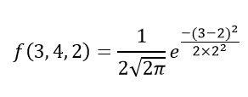
Example https://byjus.com/maths/normal-distribution/
Question 1: Calculate the probability density function of normal distribution using the following data. x = 3, μ = 4 and σ = 2.
Solution: Given, variable, x = 3
Mean = 4 and
Standard deviation = 2
By the formula of the probability density of normal distribution, we can write; where,
x is the variable
μ is the mean
σ is the standard deviation

Slide 39
Normal Distribution Problems and Solutions
Question 1: Calculate the probability density function of normal distribution using the following data. x = 3, μ = 4 and σ = 2.
Solution: Given, variable, x = 3
Mean = 4 and
Standard deviation = 2
By the formula of the probability density of normal distribution, we can write;
Hence, f(3,4,2) = 1.106.

Slide 40
Example 2
Question 2: If the value of random variable is 2, mean is 5 and the standard deviation is 4, then find the probability density function of the gaussian distribution.
Solution: Given,
Variable, x = 2
Mean = 5 and
Standard deviation = 4
By the formula of the probability density of normal distribution, we can write;
f(2,2,4) = 1/(4√2π) e⁰
f(2,2,4) = 0.0997

Slide 41
T-distribution
https://byjus.com/t-distribution-formula/
Example: The CEO of light bulbs manufacturing company claims that an average light bulb lasts 300 days. A researcher randomly selects 15 bulbs for testing. The sampled bulbs last an average of 290 days, with a standard deviation of 50 days. If the CEO’s claim were true, what is the probability that 15 randomly selected bulbs would have an average life of no more than 290 days?

Slide 42
Solution
Solution:
The traditional approach requires you to compute the t statistic, based on data presented in the problem description.
The first thing we need to do is compute the t statistic, based on the following equation:
Where x¯¯¯ is the sample mean, μ is the population mean, s is the standard deviation of the sample, and n is the sample size.
Using the formula: t=x¯¯¯−μsN√
t=290−3005015√
=−1012.909945=0.7745966
Since we will work with the raw data, we select “Sample mean” from the Random Variable dropdown box.
The degrees of freedom are equal to 15 – 1 = 14.
Assuming the CEO’s claim is true, the population mean equals 300.
The sample mean equals 290.
The standard deviation of the sample is 50.
The cumulative probability: 0.226. Hence, if the true bulb life were 300 days, there is a 22.6% chance that the average bulb life for 15 randomly selected bulbs would be less than or equal to 290 days

