Slide 1
Introduction to RNN, LSTM
  RNN (Recurrent neural network)
  LSTM (Long short-term memory)
KH Wong

Slide 2
Overview
Introduction
Concept of RNN (Recurrent neural network) ?
The Gradient vanishing problem
LSTM Long Short Term Memory
  LSTM theory and concept
  LSTM Numerical example

Slide 3
Introduction
RNN (Recurrent neural network) is a form of neural networks that feed outputs back to the inputs during operation
LSTM (Long short-term memory) is a form of RNN. It fixes the vanishing gradient problem of the original RNN.
  Application: Sequence to sequence model based using LSTM for machine translation
References:
Materials are mainly based on links found in https://www.tensorflow.org/tutorials
https://towardsdatascience.com/illustrated-guide-to-lstms-and-gru-s-a-step-by-step-explanation-44e9eb85bf21

Slide 4
Concept of RNN (Recurrent neural network)
concept

Slide 5
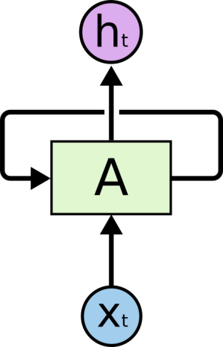
RNN Recurrent neural network
X_{t}= input at time t
h_{t}= output at time t
A=neural network
The loop allows information to pass from t to t+1
reference:
http://colah.github.io/posts/2015-08-Understanding-LSTMs/

Slide 6
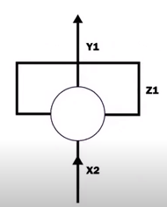
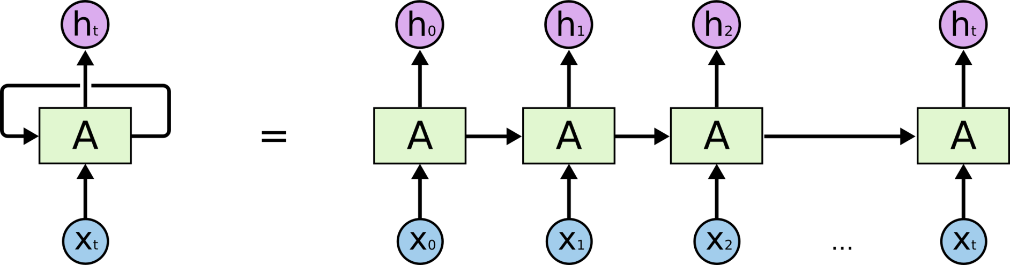
RNN unrolled
But RNN suffers from the vanishing gradient problem to be discussed later
https://www.youtube.com/watch?v=zt18u6BgdK8 RNN Animation
Unroll and treat each time sample as a unit.
An unrolled RNN
Problem:
Learning long-term dependencies with gradient descent is difficult , Bengio, et al. (1994)
LSTM can fix the vanishing gradient problem

Slide 7
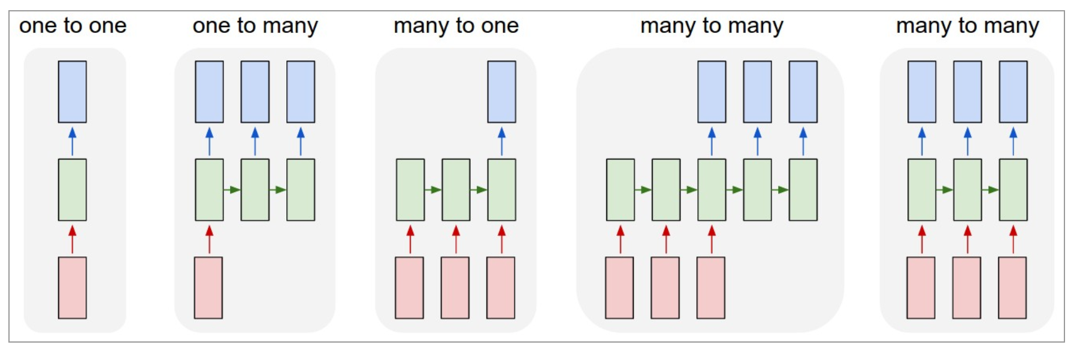
Different types of RNN
(1) Vanilla (classical) mode of processing without RNN, from fixed-sized input to fixed-sized output (e.g., image classification). Feedforward NN
(2) Sequence output (e.g., image captioning takes an image and outputs a sentence of words).
(3) Sequence input (e.g., sentiment analysis where a given sentence is classified as expressing positive or negative sentiment).
(4) Sequence input and sequence output (e.g. Machine Translation: an RNN reads a sentence in English and then outputs a sentence in French).
(5) Synced sequence input and output (e.g. video classification where we wish to label each frame of the video).
http://karpathy.github.io/2015/05/21/rnn-effectiveness/
Output layer
Hidden layer
(recurrent layer)
Input
layer
(1) (2) (3) (4) (5)

Slide 8
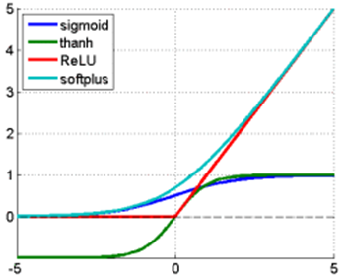

Activation function choices
https://imiloainf.wordpress.com/2013/11/06/rectifier-nonlinearities/
https://www.simonwenkel.com/2018/05/15/activation-functions-for-neural-networks.html#softplus
Max. gradient of Signmoid is 0.25, it will cause the vanishing gradient problem
$$\text{Sigmoid} (\text{from}\text{ 0 }\text{to}\text{ 1}): \\ g\left(x\right)=\frac{1}{1+e^{−x}},$$
$$gradient=\frac{dg(x)}{dx}=g(x)⋅(1−g(x))$$
$$\text{Tanh} (\text{from}\text{ −1 }\text{to}\text{ 1}): \\ g\left(x\right)=\frac{\sinh{(}x)}{\cosh{(}x)}=\frac{e^{x}−e^{−x}}{e^{x}+e^{−x}},$$
$$gradient of g(x)=\frac{dg(x)}{dx}=\frac{4}{{\left(e^{−x}+e^{x}\right)}^{2}}$$
$$\text{Rectified} \text{Linear} \text{Unit} \left(Relu\right)\left(\text{from}\text{ 0 }\text{to} ∞\text{,}\text{hard} \text{change}\right):$$
$$g(x)=\max{(}0,x),$$
$$gradient=\frac{dg(x)}{dx} =\left\{\begin{matrix}1, \text{if} \text{x}≥0 \\ 0, \text{if} \text{x}<0\end{matrix}\right.$$
$$\text{Softplus} (\text{from}\text{ 0 }\text{to} ∞\text{,}\text{soft} \text{change})\text{: } \\ g(x)=\ln{(}1+e^{x}),gradient=\frac{dg(x)}{dx}=\frac{1}{1+e^{−x}}$$
Relu is now very popular and shown to be working better other methods
Tanh: Output is in between -1 to +1 for all input values
(green line)

Slide 9
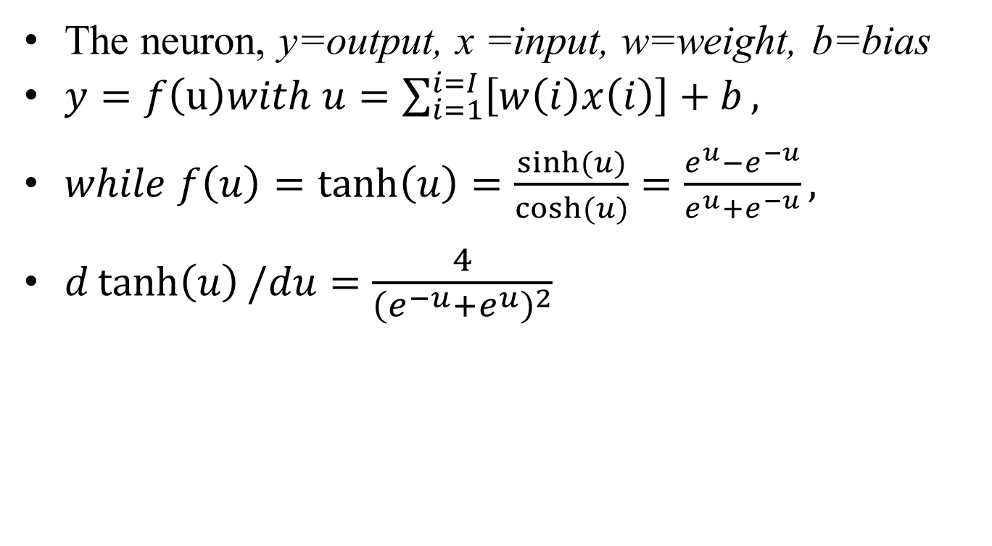
Tanh neuron
The neuron, y=output, x =input, w=weight, b=bias
$y=f\left(u\right)with u=\sum_{i=1}^{i=I}{\left[w\left(i\right)x\left(i\right)\right]+b},$
$while f\left(u\right)=\tanh\left(u\right)=\frac{\sinh{(}u)}{\cosh{(}u)}=\frac{e^{u}−e^{−u}}{e^{u}+e^{−u}},$
$d\tanh\left(u\right)/du=\frac{4}{{\left(e^{−u}+e^{u}\right)}^{2}}$

Slide 10
A simple RNN (recurrent Neural network) for weather (sequence) prediction (type4: many-to-many)
S=Sunny; C=Cloudy; R=Rainy; T=Thundery (weather in a day)
First: define the characters. The dictionary has 4 types, one-hot representation
X=Use 4-bit code (one hot) to represent the weather, it means
  at any time, only one output is 1, others are 0.
  X _{t} can be one of those {X1,X2,X3,X4}_{t}
  E.g. when the input X=X1=“1000”, it is sunny
Assume the training input sequence is S,C,R,T,S,C,R,T….etc. After training, predict the weather tomorrow.
This mechanism (type4: many-to-many) can be extended to other applications such as machine translation
One hot Encoding (X) | S | C | R | T
X1 | 1 | 0 | 0 | 0
X2 | 0 | 1 | 0 | 0
X3 | 0 | 0 | 1 | 0
X4 | 0 | 0 | 0 | 1

Slide 11
The architecture: 4 inputs(x_{i}), 3 hidden neurons(h_{j}), 4 outputs (sy)
Only partial weights are shown to avoid crowdedness
smy= softmax_out_y
smy1(t)
smy1(t)
smy2(t)
smy3(t)
smy4(t)
softmax
softmax
softmax
softmax
softmax
y= output
Weights
=why
Why
A
A
Whh, size 3x3
Weights types
Whh=h(t) to h(t+1)
Whx=x to h
Why=h to y
Assume all fully connected
h_{t+1}
h(j=1,t)
h(j=1,t+1)
Hidden
(recurrent)
layer
A
=
h(j=2,t)
h(j=2,t+1)
Input layer
X_{t}
h(j=3,t)
h(j=3,t+1)
h_{t}
Whx, size 3x4
X(i=1,t)
X(i=2,t)
X(i=3,t)
X(i=4,t), X is of size 4x1
Hidden neurons at time t
Hidden neurons at time t,
which depend on x_{t} and h_{t}

Slide 12
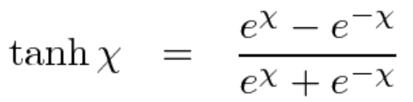
A simple RNN (recurrent Neural network) for sequence prediction
From t to t+1
Unroll an RNN: If ‘S’,’C’,’R’→ are received, the prediction is ‘T’
Tanh(Whx(1,:)*X_{t} + Whh(1,:)*h_{t} + bias(1) )=h_{t+1}(1)
Tanh(Whx(2,:)*X_{t} + Whh(2,:)*h_{t} + bias(2) )=h_{t+1}(2)
Tanh(Whx(3,:)*X_{t} + Whh(3,:)*h_{t} + bias(3) )=h_{t+1}(3)
A is an RNN with 3 neurons : After training, if you enter ‘S’,’C’,’R’ step by step to X_{t} at each time t , the system will output T after you input X_{t=3}
Note:
For softmax, see
http://www.cse.cuhk.edu.hk/~khwong/www2/cmsc5707/5707_likelihood.pptx
External output
‘C’
‘R’
‘T’
Output layer
(Softmax)
Output layer
(Softmax)
Output layer
(Softmax)
Output layer
(Softmax)
h_{t+1}
h_{t=2}
Time-unrolled diagram of the RNN
h_{t=3}
h_{t=4}
Hidden
(recurrent)
layer
A
=
tanh
tanh
tanh
Whx
Whh
Inside A,
3 neurons
Input layer
X_{t}
h_{t}
X_{t=1}=
‘S’
X_{t=2}=
‘C’
X_{t=3}=
‘R’
https://www.analyticsvidhya.com/blog/2017/12/introduction-to-recurrent-neural-networks/

Slide 13
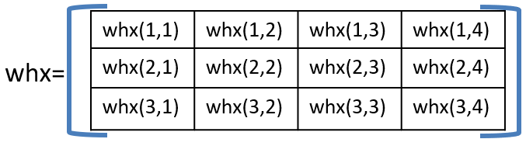
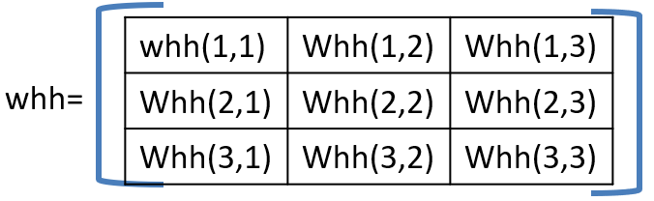
Inside A : 3 neurons at time from t to t+1, X=[X(1), X(2), X(3), X(4)]’,
Bias=[bias(1),
bias(2),
bias(3)]
h=[h1,h2,h3]’
h_{t}(1)
h_{t+1}(1)
Output, also
feedback to neurons’
inputs
Whh(1,1)
h_{t}(2)
Tanh(Whx(1,:)*X_{t}+Whh(1,:)*h_{t}+bias(1))=h_{t+1}(1)
Whh(1,2)
h_{t}(3)
Whh(1,3)
Whx(1,1)
Whx(1,2)
Whx(1,3)
Whx(1,4)
neuron1
X(1)
X(2)
X(3)
X(4)
h_{t}(1)
h_{t+1}(2)
Output, also
feedback to neurons’
inputs
Whh(2,1)
h_{t}(2)
Tanh(Whx(2,:)* X_{t} +Whh(2,:)*h_{t}+bias(2))=h_{t+1}(2)
Whh(2,2)
h_{t}(3)
Whh(2,3)
Whx(2,2)
Whx(2,1)
Whx(2,3)
Whx(2,4)
neuron2
X(1)
X(2)
X(3)
X(4)
h_{t}(1)
h_{t+1}(3)
Output, also
feedback to neurons’
inputs
Whh(3,1)
Tanh(Whx(3,:)* X_{t} +Whh(3,:)*h_{t1}+bias(3))=h_{t+1}(3)
h_{t}(2)
Whh(3,2)
Whx(3,1)
Whx(3,2)
Whx(3,3)
Whx(3,4)
neuron3
h_{t}(3)
Whh(3,3)
X(1)
X(2)
X(3)
X(4)

Slide 14
Define weights whx, whh, why
whx(1,1) | whx(1,2) | whx(1,3) | whx(1,4)
whx(2,1) | whx(2,2) | whx(2,3) | whx(2,4)
whx(3,1) | whx(3,2) | whx(3,3) | whx(3,4)
whx=
Input X to h output weights
(not recurrent)
whh(1,1) | Whh(1,2) | Whh(1,3)
Whh(2,1) | Whh(2,2) | Whh(2,3)
Whh(3,1) | Whh(3,2) | Whh(3,3)
whh=
Current h_{t} to next h_{t+1} weights
(recurrent)
why=
why(1,1) | why(1,2) | why(1,3)
why(2,1) | why(2,2) | why(2,3)
why(3,1) | why(3,2) | why(3,3)
why(4,1) | why(4,2) | why(4,3)
Output h_{t} to y_output_{t} weights
(Not recurrent)

Slide 15
Zoom inside to see the connections of neuron 1
whx(1,1) | whx(1,2) | whx(1,3) | whx(1,4)
whx(2,1) | whx(2,2) | whx(2,3) | whx(2,4)
whx(3,1) | whx(3,2) | whx(3,3) | whx(3,4)
whh(1,1) | Whh(1,2) | Whh(1,3)
Whh(2,1) | Whh(2,2) | Whh(2,3)
Whh(3,1) | Whh(3,2) | Whh(3,3)
whx=
whh=
From h_{t}(3) of neuron3
From h_{t}(2) of neuron2
h_{t}(1)
h_{t+1}(1)
whh(1,1)
h_{t}(2)
neuron1
whh(1,2)
Output, also
feedback to neurons’
inputs
h_{t-}3)
whh(1,3)
whx(1,1)
whx(1,2)
whx(1,3)
whx(1,4)
X(1)
X(2)
X(3)
X(4)
h_{t}(1) from neuron1 previous output
Inside view of neuron1 with connections
h_{t+1}(1)
h_{t+1}(1) =Tanh(
whx(1,1)*X_{t}(1)+whx(1,2)*X_{t} (2)+whx(1,3)*X_{t} (3)+whx(1,4)*X_{t} (4)
+whh(1,1)*h_{t}(1)+whh(1,2)*h_{t}(2)+whh(1,3)*h_{t}(3) + Bias)
neuron1
Output, also
feedback to neurons’
inputs
h_{t}(2)
From neuron2 previous output
whx(1,1)
whx(1,2)
whx(1,3)
whx(1,4)
X(1)
X(2)
X(4)
h_{t}(3) from neuron3 previous output
X(3)

Slide 16
Zoom inside to see the connections of neuron 2
whx(1,1) | whx(1,2) | whx(1,3) | whx(1,4)
whx(2,1) | whx(2,2) | whx(2,3) | whx(2,4)
whx(3,1) | whx(3,2) | whx(3,3) | whx(3,4)
whh(1,1) | Whh(1,2) | Whh(1,3)
Whh(2,1) | Whh(2,2) | Whh(2,3)
Whh(3,1) | Whh(3,2) | Whh(3,3)
whx=
whh=
From h_{t}(3) of neuron3
From h_{t}(2) of neuron2
h_{t}(1)
h_{t+1}(2)
whh(2,1)
h_{t}(2)
neuron2
whh(2,2)
Output, also
feedback to neurons’
inputs
h_{t}(3)
whh(2,3)
whx(2,1)
whx(2,2)
whx(2,3)
whx(2,4)
X(1)
X(2)
X(3)
X(4)
h_{t}(1) from neuron1 previous output
Inside view of neuron1 with connections
h_{t+1}(1) =Tanh(
whx(2,1)*X_{t}(1)+whx(2,2)*X_{t} (2)+whx(2,3)*X_{t} (3)+whx(2,4)*X_{t} (4)
+whh(2,1)*h_{t}(1)+whh(2,2)*h_{t}(2)+whh(2,3)*h_{t}(3) + Bias)
h_{t+1}(2)
Output, also
feedback to neurons’
inputs
neuron2
h_{t}(2)
From neuron2 previous output
whx(2,1)
whx(2,2)
whx(2,3)
whx(2,4)
X(1)
X(2)
X(4)
h_{t}(3) from neuron3 previous output
X(3)

Slide 17
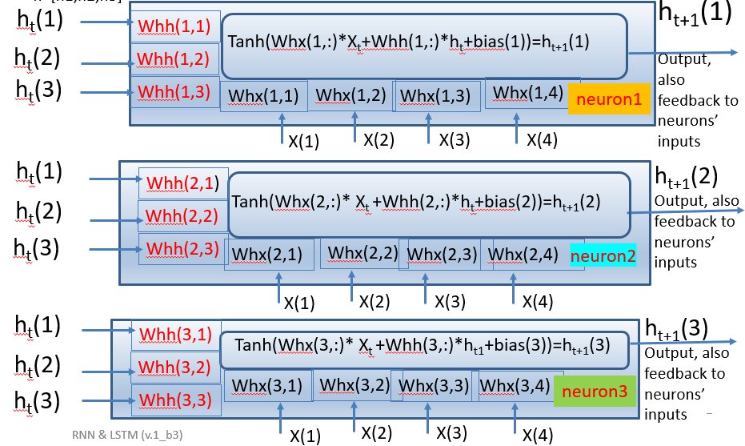

demo_rnn4b.m: Numerical examples, give at t=0, weight/bias are initialized as:
whx=[0.28 0.84 0.57 0.48
0.90 0.87 0.69 0.18
0.53 0.09 0.55 0.49];
whh =[0.41 0.12 0.13
0.51 0.24 0.26
0.61 0.34 0.36];
ht(:,1)=[0.11 0.21 0.31]'; %assume ht initially at t=1
bias=[0.51, 0.62, 0.73]';%bias initialized
why=[0.37 0.97 0.83
0.39 0.28 0.65
0.64 0.19 0.33
0.91 0.32 0.14];
ht(:,t+1)=tanh(whx*in(:,t)+whh*ht(:,t)+bias)
% //// eqn.for h(t+1) ///////////////////
Exercise 1a, if X=[1,0,0,0]
MC question: choices: find h_{t=2}(1)=_____?
(1) tanh(0.28*1+0.84*0+ 0.57*0+ 0.48*0+ 0.41*0.11+0.12*0.21+0.13*0.31+ 0.51)
(2) tanh(0.28*0+0.84*1+ 0.57*0+ 0.48*0+ 0.41*0.11+0.12*0.21+0.13*0.31+ 0.51)
(3) tanh(0.28*0+0.84*0+ 0.57*1+ 0.48*0+ 0.41*0.11+0.12*0.21+0.13*0.31+ 0.51)
(4) tanh(0.28*0+0.84*0+ 0.57*0+ 0.48*1 0.41*0.11+0.12*0.21+0.13*0.31+ 0.51)
Exercise 1b : find h_{t=2}(2)=___? , Exercise 1c : find h_{t=2}(3)= ___?
whx(1,1) | whx(1,2) | whx(1,3) | whx(1,4)
whx(2,1) | whx(2,2) | whx(2,3) | whx(2,4)
whx(3,1) | whx(3,2) | whx(3,3) | whx(3,4)
whx=
whh(1,1) | Whh(1,2) | Whh(1,3)
Whh(2,1) | Whh(2,2) | Whh(2,3)
Whh(3,1) | Whh(3,2) | Whh(3,3)
whh=

Slide 18
Step1 find initialized h_{t=1}
%Explanation of how to find answer of Ex.1a, h_{t=2}(1), h_{t=2}(2), h_{t=2}(3)
%To find output at t=2,
%Equation:X=[1,0,0,0]
ht(1,t+1)= Tanh(
Whx(1,1)*X_{t}(1)+Whx(1,2)*X_{t}(2)+Whx(1,3)*X_{t}(3)+Whx(1,4)*X_{t} (4)
+Whh(1,1)*(h1)+Whh(1,2)*(h2)+Whh(1,3)*(h3) + bias(1))
Exercise 1a,
MC question: choices: find h_{t=2}(1)=_____?
(1) tanh(0.28*1+ 0+0+0+ 0.41*0.11+0.12*0.21+0.13*0.31+ 0.51)
= 0.7166
(2) tanh(0+0.84*1+0+0+ 0.41*0.11+0.12*0.21+0.13*0.31+ 0.51)
(3) tanh(0+0+0.57*1+0+ 0.41*0.11+0.12*0.21+0.13*0.31+ 0.51)
(4) tanh(0+0+0+0.48*1+ 0.41*0.11+0.12*0.21+0.13*0.31+ 0.51)
(choice 1 is correct) h_{t=2}(1)= 0.7166
h_{t=2}(2)=
tanh(0.90*1+ 0+0+0+ 0.51*0.11+0.24*0.21+0.26*0.31+ 0.62) =0.9363
h_{t=2}(3)=
tanh(0.53*1+ 0+0+0+ 0.61*0.11+0.34*0.21+0.36*0.31+ 0.73)=0.9070
h_2=[0.7166,0.9363,0.9070]’
Ans. For Exercise0.1a,b,c
At time t=1 ,X= 1 0 0 0
whx=[0.28 0.84 0.57 0.48
0.90 0.87 0.69 0.18
0.53 0.09 0.55 0.49];
whh =[0.41 0.12 0.13
0.51 0.24 0.26
0.61 0.34 0.36];
ht(:,1)=[0.11
0.21
0.31]; %assume ht initially at t=1
bias=[0.51, 0.62, 0.73]';%bias initialized
time t=1 ,X= [1,0,0,0]’

Slide 19
Exercise 2 : After ht(:,2) is found , find y_out
Look at the output network, it finds y_out() from h()
Recall ht(:,2)=[0.7002, 0.9321, 0.9009]’
why=
why(1,1) | why(1,2) | why(1,3)
why(2,1) | why(2,2) | why(2,3)
why(3,1) | why(3,2) | why(3,3)
why(4,1) | why(4,2) | why(4,3)
y_out(1)=why(1,1)*ht(1)+why(1,2)*ht(2)+ why(1,3)*ht(3)
y_out(2)=why(2,1)*ht(1)+why(2,2)*ht(2)+ why(2,3)*ht(3)
y_out(3)=why(3,1)*ht(1)+why(3,2)*ht(2)+ why(3,3)*ht(3)
y_out(4)=why(4,1)*ht(1)+why(4,2)*ht(2)+ why(4,3)*ht(3)
h , y_out are fully connected so
Weights(the “why” variable)=(4x3)
why=[0.37 0.97 0.83
0.39 0.28 0.65
0.64 0.19 0.33
0.91 0.32 0.14];
%h_2=[0.7166,0.9363,0.9070]
ht=[0.7166,0.9363,0.9070]’
Y_out=why*ht=
1.9262
1.1312
0.9358
1.0787
y_out(1) (2) (3) (4)
(This SoftMax output network requires
no bias, but can add bias =1 to make resulst stable. See the chapter on cnn for details)
h_{t}(1)
h_{t}(2)
h_{t}(3)

Slide 20
Answer for Ex2
Softmax is to make sum_all_i{softmax[y_out(i)]}=1
,each softmax[y_out(i)] is a probability
A=exp(1.9262)
B=exp(1.1312)
C=exp(0.9358)
D=exp(1.0787)
tot=A+B+C+D
soft_max_y_out(1)=A/tot;
soft_max_y_out(2)=B/tot;
soft_max_y_out(3)=C/tot;
soft_max_y_out(4)=D/tot;
soft_max_y_out
0.4441 0.2006 0.1650 0.1903
This is to make Softmax is a probability (sum of the above vector is 1)
[ 0.4441 0.2006 0.1650 0.1903]
Softmax_y_out(1) (2) (3) (4)
The
output
layer
1.9262 1.1312 0.9358 1.0787
y_out_{i=1,2,3,4}
h , Y_out are fully connected so
Weights(the “why” variable)=(4x3)
(This output network requires
no bias)
h_{t}(1)=
0.7002
h_{t}(2)=
0.9321
h_{t}(3)=
0.9009

Slide 21
After y_out is is found , find softmax_y_out
Look at the softmax output module it transforms y_out() to softmax_y_out()
A1=exp(y_out(1))
A2=exp(y_out(2))
A3=exp(y_out(3))
A4=exp(y_out(4))
Tot=A1+A2+A3+A4
Softmax_y_out(1)=A1/Tot
Softmax_y_out(2)=A2/Tot
Softmax_y_out(3)=A3/Tot
Softmax_y_out(4)=A4/Tot
Exercise 3
MC question: This stage is to make sure
each softmax_y_out is positive,
each softmax_y_out is negative,
each softmax_y_out is a probability
each softmax_y_out is smaller than 2.
Softmax_y_out(1) (2) (3) (4)
y_out(1) (2) (3) (4)
(This output network requires
no bias)
h_{t}(1)
h_{t}(2)
h_{t}(3)

Slide 22
Calculate recurrently for t=1,2,3,4
Answer of ex3 is choice 3:each softmax_y_out is a probability
Assume the training input sequence is S,C,R,T,S,C,R,T….etc.
When t=1, input is ‘S’, so x(1)=1,x(2)=0,x(3)=0,x(4)=0 [i.e.X=1000]
Find h_{t=1}(1), h_{t=1}(2), h_{t=1}(3), (shown before)
Then for t=2, input is ‘C’, use X=0100] and also the current weights and h values
Find h_{t=2}(1), h_{t=2}(2), h_{t=2}(3), and so on
After h_{t=2}(1), h_{t=2}(2), h_{t=2}(3) are found calculate softmax_y_out at time t=3 ,
is [ 0.4441 0.2006 0.1650 0.1903]
Calculate recurrently until you find all h and softmax output values. They will be used for training
See the program in the next slide
One hot Encoding (X) | S | C | R | T
X1 | 1 | 0 | 0 | 0
X2 | 0 | 1 | 0 | 0
X3 | 0 | 0 | 1 | 0
X4 | 0 | 0 | 0 | 1

Slide 23
Ans. 1,2,3(overall result)
%MatlabDemo rnn4b.m modified f2023 Dec30a
%https://stackoverflow.com/questions/50050056/simple-rnn-example-showing-numerics
%https://www.analyticsvidhya.com/blog/2017/12/introduction-to-recurrent-neural-networks/
clear, %clc
in_S=[1 0 0 0]';
in_C=[0 1 0 0]';
in_R=[0 0 1 0]';
in_T=[0 0 0 1]';
X=[in_S,in_C,in_R, in_T];
%assume whx,whh,why are initialised at t=1 as
whx=[ 0.28 0.84 0.57 0.48
0.90 0.87 0.69 0.18
0.53 0.09 0.55 0.49];
whh =[0.41 0.12 0.13
0.51 0.24 0.26
0.61 0.34 0.36];
why=[ 0.37 0.97 0.83
0.39 0.28 0.65
0.64 0.19 0.33
0.91 0.32 0.14];
bias=[0.51, 0.62, 0.73]';%bias initialised
ht(:,1)=[0.11 0.21 0.31]'; %assume ht has value initally at t=1
%Forward pass only, %for t = 1:length(in)-1 %
%(y_out not feedback to network, only h feeback to network)
y_out(:,1)=why*ht(:,1);%the outputs at t=1 (inital value)
softmax_y_out(:,1)=softmax(y_out(:,1)); %outputs at t=1(init)
for t = 1:3 % assume we want to see 3 steps
ht(:,t+1)=tanh( whx*X(:,t)+whh*ht(:,t)+bias); %recurrent layer
y_out(:,t+1)=why*ht(:,t+1) ;
softmax_y_out(:,t+1)=softmax(y_out(:,t+1)); %output layer
end
%'print result ===================‘
X, ht, y_out, softmax_y_out
print result ===================
X =
1 0 0 0
0 1 0 0
0 0 1 0
0 0 0 1
ht =
0.1100 0.7166 0.9540 0.9370
0.2100 0.9363 0.9807 0.9793
0.3100 0.9070 0.9564 0.9876
y_out =
0.5017 1.9261 2.0981 2.1164
0.3032 1.1312 1.2683 1.2816
0.2126 0.9358 1.1125 1.1117
0.2107 1.0787 1.3158 1.3043
softmax_y_out =
0.3015 0.4441 0.4412 0.4456
0.2472 0.2006 0.1924 0.1934
0.2258 0.1650 0.1646 0.1632
0.2254 0.1903 0.2018 0.1978
T = 1 2 3 4
Time

Slide 24
Discussion: Output layer: softmax
Assume you train this network using SCRTSCRT,… SCRT,.. etc
Prediction is achieved by seeing which y_out is biggest after the softmax processing of the output layer
softmax_y_out =
Time= 1 2 3 4
0.3015 0.4441 0.4412 0.4456
0.2472 0.2006 0.1924 0.1934
0.2258 0.1650 0.1646 0.1632
0.2254 0.1903 0.2018 0.1978
From the above result, at t=3 prediction is ‘S’=[high,low,low,low]=[1,0,0,0] which is not correct, it should be ‘T’.
Why? Because at t=1, predicted output should be ‘C’, then at t=2, output should be ‘R’, at t=3 output should be ‘T’. Here weights are just randomly initialized in this example, so currently predict is wrong. After training, the prediction should be fine.
One hot Encoding (X) | S | C | R | T
X1 | 1 | 0 | 0 | 0
X2 | 0 | 1 | 0 | 0
X3 | 0 | 0 | 1 | 0
X4 | 0 | 0 | 0 | 1
y
For softmax, see
http://www.cse.cuhk.edu.hk/~khwong/www2/cmsc5707/5707_likelihood.pptx

Slide 25
How to train a recurrent Neural net RNN
S=Sunny; C=Cloudy; R=Rainy; T=Thundery (average weather in a day)
After unrolled the RNN, it becomes a Feedforward neural network
Give sequence samples, say 3 years=(365*3) days samples
E.g. S,C,R,T,S,C,R,T,S,C,R,T…… SSCRT……(mostly the sequence of SCRT,SCRT)
Train by backpropagation, the rule: If X_{t=1} is the INPUT then X_{t=2} is the TARGET
  e.g. input =‘S’ (X_{t=1} =1000), output is at the softmax output, and target is ‘C’ (X_{t=2} =0100), or, in another example case, if
  input =‘R’ (X_{t=1} =0010), output is at the softmax output, and target is ‘T’(X_{t=2} =0001)
  After unroll the RNN, we will use : (1) input, (2) output(softmax output) and (3) target, to train weights/biases as if it is a feedforward network (discuss before)
Ideally, after successfully trained the RNN, if “SCR” for 3 consecutive days are observed, the weather prediction for the next day is ‘T’
h_{t+1}
Target
target=‘C’
target=‘R’
target=‘T’
h = O_{t}= encoder hidden vector is generated after a sequence is entered. You will see that it will be used for machine translation
Softmax
Softmax
Softmax
h_{t=2}
h_{t=3}
h_{t=4}
A
=
tanh
tanh
tanh
X_{t}
h_{t}
X_{t=2}=
‘C’
X_{t=1}=
‘S’
X_{t=3}=
‘R’
X_{t=1} is the input, X_{t=2} is the target,
Time-unrolled diagram of the RNN

Slide 26
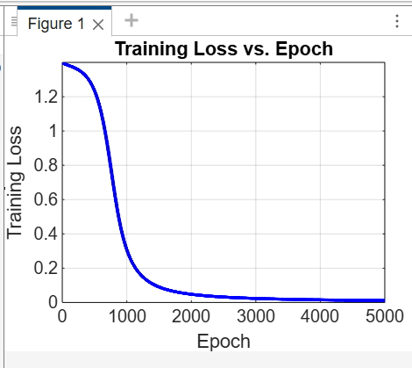
Example of RNN backpropagating
% Clear workspace
clear;
% Define parameters
num_symbols = 4; % Four one-hot encoded symbols
num_hidden = 6; % Hidden units in RNN
%num_timesteps = 5; % Length of sequence
learning_rate = 0.001;
num_epochs = 10000; % Total training iterations
% Define one-hot encoded symbols (4 symbols)
% Training Set (Fixed)
%//// training dataset ///////////
%train_seq=[1, 2, 3, 4,1]
%train_target_seq=[ 2, 3, 4,1,2]
train_seq=[1, 2, 3, 4,1, 2, 3, 4,1, 2, 3, 4 ]
train_target_seq=[ 2, 3, 4,1, 2, 3, 4,1, 2, 3, 4 ,1]
num_timesteps_train= length(train_seq); % Length of sequence
X_train=convert_to_one_hot(train_seq);
Y_true_train=convert_to_one_hot(train_target_seq);
%///// testing dataset /////////////////////////
%test_seq=[ 3, 4,1,2,3,4,1,2,3,4]
%test_target_seq=[ 4,1,2,3,4,1,2,3,4,1]
test_seq=[ 3 4 2 4 1 4 2 3 1 ] %NEXT PREDICTION IS OK
test_target_seq=[ 4 1 3 1 2 1 3 4 2 ]%NEXT PREDICTION IS OK
num_timesteps_test= length(test_seq); % Length of sequence
X_test=convert_to_one_hot(test_seq);
Y_true_test = convert_to_one_hot(test_target_seq); % Expected output
% Initialize weights randomly
W_xh = randn(num_hidden, num_symbols) * 0.1; % Input-to-hidden weights
W_hh = randn(num_hidden, num_hidden) * 0.1; % Hidden-to-hidden weights
W_hy = randn(num_symbols, num_hidden) * 0.1; % Hidden-to-output weights
b_h = randn(num_hidden, 1) * 0.1; % Hidden bias
b_y = randn(num_symbols, 1) * 0.1; % Output bias
% Store loss for visualization
loss_history = zeros(1, num_epochs);
% Training Loop for Multiple Epochs
for epoch = 1:num_epochs
% Store hidden states and predictions
h = zeros(num_hidden, num_timesteps_train);
Y_pred_train = zeros(num_symbols, num_timesteps_train);
% Forward Pass (Training)
for t = 1:num_timesteps_train
if t == 1
h(:,t) = tanh(W_xh * X_train(:,t) + b_h); % First time step
else
h(:,t) = tanh(W_xh * X_train(:,t) + W_hh * h(:,t-1) + b_h);
end
% Compute output (softmax activation for classification)
Y_pred_train(:,t) = softmax(W_hy * h(:,t) + b_y);
end
% Compute loss (Cross-Entropy)
loss = -sum(sum(Y_true_train .* log(Y_pred_train))) / num_timesteps_train;
loss_history(epoch) = loss; % Store loss value
% Backpropagation Through Time (BPTT)
dW_xh = zeros(size(W_xh));
dW_hh = zeros(size(W_hh));
dW_hy = zeros(size(W_hy));
db_h = zeros(size(b_h));
db_y = zeros(size(b_y));
for t = num_timesteps_train:-1:1
% Compute output gradient
dY = Y_pred_train(:,t) - Y_true_train(:,t);
% Compute gradient for output weights
dW_hy = dW_hy + dY * h(:,t)';
db_y = db_y + dY;
% Compute gradient for hidden state
dh = W_hy' * dY .* (1 - h(:,t).^2);
% Accumulate gradients for hidden weights
dW_xh = dW_xh + dh * X_train(:,t)';
db_h = db_h + dh;
if t > 1
dh_next = W_hh' * dh .* (1 - h(:,t-1).^2);
dW_hh = dW_hh + dh * h(:,t-1)';
end
end
% Update weights using gradient descent
W_xh = W_xh - learning_rate * dW_xh;
W_hh = W_hh - learning_rate * dW_hh;
W_hy = W_hy - learning_rate * dW_hy;
b_h = b_h - learning_rate * db_h;
b_y = b_y - learning_rate * db_y;
% Display loss every 100 epochs
if mod(epoch, 100) == 0
disp(['Epoch ', num2str(epoch), ' - Training Loss: ', num2str(loss)]);
end
end
% --- Plot Training Loss ---
figure(1)
clf;
plot(1:num_epochs, loss_history, 'b', 'LineWidth', 2);
xlabel('Epoch');
ylabel('Training Loss');
title('Training Loss vs. Epoch');
grid on;
'now testing'
'////////////////////////////////'
% --- Testing Session ---
% Store hidden states and predictions
h_test = zeros(num_hidden, num_timesteps_test);
Y_pred_test = zeros(num_symbols, num_timesteps_test);
% Forward Pass (Testing)
for t = 1:num_timesteps_test
if t == 1
h_test(:,t) = tanh(W_xh * X_test(:,t) + b_h); % First time step
else
h_test(:,t) = tanh(W_xh * X_test(:,t) + W_hh * h_test(:,t-1) + b_h);
end
% Compute output (softmax activation for classification)
Y_pred_test(:,t) = softmax(W_hy * h_test(:,t) + b_y);
end
% Compute test loss
Y_true_test
Y_pred_test
err=Y_true_test-Y_pred_test
sum(sum(err.^2))
test_loss = -sum(sum(Y_true_test .* log(Y_pred_test))) / num_timesteps_test;
disp(['Test Loss: ', num2str(test_loss)]);
% Display test results
disp('Test Input Sequence:');
disp(X_test);
disp('Predicted Output Sequence:');
disp(Y_pred_test);
disp('Expected Output Sequence:');
disp(Y_true_test);
'/////////////////////////////'
disp(['Epoch ', num2str(epoch), ' - Training Loss: ', num2str(loss)]);
test_loss
function one_hot_matrix = convert_to_one_hot(seq)
% Define number of symbols (1 to max value in train_seq)
num_symbols = max(seq);
% Initialize one-hot matrix
one_hot_matrix = zeros(num_symbols, length(seq));
% Convert sequence to one-hot representation
for i = 1:length(seq)
one_hot_matrix(seq(i), i) = 1; % Assign 1 to corresponding row
end
end
Demo program
X_{1,2,3,4} (4 inputs one-hot)
T_{1,2,3,4} (4 targets one-hot)
h_{1,2,3,4,5,6} (Hidden neuron outputs)
y_{1,2,3,4} (4 Softmax outputs )

Slide 27
Rnn with soft attention
% Generate synthetic data %by copilot 2025.5.8
numFeatures = 10;
numClasses = 3;
numObservations = 100;
sequenceLength = 20;
XTrain = rand(numObservations, sequenceLength, numFeatures);
YTrain = categorical(randi([1 numClasses], numObservations, 1));
% Define RNN parameters
inputSize = numFeatures;
hiddenSize = 100;
outputSize = numClasses;
% Initialize weights
W_xh = randn(hiddenSize, inputSize);
W_hh = randn(hiddenSize, hiddenSize);
W_hy = randn(outputSize, hiddenSize);
b_h = randn(hiddenSize, 1);
b_y = randn(outputSize, 1);
% Initialize attention weights
W_a = randn(hiddenSize, hiddenSize);
b_a = randn(hiddenSize, 1);
% Training parameters
learningRate = 0.01;
numEpochs = 30;
% Softmax function
function y = softmax(x)
exp_x = exp(x - max(x));
y = exp_x ./ sum(exp_x);
end
% Training loop
for epoch = 1:numEpochs
for i = 1:numObservations
% Forward pass
h = zeros(hiddenSize, sequenceLength);
for t = 1:sequenceLength
x_t = squeeze(XTrain(i, t, :));
if t == 1
h(:, t) = tanh(W_xh * x_t + b_h);
else
h(:, t) = tanh(W_xh * x_t + W_hh * h(:, t-1) + b_h);
end
end
% Attention mechanism (soft attention)
scores = W_a * h + b_a;
weights = softmax(scores);
context = sum(weights .* h, 2);
% Output layer
y = softmax(W_hy * context + b_y);
% Compute loss (cross-entropy)
target = zeros(outputSize, 1);
target(YTrain(i)) = 1;
loss = -sum(target .* log(y));
% Backward pass (gradient descent)
dL_dy = y - target;
dL_dW_hy = dL_dy * context';
dL_db_y = dL_dy;
dL_dcontext = W_hy' * dL_dy;
dL_dweights = dL_dcontext .* h;
dL_dW_a = dL_dweights * h';
dL_db_a = dL_dweights;
% Update weights
W_hy = W_hy - learningRate * dL_dW_hy;
b_y = b_y - learningRate * dL_db_y;
W_a = W_a - learningRate * dL_dW_a;
b_a = b_a - learningRate * dL_db_a;
end
% Display loss
fprintf('Epoch %d, Loss: %.4f\n', epoch, loss);
end

Slide 28
Problem with RNN:
The vanishing gradient problem
Ref: https://hackernoon.com/exploding-and-vanishing-gradient-problem-math-behind-the-truth-6bd008df6e25

Slide 29
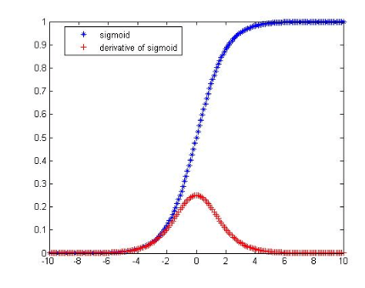
Problem with RNN:
The vanishing gradient problem
The maximum of derivative of sigmoid is 0.25, Hence feedback will vanish when the number of layers is large.
sigmoid
0.25
During backpropagation, signals are fed backward from output to input using gradient-based learning methods
In each iteration, a network weight receives an update proportional to the gradient of the error function with respect to the current weight.
In theory, the maximum gradient is less than 1 (max derivative of sigmoid is 0.25). So, the learning signal is reduced from layer to layer.
In RNN, after unrolled the network, the difference between the target and the output of the last element of the sequence has to back-propagate to update the weights/biases of all the previous neurons. The backpropagation signal will be reduced to zero if the training sequence is long.
It also happens to a feedforward neural network with many hidden layers (deep net).

Slide 30
Recall the weight updating process by gradient decent in Back-propagation (see previous lecture notes)
Case1: Δw in Back-propagation from output layer (L) to hidden layer
Δw=(output-target)*dsigmoid(f)*input to w
Δw= sensitivity δ^{L} *input to w
Case 2: Δw in Back-propagation a hidden layer to the previous hidden layer
Δw= δ^{L-1} *input to w
sensitivity δ^{L-1} will be used for the layer in front of layer L-1, .. etc
Input to w
Gradient of sigmoid
(disgmoid)
Cause of the vanishing gradient problem : Gradient of the activation function (sigmoid here) is less then 1, so the back-propagated values may diminish if more layers are involved

Slide 31

Popular neuron activation functions
https://imiloainf.wordpress.com/2013/11/06/rectifier-nonlinearities/
https://www.simonwenkel.com/2018/05/15/activation-functions-for-neural-networks.html#softplus
Max. gradient of Signmoid is 0.25, it can cause the vanishing gradient problem
$$\text{Sigmoid} (\text{from}\text{ 0 }\text{to}\text{ 1}): \\ g\left(x\right)=\frac{1}{1+e^{−x}},$$
$$gradient=\frac{dg(x)}{dx}=g(x)⋅(1−g(x))$$
$$\text{Tanh} (\text{from}\text{ −1 }\text{to}\text{ 1}): \\ g\left(x\right)=\frac{\sinh{(}x)}{\cosh{(}x)}=\frac{e^{x}−e^{−x}}{e^{x}+e^{−x}},$$
$$gradient of g(x)=\frac{dg(x)}{dx}=\frac{4}{{\left(e^{−x}+e^{x}\right)}^{2}}$$
$$\text{Rectified} \text{Linear} \text{Unit} \left(Relu\right)\left(\text{from}\text{ 0 }\text{to} ∞\text{,}\text{hard} \text{change}\right):$$
$$g(x)=\max{(}0,x),$$
$$gradient=\frac{dg(x)}{dx} =\left\{\begin{matrix}1, \text{if} \text{x}≥0 \\ 0, \text{if} \text{x}<0\end{matrix}\right.$$

Slide 32
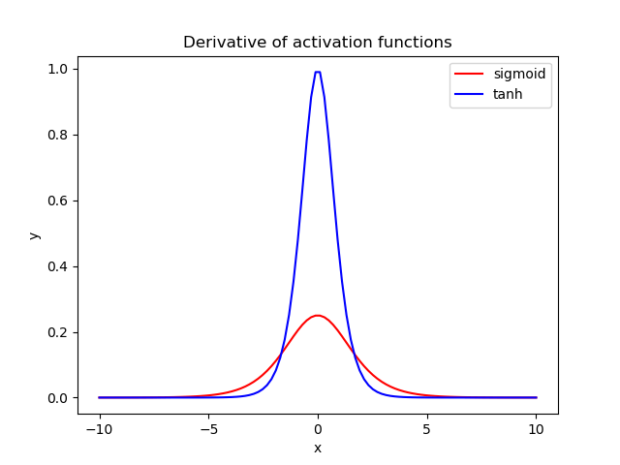
Advantages of these activation functions
Sigmoid :output range from 0 to 1, good to model probability.
Tanh: Max. gradient is 4 times greater than that of sigmoid. Using Tanh can help to reduce the gradient vanishing problem. Popular for building RNN.
Relu: The gradient is 1 which can reduce the gradient vanishing problem. It is computationally efficient, and popular for building hidden layers.
1
Tanh gradient
Sigmoid gradient
0.25
https://www.baeldung.com/cs/sigmoid-vs-tanh-functions

Slide 33
To solve the vanishing gradient problem, LSTM adds C (cell state)
RNN has x_{i} (input) and h_{t} (output) only
In LSTM (Long Short Term Memory), add
  Cell state (C_{t}) to solve gradient vanishing problem
  In each time (t), updates
    C_{t}=cell state (ranges from -1 to 1)
    h_{t}= output (ranges from 0 to 1)
    The system learns C_{t} and h_{t} together

Slide 34
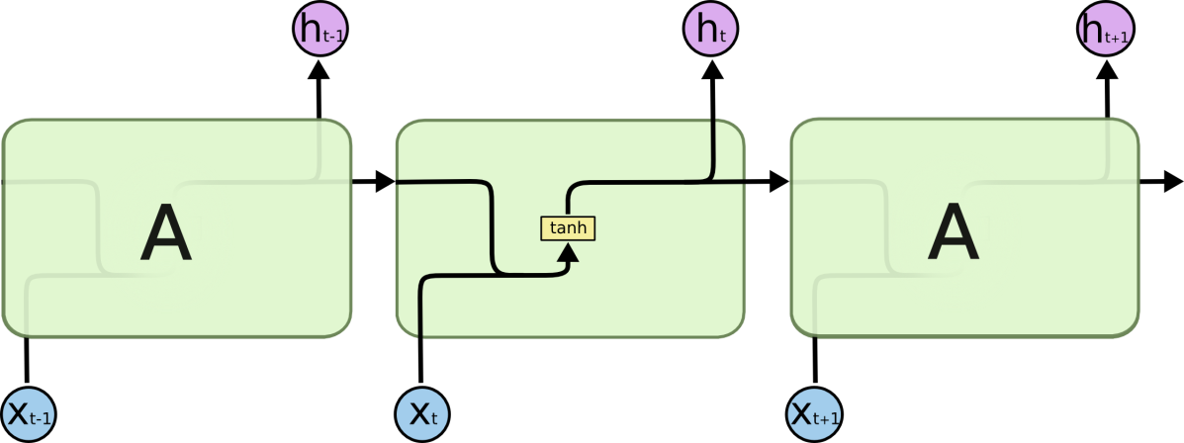
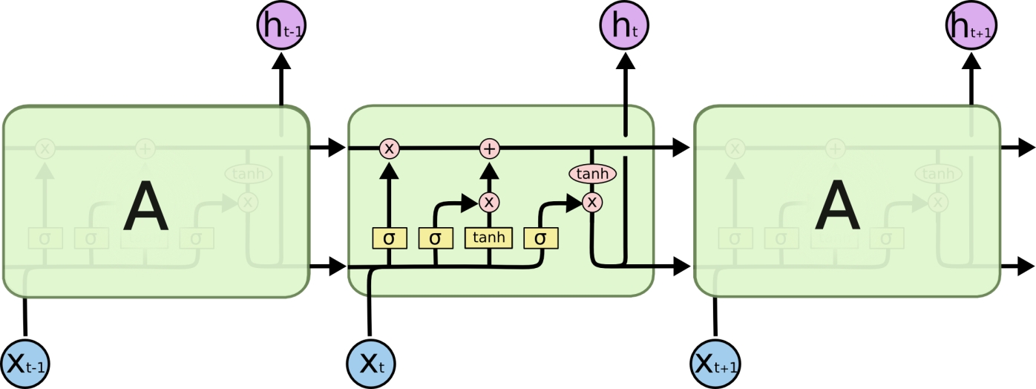
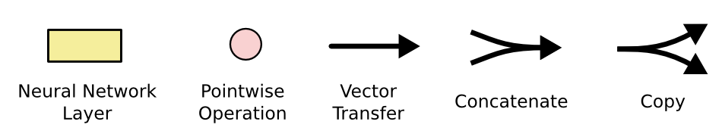
LSTM (Long short-term memory)
Standard RNN
Input concatenate with output then feed to input again
LSTM
The repeating structure is more complicated
(the complexity is 4 times of the standard RNN)

Slide 35
Stacked LSTM
Stacked Long short-term memory
Hierarchical structure
Theory and concept

Slide 36
Hierarchical structure of a form of stacked LSTM
(1) Overall view
Real Output (y) output neurons
n inputs (X)
M layers
  i-th layer has m_{i} cells, (i=1,2,..,M)
y real output neurons.
The “Output activation function” can be sigmoid or softmax
Initialize h(t=0),C(t=0)=zeros
Output activation function, e.g. sigmoid(σ) or softmax
h
LSTM Layer M, m_{M} cells
t→t+1
h
LSTM Layer 2, m₂ cells
h
h
LSTM Layer 1, m₁ cells
{X(1),X(2),…,X(n)}_{t}
https://towardsdatascience.com/implementation-of-rnn-lstm-and-gru-a4250bf6c090

Slide 37
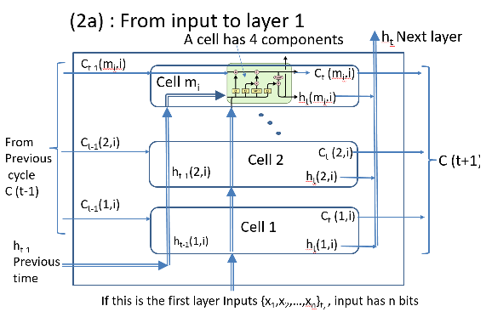
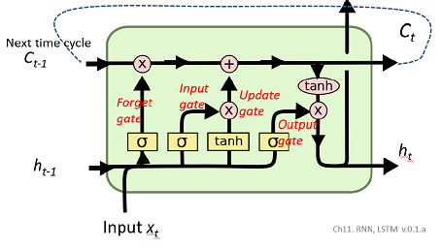
Relations amongst modules inside the Hierarchical structure of stacked LSTM
(see
2a and b)
Real Output (y) output neurons
Output activation function, e.g. sigmoid(σ) or softmax
(see 4)
h
LSTM Layer M, m_{M} cells
t→t+1
Note:
m₁,
m₂,..,
m_{M}
can be different
h
Inside an LSTM cell
(see 3)
LSTM Layer 2, m₂ cells
Inside a layer
h
h
LSTM Layer 1, m₁ cells
{X(1),X(2),…,X(n)}_{t}

Slide 38
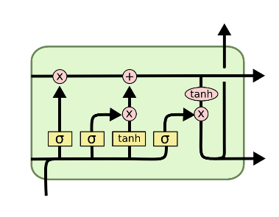
(2a) : From input to layer 1
A cell has 4 components
h_{t} Next layer
C_{t-1}(m_{i},i)
Cell m_{i}
C_{t} (m_{i},i)
h_{t}(m_{i},i)
From
Previous
cycle
C (t-1)
C_{t-1}(2,i)
Cell 2
C_{t} (2,i)
C (t+1)
h_{t-1}(2,i)
h_{t}(2,i)
C_{t-1}(1,i)
C_{t} (1,i)
Cell 1
h_{t-1}(1,i)
h_{t-1}
Previous time
h_{t}(1,i)
If this is the first layer Inputs {x₁,x₂,…,x_{n}}_{t,} , input has n bits, m_{i} cells
https://towardsdatascience.com/implementation-of-rnn-lstm-and-gru-a4250bf6c090

Slide 39
(2b) : From hidden i^{th} layer to i+1th layer
A cell has 4 components
h_{t} Next layer
C_{t-1}(m_{i},i)
Cell m_{i}
C_{t} (m_{i},i)
h_{t}(m_{i},i)
From
Previous
cycle
C (t-1)
C_{t-1}(2,i)
Cell 2
C_{t} (2,i)
C (t+1)
h_{t-1}(2,i)
h_{t}(2,i)
C_{t-1}(1,i)
C_{t} (1,i)
Cell 1
h_{t-1}(1,i)
h_{t-1}
Previous time
h_{t}(1,i)
If this is the i^{th} hidden layer, input is from i-1th layer
Assume in this i^{th} layer, there are m_{i} cells
The previous layer has m_{i-1} cells
https://towardsdatascience.com/implementation-of-rnn-lstm-and-gru-a4250bf6c090

Slide 40

(3) Inside an LSTM cell (the layer has m cells)
Number of weights for each layer = 4*m(m+n)
Will explain the details later
h cell-output for next layer
C_{t}
Next time cycle
C_{t-1}
Input
gate
Update
gate
Forget
gate
Output
gate
h_{t}
h_{t-1}
Input x_{t}

Slide 41
(4) Hierarchical structure of LSTM : Layer output: generate final output from the final (m^{th}) layer
Activation function: may use sigmoid (σ) or softmax. For softmax, see http://www.cse.cuhk.edu.hk/~khwong/www2/cmsc5707/5707_likelihood.pptx
Real Output (y) output neurons
Output activation function, e.g. sigmoid(σ) or softmax
Output (h) of the layer m

Slide 42
Now concentrate on each LSTM cell
Inside each cell:
  There are 4 neural sub-networks (gates)
  The Cell (C) channel is like a highway: can pass information from much earlier layers to faraway later layers.
  The forget gate layer : decides which current information is kept or not.
  The input(or ignore) layer : decides what information to store in the cell state
  The output layer: decides what to output.

Slide 43
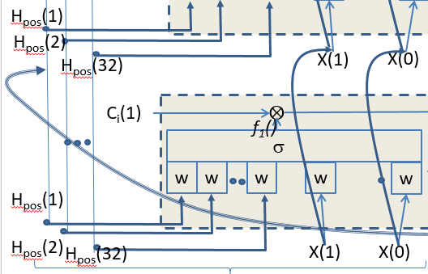
Inside each LSTM cell
How to read our diagrams
The weights are not shown for clarity
Each one is a neural network similar to this one

Slide 44
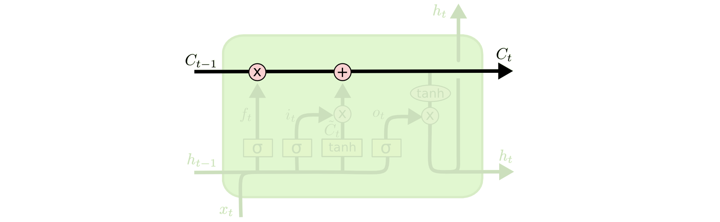
Inside each LSTM cell
Basic concept of LSTM
The Cell (C) channel is like a highway
  Using the information in C, any later layers can use previous information directly without reduction (because it doesn't involve any weight). This is designed to solve the gradient vanishing problem.
Each state can determine to keep the memory or pass on to the next state.

Slide 45
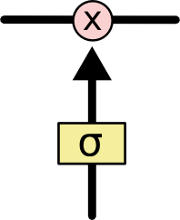
Inside an LSTM cell: (i) C state
C= State
Using gates, it can add or remove information to avoid the long-term dependencies problem Bengio, et al. (1994)
C_{t-1} =
State of time t-1
C_{t} =
State of time t
A gate controlled by σ :
The sigmoid layer outputs numbers between zero and one, describing how much of each component should be let through. A value of zero means “let nothing through,” while a value of one means “let everything through!”
An LSTM has three of these gates, to protect and control the cell state
http://colah.github.io/posts/2015-08-Understanding-LSTMs/
σ=a sigmoid function.

Slide 46
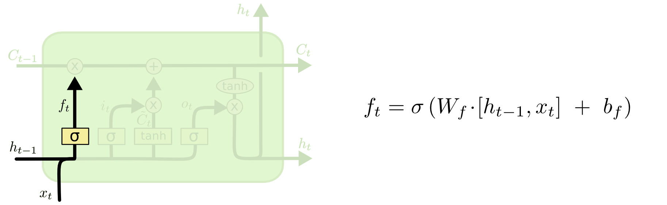
Inside an LSTM cell:(ii) forget gate layer
Decide what to throw away from the cell state
Depends on current time x (x_{t}) and previous h (h_{t-1}), if they match keep C (C_{t-1}→C_{t}), otherwise, throw away C_{t-1}
“For the language model example.. the cell state might include the gender of the present subject, so that the correct pronouns can be used. When we see a new subject, we want to forget the gender of the old subject.”
What to be kept/forget
“It looks at h_{t−1} and x_{t}, and outputs a number between 0 and 1 for each number in the cell state C_{t−1}. A 1 represents “completely keep this” while a 0 represents “completely get rid of this.” ”
http://colah.github.io/posts/2015-08-Understanding-LSTMs/

Slide 47

Exercise 4
MC question: Which is correct? The output of the
Sigmoid function is from -1 to 1,
Tanh function is from -1 to 1 ,
Relu function is from 0 to 1,
Tanh function is from 0 to 1.

Slide 48
Answer 4
MC question: Which is correct? The output of the
Sigmoid function is from -1 to 1,
Tanh function is from -1 to (correct)
Relu function is from 0 to 1,
Tanh function is from 0 to 1.

Slide 49
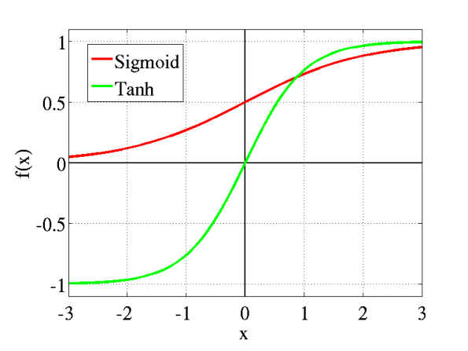
Tutorial question and answer
What is the difference between Sigmoid and Tanh activation function?
  Answer: See these curves
Under what situation you will use Sigmoid activation function?
  Answer: If the required output is between 0 to +1
Under what situation you will use Tanh activation function?
  Answer: If the required output is between -1 to +1

Slide 50
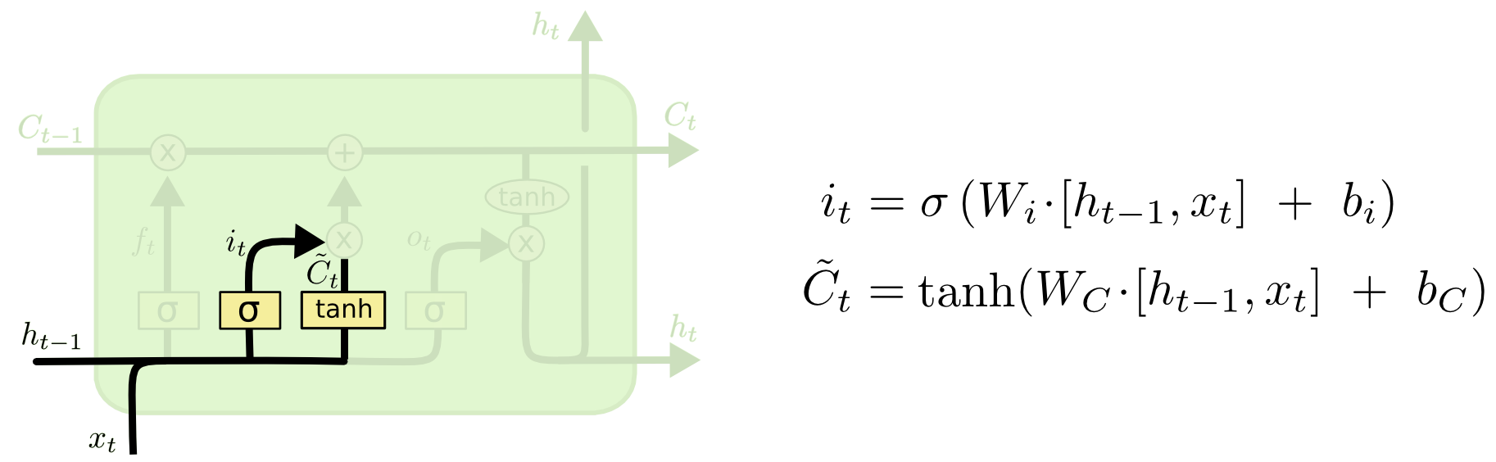
Inside an LSTM cell:(iii) input(or ignore) gate
The ‘tanh’ block will output –ve value to remove some information in C_{t}
Decide what information to store in the cell state
if x (x_{t}) and previous h (h_{t-1}) match, x_{t} and h_{t-1} work out some output to be stored in C_{t} .
New information (in x_{t}) added to become the state C_{t}
What to be kept/forget
“For the language model example ..
In the example of our language model, we’d want to add the gender of the new subject to the cell state, to replace the old one we’re forgetting.”
Since i ranges from 0 to 1, so use sigmoid;
~C_{t} ranges from -1 to 1, so use tanh
“Next, a tanh layer creates a vector of new candidate values, ~C_{t}, that could be added to the state. In the next step, we’ll combine these two to create an update to the state.”
http://colah.github.io/posts/2015-08-Understanding-LSTMs/

Slide 51
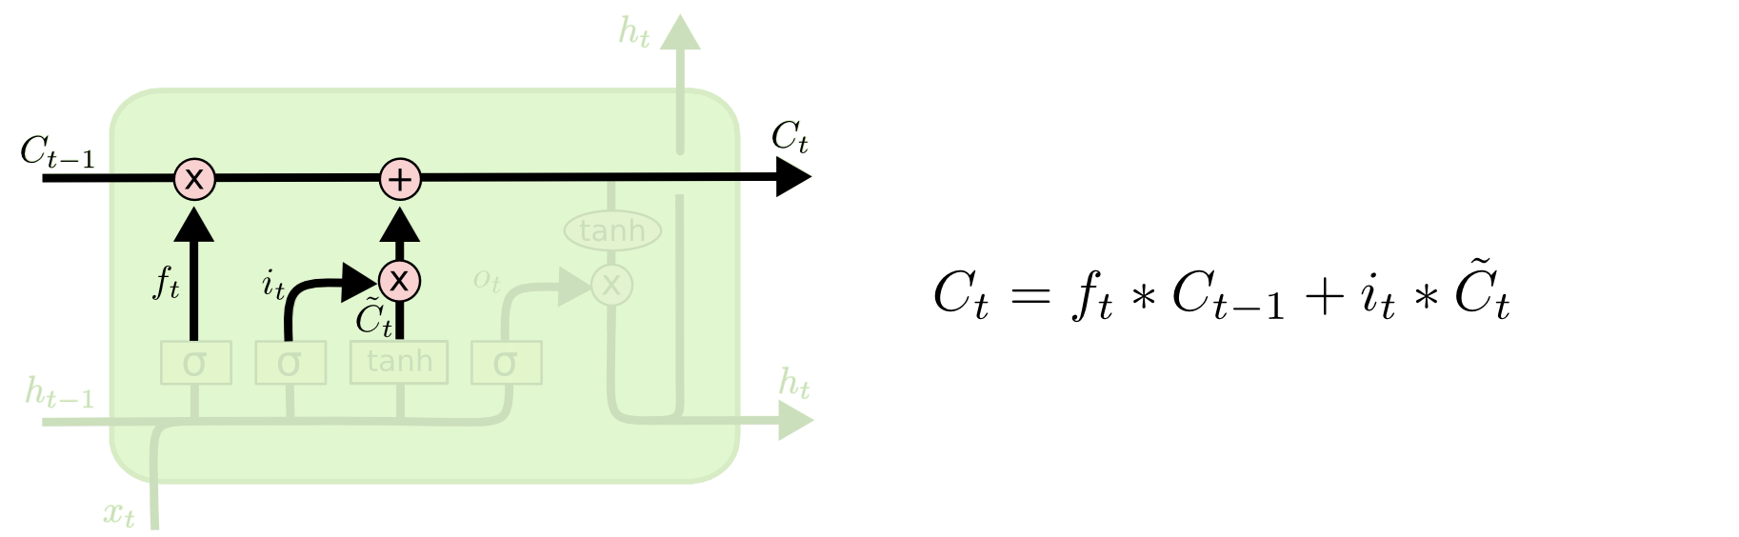
Inside an LSTM cell:(iv) update the old cell state
“We multiply the old state by f_{t}, forgetting the things we decided to forget earlier. Then we add i_{t} ∗ ~C_{t}. This is the new candidate values, scaled by how much we decided to update each state value.”
http://colah.github.io/posts/2015-08-Understanding-LSTMs/
C_{t-1} → C_{t}
These (x) or (*) here are element-wise or Hadamard multiplications
“For the language model example.. this is where we’d actually drop the information about the old subject’s gender and add the new information, as we decided in the previous steps.”
See https://en.m.wikipedia.org/wiki/Hadamard_product_(matrices)

Slide 52
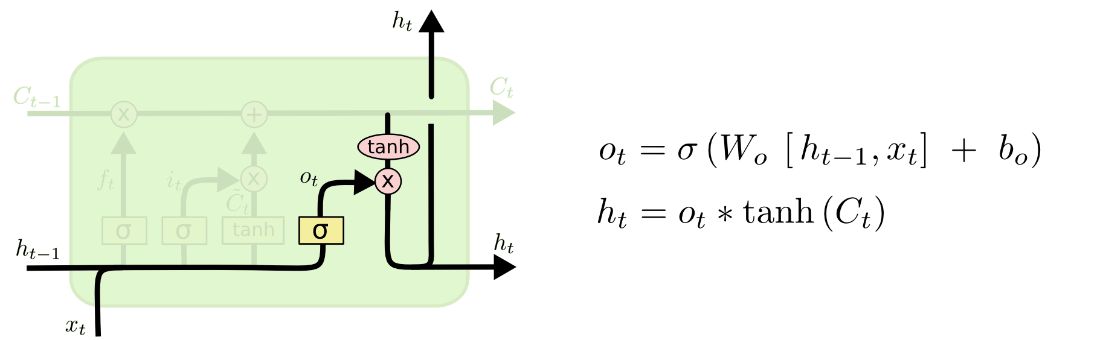
Inside an LSTM cell:(v) : output layer
“Finally, we need to decide what we’re going to output. This output will be based on our cell state, but will be a filtered version. First, we run a sigmoid layer which decides what parts of the cell state we’re going to output. Then, we put the cell state through tanh (to push the values to be between −1 and 1) and multiply it by the output of the sigmoid gate, so that we only output the parts we decided to.”
Decide what to output (h_{t}).
h ranges from -1 to 1, so use tanh
“For the language model example, since it just saw a subject, it might want to output information relevant to a verb, in case that’s what is coming next. For example, it might output whether the subject is singular or plural, so that we know what form a verb should be conjugated into if that’s what follows next.”
These (x) are element-wise or hadamard multiplications
http://colah.github.io/posts/2015-08-Understanding-LSTMs/

Slide 53
The matrix sizes shown in the formulas and the diagram are for all m duplicated cells
.*=element_wise multiplication
Forget gate
C_{t-1(mx1)}
C_{t}(mx1)
http://kvitajakub.github.io/2016/04/14/rnn-diagrams/
i(mx1)
U(mx1)
o_{t}(mx1)
f_{t}(mx1)
h_{t(mx1)}
X is of size nx1
h is of size mx1
h_{t-1(mx1)}
Size( X_{t(nx1)} append h_{t-1(mx1)} )=(n+m)x1
X is of size nx1

Slide 54
Exercise 5
In the previous slide,
  which part handles long term memory?
  which part handles short term memory?

Slide 55
Answer Exercise 5
  which part handles long term memory?
    Answer: C, Forget, input, update gates
  which part handles short term memory?
    Answer: C, Forget, input, update gates, output gates
h cell-output for next layer
C_{t}
C_{t-1}
Input
gate
Update
gate
Forget
gate
Output
gate
h_{t}
h_{t-1}
Input x_{t}
Ch11. RNN, LSTM

Slide 56
Summary of the 7 LSTM equations
W_{xy} are weights
σ()=sigmoid & tanh()=hyperbolic tangent are activation functions
Layer1 input is from x: The matrix sizes shown in the formulas are for all m duplicated cells
Input is n-bit

Slide 57
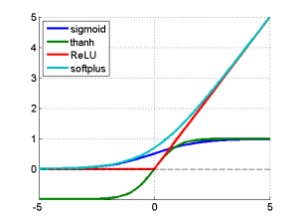

Recall : Activation function choices
https://imiloainf.wordpress.com/2013/11/06/rectifier-nonlinearities/
https://www.simonwenkel.com/2018/05/15/activation-functions-for-neural-networks.html#softplus
$$\text{Sigmoid}\text{:} \\ g\left(x\right)=\frac{1}{1+e^{−x}},$$
$$g^{′}\left(x\right)=\frac{e^{−x}}{{\left(1+e^{−x}\right)}^{2}}=g\left(x\right)⋅\left(1−g\left(x\right)\right)$$
$$\text{Tanh}\text{:} \\ g\left(x\right)=\frac{\sinh{(}x)}{\cosh{(}x)}=\frac{e^{x}−e^{−x}}{e^{x}+e^{−x}},$$
$$g^{′}\left(x\right)=\frac{4}{{\left(e^{−x}+e^{x}\right)}^{2}}$$
Relu is now very popular and shown to be working better other methods

Slide 58
LSTM Example
Numerical example

Slide 59
Example: The idea of using LSTM (lstm_x_version.m) to add two 8-bit binary numbers (code included in this ppt)
Since addition depends on previous history( carry=1 or not). LSTM is suitable. See the example on the right.
The two examples show the bit 7th (MSB) result is influenced by the result at bit 0. LSTM can solve this problem.
We treat addition as a sequence of related 8 pairs:
  Input → output bits:
  A[0],B[0]→ Y[0]
  A[1],B[1]→ Y[1]
  ….
  A[7],B[7] → Y[7] .
Train the system with many examples, after training when a new input sequence bits: [A(8-bit),B(8-bit)] arrive, the LSTM can find the output sequence (8-bit) correctly.
E.g. A=0111 1111
+ B=0000 0001
Y=1000 0000
E.g. A=0111 1111
+ B=0000 0000
Y=0111 1111
Bit 7,6,5,4,3,2,1,0
Bit 7,6,5,4,3,2,1,0

Slide 60
Exercise 6
MC question: Which of the following addition require of long-term memory operation?
  1111 1111 + 0000 0000 = 1111 1111
  0001 1111 + 0000 0001 = 0010 0000
  1111 0000 + 0000 1111 = 1111 1111
  0001 0001 + 0010 0010 = 0011 0011

Slide 61
Answer 6
Which of the following addition require of long-term memory operation?
  1111 1111 + 0000 0000 = 1111 1111
  0001 1111 + 0000 0001 = 0010 0000 (correct)
    Reason: Addition or subtraction involves the carry
  1111 0000 + 0000 1111 = 1111 1111
  0001 1110 + 0010 0001 = 0011 1111

Slide 62
Exercises on RNN and LSTM
Exercise 7: Algorithm : LSTM for an adder
Initialization
For j=1=999999; %Iterate till the weights are stable or error is samll
{ generate Y=A+B training sample, clear previous error
forward pass, for bit_position pos= 0 to 7
  { X(2-bit)=A(pos),B(pos), y=C(pos)
  for each pos, run LSTM once,
  use LSTM eq.1-7, find I,F,O,G,C,H parameters
  pred_out=sigmoid(ht*outpara),
  real output: d(i)=round(Pred_out (pos))
  }
  Part 5: backward pass, for bit_position pos= 0 to 7
  { X(2-bit)=A(pos),B(pos)
  use feed-backward eqs..
  to find weight/state updates
  }
  Part 6: 6(i): Calculate new weights/Bias
  6(ii): Clear updated before next iteration
  Part 7: Show temporary results (display only)
  } Part 8 : testing , random test 10 times
Y7 | Y6 | Y5 | Y4 | Y3 | Y2 | Y1 | Y0
P7 | P6 | P5 | P4 | P3 | P2 | P1 | P0
Yi=Pred_out(i)
C(pos+1)
H(pos+1)
C(pos)
H(pos)
LSTM_layer
See next slide
[X1(i)
X0(i)]
X_{i(1x2)}=[A_{i}]
[B_{i}]
Each pos=0→7
A7 | A6 | A5 | A4 | A3 | A2 | A1 | A0
B7 | B6 | B5 | B4 | B3 | B2 | B1 | B0
MC: what is the sizes of the input and output?
(1) input=1, output=1; (2) input=1, output=2;
(3) input=2, output=2; (4) input=2, output=1
Bit_{i} 7 6 5 4 3 2 1 0

Slide 63
Exercises on RNN and LSTM
Answer: 7: Algorithm : LSTM for an adder
Initialization
For j=1=999999; %Iterate till the weights are stable or error is samll
{ generate Y=A+B training sample, clear previous error
forward pass, for bit_position pos= 0 to 7
  { X(2-bit)=A(pos),B(pos), y=C(pos)
  for each pos, run LSTM once,
  use LSTM eq.1-7, find I,F,O,G,C,H parameters
  pred_out=sigmoid(ht*outpara),
  real output: d(i)=round(Pred_out (pos))
  }
  Part 5: backward pass, for bit_position pos= 0 to 7
  { X(2-bit)=A(pos),B(pos)
  use feed-backward eqs..
  to find weight/state updates
  }
  Part 6: 6(i): Calculate new weights/Bias
  6(ii): Clear updated before next iteration
  Part 7: Show temporary results (display only)
  } Part 8 : testing , random test 10 times
Y7 | Y6 | Y5 | Y4 | Y3 | Y2 | Y1 | Y0
P7 | P6 | P5 | P4 | P3 | P2 | P1 | P0
Yi=Pred_out(i)
C(pos+1)
H(pos+1)
C(pos)
H(pos)
LSTM_layer
See next slide
[X1(i)
X0(i)]
X_{i(1x2)}=[A_{i}]
[B_{i}]
Each pos=0→7
A7 | A6 | A5 | A4 | A3 | A2 | A1 | A0
B7 | B6 | B5 | B4 | B3 | B2 | B1 | B0
Bit_{i} 7 6 5 4 3 2 1 0
Ex1: what is the sizes of the input and output?
ans=Input=2 neurons =2x1 [A(i), B(i)], output_1 neuron =1x1 [pred_Out(i)].choice 4 is correct

Slide 64
A LSTM example using MATLAB. The algorithm (lstm_x_version.m)
Part 1: initialize system
Part 2: initialize weights/variables
Part 3a : iterate (j=1:99999) for training
{ Part 3b: 3b(i):generate C=A+B,clear overallError
3b(ii):clear weights, output H , state C
Part 4: forward pass, for bit_position pos= 0 to 7
  { 4(i):X(2-bit)=A(pos),B(pos), y=C(pos)
  4(ii): use equations 1-7 to find I,F,O,G,C,H
  4(iii): store I,F,O,G,C,H .
  4(iv): pred_out=sigmoid(ht*outpara),
  4(v): find errors,
  4(vi): real output: d(i)=round(Pred_out (pos))
  }
  Part 5: backward pass, for bit_position pos= 0 to 7
  { 5(i): X(2-bit)=A(pos),B(pos)
  5(ii):store h_{t},h_{t-1}, C_{t},C_{t-1}, O_{t}, F_{t}, G_{t}, I_{t},
  5(iii): find h_{t}_diff Out_para, O_{t}_diff, C_{t}_diff,F_{t}_diff, I_{t}_diff, G_{t}_diff,
  5(iv): find update of weights, states etc.
  }
  Part 6: 6(i): Calculate new weights/Bias
  6(ii): Clear updated fore next iteration
  Part 7: Show temporary results (display only)
  } Part 8 : testing , random test 10 times
Teacher (C) = Y, for C=A+B
Pred_out = P
Y7 | Y6 | Y5 | Y4 | Y3 | Y2 | Y1 | Y0
P7 | P6 | P5 | P4 | P3 | P2 | P1 | P0
Yi=Pred_out(i)
C(pos+1)
H(pos+1)
C(pos)
H(pos)
LSTM_layer
See next slide
[X1(i)
X0(i)]
X_{i(1x2)}=[A_{i}]
[B_{i}]
Each pos=0→7
A7 | A6 | A5 | A4 | A3 | A2 | A1 | A0
B7 | B6 | B5 | B4 | B3 | B2 | B1 | B0
Bit_{i} 7 6 5 4 3 2 1 0

Slide 65
LSTM_layer:For each bit j, (j=0,..,7) for one hidden layer architetcure
C_{pos}(32)
f₃₂()
C_{pos+1}(32)
Total weights
=4*[32*(32+2)]
Similar to the boxes below
u₃₂()
o₃₂()
i₃₂()
H_{pos+1}(32)
Output
(1 bit):
Pred_out(j)
C_{pos}(2)
⊗
⊕
C_{pos+1}(2)
σ
Similar
to the box below
w
w
w
w
w
σ
Output activation function
H_{pos}(1)
H_{pos}(2)
H_{pos+1}(2)
H_{pos}(32)
X(1)
X(0)
C_{i}(1)
⊗
⊕
C_{pos+1}(1)
f₁()
u₁()
σ
⊗
tanh
I₁()
o₁()
⊗
w
w
w
w
w
tanh
H_{pos}(1)
σ
σ
H_{pos+1}(1)
H_{pos}(2)
H_{pos}(32)
X(1)
X(0)
From previous time t
H_{pos(32-bit)} and X(1)=B_{pos}, X(0)=A_{pos}
Input (2 bits): B_{pos}A_{pos}

Slide 66
Recall: Hierarchical structure of a form of stacked LSTM
If SoftMax output neurons are employed, assume no bias is used.
Real Output (y) output neurons
n inputs (X)
M layers
  i-th layer has m_{i} cells, (i=1,2,..,M)
y real output neurons.
The “Output activation function” can be sigmoid or softmax
Initialize h(t=0),C(t=0)=zeros
Output activation function, e.g., sigmoid(σ) or softmax
h
LSTM Layer M, m_{M} cells
h
LSTM Layer 2, m₂ cells
h
h
LSTM Layer 1, m₁ cells
t→t+1
{X(1) , X(2),…,X(n)}_{t}
https://towardsdatascience.com/implementation-of-rnn-lstm-and-gru-a4250bf6c090

Slide 67
Recall : From input to layer 1
A cell has 4 components
h_{t} Next layer
C_{t-1}(m_{i},i)
Cell m_{i}
C_{t} (m_{i},i)
h_{t}(m_{i},i)
From
Previous
cycle
C (t-1)
C_{t-1}(2,i)
Cell 2
C_{t} (2,i)
C (t+1)
h_{t-1}(2,i)
h_{t}(2,i)
C_{t-1}(1,i)
C_{t} (1,i)
Cell 1
h_{t-1}(1,i)
h_{t-1}
Previous time
h_{t}(1,i)
If this is the first layer Inputs {x₁,x₂,…,x_{n}}_{t,} , input has n bits
https://towardsdatascience.com/implementation-of-rnn-lstm-and-gru-a4250bf6c090

Slide 68
Recall : From hidden i^{th} layer to i+1th layer
A cell has 4 components
h_{t} Next layer
C_{t-1}(m_{i},i)
Cell m_{i}
C_{t} (m_{i},i)
h_{t}(m_{i},i)
From
Previous
cycle
C (t-1)
C_{t-1}(2,i)
Cell 2
C_{t} (2,i)
C (t+1)
h_{t-1}(2,i)
h_{t}(2,i)
C_{t-1}(1,i)
C_{t} (1,i)
Cell 1
h_{t-1}(1,i)
h_{t-1}
Previous time
h_{t}(1,i)
If this is the i^{th} hidden layer, input is from i-1th layer
Assume in this i^{th} layer, there are m_{i} cells
The previous layer has m_{i-1} cells
https://towardsdatascience.com/implementation-of-rnn-lstm-and-gru-a4250bf6c090

Slide 69
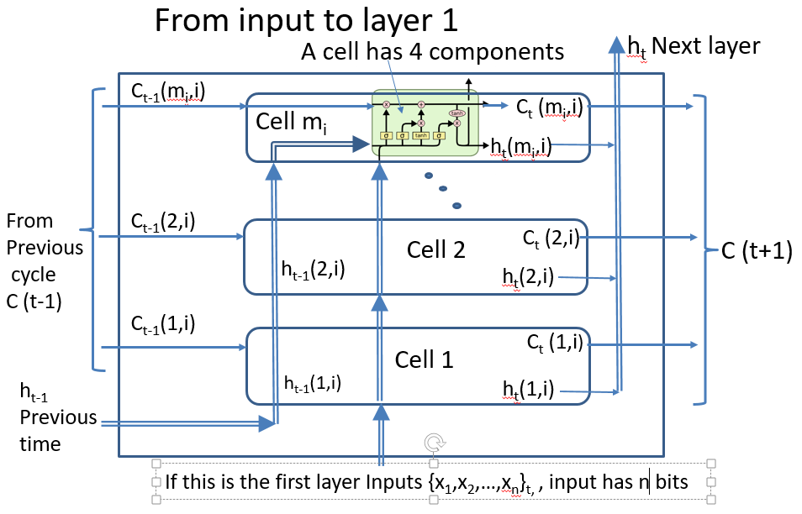
From input to layer 1
Input has n bits
Layer 1 has m_{i=1} cells
Interconnection between current output h and one of the components= m_{i}*m_{i}
Interconnections between input to each component = m_{i}*n
There are 4 components in each cell so total connections (weights)
=4*m_{i=1}*(m_{i=1}+n)

Slide 70
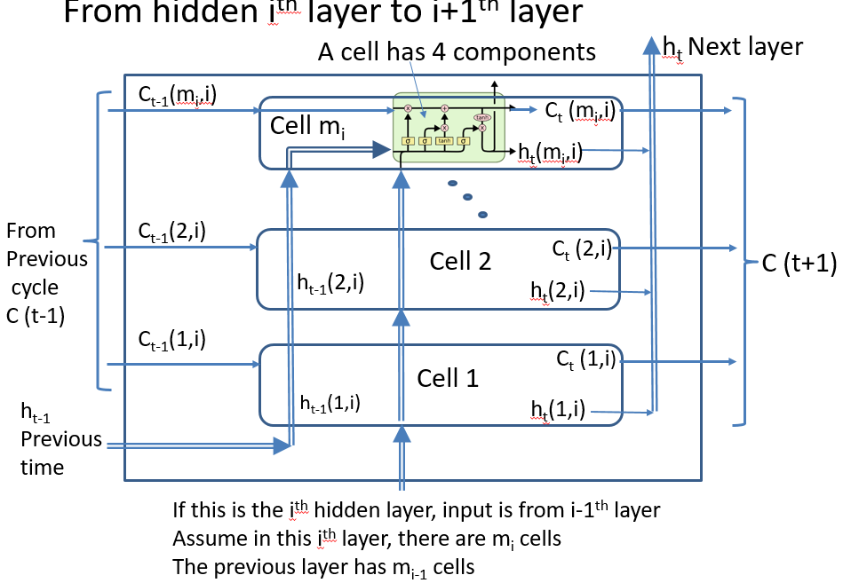
From i^{th} layer to i+1th layer
Current layer has m_{i} cells
Previous layer has m_{i-1} cells
Interconnection between current output h and one of the components= mi*mi
Connections between this layer and previous layer is mi*m_{i-1}
There are 4 components in each cell so total connections (weights)= 4*m_{i}*(m_{i}+m_{i-1}) weights

Slide 71
Example1: Calculate the number of weights in LSTM
https://stats.stackexchange.com/questions/226593/how-can-calculate-number-of-weights-in-lstm
Question1: Input 39, Output 34, Hidden Layers = 3, Cells in each layer = 1024
Answers: Each cell in the LSTM has four components: the cell weights, the input gate, the forget gate, and the output gate. Each component has weights associated with all of its input from the previous layer, plus input from the previous time step. So if there are m_{i} cells in an LSTM layer, and m_{i−1} in the earlier layer, there will be (m_{i−1}+m_{i} ) inputs to each component of the cell. Since there are four components, that means there are 4(m_{i−1}+m_{i}) weights associated with each cell. And since we have m_{i} cells, that means there are 4m_{i} (m_{i−1}+m_{i} ) weights associated with that layer.
If the last hidden layer has m_{i} cells, and the number of real output is m_{y}. For the output layer, the h of the last hidden layer will be combined by a softmax (or sigmoid) activation function to be sent to the output neurons, hence the weights required is m_{i}*m_{y}.
Answer1: Since n_{i}=num. of neurons in layer i, so we have n=39 (input neuron number) ,m_{i=1}= m_{i=2}=m_{i=3} =1024, and m_{y}=34 (output neuron number). So, the overall number of weights = input_to_first_layer_connections+ first_to_second_layer_connections+ second_to_third_layer_connections+third_layer_to_output_connections=
=4*(m_{i=1}+n)*m_{i=1}+4*m_{i=2}*(m_{i=1}+m_{i=2})+ 4*m_{i=3}*(m_{i=2}+m_{i=3})+ m_{y}*(m_{i=3})
=4*(1024+39)*1024 +4*1024*(1024+1024)*2 +34*(1024)=21,166,080 ( about 21M).
For this calculation: Assume SoftMax output neurons with no bias are employed

Slide 72
Example2: Calculate the number of weights in LSTM
https://stats.stackexchange.com/questions/226593/how-can-calculate-number-of-weights-in-lstm
Question2: Input neurons =n= 205, Output neurons =m_{y}= 205, Hidden Layers = 5,Cells in each layer =m_{i=1,2,3,4,5}= 700 (same for all hidden layers)
If the last hidden layer has m_{last} cells, and the number of real output is m_{y}. For the output layer, the ‘h’ of the last layer will be combined by a softmax (or sigmoid) activation function, hence the weights required is m_{last}*m_{y}.
Answer2: Since m_{i}=num. of neurons in a hidden layer , so n=205, m_{i=1}=m_{i=2}=m_{i=3}=m_{i=4}= m_{i=5}=700, and m_{y}=205. So, the total number of weights=
=4*(m_{i=1}+n)*m_{i=1}*+
4*m_{i=2}*(m_{i=1}+m_{i=2})+
4*m_{i=3}*(m_{i=2}+m_{i=3})+
4*m_{i=4}*(m_{i=3}+m_{i=4})+
4*m_{i=5}*(m_{i=4}+m_{i=5})+
+ m_{y}*(m_{i=5})
=4*(700+205)*700 +4*700*(700+700)*4 +205*(700) =18,357,500
For this calculation: Assume SoftMax output neurons with no bias are employed

Slide 73
Example 3: A detailed stacked LSTM
For this LSTM
It has 4 inputs.
It has 3 hidden layers,
  the 1st hidden layer has 3 cells, (see part3a)
  the 2nd hidden layer has 2 cells, (see part3b)
  the 3rd hidden layer has 3 cells. (see part3c)
It has 2 outputs (see part3d)

Slide 74
Part 3a: 1st hidden layer, it has m_{i=1}=3 cells, input=n=4
h_{t}3 h_{t}2 h_{t}1
To next layer
⊗
⊕
C_{t}(3)
C_{t-1}(3)
f₁()
u₁()
tanh
σ
⊗
I₁()
o₁()
⊗
Each cell has 4 components
Only the details of one of the components (forget gate) is shown. The other components are similar
Total weights=
4*(m_{i=1}*m_{i=1}+m_{i=1}*n)
=4*m_{i=1}*(m_{i=1}+n)
=4*3*(3+4)
w
w
w
w
w
w
w
tanh
σ
σ
h_{t}(3)
C_{t-1}(2)
⊗
⊕
C_{t}(2)
f₁()
u₁()
tanh
σ
⊗
I₁()
o₁()
⊗
w
w
w
w
w
w
w
tanh
σ
σ
h_{t}(2)
C_{t-1}(1)
f₁()
⊗
⊕
C_{t}(1)
u₁()
tanh
σ
⊗
I₁()
o₁()
⊗
w
w
w
w
w
w
w
tanh
h_{t}(1)
h_{t-1}(1)
σ
σ
x₁ x₂ x₃ x_{n=4} input

Slide 75
Part 3b: 2nd hidden layer, it has m_{i=2}=2 cells,
Each cell has 4 components
Total weights=
4*(m_{i=2}*m_{i=2}+m_{i=2}*m_{i=1})
=4*m_{i=2}*(m_{i=2}+m_{i=1})
=4*2*(2+3)
To next layer
h_{t}1 h_{t}2
f₁()
⊗
⊕
u₁()
tanh
σ
⊗
I₁()
o₁()
⊗
w
w
w
w
w
tanh
σ
σ
C_{t-1}(1)
f₁()
⊗
⊕
u₁()
tanh
C_{t}(1)
σ
⊗
I₁()
o₁()
⊗
w
w
w
w
w
tanh
h_{t}(1)
σ
σ
h_{t-1}(1)
h_{t}1 h_{t}2 h_{t}3 from previous layer

Slide 76
Part 3c: 3rd hidden layer, it has m_{i=3}=3 cells
To output
h_{t}1 h_{t}2 h_{t}3
A cell has 4 components
Total weights=
4*(m_{i=3}*m_{i=3}+m_{i=3}*m_{i=2})
=4*m_{i=3}*(m_{i=3}+m_{i=2})
=4*3*(3+2)
Only one component (forget gate) is shown
f₁()
⊗
⊕
u₁()
tanh
σ
⊗
I₁()
o₁()
⊗
w
w
w
w
w
tanh
σ
σ
f₁()
⊗
⊕
u₁()
tanh
σ
⊗
I₁()
o₁()
⊗
w
w
w
w
w
tanh
σ
σ
C_{t-1}(1)
f₁()
⊗
⊕
u₁()
tanh
C_{t}(1)
σ
⊗
I₁()
o₁()
⊗
w
w
w
w
w
tanh
h_{t}(1)
h_{t-1}(1)
σ
σ
h_{t}1 h_{t}2 from previous layer

Slide 77
Part 3d: Final Output stage
Use Sigmoid (σ) activation function here.
  It has 2 outputs
  Total weights=2*3
  Bias =2
Alternatively: if SoftMax output neurons with no bias are employed, number of bias=0
output1
output2
σ
σ
w
w
w
w
w
w
From 3rd hidden layer
h_{t}1 h_{t}2 h_{t}3

Slide 78
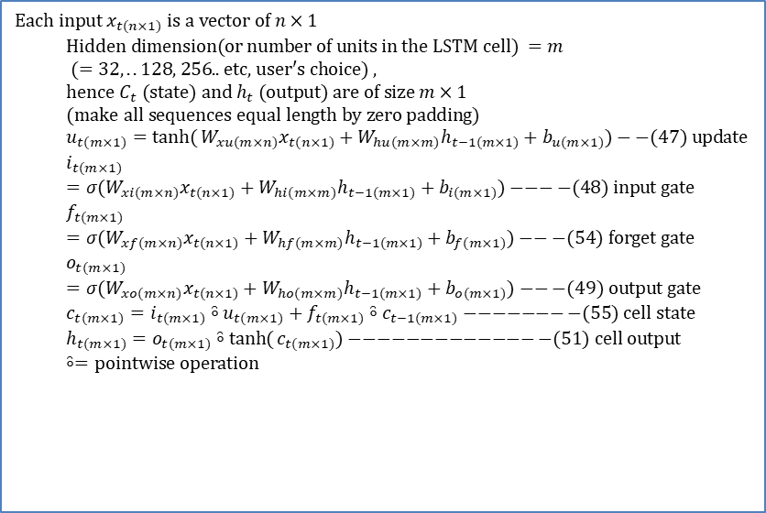
Exercise 8: Implementation: One layer of 32 LSTM cells, m=32 LSTM cells, 2 inputs, 1 output
Forget gate
Update u (or ~C_{t})
AN LSTM cell
C_{t}
C_{t-1}
$$\text{Each} \text{input} x_{t(n×1)} \text{is} \text{a} \text{vector} \text{of} n×1 \\ \text{Hidden} \text{dimension}(\text{or} \text{number} \text{of} \text{units} \text{in} \text{the} \text{LSTM} \text{cell}) =m \\ (=32,..\text{128, 256.. }\text{etc}\text{, }\text{user}\text{′}\text{s} \text{choice})\text{ , } \\ \text{hence} C_{t} (\text{state}) \text{and} h_{t} (\text{output}) \text{are} \text{of} \text{size} m×1 \\ (\text{make} \text{all} \text{sequences} \text{equal} \text{length} \text{by} \text{zero} \text{padding}) \\ u_{t(m×1)}=\tanh{(}W_{xu(m×n)}x_{t(n×1)}+W_{hu(m×m)}h_{t−1(m×1)}+b_{u(m×1)})−−(47) \text{update} \\ i_{t(m×1)}=σ(W_{xi(m×n)}x_{t(n×1)}+W_{hi(m×m)}h_{t−1(m×1)}+b_{i(m×1)})−−−−(48) \text{input} \text{gate} \\ f_{t(m×1)}=σ(W_{xf(m×n)}x_{t(n×1)}+W_{hf(m×m)}h_{t−1(m×1)}+b_{f(m×1)})−−−(54) \text{forget} \text{gate} \\ o_{t(m×1)}=σ(W_{xo(m×n)}x_{t(n×1)}+W_{ho(m×m)}h_{t−1(m×1)}+b_{o(m×1)})−−−(49) \text{output} \text{gate} \\ c_{t(m×1)}=i_{t(m×1)}\overset{̑}{∘}u_{t(m×1)}+f_{t(m×1)}\overset{̑}{∘}c_{t−1(m×1)}−−−−−−−−(55) \text{cell} \text{state} \\ h_{t(m×1)}=o_{t(m×1)}\overset{̑}{∘}\tanh{(}c_{t(m×1)})−−−−−−−−−−−−−−(51) \text{cell} \text{output} \\ \overset{̑}{∘}=\text{pointwise} \text{operation}$$
i_{t}
o_{t}
f_{t}
u_{t}
h_{t}
h_{t-1}
x_{t}
input gate
output gate
P31-33 of Neural Machine Translation and Sequence-to-sequence Models: A Tutorial by Graham Neubig
https://arxiv.org/pdf/1703.01619.pdf
https://github.com/yandexdataschool/gumbel_lstm
If SoftMax output neurons with no bias are employed
For this simple 8-binary number adder (n=2-bit input,1-bit output)
e.g. n=2, m=32, 1 output
Number of weights for all 32 LSTM cells =4*32*(32+2)
Number of weights to generate y from all h =32 (sigmoid is used here, “W_out_para “in the matlab code:lstm_x_version.m, around slide 84)
Total weights (add the above 2 results) = 4*32*(32+2) +32 =4384.
Exercise: If n=256 inputs, m=4096 LSTM cells , 4 outputs (y=4), find weights and biases of the whole network.
Number of weights =_____________?
Number of biases =_______________?
http://www.4answered.com/questions/view/2450e23/How-to-calculate-the-number-of-parameters-of-an-LSTM-network

Slide 79

ANSWER:Exercise 8: Implementation: One layer of 32 LSTM cells, m=32 LSTM cells, 2 inputs, 1 output
Forget gate
Update u (or ~C_{t})
AN LSTM cell
C_{t}
$$\text{Each} \text{input} x_{t(n×1)} \text{is} \text{a} \text{vector} \text{of} n×1 \\ \text{Hidden} \text{dimension}(\text{or} \text{number} \text{of} \text{units} \text{in} \text{the} \text{LSTM} \text{cell}) =m \\ (=32,..\text{128, 256.. }\text{etc}\text{, }\text{user}\text{′}\text{s} \text{choice})\text{ , } \\ \text{hence} C_{t} (\text{state}) \text{and} h_{t} (\text{output}) \text{are} \text{of} \text{size} m×1 \\ (\text{make} \text{all} \text{sequences} \text{equal} \text{length} \text{by} \text{zero} \text{padding}) \\ u_{t(m×1)}=\tanh{(}W_{xu(m×n)}x_{t(n×1)}+W_{hu(m×m)}h_{t−1(m×1)}+b_{u(m×1)})−−(47) \text{update} \\ i_{t(m×1)}=σ(W_{xi(m×n)}x_{t(n×1)}+W_{hi(m×m)}h_{t−1(m×1)}+b_{i(m×1)})−−−−(48) \text{input} \text{gate} \\ f_{t(m×1)}=σ(W_{xf(m×n)}x_{t(n×1)}+W_{hf(m×m)}h_{t−1(m×1)}+b_{f(m×1)})−−−(54) \text{forget} \text{gate} \\ o_{t(m×1)}=σ(W_{xo(m×n)}x_{t(n×1)}+W_{ho(m×m)}h_{t−1(m×1)}+b_{o(m×1)})−−−(49) \text{output} \text{gate} \\ c_{t(m×1)}=i_{t(m×1)}\overset{̑}{∘}u_{t(m×1)}+f_{t(m×1)}\overset{̑}{∘}c_{t−1(m×1)}−−−−−−−−(55) \text{cell} \text{state} \\ h_{t(m×1)}=o_{t(m×1)}\overset{̑}{∘}\tanh{(}c_{t(m×1)})−−−−−−−−−−−−−−(51) \text{cell} \text{output} \\ \overset{̑}{∘}=\text{pointwise} \text{operation}$$
C_{t-1}
i_{t}
o_{t}
f_{t}
u_{t}
h_{t}
h_{t-1}
x_{t}
input gate
output gate
P31-33 of Neural Machine Translation and Sequence-to-sequence Models: A Tutorial by Graham Neubig
https://arxiv.org/pdf/1703.01619.pdf
https://github.com/yandexdataschool/gumbel_lstm
If SoftMax output neurons with no bias are employed
For this simple 8-binary number adder (n=2-bit input,1-bit output)
e.g. n=2, m=32, 1 output
Number of weights for all 32 LSTM cells =4*32*(32+2)
Number of weights to generate y from all h =32 (sigmoid is used here, “W_out_para “in the matlab code:lstm_x_version.m, around slide 84)
Total weights (add the above 2 results) = 4*32*(32+2) +32 =4384.
Exercise: If n=256 inputs, m=4096 LSTM cells , 4 outputs (y=4), find weights and biases of the whole network. Answer:
Number of weights =4*4096*(4096+256)+4*(4096)=
71319552, Number of biases =4*m=4*4096=16384
https://stats.stackexchange.com/questions/226593/how-can-calculate-number-of-weights-in-lstm

Slide 80
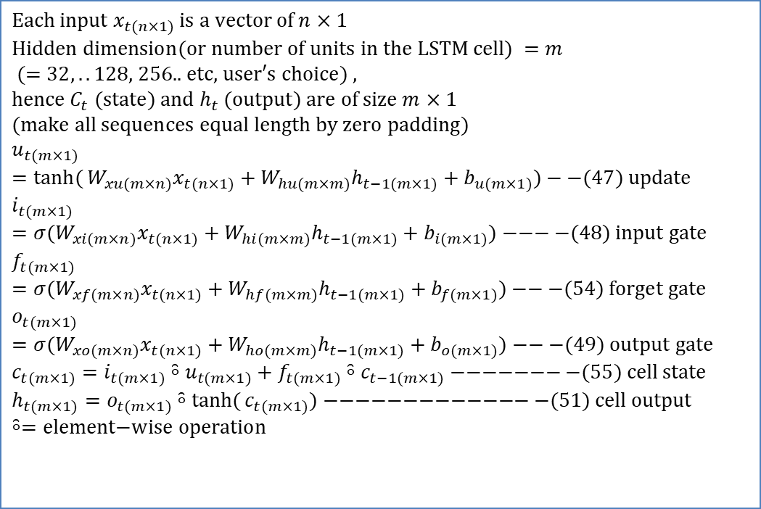
Exercise 9
If a=[1,2]’,b=[3,4]’
Find the element-wise product results of a and b
MC question
[1*3,2*4]’
[1*4,2*3]’
[1*2,3*4]’
[3*4, 1*2,]’
What is the maximum value of t in this example?
Answer:___?
Answer:__?
Please point out where are the element-wise operations occur in the equations on the right.
$$\text{Each} \text{input} x_{t(n×1)} \text{is} \text{a} \text{vector} \text{of} n×1 \\ \text{Hidden} \text{di}\text{mension}(\text{or} \text{number} \text{of} \text{units} \text{in} \text{the} \text{LSTM} \text{cell}) =m \\ (=32,..\text{128, 256.. }\text{etc}\text{, }\text{user}\text{′}\text{s} \text{choice})\text{ , } \\ \text{hence} C_{t} (\text{state}) \text{and} h_{t} (\text{output}) \text{are} \text{of} \text{size} m×1 \\ (\text{make} \text{all} \text{sequences} \text{equal} \text{length} \text{by} \text{zero} \text{padding}) \\ u_{t(m×1)}=\tanh{(}W_{xu(m×n)}x_{t(n×1)}+W_{hu(m×m)}h_{t−1(m×1)}+b_{u(m×1)})−−(47) \text{update} \\ i_{t(m×1)}=σ(W_{xi(m×n)}x_{t(n×1)}+W_{hi(m×m)}h_{t−1(m×1)}+b_{i(m×1)})−−−−(48) \text{input} \text{gate} \\ f_{t(m×1)}=σ(W_{xf(m×n)}x_{t(n×1)}+W_{hf(m×m)}h_{t−1(m×1)}+b_{f(m×1)})−−−(54) \text{forget} \text{gate} \\ o_{t(m×1)}=σ(W_{xo(m×n)}x_{t(n×1)}+W_{ho(m×m)}h_{t−1(m×1)}+b_{o(m×1)})−−−(49) \text{output} \text{gate} \\ c_{t(m×1)}=i_{t(m×1)}\overset{̑}{∘}u_{t(m×1)}+f_{t(m×1)}\overset{̑}{∘}c_{t−1(m×1)}−−−−−−−−(55) \text{cell} \text{state} \\ h_{t(m×1)}=o_{t(m×1)}\overset{̑}{∘}\tanh{(}c_{t(m×1)})−−−−−−−−−−−−−−(51) \text{cell} \text{output} \\ \overset{̑}{∘}=\text{element}\text{−}\text{wise} \text{operation}$$
See https://en.m.wikipedia.org/wiki/Hadamard_product_(matrices)
https://stats.stackexchange.com/questions/226593/how-can-calculate-number-of-weights-in-lstm

Slide 81
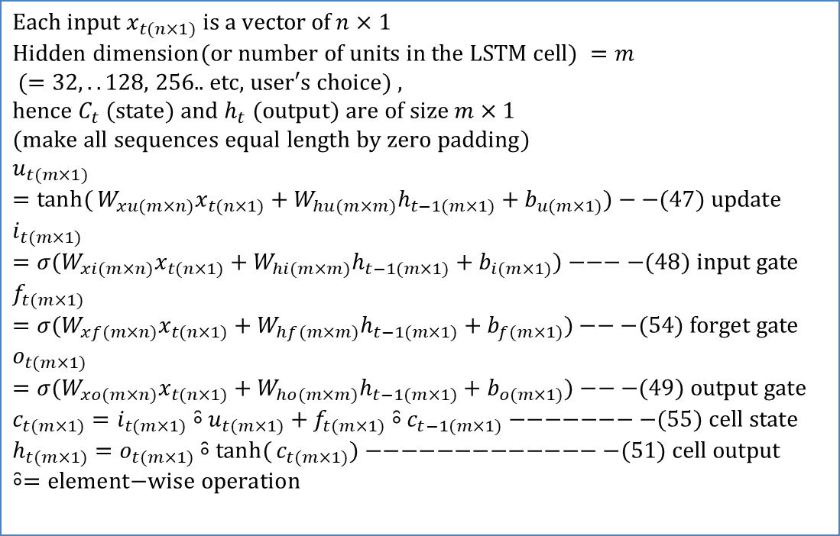
ANSWER: Exercise 9
If a=[1,2]’,b=[3,4]’
Find the element-wise product results of a and b
Answer:____? [1*3,2*4]’=[3,8]’
Choice 1 is correct
What is the maximum value of t in this example?
Answer:_____? t=0,1,2,..,7, max=7
Total 8 time steps
Please point out where are the element-wise operations occur in the equations on the right.
$$\text{Each} \text{input} x_{t(n×1)} \text{is} \text{a} \text{vector} \text{of} n×1 \\ \text{Hidden} \text{dimension}(\text{or} \text{number} \text{of} \text{units} \text{in} \text{the} \text{LSTM} \text{cell}) =m \\ (=32,..\text{128, 256.. }\text{etc}\text{, }\text{user}\text{′}\text{s} \text{choice})\text{ , } \\ \text{hence} C_{t} (\text{state}) \text{and} h_{t} (\text{output}) \text{are} \text{of} \text{size} m×1 \\ (\text{make} \text{all} \text{sequences} \text{equal} \text{length} \text{by} \text{zero} \text{padding}) \\ u_{t(m×1)}=\tanh{(}W_{xu(m×n)}x_{t(n×1)}+W_{hu(m×m)}h_{t−1(m×1)}+b_{u(m×1)})−−(47) \text{update} \\ i_{t(m×1)}=σ(W_{xi(m×n)}x_{t(n×1)}+W_{hi(m×m)}h_{t−1(m×1)}+b_{i(m×1)})−−−−(48) \text{input} \text{gate} \\ f_{t(m×1)}=σ(W_{xf(m×n)}x_{t(n×1)}+W_{hf(m×m)}h_{t−1(m×1)}+b_{f(m×1)})−−−(54) \text{forget} \text{gate} \\ o_{t(m×1)}=σ(W_{xo(m×n)}x_{t(n×1)}+W_{ho(m×m)}h_{t−1(m×1)}+b_{o(m×1)})−−−(49) \text{output} \text{gate} \\ c_{t(m×1)}=i_{t(m×1)}\overset{̑}{∘}u_{t(m×1)}+f_{t(m×1)}\overset{̑}{∘}c_{t−1(m×1)}−−−−−−−−(55) \text{cell} \text{state} \\ h_{t(m×1)}=o_{t(m×1)}\overset{̑}{∘}\tanh{(}c_{t(m×1)})−−−−−−−−−−−−−−(51) \text{cell} \text{output} \\ \overset{̑}{∘}=\text{element}\text{−}\text{wise} \text{operation}$$
https://en.m.wikipedia.org/wiki/Hadamard_product_(matrices)

Slide 82
Code example : Dimension of parameters may be reversed as compared to the previous example. But result is same.
Use LSTM to add two 8-bit binary numbers, since addition depends on previous history( carry=1 or not). LSTM is suitable
E.g. 0100 0001 + 0100 0001=1000 0010 etc.
For each iteration (epoch)
  Execute forward transform to get an 8-bit addition result from two 8-bit random numbers as an example. A[8bi]+B[8bit]=result[8bit]
  For a pair of 8-bit A and B, backpropagation is done bit by bit. That is,
  A[i]and B[i] bit-pair are fed to the LSTM as input, the learning sequence fir ‘i’ is from the Most-significant bit to the Least significant bit.
  Target-Output is compared to the output bit found by the forward transform. Backpropagation will start to learn and change the weights. Then a second bit-pair will be sent to the LSTM and learn again until the last pair.

Slide 83
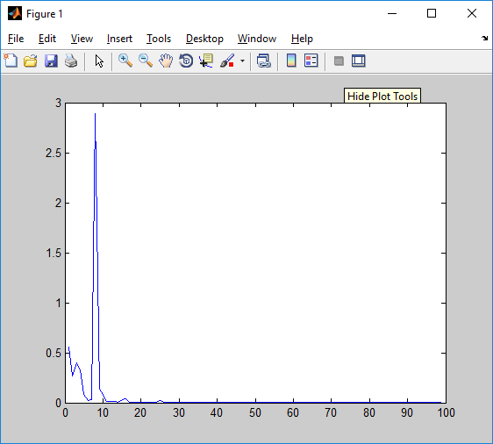
Demo code
Lstm_X_version.m
Result -----EPOCH-------
-------97000------
Error:0.00047496
Pred:01011010 (predicted by LSTM)
True:01011010 (ground truth)
11 + 79 = 90
-------98000------
Error:0.00036832
Pred:11000010 (unsigned integer)
True:11000010 (unsigned integer)
70 + 124 = 194
-------99000------
The toy problem is to make a machine that can perform 8-bit digital addition
E.g. 0100 0001
+ 0100 0001=1000 0010 etc.
--Code overview-----
Create testing data
Train: Epoch =1:99999
  Init. parameters
  Forward pass
  Backward pass
  Test it once when mod(epoch)==1000
Overall
Error
(allErr)
Epoch *1000

Slide 84
Learning thru. Back propagation to find weights: out_para and other weights
For each training C=A+B sample:
Loop each training i-th (i=0 to 7)bit:
Input (2 bits): [A_{i},B_{i}]
Teacher (1 bit):C_{i}=y in code
Line 160:Out_error=y-pred_out
Pred_out(1x1)
C_{i}=y
(Sigmoid
(H_{t(1x32)} *w_out_para _{(32x1)}))
Forward pass
  for position =1:8:
    Generate Pred_out
    output_deltas(position) =output_error = y - pred_out;
    End of for position =1:8:
  output_deltas(8x1) is the difference to be fed-back
Back propagation
  For position =1:8:
  output_diff=output_deltas(position)
  H_t_diff = output_diff * dsigmoid(H_t.*out_para');
  w_out_para_diff =( output_diff * (H_t) * sigmoid_output_to_derivative(pred_out))';
  O_t_diff = H_t_diff .* tan_h(C_t) .* sigmoid_output_to_derivative(O_t);
  Etc
  In the code:w_out_para=out_para
W_out_para is (1x32)
w_out_para(1)_{position=1}
W_out_para(2)
W_out_para(32)
Output of lstm cell
H_{t}is (1x32)
H_{t}(1)
H_{t}(2)
H_{t}(32)
LSTM Cell 1
Do it bit by bit, for every i (from 0 to 7)
X_{i(1x2)}=[A_{i}]
[B_{i}]
A
B
A7 | B6 |  |  |  |  |  | A0
B7 |  |  |  |  |  |  | B0
Bit_{i} 7 6 5 4 3 2 1 0
Problem C=A+B (8-bit addition)
Notes:
Structure of the LSTM
Calculate bit by bit from b_{i=0}, b_{i=1} .. b_{i=7}
for each i=0,1,2..7
Pass x_{i,size=1x2} into the LSTM cell input ,
find a digital output C_{i,size=1x1}
For the LSTM, input x_{i} is 2 bits, output h_{t} is 32 bits. Use a soft_max function to generate a one-bit output Ci
Calculate bit by bit from b_{i=0}, b_{i=1} .. b_{i=7}
for each i=0,1,2..7
Pass x_{i,size=1x2} into the LSTM cell input ,
find a digital output C_{i,size=1x1}
For the LSTM, input x_{i} is 2 bits, output h_{t} is 32 bits. Use a soft_max function to generate a one-bit output Ci

Slide 85
Exercise 10
For each training C=A+B sample:
Loop each training i-th (i=0 to 7)bit:
Input (2 bits): [A_{i},B_{i}]
Teacher (1 bit):C_{i}=y in code
Line 160:Out_error=y-pred_out
Pred_out(1x1)
C_{i}=y
(Sigmoid
(H_{t(1x32)} *w_out_para _{(32x1)}))
(Ex10a) If the teacher (target) is y, write the formula for the term that back-propagate back to the network.
  MC question
  -y-pred_out,
  pred_out –y,
  y-pred_out
  pred_out +y.
(Ex10b) Write the equation for the output (Pred_out).
W_out_para is (1x32)
w_out_para(1)_{position=1}
W_out_para(32)
W_out_para(2)
Output of lstm cell
H_{t}is (1x32)
H_{t}(1)
H_{t}(2)
H_{t}(32)
LSTM Cell 1
Do it bit by bit, for every i (from 0 to 7)
X_{i(1x2)}=[A_{i}]
[B_{i}]
A
B
A7 | B6 |  |  |  |  |  | A0
B7 |  |  |  |  |  |  | B0
Bit_{i} 7 6 5 4 3 2 1 0
Problem C=A+B (8-bit addition)
Notes:
Structure of the LSTM
Calculate bit by bit from b_{i=0}, b_{i=1} .. b_{i=7}
for each i=0,1,2..7
Pass x_{i,size=1x2} into the LSTM cell input ,
find a digital output C_{i,size=1x1}
For the LSTM, input x_{i} is 2 bits, output h_{t} is 32 bits. Use a soft_max function to generate a one-bit output Ci
Calculate bit by bit from b_{i=0}, b_{i=1} .. b_{i=7}
for each i=0,1,2..7
Pass x_{i,size=1x2} into the LSTM cell input ,
find a digital output C_{i,size=1x1}
For the LSTM, input x_{i} is 2 bits, output h_{t} is 32 bits. Use a soft_max function to generate a one-bit output Ci

Slide 86
ANSWER
Exercise 10
For each training C=A+B sample:
Loop each training i-th (i=0 to 7)bit:
Input (2 bits): [A_{i},B_{i}]
Teacher (1 bit):C_{i}=y in code
Line 160:Out_error=y-pred_out
Pred_out(1x1)
C_{i}=y
(Sigmoid
(H_{t(1x32)} *w_out_para _{(32x1)}))
If the teacher is y, write the formula for the term that back-propagate back to the network. Answer: ___? MC question
  -y-pred_out
  pred_out -y
  y-pred_out (correct)
  pred_out +y
Write the equation for the output (Pred_out). Answer:__________________? Y=logistic_sigmoid{Ht(1)*w_out_para(1)+Ht(2)*w_out_para(2)+…+H(7)*w_out_para(7)}
W_out_para is (1x32)
w_out_para(1)_{position=1}
W_out_para(2)
W_out_para(32)
Output of lstm cell
H_{t}is (1x32)
H_{t}(1)
H_{t}(2)
H_{t}(32)
LSTM Cell 1
Do it bit by bit, for every i (from 0 to 7)
X_{i(1x2)}=[A_{i}]
[B_{i}]
A
B
A7 | B6 |  |  |  |  |  | A0
B7 |  |  |  |  |  |  | B0
Bit_{i} 7 6 5 4 3 2 1 0
Problem C=A+B (8-bit addition)
Notes:
Structure of the LSTM
Calculate bit by bit from b_{i=0}, b_{i=1} .. b_{i=7}
for each i=0,1,2..7
Pass x_{i,size=1x2} into the LSTM cell input ,
find a digital output C_{i,size=1x1}
For the LSTM, input x_{i} is 2 bits, output h_{t} is 32 bits. Use a soft_max function to generate a one-bit output Ci
Calculate bit by bit from b_{i=0}, b_{i=1} .. b_{i=7}
for each i=0,1,2..7
Pass x_{i,size=1x2} into the LSTM cell input ,
find a digital output C_{i,size=1x1}
For the LSTM, input x_{i} is 2 bits, output h_{t} is 32 bits. Use a soft_max function to generate a one-bit output Ci

Slide 87
A LSTM example using MATLAB
The algorithm (lstm_x_version.m
Part 1: initialize system
Part 2: initialize weights/variables
Part 3a : iterate for training, all epochs
{ Part 3b: generate inputs/teacher i.e. a+b=c
Part 4: forward pass, from bit i= 0 to 7
Part 5: backward pass, from bit i= 0 to 7
Part 6: update all weights
Part 7: display only, show temporary results
}
Part 8 : testing , random test 10 times

Slide 88
Part 1: initialize system
%% part 1 , system setup
function lstm_x()
clc
% clear
close all
%% training dataset generation
binary_dim = 8;
largest_number = 2^binary_dim - 1;
binary = cell(largest_number, 1);
for i = 1:largest_number + 1
binary{i} = dec2bin(i-1, binary_dim);
int2binary{i} = binary{i};
end
%% input variables
alpha = 0.1;
input_dim = 2;
hidden_dim = 32;
output_dim = 1;
allErr = [];

Slide 89
Part 2: initialize weights/variables
%% part 2 , initlize weight/variables
%% initialize neural network weights
% in_gate = sigmoid(X(t) * X_i + H(t-1) * H_i) ------- (1)
X_i = 2 * rand(input_dim, hidden_dim) - 1;
H_i = 2 * rand(hidden_dim, hidden_dim) - 1;
X_i_update = zeros(size(X_i));
H_i_update = zeros(size(H_i));
bi = 2*rand(1,1) - 1;
bi_update = 0;
% forget_gate = sigmoid(X(t) * X_f + H(t-1) * H_f) ------- (2)
X_f = 2 * rand(input_dim, hidden_dim) - 1;
H_f = 2 * rand(hidden_dim, hidden_dim) - 1;
X_f_update = zeros(size(X_f));
H_f_update = zeros(size(H_f));
bf = 2*rand(1,1) - 1;
bf_update = 0;
% out_gate = sigmoid(X(t) * X_o + H(t-1) * H_o) ------- (3)
X_o = 2 * rand(input_dim, hidden_dim) - 1;
H_o = 2 * rand(hidden_dim, hidden_dim) - 1;
X_o_update = zeros(size(X_o));
H_o_update = zeros(size(H_o));
bo = 2*rand(1,1) - 1;
bo_update = 0;
% g_gate = tanh(X(t) * X_g + H(t-1) * H_g) ------- (4)
X_g = 2 * rand(input_dim, hidden_dim) - 1;
H_g = 2 * rand(hidden_dim, hidden_dim) - 1;
X_g_update = zeros(size(X_g));
H_g_update = zeros(size(H_g));
bg = 2*rand(1,1) - 1;
bg_update = 0;
out_para = 2 * rand(hidden_dim, output_dim) - 1;
out_para_update = zeros(size(out_para));
% C(t) = C(t-1) .* forget_gate + g_gate .* in_gate ------- (5)
% S(t) = tanh(C(t)) .* out_gate ------- (6)
% Out = sigmoid(S(t) * out_para) ------- (7)
% Note: Equations (1)-(6) are cores of LSTM in forward, and equation (7) is
% used to transfer hiddent layer to predicted output, i.e., the output layer.
% (Sometimes you can use softmax for equation (7))

Slide 90
Part 3a : iterate for training, all epochs
{Part 3b: generate inputs/teacher i.e. a+b=c
%% train, set iter=99999 by default
%% part 3a,main training loop,setup input/output for training.For each epcoh
iter = 99999;%if =9999 iterations,shorter,faster,may not be accurate enough
for j = 1:iter
%% part 3b % generate input/output a simple addition problem (a + b = c)
a_int = randi(round(largest_number/2)); % int version
a = int2binary{a_int+1}; % binary encoding
b_int = randi(floor(largest_number/2)); % int version
b = int2binary{b_int+1}; % binary encoding
% true answer
c_int = a_int + b_int; % int version
c = int2binary{c_int+1}; % binary encoding
% where we'll store our best guess (binary encoded)
d = zeros(size(c));
if length(d)<8
pause;
end
% total error
overallError = 0;
% difference in output layer, i.e., (target - out)
output_deltas = [];
% values of hidden layer, i.e., S(t)
hidden_layer_values = [];
cell_gate_values = [];
% initialize S(0) as a zero-vector
hidden_layer_values = [hidden_layer_values; zeros(1, hidden_dim)];
cell_gate_values = [cell_gate_values; zeros(1, hidden_dim)];
% initialize memory gate
% hidden layer
H = [];
H = [H; zeros(1, hidden_dim)];
% cell gate
C = [];
C = [C; zeros(1, hidden_dim)];
% in gate
I = [];
% forget gate
F = [];
% out gate
O = [];
% g gate
G = [];

Slide 91
Part 4: forward pass, from bit i=0 to 7
%% part 4 , forward pass of training, for all 8-bits
% Forward pass: start to process a sequence,
% Note: the output of a LSTM cell is the hidden_layer,and you need % to transfer it to predicted output
for position = 0:binary_dim-1 %from bit 0 to highest bit
% X ------> input, size: 1 x input_dim
X = [a(binary_dim - position)-'0' b(binary_dim - position)-'0'];
% y ------> label, size: 1 x output_dim
y = [c(binary_dim - position)-'0']';
% use equations (1)-(7) in a forward pass.
in_gate = sigmoid(X * X_i + H(end, :) * H_i + bi); % eq. (1)
forget_gate = sigmoid(X * X_f + H(end, :) * H_f + bf); % eq. (2)
out_gate = sigmoid(X * X_o + H(end, :) * H_o + bo); % eq. (3)
g_gate = tan_h(X * X_g + H(end, :) * H_g + bg); % eq. (4)
C_t = C(end, :) .* forget_gate + g_gate .* in_gate;% eq.(5)
H_t = tan_h(C_t) .* out_gate; % eq.(6)
% store these memory gates
I = [I; in_gate];
F = [F; forget_gate];
O = [O; out_gate];
G = [G; g_gate];
C = [C; C_t];
H = [H; H_t];
% compute predict output
pred_out = sigmoid(H_t * out_para);
% compute error in output layer
output_error = y - pred_out;
% compute difference in output layer using derivative
output_deltas = [output_deltas; output_error];
%*sigmoid_output_to_derivative(pred_out)];
% output_deltas = [output_deltas; output_error*(pred_out)];
% compute total error
% note that if the size of pred_out or target is 1 x n or m x n,
% you should use other approach to compute error. here the diension of pred_out is 1 x 1
overallError = overallError + abs(output_error(1));
% decode estimate so we can print it out
d(binary_dim - position) = round(pred_out);
end
% from the last LSTM cell, you need a initial hidden layer difference
future_H_diff = zeros(1, hidden_dim);

Slide 92
Part 5: backward pass, learning bit-by-bit from bit i=0 to 7
%% part 5 , backward pass of training for all 8-bits
% back-propagation pass
% the goal is to compute differences and use them to update weights
% start from the last LSTM cell
for position = 0:binary_dim-1 %from bit 0 to highest bit
X = [a(position+1)-'0' b(position+1)-'0'];
% hidden layer
H_t = H(end-position, :); % H(t)
% previous hidden layer
H_t_1 = H(end-position-1, :); % H(t-1)
C_t = C(end-position, :); % C(t)
C_t_1 = C(end-position-1, :); % C(t-1)
O_t = O(end-position, :);
F_t = F(end-position, :);
G_t = G(end-position, :);
I_t = I(end-position, :);
% output layer difference
output_diff = output_deltas(end-position, :);
% hidden layer difference
H_t_diff = output_diff * (out_para');%
out_para_diff = (H_t') * output_diff;%
% out_gate diference
O_t_diff = H_t_diff.*tan_h(C_t).*sigmoid_output_to_derivative(O_t);
% C_t difference
C_t_diff = H_t_diff .* O_t .* tan_h_output_to_derivative(C_t);
% forget_gate_diffeence
F_t_diff = C_t_diff .* C_t_1 .* sigmoid_output_to_derivative(F_t);
% in_gate difference
I_t_diff = C_t_diff .* G_t .* sigmoid_output_to_derivative(I_t);
% g_gate difference
G_t_diff = C_t_diff .* I_t .* tan_h_output_to_derivative(G_t);
% differences of X_i and H_i
X_i_diff = X' * I_t_diff;%
H_i_diff = (H_t_1)' * I_t_diff;%
% differences of X_o and H_o
X_o_diff = X' * O_t_diff;%
H_o_diff = (H_t_1)' * O_t_diff;%
% differences of X_o and H_o
X_f_diff = X' * F_t_diff;%
H_f_diff = (H_t_1)' * F_t_diff;%
% differences of X_o and H_o
X_g_diff = X' * G_t_diff;% .* tan_h_output_to_derivative(X_g);
H_g_diff = (H_t_1)' * G_t_diff;% .* tan_h_output_to_derivative(H_g);
% update
X_i_update = X_i_update + X_i_diff;
H_i_update = H_i_update + H_i_diff;
X_o_update = X_o_update + X_o_diff;
H_o_update = H_o_update + H_o_diff;
X_f_update = X_f_update + X_f_diff;
H_f_update = H_f_update + H_f_diff;
X_g_update = X_g_update + X_g_diff;
H_g_update = H_g_update + H_g_diff;
bi_update = bi_update + I_t_diff;
bo_update = bo_update + O_t_diff;
bf_update = bf_update + F_t_diff;
bg_update = bg_update + G_t_diff;
out_para_update = out_para_update + out_para_diff;
end

Slide 93
Part 6: update all weights
%% part 6 , backward pass of training for all 8-bits
%Update all weights
X_i = X_i + X_i_update * alpha;
H_i = H_i + H_i_update * alpha;
X_o = X_o + X_o_update * alpha;
H_o = H_o + H_o_update * alpha;
X_f = X_f + X_f_update * alpha;
H_f = H_f + H_f_update * alpha;
X_g = X_g + X_g_update * alpha;
H_g = H_g + H_g_update * alpha;
bi = bi + bi_update * alpha;
bo = bo + bo_update * alpha;
bf = bf + bf_update * alpha;
bg = bg + bg_update * alpha;
out_para = out_para + out_para_update * alpha;
X_i_update = X_i_update * 0;
H_i_update = H_i_update * 0;
X_o_update = X_o_update * 0;
H_o_update = H_o_update * 0;
X_f_update = X_f_update * 0;
H_f_update = H_f_update * 0;
X_g_update = X_g_update * 0;
H_g_update = H_g_update * 0;
bi_update = 0;
bf_update = 0;
bo_update = 0;
bg_update = 0;
out_para_update = out_para_update * 0;

Slide 94
%part7,for display and user analysis,no need for theLSTM core algorithm
if 1%overallError>1
pred = sprintf('Pred:%s\n',dec2bin(d,8)); fprintf(pred);
Tru = sprintf('True:%s\n', num2str(c)); fprintf(Tru);
end
out = 0;
tmp = dec2bin(d,8);
for i = 1:8
out = out + str2double(tmp(8-i+1)) * power(2,i-1);
end
if 1%overallError>1
fprintf('%d + %d = %d\n',a_int,b_int,out);
sep = sprintf('-------%d------\n', j); fprintf(sep);
end
end
end
figure;
plot(allErr);
%% part 7 ,display only , for user analysis, no need fo the algorithm
if(mod(j,1000) == 0)
if 1%overallError > 1
err = sprintf('Error:%s\n', num2str(overallError)); fprintf(err);
end
allErr = [allErr overallError];
% try
d = bin2dec(num2str(d));
% catch
% disp(d);
% end

Slide 95
Code : LSTM_x4a.m
%khwong 12 sept. 2017
%http://blog.csdn.net/u010866505/article/details/74910525
%http://blog.sina.com.cn/s/blog_a5fdbf010102w7y8.html
%https://iamtrask.github.io/2015/11/15/anyone-can-code-lstm/
%http://blog.csdn.net/u010866505/article/details/74910525 code
% implementation of LSTM
%function g=lstm_demo
%-------LSTM-Matlab-------------------
% implementation of LSTM
%% part 1 , system setup
function lstm_x()
clc
% clear
close all
%% training dataset generation
binary_dim = 8;
largest_number = 2^binary_dim - 1;
binary = cell(largest_number, 1);
for i = 1:largest_number + 1
binary{i} = dec2bin(i-1, binary_dim);
int2binary{i} = binary{i};
end
%% input variables
alpha = 0.1;
input_dim = 2;
hidden_dim = 32;
output_dim = 1;
allErr = [];
%% part 2 , initlize weight/variables
%% initialize neural network weights
% in_gate = sigmoid(X(t) * X_i + H(t-1) * H_i) ------- (1)
X_i = 2 * rand(input_dim, hidden_dim) - 1;
H_i = 2 * rand(hidden_dim, hidden_dim) - 1;
X_i_update = zeros(size(X_i));
H_i_update = zeros(size(H_i));
bi = 2*rand(1,1) - 1;
bi_update = 0;
% forget_gate = sigmoid(X(t) * X_f + H(t-1) * H_f) ------- (2)
X_f = 2 * rand(input_dim, hidden_dim) - 1;
H_f = 2 * rand(hidden_dim, hidden_dim) - 1;
X_f_update = zeros(size(X_f));
H_f_update = zeros(size(H_f));
bf = 2*rand(1,1) - 1;
bf_update = 0;
% out_gate = sigmoid(X(t) * X_o + H(t-1) * H_o) ------- (3)
X_o = 2 * rand(input_dim, hidden_dim) - 1;
H_o = 2 * rand(hidden_dim, hidden_dim) - 1;
X_o_update = zeros(size(X_o));
H_o_update = zeros(size(H_o));
bo = 2*rand(1,1) - 1;
bo_update = 0;
% g_gate = tanh(X(t) * X_g + H(t-1) * H_g) ------- (4)
X_g = 2 * rand(input_dim, hidden_dim) - 1;
H_g = 2 * rand(hidden_dim, hidden_dim) - 1;
X_g_update = zeros(size(X_g));
H_g_update = zeros(size(H_g));
bg = 2*rand(1,1) - 1;
bg_update = 0;
out_para = 2 * rand(hidden_dim, output_dim) - 1;
out_para_update = zeros(size(out_para));
% C(t) = C(t-1) .* forget_gate + g_gate .* in_gate ------- (5)
% S(t) = tanh(C(t)) .* out_gate ------- (6)
% Out = sigmoid(S(t) * out_para) ------- (7)
% Note: Equations (1)-(6) are cores of LSTM in forward, and equation (7) is
% used to transfer hiddent layer to predicted output, i.e., the output layer.
% (Sometimes you can use softmax for equation (7))
%% train, set iter=99999 by default
%% part 3a,main training loop,setup input/output for training.For each epcoh
iter = 99999;%if =9999 iterations,shorter,faster,may not be accurate enough
for j = 1:iter
%% part 3b % generate input/output a simple addition problem (a + b = c)
a_int = randi(round(largest_number/2)); % int version
a = int2binary{a_int+1}; % binary encoding
b_int = randi(floor(largest_number/2)); % int version
b = int2binary{b_int+1}; % binary encoding
% true answer
c_int = a_int + b_int; % int version
c = int2binary{c_int+1}; % binary encoding
% where we'll store our best guess (binary encoded)
d = zeros(size(c));
if length(d)<8
pause;
end
% total error
overallError = 0;
% difference in output layer, i.e., (target - out)
output_deltas = [];
% values of hidden layer, i.e., S(t)
hidden_layer_values = [];
cell_gate_values = [];
% initialize S(0) as a zero-vector
hidden_layer_values = [hidden_layer_values; zeros(1, hidden_dim)];
cell_gate_values = [cell_gate_values; zeros(1, hidden_dim)];
% initialize memory gate
% hidden layer
H = [];
H = [H; zeros(1, hidden_dim)];
% cell gate
C = [];
C = [C; zeros(1, hidden_dim)];
% in gate
I = [];
% forget gate
F = [];
% out gate
O = [];
% g gate
G = [];
%% part 4 , forward pass of training, for all 8-bits
% Forward pass: start to process a sequence,
% Note: the output of a LSTM cell is the hidden_layer, and you need to
% transfer it to predicted output
for position = 0:binary_dim-1 %from bit 0 to highest bit
% X ------> input, size: 1 x input_dim
X = [a(binary_dim - position)-'0' b(binary_dim - position)-'0'];
% y ------> label, size: 1 x output_dim
y = [c(binary_dim - position)-'0']';
% use equations (1)-(7) in a forward pass. here we do not use bias
in_gate = sigmoid(X * X_i + H(end, :) * H_i + bi); % eq. (1)
forget_gate = sigmoid(X * X_f + H(end, :) * H_f + bf); % eq. (2)
out_gate = sigmoid(X * X_o + H(end, :) * H_o + bo); % eq. (3)
g_gate = tan_h(X * X_g + H(end, :) * H_g + bg); % eq. (4)
C_t = C(end, :) .* forget_gate + g_gate .* in_gate;% eq.(5)
H_t = tan_h(C_t) .* out_gate; % eq.(6)
% store these memory gates
I = [I; in_gate];
F = [F; forget_gate];
O = [O; out_gate];
G = [G; g_gate];
C = [C; C_t];
H = [H; H_t];
% compute predict output
pred_out = sigmoid(H_t * out_para);
% compute error in output layer
output_error = y - pred_out;
% compute difference in output layer using derivative
output_deltas = [output_deltas; output_error];%*sigmoid_output_to_derivative(pred_out)];
% output_deltas = [output_deltas; output_error*(pred_out)];
% compute total error
% note that if the size of pred_out or target is 1 x n or m x n,
% you should use other approach to compute error. here the dimension
% of pred_out is 1 x 1
overallError = overallError + abs(output_error(1));
% decode estimate so we can print it out
d(binary_dim - position) = round(pred_out);
end
% from the last LSTM cell, you need a initial hidden layer difference
future_H_diff = zeros(1, hidden_dim);
%% part 5 , backward pass of training for all 8-bits
% back-propagation pass
% the goal is to compute differences and use them to update weights
% start from the last LSTM cell
for position = 0:binary_dim-1 %from bit 0 to highest bit
X = [a(position+1)-'0' b(position+1)-'0'];
% hidden layer
H_t = H(end-position, :); % H(t)
% previous hidden layer
H_t_1 = H(end-position-1, :); % H(t-1)
C_t = C(end-position, :); % C(t)
C_t_1 = C(end-position-1, :); % C(t-1)
O_t = O(end-position, :);
F_t = F(end-position, :);
G_t = G(end-position, :);
I_t = I(end-position, :);
% output layer difference
output_diff = output_deltas(end-position, :);
% hidden layer difference
H_t_diff = output_diff * (out_para');%
out_para_diff = (H_t') * output_diff;%
% out_gate diference
O_t_diff = H_t_diff.*tan_h(C_t).*sigmoid_output_to_derivative(O_t);
% C_t difference
C_t_diff = H_t_diff .* O_t .* tan_h_output_to_derivative(C_t);
% forget_gate_diffeence
F_t_diff = C_t_diff .* C_t_1 .* sigmoid_output_to_derivative(F_t);
% in_gate difference
I_t_diff = C_t_diff .* G_t .* sigmoid_output_to_derivative(I_t);
% g_gate difference
G_t_diff = C_t_diff .* I_t .* tan_h_output_to_derivative(G_t);
% differences of X_i and H_i
X_i_diff = X' * I_t_diff;%
H_i_diff = (H_t_1)' * I_t_diff;%
% differences of X_o and H_o
X_o_diff = X' * O_t_diff;%
H_o_diff = (H_t_1)' * O_t_diff;%
% differences of X_o and H_o
X_f_diff = X' * F_t_diff;%
H_f_diff = (H_t_1)' * F_t_diff;%
% differences of X_o and H_o
X_g_diff = X' * G_t_diff;% .* tan_h_output_to_derivative(X_g);
H_g_diff = (H_t_1)' * G_t_diff;% .* tan_h_output_to_derivative(H_g);
% update
X_i_update = X_i_update + X_i_diff;
H_i_update = H_i_update + H_i_diff;
X_o_update = X_o_update + X_o_diff;
H_o_update = H_o_update + H_o_diff;
X_f_update = X_f_update + X_f_diff;
H_f_update = H_f_update + H_f_diff;
X_g_update = X_g_update + X_g_diff;
H_g_update = H_g_update + H_g_diff;
bi_update = bi_update + I_t_diff;
bo_update = bo_update + O_t_diff;
bf_update = bf_update + F_t_diff;
bg_update = bg_update + G_t_diff;
out_para_update = out_para_update + out_para_diff;
end
%% part 6 , backward pass of training for all 8-bits
%Update all weights
X_i = X_i + X_i_update * alpha;
H_i = H_i + H_i_update * alpha;
X_o = X_o + X_o_update * alpha;
H_o = H_o + H_o_update * alpha;
X_f = X_f + X_f_update * alpha;
H_f = H_f + H_f_update * alpha;
X_g = X_g + X_g_update * alpha;
H_g = H_g + H_g_update * alpha;
bi = bi + bi_update * alpha;
bo = bo + bo_update * alpha;
bf = bf + bf_update * alpha;
bg = bg + bg_update * alpha;
out_para = out_para + out_para_update * alpha;
X_i_update = X_i_update * 0;
H_i_update = H_i_update * 0;
X_o_update = X_o_update * 0;
H_o_update = H_o_update * 0;
X_f_update = X_f_update * 0;
H_f_update = H_f_update * 0;
X_g_update = X_g_update * 0;
H_g_update = H_g_update * 0;
bi_update = 0;
bf_update = 0;
bo_update = 0;
bg_update = 0;
out_para_update = out_para_update * 0;
%% part 7 ,dispaly only , for user analysis, no need fo the algorithm
if(mod(j,1000) == 0)
if 1%overallError > 1
err = sprintf('Error:%s\n', num2str(overallError)); fprintf(err);
end
allErr = [allErr overallError];
% try
d = bin2dec(num2str(d));
% catch
% disp(d);
% end
if 1%overallError>1
pred = sprintf('Pred:%s\n',dec2bin(d,8)); fprintf(pred);
Tru = sprintf('True:%s\n', num2str(c)); fprintf(Tru);
end
out = 0;
tmp = dec2bin(d,8);
for i = 1:8
out = out + str2double(tmp(8-i+1)) * power(2,i-1);
end
if 1%overallError>1
fprintf('%d + %d = %d\n',a_int,b_int,out);
sep = sprintf('-------%d------\n', j); fprintf(sep);
end
end
end
figure;
plot(allErr);
%%%%%%%%%%%%%%%%%%%%%%%%%%%%%%%%%%%%%%%%%%%%%%%%%%%%%%%%%%%%%%%%%%%%%%%%%%%
%%%%%%%%%%%%%%%%%%%%%%%%%%%%%%%%%%%%%%%%%%%%%%%%%%%%%%%%%%%%%%%%%%%%%%%%%%%
%%%%%%%%%%%%%%%%%%%%%%%%%%%%%%%%%%%%%%%%%%%%%%%%%%%%%%%%%%%%%%%%%%%%%%%%%%%
%part 8, testing , after weights are tranined, you machien can add 2 numbers
for jj=1:10 %randomly test 10 numbers
% generate a simple addition problem (a + b = c)
a_int = randi(round(largest_number/2)); % int version
a = int2binary{a_int+1}; % binary encoding
b_int = randi(floor(largest_number/2)); % int version
b = int2binary{b_int+1}; % binary encoding
% true answer
c_int = a_int + b_int; % int version
c = int2binary{c_int+1}; % binary encoding
% where we'll store our best guess (binary encoded)
d = zeros(size(c));
if length(d)<8
pause;
end
% total error
overallError = 0;
% difference in output layer, i.e., (target - out)
output_deltas = [];
% values of hidden layer, i.e., S(t)
hidden_layer_values = [];
cell_gate_values = [];
% initialize S(0) as a zero-vector
hidden_layer_values = [hidden_layer_values; zeros(1, hidden_dim)];
cell_gate_values = [cell_gate_values; zeros(1, hidden_dim)];
% initialize memory gate
% hidden layer
H = [];
H = [H; zeros(1, hidden_dim)];
% cell gate
C = [];
C = [C; zeros(1, hidden_dim)];
% in gate
I = [];
% forget gate
F = [];
% out gate
O = [];
% g gate
G = [];
% start to process a sequence, i.e., a forward pass
% Note: the output of a LSTM cell is the hidden_layer, and you need to
% transfer it to predicted output
for position = 0:binary_dim-1
% X ------> input, size: 1 x input_dim
X = [a(binary_dim - position)-'0' b(binary_dim - position)-'0'];
% y ------> label, size: 1 x output_dim
y = [c(binary_dim - position)-'0']';
% use equations (1)-(7) in a forward pass. here we do not use bias
in_gate = sigmoid(X * X_i + H(end, :) * H_i + bi); % equation (1)
forget_gate = sigmoid(X * X_f + H(end, :) * H_f + bf); % equation (2)
out_gate = sigmoid(X * X_o + H(end, :) * H_o + bo); % equation (3)
g_gate = tan_h(X * X_g + H(end, :) * H_g + bg); % equation (4)
C_t = C(end, :) .* forget_gate + g_gate .* in_gate; % equation (5)
H_t = tan_h(C_t) .* out_gate; % equation (6)
% store these memory gates
I = [I; in_gate];
F = [F; forget_gate];
O = [O; out_gate];
G = [G; g_gate];
C = [C; C_t];
H = [H; H_t];
% compute predict output
pred_out = sigmoid(H_t * out_para);
% compute error in output layer
output_error = y - pred_out;
% compute difference in output layer using derivative
% output_diff = output_error * sigmoid_output_to_derivative(pred_out);
output_deltas = [output_deltas; output_error];%*sigmoid_output_to_derivative(pred_out)];
% output_deltas = [output_deltas; output_error*(pred_out)];
% compute total error
% note that if the size of pred_out or target is 1 x n or m x n,
% you should use other approach to compute error. here the dimension
% of pred_out is 1 x 1
overallError = overallError + abs(output_error(1));
% decode estimate so we can print it out
d(binary_dim - position) = round(pred_out);
end
%khw, added begines , this is when the error must be very low, becuase ietartion is
%7000, we will try to do a feedforward to check its result
'testing jj=', jj
a_int %input
b_int %input
c_int %truth
d_int = bin2dec(num2str(d))%result , should be the same as c_int
'testing '
%end
%khw added ends
end
end
%%%%%%%%%%%%%%%%%%%%%%%%%%%%%%%%%%%%%%%%%%%%%%%%%%%%%%%%%%%%%%%%%%%%%%%%%
%%% part 9: useful libaries %%%%%%%%%%%%%%%%%%%%%%%%%%%%%%%%%%%%%%%%%%%%%%%%%%%%
function output = sigmoid(x)
output = 1./(1+exp(-x));
end
function y = sigmoid_output_to_derivative(output)
y = output.*(1-output);
end
function y = tan_h_output_to_derivative(x)
y = (1-x.^2);
end
function y=tan_h(x)
y=(exp(x)-exp(-x))./(exp(x)+exp(-x));
end
%%%%%%%%%%%%%%%%%%%%%%%%%%%%%%%%%%%%%%%%%%%%%%%%%%%%%%%%%%%%%%%%%%%%%%%%%

Slide 96
Student Exercise
4 input neurons, 2 output neurons, 16 weights for each neuron.
How many weights and biases in the network?
Draw a data flow diagram of an LSTM with weights.

Slide 97
Run LSTM in tensor flow
Read https://www.tensorflow.org/tutorials/recurrent
Download files
  The data required for this tutorial is in the data/ directory of the PTB dataset from Tomas Mikolov's webpage. Get simple-examples.tgz, unzip into D:\tensorflow\simple-examples
  https://github.com/tensorflow/models
  Save in some location, e.g. D:\tensorflow\models-master\tutorials\rnn
To run the learning program, open cdm (command window in windows)
  cd D:\tensorflow\models-master\tutorials\rnn
  **locate the files in these directories first
  cd D:\tensorflow\models-master\tutorials\rnn\ptb
  python ptb_word_lm.py --data_path=D:\tensorflow\simple-examples\data --model=small
  Will display, ,……
    Epoch: 1 Learning rate: 1.000
    0.004 perplexity: 7977.018 speed: 1398 wps
    0.104 perplexity: 857.681 speed: 1658 wps
    0.204 perplexity: 627.014 speed: 1666
To run the Read reader test: reader_test.py

Slide 98
Extensions of LSTM
Gated Recurrent Unit (GRU)
CNN (convolution neural network)+LSTM (long short-term memory)

Slide 99
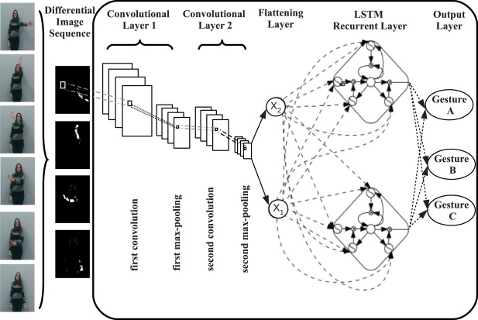
LSTM can combine with CNN example: CNN +LSTM
https://www.sciencedirect.com/science/article/pii/S0925231217307555

Slide 100
TensorFlow example
https://github.com/aymericdamien/TensorFlow-Examples/blob/master/examples/3_NeuralNetworks/recurrent_network.py
LSTM for MNIST data optical character recognition

Slide 101
LSTM_for_MNIST (recurrent_network.py)
""" Recurrent Neural Network.
A Recurrent Neural Network (LSTM) implementation example using TensorFlow library.
This example is using the MNIST database of handwritten digits (http://yann.lecun.com/exdb/mnist/)
Links:
[Long Short Term Memory](http://deeplearning.cs.cmu.edu/pdfs/Hochreiter97_lstm.pdf)
[MNIST Dataset](http://yann.lecun.com/exdb/mnist/).
Author: Aymeric Damien
Project: https://github.com/aymericdamien/TensorFlow-Examples/
"""
from __future__ import print_function
import tensorflow as tf
from tensorflow.contrib import rnn
# Import MNIST data
from tensorflow.examples.tutorials.mnist import input_data
mnist = input_data.read_data_sets("/tmp/data/", one_hot=True)
'''
To classify images using a recurrent neural network, we consider every image
row as a sequence of pixels. Because MNIST image shape is 28*28px, we will then
handle 28 sequences of 28 steps for every sample.
'''
# Training Parameters
learning_rate = 0.001
training_steps = 10000
batch_size = 128
display_step = 200
# Network Parameters
num_input = 28 # MNIST data input (img shape: 28*28)
timesteps = 28 # timesteps
num_hidden = 128 # hidden layer num of features
num_classes = 10 # MNIST total classes (0-9 digits)
# tf Graph input
X = tf.placeholder("float", [None, timesteps, num_input])
Y = tf.placeholder("float", [None, num_classes])
# Define weights
weights = {
'out': tf.Variable(tf.random_normal([num_hidden, num_classes]))
}
biases = {
'out': tf.Variable(tf.random_normal([num_classes]))
}
def RNN(x, weights, biases):
# Prepare data shape to match `rnn` function requirements
# Current data input shape: (batch_size, timesteps, n_input)
# Required shape: 'timesteps' tensors list of shape (batch_size, n_input)
# Unstack to get a list of 'timesteps' tensors of shape (batch_size, n_input)
x = tf.unstack(x, timesteps, 1)
# Define a lstm cell with tensorflow
lstm_cell = rnn.BasicLSTMCell(num_hidden, forget_bias=1.0)
# Get lstm cell output
outputs, states = rnn.static_rnn(lstm_cell, x, dtype=tf.float32)
# Linear activation, using rnn inner loop last output
return tf.matmul(outputs[-1], weights['out']) + biases['out']
logits = RNN(X, weights, biases)
prediction = tf.nn.softmax(logits)
# Define loss and optimizer
loss_op = tf.reduce_mean(tf.nn.softmax_cross_entropy_with_logits(
logits=logits, labels=Y))
optimizer = tf.train.GradientDescentOptimizer(learning_rate=learning_rate)
train_op = optimizer.minimize(loss_op)
# Evaluate model (with test logits, for dropout to be disabled)
correct_pred = tf.equal(tf.argmax(prediction, 1), tf.argmax(Y, 1))
accuracy = tf.reduce_mean(tf.cast(correct_pred, tf.float32))
# Initialize the variables (i.e. assign their default value)
init = tf.global_variables_initializer()
# Start training
with tf.Session() as sess:
# Run the initializer
sess.run(init)
for step in range(1, training_steps+1):
batch_x, batch_y = mnist.train.next_batch(batch_size)
# Reshape data to get 28 seq of 28 elements
batch_x = batch_x.reshape((batch_size, timesteps, num_input))
# Run optimization op (backprop)
sess.run(train_op, feed_dict={X: batch_x, Y: batch_y})
if step % display_step == 0 or step == 1:
# Calculate batch loss and accuracy
loss, acc = sess.run([loss_op, accuracy], feed_dict={X: batch_x,
Y: batch_y})
print("Step " + str(step) + ", Minibatch Loss= " + \
"{:.4f}".format(loss) + ", Training Accuracy= " + \
"{:.3f}".format(acc))
print("Optimization Finished!")
# Calculate accuracy for 128 mnist test images
test_len = 128
test_data = mnist.test.images[:test_len].reshape((-1, timesteps, num_input))
test_label = mnist.test.labels[:test_len]
print("Testing Accuracy:", \
sess.run(accuracy, feed_dict={X: test_data, Y: test_label}))

Slide 102
Conclusion
We studied the basic structure of Recurrent Neural Networks (RNN) and its applications
The neural network vanishing gradient problem is discussed.
The solution for the vanishing gradient problem using LSTM (Long short-term memory) is discussed.

Slide 103
References
Deep Learning Book.
http://www.deeplearningbook.org/
Papers:
Fully convolutional networks for semantic segmentation by J Long, E Shelhamer, T Darrell
Sequence to sequence learning with neural networks by I Sutskever, O Vinyals, QV Le -
tutorials
http://colah.github.io/posts/2015-08-Understanding-LSTMs/
https://github.com/terryum/awesome-deep-learning-papers
turtorial:
https://theneuralperspective.com/tag/tutorials/
RNN encoder-decoder
https://theneuralperspective.com/2016/11/20/recurrent-neural-networks-rnn-part-3-encoder-decoder/
sequence to sequence model
  https://arxiv.org/pdf/1703.01619.pdf
  https://indico.io/blog/sequence-modeling-neuralnets-part1/
  https://medium.com/towards-data-science/lstm-by-example-using-tensorflow-feb0c1968537
  https://google.github.io/seq2seq/nmt/
  https://chunml.github.io/ChunML.github.io/project/Sequence-To-Sequence/
  parameters of lstm
    https://stackoverflow.com/questions/38080035/how-to-calculate-the-number-of-parameters-of-an-lstm-network
    https://datascience.stackexchange.com/questions/10615/number-of-parameters-in-an-lstm-model
    https://stackoverflow.com/questions/38080035/how-to-calculate-the-number-of-parameters-of-an-lstm-network
    https://www.quora.com/What-is-the-meaning-of-%E2%80%9CThe-number-of-units-in-the-LSTM-cell
    https://www.quora.com/In-LSTM-how-do-you-figure-out-what-size-the-weights-are-supposed-to-be
    http://kbullaughey.github.io/lstm-play/lstm/ (batch size example)
  feedback
    https://medium.com/@aidangomez/let-s-do-this-f9b699de31d9
  Numerical examples
    https://blog.aidangomez.ca/2016/04/17/Backpropogating-an-LSTM-A-Numerical-Example/
    https://karanalytics.wordpress.com/2017/06/06/sequence-modelling-using-deep-learning/
    http://monik.in/a-noobs-guide-to-implementing-rnn-lstm-using-tensorflow/

Slide 104
Appendix

Slide 105
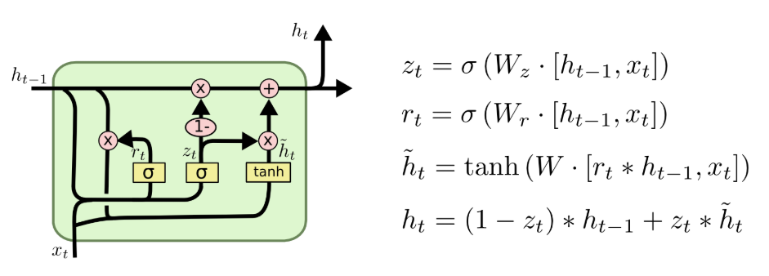
Modification of LSTM : GRU
A slightly more dramatic variation on the LSTM is the Gated Recurrent Unit, or GRU, introduced by Cho, et al. (2014). It combines the forget and input gates into a single “update gate.” It also merges the cell state and hidden state, and makes some other changes. The resulting model is simpler than standard LSTM models, and has been growing increasingly popular.
http://colah.github.io/posts/2015-08-Understanding-LSTMs/

Slide 106
Appendix 1a:
Using Square error for output measurement

Slide 107
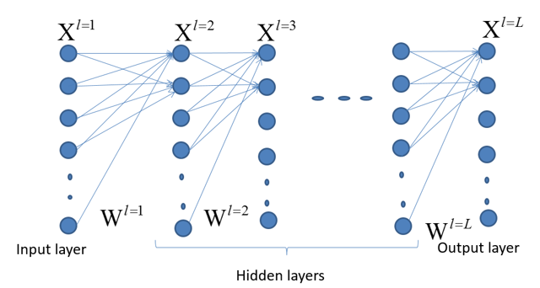
Case 1: if the neuron in between the output and the hidden layer
Definition
Output
t_{i}
Neuron n as an output neuron
http://cogprints.org/5869/1/cnn_tutorial.pdf

Slide 108
Case2 : if neuron in between a hidden to hidden layer.
We want to find
A1
Weight
Layer L
Indexed by k
Output
layer

Slide 109
Appendix 1b
Using softmax with cross-entropy_loss
for a 2-class classifier (single output neuron)

Slide 110
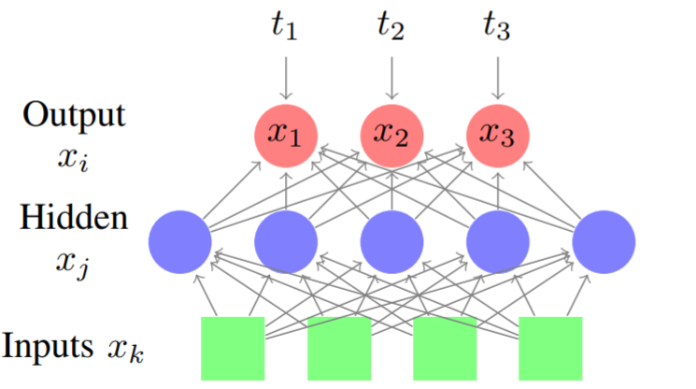
Using softmax with cross-entropy_loss for a 2-class classifier (single output neuron)
https://www.ics.uci.edu/~pjsadows/notes.pdf

Slide 111
Continue for hidden to hidden (single output neuron)

Slide 112
Appendix 1c
Using softmax with cross-entropy_loss for a mult-class classifier
https://www.ics.uci.edu/~pjsadows/notes.pdf

Slide 113
Using softmax with cross-entropy_loss for a multi-class classifier

Slide 114
continue

Slide 115
Compare multi-class square/softmax-entropy-loss formulas
http://cogprints.org/5869/1/cnn_tutorial.pdf

Slide 116
information entropy :H(x)
Measurement of information content
Measure the number of bits for holding the random variable
E.g. flipping fair coin: ½ tail + ½ tail is 1 bit , why?
And what is number of bits for an unfair coin 0.3 head, 0,7 tail?
(answer: 0.881 bit)
https://en.wikipedia.org/wiki/Entropy_(information_theory)
http://mathforum.org/library/drmath/view/70648.html

Slide 117
Appendix 2:
Cross entropy
The number of bits required to encode p if we use the channel for q
https://en.wikipedia.org/wiki/Cross_entropy
https://rdipietro.github.io/friendly-intro-to-cross-entropy-loss/

Slide 118
Appendix 3:
KL Kullback–Leibler divergence
KL(p,q)= difference between cross entropy of (p,q) and entropy (p)
Measurement of the extra bits required to encode q if the channel is designed for p
It is never -ve, the minimum is 0.
Minimizing cross entropy is the same as minimizing KL
https://en.wikipedia.org/wiki/Kullback%E2%80%93Leibler_divergence

Slide 119
Appendix 4
The vanishing gradient problem
The maximum of derivative of sigmoid is 0.25, Hence feedback will vanish when the number of layers is large.
sigmoid
0.25
In machine learning, the vanishing gradient problem is a difficulty found in training artificial neural networks with gradient-based learning methods and backpropagation. In such methods, each of the neural network's weights receives an update proportional to the gradient of the error function with respect to the current weight in each iteration of training. Traditional activation functions such as the hyperbolic tangent function have gradients in the range (−1, 1), and backpropagation computes gradients by the chain rule. This has the effect of multiplying n of these small numbers to compute gradients of the "front" layers in an n-layer network, meaning that the gradient (error signal) decreases exponentially with n while the front layers train very slowly.
https://en.wikipedia.org/wiki/Vanishing_gradient_problem

Slide 120
Solutions to the vanishing gradient problem
Multi-level hierarchy
  To overcome this problem, several methods were proposed. One is Jürgen Schmidhuber's multi-level hierarchy of networks (1992) pre-trained one level at a time through unsupervised learning, fine-tuned through backpropagation.^{[3]} Here each level learns a compressed representation of the observations that is fed to the next level.
Related approach
  Similar ideas have been used in feed-forward neural network for unsupervised pre-training to structure a neural network, making it first learn generally useful feature detectors. Then the network is trained further by supervised back-propagation to classify labeled data. The Deep belief network model by Hinton et al. (2006) involves learning the distribution of a high level representation using successive layers of binary or real-valued latent variables. It uses a restricted Boltzmann machine to model each new layer of higher level features. Each new layer guarantees an increase on the lower-bound of the log likelihood of the data, thus improving the model, if trained properly. Once sufficiently many layers have been learned the deep architecture may be used as a generative model by reproducing the data when sampling down the model (an "ancestral pass") from the top level feature activations.^{[4]} Hinton reports that his models are effective feature extractors over high-dimensional, structured data.^{[5]} This work plays a keyrole in reintroducing the interests in deep neural network research and consequently leads to the developments of Deep learning, although deep belief network is no longer the main deep learning technique.
Long short-term memory
  Another method particularly used for Recurrent neural network is the long short-term memory (LSTM) network of 1997 by Hochreiter & Schmidhuber.^{[6]} In 2009, deep multidimensional LSTM networks demonstrated the power of deep learning with many nonlinear layers, by winning three ICDAR 2009 competitions in connected handwriting recognition, without any prior knowledge about the three different languages to be learned.^{[7][8]}

Slide 121
Variations of LSTM
Alternative implementations

Slide 122
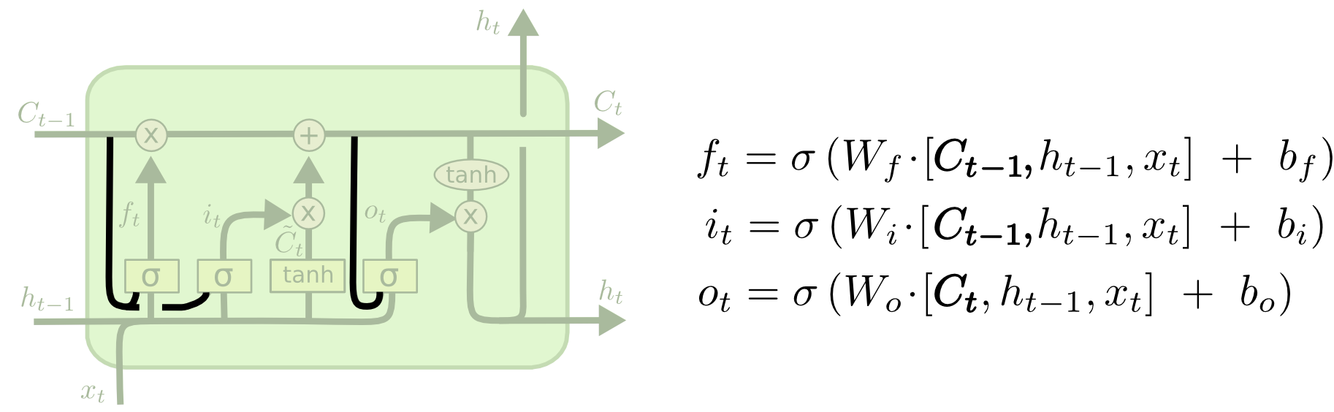
Variation1 of LSTM
Gers & Schmidhuber (2000), adds “peephole connections.” This allows the gate layers look at the cell state.

Slide 123
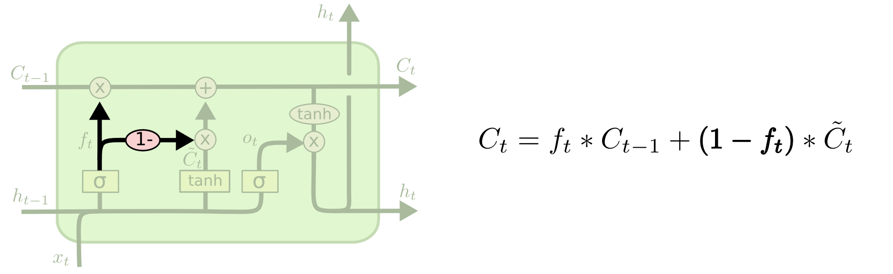
Variation2 of LSTM
Coupled forget and input gates. “Another variation is to use coupled forget and input gates. Instead of separately deciding what to forget and what we should add new information to, we make those decisions together. We only forget when we’re going to input something in its place. We only input new values to the state when we forget something older.”

Slide 124
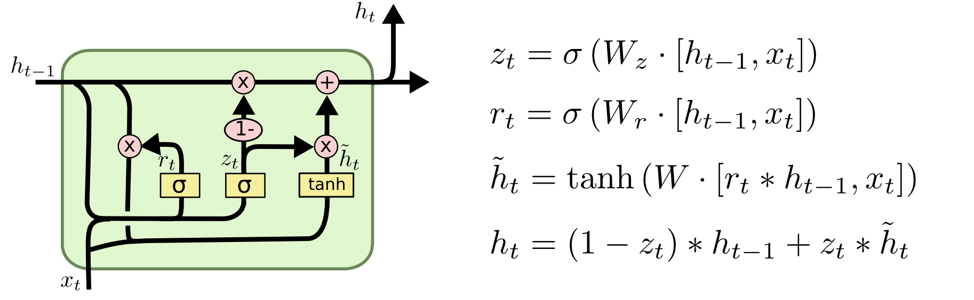
Variation3 of LSTM: GRU (popular)
“A slightly more dramatic variation on the LSTM is the Gated Recurrent Unit, or GRU, introduced by Cho, et al. (2014). It combines the forget and input gates into a single “update gate.” It also merges the cell state and hidden state, and makes some other changes. The resulting model is simpler than standard LSTM models, and has been growing increasingly popular.”
Comparisons of LSTM variations: Greff, et al. (2015) Jozefowicz, et al. (2015)
See https://towardsdatascience.com/illustrated-guide-to-lstms-and-gru-s-a-step-by-step-explanation-44e9eb85bf21

Slide 125
Solutions to the vanishing gradient problem
Multi-level hierarchy
  To overcome this problem, several methods were proposed. One is Jürgen Schmidhuber's multi-level hierarchy of networks (1992) pre-trained one level at a time through unsupervised learning, fine-tuned through backpropagation.^{[3]} Here each level learns a compressed representation of the observations that is fed to the next level.
Related approach
  Similar ideas have been used in feed-forward neural network for unsupervised pre-training to structure a neural network, making it first learn generally useful feature detectors. Then the network is trained further by supervised back-propagation to classify labeled data. The Deep belief network model by Hinton et al. (2006) involves learning the distribution of a high level representation using successive layers of binary or real-valued latent variables. It uses a restricted Boltzmann machine to model each new layer of higher level features. Each new layer guarantees an increase on the lower-bound of the log likelihood of the data, thus improving the model, if trained properly. Once sufficiently many layers have been learned the deep architecture may be used as a generative model by reproducing the data when sampling down the model (an "ancestral pass") from the top level feature activations.^{[4]} Hinton reports that his models are effective feature extractors over high-dimensional, structured data.^{[5]} This work plays a keyrole in reintroducing the interests in deep neural network research and consequently leads to the developments of Deep learning, although deep belief network is no longer the main deep learning technique.
Long short-term memory
  Another method particularly used for Recurrent neural network is the long short-term memory (LSTM) network of 1997 by Hochreiter & Schmidhuber.^{[6]} In 2009, deep multidimensional LSTM networks demonstrated the power of deep learning with many nonlinear layers, by winning three ICDAR 2009 competitions in connected handwriting recognition, without any prior knowledge about the three different languages to be learned.^{[7][8]}
GRU (Gated Recurrent Unit)

Slide 126
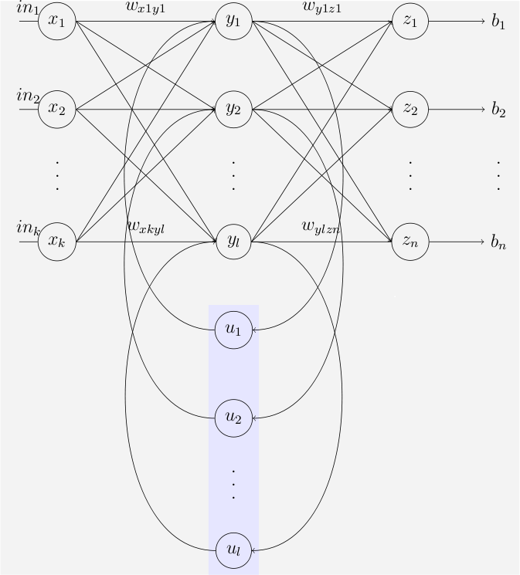
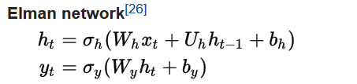
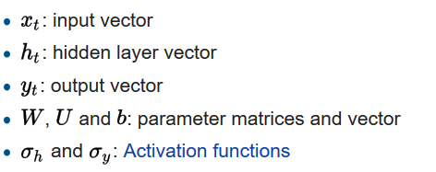
The Elman RNN network
An Elman network is a three-layer network (arranged horizontally as x, y, and z in the illustration), with the addition of a set of "context units" (u in the illustration). The middle (hidden) layer is connected to these context units fixed with a weight of one.^{[25]} At each time step, the input is fed-forward and then a learning rule is applied. The fixed back connections save a copy of the previous values of the hidden units in the context units (since they propagate over the connections before the learning rule is applied). Thus the network can maintain a sort of state, allowing it to perform such tasks as sequence-prediction that are beyond the power of a standard multilayer perceptron
https://en.wikipedia.org/wiki/Recurrent_neural_network

Slide 127
Extra example for 1st hidden layer, it has m_{i=1}=2 cells, input=n=5
h_{t}2 h_{t}1
To next layer
C_{t-1}(2)
f₁()
⊗
⊕
u₁()
tanh
C_{t}(2)
σ
⊗
I₁()
o₁()
⊗
Each cell has 4 components
Only the details of one of the components (forget gate) is shown. The other components are similar
w
w
w
w
w
w
w
tanh
σ
σ
h_{t}(3)
C_{t-1}(1)
f₁()
⊗
⊕
u₁()
tanh
C_{t}(1)
σ
⊗
I₁()
o₁()
⊗
w
w
w
w
w
w
w
tanh
h_{t}(1)
h_{t-1}(1)
σ
σ
x₁ x₂ x₃ x₄ x_{n=5} input

