Slide 1
Face detection
KH Wong

Slide 2

Introduction
Face interface
  Face detection
  Face recognition
Face database
Output:
Mr. Jones
Ms. Fox
Face detection
Face recognition
https://www.facebook.com/littlepartyfaces/

Slide 3
Face detection [1]
To detect faces in an image (Not recognize it yet)
Challenges
  A picture has 0,1 or many faces.
  Faces are not the same: with spectacles, mustache etc.
  Sizes of faces vary a lot.
Available in most digital cameras nowadays
The simple method
  Slide a window across the window and detect faces.
    Too slow, pictures have too many pixels. (1280x1024=1.3M pixels)

Slide 4
Evaluation of face detection
Detection rate
  Total number of faces that are correctly detected/total number of faces actually exist in the picture
  Should be high > 95%.
False positive rate
  The detector output is positive, but it is false (there is actually no face).Definition of False positive: A result that is erroneously positive when a situation is normal. An example of a false positive: a particular test designed to detect cancer of the toenail is positive, but the person does not have toenail cancer. (http://www.medterms.com/script/main/art.asp?articlekey=3377)
  Should be low <10⁻⁶
A good system has
  High detection rate,
  Low false positive rate.

Slide 5
Example
What are the detection rate and false positive rate here?
  Answer
    detection rate=(6/8)*100%
    false positive rate=(1/7)*100%
6 faces correctly detected in the picture, 8 actually faces exist in the image
7 windows reported to have faces , but in 1 window it is not a face
False positive result

Slide 6

Class exercise 1
Detected results are in red frames
What are the detection rate and false positive rate here?
  (a) Mc questions:
    1) detection rate=(5/8)*100%
    2) detection rate=(6/10)*100%
    3) detection rate=(7/8)*100 %
    4) detection rate=(7/10)*100%
  (b) Mc questions:
    false positive rate=(2/10)*100%
    false positive rate=(3/10)*100 %
    false positive rate=(4/10)*100%
    false positive rate=(5/10)*100%

Slide 7
Answer: Class exercise 1
Detected results are in red frames
What are the detection rate and false positive rate here?
  Answers
  (a) detection rate=(7/8)*100%, (choice3 is correct)
  (b) false positive rate=(3/10)*100%
7 faces correctly detected in the picture, 8 actually faces exist in the image
False positive results
10 windows reported to have faces , but in 3 such windows they are not faces. (choice 2 is correct)

Slide 8
The Viola and Jones method [1]
The most famous method
Training may need weeks
Recognition is very fast, e.g. real-time for digital cameras.
Techniques
  Integral image for feature extraction
  Ada-Boost for face detection
  Attentional cascade for fast rejection of non-face sub-windows

Slide 9
The Viola and Jones method Technique 1:
Integral image for feature extraction

Slide 10

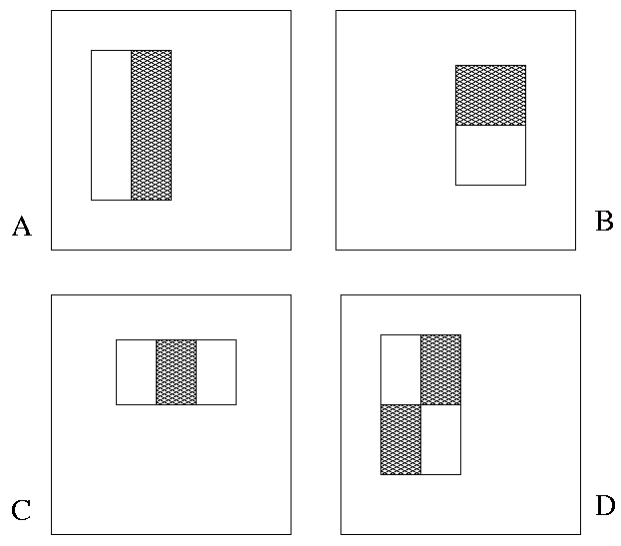
Image Features ref[3]
A very simple feature calculation method
“Rectangle filters”
Rectangle_Feature_value f=
∑ (pixels values in white area) –
∑ (pixels values in shaded area)
Notes:
10
For real problems results are only as good as the features used...
This is the main piece of ad-hoc (or domain) knowledge
Rather than the pixels, we have selected a very large set of simple functions
Sensitive to edges and other critcal features of the image
** At multiple scales
Since the final classifier is a perceptron it is important that the features be non-linear… otherwise the final classifier will be a simple perceptron.
We introduce a threshold to yield binary features

Slide 11
Example
An image with gray levels shown
1 | 2 | 3 | 3
3 | 0 | 1 | 3
5 | 8 | 7 | 1
0 | 2 | 3 | 6
Find the Rectangle_Feature_value (f) of the box enclosed by the dotted line
Rectangle_Feature_value f=
∑ (pixel value in white area) –
∑ (pixel value in shaded area)
f=(8+7)-(0+1)
=15-1= 14

Slide 12
Class exercise 2
Find the Rectangle_Feature_value (f) of the box enclosed by the dotted line
Rectangle_Feature_value f=
∑ (pixel value in white area) –
∑ (pixel value in shaded area)
MC choices:
f= 2
f= 3
f= 4
f= 5
2 | 7 | 5 | 8
2 | 6 | 2 | 9
5 | 4 | 8 | 2
8 | 2 | 5 | 10

Slide 13
Answer: Class exercise 2
Find the Rectangle_Feature_value (f) of the box enclosed by the dotted line
Rectangle_Feature_value f=
∑ (pixel value in white area) –
∑ (pixel value in shaded area)
f=(4+8)-(6+2)=12-8=4
MC choices:
f= 2
f= 3
f= 4 (is correct)
f= 5
2 | 7 | 5 | 8
2 | 6 | 2 | 9
5 | 4 | 8 | 2
8 | 2 | 5 | 10

Slide 14
How to find features faster?
Integral images fast calculation method [Lazebnik09 ]
The integral image = sum of all pixel values above and to the left of (x,y)
Can be found very quickly by the hardware system
(x,y)
Notes:
14

Slide 15
Examples on integral image
Top-left corner(x,y)position=(1,1)
x
The integral image = sum of all pixel values above and to the left of (x,y)
Pixel P is at (x=3,y=2)
  integral image of P is =1+2+3+3+4+6
integral image of Q is
=1+2+3+3+4+6+5+2+4+0+2+3
1 | 2 | 3 | 3
3 | 4 | 6 | 3
5 | 2 | 4 | 1
0 | 2 | 3 | 6
P
Q
y

Slide 16
Computing the integral image [Lazebnik09 ]
(x=1,y=1)
Integral_img_ii(x, y-1)
i(x, y-1)
row_s(x-1, y)
i(x, y)
Cumulative row sum: row_s(x, y) = row_s(x–1, y) + i(x, y)
Integral image : Integral_img_ii(x, y) = Integral_img_ii(x, y−1) + row_s(x, y)
Notes:
16

Slide 17
Calculate sum within a rectangle
A,B,C,D are the values of the integral images at the corners of the rectangle R.
The sum of image values inside R is:
  Area_R = A – B – C + D
If A,B,C,D are found , only 3 additions are needed to find Area_R
Calculations of areas can reused for other windows.
D
B
For the
Rectangle R
the Area is Area_R
C
A
Notes:
17

Slide 18
Why do we need to find pixel sum of rectangles?
Answer: We want to get face features
You may consider these features as face features
  Left Eye: (Area_A-Area_B)
  Nose :(Area_C+Area_E-Area_D)
  Mouth:(Area_F+Area_H-Area_G)
They can be different sizes, polarity and aspect ratios
A
B
C
D
E
F
G
H

Slide 19
Face feature and example
Pixel values inside
the areas
10 | 20 | 4
7 | 45 | 7
216 | 102 | 78
129 | 210 | 111
Shaded area
-1
White area
+2
F=Feat_val =
pixel sum in white area - pixel sum in shaded area
Example
Pixel sum in white area= 216+102+78+129+210+111=846
Pixel sum in shared area= 10+20+4+7+45+7=93
Feat_val=F=846-93=753
If F>threshold,
feature= +1
Else
feature= -1 End if;
If we can choose threshold =700 , so feature is +1.
A face
Notes:
19

Slide 20
Definition: Area_X = sum of pixels in the rectangular area from the left-top corner to pixel X (including the top left corner and pixel X).
Top-left corner
1 | 2 | 3 | 3
3 | 4 | 6 | 3
5 | 2 | 4 | 1
0 | 2 | 3 | 6
Find the feature output of this image.
Area_D=1
Area_B=1+2+3=6
Area_C =1+3=4
Area_A=1+2+3+3+4+6=19
Area_E=? 1+3+5=9
Area_F=? 1+2+3+3+4+6+5+2+4=30
Pixel sum of the area inside the box enclosed by the dotted lines=
Area_F - Area_B - Area_E +Area_D =? 30-6-9+1=16
D
B
C
A
E
F

Slide 21
Class exercise 3
Definition: Area at X =pixel sum of the area from top-left corner to X= Area_X
Top-left corner
Find the feature output of this image.
Area_D=1
Area_B=1+2+3=6
Area_C =1+3=4
Area_A=1+2+3+3+4+6=19
Area_E=? 1+3+5=9
Area_F=? 1+2+3+3+4+6+5+2+4=30
Pixel sum of the area inside the box enclosed by the dotted lines=
Area_F - Area_B - Area_E +Area_D =30-6-9+1=16
Find WA=White area enclosed by the dotted line.
Find GA=Gray area enclosed by the dotted line.
MC question:
(white area-shaded area)=WA-WG
WA-WG= -1
WA-WG= -2
WA-WG= -3
WA-WG= -4
1 | 2 | 3 | 3
3 | 4 | 6 | 3
5 | 2 | 4 | 1
0 | 2 | 3 | 6
D
B
C
A
E
F

Slide 22
Answer: Class exercise 3
Definition: Area at X =pixel sum of the area from top-left corner to X= Area_X
Top-left corner
Find the feature output of this image.
Area_D=1
Area_B=1+2+3=6
Area_C =1+3=4
Area_A=1+2+3+3+4+6=19
Area_E=? 1+3+5=9
Area_F=? 1+2+3+3+4+6+5+2+4=30
Pixel sum of the area inside the box enclosed by the dotted lines=
Area_F - Area_B - Area_E +Area_D =? 30-6-9+1=16
WA=White area enclosed by the dotted line= Area_F - Area_A - Area_E +Area_C=30-19-9+4= 6
GA=Gray area enclosed by the dotted line= Area_A - Area_B - Area_C +Area_D=19-6-4+1=10
(white are
a-shaded area)=WA-WG=6-10=-4
MC question:
(white area-shaded area)=WA-WG
WA-WG= -1
WA-WG= -2
WA-WG= -3
WA-WG= -4 (correct)
1 | 2 | 3 | 3
3 | 4 | 6 | 3
5 | 2 | 4 | 1
0 | 2 | 3 | 6
D
B
C
A
E
F

Slide 23
Basic types of Rectangular Features for (white_area)-(gray_area)
Type) Rows x columns
Type 1) 1x2
Type 2) 2x1
Type 3) 1x3
Type 4) 3x1
Type 5) 2x2
Each basic type can have difference sizes and aspect ratios.
I.e. the following feature windows are of the same type (Type2) even they have different pixel sizes, or aspect ratios
Each rectangle inside is of the same dimension

Slide 24
Faces can be any sizes,
Example: a face can be big or small , from 24 x24 to 1024x1024,
So, we need feature windows with different sizes.
There are faces with different sizes
As long as white/gray areas have the relations
The followings are Type2 Rectangular Features
  The white rectangle is above the shaded rectangle
  White and shaded rectangle are of same dimension

Slide 25
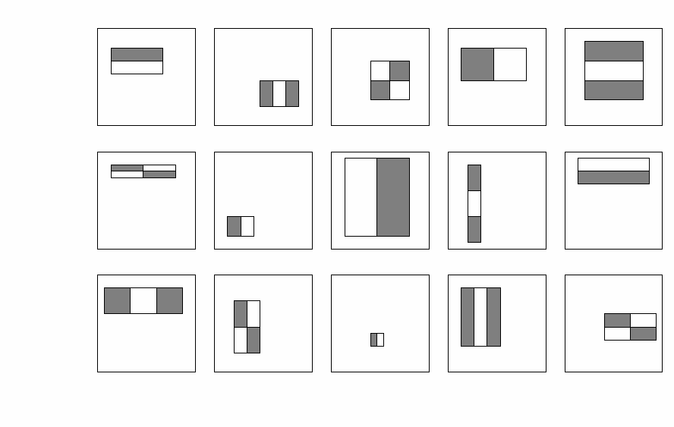
Class exercise 4
Feature selection [Lazebnik09 ]
Some examples and their types
Fill in the types for the 2nd, 3rd rows
Name the types (type 1,2,3,4,5) of the rectangular features in the BOX1.
MC Choices: 1,3,3,4,5
Student exercise:
Name the types (type 1,2,3,4,5) of the rectangular features in all boxes
2
3
5
1
4
BOX1
Standard Rectangular Feature Types
1)
2)
3)
4)
5)
Notes:
25

Slide 26
Answer: class exercise 4
Feature selection [Lazebnik09 ]
Some examples and their types
Fill in the types for the 2nd, 3rd rows
Name the types (type 1,2,3,4,5) of the rectangular features in the BOX1.
MC Choices: 1,3,3,4,5
Student exercise:
Name the types (type 1,2,3,4,5) of the rectangular features in all boxes
2
3
5
1
4
1
1
4
5
2
5
1
3
5
3
BOX1
Standard Types
1)
2)
3)
4)
5)
Notes:
26

Slide 27
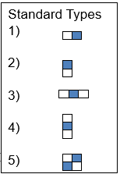
Class exercise 5a,b,c : Features in a NxN window
Exercise (5a) MC question : How many rectangular features of 1-type can be found a 5x5 pixel window? MC choices:
  40
  60
  90
  100
//////Discussion exercise//////
Exercise (5b): How many rectangular features of all-5-types can be found a 24x24 pixel window?
Answer: 162,336 (explain)
http://stackoverflow.com/questions/1707620/viola-jones-face-detection-claims-180k-features

Slide 28

Answer for 5a
clear, clc,
win_width=5, win_height=5
temp=0; %type 1 for 5x5
for nx=1:win_width/2%
for ny=1:win_height%
number_of_blocks_x=(win_width-2*nx+1);%
number_of_blocks_y=(win_height-ny+1);%
temp=number_of_blocks_x*number_of_blocks_y+temp;
end
end
temp %type 1 total=90
MC choices:
  40
  60
  90 (correct)
  100

Slide 29
Answer Class exercise 5b(i) : How many type 1 features in a 24x24 (pixel) window?
We see that win_width=24, win_height=24,
win_width=24, win_height=24
temp=0; %Type1 feature: block aspect ratio is width=2 units, height=1unit
for nx=1:win_width/2%nx=no. of x pixels in white area. Min =1,max=win_width/2
for ny=1:win_height%ny=no. of y pixels in white area. Min =1,max=win_height
number_of_blocks_x=(win_width-2*nx+1);%no.of x Blocks fit in win_width
number_of_blocks_y=(win_height-ny+1);%no.of y Blocks fit in win_height
temp=number_of_blocks_x*number_of_blocks_y+temp;
end
end
temp %type 1 total= 43200. Same for type 2 (similar case) , total(1+2)=43200*2
nx (from 1 to win_width/2 pixels for Type1)
ny (from 1 to win_width pixels for Type 1)
)
win_height=24
Two examples of Type1 feature blocks
(aspect ratio is 2-column x 1-row)
win_width=24
http://stackoverflow.com/questions/1707620/viola-jones-face-detection-claims-180k-features

Slide 30
Answer Class exercise 5b(ii) : How many type 3 features in a 24x24 (pixel) window?
temp=0;
%Type3: aspect ratio of the feature block, width=3 units, height=1unit
for nx=1:win_width/3 %nx=no. of x pixels in white area.Min =1,max=win_width/3
for ny=1:win_height %ny=no. of y pixels in white area.Min =1,max=win_height
number_of_blocks_x=(win_width-3*nx+1);%no.of x Blocks fit in win_width
number_of_blocks_y=(win_height-ny+1);%no.of y Blocks fit in win_height
temp=number_of_blocks_x*number_of_blocks_y+temp;
end
end
N_Type3=temp %answer= 27600. similar for type 4, total(type3+type4)=27600*2
nx (from 1 to win_width/2 pixels for Type3)
ny (from 1 to win_width pixels for Type 3)
win_height=24
Example of Type3 feature blocks
(aspect ratio is 3-column x 1-row)
win_width=24
http://stackoverflow.com/questions/1707620/viola-jones-face-detection-claims-180k-features

Slide 31
Answer Exercise 5b(iii) : How many type 5 features in a 24x24 (pixel) window?
temp=0; %--------------------------------------------------------------------
%type5: aspect ratio of the feature block, width=2 units, height=2unit
for nx=1:win_width/2%nx=no. of x pixels in white area.Min =1,max=win_width/2
for ny=1:win_height/2%ny=no. of y pixels in white area.Min =1,max=win_height/2
number_of_blocks_x=(win_width-2*nx+1);%no.of x Blocks fit in win_width
number_of_blocks_y=(win_height-2*ny+1);%no.of y Blocks fit in win_height
temp=number_of_blocks_x*number_of_blocks_y+temp;
end
end
N_Type5=temp %=20736
nx (from 1 to win_width/2 pixels for Type5)
ny (from 1 to win_width/2 pixels for Type 5)
)
win_height=24
An example of Type5 feature blocks
(aspect ratio is 2-column x 2-row)
win_width=24
http://stackoverflow.com/questions/1707620/viola-jones-face-detection-claims-180k-features

Slide 32
Answer for Exercise 5(iv) and 6:Matlab: for a 24x24 windows, add all types N_type1x2+N_type3x2+N_type5=(43200x2+27600x2+20736)=162336
clear; temp=0;
%--matlab program to find number of features %(5 types (columns x rows):
%type1: 2x1; type2: 1x2; type3: 3x1; type 4: 1x3; type 5: 2x2)
%in Viola-Jones face detection cascaded Adaboost algorithm-
%%%% 2x1 shape : (2 rows x 1 column, same as 1 row x 2 columns) , 2 types
%win_width=24%(you may choose 36 or 24 etc.)
win_width=24%(you may choose 36 or 24 or 12etc.)
win_height=win_width; %x=hornizontal direction; y=vertical direction
%Type1: aspect ratio of the feature block, width=2 units, height=1unit
for nx=1:win_width/2%nx=no. of x pixels of each square. Min =1,max=win_width/2
for ny=1:win_height%ny=no. of y pixels of each square. Min =1,max=win_height
number_of_blocks_x=(win_width-2*nx+1);%no.of x Blocks fit in win_width
number_of_blocks_y=(win_height-ny+1);%no.of y Blocks fit in win_height
temp=number_of_blocks_x*number_of_blocks_y+temp;
end
end
N_Type1=temp
N_Type2=N_Type1 % same as 2 rows x 1 column
pause
temp=0;
%Type3: aspect ratio of the feature block, width=3 units, height=1unit
for nx=1:win_width/3%nx=no. of x pixels of each square.Min =1,max=win_width/3
for ny=1:win_height%ny=no. of y pixels of each square.Min =1,max=win_height
number_of_blocks_x=(win_width-3*nx+1);%no.of x Blocks fit in win_width
number_of_blocks_y=(win_height-ny+1);%no.of y Blocks fit in win_height
temp=number_of_blocks_x*number_of_blocks_y+temp;
end
end
N_Type3=temp
N_Type4=N_Type3 % same as 3 rows x 1 column
pause
%
temp=0; %--------------------------------------------------------------------
%type5: aspect ratio of the feature block, width=2 units, height=2unit
for nx=1:win_width/2%nx=no. of x pixels of each square.Min =1,max=win_width/2
for ny=1:win_height/2%ny=no. of y pixels of each square.Min =1,max=win_height/2
number_of_blocks_x=(win_width-2*nx+1);%no.of x Blocks fit in win_width
number_of_blocks_y=(win_height-2*ny+1);%no.of y Blocks fit in win_height
temp=number_of_blocks_x*number_of_blocks_y+temp;
end
end
N_Type5=temp
'total'
N_ALL=N_Type1+N_Type2+N_Type3+N_Type4+N_Type5
%Result= 162336 if width =24
%Result= : 816264 if width =36 ( ??or 704004??)

Slide 33
Class exercise 6
Still keeping the 5 basic rectangular features types (1,2,3,4,5) (5 types: 2x1,1x2,3x1,1x3,2x2)
  Find the number of rectangular features for a resolution of 36 x36 windows
  Answer: 816264, (student exercise, explain your answer)
Standard Types
1)
2)
3)
4)
5)

Slide 34
The Viola and Jones method Technique 2:
AdaBoost for face detection

Slide 35
Class exercise 7: The detection challenge
Use 24x24 base window
For y=1;y<=1024;y++
  {For x=1;x<=1024;x++{
    Set (x,y) = the left top corner of the 24x24 sub-window, different scales are needed to be considered too.
    For the 24x24 sub-window, extract 162,336 features and see they combine to form a face or not.}
  }
Exercise 7 : Discuss the number of operations required.
Conclusion : too slow, solution use boosting
(x,y)
24x24Sub-window
X-axis
1280
(1,1)
Y-axis
1024
Answer 7:

Slide 36
Answer 7:
The detection challenge
Use 24x24 base window
For y=1;y<=1024;y++
  {For x=1;x<=1024;x++{
    Set (x,y) = the left top corner of the 24x24 sub-window, different scales are needed to be considered too.
    For the 24x24 sub-window, extract 162,336 features and see they combine to form a face or not.
    }
    }
Exercise 7 : Discuss the number of operations required.
Conclusion : too slow, solution use boosting
(x,y)
24x24Sub-window
X-axis
1280
(1,1)
Y-axis
1024
Answer 7:
possible locations of (x,y)≈(1024-24)x(1280-24).
Each (x,y) location, for zoom factor i=1,2,3..obtain sub-images: each sub-image window has size (24ix24i) with left-top corner at (x,y) as long as x+24i<1024
For a sub-image, shrink it to a 24x24 window for processing.
For each 24x24 window, it has 162336 features to be calculated as calculated before.

Slide 37
Solution to make it efficient
The whole 162,336 feature set is too large
  Solution: select good features to make it more efficient.
  Use: “Boosting”
Boosting
  Combine many small weak classifiers to become a strong classifier.
  Training is needed.

Slide 38
Boosting for face detection
Define weak learners based on rectangle features
value of rectangle feature
P_{t}= polarity{+1,-1}
threshold
window
Notes:
38

Slide 39
Face detection using Adaboost
AdaBoost training
  E.g. Collect 5000 faces, and 9400 non-faces. Different scales.
  Use AdaBoost for training to build a strong classifier.
  Pick suitable features of different scales and positions, pick the best few. (Take months to do , details is in [Viola 2004] paper)
Testing
  Scan through the image (any where), pick a window (any size ≥ 24x24) and rescale it to 24x24,
  Pass it to the strong classifier for detection.
  Report face, if the output is positive
Notes:
39

Slide 40
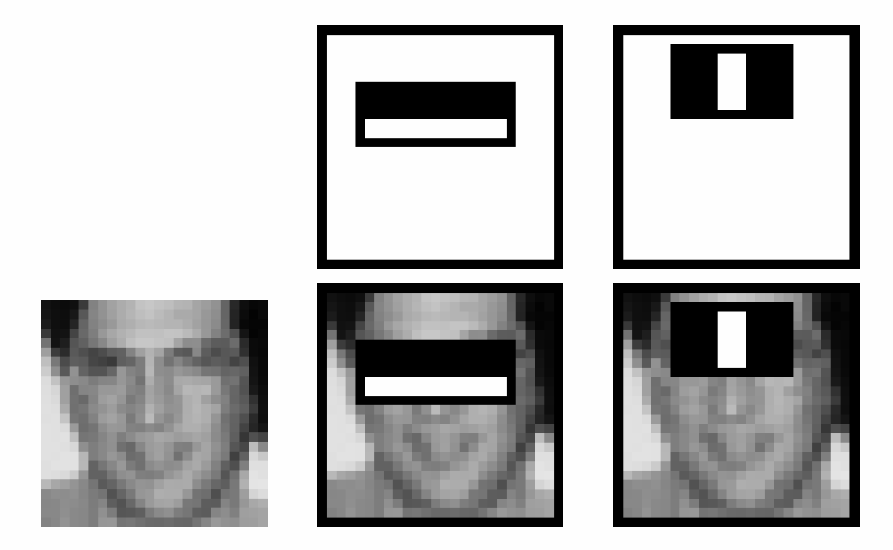
Boosting for face detection [viola2004]
In the paper it shows that the following two features (obtained after training) in cascaded picked by AdaBoost have 100% detection rate and 50% false positive rate
But 50% false positive rate is not good enough
Approach [viola2004] :Attentional cascade
I.e. Strong classifier
H(face)=
Sign{α₁h₁(image)
+α₂h₂(image)}
H(face)=+1→ face
H(face)=-1→non-face
Pick a window in the image and rescale it to 24x24 as “image”
h₂(image)
h₁(image)
type3
type2
Standard Types
1)
2)
3)
4)
5)
Notes:
40

Slide 41
Boosting for face detection
An experiment shows: A 200-feature classifier can yield 95% detection rate and a false positive rate of 1 in 14084 (7.1x10⁻⁵ Still not good enough)
Recall: False positive rate
  The detector output is positive but it is false (there is actually no face). Definition of False positive: A result that is erroneously positive when a situation is normal. An example of a false positive: a particular test designed to detect cancer of the toenail is positive but the person does not have toenail cancer. (http://www.medterms.com/script/main/art.asp?articlekey=3377)
Correct
Detection
rate
Still not good enough!
X10⁻³
False positive rate
Notes:
41

Slide 42
The Viola and Jones method Technique 3:
  Attentional cascade for fast rejection of non-face sub-windows

Slide 43
To improve false positive rate:
Attentional cascade
Cascade of many AdaBoost strong classifiers.
Begin with simple classifiers to reject many negative sub-windows.
Many non-faces are rejected at the first few stages.
Hence the system is efficient enough for real time processing.
Input image
Adaboost
Classifier1
True
Adaboost
Classifier2
True
Adaboost
Classifier3
True
Face
found
False
False
False
Non-face
Non-face
Non-face
Notes:
43

Slide 44
An example
More features for later stages in the cascade [viola2004]
type2
type3
2 features
Based on type2,3
10 features
25 features
50 features…
Input image
Adaboost
Classifier1
True
Adaboost
Classifier2
True
Adaboost
Classifier3
True
Face
found
False
False
False
Non-face
Non-face
Non-face

Slide 45
Class exercise 8a,b,c : Attentional cascade
Chain classifiers that are progressively more complex and have lower false positive rates:
MC question:
Receiver operating characteristic
Name the Adaboost classifier (1 or 2 or 3), explain your answer
% False Pos
0
50
vs
false
neg
determined by
(a)?__
(b)?__
(c)?__
0 100
% True positive
False positive rate
Input image
Adaboost
Classifier1
True
Adaboost
Classifier2
True
Adaboost
Classifier3
True
Face
found
False
False
False
Non-face
Non-face
Non-face
Notes:
45
In general simple classifiers, while they are more efficient, they are also weaker.
We could define a computational risk hierarchy (in analogy with structural risk minimization)…
A nested set of classifier classes
The training process is reminiscent of boosting…
- previous classifiers reweight the examples used to train subsequent classifiers
The goal of the training process is different
- instead of minimizing errors minimize false positives

Slide 46
Answer: Class exercise 8a,b,c: Attentional cascade
Chain classifiers that are progressively more complex and have lower false positive rates:
MC question:
Receiver operating characteristic
Name the Adaboost classifier (1 or 2 or 3), explain your answer
% False Pos
0
50
vs
false
neg
determined by
(a)?_3_
(b)?_2_
(c)?_1_
0 100
% True positive
False positive rate
Input image
Adaboost
Classifier1
True
Adaboost
Classifier2
True
Adaboost
Classifier3
True
Face
found
False
False
False
Non-face
Non-face
Non-face
Notes:
46
In general simple classifiers, while they are more efficient, they are also weaker.
We could define a computational risk hierarchy (in analogy with structural risk minimization)…
A nested set of classifier classes
The training process is reminiscent of boosting…
- previous classifiers reweight the examples used to train subsequent classifiers
The goal of the training process is different
- instead of minimizing errors minimize false positives

Slide 47
Attentional cascade [Viola2004]
Detection rate for each stage is 0.99 , for 10 stages,
  overall detection rate is 0.99¹⁰ ≈ 0.9
False positive rate at each stage is 0.3, for 10 stages
  false positive rate =0.3¹⁰ ≈ 6×10⁻⁶
Input image
Adaboost
Classifier1
True
Adaboost
Classifier2
True
Adaboost
Classifier3
True
Face
found
False
False
False
Non-face
Non-face
Non-face
Notes:
47

Slide 48
Detection process in practice [smyth2007]
Use 24x24 sub-window
Scaling
  scale the detection (not the input image)
  Features evaluated at scales by factors of 1.25 at each level
  Location : move detector around the image (1 pixel increments)
Final detections
  A real face may result in multiple nearby detections (merge them to become the final result)

Slide 49
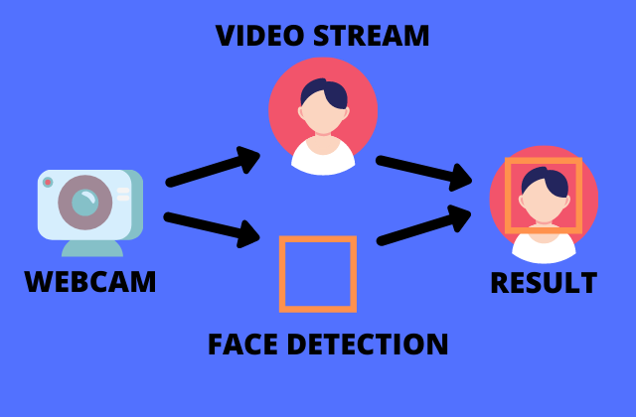
Real time demo using colab
Temporary stop anti-virus software (e.g. Kaspersky before use. Right lick the icon and pause protection for 30 minutes.)
Haar Cascade Face Detection: This notebook demonstrates how to use OpenCV's Haar cascade classifier for detecting faces in images and videos.
Click on
https://colab.research.google.com/github/kauaa0361/ML-Detectar-Faces/blob/main/colab_webcam.ipynb/

Slide 50
Summary
Learned
  How to extract face feature
  How to apply Adaboost for face detection
  How to train up the system and how to detect faces
  Learned the technique of attentional cascade

Slide 51

Additional
Exercise A1
Type | Rows × Columns | Feature value | Features
Type-3 | 1 × 3 | (Sum of pixles in shaded area) - (Sum of pixles in white area) | Three rectangular blocks in a row. Width of each rectangle =W pixels. Height of each rectangle =H pixels.
Definition: = Area_X = sum of pixels in the area from left-top corner to pixel X
Based on the window in image1, answer the following questions.
i) Find Area_A, Area_B, Area_C, Area_D, Area_E, Area_F
In image1, calculate the number of Type-3 features found in each of the following different cases :
W=1 pixel, H=1 pixel,
W=2 pixels, H=2 pixels.
2 A | 7 | 3 | 8 | 2 | 4 B
0 C | 4 | 2 | 3 | 5 | 5 D
1 E | 3 | 6 | 8 | 2 | 8 F
8 | 0 | 3 | 5 | 3 | 2
1 | 3 | 5 | 7 | 4 | 1
Image 1

Slide 52
Answer for A1
Definition: = Area_X = sum of pixels in the area from left-top corner to pixel X
Based on the window in Figure 1, answer the following questions.
i) Find Area_A, Area_B, Area_C, Area_D, Area_E, Area_F
Answer:
Area_A=2
Area_B=2+7+3+8+2+4=26
Area_C=2
Area_D=AreaB+4+2+3+5+5=26+4+2+3+5+5=45
Area_E=3
Area_F=Area_D+1+3+6+8+2+8=45+73
ii) Find the area inside the box CDFE based on the result in (i).
Answer: Area_F-Area_B=73-26=47
iii)Calculate the type 3 feature value in the area CDFE.
Answer:(2+3+6+8)-(0+4+1+3)-(5+5+2+8)= -9
iv)Calculate the number of features found in each of the following cases if W and H are the features are :
W=1 pixel,H=1 pixels, answer=5x4=20
W=2 pixels,H=2 pixels, Answer:4x1= 4
2 A | 7 | 3 | 8 | 2 | 4 B
0 C | 4 | 2 | 3 | 5 | 5 D
1 E | 3 | 6 | 8 | 2 | 8 F
8 | 0 | 3 | 5 | 3 | 2
1 | 3 | 5 | 7 | 4 | 1

Slide 53
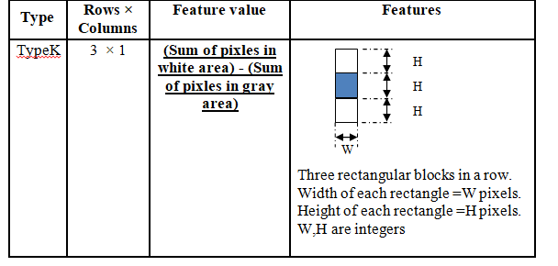
Additional exercise: A2
If the window is 6x6, how many type K features are there in the window?

Slide 54
Answer: ex for A2
Hi=Horizontal width of possible choices i
Wi=vertical height of possible choices j
In this problem possible choices of i and j are: possible i=1,2, j=1,2,3,4,5,6
H=1, W=1: 4x6=24
H=2, W=1: =6
H=1, W=2: 4x5=20
H=2, W=2: =5
H=1, W=3: =4x4=16
H=2, W=3: =4
H=1, W=4: =4x3=12
H=2, W=4: =3
H=1, W=5: =4x2=8
H=2, W=5: =2
H=1, W=6: =4x1=4
H=2, W=6: =1
ii) Total= 24+6 +20+5+ 16+4+ 12+3+ 8+2+ 4+1 =105

Slide 55
References
[viola2004] Paul A. Viola, Michael J. Jones: Robust Real-Time Face Detection. International Journal of Computer Vision 57(2): 137-154 (2004) (PDF: http://citeseerx.ist.psu.edu/viewdoc/download?doi=10.1.1.137.4879&rep=rep1&type=pdf )
[viola2001] Paul A. Viola, Michael J. Jones, Rapid object detection using a boosted cascade of simple features CVPR 2001 (PDF: http://research.microsoft.com/en-us/um/people/viola/Pubs/Detect/violaJones_CVPR2001.pdf)
[Lazebnik09 ] www.cs.unc.edu/~lazebnik/spring09/lec23_face_detection.ppt
[stackoverflow] http://stackoverflow.com/questions/1707620/viola-jones-face-detection-claims-180k-features
[Jensen 2008 ] Ole Helvig Jensen," Implementing the Viola-Jones Face Detection Algorithm "Kongens Lyngby 2008 “, IMM-M.Sc.-2008-93,Technical University of Denmark Informatics and Mathematical Modeling
[smyth2007] Face detection using the viola Jones method ppt, UL Irvine (lecture notes of CS175 Fall 2007)
[yu tm ]http://aimm02.cse.ttu.edu.tw/class_2009_1/PR/Lecture%207/Adaboost.ppt
[stackoverflow] http://stackoverflow.com/questions/1707620/viola-jones-face-detection-claims-180k-features

