Slide 1
Chapter 11
Multiple interrupts
CEG2400 - Microcomputer Systems
http://www.nxp.com/acrobat_download/usermanuals/UM10120_1.pdf (software)

Slide 2
Overview
To demonstrate multiple interrupts
timer_int_demo1.c
Control the on/off of the green LED by a switch

Slide 3
To demonstrate multiple interrupts timer_int_demo1.c
Important parts
main(),
init_timer_Eint () //init timer
__irq isr_Eint3() //external interrupt, blink green-led

Slide 4
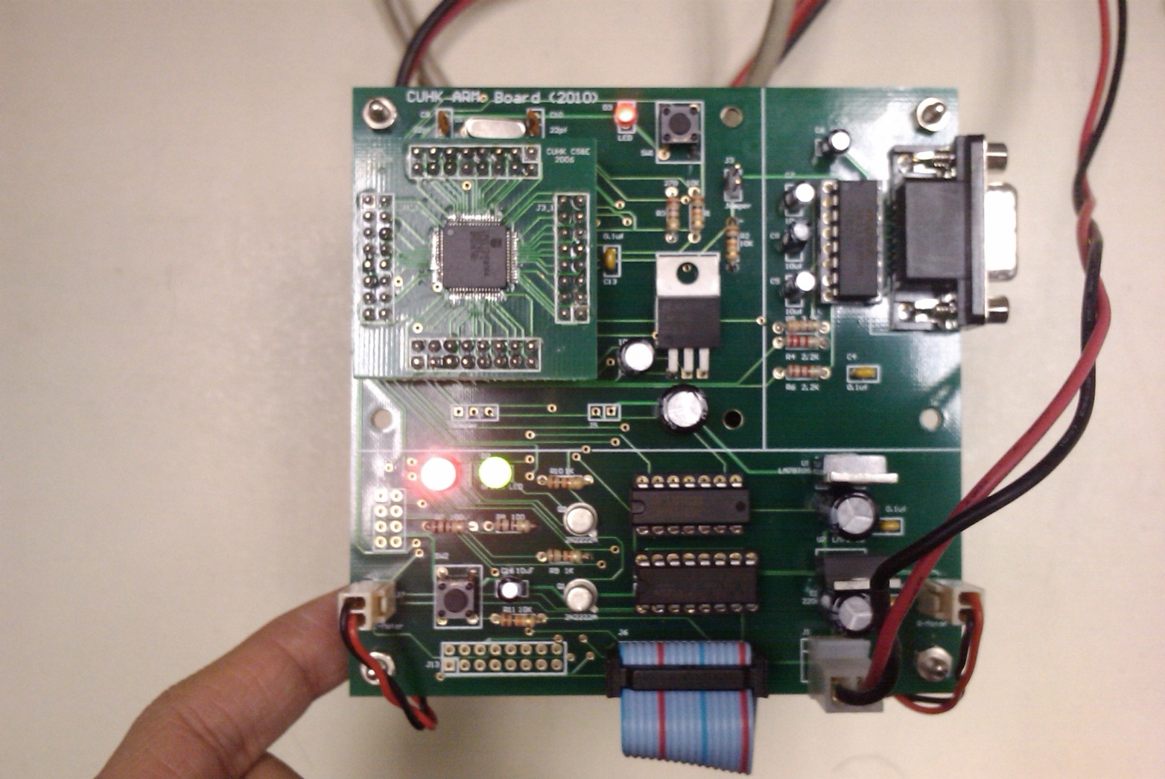
In part B, we will show how to change the state of the Green LED by pressing SW1
-- after pressing the switch SW1, the LED will change state once ( from on-to-off, or from off-to-on)
Arm board
red led
green led
switch

Slide 5
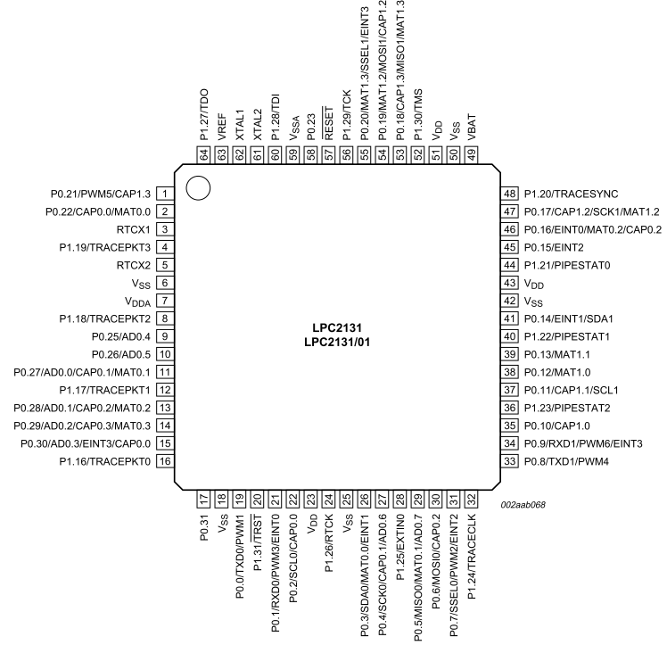
Our testing board
CEG2400 Ch7: Driving Parallel Loads V1a
5

Slide 6
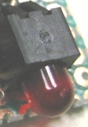
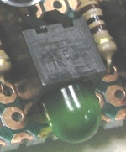



For 3.3V driving LEDs from a 3.3V system
CEG2400 Ch7: Driving Parallel Loads V1a
6

Slide 7
Advanced topic
Nested interrupt using timer_int_demo1.c
  Multiple interrupt occurrences
    Timer
    External (a switch)
Further references
  http://www.nxp.com/acrobat_download/applicationnotes/AN10254_2.pdf
  http://www.nxp.com/acrobat_download/applicationnotes/AN10381_1.pdf

Slide 8
Multiple Interrupt
Vectored interrupt concept
Highest priority
Slot0:
Source: timer
MCU with the
Interrupt module
LPC2131
2nd highest priority
Slot1: external interrupt3
Source: EINt3
^{3nd} highest priority
Slot2: Others etc..
Source :E,g, UART

Slide 9

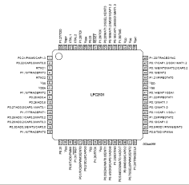
Multiple interrupt example
Nested interrupts can occur
Main()
{PINSEL1 = 0x00000300;//pin65=Eint3
void init_timer_Eint()
:Do something
:
:
:
:
:
:
:
:
:
:}
Timer1 set
//Timer0 interrupt
__irq isr_Timer0()
{
:
}
Blinks red-LED
timer0
//external interrupt
__irq isr_Eint3()
{
: blinks green-LED
}
Eint3
(pin65)
Occurs when Eint3 is pulled down

Slide 10
The theory for External interrupt3 (EINT3)
ISR Interrupt service routine for /EINT3 is _irq isr_Eint3()
Not only the timer can generate interrupts, an external signal through EINT3 can also initiate an interrupt.
An falling edge at EINT3 will trigger the execution of ISR void __irq isr_Eint3()
External signal
/EINT3 (p0.20, pin65)
When /ENT3 is pulled down
__irq isr_Eint3()
Will be executed
LPC2213x

Slide 11
2i) /* Setup timer 0*/
Important 3 lines for timer (priority is 0 →highest priority)
144)/* Setup the Timer Counter 0 Interrupt */
145)void init_timer_Eint (void) {
146) T0PR = 0; // set prescaler to 0
147) T0MR0 =1382400; // set interrupt rate 10Hz, (interval=100mS)
148) // Pclk/10Hz = (11059200 x 5/4)/ 10
149) T0MCR = 3; // Interrupt and Reset on MR0
150) T0TCR = 1; // Timer0 Enable
151) VICVectAddr0 = (unsigned long) isr_Timer0; // set interrupt vector in 0
152) VICVectCntl0 = 0x20 | 4; // use it for Timer 0 Interrupt
153) VICIntEnable=0x1<<4;” // Enable Timer0 Interrupt, or “VICIntEnable = 0x00000010;”
154)
155) EXTMODE=0x08; // set EINT3 as edge trigger
156) VICVectAddr1 = (unsigned long)isr_Eint3; // set interrupt vector in 1
157) VICVectCntl1 = 0x20 | 17; // use it for EINT3 Interrupt
158) VICIntEnable |= 0x1<<17; // Enable EINT3 interrupt,or “VICIntEnable |= 0x00020000; ”
159) EXTINT = 0x08; // Clear EINT3 flag
160) }

Slide 12
2ii) /* Setup external interrupt EINT3*/
Important 3 lines for Eint3 (external interrupt3) (priority is 1 →2nd highest priority)
144)/* Setup the Timer Counter 0 Interrupt */
145)void init_timer_Eint (void) {
146) T0PR = 0; // set prescaler to 0
147) T0MR0 =1382400; // set interrupt rate 10Hz, (interval=100mS)
148) // Pclk/10Hz = (11059200 x 5/4)/ 10
149) T0MCR = 3; // Interrupt and Reset on MR0
150) T0TCR = 1; // Timer0 Enable
151) VICVectAddr0 = (unsigned long) isr_Timer0; // set interrupt vector in 0
152) VICVectCntl0 = 0x20 | 4; // use it for Timer 0 Interrupt
153) VICIntEnable=0x1<<4;” // Enable Timer0 Interrupt, or “VICIntEnable = 0x00000010;”
154)
155) EXTMODE=0x08; // set EINT3 as edge trigger
156) VICVectAddr1 = (unsigned long)isr_Eint3; // set interrupt vector in 1
157) VICVectCntl1 = 0x20 | 17; // use it for EINT3 Interrupt
158) VICIntEnable |= 0x1<<17; // Enable EINT3 interrupt,or “VICIntEnable |= 0x00020000; ”
159) EXTINT = 0x08; // Clear EINT3 flag
160) }

Slide 13
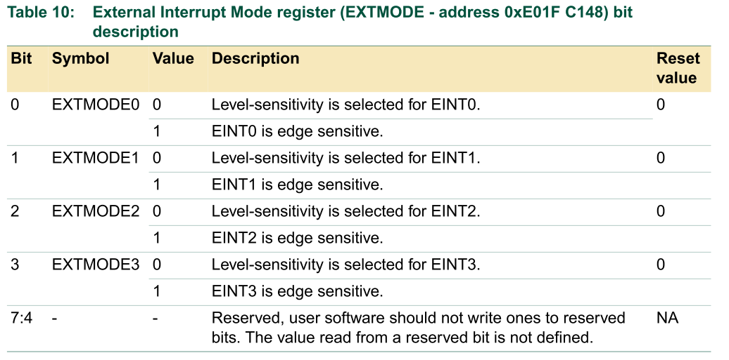
setup external interrupt line 155 (Eint3 is edge triggered)
155) EXTMODE=0x08; // set EINT3 as edge trigger
156) VICVectAddr1 = (unsigned long)isr_Eint3; // set interrupt vector in 1
157 VICVectCntl1 = 0x20 | 17; // use it for EINT3 Interrupt
158) VICIntEnable |= 0x1<<7;// Enable EINT3 intrp.or “VICIntEnable |= 0x20000;”
159) EXTINT = 0x08; //

Slide 14
setup external interrupt line 156
155) EXTMODE=0x08; // set EINT3 as edge trigger
156) VICVectAddr1 = (unsigned long)isr_Eint3; // set interrupt vector in 1
157 VICVectCntl1 = 0x20 | 17; // use it for EINT3 Interrupt
158) VICIntEnable |= 0x1<<17; // Enable EINT3 intp,or“VICIntEnable |= 0x20000; ”
159) EXTINT = 0x08; //
Point to which interrupt service program will
run when EINT1 is pulled low

Slide 15
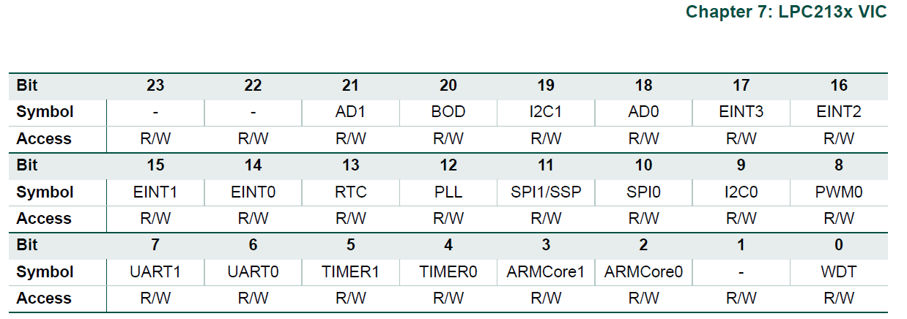
line 157) VICVectCntl1 = 0x20 | 17;
// use it for EINT3 Interrupt, because 0x20=>bit 5=1 , is the IRQslot_en
‘17’ is the source mask of external interrupt1 (EINT3),(see next slide)
0x020 → bit5=1
Each bit represents an interrupt source

Slide 16
Source mask
(same as the table in the last slide)
E.g.
timer0=4
external interrupt=15

Slide 17
Exercise 11.1
Student ID: ___________,Date:_____________
Name: __________________________________
What is the interrupt source mask for UART 1?
Answer: ?_____________________
How do you setup the pirorty of different interrupts?
Answer:
?____________________________

Slide 18
Exercise: 11.2
Examples of other interrupt sources
If you want to use Eint3(source mask=17)
VICVectCntl1 = 0x20 | 17
VicIntEnable=?: Answer: VICIntEnable |= 0x00020000 (why?)
If you want to use Eint0(source mask=14)
VICVectCntl1 = 0x20 | 14
VicIntEnable=? Answer:?_________________________
If you want to use Uart0(source mask=6)
VICVectCntl1 = 0x20 | 6
VicIntEnable=? Answer:?____________________________

Slide 19
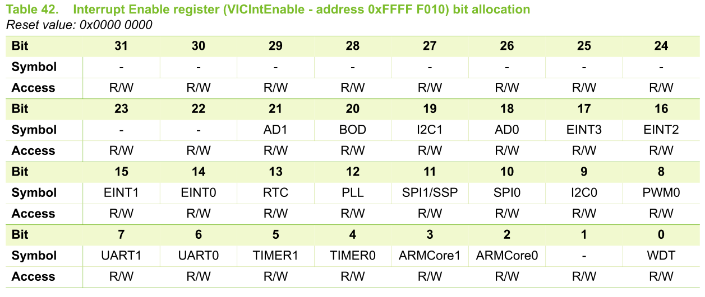
setup external interrupt3 (EINT3) line 158
Bit17 is set
158) VICIntEnable |= 0x1<<17; // Enable EINT3 intp,or“VICIntEnable |= 0x20000; ”
159) EXTINT = 0x08; //
Enable external interrupt 3 (EINT3)

Slide 20
setup external interrupt line 159
155) EXTMODE=0x08; // set EINT3 as edge trigger
156) VICVectAddr1 = (unsigned long)isr_Eint3; // set interrupt vector in 1
157 VICVectCntl1 = 0x20 | 17; // use it for EINT3 Interrupt
158) VICIntEnable |= 0x00020000; // Enable EINT3 interrupt
159) EXTINT = 0x08; //
External Interrupt Flag register (EXTINT - address 0xE01F C140)
bit

Slide 21
4) External interrupt3 (EINT3)
Green-led changes state every time you press the interrupt switch SW1
130) //external interrupt
131) void __irq isr_Eint3() //runs when key depressed. 132 {
133) exint++;
134) //turn on /off the Green LED
135) if((exint%2)==0)
136) IO0SET|=GREEN_LED;
137) else IO0CLR|=GREEN_LED;
138)
139) EXTINT = 0x08; // Clear EINT3 flag
140) VICVectAddr = 0; // Acknowledge Interrupt
141) }

Slide 22
Programming Exercise: study the following programs
GPIO.c is a polling software program and a switch (SW1) to change the state of the Green LED
timer_int_demo1.c is a program uses hardware external interrupt3 (EINT3) and a switch (SW1) to change the state of the Green LED.
Compare the difference between timer_int_demo1.c and GPIO.c in terms of technology and performance

Slide 23
Summary
Learned how to initialize an ARM system
Learned how to use timer interrupt
timer_int_demo1.c can be used as a template for building interrupt driven programs.

Slide 24
Appendix
(ESTR2100 students should study this)

Slide 25
Interrupt details : chapter5 of [1] from http://www.nxp.com/acrobat_download/usermanuals/UM10120_1.pdf Example UART generates an interrupt request and has the highest priory
0xffff f030 | VICVectAddr reg contans, starting address of ISR_UART()
: | :
0x0000 0018 | LDR pc, [pc,#-0xFF0] Machine code:0xE51F FFF0
Interrupt service routine ISR_UART (software to handle UART) starting address is at VICVectAddr address reg 0xFFFF F030
At 0x18,the instruction is LDR pc, [pc,#-0xFF0] which will redirect Arm to executed ISR_UART() when UART interrupt request is received
VIC places the address there automatically
VIC
IRQ_vector=0x18
ARM7TDMI Processor
Or
function
IRQ
Other interrupt sources
UART
Serial interface
End of transmission
Logic_or
all requests

Slide 26
IRQ execution vector
After initialization, any IRQ on UART0, SPI0, UART1 or I2C will cause jump to IRQ vector (0x18)
  Could put LDR pc, [pc,#-0xFF0] instruction there
  This instruction loads PC with the address that is present in VICVectAddr (0xFFFFF030) register! (meaning goto the address in VICVectAddr=0xFFFF F030)
LDR pc, [addr] → goes to PC+8+addr
  Since “-0x0000 0ff0”=0xFFFFF00F+1=0xFFFFF010
  PC=0x18+8+-0x0ff0=0x20 +0xFFFFF010= 0xFFFFF030
  so LDR pc, [pc,#-0xFF0] will branch to 0xFFFFF030
This instruction handles all 32 hardware interrupt sources
“-” : a negative number can be represented in 2’s compliment format
0x0000 0018 | LDR pc, [pc,#-0xFF0] Machine code:0xE51F FFF0

