Slide 1
Chapter 9: Hardware Interrupts
-- IRQ=External Interrupt Request
CEG2400 - Microcomputer Systems
[1] ARM7TDMI, Revision: r4p1, Technical Reference Manual
http://www.keil.com/dd/docs/datashts/philips/lpc2131_32_34_36_38.pdf
Demo program: ext3_interrupt_demo1.c

Slide 2



What is interrupt?
Main ()
{
:
Doing something
(e.g.
browsing)
:
} ring
Phone rings
Can happen anytime
Depends on types of interrupts
_isr() //Interrupt service routine
{
some tasks (e.g. answer
telephone)
}//when finished,
//goes back to main
Phone rings

Slide 3
Examples
When your computer is running, a key press will trigger an interrupt to input a character to your system
Application example: The operating system (in the dispatcher) is implemented by timer interrupt. E.g.
  Timer interrupts the CPU at a rate of 1KHz
  At each interrupt the system determines which task to run next.

Slide 4
Important interrupts
Interrupts
Reset
(or power up)
Triggered by power_up/
reset_key
Software
Interrupt
SWI-XX
Triggered by swi command in software
Hardware
Interrupt
FIQ,IRQ
Timer
ADC
External
Interrupt
EINT
Triggered by hardware sources

Slide 5
Important interrupts
Reset, a special interrupt to start the system– happens at power up , or reset button depressed)
Software interrupt SWI: similar to subroutine – happens when “SWI 0x??” Is in the program
Hardware interrupt
  FIQ (fast interrupt) or IRQ (external interrupt), when
    the external interrupt request pin is pulled low, or
    an analogue to digital conversion is completed, or
    A timer/counter has made a regular request
Inside LPC2131
Interrupt request generated
Timer/Counter
Counter overflow
Interrupt handling hardware
IRQ
ADC
End of conversion
FIQ
UART
End of transmission

Slide 6
Introduction
to Interrupt

Slide 7

Introduction
Interrupt arises whenever the normal flow of a program has to be halted temporarily to another routine.
  For example to serve an interrupt (IRQ) for a hardware key press input
computer

Slide 8
Hardware interrupt model Summary
When an Interrupt Request (e.g. IRQ-external-interrupt-request, timer overflow, UART end of transmission) is received,
The processor automatically saves the PC & CPSR to the appropriate LR and SPSR and jumps to the Interrupt Service Routine _ISR()
_ISR() : The ISR processes the interrupt
  Clear the interrupt source (so no interrupt of the same type may occur)
  Do some work e.g. blink LEDs, update counters, save data etc.
  Return from the interrupt

Slide 9
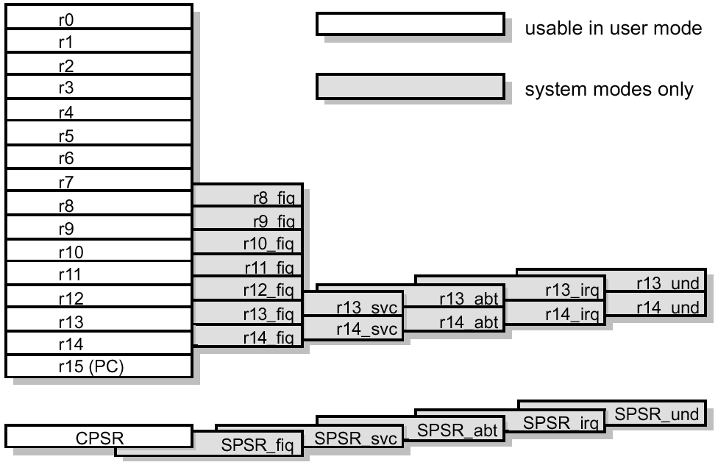
Details of entering an interrupt (exception)
Preserves the address of the next instruction in the appropriate Link Register (e.g. r14_svc → r14 of supervisor mode)
Copies the CPSR (Current Program Status Register ) into the appropriate SPSR (Saved Process Status Reg. e.g. SPSR_svc)
Forces the CPSR mode bits to a value which depends on the exception (supervisor, interrupt etc)
Forces the PC (program counter r15) to fetch the next instruction from the relevant exception vector
It also sets the interrupt disable flags to prevent otherwise unmanageable nesting of exceptions.
http://infocenter.arm.com/help/topic/com.arm.doc.ddi0210c/DDI0210B.pdf
SPSR_SVC

Slide 10
Example of using interrupt for IO e.g. serial IO
Send data to serial port
  Polling method (not efficient)
    The program will wait until the line is ready to send.
  Interrupt method (efficient)
    When the line is ready to send, serial_IO (UART) interrupt the main( ) program,
    interrupt service routine (ISR) is run to send data
    So the main( ) program can handle other tasks, hence the system is more efficient.

Slide 11
Real example to demonstrate interrupts
Demo program: ext3_interrupt_demo1.c
Demo youtube movie
Hardware
Interrupt source connected to the ARM processor interrupt request input (e.g. IRQ=external interrupt request)
Software
main( )
Initialize the IRQ system ( init_Eint (void))
IRQ-interrupt service routine __irq IRQ_Eint1()
void simple_delay_loop(void)

Slide 12
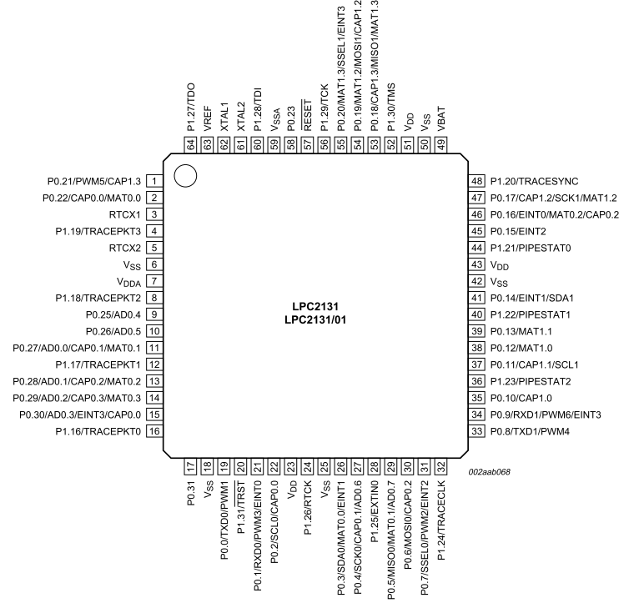
Student ID: ________________,Date:_____________,Name: ______________________
CENG2400 , Chapter 9: Interrupt, Exercise 1: Hardware interrupt for our testing board
P0.10
RED
LED
Green
LED
P0.11
Exercise 9.1a : How do you initialize the pins for this circuit in a “C-program”?
Answer:?______
Exercise 9.1b : What will happen when SW2 is depressed?
Answer?________
EINT3
P0.20

Slide 13
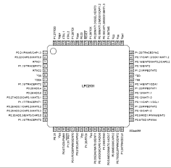


Software : IRQ interrupt example (ext3_interrupt_demo1.c)
Main() //part 5
{//Initialize-interrupt
init_Eint();
Click here to see video:
https://www.youtube.com/watch?v=GbnMxZgEgDA
BLINKS RED LED
while(1)
{ Off Red LED
delay_loop(0.5 sec.);
On Red LED
delay_loop(0.5 sec.);
}
Occurs any time
when Eint3 (P0.20) is pulled down
//external interrupt
__irq isr_EINT3()
{
Green-LED LED toggles (change state) when the switch is depressed once.
}
Eint3
(P0.20 of ARM7-LPC2131)

Slide 14
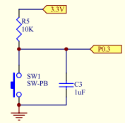
The theory for External interrupt (EINT3)
ISR Interrupt service routine for /EINT3 is _irq isr_EINT3()
Hardware action → triggers execution of a software routine
A falling edge at an interrupt input pin (e.g. EINT3 -P0.20) will trigger the execution of an interrupt service routine ISR void __irq isr_Eint3()
ARM7-LPC2213x
External signal
/EINT3 (P0.20)
When /ENT3 is pulled down
void __irq isr_Eint3()
Will be executed

Slide 15
//ext3_interrupt_demo1.c
//part 1: header/////////////////////////////
#include <lpc21xx.h>
#define D1_red_led 0x400 //p0.10=D1_red_led
#define D2_green_led 0x800 //p0.11=D2_green_led
//define global variables
long timeval; long excount; void init_Eint (void);
void simple_delay_loop(void);
//part 2 -ISR Interrupt service routine,put before main()
void __irq isr_Eint3()
{ excount++;
//Toggle the Green LED by pressing SW3
if((excount%2)==0) {
IO0CLR|=D2_green_led; //OFF GREEN LED
excount = 0;
}
else IO0SET|=D2_green_led; //ON GREEN LED
EXTINT = 0x08; // Clear EINT3 flag
VICVectAddr = 0; // Acknowledge Interrupt
}
// part 3 /////// initialize interrupt ////////////
void init_Eint (void){
EXTMODE=0x08; // EINT3 is edge triggered
VICVectAddr1 = (unsigned long)isr_Eint3;
// set interrupt vector in 1
VICVectCntl1 = 0x20 | 17;// use EINT3 intp’
VICIntEnable |= 0x00020000;//Enable EINT3
EXTINT = 0x08; // Clear EINT3 flag
}
// part 4/////////////////////////////
void simple_delay_loop(void) {
int i,k,delay_count;
delay_count = 900000;
//exercise:change delay_count to see the effect for (i = 0; i < delay_count; i++)
{k++;}}
/// part 5 /////////////// main () program //////////////////
int main(void) //place main() at the end of teh program
{ PINSEL1 |= 0x00000300;
// set p0.20=EINT3 external
//interrupt input
init_Eint();// Init External Interrupt
IO0DIR|=D1_red_led;
IO0DIR|=D2_green_led;
while(1) { // Off Red LED/////////////
IO0CLR|=D1_red_led;
simple_delay_loop();
// On Red LED////////////
IO0SET|=D1_red_led;
simple_delay_loop();
}
}

Slide 16
The External interrupt program
Over view
//ext3_interrupt_demo1.c
We will explain the modules in this order
  Part 1: //header
  Part 4://simple_delay_loop (Blink the red LED)
  Part 5: //main()
  Part 3:// part 3 , initialize interrupt
  Part 2://part 2 -ISR Interrupt service routine: (Toggle the Green LED by SW3)

Slide 17
Part 1: header
Include #include <lpc21xx.h> file,
Define constants
Declare variables
//ext3_interrupt_demo1.c
//part 1: header/////////////////////////////
#include <lpc21xx.h>
#define D1_red_led 0x400 //p0.10=D1_red_led
#define D2_green_led 0x800 //p0.11=D2_green_led
//define global variables
long timeval; long excount; void init_Eint (void);
void simple_delay_loop(void);

Slide 18
Part 4: The delay loop (Blink the red LED)
// part 4//////////////////////////////
void simple_delay_loop(void) {
int i,k,delay_count;
delay_count = 900000;
//change delay_count to see how
// it affects the delay time
for (i = 0; i < delay_count; i++)
{ k++;
}
}

Slide 19
Part 5: main()
/// part 5 /////////////// main () program //////////////////
int main(void) //place main() at the end of the program
{ PINSEL1 |= 0x00000300;
// set p0.20=EINT3 external
//interrupt input
init_Eint();// Init External Interrupt
IO0DIR|=D1_red_led;
IO0DIR|=D2_green_led;
while(1) {
// Off Red LED/////////////
IO0CLR|=D1_red_led;
simple_delay_loop();
// On Red LED////////////
IO0SET|=D1_red_led;
simple_delay_loop();
}
}

Slide 20
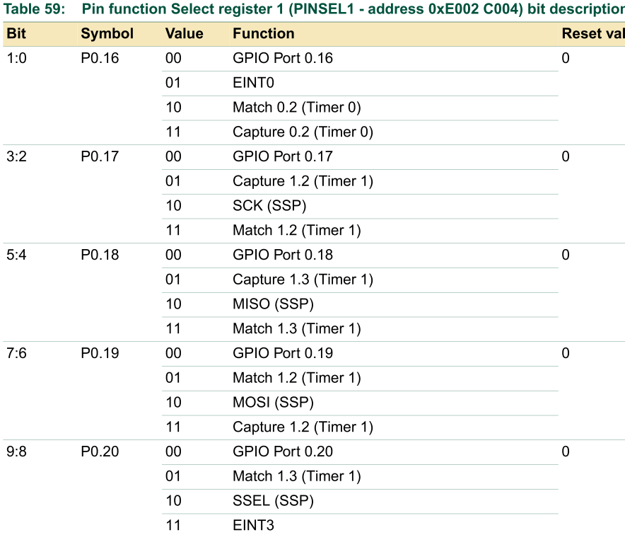
Exercise 9.2: Setup pin for external interrupt: (pin P0.20=Eint3) PINSEL1 |= 0x00000300;
PINSEL1 |= 0x00000300;
=0011 0000 0000B (binary)
// set p0.20=EINT3 external interrupt :
Got to reference
http://www.nxp.com/documents/user_manual/UM10120.pdf
Find definition of “PINSEl1”.
To make p0.20 to be Eint3
Bit 8,9 are 1 and other bits are 0, the hex number is 0x0000 0300, so PINSEL1 |= 0x00000300;
Exercise 2a: If A=0x55, show the result of A for the ‘C’ statement : A |=0x02;
Answer:?________________________
Exercise 2b: For “PINSEL1 |= 0x00000300; “ in main.c, why “|=“ is used?
Answer:?_____________
Exercise 2c: How do you change the program if EINT0 instead of ENTI3 is used
as the external interrupt input.
Answer?______________.

Slide 21
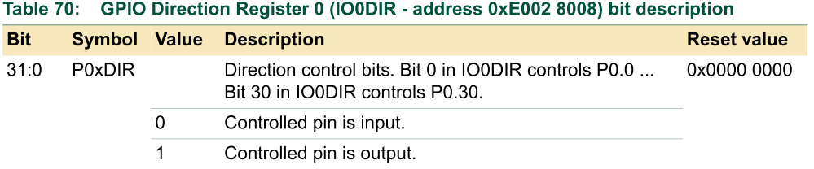
Exercise 9.3: Setup p0.10=RED_LED, P0.11=GREEN_LED
0100 0000 0000B (binary), Bit 10 is 1
#define D1_red_led 0x400 //bit 10 is 1, all other bits are 0
#define D2_green_led 0x800 //bit 11, is , all other bits are 0
:
IO0DIR|= D1_red_led;
IO0DIR|= D2_green_led;
Bits 10,11 are set to 1
So they are outputs.
for the Red and Green
LEDs.
The use of “|=“ makes the
program easier to write/ read/modify
1000 0000 0000B (binary), Bit 11 is 1
http://www.nxp.com/documents/user_manual/UM10120.pdf
Exercise3a: Rewrite the program if “|=“ cannot be used.
Answer:?________________________
Exercise3b: Rewrite the program if p0.18 is used for the RED LED output.
Answer:?________________________

Slide 22
Part 3: Initialize the IRQ (EINT3) system template (see appendix 1 for details)
// part 3 // initialize interrupt ////////////
void init_Eint (void){
EXTMODE=0x08; // EINT3 is edge triggered
VICVectAddr1 = (unsigned long)isr_Eint3;
// set interrupt vector in 1
VICVectCntl1 = 0x20 | 17;// use EINT3 intp’
VICIntEnable |= 0x00020000;//Enable EINT3
EXTINT = 0x08; // Clear EINT3 flag
}

Slide 23
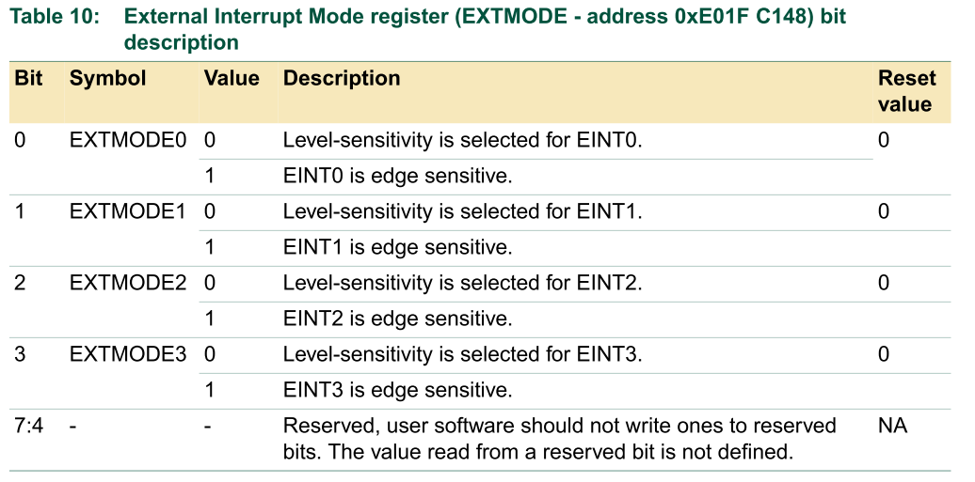
Explanation: init_Eint ( ) : Initialize the interrupt system
See Appendix for full explanation
void init_Eint (void) {
EXTMODE=0x08; // set EINT3 as edge trigger
VICVectAddr1 = (unsigned long) isr_Eint3; ///give the name of the isr ( )
// set interrupt vector in 1
VICVectCntl1 = 0x20 | 17; // use it for EINT3 Interrupt See Appendix
VICIntEnable |= 0x00020000; // Enable EINT3 interrupt See Appendix
EXTINT = 0x08; // Clear EINT3 flag
}
http://www.nxp.com/documents/user_manual/UM10120.pdf

Slide 24
  Part 2: Interrupt service routine template void __irq isr_Eint3() //(Toggle the Green LED by SW3)
  *The same init_Eint ( ) can be written as in the previous slide in different applications, what you need to write is this irq isr_Eint3()
Write specific actions
you want the Interrupt
Service Routine to do
//part 2 -ISR Interrupt service routine, put before main()
void __irq isr_Eint3()
{ excount++;
//Toggle the Green LED by pressing SW3
if((excount%2)==0) {
IO0CLR|=D2_green_led; //OFF GREEN LED
excount = 0;
}
else IO0SET|=D2_green_led; //ON GREEN LED
EXTINT = 0x08; // Clear EINT3 flag
VICVectAddr = 0; // Acknowledge Interrupt
}
Must include this in order
for the system to accept
the next interrupt.

Slide 25

Polling vs. interrupt (serial UART example)
Polling (no interrupt)
(BAD) Idle (do nothing) most of the time
Main ( )
{
}
Interrupt (IRQ)
(Good) Efficient, the CPU is productive all the time
Main()
{
:
:
:
:
}
Serial_io generates
an interrupt when ready
Is serial line
ready?
No
Interrupt
Service
Routine (ISR)
Yes

Slide 26
The interrupt method is efficient
More efficient scheme: jump to an interrupt service routine when a device requests service
When the device is idle, the processor can do something worthwhile in main()
Main loop :
Instruction 1
Instruction 2
Instruction 3
Instruction 4
Instruction 5
Interrupt routine :
Instruction A
Instruction B
Instruction C
Return from interrupt
Source: http://www.at91.com/selftraining/ppt%20files/ARM7TDMI-based/AT91%20Interrupt%20Handling.ppt

Slide 27
Summary
Learned how to use hardware interrupt
Studied a typical hardware interrupt example ext3_interrupt_demo1.c

Slide 28
Appendix
(ESTR2100 students should study this)
Based on
http://www.nxp.com/documents/user_manual/UM10120.pdf

Slide 29
Appendix 1: Details of void init_Eint (void)
How to Initialize interrupt
Study init_Eint (void)

Slide 30
init_Eint ( ) : Initialize the interrupt system
void init_Eint (void) {
EXTMODE=0x08; // set EINT3 as edge trigger
VICVectAddr1 = (unsigned long) isr_Eint3;
// set interrupt vector in 1
VICVectCntl1 = 0x20 | 17; // use it for EINT3 Interrupt
VICIntEnable |= 0x00020000; // Enable EINT3 interrupt
EXTINT = 0x08; // Clear EINT3 flag
}
http://www.nxp.com/documents/user_manual/UM10120.pdf

Slide 31
For control vector slot 1, there are
16 slots from 0 (highest priory) to 15 (lowest priority))
void init_Eint (void) {
EXTMODE=0x08; // set EINT3 as edge trigger
VICVectAddr1 = (unsigned long) isr _Eint3;
// set interrupt vector in 1
VICVectCntl1 = 0x20 | 17; // use it for EINT3 Interrupt
VICIntEnable |= 0x00020000; // Enable EINT3 interrupt
EXTINT = 0x08; // Clear EINT3 flag
}
Point to which interrupt service program (IRQ_Eint3) will
Run. I.e. when EINT3 is pulled low IRQ_Eint3( ) will run.

Slide 32
void init_Eint (void) {
EXTMODE=0x08; // set EINT3 as edge trigger
VICVectAddr1 = (unsigned long)IRQ_Eint1;
// set interrupt vector in slot1 (16 slots from 0 (highest priory) to 15 (lowest priority))
VICVectCntl1 = 0x20 | 17; // use it for EINT3 Interrupt
VICIntEnable |= 0x00020000; // Enable EINT3 interrupt
EXTINT = 0x08; // Clear EINT3 flag}
From http://www.nxp.com/documents/user_manual/UM10120.pdf
For control vector slot 1, there are
16 slots from 0 (highest priory) to 15 (lowest priority))
‘17’ is the source mask of external interrupt3
(EINT3),(see next slide)
0x020 → bit5=1

Slide 33
Source mask
E.g.
external interrupt=17
From http://www.nxp.com/documents/user_manual/UM10120.pdf

Slide 34
Examples of other interrupt sources
If you want to use Eint1(source mask=15)
VICVectCntl1 = 0x20 | 15 ;//the 0x20 is to set bit5 to 1
If you want to use Eint0(source mask=14)
VICVectCntl1 = 0x20 | 14;//the 0x20 is to set bit5 to 1
If you want to use Uart0(source mask=6)
VICVectCntl1 = 0x20 | 6; //the 0x20 is to set bit5 to 1

Slide 35
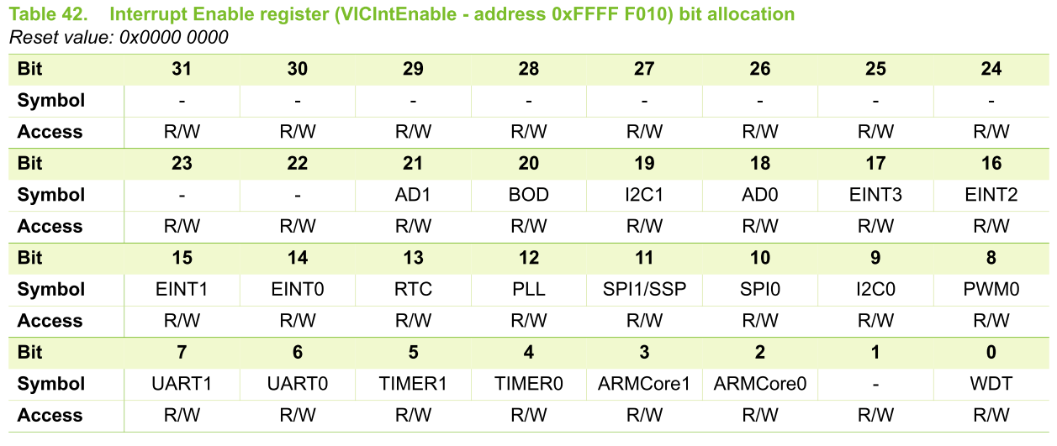
void init_Eint (void) {
EXTMODE=0x08; // set EINT3 as edge trigger
VICVectAddr1 = (unsigned long)IRQ_Eint1;
// set interrupt vector in 1
VICVectCntl1 = 0x20 | 17; // use it for EINT3 Interrupt
VICIntEnable |= 0x00020000; // Enable EINT3 interrupt
EXTINT = 0x08; // Clear EINT3 flag
}
Bit17 is set for 0x00020000
From http://www.nxp.com/documents/user_manual/UM10120.pdf

Slide 36
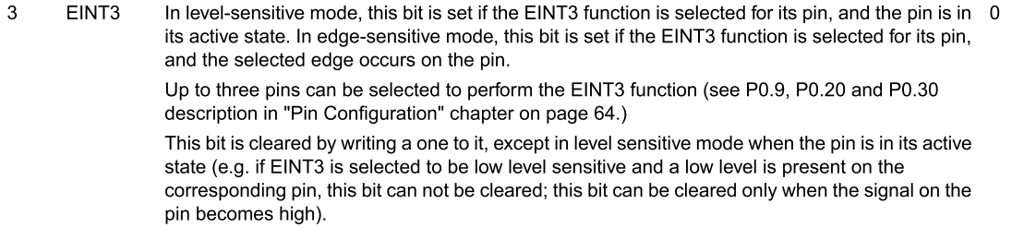
void init_Eint (void) {
EXTMODE=0x08; // set EINT3 as edge trigger
VICVectAddr1 = (unsigned long)IRQ_Eint1;
// set interrupt vector in 1
VICVectCntl1 = 0x20 | 17; // use it for EINT3 Interrupt
VICIntEnable |= 0x00020000; // Enable EINT3 interrupt
EXTINT = 0x08; (see next page) // Clear EINT3 flag
}
External Interrupt Flag register (EXTINT - address 0xE01F C140) (see next page)
0x08=1000(B)
Bit3 set to1
From http://www.nxp.com/documents/user_manual/UM10120.pdf

Slide 37
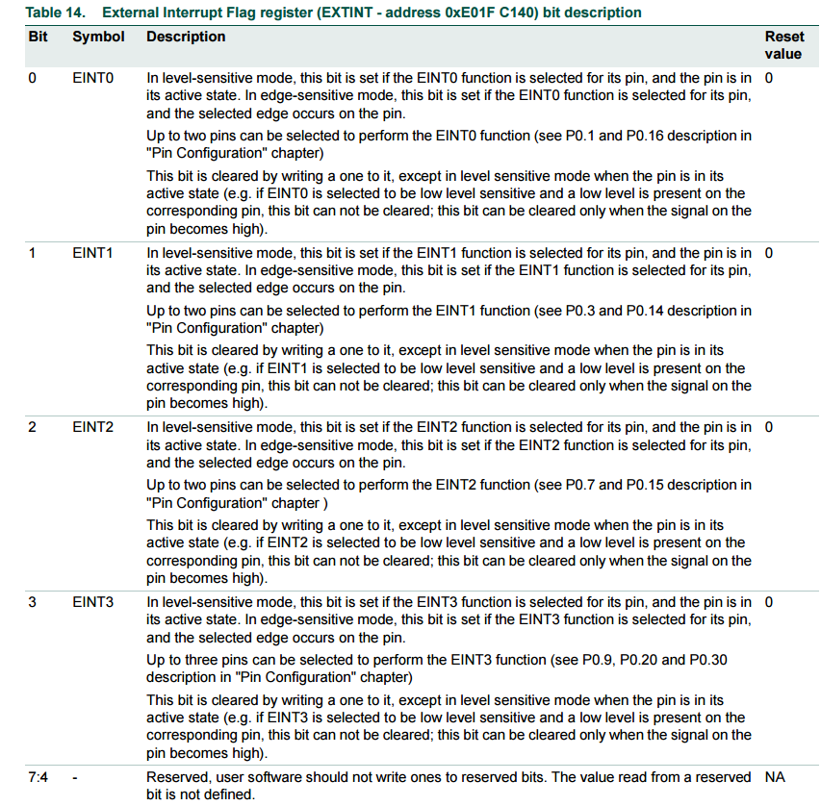

Slide 38
Appendix 2
Other important interrupts
Reset, SWI, FIQ, IRQ
We will study IRQ here

Slide 39
Different interrupts depend on how they are triggered
Reset
Undefined Instruction
Prefetch Abort
Data Abort
Interrupt Request
Fast Interrupt Request
Will study the underlined

Slide 40
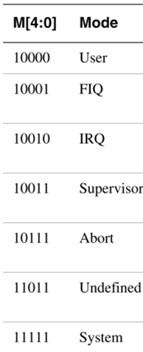
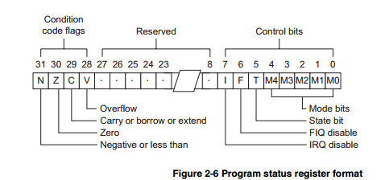
Entry/Exit Actions for different interrupts
*Interrupt Disable bits.
I = 1, disables the IRQ.
F = 1, disables the FIQ.
when the I bit is set, IRQ
interrupts are disabled, etc.
*Mode bits
Supervisor=M[0:4]=10011
Reset
  When the processor’s Reset input is asserted
    CPSR ⇐ Supervisor + I + F
    PC ⇐ 0x00000000
Undefined Instruction
  If an attempt to execute an instruction that is undefined
    LR_undef ⇐ Undefined Instruction Address + #4
    PC ⇐ 0x00000004, CPSR ⇐ Undefined + I
    Return with : MOVS pc, lr
Prefetch Abort
  Instruction fetch memory abort, invalid fetched instruction
    LR_abt ⇐ Aborted Instruction Address + #4, SPSR_abt ⇐ CPSR
    PC ⇐ 0x0000000C, CPSR ⇐ Abort + I
    Return with : SUBS pc, lr, #4
http://infocenter.arm.com/help/topic/com.arm.doc.ddi0210c/DDI0210B.pdf

Slide 41
Entry/Exit Actions
Data Abort
  Data access memory abort, invalid data
    LR_abt ⇐ Aborted Instruction + #8, SPSR_abt ⇐ CPSR
    PC ⇐ 0x00000010, CPSR ⇐ Abort + I
    Return with : SUBS pc, lr, #4 or SUBS pc, lr, #8
Software Interrupt
  Enters Supervisor mode
    LR_svc ⇐ SWI Address + #4, SPSR_svc ⇐ CPSR
    PC ⇐ 0x00000008, CPSR ⇐ Supervisor + I
    Return with : MOV pc, lr

Slide 42
Entry/Exit Actions
Interrupt Request (IRQ)
  Externally generated by asserting the processor’s IRQ input
    LR_irq ⇐ PC - #4, SPSR_irq ⇐ CPSR //save next instruction after interrupt
    PC ⇐ 0x00000018, CPSR ⇐ Interrupt + I //stop other IRQ interrupts
    Return with : SUBS pc, lr, #4 //return to the orginal program
Fast Interrupt Request
  Externally generated by asserting the processor’s FIQ input
    LR_fiq ⇐ PC - #4, SPSR_fiq ⇐ CPSR
    PC ⇐ 0x0000001C, CPSR ⇐ Fast Interrupt + I + F
    Return with : SUBS pc, lr, #4
    Handler @0x1C speeds up the response time

Slide 43
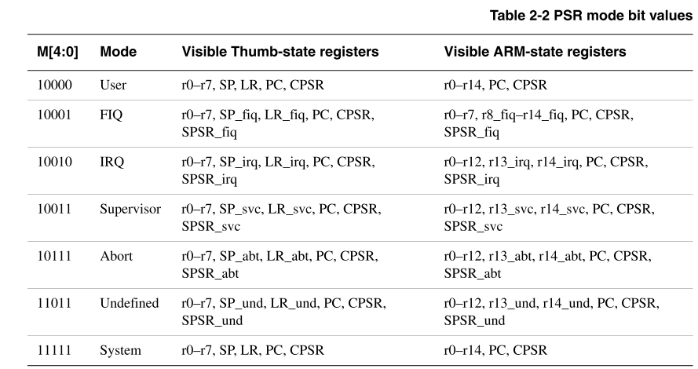
Recall
Mode bits M[0:4] : bit0->bit4 of CPSR
http://infocenter.arm.com/help/topic/com.arm.doc.ddi0210c/DDI0210B.pdf

Slide 44
Important interrupt descriptions
Reset (at power up , or reset button depressed)
Software Interrupt (SWI) : operating sys. calls
Fast hardware interrupts FIQ
Hardware interrupts IRQ

Slide 45
1) Reset section 2.10 [1]
Reset (a summary of the essential procedures)
When the hardware input pin nRESET=0 then 1 and 0 again, then
Overwrites R14_svc and SPSR_svc by copying the current values of the PC and CPSR into them.
Forces M[4:0] to bit:10011, Supervisor mode, sets the I and F bits, and clears the T-bit in the CPSR. Hence IRQ, FIQ are disabled.
Forces the PC to fetch the next instruction from address 0x0000 0000.
Reverts to ARM state if necessary and resumes execution.
After reset, all register values except the PC and CPSR are indeterminate.

Slide 46
Details of entering an interrupt (exception)
Preserves the address of the next instruction in the appropriate Link Register (e.g. r14_svc → r14 of supervisor mode)
Copies the CPSR (Current Program Status Register ) into the appropriate SPSR (Saved Process Status Reg. e.g. SPSR_svc)
Forces the CPSR mode bits to a value which depends on the exception (supervisor, interrupt etc)
Forces the PC (program counter r15) to fetch the next instruction from the relevant exception vector
It may also set the interrupt disable flags to prevent otherwise unmanageable nesting of exceptions.
http://infocenter.arm.com/help/topic/com.arm.doc.ddi0210c/DDI0210B.pdf

Slide 47
2) Software interrupt instruction
SWI
The Software Interrupt instruction (SWI) is used to enter Supervisor mode, usually to request a particular supervisor function.
The SWI handler ( a software routine in the Operating system,) reads the op-code to extract the SWI function number (vector), e.g. print a character on screen.
Then runs the routine for that vector– print a character on screen.
A SWI handler returns by executing MOVS PC, R14_svc

Slide 48
software interrupt (excpetion)
31
28
27
24
23
0
Cond 1 1 1 1
Comment field (ignored by Processor)
Condition Field
In effect, a SWI is a user-defined instruction.
It causes an exception trap to the SWI hardware vector (thus causing a change to supervisor mode, plus the associated state saving), thus causing the SWI exception handler to be called.
The handler can then examine the comment field of the instruction to decide what operation has been requested.
By making use of the SWI mechanism, an operating system can implement a set of privileged operations which applications running in user mode can request.
See Exception Handling Module for further details.

Slide 49
3) FIQ Fast interrupt request
ARM FIQ mode has eight banked registers to save contents of working registers hence minimizes the overhead of context switching.

Slide 50
User to FIQ mode (fast interrupt)
Registers in use
Registers in use
User Mode
FIQ Mode
r0
r0
r1
r1
r2
r2
r3
r3
r4
r4
r5
r5
r6
r6
r7
Interrupt
r7
r8
r8_fiq
r8
r8_fiq
r9
r9_fiq
r9
r9_fiq
r10
r10_fiq
r10
r10_fiq
r11
r11_fiq
r11
r11_fiq
r12
r12_fiq
r12
r12_fiq
r13 (sp)
r13_fiq
r13 (sp)
r13_fiq
r14 (lr)
r14_fiq
r14 (lr)
r14_fiq
r15 (pc)
r15 (pc)
Return address calculated from User mode
PC value and stored in FIQ mode LR
cpsr
cpsr
spsr_fiq
Status reg. for fig mode
spsr_fiq
Status reg.
User mode CPSR copied to FIQ mode SPSR

Slide 51
FIQ vs IRQ latency
FIQ
  Fast interrupt that has a latency of 12 cycles
  Note that it is the last entry in the interrupt vector table: the interrupt handler can be directly placed at 0x1c (or a jump can be made as for the other entries)
IRQ
  Latency of 25 cycles

