Slide 1

ENGG1000 IT Foundation
Information Literacy

Slide 2
Information Literacy
” TO PROSPER IN THE DIGITAL AGE, PEOPLE MUST BECOME MASTERS OF INFORMATION.”
C. STERN (2003)
Since 2009, October is the National Information Literacy Awareness Month in U.S.

Slide 3
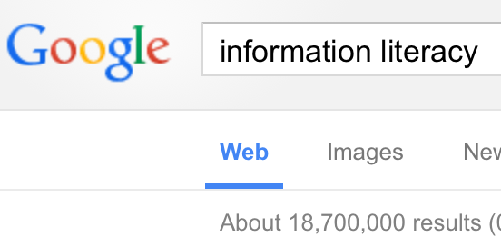
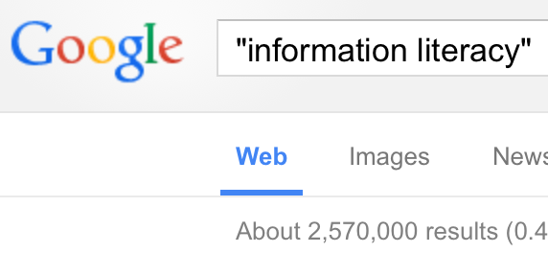
Information Growth
Google “information literacy”
Assume spending 15 seconds for each result:
  18,700,000 → 8.89 Years
  2,570,000 → 1.22 Years

Slide 4
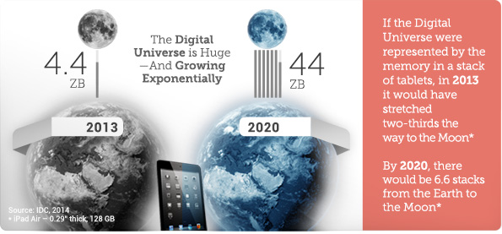
Information Growth
Courtesy of IDC

Slide 5
Information Overload
Information overload is when you are trying to deal with more information than you are able to process to make sensible decisions, otherwise, you will
  Delay making decisions
  Make the wrong decisions
Decision
accuracy
overload
Amount of information
http://www.infogineering.net/understanding-information-overload.htm

Slide 6
Causes of Information Overload
More information than we can process
  Search the web for almost any topic and you will get millions of web pages as a result
Bombardment of unsolicited information
  How many unsolicited emails do you receive each day?
Speed of new information accelerates
  Not only has the speed of delivery increased over time, but it continues to accelerate, creating an exponential effect
Value of information plummets
  we have no effective mechanisms to evaluate what is truly important, what is simply redundant and what is plain junk
Amount of Contradiction Increase
  With a thousand voices screaming at you, who do you trust?
Our Information Needs Increase
  "the one with the most information wins” leads to an ever increasing appetite for more information
http://www.streetdirectory.com/travel_guide/126101/computers/information_overload___6_primary_causes.html

Slide 7

What can we do?
Read faster?
Work longer?
We need a smarter solution

Slide 8
A Better Solution
To develop the skills and understandings to:
  find information
  effectively use the information
  evaluate the information
This is called information literacy (資訊素養)

Slide 9
The Big6 Model
One approach to information literacy is the Big6 model, by Mike Eisenberg and Bob Berkowitz
  Not about particular tools or technologies
The model is applicable to:
  people of all ages
  solving all problems that requires information

Slide 10
The Big6 Model
NOT necessarily in linear order
1. Task Definition
2. Info Seeking Strategies
3. Location & Access
4. Use of Information
5. Synthesis
6. Evaluation

Slide 11
1. Task Definition
Define the problem
  What do I have to do or find out?
    What kind of final product are you expected?
    Any specific requirement or limitation?
    Deadline?

Slide 12
1. Task Definition
Identify the information needed
  What information do I need?
  How much information?
  What type of information?
    Facts? Opinions? Graphics? Maps? …

Slide 13
2. Information Seeking Strategies
Determine all possible sources
  Brainstorm any possible information sources to answer your questions in (1)
    Books, newspapers, TV, radio, magazines, encyclopedias, websites, human experts, e-mails, …
  Distinguish between primary and secondary sources

Slide 14
Primary vs Secondary Sources
Primary source is first-hand information or data on a topic
  Newspaper articles, diaries, autobiographies, movies, statistics and surveys, …
Secondary source is information that reports or comments on primary sources
  Reviews, commentaries, magazine articles, textbooks, encyclopedias, …
What are the merits or demerits of primary and secondary information sources?

Slide 15

2. Information Seeking Strategies
Select the best sources
  Will you find the latest stock price in a book?
  Timing is important!
Courtesy of CUHK Library

Slide 16
Evaluating Information Sources
Authority: is the author mentioned? Is (s)he reputable in the field?
Currency: when was the information published? Does the time frame suit your needs?
Accuracy: can you verify the information?
Objectivity: is the information biased?

Slide 17
Evaluating Information Sources
For web resource, the URL provides some clues (only) for its usefulness
Domain | Intended use
.com | Commercial organizations
.edu | Educational establishments
.gov | Government entities
.mil | Military
.net | Organizations involved in networking technologies (loosely enforced)
.org | Non-profit or public organizations

Slide 18
3. Location and Access
Locate sources
  Web URL, library, e-mail address, phone number, …
Find information within sources
  E.g., find the appropriate chapter of a book
  If the exact location (e.g., URL) is not yet known, you need to search them using keywords

Slide 19
Internet Search Engines
Quickly gives you lots of Internet resources
Almost all search engines use a "Boolean conjunction" model
  E.g.,
information technology
Search
Search
result
Pages containing "information"
Pages containing "technology"

Slide 20
Properties of Search Engines
Case insensitive
  [ information ] is the same as [ InFoRmAtIoN ]
Generally, punctuation marks are not needed
  [ e.g. ]
  Exception sometimes: [ C++ ]
Generally, prepositions, pronouns, etc. are not needed
  [ to ], [ at ], [ he ] don’t make much sense
  Exception sometimes: [ to be or not to be ]

Slide 21

Internet Search Engines
Sometimes you get too many results
How can we narrow down the results?

Slide 22


Narrowing Down Results
Phrase search (“”) (exact order)
Exclude terms (-)
“information technology”
“hong kong”
government
“information technology”
“hong kong”

Slide 23

Broadening Results
Combining search results (OR)
Note: usually, OR has to be in capital letters
“information technology”
Search result
“資訊科技”

Slide 24
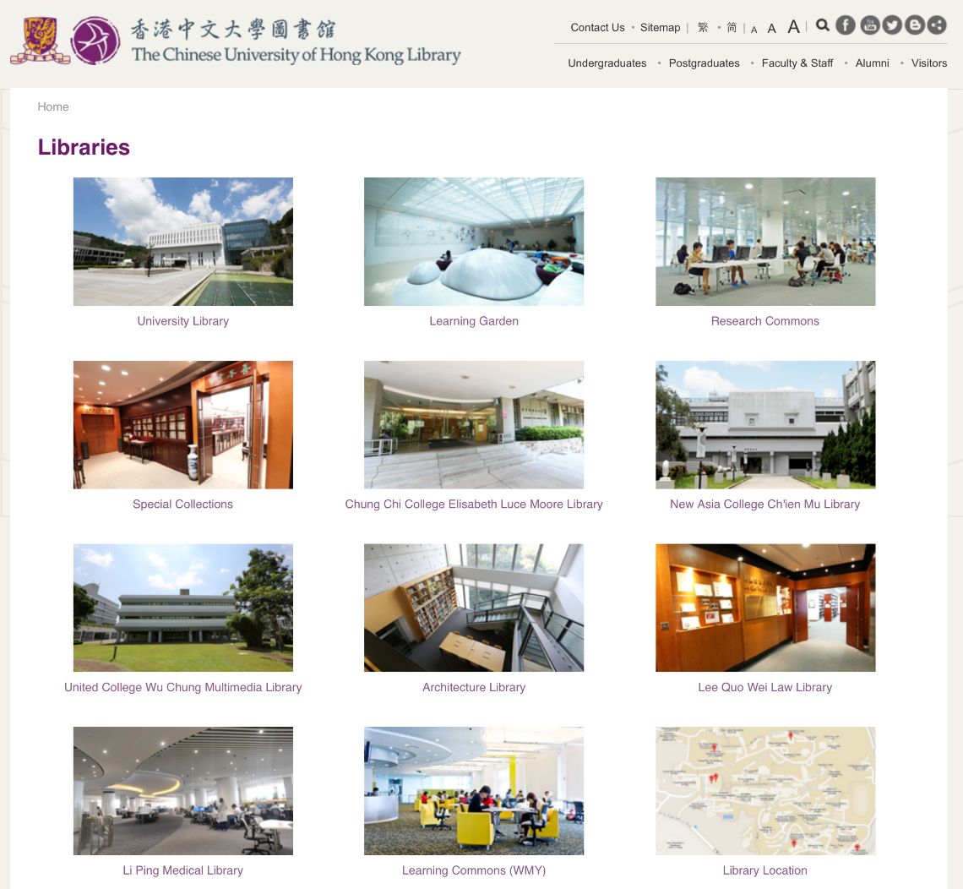
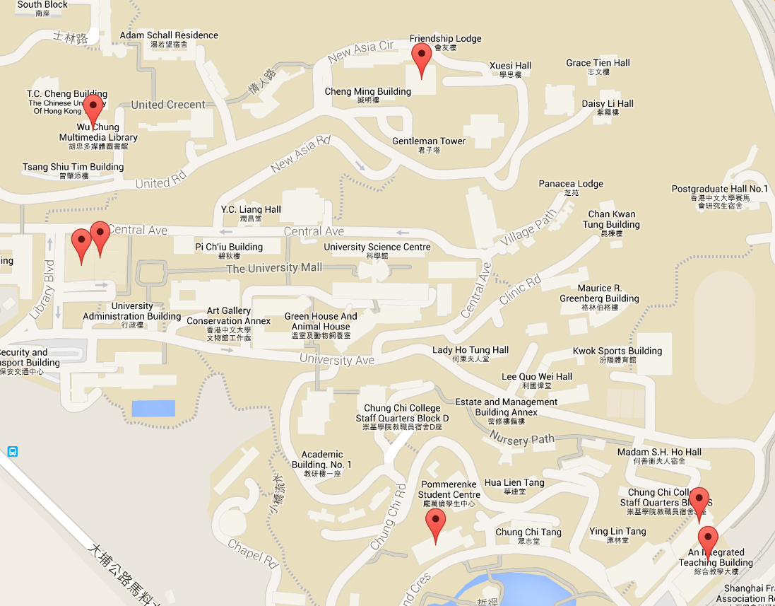
Library Search
CUHK has 7 libraries on campus

Slide 25

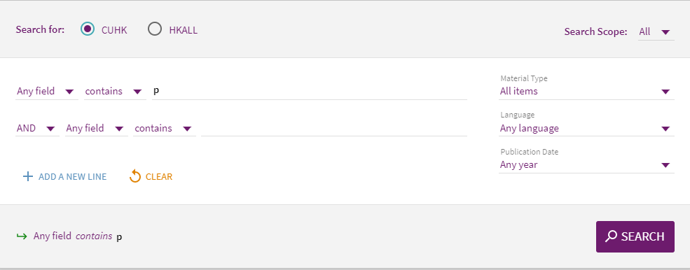
Library Search (library.cuhk.edu.hk)
All search are case-insensitive
Choose whether to search only CUHK library collections or HKALL
Choose material types (e.g., books, articles, exam papers, etc.)
Advanced Search offers additional search options. E.g.,by fields (title, subjects, etc.), by language, use of logical operators (AND, OR, NOT).

Slide 26
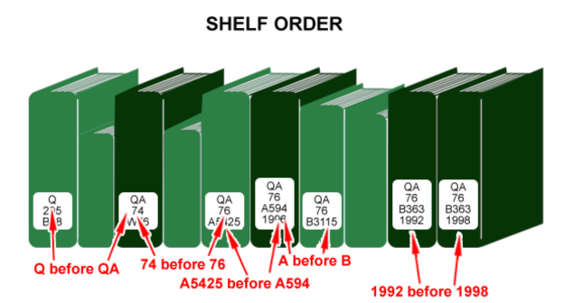

Library Search
Each item in the library collection is assigned a call number
Books are shelved by the call number assigned
For example, the call number:
QA76.A594 1996
Please refer to the “How-to Guides” in the LibraryGuides page:
http://libguides.lib.cuhk.edu.hk/Howtoguides

Slide 27
4. Use of Information
Engage (e.g., read, hear, view, touch)
  If you do not understand the information, ask for help
    “It’s OK not to understand, but it’s not OK not to ask for help”
Extract relevant information
  Take notes
  Citations (引用)

Slide 28


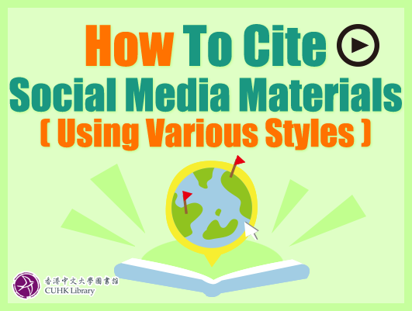
Citations
Give credit to the original author(s)
Add credibility to your arguments or facts
Allow others to locate the source
Avoid being accused of plagiarism (剽竊)
Find out more on the proper way to cite various kinds of materials in the Library:
http://libguides.lib.cuhk.edu.hk/Howtoguides

Slide 29
Citations
Usually contain the author(s) and title of the information source
  Book/journal: year, page numbers, publisher
  Newspaper: name of newspaper, section, date of publication
  Website: URL, date of retrieval
Different citation style may use in different discipline
  http://libguides.lib.cuhk.edu.hk/Citation_Styles

Slide 30
Citation Management Tools
Create a personal library of references and documents in one place and organize them by topic, project, etc.
Store abstracts, annotations, and notes with your references.
Easily locate your collected research references and documents.
Cite your resources and provide a bibliography while you write.
Easily change your citation style to match your need or the requirement of publishers
CUHK library supports different citation management tools
  http://www.lib.cuhk.edu.hk/en/research/citation/tool
The currently in-use cloud citation management tool is called Refworks Flow (or ProQuest Flow):
  http://libguides.lib.cuhk.edu.hk/refworks

Slide 31
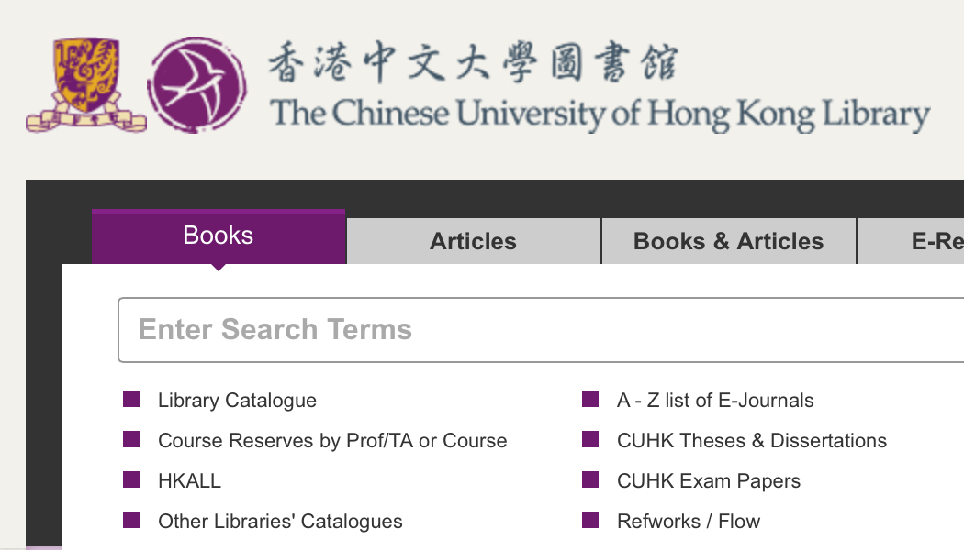
Citation Management Tool – Flow
Provided by ProQuest
A cloud-based collaboration platform
Click this to login/Signup

Slide 32
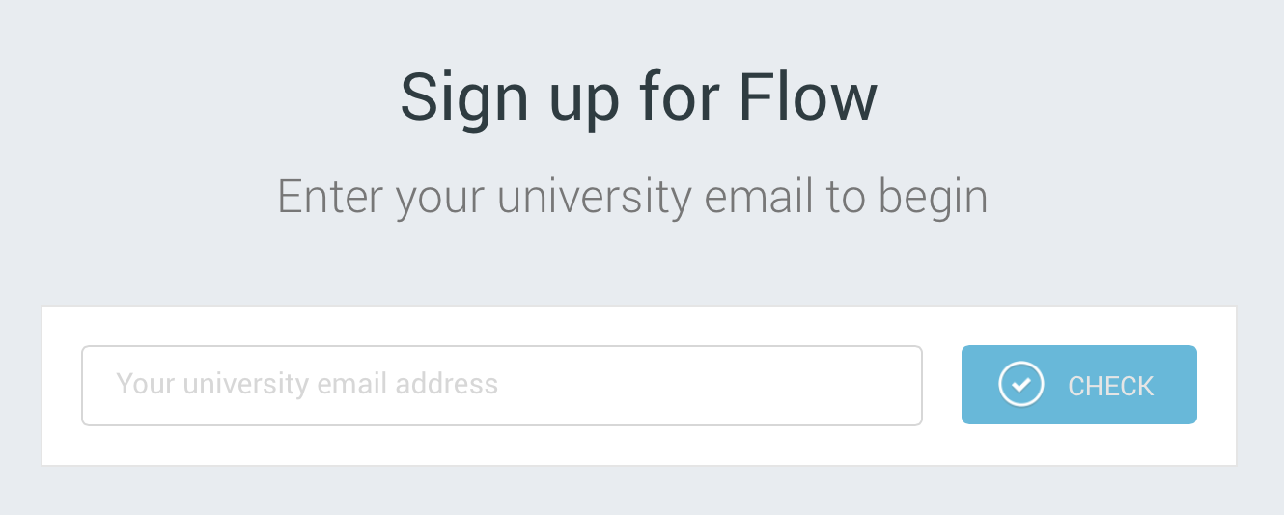

Citation Management Tool – Flow
You need to use your CUHK email to sign up
You will receive an activation email and follow the instructions to complete your sign up.

Slide 33
Citation Management Tool – Flow
Using Flow, you can
  Save references on the web
  Cite in Microsoft Word and Google Docs
  Create bibliographies
  Get information automatically
  Read and annotate documents
  Share and collaborate with others

Slide 34
5. Synthesis
Organize information from multiple sources
  Put together your notes, by:
    Create an outline
    Write a draft
    Make a storyboard
    Make a sketch
  You may also reference on the Library’s General Study Guide:
    http://libguides.lib.cuhk.edu.hk/generalstudyguide

Slide 35
5. Synthesis
Present the information
  Prepare your paper, oral presentation, video, or audio
  Remember to include:
    Your own comments and ideas
    A bibliography (list of citation)
  Choose the appropriate computer tools if necessary
  Always think for your audience!

Slide 36

Web Accessibility (無障礙網頁)
Web accessibility is to make sure the website content is available for all, including persons with disabilities or specific difficulties
  Social and legal responsibility
  Open up potential markets
  Better ranking by search engines

Slide 37
Categories of Disabilities
Visual Impairment
  Completely or partially blind, have poor eye-sight, or suffer from color blindness
Physical Impairment
  Missing limbs, have reduced control of their limbs, or suffer from dexterity problems or epilepsy
Hearing Impairment
  Completely or partially deaf
Cognitive Impairment
  Have difficulties in learning

Slide 38
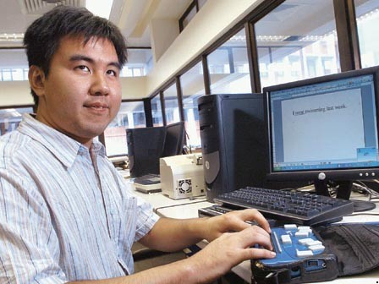
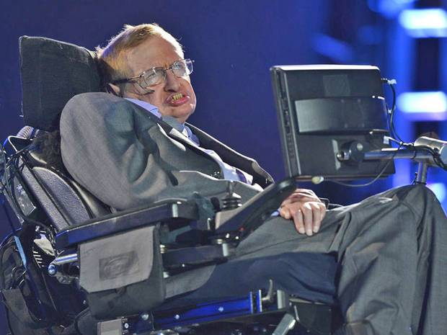
Ways to Overcome the Constraints
Visual Impairment
  Screen readers
  Screen magnifiers
Physical Impairment
  Voice control software
  Large buttons
  Special mouse and keyboard
Hearing Impairment
  Text transcript
  Subtitles
Cognitive Impairment
  Easy Content
Courtesy of pof.org.hk
Courtesy of independent.co.uk

Slide 39
Top 10 Concerns from Persons with Disabilities
Unable to skip Adobe Flash and moving objects
Small Font sizes or insufficient color contrast
No alternatives for non-text information
Website structure is too complicated to understand and/or navigate using assistive tools
Difficulties in browsing websites with background audio
Websites with outdated text versions
For time-limited functions, the time allowed is too short
Volume bars are difficult to control
Ambiguous links for screen readers
Difficulties in accessing PDF
http://www.ogcio.gov.hk/en/community/web_accessibility/handbook/top_ten_concerns/

Slide 40
6. Evaluation
Judge the result (effectiveness)
  Did you fulfill all requirements? (Completeness)
  Did you give credit to all sources?
  Is your work neat and tidy?
  If you were the audience, would you think this is a good work?

Slide 41
6. Evaluation
Judge the process (efficiency)
  Reflect (反思) on all your actions.
  Did you learn something reusable?
  What did you do well this time?
  What would you do differently next time?
  What information source did you find useful/reliable/unreliable?
  Any sources that you cannot locate?

Slide 42
The Big6 Model: Summary
Task definition
  Define the problem
  Identify the information needed
Information seeking strategies
  Determine all possible sources
  Select the best sources
Location and access
  Locate sources
  Find information within sources
Use of information
  Engage (read, hear, view, touch)
  Extract relevant information
Synthesis
  Organize information from multiple sources
  Present the information
Evaluation
  Judge the result (effectiveness)
  Judge the process (efficiency)

Slide 43
Conclusion
Information literacy is a set of life-long, basic, essential skills which are applicable:
  At school, personally, or at work
  To all subject areas
  To solve a problem, make a decision, or complete a task
More information can be found in the Library’s:
  ResearchSmart website (http://smart.lib.cuhk.edu.hk/)
  eLearning Resources website (http://elearning.lib.cuhk.edu.hk/?literacy)
Choose cloud or USB storage for doing group projects with classmates?
Write an essay on economic growth of HK in 2015
Choose between ISPs covered by optical fibres and copper wires?

Slide 44
Disclaimer
The “Big6™” is copyright © (1987) Michael B. Eisenberg and Robert E. Berkowitz.
Using Big6 for educational, non-profit instruction is permitted
  For more on Big6, visit: www.big6.com
infolit.lib.cuhk.edu.hk
smart.lib.cuhk.edu.hk
Materials on web accessibility are obtained from OGCIO, HKSAR Government

