Slide 1

ENGG1000 IT Foundation
Information Security

Slide 2


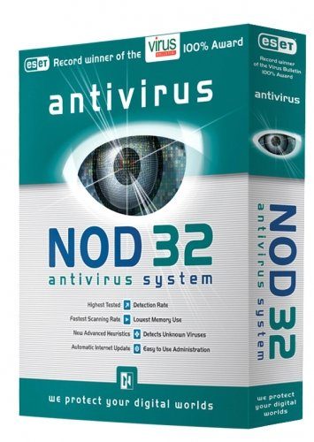

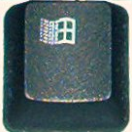
Are you being protected by these?
Do you set login password/ pin for your computers and devices?
Do you Lock your Windows desktop?
+ L (Image source: http://en.wikipedia.org/wiki/File:Keyboard-left_keys.jpg)

Slide 3
Common Types of Cyber Crime Nowadays
Steal 偷 – information and money
Cheat 呃 – false identity and transaction
Abduct 拐 – hijacking web sites
Fraud 騙 – various kind
Rob 搶 – cyber asset
Blackmail 勒索 – DDoS attack revenue model
Libel 誹謗 – abuse of cyberspace “freedom of speech”
Harassment 騷擾 – sexual or other means
Online Gambling 網上賭博
Refer to an example fraud case in the Appendix [Self-study]

Slide 4
Topics
This course does not cover the technical aspects of hacking and professional defense!
Information security
  System security issues and measures
  Using IT services in a secure manner
  Mobile Security
  Protection of Personal Sensitive Data
  Information security policies and practices
Assignment 2
Notes:
4

Slide 5
Source of Risk
Natural
Criminal
Organizational
Personal

Slide 6
Source of Hazard: Natural
"Act of God"
  Fire hazard
  Water hazard
  Quake hazard
  Lightning hazard
Physical hardware failure
  Mean Time of Failure (MToF)
  Wear and tear
  Over-heat

Slide 7


Source of Hazard: Personal
Lack of AWARENESS
  Mis-understanding or
  Under-estimating certain risks
  Lack of proper Precautions
Careless mistakes
  Accidental data erasure/ overwrite
  Confidential data exposure
  Data loss such as losing a data disc or USB drive

Slide 8
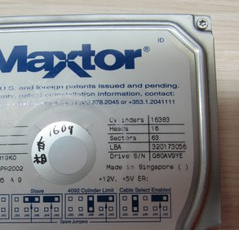

Source of Hazard: Organizational
Information infra-structure break-down/ brown-out
  Power failure
  Network outage
System loop-hole
Improper management of confidential or credential information
  Bad key distribution system
  Improper "Trust" system
  Improper data disposal procedure
Your Password is: 123456

Slide 9

Source of Hazard: Criminal
"Mal-ware" (unauthorized harmful software)
  Computer virus
  Computer worm
  Spyware
  Adware
Cyber Attacks/ Cyber Crime
  Web De-facing damage (change of web-page information)
  Web Phishing cheat (cheating email)
  Data Snooping (get statistic)
  Denial-of-Service (DoS) attack
  Or ( A distributed denial-of-service (DDoS) attack is a DoS attack in which numerous computers or machines flood a targeted resource)
"Hacking" activities
  Unauthorized information system access
  Back-door
  Trojan horse
  Key-logger
  Joke program/ Hoax
不易

Slide 10
Using IT Services in a Secure Manner
First of all, safety and security first
  Virtual Private Network (VPN)
  Secure Browsing (HTTPS)
  Securing Wi-Fi Connections
  Using Security Suite Software
    E.g. Kaspersky (subscribed by CUHK)
  Configuring Personal Firewall
  Junk/ Spam Mail Filtering and Sorting
  Smartphones Security Risks

Slide 11
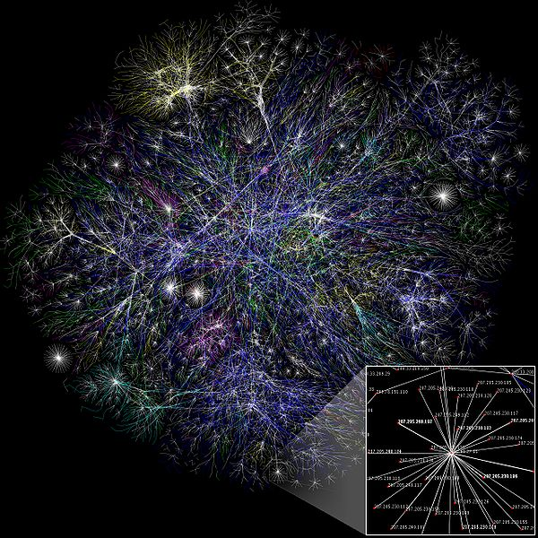
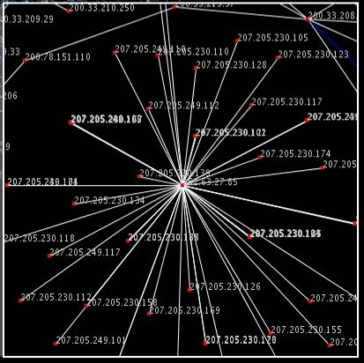
Internet is Globally Connected, thus…
Susceptible to Attacks
Partial map of the Internet
(Image source: http://en.wikipedia.org/wiki/File:Internet_map_1024.jpg)

Slide 12
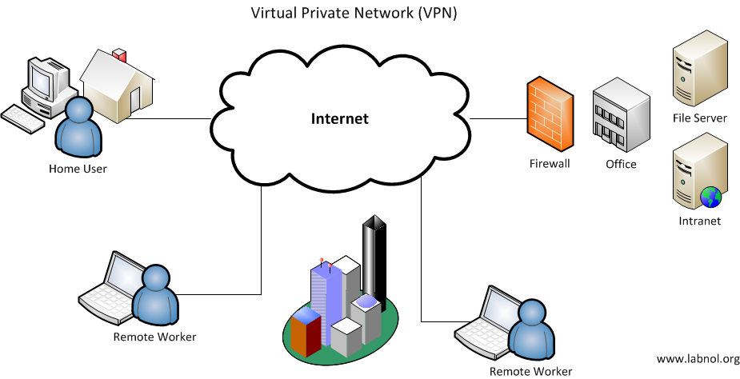
Virtual Private Network (VPN)
To build a Private network on top of Public connections
Concept of “tunneling”
By means of mutual authentication and data encryption
For example, a student can connect back to CUHK VPN overseas or via ISP, thus be able to use most CUHK IT services as if in campus
Image source: Digital Inspiration http://www.labnol.org/software/setup-virtual-private-network-vpn/12208/
How to setup and use VPN in CUHK:
https://www.itsc.cuhk.edu.hk/all-it/wifi-and-network/cuhk-vpn/

Slide 13
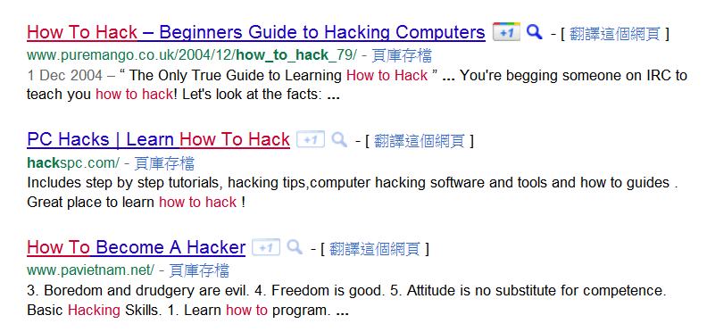
Secure Browsing
Secure Searching
  Are you sure the search results are safe links?
Google Safe Browsing
https://transparencyreport.google.com/safe-browsing/search?url=

Slide 14
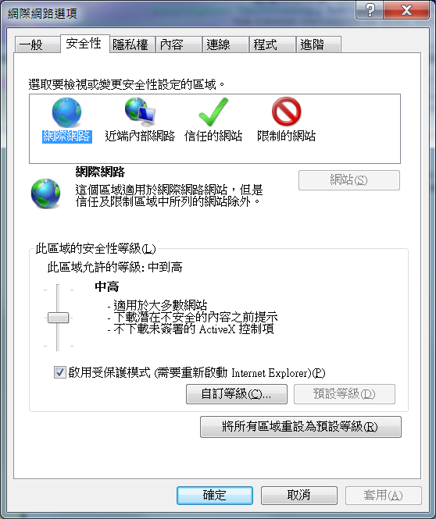
Adjust protection level in windows
Go to Start and open Control Panel.
Select System and Security.
Under Security and Maintenance, select Change User Account Control settings.
Move the slider to one of the following levels: ...
Select OK to save your changes.
Select Yes when prompted to confirm the changes.
On your computer, e.g., open Chrome.
At the top right, click More. Settings.
Click Privacy and security Site Settings. Pop-ups and redirects.
Choose the option that you want as your default setting.
Enable Pop-up Blocker/ Defender
Strengthen browser security settings
Install Security Suite Software: e.g., Anti-Spy, Anti-Adware, etc.
Type HTTPS://www... explicitly as much as possible for server identification and encrypted communication
Secure Browsing
Antivirus software free download:
https://www.itsc.cuhk.edu.hk/all-it/information-security/anti-virus-on-pcs

Slide 15
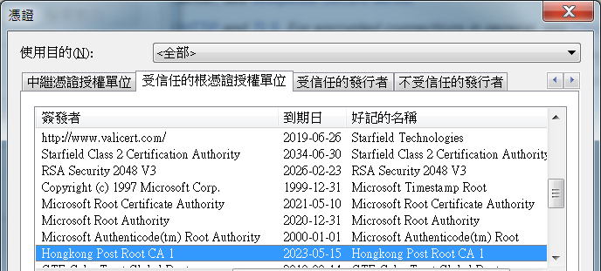
What is HTTPS?
Click the padlock icon in the address bar for the website.
Click on Certificate (Valid) in the pop-up.
Check the Valid from dates to validate the SSL certificate is current.
HyperText Transfer Protocol Secure
By trust of
  Good browser
  Faithful Certificate Authority (CA)
  Valid server certificate issued by CA
To identify legitimate server
Widely-Trusted Root CA’s and their record on a browser

Slide 16
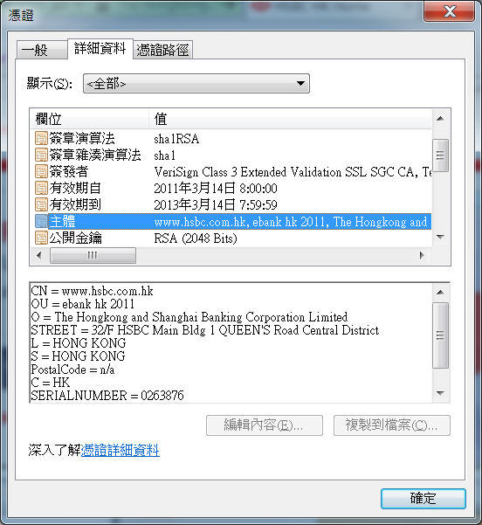
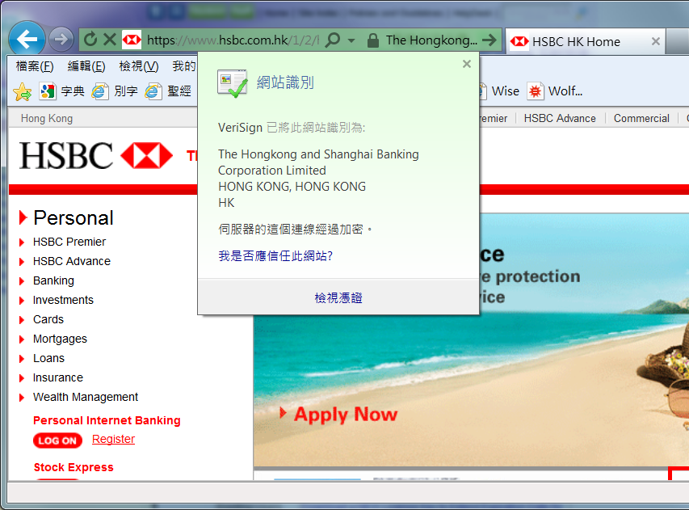
HTTPS Example

Slide 17
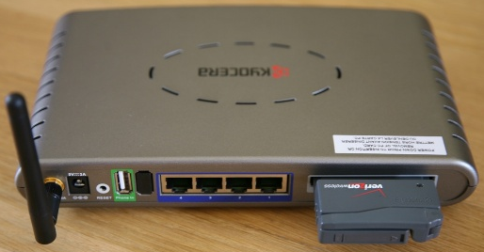
Securing Wi-Fi Connections
Service Provider’s Perspective
Setup Wi-Fi Router/ Access Point securely
  Check and assess firmware updates properly
  Hide SSID (disable network name broadcast)
    I.e. make the AP invisible to passers-by
  Enable enhanced wireless security features such as WPA2
    I.e. enable data encryption and user authentication
  Enable MAC address filtering and hardware firewall
  Check system status and log routinely
  Image source: "Scott Beale / Laughing Squid" laughingsquid.com

Slide 18

Securing Wi-Fi Connections
User’s Perspective
Only use registered and legitimate Wi-Fi services
  Create/ save profiles for trusted SSID
  Do NOT use open/ unsecured Wi-Fi AP
  Do NOT use Ad-hoc Mode (Mesh Networking)
Prefer using 802.1x or WPA2 to web portal login
Create a VPN connection on top of the Wi-Fi connection
Avoid doing confidential/ sensitive transactions
See: https://www.itsc.cuhk.edu.hk/all-it/wifi-and-network/on-campus-wifi/

Slide 19
Firewall
Windows 10 lets you quickly check your network connection status. And if you're having trouble with your connection, you can run the Network troubleshooter to try and fix it.
Select the Start button, then select Settings > Network & Internet > Status.
A firewall is to deny (or allow) certain network connections
Network connections can be in-bound or out-bound where in-bound connections are more susceptible
Example active network connections on a PC:
C:\Users\ENGG1000> netstat -a
使用中連線
協定 本機位址 外部位址 狀態
TCP 127.0.0.1:1110 PC91123:50409 ESTABLISHED
TCP 127.0.0.1:50409 PC91123:nfsd-status ESTABLISHED
TCP 127.0.0.1:51464 PC91123:nfsd-status TIME_WAIT
TCP 137.189.91.123:49166 ocean:microsoft-ds ESTABLISHED
TCP 137.189.91.123:50410 stfimap:imaps ESTABLISHED
TCP 137.189.91.123:51465 portia:8000 TIME_WAIT
UDP 137.189.91.123:138 *:*
UDP [fe80::6d3c:7d7f:b1e0:b835%11]:1900 *:*

Slide 20
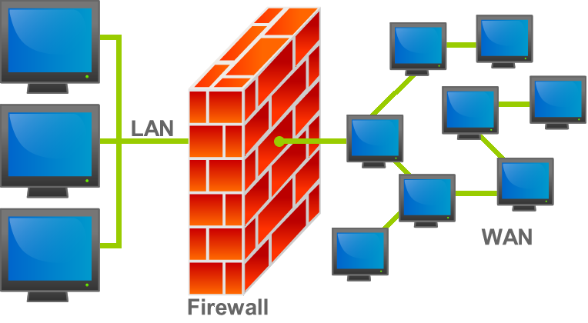
Firewall
Different types and layers:
  Institutional and Personal
  Hardware and Software
We should always turn on firewall(s)
Software firewalls on the same computer usually cause compatibility issues, e.g.
  Windows Firewall
  Kaspersky Firewall
  ONLY ONE of them should be turned on but not both!
Improperly configured firewalls may prevent some software and/ or network service from running
Image source: http://en.wikipedia.org/wiki/File:Firewall.png

Slide 21

Using Email and Messaging Services
Open Gmail.
At the top right, click Settings See all settings.
Click Filters and Blocked Addresses.
Find the filter you'd like to change.
Click Edit or Delete to remove the filter. If you’re editing the filter, click Continue when you’re done editing.
Click Update filter or OK.
Email, Private Messaging (PM), Instant Messaging (IM), SMS services and Apps-based Messaging (WhatsApp/ LINE)
Related security issues:
  Spamming: unsolicited messaging
  Phishing: message leading to fake web sites
  Cheat: ask for password or other personal privacy data
  Eavesdropping: un-encrypted messages may be overheard
  Spoofing: pretended message sender
Be smart!
  Use message filtering and sorting services
  Do NOT click on links in a message
  Verify the identity of the message sender
Image source: http://www.hksilicon.com/kb/articles/41471/IM
by Tech2IPO and《數字商業時代》

Slide 22

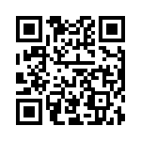
QR Codes
Attacker can easily fool users into scanning malicious QR codes
  Put a sticker over a legitimate QR code
  Distribute “fake” flyers in public places
Notes:
http://www.channelinsider.com/c/a/Security/Threat-Update-Malicious-QR-Codes-Pose-Risk-to-iPhone-Android-Devices-741543/

Slide 23
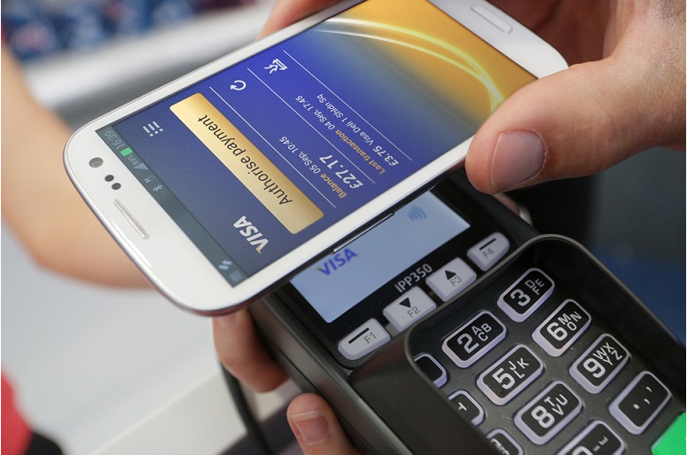
Near Field Comm.
(NFC)
Mobile Payment
on Smartphones
  Google wallet
  Visa payWave
  MasterCard PayPass
  Octopus Mobile SIM
NFC ads and promotions
Attackers could exploit NFC via:
  Eavesdropping to gain access for identity theft
  Insertion of spyware and other tracking codes
Notes:
http://www.qwiktag.com/index.php/knowledge-base/150-technology-security-risks-qr-codes
http://thefonecast.com/News/tabid/62/ArticleID/6891/ArtMID/541/

Slide 24
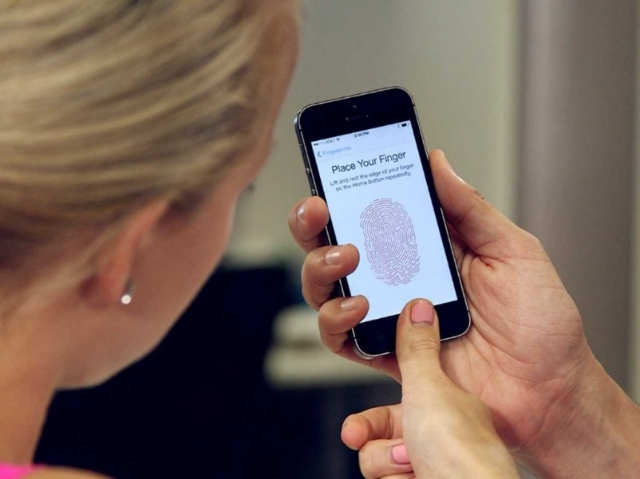
Fingerprint Sensor
Offers a false sense of “high” security
  Most consumer-level fingerprint scanners failed to differentiate a real “live” finger versus just a copy of a print
  Low-cost “high-quality” fakes are possible
Unconscious phone users (e.g. drunker ) may fall victim of unauthorized device access
Identity Theft
  Malicious Apps read user’s fingerprint and transmit to criminals
  Passwords can easily be reset, but fingerprints are for life
Notes:
https://www.flashrouters.com/blog/2013/09/27/hackers-iphone/

Slide 25
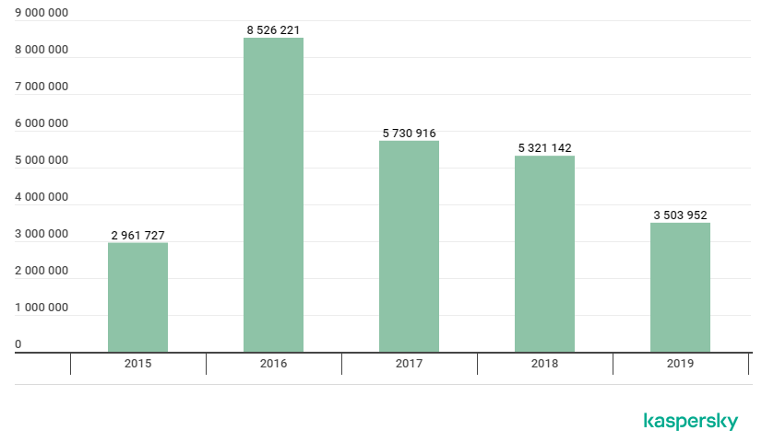
Mobile Security
Malware consists of primarily adware & Trojan
Focus mostly on system security as network (port scanning, ..etc) security is not that prevalent at this moment
Through SMS & other messaging clients, QR code etc
Mobile Malware Statistics evolution
https://securelist.com/mobile-malware-evolution-2019/96280/

Slide 26
Malware on Mobile Devices
Estimated number of Internet-connected wearables grow to 780 million by 2018
Breaking into a wearable device does not necessarily provide immediate value, real value lies in the wearable’s connection to a smartphone
Bluetooth LE (low energy) has suffered a number of very well-documented security flaws and likely will produce more with each new version
It makes the connection between wearable and smartphone easier for hackers

Slide 27
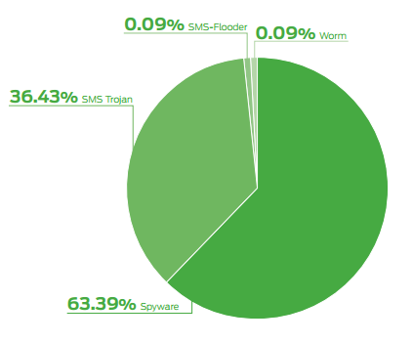
Malware on Mobile Devices
Android platform in particular is having much more malware activities
Google & Apple can remotely remove malware from user devices if the apps are being disseminated through their market place platform
This didn’t apply to 3rd party app stores
Types of malware targeting
mobile devices

Slide 28
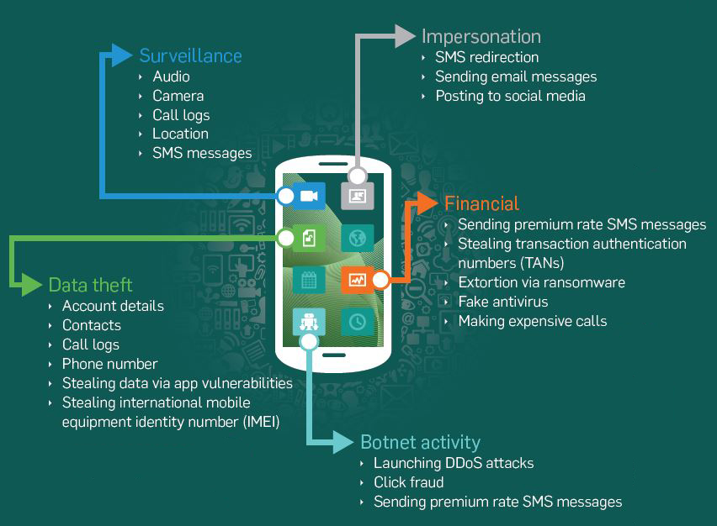
Malware on Mobile Devices
What mobile malware do

Slide 29
Android Malware
A clear link between market leadership & attention of cybercriminals
Spyware
  the dominant(63%) malware affecting Android
  Capture & transfer data e.g. browser history, password etc. on victim’s device
  Can lead to financial gain for attackers ultimately
SMS Trojans
  Second major category (36%)
  Run in background and send SMS messages to premium rate numbers owned by attacker

Slide 30
Android Malware
Infection methods
  Repackaging
  Update attack
  Drive-by Download

Slide 31
Android Malware (1. Repackaging)
Infection methods
  Repackaging
  Infecting legitimate apps
    Mod app with malicious codes aka Trojan
    Upload to Market or 3rd party hosting
  Fake apps e.g. FlappyBird clones.

Slide 32
Android Malware
Fake apps (App Phishing)
  Rogue apps can masquerade as legitimate apps you trust, e.g. Acecard, a banking trojan faking a “Black Jack” game app.
  App waits for activity (UI Element) of interest to spawn.
  Phishing app will then overlay it’s own interface, tricking the user into entering sensitive information into the phishing app.

Slide 33
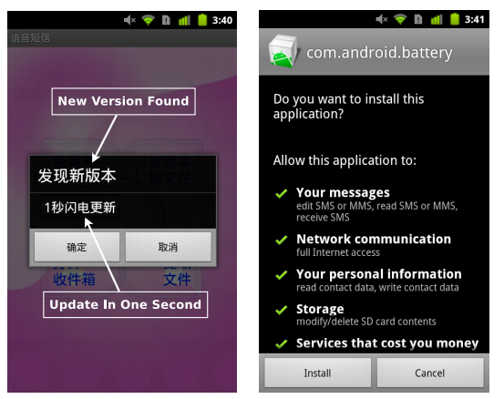
Android Malware (2. Update attack )
Infection methods
  Update attack
  Repackaging piggybacks the mal-code into host, makes it easy to detect
  Includes as an update component that fetch malicious payloads at runtime
  Static scanning of host apps fail to capture the malware

Slide 34
Android Malware (3. Drive-by Download)
Infection methods
  Drive-by Download
  Enticing users to download “interesting” or “feature rich” apps
  Remote install, require victim’s to input credential and install app into victim’s phone remotely
  Little did exploiting Android’s bug

Slide 35
Mobile Security Threats
Social engineering
  Tricking users to either paying for pirated or free apps.
  Require much less technical skill such as understanding in vulnerabilities
Fake Installers
  Exploited user ignorance
  Operate as SMS Trojans that trick users into agreeing to automatically send premium text messages to attackers
  Doing so during downloading pirated paid apps or even free apps

Slide 36
Social Engineering
art of gaining access to buildings, systems or data by exploiting human psychology, rather than by breaking in or using technical hacking techniques
On mobile platform such as smartphone & tablets:
  Malicious apps that look like legitimate apps
  Malicious mobile apps that come from ads
  Apps that claim to be for “security”

Slide 37
Browser-based Attacks
Patterns in browser-based attacks
  Mobile device visits a malicious page
  Malicious page exploit the device, enables a connection between device & attacker
  Attacker send commands to obtain data from device e.g. information available via vulnerabilities in Skype application
  (Skype) data stolen by attacker

Slide 38
Why Android attract Malware?
Great market shares
Android official app store – Google Play has little vetting mechanism to block pirated/malicious apps
  Apps only be removed when they are detected of malware
  Time window between malware upload & detected that attract attackers to upload malware
3rd party stores or even direct install from any page in Android are also allowed to provide more convenient apps install choices
  Most of them are having little or no efforts to remove malware even reported

Slide 39
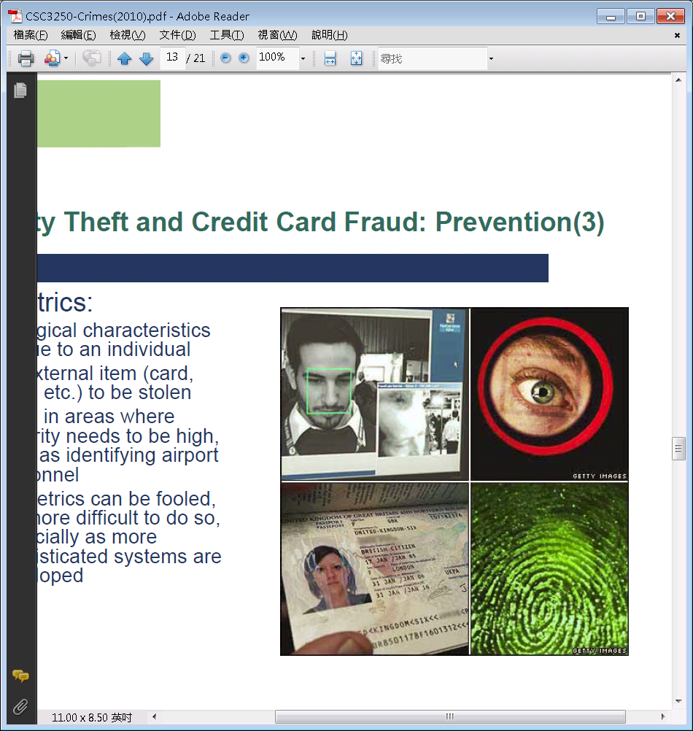
Identity Theft
Personal Identity is a special kind of Personal Data
Prior to the Digital Age, identity theft can be done through fraudulent identity documents/ proofs
In the Digital Age, identity theft can be done inevitably and the incurred loss could be enormous
18-29 year-olds are the most common victims because they use the web most and are unaware of risks

Slide 40
Protection of Personal Sensitive Data
Password management
Employ data encryption
Perform Authentication
Using mobile data storage devices safely
Using online services cautiously

Slide 41
J*fg3#7Ke199qMn
Each individual has tons of passwords and Personal Identity Numbers (PIN)
  They should be composed of as many characters as possible from a large pool of symbols (letters, digits, etc.)
  They should be unique
  They should be hard to guess
  They should be changed regularly
  They should NOT be written down
  They should be hard to remember?!
For example, a single credit card account can bear ATM PIN, phone PIN, e-banking password, Verified-by-VISA password!!!
Why?
Any good strategy?

Slide 42
Have It Your Own Way
Door Lock
CUSIS
Discuss
J*fg3#7Ke199qMn
QwertAsdf
9876543
Prepare difficult passwords which you can remember
  How to Create a Strong Password - YouTube
Be aware that web administrators and hackers *may* capture your password and try to login other services on your behalf
→ do NOT use the same password for different services
Facebook
Wi-Fi
PayPal
e-banking
PayPal
e-banking
Forum
School
School

Slide 43
Reading Assignment
[做個智Net的]網站
  www.benetwise.hk/download/parent_edu_kit.pdf
  www.benetwise.hk/tips1.php [1-4]
Web Article “Easing the PAIN – How PKI can reduce the risks...” by Stacy Cannady and Thomas Stockton
  https://www.ibm.com/developerworks/library/s-pain/

Slide 44
Further Readings
InfoSec 資訊安全網 www.infosec.gov.hk
HK Police TCD “Be a Smart Netizen – Beware of Technology Crime”
  www.police.gov.hk/ppp_en/04_crime_matters/tcd/smart.html
GovHK Information Security & Anti-Spam
  www.gov.hk/tc/residents/communication/mobilecomm/#/tc/residents/communication/infosec/

Slide 45
Appendix
Cheat Example
  Emails saying you have won a lottery
  Ask for your help to transfer a big sum of money…
  It’s just too good to be true!
[Self-study]

Slide 46
Credit Card Fraud with Money Laundry Step 1
Steal personal identity information:
  Name
  ID Number
  Date of birth
Or steal credit card credentials:
  Card Holder Name, Credit Card Number,
  CCV Code, Expiry Date
How to steal?
Victim
Credit CHAN
[Self-study]

Slide 47
Credit Card Fraud with Money Laundry Step 2
Invite bank account holder(s) by mass emailing
  “… the balance of $11,300,000 Million contract payment was in the Process of being transferred into [someone’s] Account … You can get a Commission”
  Reply and give me your bank account number!
  Responder AU-YEUNG may think that there is no loss!
Victim
Account AU-YEUNG
Have you read the assigned readings?
[Self-study]

Slide 48
Credit Card Fraud with Money Laundry Step 3
Invite domestic goods (e.g. Dell PC) buyers through
  Mass emails
  Posts on forums
  Auction sites
  AT A BARGAIN!
Ask for delivery addresses
Victim Buyer BOB
[Self-study]

Slide 49
Credit Card Fraud with Money Laundry Step 4
Criminals order the requested goods (e.g. a PC) online using
  Victim Credit CHAN’s credit card
  Victim Buyer BOB’s delivery address
The unaware online shop will ship the goods shortly
How can shops do better?
Do they have the incentive?
[Self-study]

Slide 50
Credit Card Fraud with Money Laundry Step 5
Victim Buyer BOB will receive the goods and think that the service is good and timely!
Victim Buyer BOB is asked to deposit payment into Victim Account AU-YEUNG’s bank account
[Self-study]

Slide 51
Credit Card Fraud with Money Laundry Step 6
Victim Account AU-YEUNG will see money coming in!
Victim Account AU-YEUNG will follow order to send part of the “balance of $11,300,000 Million payment” to someone off-shore
[Self-study]

Slide 52

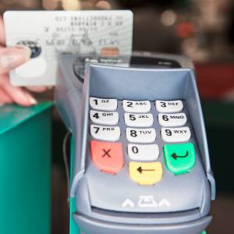
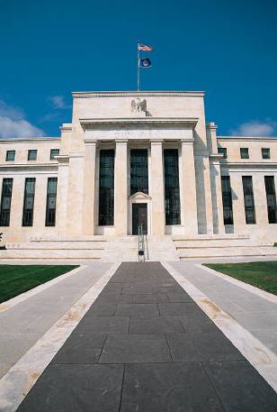

Credit Card Fraud with Money Laundry Puzzle Pieces in Place
Victim
Credit CHAN
Victim Buyer BOB
Online
Shop
Bank
Victim
Account AU-YEUNG
[Self-study]

Slide 53
Credit Card Fraud with Money Laundry Discussion
Who is liable?
  Victim Account AU-YEUNG?
  Victim Buyer BOB?
  Victim Credit CHAN?
  The invisible hand behind the scene?
Who will bear the loss?
  The online shop?
  The bank?
  The credit card issuing agent?
  Some or all of the victims?
[Self-study]

