Slide 1
Artificial Intelligence
ENGG1000

Slide 2
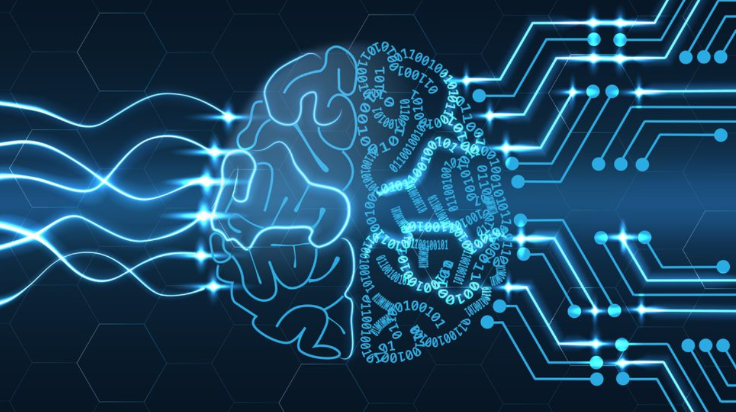
Artificial Intelligence
Intelligence demonstrated by machines
Study of “intelligent agents” : any devices perceive its environment and take actions that maximize chance of achieving its goals
https://cbk.bschool.cuhk.edu.hk/artificial-intelligence-wont-solve-everything/

Slide 3
AI
Strong & Weak AI
Weak AI – focuses on a single task and works based on programmed algorithms e.g. when we ask Siri for nearest restaurant, Siri only takes keywords “nearest” & “restaurant” and respond accordingly
Chatbot is very common nowadays

Slide 4
AI
Strong AI - form of artificial intelligence that replicate human intelligence, or cognitive functions
E.g. even young children can easily make inference like “if I roll this pen off a table, it will fall on the floor”
This is not possible for weak AI (existing)
Existing AI lacks human common-sense reasoning
Existing self-driving cars cannot reason about the location nor the intentions of pedestrians in exact way humans do, and instead must use non-human modes of reasoning to avoid accidents

Slide 5
Strong AI
Turing test - puts a machine, an interrogator, and a human in a conversational setting
If the interrogator fails to distinguish between the machine and human, the Turing test is passed
https://www.javatpoint.com/turing-test-in-ai

Slide 6
Strong AI
Even though passing Turing test, strong AI has to pass Chinese room test also
It argues that without the process of understanding, it’s impossible to determine whether a strong AI is just a glorified version of a less smart simulation
It’s getting philosophic!
https://philosophy.hku.hk/joelau/?n=Main.TheChineseRoomArgument
Notes:
The argument and thought-experiment now generally known as the Chinese Room Argument was first published in a 1980 article by American philosopher John Searle (1932– ). It has become one of the best-known arguments in recent philosophy. Searle imagines himself alone in a room following a computer program for responding to Chinese characters slipped under the door. Searle understands nothing of Chinese, and yet, by following the program for manipulating symbols and numerals just as a computer does, he sends appropriate strings of Chinese characters back out under the door, and this leads those outside to mistakenly suppose there is a Chinese speaker in the room.
The narrow conclusion of the argument is that programming a digital computer may make it appear to understand language but could not produce real understanding. Hence the “Turing Test” is inadequate. Searle argues that the thought experiment underscores the fact that computers merely use syntactic rules to manipulate symbol strings, but have no understanding of meaning or semantics. The broader conclusion of the argument is that the theory that human minds are computer-like computational or information processing systems is refuted. Instead minds must result from biological processes; computers can at best simulate these biological processes. Thus the argument has large implications for semantics, philosophy of language and mind, theories of consciousness, computer science and cognitive science generally. As a result, there have been many critical replies to the argument.

Slide 7
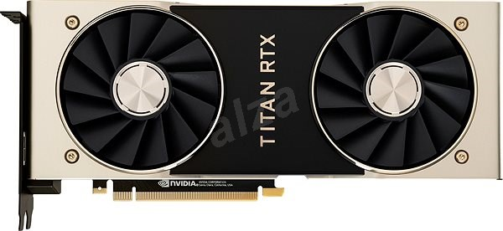
Artificial Intelligence
Further divided into
Reasoning,
knowledge representation,
planning,
learning,
natural language processing,
ability to move and manipulate objects
Recently, AI experienced a resurgence following advances in hardware, software technology
Advance of GPU (Graphics Processing Unit) is
A major pushing force behind AI

Slide 8
Reasoning
Imitating step-by-step reasoning that humans use when they solve puzzles at early times (if-then-else)
Insufficient for solving large reasoning problems because they experienced a "combinatorial explosion"
Source : Andriy Burkov.
Notes:
This is the early stage of AI during 60’s to 70’s.

Slide 9
Knowledge Representation
Central to classical AI research e.g. In 70’s "expert systems" attempted to gather explicit knowledge possessed by experts in some narrow domain
A representation of "what exists" is an ontology (存在論): the set of objects, relations, concepts, and properties formally described so that software agents can interpret them
An ontology represents knowledge as a set of concepts within a domain and the relationships between those concepts.
https://en.wikipedia.org/wiki/Artificial_intelligence

Slide 10
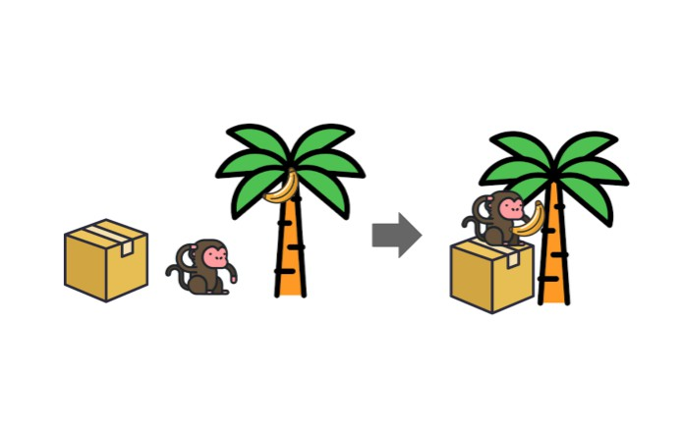
Planning
Intelligent agents need a way to visualize the future—a representation of the state of the world and be able to make predictions about how their actions will change it, e.g. a robot constructing a path to goal
Source: https://pythonawesome.com/python-framework-for-ai-planning-and-automated-programming/
Notes:
Path finding is popular in daily applications from robot navigation to AI in games controlling computer enemies moving.

Slide 11
Learning
Study of computer algorithms that improve automatically through experience
Further divided into supervised learning and unsupervised learning; the former employs human-labeled input data for learning; the latter does not
Supervised learning includes classification e.g. handwritten digit analysis, and regression e.g. develop a way to predict house price based on current data
Supervised Learning of classifying cat/dog
https://www.javatpoint.com/machine-learning-support-vector-machine-algorithm
Notes:
Deep learning is the most vibrant field in AI nowadays due to its tremendous success in recent years on vision related applications.

Slide 12
Learning
In “reinforcement learning “, agent is rewarded for good responses and punished for bad ones.
The agent uses this sequence of rewards and punishments to form a strategy for operating in its problem space
Source: https://openai.com/blog/gym-retro/
Notes:
Reinforcement learning got great success in teaching computer to play classic arcade games. They even set up their tournament platform in Openai.com Check it out for what computer can do in those games

Slide 13
Natural Language Processing (NLP)
Allows machines to read and understand human language
Applications include information retrieval, text mining, question answering (bot in online chat system), and machine translation
Poe – Fast, Helpful AI Chat
https://apps.apple.com/hk/app/poe-fast-helpful-ai-chat/id1640745955
https://www.researchgate.net/publication/323635232_Talk_to_me_Exploring_user_interactions_with_the_Amazon_Alexa/figures?lo=1

Slide 14
Perception
Ability to use input from sensors (such as cameras) to deduce aspects of the world
Applications include speech recognition, facial recognition, and object recognition
In computer game, how an NPC (non-playable character) perceive the world and plan for next action
Source : Unreal engine https://answers.unrealengine.com/questions/669642/view.html

Slide 15
Motion & Manipulation (Robotics)
Motion planning - process of breaking down a movement task into "primitives" such as individual joint movements
Modern robot when given a small, static, and visible environment, can easily determine its location and map its environment
More about the parkour
https://youtu.be/EezdinoG4mk?t=121
Boston Dynamics – a company experts in robot manufacturing https://www.bostondynamics.com/
Notes:
Can show them a clip of how Boaston Dynamics robots can do now (link embedded in image)..

Slide 16
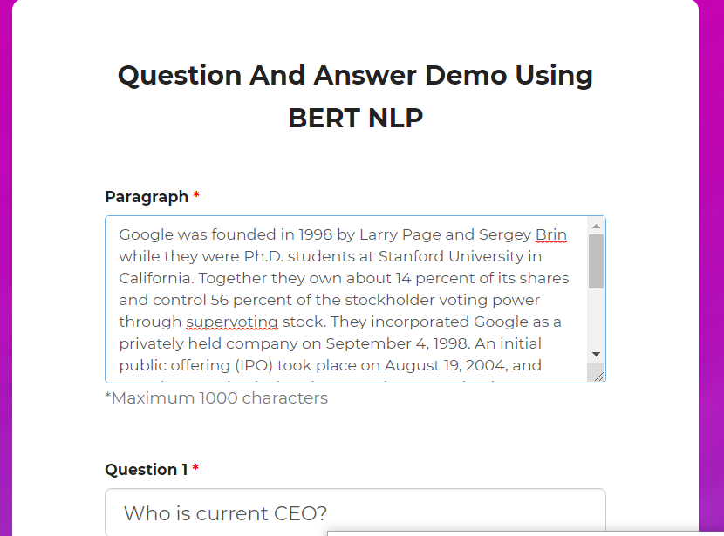
Social Intelligence
Systems which recognize, interpret, process, or simulate human affects, also called “affective computing”
Moderate success in textual sentiment analysis
English paragraph comprehension demo https://www.pragnakalp.com/demos/BERT-NLP-QnA-Demo/

Slide 17
General Intelligence
Most of mentioned AI belongs to “narrow AI” – works in individual domain, e.g. automobile navigation
Combining these into a more general intelligence is proved to be difficult
Machine translation requires that a machine read and write in both languages (NLP), follow the author's argument (reason), know what is being talked about (knowledge), and faithfully reproduce the author's original intent (social intelligence)
Thus is considered “AI-Complete", that reach human-level machine performance.

Slide 18
Artificial Intelligence
AI will have a goal, e.g. win a game of GO
AI will achieve its goal through the use of algorithms
Algorithm : a set of unambiguous instructions that a computer can execute
Google Map can provide you an algorithm from, say Central to Shatin step by step

Slide 19
AI Algorithms
(Appendix)
Earliest approach – symbolism
Also called rule-based AI
E.g. If an otherwise healthy adult has a fever, then they may have influenza
https://bdtechtalks.com/2019/11/18/what-is-symbolic-artificial-intelligence/

Slide 20
AI Algorithms
(Appendix)
More general approach – Bayesian inference
E.g. If the current patient has a fever, adjust the probability they have influenza in such-such way
https://www.analyticsvidhya.com/blog/2016/06/bayesian-statistics-beginners-simple-english/
An introduction, still very mathematical though

Slide 21
AI Algorithms
(Appendix)
Analogizers (Support Vector Machine SVM, nearest neighbor” approach )
E.g. After examining the records of known past patients whose temperature, symptoms, age, and other factors mostly match the current patient, X% of those patients turned out to have influenza
https://www.javatpoint.com/machine-learning-support-vector-machine-algorithm

Slide 22
AI Algorithms
(Appendix)
Artificial Neural Network approach e.g. uses artificial “neurons" that learn by comparing itself to the desired output and altering the strengths of connections between its internal neurons to "reinforce" connections that seemed to be useful
This approach received much attentions lately due to its success in a number of areas
An introduction
https://www.innoarchitech.com/blog/artificial-intelligence-deep-learning-neural-networks-explained

Slide 23
AI Algorithms
(Appendix)
The above approaches can overlap with each other and with evolutionary systems; for example, neural nets can learn to make inferences, to generalize, and to make analogies
Achieving artificial general intelligence (a.k.a. strong AI) through developing more powerful algorithms is still the major research direction

Slide 24
Reference
https://en.wikipedia.org/wiki/Artificial_intelligence
https://apps.apple.com/hk/app/poe-fast-helpful-ai-chat/id1640745955

