Slide 1




Big Graph Analytics Systems
Da Yan
The Chinese University of Hong Kong
The Univeristy of Alabama at Birmingham
Yingyi Bu
Couchbase, Inc.
Yuanyuan Tian
IBM Research Almaden Center
Amol Deshpande
University of Maryland
James Cheng
The Chinese University of Hong Kong

Slide 2

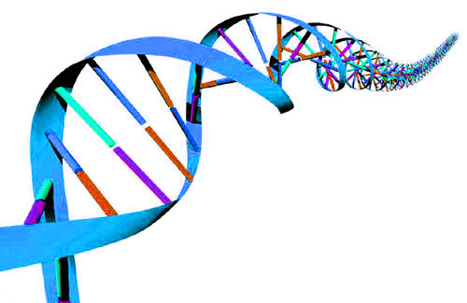

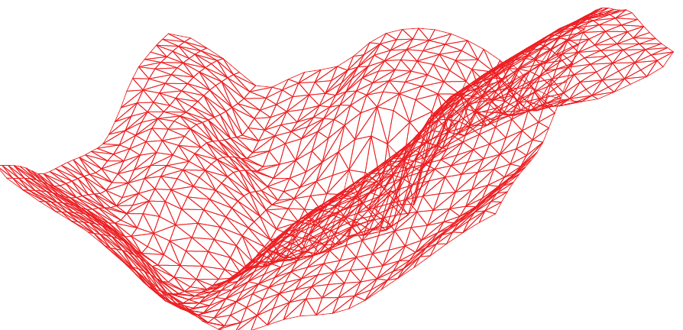
Motivations
Big Graphs Are Everywhere

Slide 3
Big Graph Systems
General-Purpose Graph Analytics
Programming Language
  Java, C/C++, Scala, Python …
  Domain-Specific Language (DSL)

Slide 4
Big Graph Systems
Programming Model
  Think Like a Vertex
    Message passing
    Shared Memory Abstraction
  Matrix Algebra
  Think Like a Graph
  Datalog

Slide 5
Big Graph Systems
Other Features
  Execution Mode: Sync or Async ?
  Environment: Single-Machine or Distributed ?
  Support for Topology Mutation
  Out-of-Core Support
  Support for Temporal Dynamics
  Data-Intensive or Computation-Intensive ?

Slide 6
Tutorial Outline
Message Passing Systems
Shared Memory Abstraction
Single-Machine Systems
Matrix-Based Systems
Temporal Graph Systems
DBMS-Based Systems
Subgraph-Based Systems
  Vertex-Centric
  Hardware-Related
  Computation-Intensive

Slide 7
Tutorial Outline
Message Passing Systems
Shared Memory Abstraction
Single-Machine Systems
Matrix-Based Systems
Temporal Graph Systems
DBMS-Based Systems
Subgraph-Based Systems

Slide 8
Message Passing Systems
Google’s Pregel [SIGMOD’10]
  Think like a vertex
  Message passing
  Iterative
    Superstep

Slide 9
Message Passing Systems
Google’s Pregel [SIGMOD’10]
  Vertex Partitioning
1
2
4
5
6
0
3
7
8
0
1 | 3
1
0 | 2 | 3
2
1 | 3 | 4 | 7
3
0 | 1 | 2 | 7
4
2 | 5 | 7
5
4 | 6
6
5 | 8
7
2 | 3 | 4 | 8
8
6 | 7
M₀
M₁
M₂

Slide 10
Message Passing Systems
Google’s Pregel [SIGMOD’10]
  Programming Interface
  u.compute(msgs)
  u.send_msg(v, msg)
  get_superstep_number()
  u.vote_to_halt()
Called inside u.compute(msgs)

Slide 11
Message Passing Systems
Google’s Pregel [SIGMOD’10]
  Vertex States
    Active / inactive
    Reactivated by messages
  Stop Condition
    All vertices halted, and
    No pending messages

Slide 12
Message Passing Systems
Google’s Pregel [SIGMOD’10]
  Hash-Min: Connected Components
3
3
1
1
7
5
0
6
8
7
5
0
6
8
2
2
4
4
Superstep 1

Slide 13
Message Passing Systems
Google’s Pregel [SIGMOD’10]
  Hash-Min: Connected Components
3
1
1
0
7
5
0
6
8
5
0
0
0
6
2
0
4
2
Superstep 2

Slide 14
Message Passing Systems
Google’s Pregel [SIGMOD’10]
  Hash-Min: Connected Components
3
0
1
0
7
5
0
6
8
0
0
0
0
0
2
0
4
0
Superstep 3

Slide 15
Message Passing Systems
Practical Pregel Algorithm (PPA) [PVLDB’14]
  First cost model for Pregel algorithm design
  PPAs for fundamental graph problems
    Breadth-first search
    List ranking
    Spanning tree
    Euler tour
    Pre/post-order traversal
    Connected components
    Bi-connected components
    Strongly connected components
    ...

Slide 16
Message Passing Systems
Practical Pregel Algorithm (PPA) [PVLDB’14]
  Linear cost per superstep
    O(|V| + |E|) message number
    O(|V| + |E|) computation time
    O(|V| + |E|) memory space
  Logarithm number of supersteps
    O(log |V|) supersteps
How about load balancing?
O(log|V|) = O(log|E|)

Slide 17
Message Passing Systems
Balanced PPA (BPPA) [PVLDB’14]
  d_{in}(v): in-degree of v
  d_{out}(v): out-degree of v
  Linear cost per superstep
    O(d_{in}(v) + d_{out}(v)) message number
    O(d_{in}(v) + d_{out}(v)) computation time
    O(d_{in}(v) + d_{out}(v)) memory space
  Logarithm number of supersteps

Slide 18
Message Passing Systems
BPPA Example: List Ranking [PVLDB’14]
  A basic operation of Euler tour technique
  Linked list where each element v has
    Value val(v)
    Predecessor pred(v)
  Element at the head has pred(v) = NULL
v₁
v₂
v₃
v₄
v₅
NULL
1
1
1
1
1
Toy Example: val(v) = 1 for all v

Slide 19
Message Passing Systems
BPPA Example: List Ranking [PVLDB’14]
  Compute sum(v) for each element v
    Summing val(v) and values of all predecessors
  Why TeraSort cannot work?
v₁
v₂
v₃
v₄
v₅
NULL
1
2
3
4
5

Slide 20
Message Passing Systems
BPPA Example: List Ranking [PVLDB’14]
  Pointer jumping / path doubling
    sum(v) ← sum(v) + sum(pred(v))
    pred(v) ← pred(pred(v))
As long as pred(v) ≠ NULL
v₁
v₂
v₃
v₄
v₅
NULL
1
1
1
1
1

Slide 21
Message Passing Systems
BPPA Example: List Ranking [PVLDB’14]
  Pointer jumping / path doubling
    sum(v) ← sum(v) + sum(pred(v))
    pred(v) ← pred(pred(v))
v₁
v₂
v₃
v₄
v₅
NULL
1
1
1
1
1
NULL
1
2
2
2
2

Slide 22
Message Passing Systems
BPPA Example: List Ranking [PVLDB’14]
  Pointer jumping / path doubling
    sum(v) ← sum(v) + sum(pred(v))
    pred(v) ← pred(pred(v))
v₁
v₂
v₃
v₄
v₅
NULL
1
1
1
1
1
NULL
1
2
2
2
2
NULL
1
2
3
4
4

Slide 23
Message Passing Systems
BPPA Example: List Ranking [PVLDB’14]
  Pointer jumping / path doubling
    sum(v) ← sum(v) + sum(pred(v))
    pred(v) ← pred(pred(v))
O(log |V|) supersteps
v₁
v₂
v₃
v₄
v₅
NULL
1
1
1
1
1
NULL
1
2
2
2
2
NULL
1
2
3
4
4
NULL
1
2
3
4
5

Slide 24
Message Passing Systems
Optimizations in
Communication Mechanism

Slide 25
Message Passing Systems
Apache Giraph
  Superstep splitting: reduce memory consumption
  Only effective when compute(.) is distributive
u₁
1
u₂
1
u₃
1
v
u₄
1
1
0
u₅
u₆
1

Slide 26
Message Passing Systems
Apache Giraph
  Superstep splitting: reduce memory consumption
  Only effective when compute(.) is distributive
u₁
u₂
u₃
6
v
u₄
0
u₅
u₆

Slide 27
Message Passing Systems
Apache Giraph
  Superstep splitting: reduce memory consumption
  Only effective when compute(.) is distributive
u₁
u₂
u₃
v
u₄
6
u₅
u₆

Slide 28
Message Passing Systems
Apache Giraph
  Superstep splitting: reduce memory consumption
  Only effective when compute(.) is distributive
u₁
1
u₂
1
u₃
1
v
u₄
0
u₅
u₆

Slide 29
Message Passing Systems
Apache Giraph
  Superstep splitting: reduce memory consumption
  Only effective when compute(.) is distributive
u₁
u₂
u₃
3
v
u₄
0
u₅
u₆

Slide 30
Message Passing Systems
Apache Giraph
  Superstep splitting: reduce memory consumption
  Only effective when compute(.) is distributive
u₁
u₂
u₃
v
u₄
3
u₅
u₆

Slide 31
Message Passing Systems
Apache Giraph
  Superstep splitting: reduce memory consumption
  Only effective when compute(.) is distributive
u₁
u₂
u₃
v
u₄
1
1
3
u₅
u₆
1

Slide 32
Message Passing Systems
Apache Giraph
  Superstep splitting: reduce memory consumption
  Only effective when compute(.) is distributive
u₁
u₂
u₃
3
v
u₄
3
u₅
u₆

Slide 33
Message Passing Systems
Apache Giraph
  Superstep splitting: reduce memory consumption
  Only effective when compute(.) is distributive
u₁
u₂
u₃
v
u₄
6
u₅
u₆

Slide 34
Message Passing Systems
Pregel+ [WWW’15]
  Vertex Mirroring
  Request-Respond Paradigm

Slide 35
Message Passing Systems
Pregel+ [WWW’15]
  Vertex Mirroring
v₁
u₁
w₁
v₂
u₂
w₂
…
…
…
…
…
v_{j}
u_{i}
w_{k}
…
…
…
M₂
M₁
M₃

Slide 36
Message Passing Systems
Pregel+ [WWW’15]
  Vertex Mirroring
v₁
u₁
w₁
v₂
u₂
w₂
u_{i}
u_{i}
…
…
…
…
…
v_{j}
u_{i}
w_{k}
…
…
…
M₂
M₁
M₃

Slide 37
Message Passing Systems
Pregel+ [WWW’15]
  Vertex Mirroring: Create mirror for u₄?
u₁
v₁
v₂
v₁
u₂
v₁
v₂
v₂
u₃
v₁
v₂
v₃
u₄
v₁
v₂
v₃
v₄
v₄
…
…
M₁
M₂

Slide 38
Message Passing Systems
Pregel+ [WWW’15]
  Vertex Mirroring v.s. Message Combining
u₁
v₁
v₂
u₁
v₁
u₂
v₁
v₂
u₂
v₂
a(u₁) + a(u₂)
+ a(u₃) + a(u₄)
u₃
v₁
v₂
u₃
v₃
u₄
v₁
v₂
v₃
v₄
u₄
v₄
…
…
…
M₁
M₁
M₂

Slide 39
Message Passing Systems
Pregel+ [WWW’15]
  Vertex Mirroring v.s. Message Combining
u₁
v₁
v₂
u₁
v₁
a(u₁) + a(u₂) + a(u₃)
u₂
v₁
v₂
u₂
v₂
u₃
v₁
v₂
u₃
v₃
a(u₄)
u₄
v₁
v₂
v₃
v₄
u₄
u₄
v₄
…
…
…
M₁
M₁
M₂

Slide 40
Message Passing Systems
Pregel+ [WWW’15]
  Vertex Mirroring: Only mirror high-degree vertices
  Choice of degree threshold τ
    M machines, n vertices, m edges
    Average degree: deg_{avg} = m / n
    Optimal τ is M · exp{deg_{avg} / M}

Slide 41
Message Passing Systems
Pregel+ [WWW’15]
  Request-Respond Paradigm
v₁
<v₁>
v₂
<v₂>
u
<v₃>
v₃
<v₄>
a(u)
v₄
M₁
M₂

Slide 42
Message Passing Systems
Pregel+ [WWW’15]
  Request-Respond Paradigm
v₁
a(u)
v₂
a(u)
u
a(u)
v₃
a(u)
v₄
a(u)
M₁
M₂

Slide 43
Message Passing Systems
Pregel+ [WWW’15]
  A vertex v can request attribute a(u) in superstep i
  a(u) will be available in superstep (i + 1)

Slide 44
Message Passing Systems
Pregel+ [WWW’15]
  A vertex v can request attribute a(u) in superstep I
  a(u) will be available in superstep (i + 1)
v₁
v₂
request u
u | D[u]
u
v₃
v₄
D[u]
M₁
M₂

Slide 45
Message Passing Systems
Load Balancing

Slide 46
Message Passing Systems
Vertex Migration
  WindCatch [ICDE’13]
    Runtime improved by 31.5% for PageRank (best)
    2% for shortest path computation
    9% for maximal matching
  Stanford’s GPS [SSDBM’13]
  Mizan [EuroSys’13]
    Hash-based and METIS partitioning: no improvement
    Range-based partitioning: around 40% improvement

Slide 47
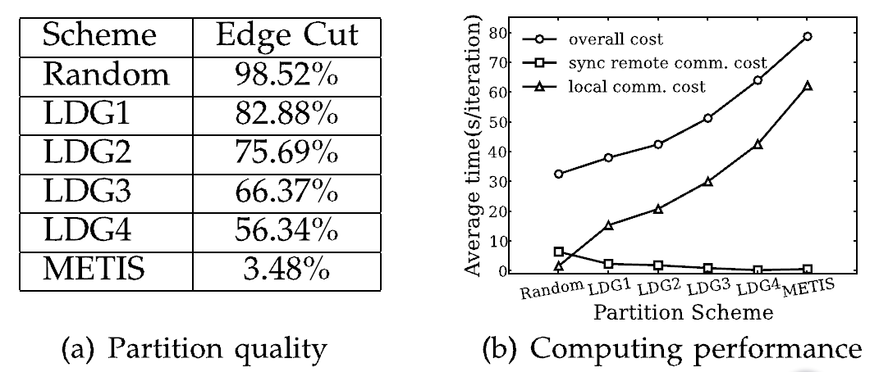
Message Passing Systems
Dynamic Concurrency Control
  PAGE [TKDE’15]
    Better partitioning → slower ?

Slide 48
Message Passing Systems
Dynamic Concurrency Control
  PAGE [TKDE’15]
    Message generation
    Local message processing
    Remote message processing

Slide 49
Message Passing Systems
Dynamic Concurrency Control
  PAGE [TKDE’15]
    Monitors speeds of the 3 operations
    Dynamically adjusts number of threads for the 3 operations
    Criteria
      Speed of message processing = speed of incoming messages
      Thread numbers for local & remote message processing are proportional to speed of local & remote message processing

Slide 50

Message Passing Systems
Out-of-Core Support
java.lang.OutOfMemoryError: Java heap space
26 cases reported by Giraph-users mailing list during 08/2013~08/2014!

Slide 51

Message Passing Systems
Pregelix [PVLDB’15]
  Transparent out-of-core support
  Physical flexibility (Environment)
  Software simplicity (Implementation)
Hyracks
Dataflow Engine

Slide 52
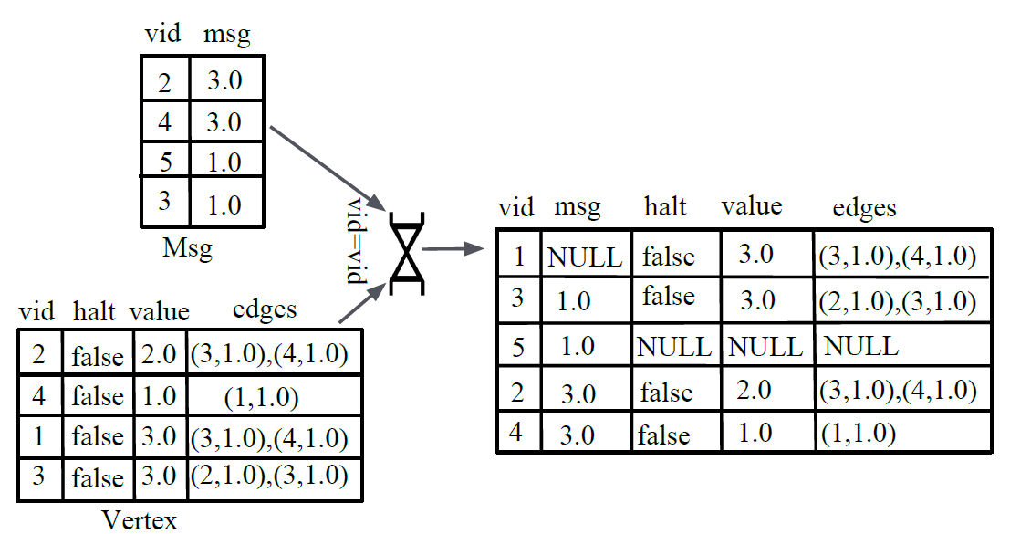
Message Passing Systems
Pregelix [PVLDB’15]

Slide 53
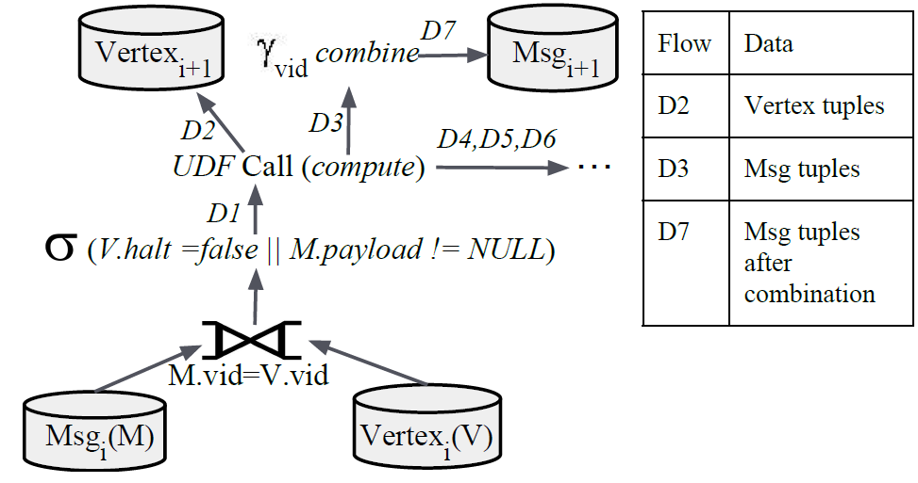
Message Passing Systems
Pregelix [PVLDB’15]

Slide 54
Message Passing Systems
GraphD
  Hardware for small startups and average researchers
    Desktop PCs
    Gigabit Ethernet switch
  Features of a common cluster
    Limited memory space
    Disk streaming bandwidth >> network bandwidth
  Each worker stores and streams edges and messages on local disks
  Cost of buffering msgs on disks hidden inside msg transmission

Slide 55
Message Passing Systems
Fault Tolerance

Slide 56
Message Passing Systems
Coordinated Checkpointing of Pregel
  Every δ supersteps
  Recovery from machine failure:
    Standby machine
    Repartitioning among survivors
An illustration with δ = 5

Slide 57
Message Passing Systems
Vertex states, edge changes, shuffled messages
Coordinated Checkpointing of Pregel
Superstep
…
…
…
4
W₁
W₂
W₃
5
W₁
W₂
W₃
Write checkpoint to HDFS
6
W₁
W₂
W₃
7
W₁
W₂
W₃
Failure occurs

Slide 58
Message Passing Systems
Coordinated Checkpointing of Pregel
Superstep
…
…
…
4
W₁
W₂
W₃
5
W₁
W₂
W₃
Load checkpoint from HDFS
6
W₁
W₂
W₃
7
W₁
W₂
W₃

Slide 59
Message Passing Systems
Chandy-Lamport Snapshot [TOCS’85]
  Uncoordinated checkpointing (e.g., for async exec)
  For message-passing systems
  FIFO channels
u
v
5
5
u : 5

Slide 60
Message Passing Systems
Chandy-Lamport Snapshot [TOCS’85]
  Uncoordinated checkpointing (e.g., for async exec)
  For message-passing systems
  FIFO channels
4
u
v
4
5
u : 5

Slide 61
Message Passing Systems
Chandy-Lamport Snapshot [TOCS’85]
  Uncoordinated checkpointing (e.g., for async exec)
  For message-passing systems
  FIFO channels
u
v
4
4
u : 5

Slide 62

Message Passing Systems
Chandy-Lamport Snapshot [TOCS’85]
  Uncoordinated checkpointing (e.g., for async exec)
  For message-passing systems
  FIFO channels
u
v
4
4
u : 5
v : 4

Slide 63
Message Passing Systems
Chandy-Lamport Snapshot [TOCS’85]
  Solution: bcast checkpoint request right after checkpointed
REQ
u
v
5
5
u : 5
v : 5

Slide 64
Message Passing Systems
Recovery by Message-Logging [PVLDB’14]
  Each worker logs its msgs to local disks
    Negligible overhead, cost hidden
  Survivor
    No re-computaton during recovery
    Forward logged msgs to replacing workers
  Replacing worker
    Re-compute from latest checkpoint
    Only send msgs to replacing workers

Slide 65
Message Passing Systems
Recovery by Message-Logging [PVLDB’14]
Superstep
…
…
…
4
W₁
W₂
W₃
5
W₁
W₂
W₃
Log msgs
Log msgs
Log msgs
6
W₁
W₂
W₃
Log msgs
Log msgs
Log msgs
7
W₁
W₂
W₃
Failure occurs

Slide 66
Message Passing Systems
Recovery by Message-Logging [PVLDB’14]
Superstep
…
…
…
4
W₁
W₂
W₃
Standby Machine
5
W₁
W₂
W₃
Load checkpoint
6
W₁
W₂
W₃
7
W₁
W₂
W₃

Slide 67
Message Passing Systems
Block-Centric Computation Model

Slide 68
Message Passing Systems
Block-Centric Computation
  Main Idea
    A block refers to a connected subgraph
    Messages exchange among blocks
    Serial in-memory algorithm within a block

Slide 69
Message Passing Systems
Block-Centric Computation
  Motivation: graph characteristics adverse to Pregel
    Large graph diameter
    High average vertex degree

Slide 70
Message Passing Systems
Block-Centric Computation
  Benefits
    Less communication workload
    Less number of supersteps
    Less number of computing units

Slide 71
Message Passing Systems
Giraph++ [PVLDB’13]
  Pioneering: think like a graph
  METIS-style vertex partitioning
  Partition.compute(.)
  Boundary vertex values sync-ed at superstep barrier
  Internal vertex values can be updated anytime

Slide 72
Message Passing Systems
Blogel [PVLDB’14]
  API: vertex.compute(.) + block.compute(.)
  A block can have its own fields
  A block/vertex can send msgs to another block/vertex
  Example: Hash-Min
    Construct block-level graph: to compute an adjacency list for each block
    Propagate min block ID among blocks

Slide 73
Message Passing Systems
Blogel [PVLDB’14]
  Performance on Friendster social network with 65.6 M vertices and 3.6 B edges

Slide 74
Message Passing Systems
Blogel [PVLDB’14]
  Web graph: URL-based partitioning
  Spatial networks: 2D partitioning
  General graphs: graph Voronoi diagram partitioning

Slide 75
Message Passing Systems
Blogel [PVLDB’14]
  Graph Voronoi Diagram (GVD) partitioning
Three seeds
v is 2 hops from red seed
v is 3 hops from green seed
v is 5 hops from blue seed
v

Slide 76
Message Passing Systems
Blogel [PVLDB’14]
  Sample seed vertices with probability p

Slide 77
Message Passing Systems
Blogel [PVLDB’14]
  Sample seed vertices with probability p

Slide 78
Message Passing Systems
Blogel [PVLDB’14]
  Sample seed vertices with probability p
  Compute GVD grouping
    Vertex-centric multi-source BFS

Slide 79
Message Passing Systems
Blogel [PVLDB’14]
State after Seed Sampling

Slide 80
Message Passing Systems
Blogel [PVLDB’14]
Superstep 1

Slide 81
Message Passing Systems
Blogel [PVLDB’14]
Superstep 2

Slide 82
Message Passing Systems
Blogel [PVLDB’14]
Superstep 3

Slide 83
Message Passing Systems
Blogel [PVLDB’14]
  Sample seed vertices with probability p
  Compute GVD grouping
  Postprocessing

Slide 84
Message Passing Systems
Blogel [PVLDB’14]
  Sample seed vertices with probability p
  Compute GVD grouping
  Postprocessing
    For very large blocks, resample with a larger p and repeat

Slide 85
Message Passing Systems
Blogel [PVLDB’14]
  Sample seed vertices with probability p
  Compute GVD grouping
  Postprocessing
    For very large blocks, resample with a larger p and repeat
    For tiny components, find them using Hash-Min at last

Slide 86
Message Passing Systems
GVD Partitioning Performance

Slide 87
Message Passing Systems
Asynchronous Computation Model

Slide 88
Message Passing Systems
Maiter [TPDS’14]
  For algos where vertex values converge asymmetrically
  Delta-based accumulative iterative computation (DAIC)
v₂
v₃
v₄
v₁

Slide 89
Message Passing Systems
Maiter [TPDS’14]
  For algos where vertex values converge asymmetrically
  Delta-based accumulative iterative computation (DAIC)
  Strict transformation from Pregel API to DAIC formulation
  Delta may serve as priority score
  Natural for block-centric frameworks

Slide 90
Message Passing Systems
Vertex-Centric Query Processing

Slide 91
Message Passing Systems
Quegel [PVLDB’16]
  On-demand answering of light-workload graph queries
    Only a portion of the whole graph gets accessed
  Option 1: to process queries one job after another
    Network underutilization, too many barriers
    High startup overhead (e.g., graph loading)

Slide 92
Message Passing Systems
Quegel [PVLDB’16]
  On-demand answering of light-workload graph queries
    Only a portion of the whole graph gets accessed
  Option 2: to process a batch of queries in one job
    Programming complexity
    Straggler problem

Slide 93
Message Passing Systems
Quegel [PVLDB’16]
  Execution model: superstep-sharing
    Each iteration is called a super-round
    In a super-round, every query proceeds by one superstep
_{Super–Round #}
1
2
3
4
5
6
7
q₁
1
2
3
4
q₂
1
2
3
4
q₃
1
2
3
4
q₄
1
2
3
4
_{Time}
_{Queries}
q₁
q₂
q₃
q₄

Slide 94
Message Passing Systems
Quegel [PVLDB’16]
  Benefits
    Messages of multiple queries transmitted in one batch
    One synchronization barrier for each super-round
    Better load balancing
time
sync
sync
sync
Worker 1
Worker 2
Individual Synchronization
Superstep-Sharing

Slide 95
Message Passing Systems
Quegel [PVLDB’16]
  API is similar to Pregel
  The system does more:
    Q-data: superstep number, control information, …
    V-data: adjacency list, vertex/edge labels
    VQ-data: vertex state in the evaluation of each query

Slide 96
Message Passing Systems
Quegel [PVLDB’16]
  Create a VQ-data of v for q, only when q touches v
  Garbage collection of Q-data and VQ-data
  Distributed indexing

Slide 97
Tutorial Outline
Message Passing Systems
Shared Memory Abstraction
Single-Machine Systems
Matrix-Based Systems
Temporal Graph Systems
DBMS-Based Systems
Subgraph-Based Systems

Slide 98
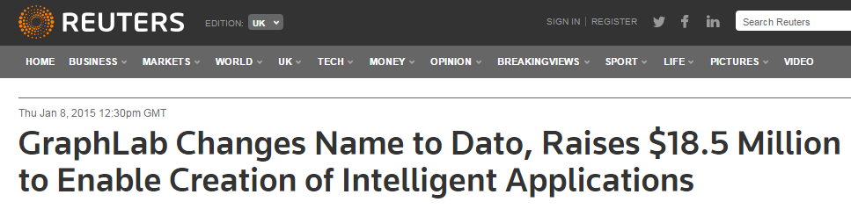


Shared-Mem Abstraction
Single Machine
(UAI 2010)
Distributed GraphLab
(PVLDB 2012)
PowerGraph
(OSDI 2012)

Slide 99
Shared-Mem Abstraction
Distributed GraphLab [PVLDB’12]
  Scope of vertex v
All that v can access
… …
… …
D_{(u,v)}
D_{(v,w)}
u
v
w
D_{u}
D_{v}
D_{w}
… …
… …

Slide 100
Shared-Mem Abstraction
Distributed GraphLab [PVLDB’12]
  Async exec mode: for asymmetric convergence
    Scheduler, serializability
  API:v.update()
    Access & update data in v’s scope
    Add neighbors to scheduler

Slide 101
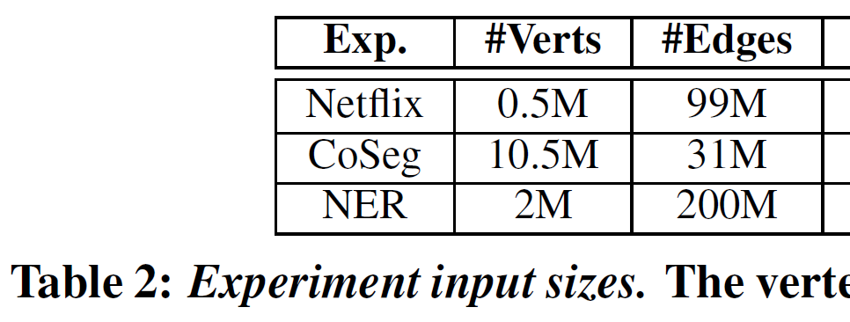
Shared-Mem Abstraction
Distributed GraphLab [PVLDB’12]
  Vertices partitioned among machines
  For edge (u, v), scopes of u and v overlap
    D_{u}, D_{v} and D_{(u, v)}
    Replicated if u and v are on different machines
  Ghosts: overlapped boundary data
    Value-sync by a versioning system
  Memory space problem
    x {# of machines}

Slide 102
Shared-Mem Abstraction
PowerGraph [OSDI’12]
  API: Gather-Apply-Scatter (GAS)
    PageRank: out-degree = 2 for all in-neighbors
1
1
0
1
1
1
1
1

Slide 103
Shared-Mem Abstraction
PowerGraph [OSDI’12]
  API: Gather-Apply-Scatter (GAS)
    PageRank: out-degree = 2 for all in-neighbors
1
1
1/2
0
1
1/2
1
1
1/2
1
1

Slide 104
Shared-Mem Abstraction
PowerGraph [OSDI’12]
  API: Gather-Apply-Scatter (GAS)
    PageRank: out-degree = 2 for all in-neighbors
1
1
1.5
1
1
1
1
1

Slide 105
Shared-Mem Abstraction
PowerGraph [OSDI’12]
  API: Gather-Apply-Scatter (GAS)
    PageRank: out-degree = 2 for all in-neighbors
1
1
0
1
1.5
1
Δ = 0.5 > ϵ
1
1

Slide 106
Shared-Mem Abstraction
PowerGraph [OSDI’12]
  API: Gather-Apply-Scatter (GAS)
    PageRank: out-degree = 2 for all in-neighbors
1
1
activated
0
1
1.5
1
activated
1
1
activated

Slide 107
Shared-Mem Abstraction
PowerGraph [OSDI’12]
  Edge Partitioning
  Goals:
    Loading balancing
    Minimize vertex replicas
      Cost of value sync
      Cost of memory space

Slide 108
Shared-Mem Abstraction
PowerGraph [OSDI’12]
  Greedy Edge Placement
u
v
W₁
W₂
W₃
W₄
W₅
W₆
Workload
100
101
102
103
104
105

Slide 109
Shared-Mem Abstraction
PowerGraph [OSDI’12]
  Greedy Edge Placement
u
v
W₁
W₂
W₃
W₄
W₅
W₆
Workload
100
101
102
103
104
105

Slide 110
Shared-Mem Abstraction
PowerGraph [OSDI’12]
  Greedy Edge Placement
u
v
∅
∅
W₁
W₂
W₃
W₄
W₅
W₆
Workload
100
101
102
103
104
105

Slide 111
Shared-Mem Abstraction
Single-Machine Out-of-Core Systems

Slide 112
Shared-Mem Abstraction
Shared-Mem + Single-Machine
  Out-of-core execution, disk/SSD-based
    GraphChi [OSDI’12]
    X-Stream [SOSP’13]
    VENUS [ICDE’14]
    …
  Vertices are numbered 1, …, n; cut into P intervals
1
v₁
v₂
n
interval(1)
interval(2)
interval(P)

Slide 113
Shared-Mem Abstraction
GraphChi [OSDI’12]
  Programming Model
    Edge scope of v
… …
… …
D_{(u,v)}
D_{(v,w)}
u
v
w
D_{u}
D_{v}
D_{w}
… …
… …

Slide 114
Shared-Mem Abstraction
GraphChi [OSDI’12]
  Programming Model
    Scatter & gather values along adjacent edges
… …
… …
D_{(u,v)}
D_{(v,w)}
u
v
w
D_{v}
… …
… …

Slide 115
Shared-Mem Abstraction
GraphChi [OSDI’12]
  Load vertices of each interval, along with adjacent edges for in-mem processing
  Write updated vertex/edge values back to disk
  Challenges
    Sequential IO
    Consistency: store each edge value only once on disk
1
v₁
v₂
n
interval(1)
interval(2)
interval(P)

Slide 116
Shared-Mem Abstraction
GraphChi [OSDI’12]
  Disk shards: shard(i)
    Vertices in interval(i)
    Their incoming edges, sorted by source_ID
shard(1)
shard(2)
shard(P)
1
v₁
v₂
n
interval(1)
interval(2)
interval(P)

Slide 117
Shared-Mem Abstraction
GraphChi [OSDI’12]
  Parallel Sliding Windows (PSW)
Vertices
1..100
Vertices
101..200
Vertices
201..300
Vertices
301..400
Shard 1
Shard 2
Shard 3
Shard 4
Shard 1
in-edges sorted by src_id

Slide 118
Shared-Mem Abstraction
GraphChi [OSDI’12]
  Parallel Sliding Windows (PSW)
Out-Edges
Vertices
1..100
Vertices
101..200
Vertices
201..300
Vertices
301..400
1
1
1
1
Shard 1
Shard 2
Shard 3
Shard 4
Shard 1
100
100
100
100
in-edges sorted by src_id
Vertices & In-Edges

Slide 119
Shared-Mem Abstraction
GraphChi [OSDI’12]
  Parallel Sliding Windows (PSW)
Out-Edges
Vertices
1..100
Vertices
101..200
Vertices
201..300
Vertices
301..400
1
1
1
1
Shard 1
Shard 2
Shard 3
Shard 4
Shard 1
100
100
100
100
200
in-edges sorted by src_id
200
200
200
Vertices & In-Edges

Slide 120
Shared-Mem Abstraction
GraphChi [OSDI’12]
  Each vertex & edge value is read & written for at least once in an iteration

Slide 121
Shared-Mem Abstraction
X-Stream [SOSP’13]
  Edge-scope GAS programming model
  Streams a completely unordered list of edges

Slide 122
Shared-Mem Abstraction
X-Stream [SOSP’13]
  Simple case: all vertex states are memory-resident
  Pass 1: edge-centric scattering
    (u, v): value(u) => <v, value(u, v)>
  Pass 2: edge-centric gathering
    <v, value(u, v)> => value(v)
update
aggregate

Slide 123
Shared-Mem Abstraction
Streamed on disk
Fit into memory
Larger than in GraphChi
X-Stream [SOSP’13]
  Out-of-Core Engine
    P vertex partitions with vertex states only
    P edge partitions, partitioned by source vertices
    Each pass loads a vertex partition, streams corresponding edge partition (or update partition)
P update files generated by Pass 1 scattering
1
v₁
v₂
n
interval(1)
interval(2)
interval(P)

Slide 124
Shared-Mem Abstraction
X-Stream [SOSP’13]
  Out-of-Core Engine
    Pass 1: edge-centric scattering
      (u, v): value(u) => [v, value(u, v)]
    Pass 2: edge-centric scattering
      [v, value(u, v)] => value(v)
Append to update file
for partition of v
Streamed from update file
for the corresponding vertex partition
1
v₁
v₂
n
interval(1)
interval(2)
interval(P)

Slide 125
Shared-Mem Abstraction
X-Stream [SOSP’13]
  Scale out: Chaos [SOSP’15]
    Requires 40 GigE
    Slow with GigE
  Weakness: sparse computation

Slide 126
Shared-Mem Abstraction
VENUS [ICDE’14]
  Programming model
    Value scope of v
… …
… …
D_{(u,v)}
D_{(v,w)}
u
v
w
D_{u}
D_{v}
D_{w}
… …
… …

Slide 127
Shared-Mem Abstraction
VENUS [ICDE’14]
  Assume static topology
    Separate read-only edge data and mutable vertex states
  g-shard(i): incoming edge lists of vertices in interval(i)
  v-shard(i): srcs & dsts of edges in g-shard(i)
  All g-shards are concatenated for streaming
Vertices in a v-shard are ordered by ID
Sources may not be in interval(i)
1
v₁
v₂
n
interval(1)
interval(2)
interval(P)

Slide 128
Shared-Mem Abstraction
VENUS [ICDE’14]
  To process interval(i)
    Load v-shard(i)
    Stream g-shard(i), update in-memory v-shard(i)
    Update every other v-shard by a sequential write
Dst vertices are in interval(i)
Dsts of interval(i) may be srcs of other intervals
1
v₁
v₂
n
interval(1)
interval(2)
interval(P)

Slide 129
Shared-Mem Abstraction
VENUS [ICDE’14]
  Avoid writing O(|E|) edge values to disk
  O(|E|) edge values are read once
  O(|V|) may be read/written for multiple times
1
v₁
v₂
n
interval(1)
interval(2)
interval(P)

Slide 130
Tutorial Outline
Message Passing Systems
Shared Memory Abstraction
Single-Machine Systems
Matrix-Based Systems
Temporal Graph Systems
DBMS-Based Systems
Subgraph-Based Systems

Slide 131
Single-Machine Systems
Categories
  Shared-mem out-of-core (GraphChi, X-Stream, VENUS)
  Matrix-based (to be discussed later)
  SSD-based
  In-mem multi-core
  GPU-based

Slide 132
Single-Machine Systems
SSD-Based Systems

Slide 133
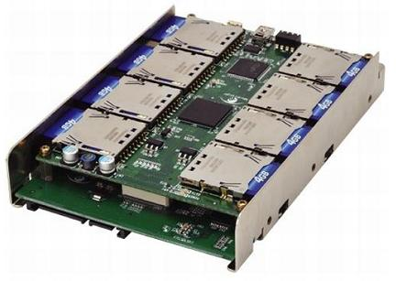
Single-Machine Systems
SSD-Based Systems
  Async random IO
    Many flash chips, each with multiple dies
  Callback function
  Pipelined for high throughput

Slide 134
Single-Machine Systems
TurboGraph [KDD’13]
  Vertices ordered by ID, stored in pages

Slide 135
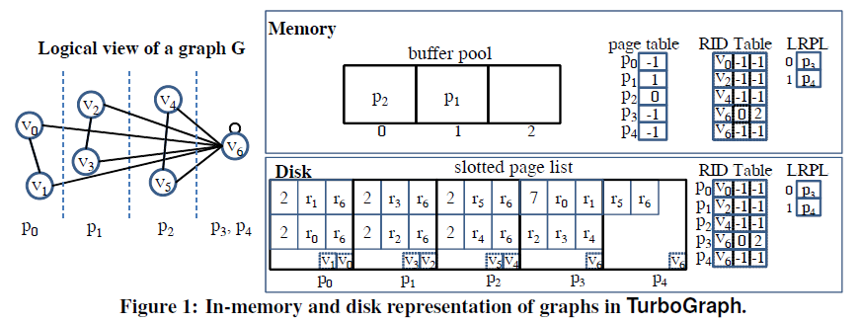
Single-Machine Systems
TurboGraph [KDD’13]

Slide 136
Single-Machine Systems
TurboGraph [KDD’13]
Read order for positions in a page

Slide 137
Single-Machine Systems
TurboGraph [KDD’13]
Record for v₆: in Page p₃, Position 1

Slide 138
Single-Machine Systems
In-mem page table: vertex ID -> location on SSD
TurboGraph [KDD’13]
1-hop neighborhood: outperform GraphChi by 10⁴

Slide 139
Single-Machine Systems
TurboGraph [KDD’13]
Special treatment for adj-list larger than a page

Slide 140
Single-Machine Systems
TurboGraph [KDD’13]
  Pin-and-slide execution model
  Concurrently process vertices of pinned pages
  Do not wait for completion of IO requests
  Page unpinned as soon as processed

Slide 141
Single-Machine Systems
FlashGraph [FAST’15]
  Semi-external memory
    Edge lists on SSDs
  On top of SAFS, an SSD file system
    High-throughput async I/Os over SSD array
    Edge lists stored in one (logical) file on SSD

Slide 142
Single-Machine Systems
FlashGraph [FAST’15]
  Only access requested edge lists
  Merge same-page / adjacent-page requests into one sequential access
  Vertex-centric API
  Message passing among threads

Slide 143
Single-Machine Systems
In-Memory Multi-Core Frameworks

Slide 144
Single-Machine Systems
In-Memory Parallel Frameworks
  Programming simplicity
    Green-Marl, Ligra, GRACE
  Full utilization of all cores in a machine
    GRACE, Galois

Slide 145
Single-Machine Systems
Green-Marl [ASPLOS’12]
  Domain-specific language (DSL)
    High-level language constructs
    Expose data-level parallelism
  DSL → C++ program
  Initially single-machine, now supported by GPS

Slide 146
Single-Machine Systems
Green-Marl [ASPLOS’12]
  Parallel For
  Parallel BFS
  Reductions (e.g., SUM, MIN, AND)
  Deferred assignment (<=)
    Effective only at the end of the binding iteration

Slide 147
Single-Machine Systems
Ligra [PPoPP’13]
  VertexSet-centric API: edgeMap, vertexMap
  Example: BFS
    U_{i+1}←edgeMap(U_{i}, F, C)
Vertices for next iteration
v
u
U_{i}

Slide 148
Single-Machine Systems
Ligra [PPoPP’13]
  VertexSet-centric API: edgeMap, vertexMap
  Example: BFS
    U_{i+1}←edgeMap(U_{i}, F, C)
C(v) = parent[v] is NULL?
v
Yes
u
U_{i}

Slide 149
Single-Machine Systems
Ligra [PPoPP’13]
  VertexSet-centric API: edgeMap, vertexMap
  Example: BFS
    U_{i+1}←edgeMap(U_{i}, F, C)
v
F(u, v):
parent[v] ← u
v added to U_{i+1}
u
U_{i}

Slide 150
Single-Machine Systems
Ligra [PPoPP’13]
  Mode switch based on vertex sparseness |U_{i}|
    When | U_{i} | is large
v
C(w) called 3 times
u
w
U_{i}

Slide 151
Single-Machine Systems
Ligra [PPoPP’13]
  Mode switch based on vertex sparseness |U_{i}|
    When | U_{i} | is large
Early pruning: just the first one for BFS
if C(v) is true
Call F(u, v) for every in-neighbor in U
v
u
w
U_{i}

Slide 152
Single-Machine Systems
GRACE [PVLDB’13]
  Vertex-centric API, block-centric execution
    Inner-block computation: vertex-centric computation with an inner-block scheduler
  Reduce data access to computation ratio
    Many vertex-centric algos are computationally-light
    CPU cache locality: every block fits in cache

Slide 153
Single-Machine Systems
Galois [SOSP’13]
  Amorphous data-parallelism (ADP)
    Speculative execution: fully use extra CPU resources
u
w
v
u’s neighborhood
v’s neighborhood

Slide 154
Single-Machine Systems
Galois [SOSP’13]
  Amorphous data-parallelism (ADP)
    Speculative execution: fully use extra CPU resources
Rollback
u
w
v
u’s neighborhood
v’s neighborhood

Slide 155
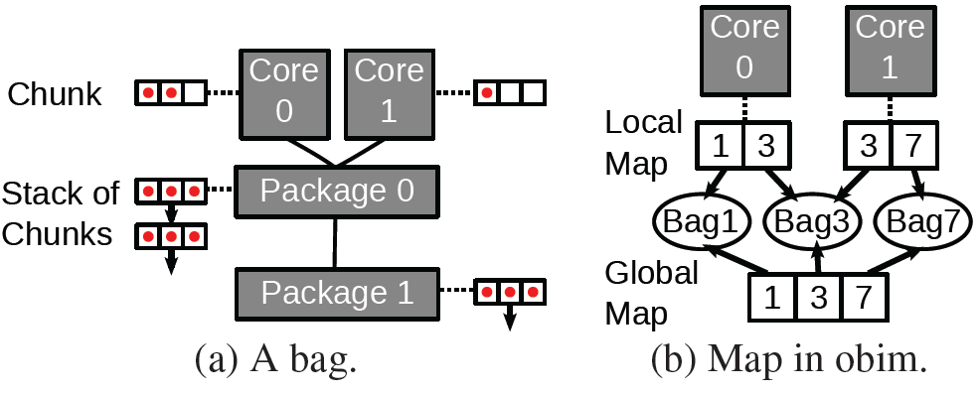
Single-Machine Systems
Galois [SOSP’13]
  Amorphous data-parallelism (ADP)
    Speculative execution: fully use extra CPU resources
  Machine-topology-aware scheduler
    Try to fetch tasks local to the current core first

Slide 156
Single-Machine Systems
GPU-Based Systems

Slide 157
Single-Machine Systems
GPU Architecture
  Array of streaming multiprocessors (SMs)
  Single instruction, multiple threads (SIMT)
  Different control flows
    Execute all flows
    Masking
  Memory cache hierarchy
Small path divergence
Coalesced memory accesses

Slide 158
Single-Machine Systems
GPU Architecture
  Warp: 32 threads, basic unit for scheduling
  SM: 48 warps
    Two streaming processors (SPs)
    Warp scheduler: two warps executed at a time
  Thread block / CTA (cooperative thread array)
    6 warps
    Kernel call → grid of CTAs
    CTAs are distributed to SMs with available resources

Slide 159
Single-Machine Systems
Medusa [TPDS’14]
  BPS model of Pregel
  Fine-grained API: Edge-Message-Vertex (EMV)
    Large parallelism, small path divergence
  Pre-allocates an array for buffering messages
    Coalesced memory accesses: incoming msgs for each vertex is consecutive
    Write positions of msgs do not conflict

Slide 160
Single-Machine Systems
Window write-back: imbalanced workload
CuSha [HPDC’14]
  Apply the shard organization of GraphChi
  Each shard processed by one CTA
  Window concatenation
Vertices
1..100
Vertices
101..200
Vertices
201..300
Vertices
301..400
1
1
1
1
Shard 1
Shard 2
Shard 3
Shard 4
Shard 1
100
100
100
100
200
in-edges sorted by src_id
200
200
200

Slide 161
Single-Machine Systems
Window write-back: imbalanced workload
CuSha [HPDC’14]
  Apply the shard organization of GraphChi
  Each shard processed by one CTA
  Window concatenation
Threads in a CTA may cross window boundaries
Pointers to actual locations in shards

Slide 162
Tutorial Outline
Message Passing Systems
Shared Memory Abstraction
Single-Machine Systems
Matrix-Based Systems
Temporal Graph Systems
DBMS-Based Systems
Subgraph-Based Systems

Slide 163
Matrix-Based Systems
Categories
  Single-machine systems
    Vertex-centric API
    Matrix operations in the backend
  Distributed frameworks
    (Generalized) matrix-vector multiplication
    Matrix algebra

Slide 164
Matrix-Based Systems
Matrix-Vector Multiplication
  Example: PageRank
Out-AdjacencyList(v₁)
Out-AdjacencyList(v₂)
Out-AdjacencyList(v₃)
Out-AdjacencyList(v₄)
PR^{i}(v₁)
PR^{i}(v₂)
PR^{i}(v₃)
PR^{i}(v₄)
Pr^{i+1}(v₁)
PR^{i+1} (v₂)
PR^{i+1} (v₃)
PR^{i+1} (v₄)
×
=

Slide 165
Matrix-Based Systems
Generalized Matrix-Vector Multiplication
  Example: HashMin
Add → Min
0/1-AdjacencyList(v₁)
0/1-AdjacencyList(v₂)
0/1-AdjacencyList(v₃)
0/1-AdjacencyList(v₄)
min^{i}(v₁)
min^{i}(v₂)
min^{i}(v₃)
min^{i}(v₄)
min^{i+1}(v₁)
min^{i+1} (v₂)
min^{i+1} (v₃)
min^{i+1} (v₄)
×
=
Assign only when smaller

Slide 166
Matrix-Based Systems
Single-Machine Systems
with Vertex-Centric API

Slide 167
Matrix-Based Systems
GraphTwist [PVLDB’15]
  Multi-level graph partitioning
    Right granularity for in-memory processing
    Balance workloads among computing threads
dst
n
w(u, v)
v
edge-weight
1
src
1
u
n

Slide 168
Matrix-Based Systems
GraphTwist [PVLDB’15]
  Multi-level graph partitioning
    Right granularity for in-memory processing
    Balance workloads among computing threads
dst
n
slice
edge-weight
1
src
1
n

Slide 169
Matrix-Based Systems
GraphTwist [PVLDB’15]
  Multi-level graph partitioning
    Right granularity for in-memory processing
    Balance workloads among computing threads
dst
n
edge-weight
stripe
1
src
1
n

Slide 170
Matrix-Based Systems
GraphTwist [PVLDB’15]
  Multi-level graph partitioning
    Right granularity for in-memory processing
    Balance workloads among computing threads
dst
n
dice
edge-weight
1
src
1
n

Slide 171
Matrix-Based Systems
GraphTwist [PVLDB’15]
  Multi-level graph partitioning
    Right granularity for in-memory processing
    Balance workloads among computing threads
dst
n
vertex cut
edge-weight
1
src
1
u
n

Slide 172
Matrix-Based Systems
GraphTwist [PVLDB’15]
  Multi-level graph partitioning
    Right granularity for in-memory processing
    Balance workloads among computing threads
  Fast Randomized Approximation
    Prune statistically insignificant vertices/edges
    E.g., PageRank computation only using high-weight edges
    Unbiased estimator: sampling slices/cuts according to Frobenius norm

Slide 173
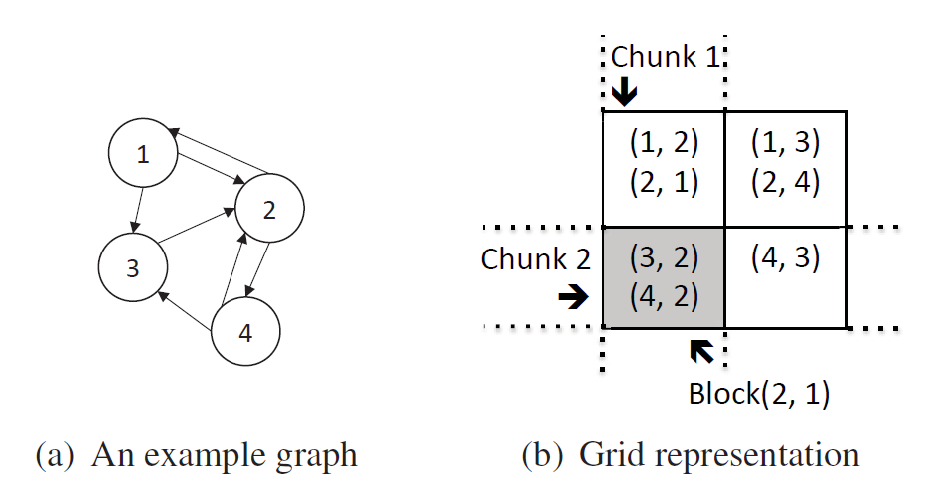
Matrix-Based Systems
GridGraph [ATC’15]
  Grid representation for reducing IO

Slide 174
Matrix-Based Systems
GridGraph [ATC’15]
  Grid representation for reducing IO
  Streaming-apply API
    Streaming edges of a block (I_{i}, I_{j})
    Aggregate value to v ∈ I_{j}

Slide 175
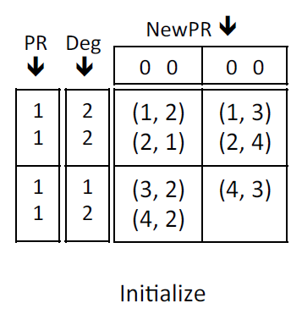
Matrix-Based Systems
GridGraph [ATC’15]
  Illustration: column-by-column evaluation

Slide 176
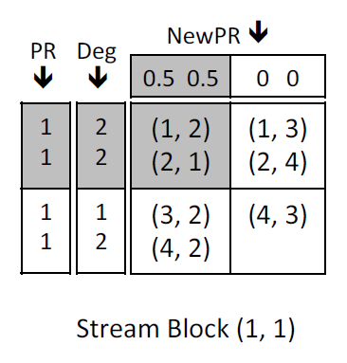
Matrix-Based Systems
GridGraph [ATC’15]
  Illustration: column-by-column evaluation
Create in-mem
Load

Slide 177
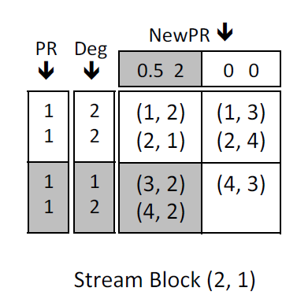
Matrix-Based Systems
GridGraph [ATC’15]
  Illustration: column-by-column evaluation
Load

Slide 178
Matrix-Based Systems
GridGraph [ATC’15]
  Illustration: column-by-column evaluation
Save

Slide 179
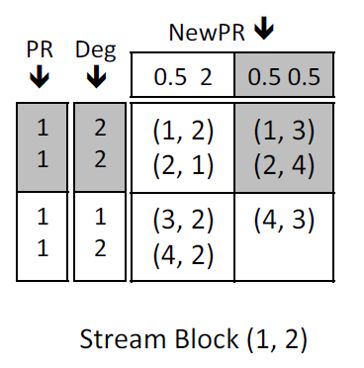
Matrix-Based Systems
GridGraph [ATC’15]
  Illustration: column-by-column evaluation
Create in-mem
Load

Slide 180
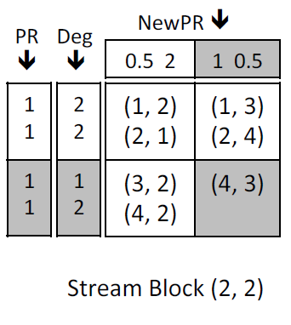
Matrix-Based Systems
GridGraph [ATC’15]
  Illustration: column-by-column evaluation
Load

Slide 181
Matrix-Based Systems
GridGraph [ATC’15]
  Illustration: column-by-column evaluation
Save

Slide 182
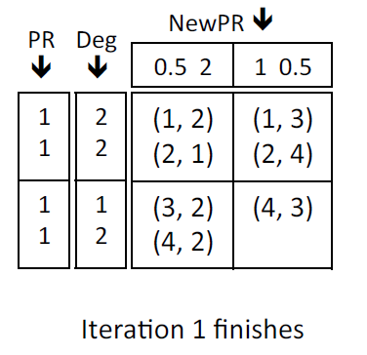
Matrix-Based Systems
GridGraph [ATC’15]
  Illustration: column-by-column evaluation

Slide 183
Matrix-Based Systems
GridGraph [ATC’15]
  Read O(P|V|) data of vertex chunks
  Write O(|V|) data of vertex chunks (not O(|E|)!)
  Stream O(|E|) data of edge blocks
    Edge blocks are appended into one large file for streaming
    Block boundaries recorded to trigger the pin/unpin of a vertex chunk

Slide 184
Matrix-Based Systems
Distributed Frameworks with Matrix Algebra

Slide 185
Distributed Systems with Matrix-Based Interfaces
PEGASUS (CMU, 2009)
GBase (CMU & IBM, 2011)
SystemML (IBM, 2011)
Commonality:
Matrix-based programming interface to the users
Rely on MapReduce for execution.

Slide 186
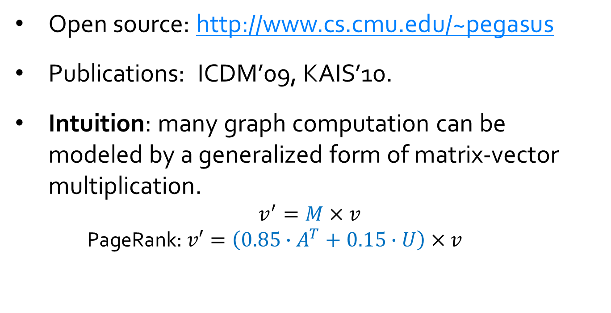
PEGASUS
Open source: http://www.cs.cmu.edu/~pegasus
Publications: ICDM’09,KAIS’10.
Intuition: many graph computation can be modeled by a generalized form of matrix-vector multiplication.
$$v^{′}=M×v$$
  PageRank: $v′=\left(0.85∙A^{T}+0.15∙U\right)×v$

Slide 187
PEGASUS Programming Interface: GIM-V
Three Primitives:
1) combine2(m_{i,j} , v_{j} ) : combine m_{i,j} and v_{j} into x_{i,j}
2) combineAll_{i} (x_{i,1} , ..., x_{i,n} ) : combine all the results from combine2() for node i into v_{i} '
3) assign(v_{i} , v_{i} ' ) : decide how to update v_{i} with v_{i} '
Iterative: Operation applied till algorithm-specific convergence
criterion is met.

Slide 188
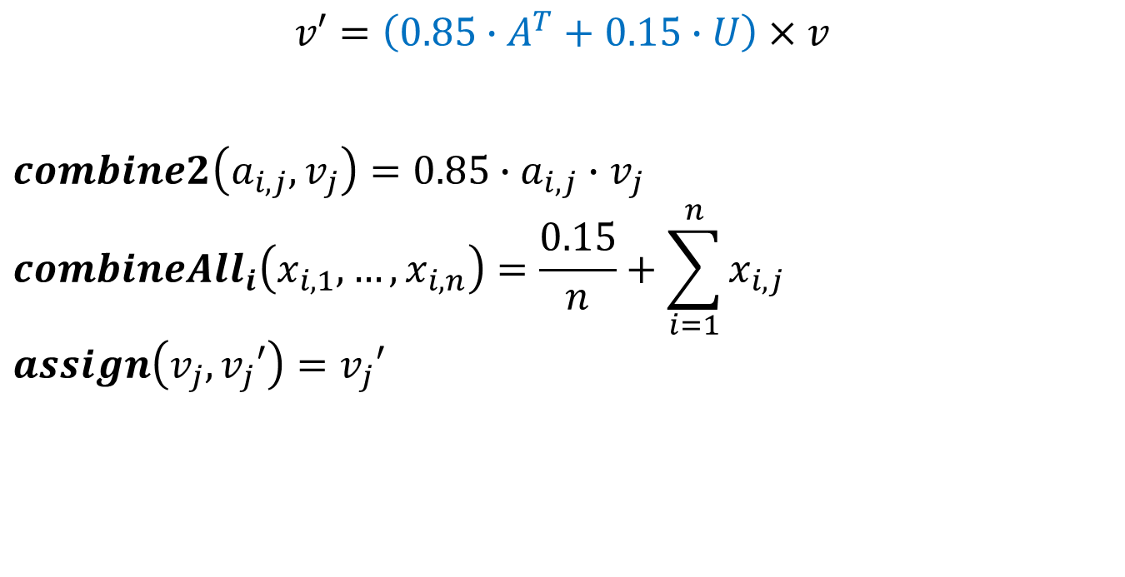
PageRank Example
$$v′=\left(0.85∙A^{T}+0.15∙U\right)×v$$
$$combine2\left(a_{i,j},v_{j}\right)=0.85∙a_{i,j}∙v_{j}$$
$${combineAll}_{i}\left(x_{i,1},…,x_{i,n}\right)=\frac{0.15}{n}+\sum_{i=1}^{n}{x_{i,j}}$$
$$assign\left(v_{j},v_{j}′\right)=v_{j}′$$

Slide 189
Execution Model
Iterations of a 2-stage algorithm (each stage is a MR job)
Input: Edge and Vector file
  Edge line : (id_{src} , id_{dst} , mval) -> cell adjacency Matrix M
  Vector line: (id, vval) -> element in Vector V
Stage 1: performs combine2() on columns of id_{dst} of M with rows of id of V
Stage 2: combines all partial results and assigns new vector -> old vector

Slide 190
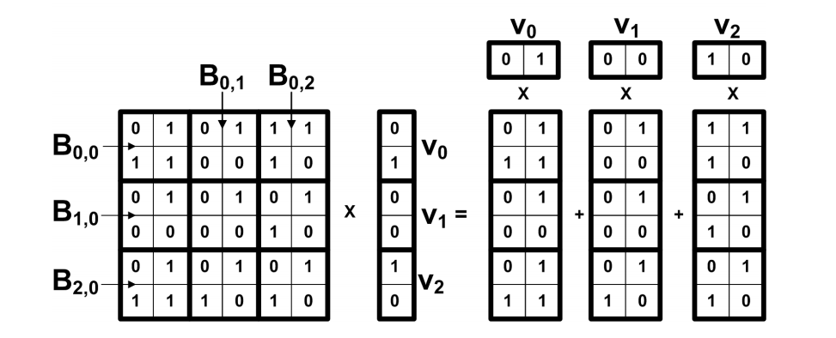
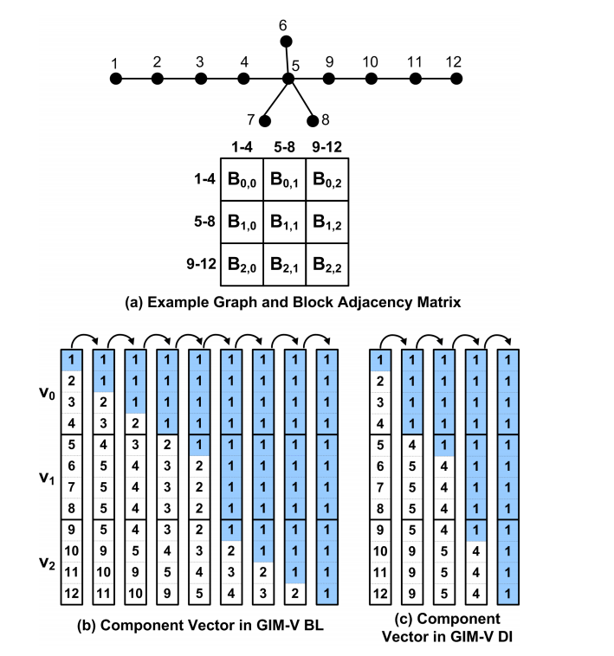
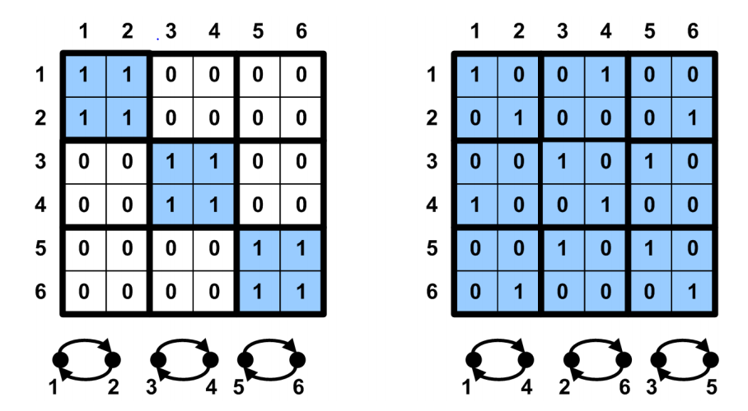
Optimizations
Block Multiplication
Clustered Edges
Diagonal Block Iteration for connected component detection
* Figures are copied from Kang et al ICDM’09

Slide 191
GBASE
Part of the IBM System G Toolkit
  http://systemg.research.ibm.com
Publications: SIGKDD’11, VLDBJ’12.
PEGASUS vs GBASE:
  Common:
    Matrix-vector multiplication as the core operation
    Division of a matrix into blocks
    Clustering nodes to form homogenous blocks
  Different:
 | PEGASUS | GBASE
Queries | global | targeted & global
User Interface | customizable APIs | build-in algorithms
Storage | normal files | compression, special placement
Block Size | Square blocks | Rectangular blocks

Slide 192
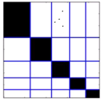
Block Compression and Placement
Block Formation
  Partition nodes using clustering algorithms e.g. Metis
Compressed block encoding
  source and destination partition ID p and q;
  the set of sources and the set of destinations
  the payload, the bit string of subgraph G(p,q)
    The payload is compressed using zip compression or gap Elias-γ encoding.
Block Placement
  Grid placement to minimize the number of input HDFS files to answer queries
* Figure is copied from Kang et al SIGKDD’11

Slide 193
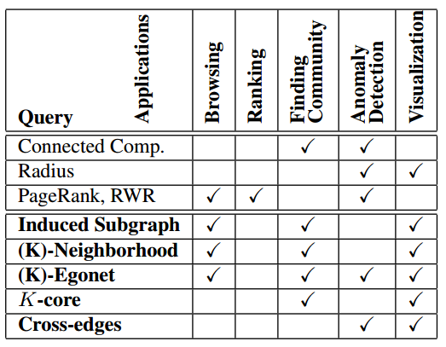
Built-In Algorithms in GBASE
Select grids containing the blocks relevant to the queries
Derive the incidence matrix from the original adjacency matrix as required
* Figure is copied from Kang et al SIGKDD’11

Slide 194
SystemML
Apache Open source: https://systemml.apache.org
Publications: ICDE’11, ICDE’12, VLDB’14, Data Engineering Bulletin’14, ICDE’15, SIGMOD’15, PPOPP’15, VLDB16.
Comparison to PEGASUS and GBASE
  Core: General linear algebra and math operations (beyond just matrix-vector multiplication)
    Designed for machine learning in general
  User Interface: A high-level language with similar syntax as R
  Declarative approach to graph processing with cost-based and rule-based optimization
  Run on multiple platforms including MapReduce, Spark and single node.

Slide 195
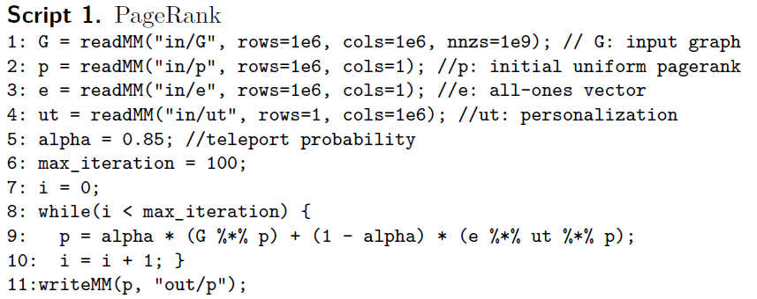
SystemML – Declarative Machine Learning
Analytics language for data scientists
(“The SQL for analytics”)
  Algorithms expressed in a declarative,
  high-level language with R-like syntax
  Productivity of data scientists
  Language embeddings for
    Solutions development
    Tools
Compiler
  Cost-based optimizer to generate
  execution plans and to parallelize
    based on data characteristics
    based on cluster and machine characteristics
  Physical operators for in-memory single node and cluster execution
Performance & Scalability

Slide 196
SystemML Architecture Overview
APIs
Command
Line
JMLC
Spark
MLContext
Spark
ML
Language (DML)
R- like syntax
Rich set of statistical functions
User-defined & external function
Parsing
  Statement blocks & statements
  Program Analysis, type inference, dead code elimination
High-Level Operator (HOP) Component
Represent dataflow in DAGs of operations on matrices, scalars
Choosing from alternative execution plans based on memory and cost estimates: operator ordering & selection; hybrid plans
Low-Level Operator (LOP) Component
Low-level physical execution plan (LOPDags) over key-value pairs
“Piggybacking” operations into minimal number Map-Reduce jobs
Runtime
Hybrid Runtime
  CP: single machine operations & orchestrate MR jobs
  MR: generic Map-Reduce jobs & operations
  SP: Spark Jobs
Numerically stable operators
Dense / sparse matrix representation
Multi-Level buffer pool (caching) to evict in-memory objects
Dynamic Recompilation for initial unknowns
Compiler
Parser/Language
Cost-based optimizations
High-Level Operators
Low-Level Operators
Runtime
Control Program
ParFor Optimizer/
Runtime
Recompiler
Runtime
Program
CP
Inst
Spark
Inst
MR
Inst
Buffer Pool
Generic
MR Jobs
Mem/FS IO
DFS IO
MatrixBlock Library
(single/multi-threaded)

Slide 197
Pros and Cons of Matrix-Based Graph Systems
Pros:
Intuitive for analytic users familiar with linear algebra
  E.g. SystemML provides a high-level language familiar to a lot of analysts
Cons:
PEGASUS and GBASE require an expensive clustering of nodes as a preprocessing step.
Not all graph algorithms can be expressed using linear algebra
Unnecessary computation compared to vertex-centric model

Slide 198
Tutorial Outline
Message Passing Systems
Shared Memory Abstraction
Single-Machine Systems
Matrix-Based Systems
Temporal Graph Systems
DBMS-Based Systems
Subgraph-Based Systems

Slide 199
Temporal and Streaming Graph Analytics
Motivation: Real world graphs often evolve over time.
Two body of work:
  Real-time analysis on streaming graph data
    E.g. Calculate each vertex’s current PageRank
  Temporal analysis over historical traces of graphs
    E.g. Analyzing the change of each vertex’s PageRank for a given time range

Slide 200
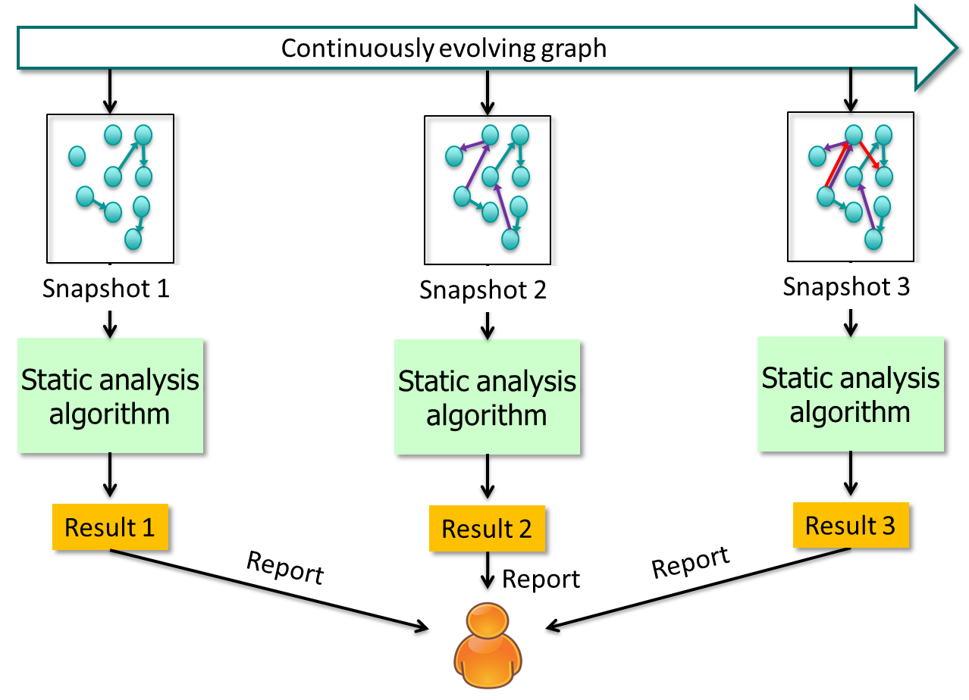
Common Features for All Systems
Temporal Graph: a continuous stream of graph updates
  Graph update: addition or deletion of vertex/edge, or the update of the attribute associated with node/edge.
Most systems separate graph updates from graph computation.
  Graph computation is only performed on a sequence of successive static views of the temporal graph
    A graph snapshot is most commonly used static view
  Using existing static graph programming APIs for temporal graph
Incremental graph computation
  Leverage significant overlap of successive static views
  Use ending vertex and edge states at time t as the starting states at time t+1
    Not applicable to all algorithms
Static view 1
Static view 2
Static view 3
Incremental update
Incremental update

Slide 201
Overview
Real-time Streaming Graph Systems
  Kineograph (distributed, Microsoft, 2012)
  TIDE (distributed, IBM, 2015)
Historical Graph Systems
  Chronos (distributed, Microsoft, 2014)
  DeltaGraph (distributed, University of Maryland, 2013)
  LLAMM (single-node, Harvard University & Oracle, 2015)

Slide 202
Kineograph
Publication: Cheng et al Eurosys’12
Target query: continuously deliver analytics results on static snapshots of a dynamic graph periodically
Two layers:
  Storage layer: continuously applies updates to a dynamic graph
  Computation layer: performs graph computation on a graph snapshot

Slide 203
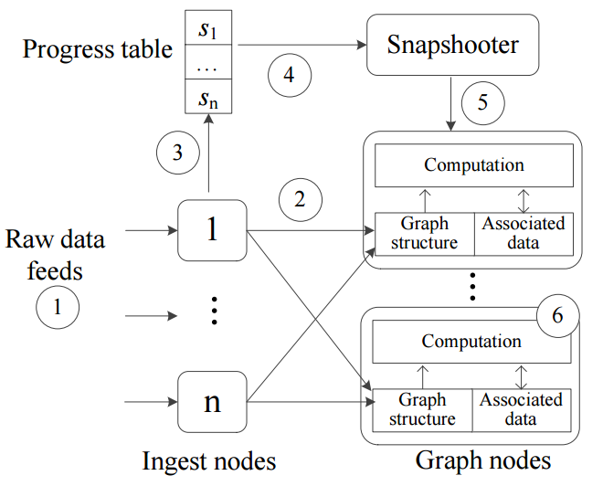
Kineograph Architecture Overview
Graph is stored in a key/value store among graph nodes
Ingest nodes are the front end of incoming graph updates
Snapshooter uses an epoch commit protocol to produce snapshots
Progress table keeps track of the process by ingest nodes
* Figure is copied from Cheng et al Eurosys’12

Slide 204
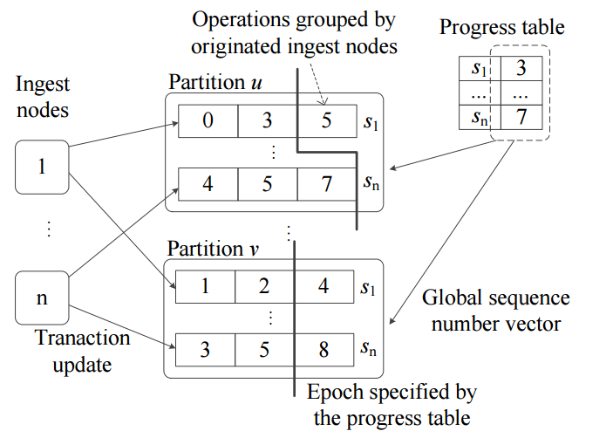
Epoch Commit Protocol
* Figure is copied from Cheng et al Eurosys’12

Slide 205
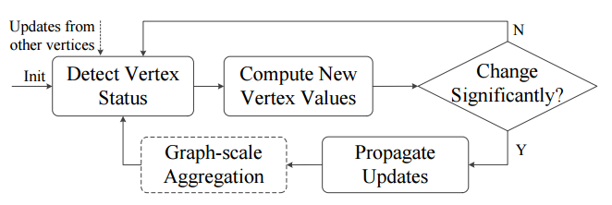
Graph Computation
Apply Vertex-based GAS computation model on snapshots of a dynamic graph
  Supports both push and pull models for inter-vertex communication.
* Figure is copied from Cheng et al Eurosys’12

Slide 206
TIDE
Publication: Xie et al ICDE’15
Target query: continuously deliver analytics results on a dynamic graph
Model social interactions as a dynamic interaction graph
  New interactions (edges) continuously added
Probabilistic edge decay (PED) model to produce static views of dynamic graphs

Slide 207
Static Views of Temporal Graph
Snapshot Model
Consider all graph data seen so far
Problem: Does not emphasize recent data (no recency)
Sliding Window Model
Consider recent graph data within a small time window
Problem: Abruptly forgets past data (no continuity)
E.g., relationship
between a and b
is forgotten
a
a
b
b

Slide 208
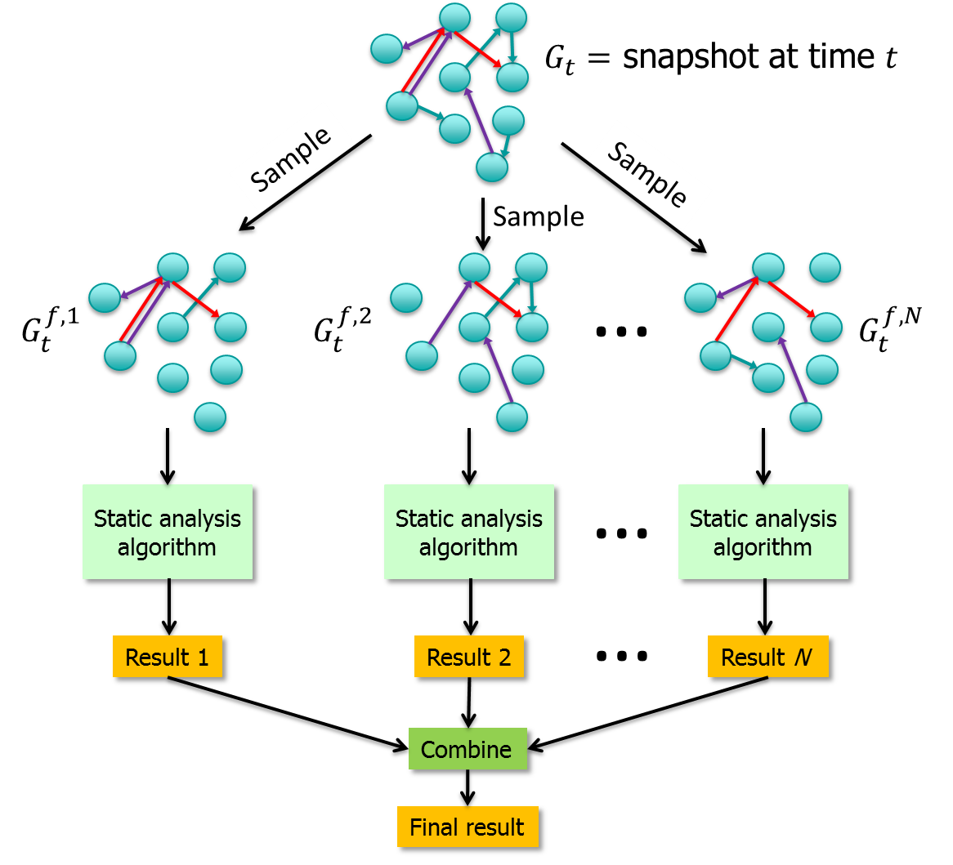
Probabilistic Edge Decay Model
Key Idea: Temporally Biased Sampling
Sample data items according to a probability that decreases over time
Sample contains a relatively high proportion of recent interactions
Probabilistic View of an Edge’s Role
All edges have chance to be considered (continuity)
Outdated edges are less likely to be used (recency)
Can systematically trade off recency and continuity
Can use existing static-graph algorithms
Create N sample graphs
Discretized Time + Exponential Decay
Typically reduces Monte Carlo
variability

Slide 209

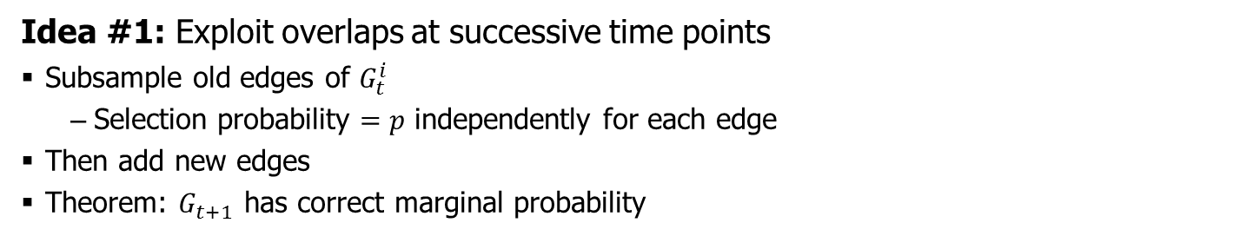

Maintaining Sample Graphs in TIDE
Naïve Approach: Whenever a new batch of data comes in
Generate N sampled graphs
Run graph algorithm on each sample
Idea #1: Exploit overlaps at successive time points
Subsample old edges of $G_{t}^{i}$
  Selection probability $=p$ independently for each edge
Then add new edges
Theorem: $G_{t+1}$ has correct marginal probability
$$G_{t}^{i}$$
$$G_{t+1}^{i}$$

Slide 210


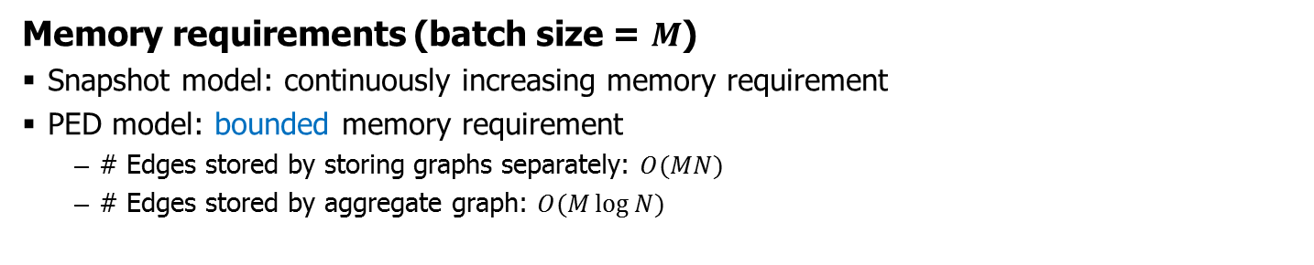


Maintaining Sample Graphs, Continued
Idea #2: Exploit overlap between sample graphs at each time point
With high probability, more than 50% of edges overlap
So maintain aggregate graph
1,2,3
1,2
2,3
1,3
$$G_{t}^{1}$$
$$G_{t}^{2}$$
$$G_{t}^{3}$$
$${\tilde{G}}_{t}$$
Memory requirements (batch size = $M$)
Snapshot model: continuously increasing memory requirement
PED model: bounded memory requirement
  # Edges stored by storing graphs separately: $O(MN)$
  # Edges stored by aggregate graph: $O(M\log{N)}$

Slide 211
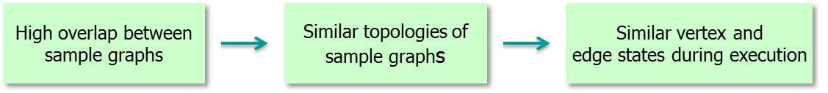
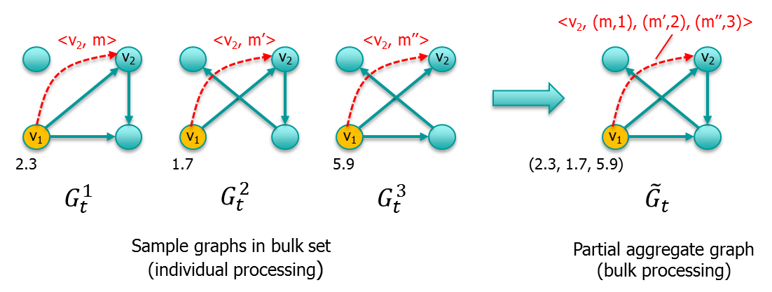
Bulk Graph Execution Model
Iterative Graph processing (Pregel, GraphLab, Trinity, GRACE, …)
User-defined compute () function on each vertex v changes v + adjacent edges
Changes propagated to other vertices via message passing or scheduled updates
Key idea in TIDE:
Bulk execution: Compute results for multiple sample graphs simultaneously
Partition N sample graphs into bulk sets with s sample graphs each
Execute algorithm on aggregate graph of each bulk set (partial aggregate graph)
Benefits
Same interface: users still think the computation is applied on one graph
Amortize overheads of extracting & loading from aggregate graph
Better memory locality (vertex operations)
Similar message values & similar state values ⇒ opportunities for compression (>2x speedup w. LZF)

Slide 212
Overview
Real-time Streaming Graph Systems
  Kineograph (distributed, Microsoft, 2012)
  TIDE (distributed, IBM, 2015)
Historical Graph Systems
  Chronos (distributed, Microsoft, 2014)
  DeltaGraph (distributed, University of Maryland, 2013)
  LLAMM (single-node, Harvard University & Oracle, 2015)

Slide 213
Chronos
Publication: Han et al Eurosys’14
Target query: graph computation on the sequence of static snapshots of a temporal graph within a time range
  E.g analyzing the change of each vertex’s PageRank for a given time range
Naïve approach: applying graph computation on each snapshot separately
Chronos: exploit the time locality of temporal graphs

Slide 214
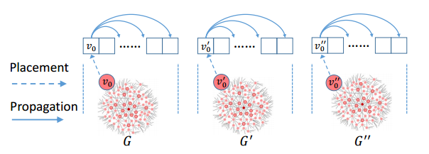
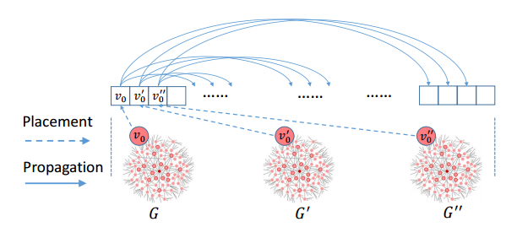
Structure Locality vs Time Locality
Structure locality
  States of neighboring vertices in the same snapshot are laid out close to each
Time locality (preferred in Chronos)
  States of a vertex (or an edge) in consecutive snapshots are stored together
* Figures are copied from Han et al EuroSys’14

Slide 215
Chronos Design
In-memory graph layout
  Data of a vertex/edge in consecutive snapshots are placed together
Locality-aware batch scheduling (LABS)
  Batch processing of a vertex across all the snapshorts
  Batch information propagation to a neighbor vertex across snapshots
Incremental Computation
  Use the results on 1st snapshot to batch compute on the remaining snapshots
  Use the results on the insersection graph to batch compute on all snapshots
On-disk graph layout
  Organized in snapshot groups
    Stored as the first snapshot followed by the updates in the remaining snapshots in this group.

Slide 216
DeltaGraph
Publication: Khurana et al ICDE’13, EDBT’16
Target query: access past states of the graphs and perform static graph analysis
  E.g study the evolution of centrality measures, density, conductance, etc
Two major components:
  Temporal Graph Index (TGI)
  Temporal Graph Analytics Framework (TAF)

Slide 217
DeltaGraph
Publication: Khurana et al ICDE’13, EDBT’16
Target query: access past states of the graphs and perform static graph analysis
  E.g study the evolution of centrality measures, density, conductance, etc
Two major components:
  Temporal Graph Index (TGI)
  Temporal Graph Analytics Framework (TAF)

Slide 218
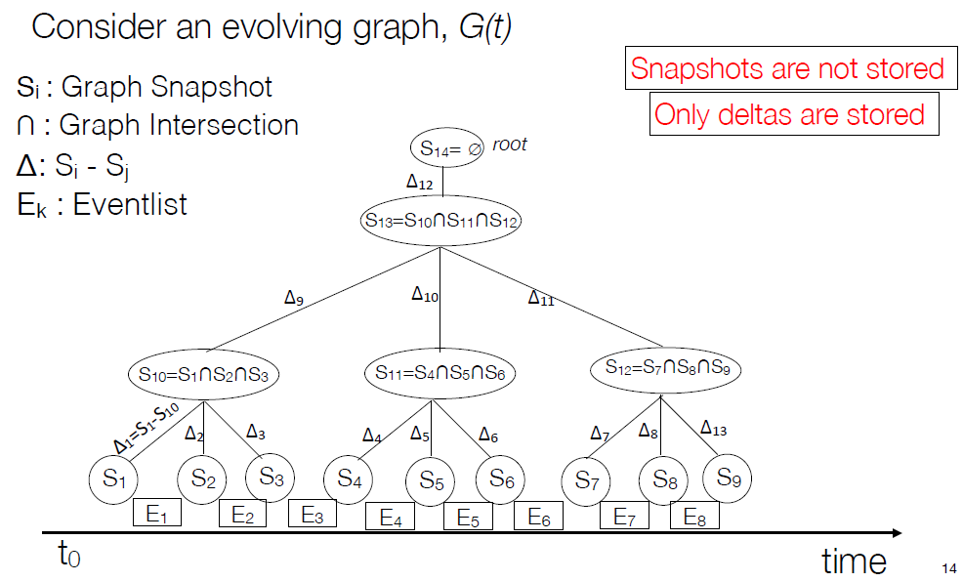
Temporal Graph Index
Partitioned delta and partitioned eventlist for scalability
Version chain for nodes
  Sorted list of references to a node
Graph primitives
  Snapshot retrieval
  Node’s history
  K-hop neighborhood
  Neighborhood evolution

Slide 219
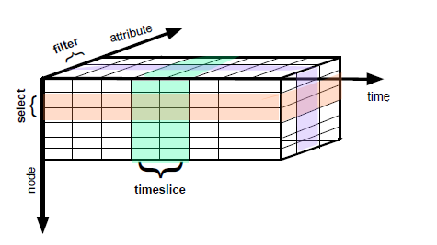
Temporal Graph Analytics Framework
Node-centric graph extraction and analytical logic
Primary operand: Set of Nodes (SoN) refers to a collection of temporal nodes
Operations
  Extract: Timeslice, Select, Filter, etc.
  Compute: NodeCompute, NodeComputeTemporal, etc.
  Analyze: Compare, Evolution, other aggregates

Slide 220
LLAMA
Publication: Macko et al ICDE’15
Target query: perform various whole graph analysis on consistent views
A single machine system that stores and incrementally updates an evolving graph in multi-version representations
LLAMA provides a general purpose programming model instead of vertex- or edge- centric models

Slide 221
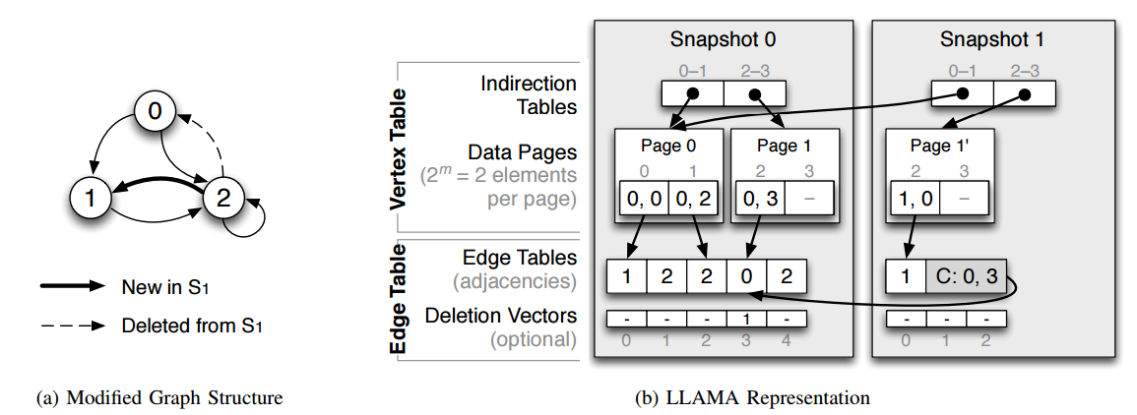
Multi-Version CSR Representation
Augment the compact read-only CSR (compressed sparse row) representation to support mutability and persistence.
  Large multi-versioned array (LAMA) with a software copy-on-write technique for snapshotting
* Figure is copied from Macko et al ICDE’15

Slide 222
Tutorial Outline
Message Passing Systems
Shared Memory Abstraction
Single-Machine Systems
Matrix-Based Systems
Temporal Graph Systems
DBMS-Based Systems
Subgraph-Based Systems

Slide 223
DBMS-Style Graph Systems

Slide 224


Reason #1
Expressiveness
  Transitive closure
  All pair shortest paths
Vertex-centric API?
public class AllPairShortestPaths extends Vertex<VLongWritable, DoubleWritable, FloatWritable, DoubleWritable> {
private Map<VLongWritable, DoubleWritable> distances = new HashMap<>();
@Override
public void compute(Iterator<DoubleWritable> msgIterator) {
.......
}
}

Slide 225







Reason #2
Easy OPS – Unified logs, tooling, configuration…!

Slide 226

Reason #3
Efficient Resource Utilization and Robustness
“I’m trying to run the sample connected components algorithm on a large data set on a cluster, but I get a ‘java.lang.OutOfMemoryError: Java heap space’ error.”
~30 similar threads on Giraph-users mailing list during the year 2015!

Slide 227

Reason #4
Physical flexibility and adaptivity
  PageRank, SSSP, CC, Triangle Counting
  Web graph, social network, RDF graph
  8 cheap machine school cluster, 200 beefy machine at an enterprise data center
One-size fits-all?

Slide 228
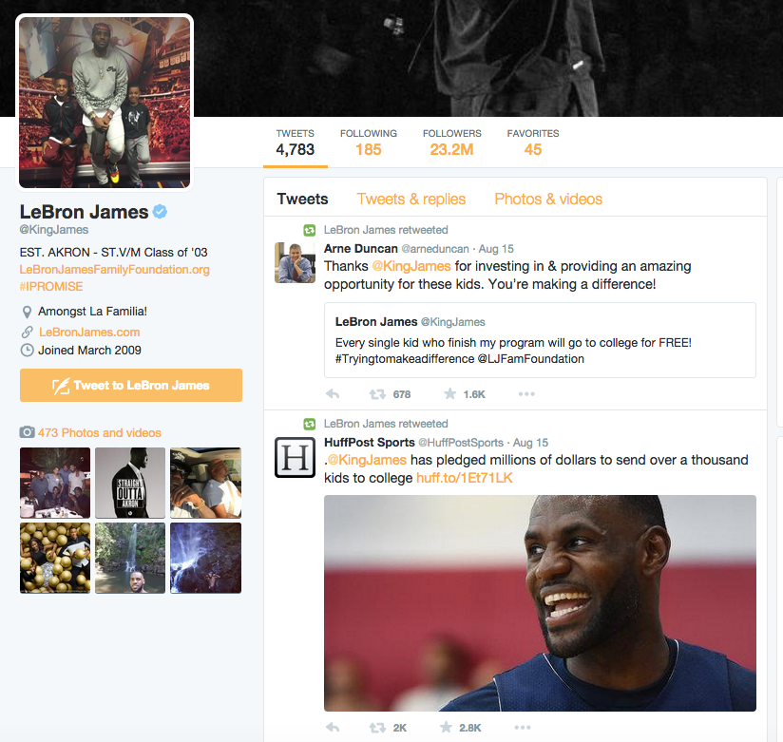
What’s graph analytics?
304 Million Monthly Active Users
500 Million Tweets Per Day!
200 Billion Tweets Per Year!

Slide 229

Reason #5
Easy Data Science
TwitterMsg(
tweetid: int64,
user: string,
sender_location: point,
send_time: datetime,
reply_to: int64,
retweet_from: int64,
referred_topics: array<string>,
message_text: string
);
MsgGraph(
vertexid: int64,
value: double
edges: array<int64>
);
INSERT OVERWRITE TABLE MsgGraph
SELECT T.tweetid, 1.0/10000000000.0,
CASE
WHEN T.reply_to >=0
RETURN array(T.reply_to)
ELSE
RETURN array(T.forward_from)
END CASE
FROM TwitterMsg AS T
WHERE T.reply_to>=0
OR T.retweet_from>=0
Result(
vertexid: int64,
rank: double
);
HDFS
Giraph PageRank Job
SELECT R.user, SUM(R.rank) AS influence
FROM Result R, TwitterMsg TM
WHERE R.vertexid=TM.tweetid
GROUP BY R.user
ORDER BY influence DESC
LIMIT 50;
HDFS
HDFS

Slide 230

Reason #6
Software Simplicity
Pregel
GraphLab Giraph
......
Vertex/Message internal format
Task scheduling
Memory management
Message delivery
Network management

Slide 231
#1 Expressiveness
Recursive Query!
  SociaLite (VLDB’13)
  Myria (VLDB’15)
  DeALS (ICDE’15)
IDB
EDB
TC(u, u) :- Edge(u, _)
TC(v, v) :- Edge(_, v)
TC(u, v) :- TC(u, w), Edge(w, v), u!=v
Path(u, v, min(d)) :- Edge(u, v, d);
:- Path(u, w, d1), Edge(w, v, d2), d=d1+d2

Slide 232
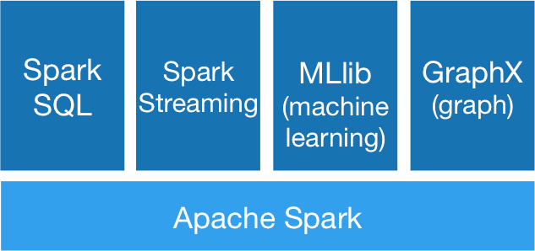
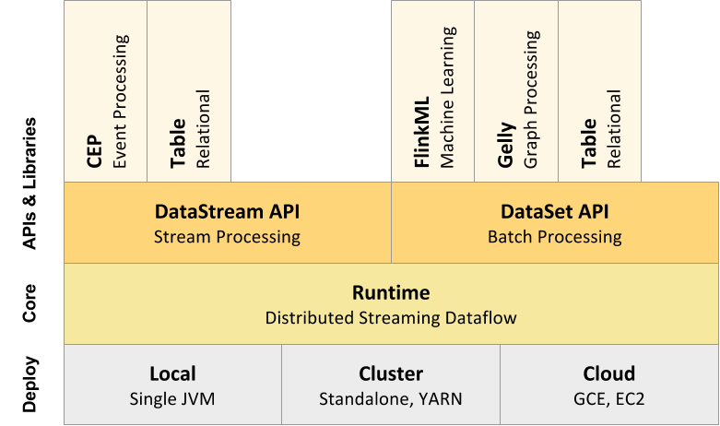
#2 Easy OPS
Converged Platforms!
  GraphX, on Apache Spark (OSDI’15)
  Gelly, on Apache Flink (FOSDEM’15)

Slide 233

#3 Efficient Resource Utilization and Robustness
Leverage MPP query execution engine!
  Pregelix (VLDB’14)
Relation
Schema
Vertex
(vid, halt, value, edges)
vid
payload
Msg
(vid, payload)
2
3.0
GS
(halt, aggregate, superstep)
4
3.0
5
1.0
1
1.0
vid
msg
halt
value
edges
Msg
vid=vid
1
NULL
false
3.0
(3,1.0),(4,1.0)
vid
halt
value
edges
3
1.0
false
3.0
(2,1.0),(3,1.0)
2
false
2.0
(3,1.0),(4,1.0)
5
1.0
NULL
NULL
NULL
4
false
1.0
(1,1.0)
2
3.0
false
2.0
(3,1.0),(4,1.0)
1
false
3.0
(3,1.0),(4,1.0)
4
3.0
false
1.0
(1,1.0)
3
false
3.0
(2,1.0),(3,1.0)
Vertex

Slide 234
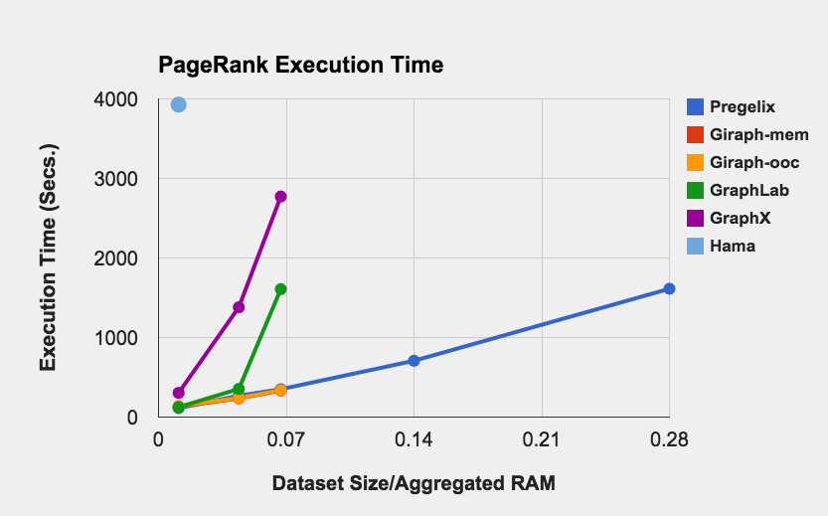
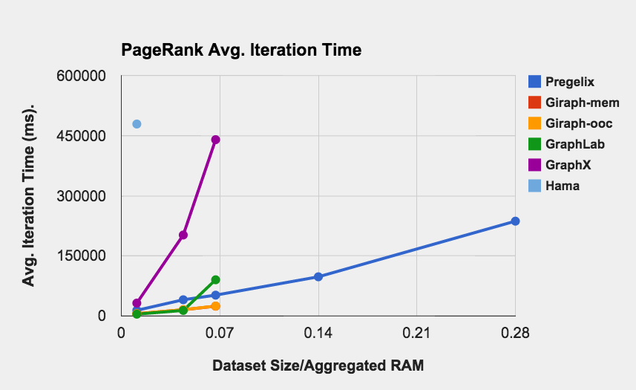
#4 Efficient Resource Utilization and Robustness
Pregelix
In-memory
In-memory
Out-of-core
Out-of-core

Slide 235
#4 Physical Flexibility
Flexible processing for the Pregel semantics
  Storage, row Vs. column, in-place Vs. LSM, etc.
    Vertexica (VLDB’14)
    Vertica (IEEE BigData’15)
    Pregelix (VLDB’14)
  Query plan, join algorithms, group-by algorithms, etc.
    Pregelix (VLDB’14)
    GraphX (OSDI’15)
    Myria (VLDB’15)
  Execution model, synchronous Vs. asynchronous
    Myria (VLDB’15)

Slide 236
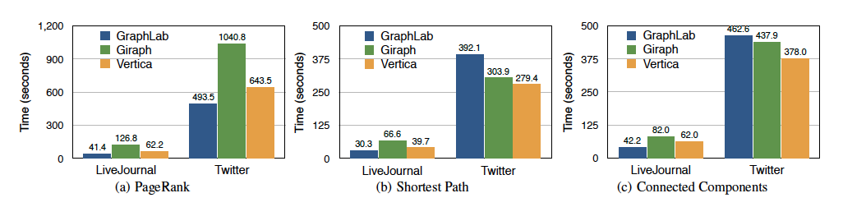
#4 Physical Flexibility
Vertica, column store Vs. row store (IEEE BigData’15)

Slide 237


#4 Physical Flexibility
Pregelix, different query plans
…
Vid_{i+1}
UDF Call (compute)
(halt = false)
…
(V.halt = false || M.paylod != NULL)
UDF Call (compute)
Index Left Outer
Join
Index Full Outer Join
Merge (choose())
M.vid=I.vid
M.vid=V.vid
M.vid=V.vid
Msg_{i}(M)
Vertex_{i}(V)
Vid_{i}(I)
Vertex_{i}(V)
Msg_{i}(M)

Slide 238
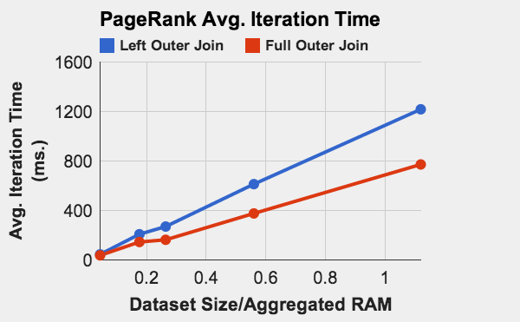
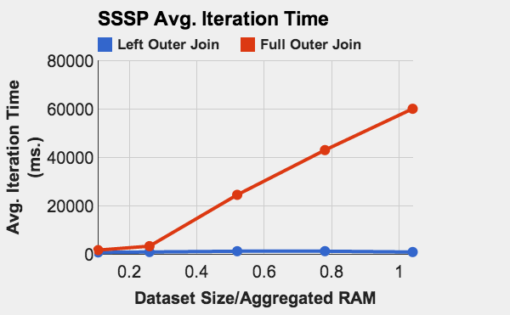
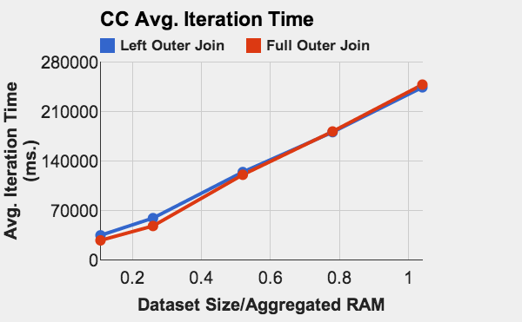
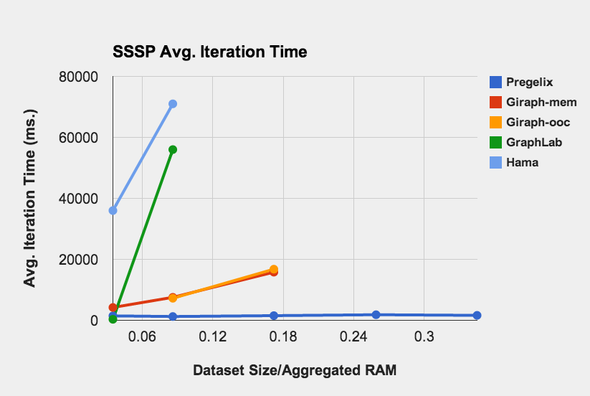
#4 Physical Flexibility
Pregelix
In-memory
Out-of-core
15x

Slide 239
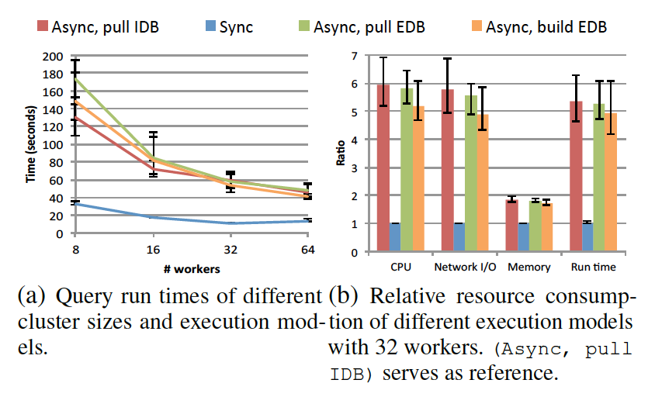
#4 Physical Flexibility
Myria, synchronous Vs. Asynchronous (VLDB’15)
  Least Common Ancestor

Slide 240

#4 Physical Flexibility
Myria, synchronous Vs. Asynchronous (VLDB’15)
  Connected Components

Slide 241
#5 Easy Data Science
Integrated Programming Abstractions
  REX (VLDB’12)
  AsterData (VLDB’14)
SELECT R.user, SUM(R.rank) AS influence
FROM PageRank( (
SELECT T.tweetid AS vertexid, 1.0/… AS value, … AS edges
FROM TwitterMsg AS T
WHERE T.reply_to>=0
OR T.retweet_from>=0
), ……) AS R,
TwitterMsg AS TM
WHERE R.vertexid=TM.tweetid
GROUP BY R.user
ORDER BY influence DESC
LIMIT 50;

Slide 242
#6 Software Simplicity
Engineering cost is Expensive!
System | Lines of source code (excluding test code and comments)
Giraph | 32,197
GraphX | 2,500
Pregelix | 8,514

Slide 243
Tutorial Outline
Message Passing Systems
Shared Memory Abstraction
Single-Machine Systems
Matrix-Based Systems
Temporal Graph Systems
DBMS-Based Systems
Subgraph-Based Systems

Slide 244
Graph Analysis Tasks
Graph analytics/network science tasks too varied
  Centrality analysis; evolution models; community detection
  Link prediction; belief propagation; recommendations
  Motif counting; frequent subgraph mining; influence analysis
  Outlier detection; graph algorithms like matching, max-flow
  An active area of research in itself…
Feed-fwd Loop
Feed- back Loop
Bi-parallel Motif
Counting network motifs
Identify Social circles in a user’s ego network
Notes:
Add an example of how this would be done in Pregel and Nscale.

Slide 245
Limitations of Vertex-Centric Framework
Vertex-centric framework
  Works well for some applications
    Pagerank, Connected Components, …
    Some machine learning algorithms can be mapped to it
  However, the framework is very restrictive
    Most analysis tasks or algorithms cannot be written easily
    Simple tasks like counting neighborhood properties infeasible
    Fundamentally: Not easy to decompose analysis tasks into vertex-level, independent local computations
Alternatives?
  Galois, Ligra, GreenMarl: Not sufficiently high-level
  Some others (e.g., Socialite) restrictive for different reasons
Notes:
Add an example of how this would be done in Pregel and Nscale.

Slide 246
Example: Local Clustering Coefficient
A measure of local density around a node:
LCC(n) = # edges in 1-hop neighborhood/max # edges possible
Compute() at Node n:
  Need to count the no. of edges between neighbors
  But does not have access to that information
  Option 1: Each node transmits its list of
  neighbors to its neighbors
  Huge memory consumption
  Option 2: Allow access to neighbors’ state
    Neighbors may not be local
    What about computations that require
    2-hop information?
2
1
3
4

Slide 247
Example: Frequent Subgraph Mining
Goal: Find all (labeled) subgraphs that appear sufficiently frequently
No easy way to map this to the vertex-centric framework
- Need ability to construct subgraphs of the graph incrementally
- Can construct partial subgraphs and pass them around
- Very high memory consumption, and duplication of state
- Need ability to count the number of occurrences of each subgraph
- Analogous to “reduce()” but with subgraphs as keys
- Some vertex-centric frameworks support such functionality for aggregation, but only in a centralized fashion
Similar challenges for problems like: finding all cliques, motif counting

Slide 248
Major Systems
NScale:
  Subgraph-centric API that generalizes vertex-centric API
  The user compute() function has access to “subgraphs” rather than “vertices”
  Graph distributed across a cluster of machines analogous to distributed vertex-centric frameworks
Arabesque:
  Fundamentally different programming model aimed at frequent subgraph mining, motif counting, etc.
  Key assumption:
    The graph fits in the memory of a single machine in the cluster,
    .. but the intermediate results might not

Slide 249
NScale
An end-to-end distributed graph programming framework
Users/application programs specify:
  Neighborhoods or subgraphs of interest
  A kernel computation to operate upon those subgraphs
Framework:
  Extracts the relevant subgraphs from underlying data and loads in memory
  Execution engine: Executes user computation on materialized subgraphs
  Communication: Shared state/message passing
Implementation on Hadoop MapReduce as well as Aparch Spark

Slide 250
NScale: LCC Computation Walkthrough
NScale programming model
Underlying graph
data on HDFS
Subgraph extraction query:
Compute (LCC) on
Extract ({Node.color=orange}
{k=1} {Node.color=white}
{Edge.type=solid}
)
Query-vertex predicate
Neighborhood Size
Neighborhood vertex predicate
Neighborhood edge predicate

Slide 251

NScale: LCC Computation Walkthrough
NScale programming model
Underlying graph
data on HDFS
Specifying Computation: BluePrints API
Program cannot be executed as is in vertex-centric programming frameworks.

Slide 252
NScale: LCC Computation Walkthrough
GEP: Graph extraction and packing
Underlying graph
data on HDFS

Slide 253
NScale: LCC Computation Walkthrough
GEP: Graph extraction and packing
Underlying graph
data on HDFS
Graph Extraction
and Loading
Extracted Subgraphs
MapReduce
(Apache Yarn)
Subgraph
extraction

Slide 254
NScale: LCC Computation Walkthrough
GEP: Graph extraction and packing
Underlying graph
data on HDFS
Graph Extraction
and Loading
Subgraphs in
Distributed Memory
MapReduce
(Apache Yarn)
Subgraph
extraction
Cost Based
Optimizer
Data Rep & Placement

Slide 255
NScale: LCC Computation Walkthrough
Distributed execution of user computation
GEP: Graph extraction and packing
Underlying graph
data on HDFS
Graph Extraction
and Loading
Subgraphs in
Distributed Memory
Distributed Execution Engine
MapReduce
(Apache Yarn)
Subgraph
extraction
Cost Based
Optimizer
Data Rep & Placement

Slide 256
Experimental Evaluation
 | Local Clustering Coefficient
Dataset | NScale |  | Giraph |  | GraphLab |  | GraphX
 | CE (Node-Secs) | Cluster Mem (GB) | CE (Node-Secs) | Cluster Mem (GB) | CE (Node-Secs) | Cluster Mem (GB) | CE (Node-Secs) | Cluster Mem (GB)
EU Email | 377 | 9.00 | 1150 | 26.17 | 365 | 20.10 | 225 | 4.95
NotreDame | 620 | 19.07 | 1564 | 30.14 | 550 | 21.40 | 340 | 9.75
Google Web | 658 | 25.82 | 2024 | 35.35 | 600 | 33.50 | 1485 | 21.92
WikiTalk | 726 | 24.16 | DNC | OOM | 1125 | 37.22 | 1860 | 32.00
LiveJournal | 1800 | 50.00 | DNC | OOM | 5500 | 128.62 | 4515 | 84.00
Orkut | 2000 | 62.00 | DNC | OOM | DNC | OOM | 20175 | 125.00
 |  | Personalized Page Rank on 2-Hop Neighborhood
Dataset |  | NScale |  | Giraph |  | GraphLab |  | GraphX
 | #Source Vertices | CE (Node-Secs) | Cluster Mem (GB) | CE (Node-Secs) | Cluster Mem (GB) | CE (Node-Secs) | Cluster Mem (GB) | CE (Node-Secs) | Cluster Mem (GB)
EU Email | 3200 | 52 | 3.35 | 782 | 17.10 | 710 | 28.87 | 9975 | 85.50
NotreDame | 3500 | 119 | 9.56 | 1058 | 31.76 | 870 | 70.54 | 50595 | 95.00
Google Web | 4150 | 464 | 21.52 | 10482 | 64.16 | 1080 | 108.28 | DNC | -
WikiTalk | 12000 | 3343 | 79.43 | DNC | OOM | DNC | OOM | DNC | -
LiveJournal | 20000 | 4286 | 84.94 | DNC | OOM | DNC | OOM | DNC | -
Orkut | 20000 | 4691 | 93.07 | DNC | OOM | DNC | OOM | DNC | -

Slide 257
NScaleSpark: NScale on Spark
Building the GEP phase
Subgraph Extraction and Bin Packing
t₁
t₂
t_{n}
Input Graph data
RDD 1
RDD 2
RDD n
Executing user computation
RDD n
G: Graph Object
G₁
SG₁
SG₂
Execution Engine Instance
SG₃
Map
Transformation
G₂
G₃
G₄
G₅
SG₄
SG₅
G_{n}
  Each graph object contains subgraphs grouped together using bin packing algorithm
  Spark RDD containing Graph objects
    Transparent instantiation of distributed execution engine
Notes:
GEP: Implemented as a series of RDD transformations starting from raw input graph
Subgraph extraction and bin packing implemented in Scala
Phase 2: Instantiating the subgraphs in distributed memory
Subgraph structural information joined with partitioning info for grouping
NScale graph library ported to NSpark
Spark RDD built containing graph objects
Each graph object contains subgraphs grouped together using bin packing algorithm
Each instantiation: Master-Worker architecture
Spark RDD built containing graph objects
on Graph RDD

Slide 258
Arabesque
“Think-like-an-embedding” paradigm
User specifies what types of embeddings to construct, and whether edge-at-a-time, or vertex-at-a-time
User provides functions to filter, and process partial embeddings
Arabesque responsibilities | User responsibilities
Graph Exploration
Aggregation (Isomorphism)
Filter
Load Balancing
Automorphism Detection
Process

Slide 259

Arabesque

Slide 260

Arabesque

Slide 261
Arabesque: Evaluation
Comparable to centralized implementations for a single thread
Drastically more scalable to large graphs and clusters
Notes:
At an architecture level, Arabesque runs on top of Hadoop.
During the execution of an exploration step, all workers execute the model we have just described with the input embeddings of size n that were passed to them from the previous step. This execution is done in parallel in all threads of a worker.
At the end of the execution, the resulting embeddings of size n + 1 are then shuffled between the workers so as to reduce the imbalancing that might be caused by highly expandable embeddings (usually containing vertices with high degrees).

Slide 262
Conclusion & Future Direction
End-to-End Richer Big Graph Analytics
  Keyword search (Elastic Search)
  Graph query (Neo4J)
  Graph analytics (Giraph)
  Machine learning (Spark, TensorFlow)
  SQL query (Hive, Impala, SparkSQL, etc.)
  Stream processing (Flink, Spark Streaming, etc.)
  JSON processing (AsterixDB, Drill, etc.)
Converged programming abstractions and platforms?

Slide 263
Conclusion & Future Direction
Frameworks for computation-intensive jobs
High-speed network for data-intensive jobs
New hardware support

Slide 264
Thanks !

