Slide 1
Motion Detail Preserving Optical Flow Estimation
Li Xu¹, Jiaya Jia¹, Yasuyuki Matsushita²
¹ The Chinese University of Hong Kong
² Microsoft Research Asia

Slide 2
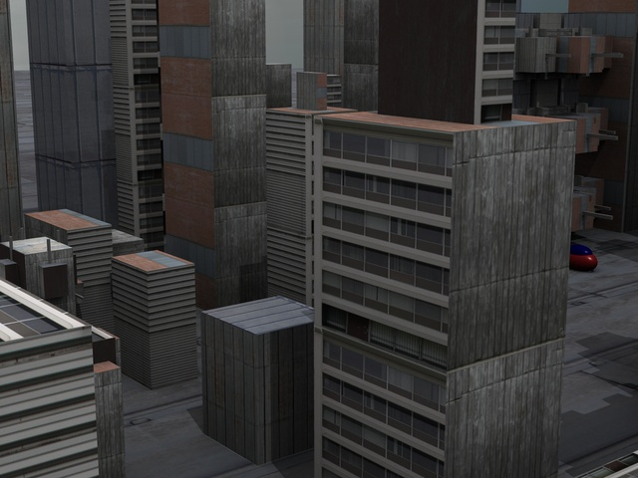
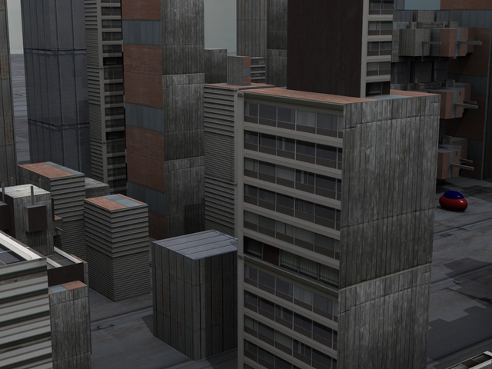
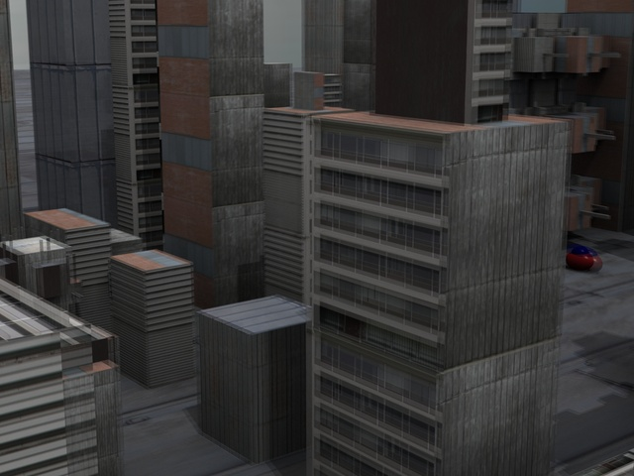
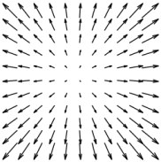
Conventional Optical Flow
Middlebury Benchmark [Baker et al. 07]
Dominant Scheme: Coarse-to-Fine Warping

Slide 3
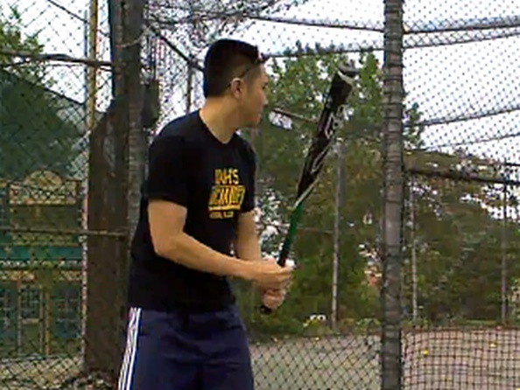
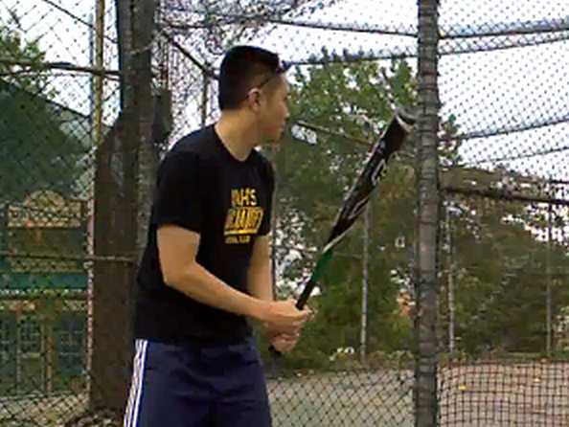
Large Displacement Optical Flow
Region Matching [Brox et al. 09, 10]
Discrete Local Search [Steinbrucker et al. 09]

Slide 4
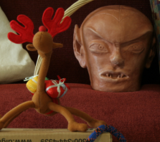
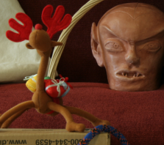
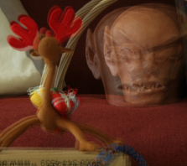
Both Large and Small Motion Exist
Capture large motion
Preserve sub-pixel accuracy

Slide 5
Our Work
Framework
Extended coarse-to-fine motion estimation for both large and small displacement optical flow
Model
A new data term to selectively combine constraints
Solver
Efficient numerical solver for discrete-continuous optimization

Slide 6
Outline
Framework
Extended coarse-to-fine motion estimation for both large and small displacement optical flow
Model
A new data term to selectively combine constraints
Solver
Efficient numerical solver for discrete-continuous optimization

Slide 7
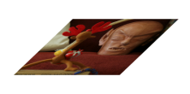
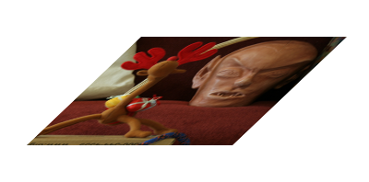
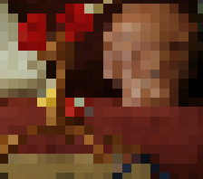
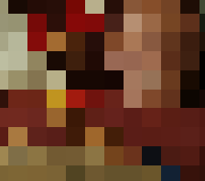
The Multi-scale Problem

Slide 8
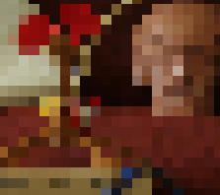
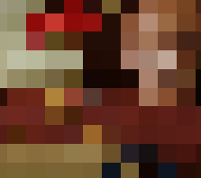
The Multi-scale Problem
Ground truth
Ground truth
Ground truth
Notes:
The ground truth flow for these highlighted pixels are shown with the arrows.

Slide 9
The Multi-scale Problem
Ground truth
Ground truth
Ground truth

Slide 10
Ground truth
Ground truth
Ground truth
Estimate
Estimate
Estimate
…

Slide 11
The Multi-scale Problem
Large discrepancy between initial values and optimal motion vectors
Our solution
Improve flow initialization to reduce the reliance on the initialization from coarser levels

Slide 12
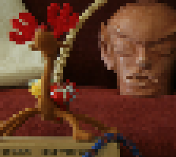
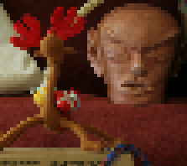
Extended Flow Initialization
Sparse feature matching for each level

Slide 13
Extended Flow Initialization
Identify missing motion vectors

Slide 14
Extended Flow Initialization
Identify missing motion vectors

Slide 15
Extended Flow Initialization
…

Slide 16
Extended Flow Initialization
…
Fuse

Slide 17
Outline
Framework: extended initialization for coarse-to-fine motion estimation
Model: selective data term
Efficient numerical solver

Slide 18
Data Constraints
Color constancy
Gradient constancy
Average

Slide 19
Problems
Pixels moving out of shadow
Color constancy is violated
: ground truth motion of p₁
Gradient constancy holds
Average:

Slide 20
Problems
Pixels undergoing rotational motion
Color constancy holds
: ground truth motion of p₂
Gradient constancy is violated
Average:

Slide 21
Our Proposal
Selectively combine the constraints
where

Slide 22
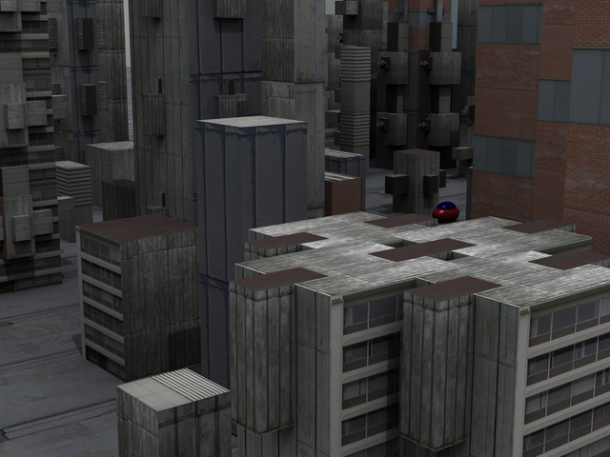
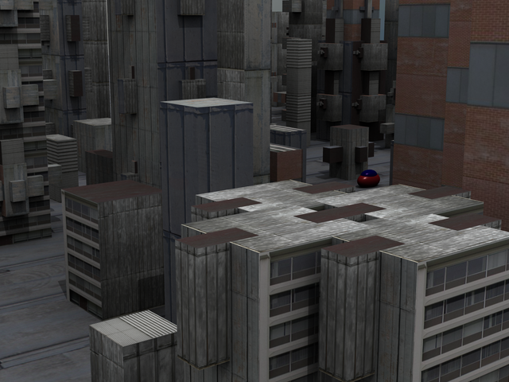
Comparisons

Slide 23
Outline
Framework: extended initialization for coarse to fine motion estimation
Model: selective data term
Efficient numerical solver

Slide 24
Energy Functions and Solver
Total energy
Probability of a particular state of the system

Slide 25
Mean Field Approximation
Partition function
Sum over all possible values of α
. . .
The effective potential E^{eff} (u) [Geiger & Girosi, 1989]

Slide 26
Optimal condition (Euler-Lagrange equations)
It decomposes to
{

Slide 27
{

Slide 28
Algorithm Skeleton
{
For each level
Extended Flow Initialization (QPBO)
Continuous Minimization (Iterative reweight)
Update
Compute flow field (Variable Splitting)

Slide 29
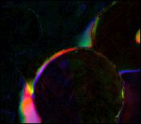
Results
Difference
Averaging constraints
Ours

Slide 30
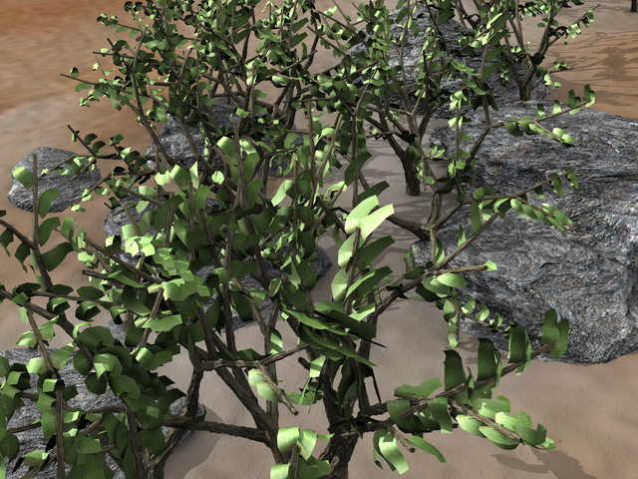
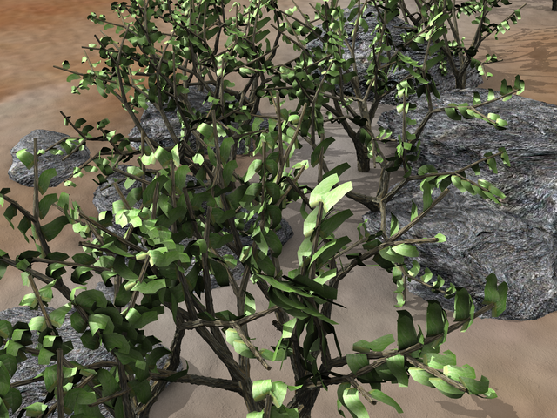
Middlebury Dataset
EPE=0.74

Slide 31
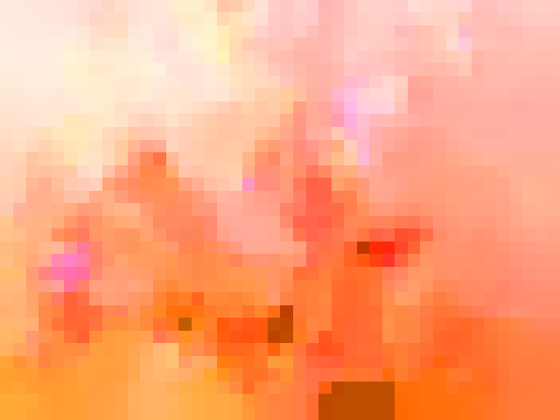
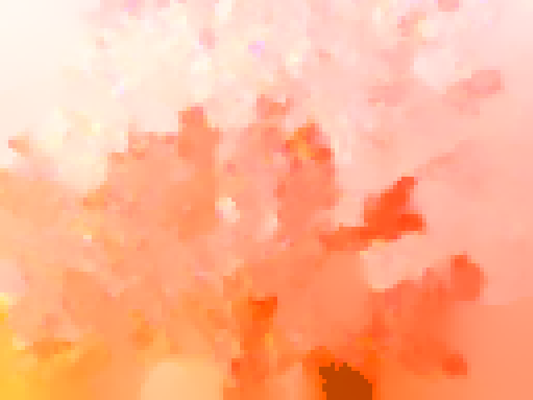
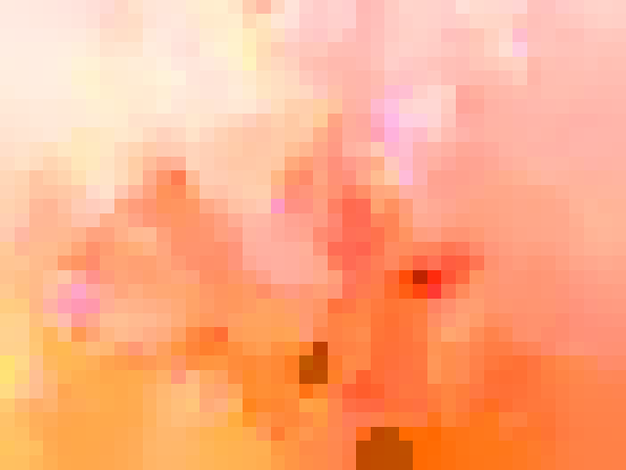
Results from Different Steps
Coarse-to-fine
Extended coarse-to-fine

Slide 32
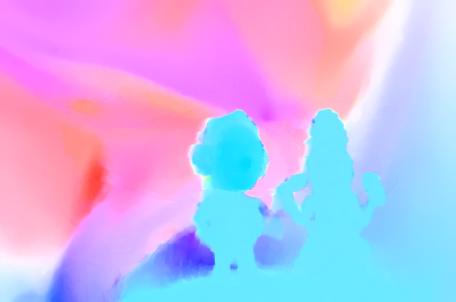
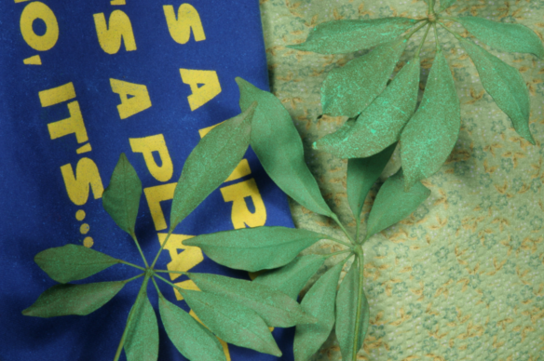
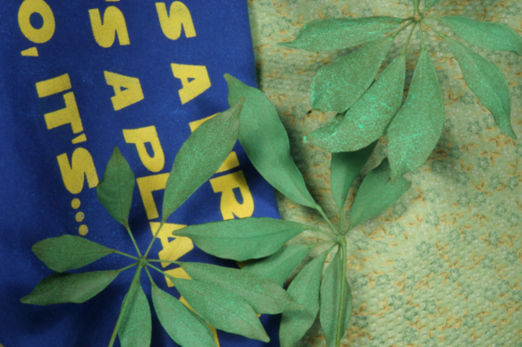
EPE=0.15 rank =1
EPE=0.24 rank =1

Slide 33
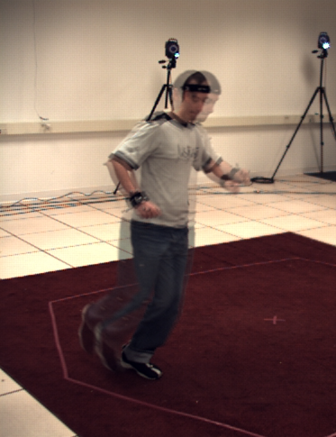
Large Displacement
Overlaid Input

Slide 34
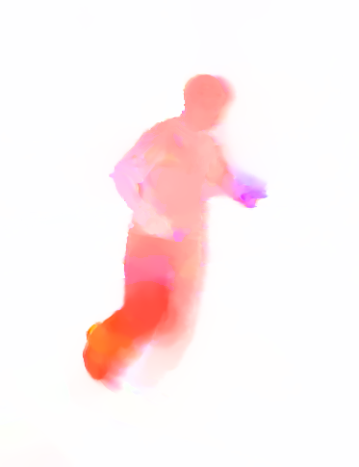
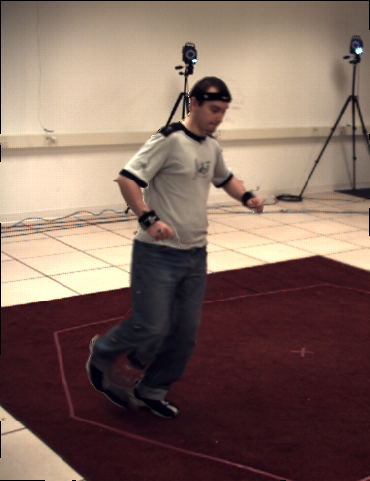
Large Displacement
Motion Estimates
Coarse-to-fine
Our Result
Warping Result

Slide 35
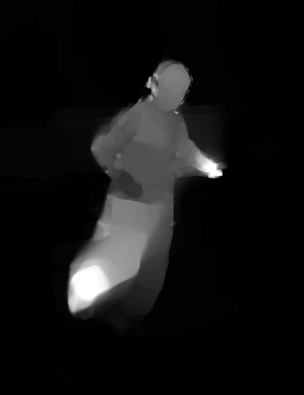
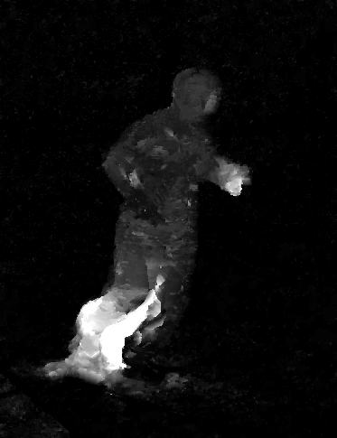
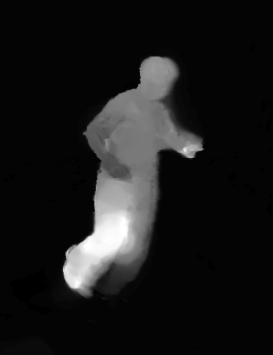
Comparison
Motion Magnitude Maps
LDOP [Brox et al. 09 ]
[Steinbrucker et al. 09]
Ours

Slide 36
More Results
Overlaid Input
Notes:
Another large displacement motion example.

Slide 37
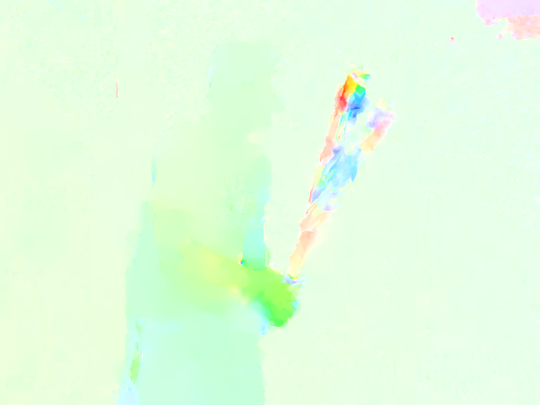
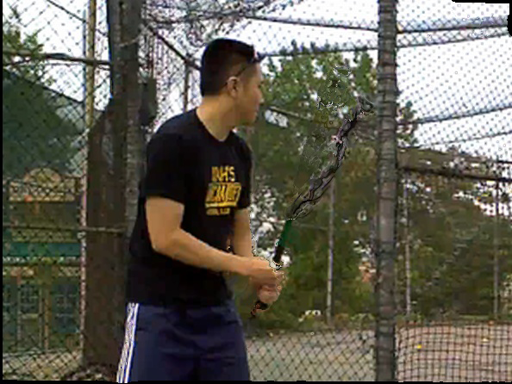
Conventional Coarse-to-fine
Our Result

Slide 38
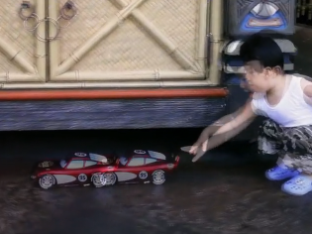
More Results
Overlaid Input

Slide 39
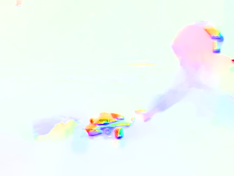
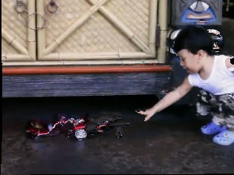
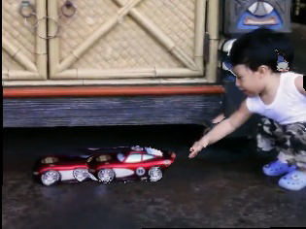
Coarse-to-fine
Our Result

Slide 40
Conclusion
Extended initialization (Framework)
Selective data term (Model)
Efficient numerical scheme (Solver)
Limitations
Featureless motion details
Large occlusions

Slide 41
Thank you!

Slide 42
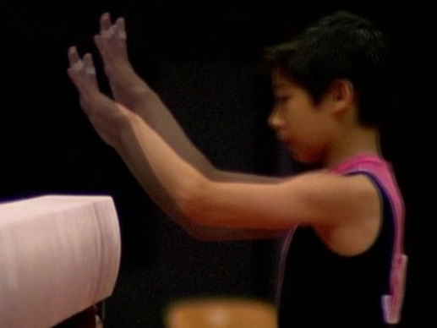
More Results
Overlaid Input

Slide 43
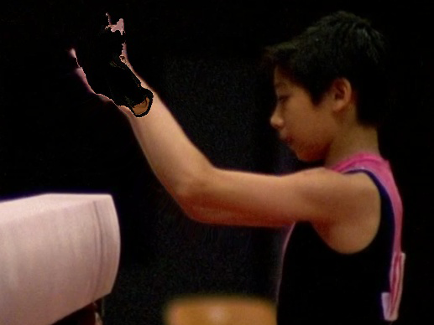
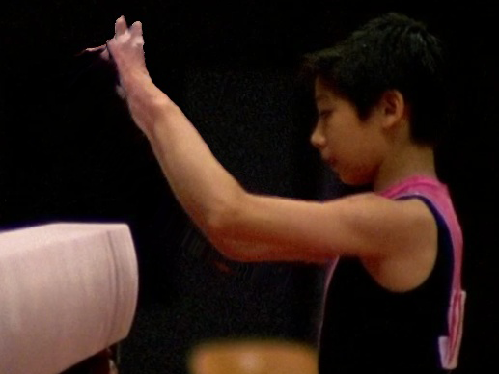
Coarse-to-fine
Our Results

