Slide 1
Quick Sort and Merge Sort
Fei Chen
CSCI2100B Data Structures Tutorial 11

Slide 2
Quick Sort
Efficient sorting algorithm
Example of Divide and Conquer algorithm
Two phases
Partition phase
Divides the work into half
Sort phase
Conquers the halves!

Slide 3
Quicksort
Partition
Choose a pivot
Find the position for the pivot so that
all elements to the left are less / equal
all elements to the right are equal / greater
< =pivot
pivot
=> pivot

Slide 4
Quicksort
Conquer
Apply the same algorithm to each half
< pivot
> pivot
<= p’
p’
=> p’
pivot
< =p”
p”
=> p”

Slide 5
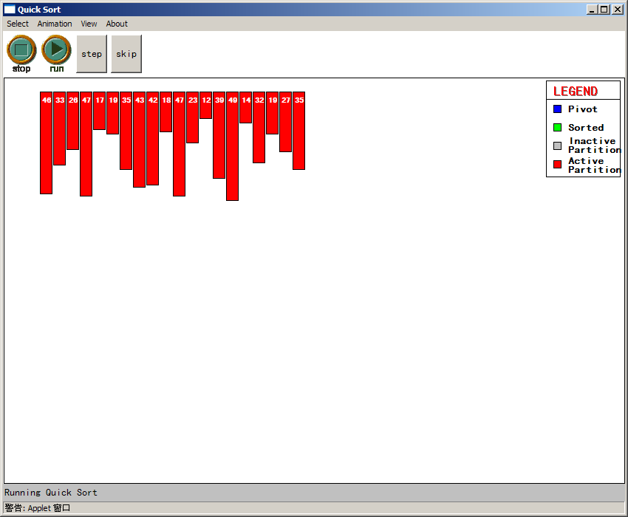

Slide 6
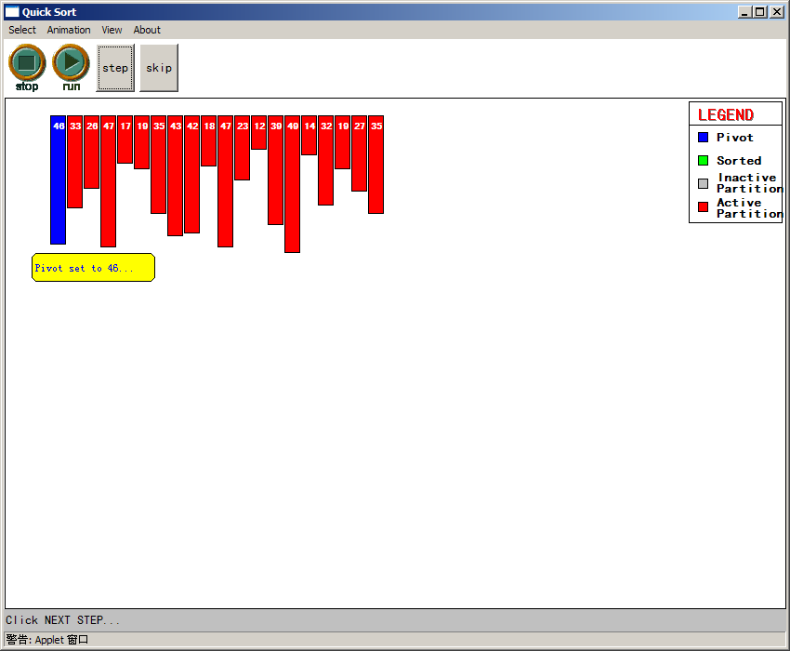

Slide 7
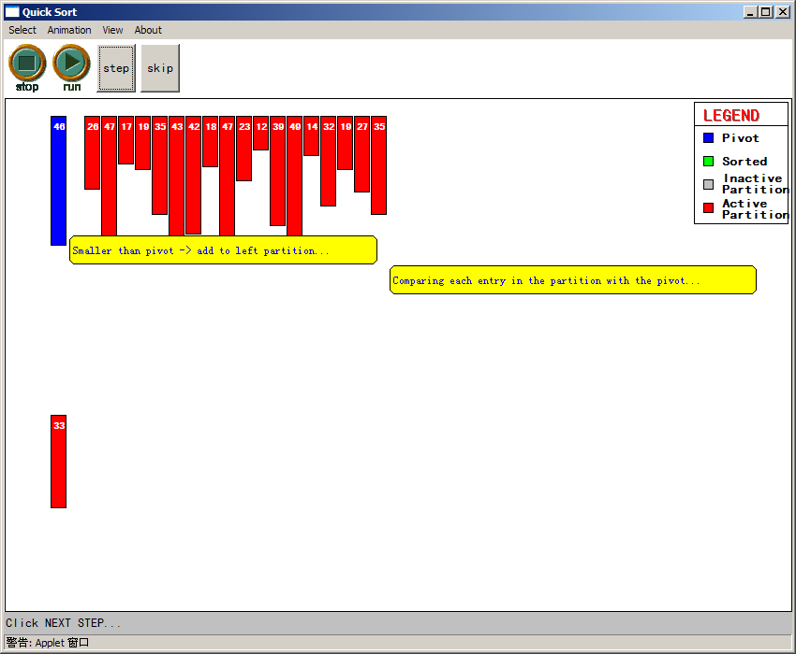

Slide 8
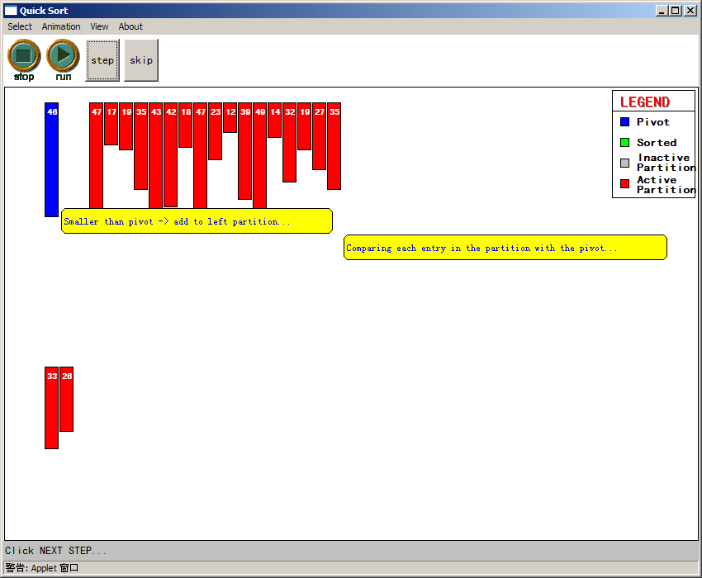

Slide 9
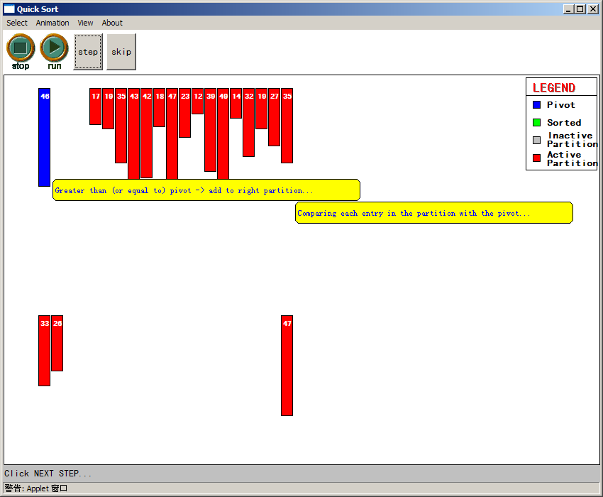

Slide 10
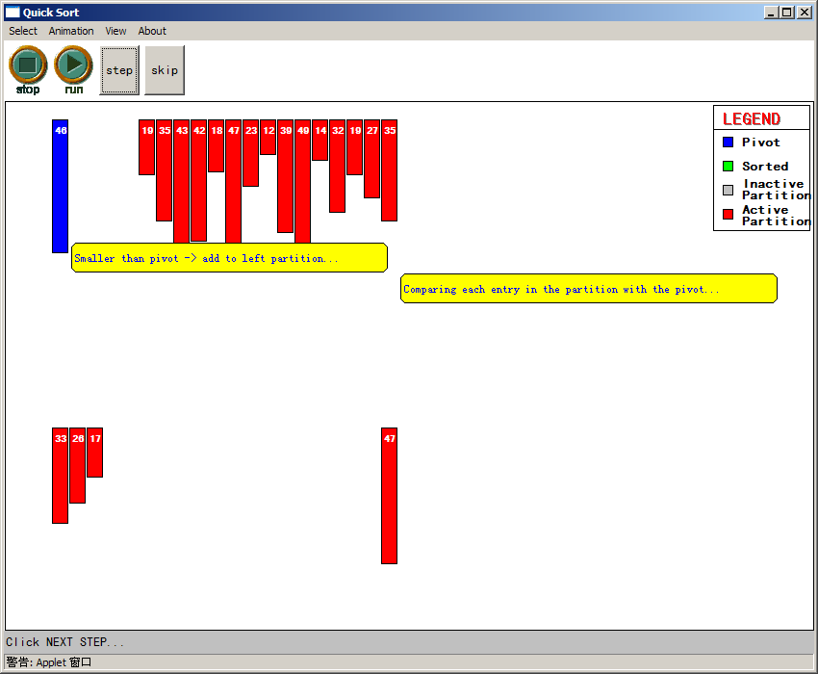

Slide 11
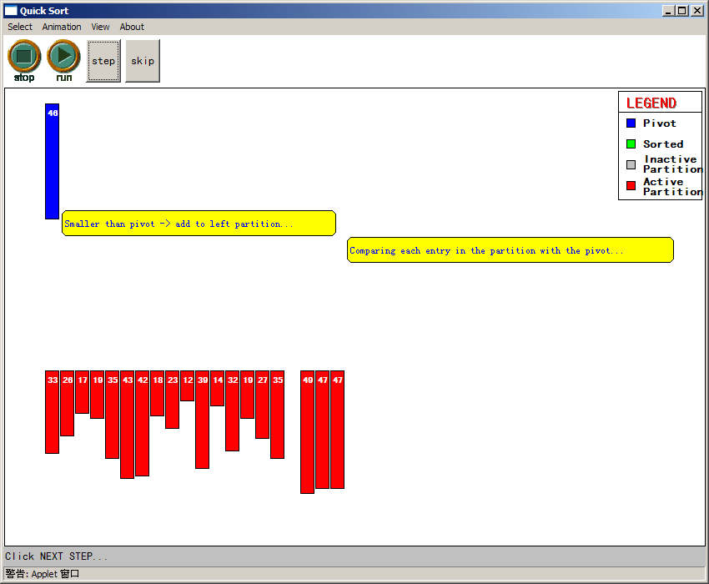

Slide 12
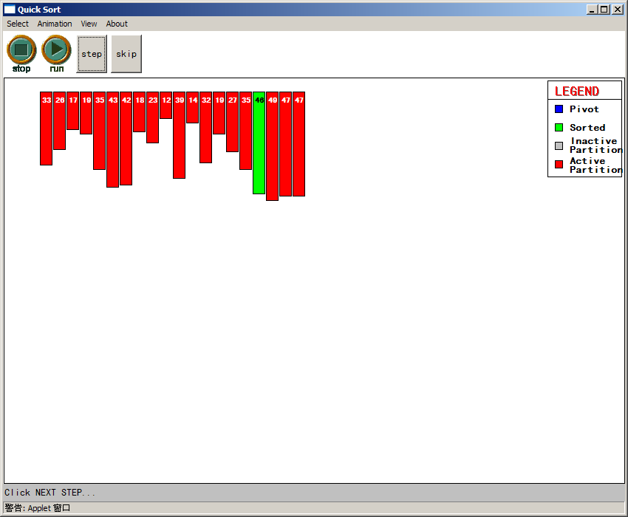

Slide 13
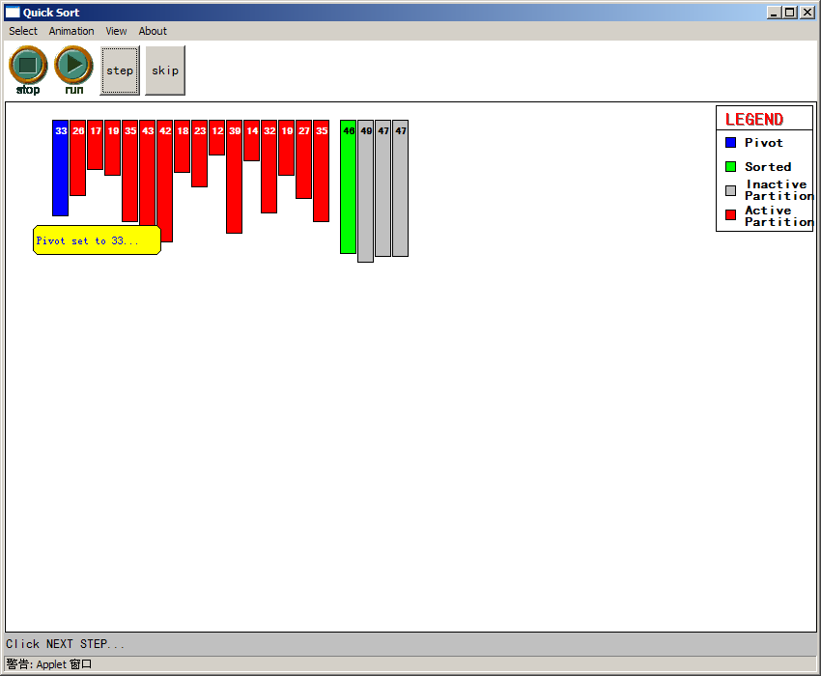

Slide 14
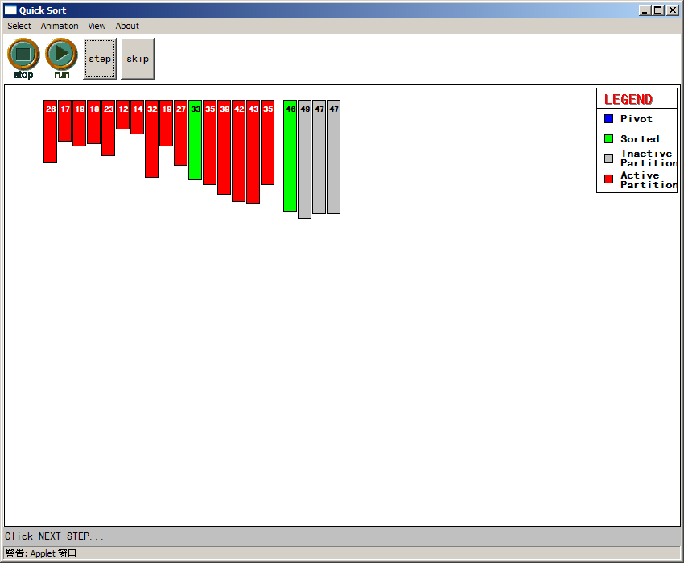

Slide 15
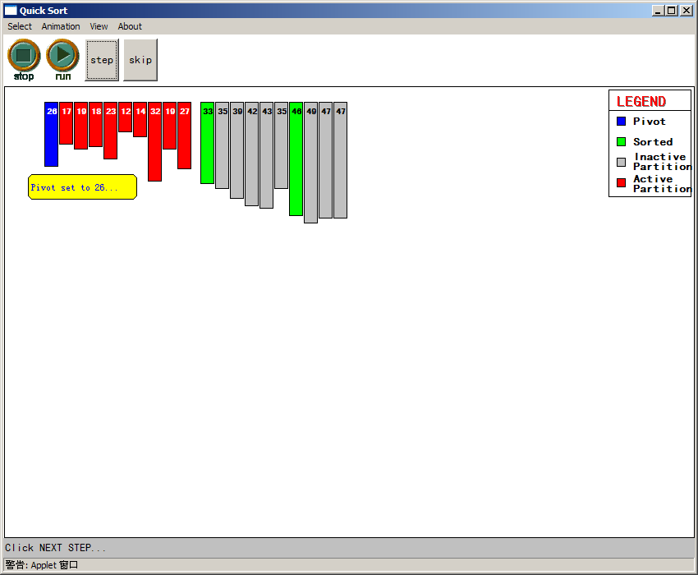

Slide 16
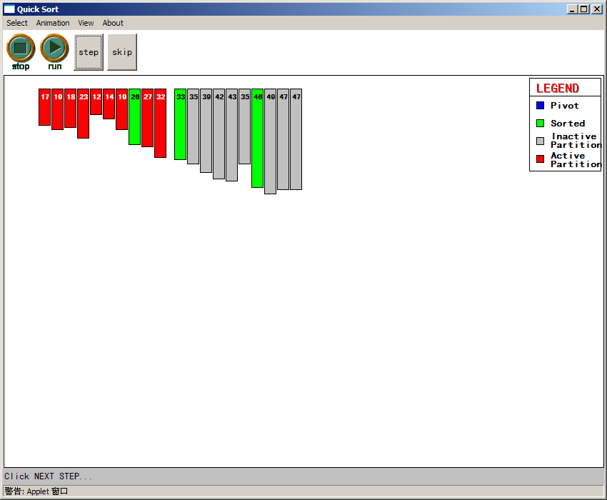

Slide 17
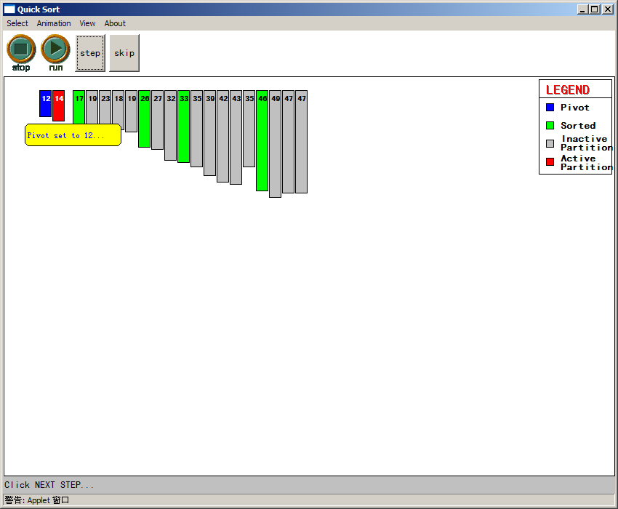

Slide 18
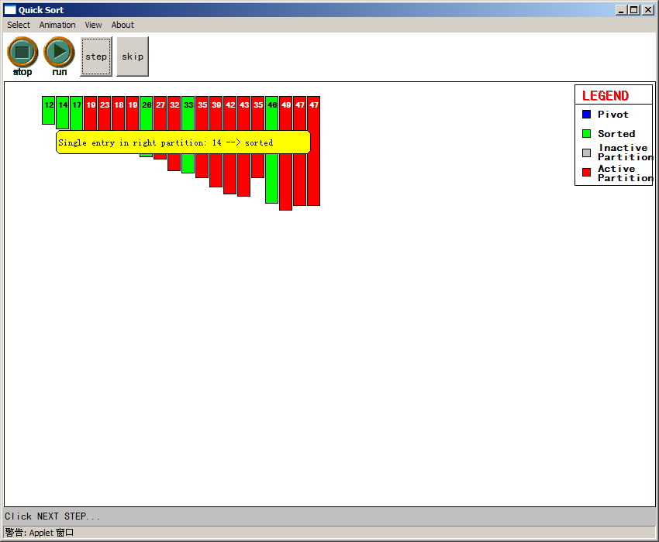

Slide 20
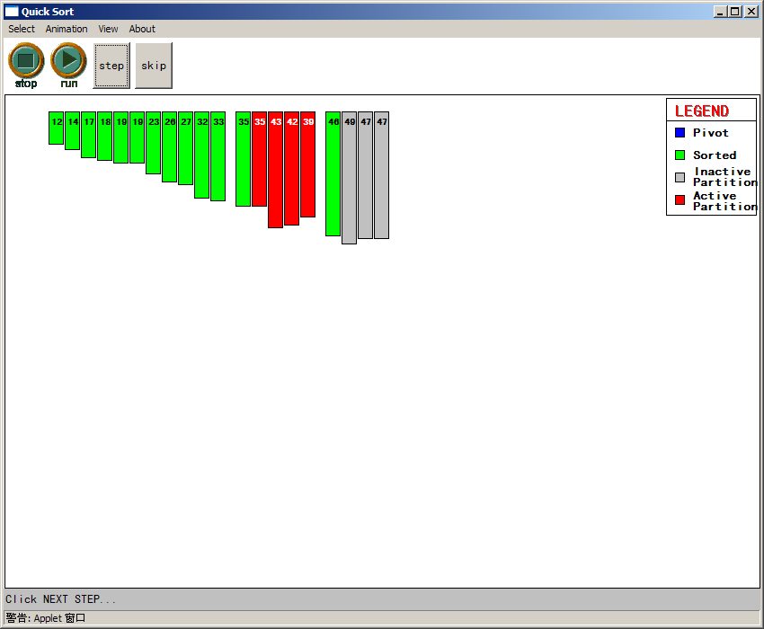

Slide 21
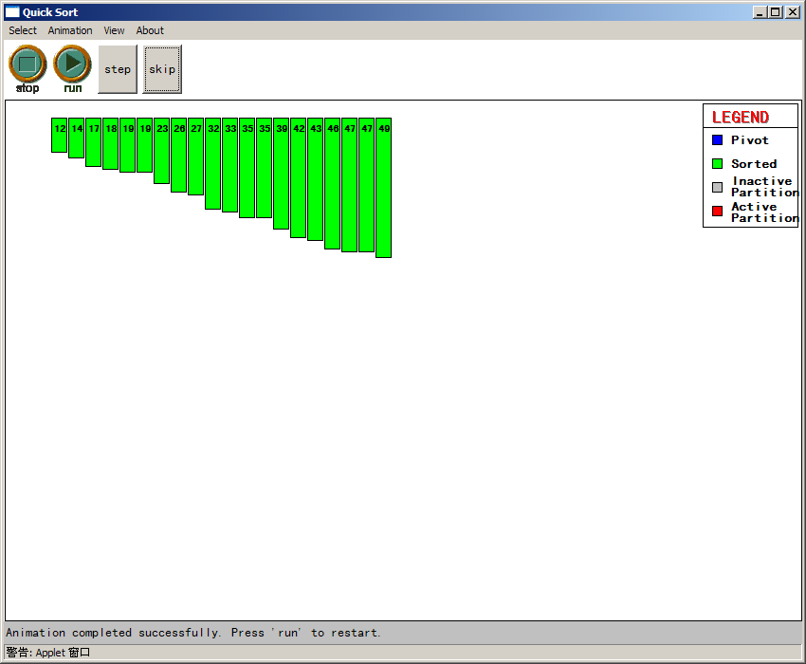

Slide 22
Quicksort
Implementation
quicksort( void *a, int low, int high )
{
int pivot;
/* Termination condition! */
if ( high > low )
{
pivot = partition( a, low, high );
quicksort( a, low, pivot-1 );
quicksort( a, pivot+1, high );
}
}
Divide
Conquer

Slide 23
Quicksort - Partition
int partition( int *a, int low, int high ) {
int left, right;
int pivot_item;
pivot_item = a[low];
pivot = left = low;
right = high;
while ( left < right ) {
/* Move left while item < pivot */
while( a[left] <= pivot_item ) left++;
/* Move right while item > pivot */
while( a[right] > pivot_item ) right--;
if ( left < right ) {
SWAP(a,left,right); left++; right--;
}
}
/* right is final position for the pivot */
a[low] = a[right];
a[right] = pivot_item;
return right;
}

Slide 24
Quicksort - Analysis
Partition
Check every item once O(n)
Conquer
Divide data in half O(log₂n)
Total
Product O(n log n)
Same as Heapsort
quicksort is generally faster
Fewer comparisons

Slide 25
Quicksort vs Heap Sort
Quicksort
Generally faster
Sometimes O(n²)
Better pivot selection reduces probability
Use when you want average good performance
Commercial applications, Information systems
Heap Sort
Generally slower
Guaranteed O(n log n)

Slide 26
Merge Sort - Definition
Definition: A sort algorithm that splits the items to be sorted into two groups, recursively sorts each group, and merge them into a final sorted sequence. Run time is O (n log n).

Slide 27
Merge Sort – Divide-and-Conquer
Divide-and-conquer is a general algorithm design paradigm:
Divide: divide the input data S in two disjoint subsets S1 and S2
Conquer: solve the sub-problems associated with S1 and S2 recursively
Combine: combine the solutions for S1 and S2 into a solution for S
The base case for the recursion are sub-problems of size 0 or 1

Slide 28
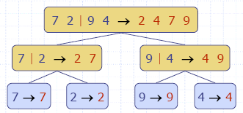
Merge Sort Tree
An execution of merge-sort is depicted by a binary tree
each node represents a recursive call of merge-sort and stores
unsorted sequence before the execution
sorted sequence at the end of the execution
the root is the initial call
the leaves are calls on subsequences of size 0 or 1

Slide 29
Merge Sort - example
Partition
7 2 9 4 | 3 8 6 1

Slide 30
Merge Sort - example
Recursive call, partition
7 2 9 4 | 3 8 6 1
7 2 | 9 4

Slide 31
Merge Sort - example
Recursive call, partition
7 2 9 4 | 3 8 6 1
7 2 | 9 4
7 | 2

Slide 32
Merge Sort - example
Recursive call, base case
7 2 9 4 | 3 8 6 1
7 2 | 9 4
7 | 2
7→7

Slide 33
Merge Sort - example
Recursive call, base case
7 2 9 4 | 3 8 6 1
7 2 | 9 4
7 | 2
7→7
2→2

Slide 34
Merge Sort - example
Merge
7 2 9 4 | 3 8 6 1
7 2 | 9 4
7|2 → 2 7
7→7
2→2

Slide 35
Merge Sort - example
Recursive call, base case, …, base case, merge
7 2 9 4 | 3 8 6 1
7 2 | 9 4
7|2 → 2 7
9|4 → 4 9
7→7
2→2
9→9
4→4

Slide 36
Merge Sort - example
Merge
7 2 9 4 | 3 8 6 1
72|94 → 2 4 7 9
7|2 → 2 7
9|4 → 4 9
7→7
2→2
9→9
4→4

Slide 37
Merge Sort - example
Recursive call, …, merge, merge
7 2 9 4 | 3 8 6 1
72|94 → 2 4 7 9
3 8 6 1→1 3 8 6
7|2 → 2 7
9|4 → 4 9
3 8 → 3 8
6 1 → 1 6
7→7
2→2
9→9
4→4
3→3
8→8
6→6
1→1

Slide 38
Merge Sort - example
Merge
7294|3861 → 12346789
72|94 → 2 4 7 9
3 8 6 1→1 3 8 6
7|2 → 2 7
9|4 → 4 9
3 8 → 3 8
6 1 → 1 6
7→7
2→2
9→9
4→4
3→3
8→8
6→6
1→1

Slide 39
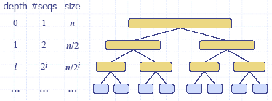
Merge Sort - analysis
The height h of the merge-sort tree is log n + 1 = O(log n)
at each recursive call we divide in half the sequence
The overall amount or work done at the nodes of depth i is O(n)
we partition and merge 2^{i} sequences of size n/2^{i}
we make 2^{i+1} recursive calls
Thus, the total running time of merge-sort is O(n log n)

Slide 40
Merge Sort – sample code
void mergesort(int low, int high)
{
if (low<high)
{
int middle=(low+high)/2;
mergesort(low, middle);
mergesort(middle+1, high);
merge(low, middle, high);
}
}

Slide 41
Merge Sort – sample code (cont.)
void merge(int low, int middle, int high)
{
int i, j, k;
// copy both halves of a to auxiliary array b
for (i=low; i<=high; i++)
b[i]=a[i];
i=low; j=middle+1; k=low;
// copy back next-greatest element at each time
while (i<=middle && j<=high)
if (b[i]<=b[j]) a[k++]=b[i++];
else a[k++]=b[j++];
// copy back remaining elements of first half (if any)
while (i<=middle)
a[k++]=b[i++];
}
Notes:
How to merge two sorted list?
Initially we put two pointers to the beginning of two lists. Then we begin to move the pointers.
The rule is, keep on moving one pointer until the elements it pointed to exceed the element pointed by the other pointer.
Each time we move either pointer, we put the corresponding element in the new merged list.

