Slide 1
Tips on Homework 2
Fei Chen

Slide 2
Goal
Understand the course material through homework 2
Show how to solve problems
Blackboard presentation and recommended answers will be posted online later.

Slide 3
Tree

Slide 4
Idea
Step 1: transform the prefix/post fix expression into an expression tree
Step2: print out the infix representation according to the tree

Slide 5
Tree

Slide 6
Idea
Insertion: for AVL trees, keep record of the height difference of each node and adjust the tree if necessary
Deletion
  Choose a leaf node to replace the deleted node
  Delete the leaf node

Slide 7
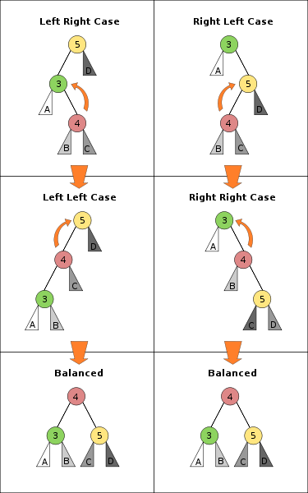
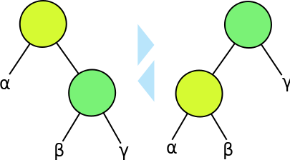
AVL Tree Tips
right rotation vs. left rotation

Slide 8
Hash

Slide 9
Idea
If a collision occurs, two words will hash into the same slot.
To compute the error probability, we need to understand the random source, i.e. the probability space

Slide 10
Heap

Slide 11
Idea
Try the standard insertion methods
For linear time heap building, start from an arbitrary tree and adapt the tree from the bottom to top
The trick for deletion is to replace the root with the last element and then adapt the tree

Slide 12
Conclusion and Q&A
All the problems are basic ones to help you understand the course material.
Q&A.

