Slide 1
Topic-Factorized Ideal Point Estimation Model for Legislative Voting Network
Yupeng Gu†, Yizhou Sun†, Ning Jiang‡, Bingyu Wang†, Ting Chen†
†Northeastern University
‡University of Illinois at Urbana-Champaign

Slide 2
Background
Federal Legislation
(bill)
The House
Senate
Law
Bill 1
Bill 2
……
United States Congress
Ronald Paul
Barack Obama
The House
Senate
Politician
Republican
Democrat
Ronald Paul
Barack Obama
liberal
conservative
Notes:
US Congress: is the bicameral legislature of the federal government of the United States consisting of two houses

Slide 3
Outline
Background and Problem Definition
Topic Factorized Ideal Point Model and Learning Algorithm
Experimental Results
Conclusion

Slide 4
Legislative Voting Network
Notes:
Solid lines (support) & dashed lines (oppo’sition)
Point out this is a heterogeneous network

Slide 5
Problem Definition
Output:
$x_{u}$: Ideal Points for Politician $u$
$a_{d}$: Ideal Points for Bill $d$
Input:
Legislative Network
$x_{u}$’s on different topics
Notes:
This result is extremely helpful to predict the party affiliation for a politician, to know her attitude towards different topics, and her placement among all politicians

Slide 6
Existing Work
1 dimensional ideal point model (Poole and Rosenthal, 1985; Gerrish and Blei, 2011)
High-dimensional ideal point model (Poole and Rosenthal, 1997)
Issue-adjusted ideal point model (Gerrish and Blei, 2012)
Notes:
(1) Each politician and bill is associated with a numeric value (idp) and the voting are inferred by the product of two numbers.
(3) First train a global ideal point like 1. When talked about different topics, they make adjustments based on the global ideal point. They train topic distribution on the text part, and use it as a guidance of the adjustment for each topic.

Slide 7
Motivations
Voters have different attitudes on different topics.
Topic 1
Topic 2
Topic 3
Topic 4
Traditional matrix factorization method cannot give the meanings for each dimension.
$$M$$
$$U$$
$$≈$$
$$⋅$$
$$V^{T}$$
$k^{th}$ latent factor
Topics of bills can influence politician’s voting, and the voting behavior can better interpret the topics of bills as well.
Topic Model:
Health
Public Transport
…
Voting-guided Topic Model:
Health Service
Health Expenses
Public Transport
…
Notes:
1, we need to find ideal points on multiple topics
2, how can we achieve this? → combine two parts
3, … that is, which topics do they concern when they vote → formulation of our model

Slide 8
Outline
Background and Problem Definition
Topic Factorized Ideal Point Model and Learning Algorithm
Experimental Results
Conclusion

Slide 9
Topic Factorized IPM
Entities:
Politicians
Bills
Terms
Links:
($P$, $B$)
($B, T$)
$$n(d,w)$$
$$w$$
$$v_{ud}$$
$$u$$
$$d$$
Politicians
Bills
Terms
Heterogeneous Voting Network
Notes:
Study the two different types of links (consists of two parts, and finally combine them together)
Weight links

Slide 10
Text Part
Politicians
Bills
Terms

Slide 11
Text Part
We model the probability of each word in each document as a mixture of multinomial distributions, as in PLSA (Hofmann, 1999) and LDA (Blei et al., 2003)
$$w_{d}=\left(n\left(d,1\right),n\left(d,2\right),…,n\left(d,N_{w}\right)\right)$$
$$p\left(w_{d} | θ,β\right)={\prod_{w}{(\sum_{k}{θ_{dk}β_{kw})}}}^{n(d,w)}$$
$$p\left(W | θ,β\right)=\prod_{d}{\prod_{w}{({\sum_{k}{θ_{dk}β_{kw})}}^{n(d,w)}}}$$
$$θ_{dk}=p(k|d)$$
$$β_{kw}=p(w|k)$$
$$d$$
$$k$$
$$w$$
Bill
Topic
Word
Notes:
\theta: the probability of bill d belonging to topic k
\beta: the probability that word w is generated from topic k

Slide 12
Voting Part
Politicians
Bills
Terms

Slide 13
Voting Part
Topic
1
Topic
2
……
Topic
$$k$$
……
Topic
$$K$$
Voter $u$
$$x_{u}$$
$$x_{u1}$$ | $$x_{u2}$$ |  |  | $$x_{uk}$$ |  | $$x_{uK}$$
$$x_{uk}∈R$$
Bill $d$
$$a_{d}$$
$$a_{d1}$$ | $$a_{d2}$$ |  |  | $$a_{dk}$$ |  | $$a_{dK}$$
$$a_{dk}∈R$$
$$d_{1}$$
$$d_{2}$$
……
$$d_{N_{D}}$$
$$u_{1}$$
0 | 1 | -1 | 1 | 1 | 1 | 1 | 1
0 | 0 | -1 | 1 | 1 | 1 | -1 | 1
1 | 1 | 1 | 1 | -1 | 1 | 0 | 0
$$x_{u1}$$
$$a_{d1}$$
$${\hat{r}}_{ud}=\sum_{k=1}^{K}{x_{uk}a_{dk}}$$
$$θ_{d1}$$
$$u_{2}$$
……
$$θ_{dk}$$
$$x_{uk}$$
$$a_{dk}$$
……
……
$${\hat{r}}_{ud}=\sum_{k=1}^{K}{θ_{dk}x_{uk}a_{dk}}$$
$$θ_{dK}$$
$$x_{uK}$$
$$a_{dK}$$
$$u_{N_{U}}$$
$$p\left(v_{ud}=1\right)=σ(\sum_{k}{θ_{dk}x_{uk}a_{dk}}+b_{d})$$
YEA
User-Bill voting matrix $V$
$$p\left(v_{ud}=−1\right)=1−σ(\sum_{k}{θ_{dk}x_{uk}a_{dk}}+b_{d})$$
NAY
$$I_{\{v_{ud}=1\}}$$
$$I_{\{v_{ud}=−1\}}$$
$$p\left(V | θ,X,A,b\right)=\prod_{\left(u,d\right):v_{ud}≠0}{(p{\left(v_{ud}=1\right)}^{\frac{1+v_{ud}}{2}}p{\left(v_{ud}=−1\right)}^{\frac{1−v_{ud}}{2}}})$$
Notes:
We use low-dimension vectors x and a for each user and bill respectively, to approximate the original voting matrix.
$b_{d}$: offset/bias (it is reasonable because some bills really have more supports than others)
$θ$: (“how can we utilize topic information?”)

Slide 14
Combining Two Parts Together
The final objective function is a linear combination of the two average log-likelihood functions over the word links and voting links.
We also add an $l_{2}$ regularization term to $A$ and $X$ to reduce over-fitting.
$$=\left(1−λ\right)\frac{\sum_{d,w}{n\left(d,w\right)log⁡(\sum_{k}{θ_{dk}β_{kw})}}}{N_{F}}+λ\frac{\sum_{\left(u,d\right):v_{ud}≠0}{(\frac{1+v_{ud}}{2}\log{p\left(v_{ud}=1\right)}+\frac{1−v_{ud}}{2}\log{p\left(v_{ud}=−1\right)})}}{N_{V}}$$
s.t.
and
$$J\left(θ,β,X,A,b\right)$$
$$0≤θ_{dk}≤1, \sum_{k}{θ_{dk}=1}$$
$$0≤β_{kw}≤1, \sum_{w}{β_{kw}=1}$$
$$=\left(1−λ\right)\frac{\sum_{d,w}{n\left(d,w\right)log⁡(\sum_{k}{θ_{dk}β_{kw})}}}{N_{F}}+λ\frac{\sum_{\left(u,d\right):v_{ud}≠0}{(\frac{1+v_{ud}}{2}\log{p\left(v_{ud}=1\right)}+\frac{1−v_{ud}}{2}\log{p\left(v_{ud}=−1\right)})}}{N_{V}}−\frac{1}{2σ^{2}}(\sum_{u}{{\left|\left|x_{u}\right|\right|}_{2}^{2}+\sum_{d}{{\left|\left|a_{d}\right|\right|}_{2}^{2})}}$$
$$J\left(θ,β,X,A,b\right)$$

Slide 15
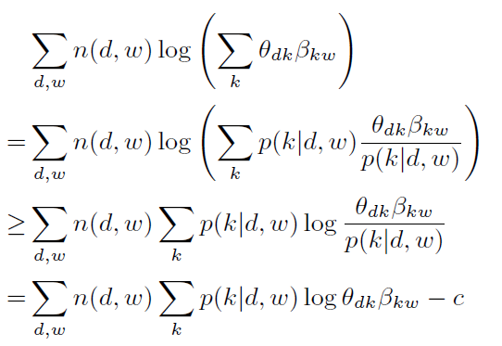
Learning Algorithm
An iterative algorithm where ideal points related parameters ($X,A,b$) and topic model related parameters ($θ,β$) enhance each other.
Step 1: Update $X,A,b$ given $θ,β$
Gradient descent
Step 2: Update $θ,β$ given $X,A,b$
Follow the idea of expectation-maximization (EM) algorithm: maximize a lower bound of the objective function in each iteration
Notes:
Step 1 (GD): because objective function is a concave function of X,A,b given \theta, \beta

Slide 16
Learning Algorithm
Update $θ$: A nonlinear constrained optimization problem.
Remove the constraints by a logistic function based transformation:
and update $μ_{dk}$ using gradient descent.
Update $β$:
Since $β$ only appears in the topic model part, we use the same updating rule as in PLSA:
where
$$\frac{e^{μ_{dk}}}{1+\sum_{k^{′}=1}^{K−1}{e^{μ_{dk′}}}}$$
if $1≤k≤K−1$
$$θ_{dk}=$$
$$\frac{1}{1+\sum_{k^{′}=1}^{K−1}{e^{μ_{dk′}}}}$$
if $k=K$

Slide 17
Outline
Background and Problem Definition
Topic Factorized Ideal Point Model and Learning Algorithm
Experimental Results
Conclusion

Slide 18
Data Description
Dataset:
U.S. House and Senate roll call data in the years between 1990 and 2013$.^{∗}$
1,540 legislators
7,162 bills
2,780,453 votes (80% are “YEA”)
Keep the latest version of a bill if there are multiple versions.
Randomly select 90% of the votes as training and 10% as testing.
${}^{∗}$ Downloaded from http://thomas.loc.gov/home/rollcallvotes.html

Slide 19
Evaluation Measures
Root mean square error (RMSE) between the predicted vote score and the ground truth
RMSE = $\sqrt{\frac{\sum_{\left(u,d\right):v_{ud}≠0}{{\left(\frac{1+v_{ud}}{2}−p\left(v_{ud}=1\right)\right)}^{2}}}{N_{V}}}$
Accuracy of correctly predicted votes (using 0.5 as a threshold for the predicted accuracy)
Accuracy = $\frac{\sum_{u,d}{(I_{\left\{p\left(v_{ud}=1\right)>0.5 \&\& v_{ud}=1\right\}}+I_{\left\{p\left(v_{ud}=1\right)<0.5 \&\& v_{ud}=−1\right\}})}}{N_{V}}$
Average log-likelihood of the voting link
AvelogL = $\frac{\sum_{\left(u,d\right):v_{ud}≠0}{{\left(\frac{1+v_{ud}}{2}\log{p}\left(v_{ud}=1\right)+\frac{1−v_{ud}}{2}\log{p(v_{ud}=−1)}\right)}^{}}}{N_{V}}$

Slide 20
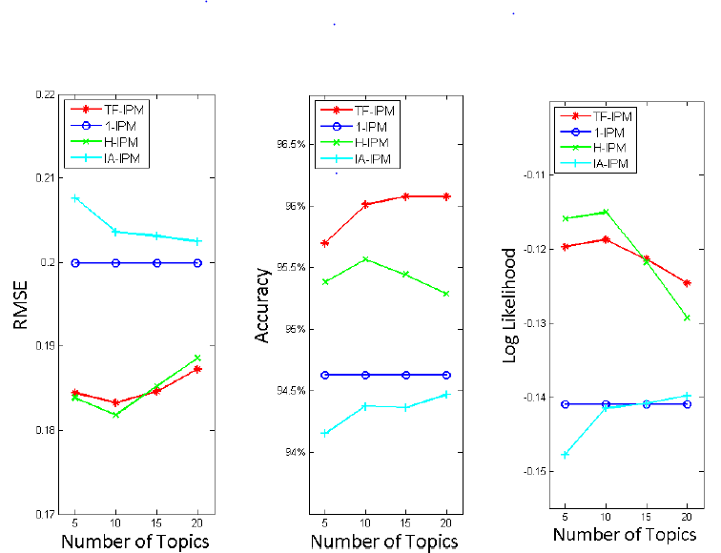
Experimental Results
Training Data set
Testing Data set
Notes:
Show our advantages over (1)1-ipm; (2)H-IPM; (3)IA-IPM

Slide 21
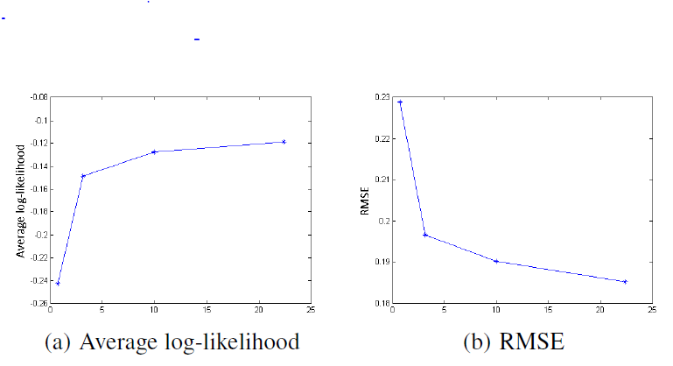
Parameter Study
$$=\left(1−λ\right)⋅avelogL\left(text\right)+λ⋅avelogL(voting)−\frac{1}{2σ^{2}}(\sum_{u}{{\left|\left|x_{u}\right|\right|}_{2}^{2}+\sum_{d}{{\left|\left|a_{d}\right|\right|}_{2}^{2})}}$$
$$J\left(θ,β,X,A,b\right)$$
Parameter study on $λ$
Parameter study on $σ$ (regularization coefficient)
Notes:
\sigma: the performance becomes less sensitive when $σ$ becomes larger

Slide 22
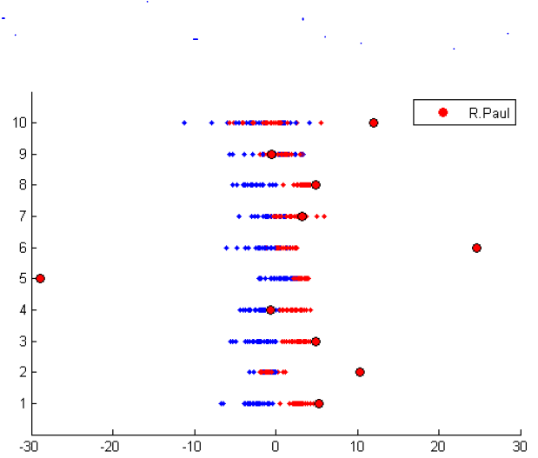
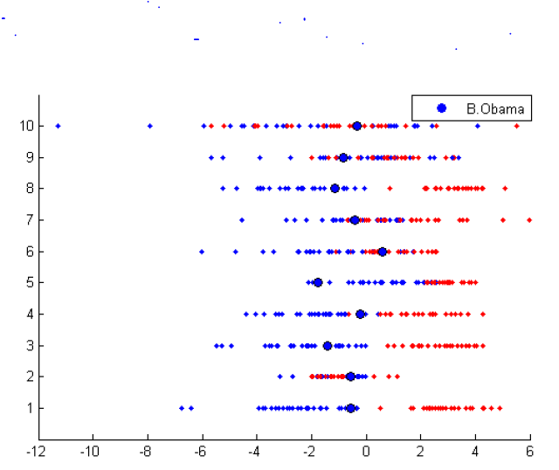
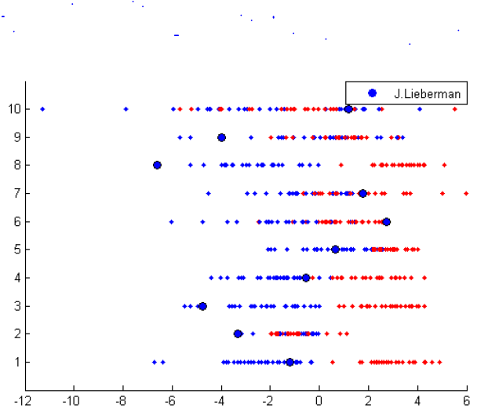
Case Studies
Ideal points for three famous politicians: (Republican, Democrat)
Ronald Paul (R), Barack Obama (D), Joe Lieberman (D)
Public Transportation
Funds
Health Expenses
Health Service
Law
Military
Financial Institution
Individual Property
Education
Foreign
Ronald Paul
Barack Obama
Joe Lieberman
Notes:
Republican: conservative Democrat: liberal
Liberal at war = anti-war

Slide 23
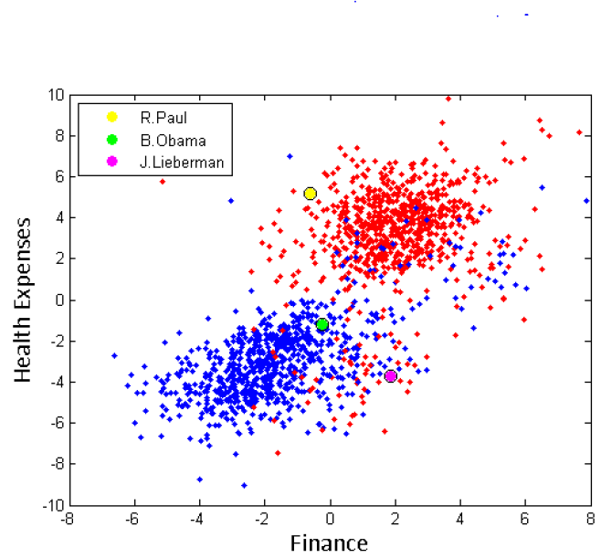
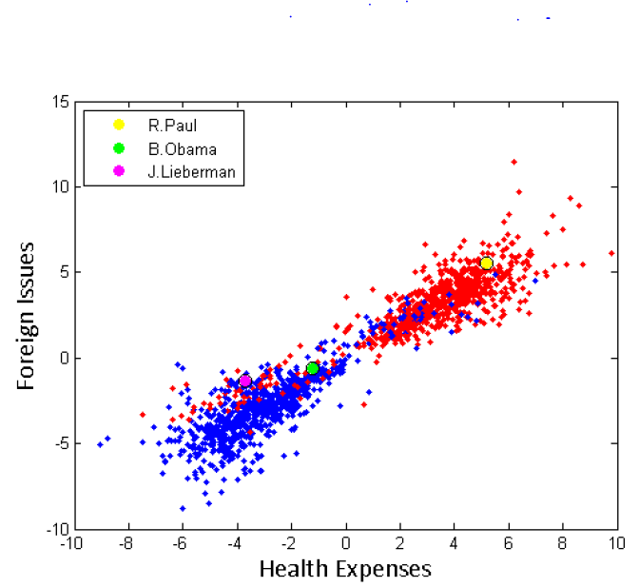
Case Studies
Pick three topics: (Republican, Democrat)
Notes:
Our method can divide two parties quite well.
We can also detect outliers from such visualization (e.g. R.Paul is an outlier in the first fig)

Slide 24
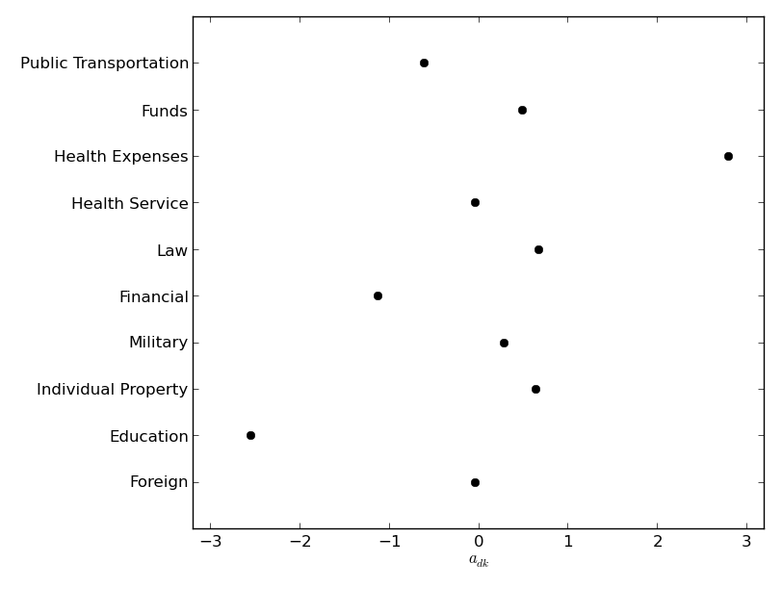
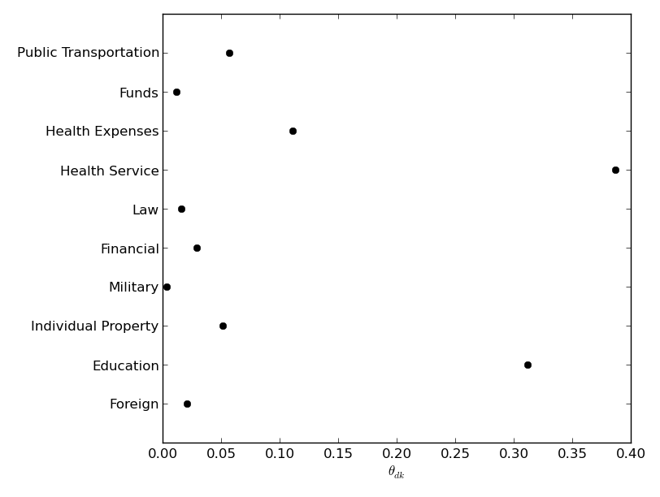
Case Studies
Bill: H_R_4548 (in 2004)
$$x_{uk}$$
Nay
R. Paul H_R_4548
For Unseen Bill $d$:
Topic Model
$$θ_{d}$$
$$a_{dk}$$
$$θ_{dk}$$
TF-IPM
$$x_{u}$$
$$p\left(v_{ud}=1\right)$$
$$p\left(v_{ud}=1\right)=σ(\sum_{k}{θ_{dk}x_{uk}a_{dk}}+b_{d})$$
Experts
$$a_{d},b_{d}$$
Notes:
One part of the bill: awarding scholarship to us citizens and the reimbursement of students for education and training costs
Another part: health insurance program, talks about protecting human health and welfare in emergency cases
Unseen bills: if $a_{dk}$ is provided by some experts

Slide 25
Outline
Background and Problem Definition
Topic Factorized Ideal Point Model and Learning Algorithm
Experimental Results
Conclusion

Slide 26
Conclusion
We estimate the ideal points of legislators and bills on multiple dimensions instead of global ones.
The generation of topics are guided by two types of links in the heterogeneous network.
We present a unified model that combines voting behavior and topic modeling, and propose an iterative learning algorithm to learn the parameters.
The experimental results on real-world roll call data show our advantage over the state-of-the-art methods.
Notes:
First.. Besides… In addition… Finally

Slide 27
Thanks Q & A

