Slide 1
Online Rank Elicitation for Plackett-Luce: A Dueling Bandits Approach
Balázs Szörényi
Technion, Haifa, Israel /
MTA-SZTE Research Group on
Artificial Intelligence,
Hungary
Róbert Busa-Fekete, Adil Paul, Eyke Hüllermeier
Department of Computer Science,
University of Paderborn Paderborn,
Germany
Twenty-ninth Annual Conference on Neural Information Processing Systems (NIPS 2015)

Slide 2
Problem: Rank Elicitation from pairwise preferences
The set of items to be ranked $I=\{1,…,M\}$
Given: a set of stochastic pairwise preferences
e.g. {$1≻3$, $7≻9$, $5≻8\},$
Goal: To infer a complete ranking of all items
e.g. $\{1,2,…,M\}$
>
1.
2.
>
3.
>
4.

Slide 3
Moving to online setting
The learner is allowed to sample the pairwise preference actively
The set of items to be ranked $I=\{1,…,M\}$
Each iteration: compare two items $i,j∈I$
Observe a stochastic pairwise preference
The goal is to learn the post probable ranking over all items
Referred as the Dueling Bandit problem
Notes:
Extend: Dueling Bandit vs K-armed bandit

Slide 4
The online ranking problem
$p_{i,j}$ denotes the probability that item $i$ is preferred over item $j$
Without probabilistic assumption on $p_{i,j}$
Sample complexity grows quadratically in number M, i.e. $O(M^{2})$
Different online ranking methods have different assumptions

Slide 5
Stochastic transitivity assumptions
if $p_{i,j}≥1/2$ and $p_{j,k}≥1/2$
Then $p_{i,k}≥\max_{}\left(p_{i,j},p_{j,k}\right)$
Allow us to devise algorithm with a lower sample complexity
e.g. $O(M log(M))$
Establish a connection to sorting algorithms

Slide 6
Connection with sorting algorithm
Naively apply a sorting algorithm as sampling scheme
Since all the pairwise comparisons are stochastic
A random order will be produced
What can we say about the optimality of such an order?
>
>
>
>
>

Slide 7
Contributions
We combine QuickSort algorithm and a stochastic preference model
This harmony was first presented in [Ailon-2008]
We exploit this harmony for online rank elicitation
We succeed in developing a budged version of QuickSort with complexity of $O(M log(M))$
We devise PAC-style algorithms based on Budged QuickSort to:
Find close-to-optimal item
Find close-to-optimal ranking

Slide 8
Preliminaries
A ranking is a bijection $r$ on $I$, where $I$ is the set of items to be ranked
Also represented as a vector $r=\left(r_{1},…,r_{M}\right)=(r\left(1\right),…,r(M))$
Where $r_{j}=r(j)$ is the rank of the $j$th item
If $i$ is preferred over $j$ in $r$, i.e. $i≻_{r}j$, then $r_{i}<r_{j}$
The set of rankings can be identified with the symmetric group $𝕊_{M}$ of order $M$
The inverse $o=r^{−1}$ defined by $o_{r(j)}=j$ for all $j∈[M]$
We denote by $𝓛\left(r_{j}>r_{i}\right)=\left\{r∈𝕊_{M} | r_{j}>r_{i}\right\}$ for the set of rankings for which $i$ is preferred over $j$

Slide 9
Dueling Bandit Framework
Parameter: $δ$
Sample the pairwise preference between $i$ and $j$
Observe a binary feedback $o^{t}$,
$o_{}^{t}=1$ means $i^{t}≻j^{t}$
$o_{}^{t}=0$ means $j^{t}≻i^{t}$
Repeat
$$t≔t+1$$
Updates the estimate ${\hat{p}}_{ij}^{t}$
Prediction
Continue
or
terminate?
Predication achieve with probability at least $1−δ$

Slide 10
Estimation of pairwise probability
Pair of items chosen in t-th step: $(i^{t},j^{t})$
Set of steps decides to compare item $i$ and $j$:
$$I_{i,j}^{t}=\left\{l∈\left[t\right] | \left(i^{l},j^{l}\right)=\left(i,j\right)\right\}$$
Size of this set: $n_{i,j}^{t}=\#I_{i,j}^{t}$
The proportion of “wins” of $i$ against $j$ by time $t$:
$${\hat{p}}_{i,j}^{t}=\frac{1}{n_{i,j}^{t}}\sum_{l∈I_{i,j}^{t}}{o^{l}}$$
which is a estimation of the pairwise probability

Slide 11
The Plackett-Luce Model
Widely-used probability distribution on rankings
Parameterized by a “skill” vector $v=\left(v_{1},…,v_{M}\right)$
$v_{i}$ is the skill associated with item $i$
An item with a higher skill is more preferred
$$v_{2}$$
$$v_{3}$$
$$v_{5}$$
$$v_{1}$$
$$v_{4}$$

Slide 12
The Plackett-Luce Model
The probability of observing a particular ranking $r$, is
where $o=r^{−1}$
Mimics the successive construction of a ranking
Each time choosing one of the remaining items with probability proportional to its skill

Slide 13
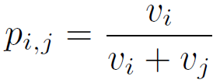
Properties of PL Model
The marginal probabilities are easy to calculate
Satisfies the stochastic transitivity
Most probable ranking:
simply sort the items according to their skill parameters

Slide 14
Harmony of QuickSort and Plackett-Luce model
This harmony was investigated in [Alion-2008]
The pairwise comparisons are drawn from the pairwise marginal of the Plackett-Luce model
The probability distribution of ranking returned by QuickSort:
$$ℙ_{QS}\left(∙ | P\right)$$
where the matrix $P$ contains the marginal of Plackett-Luce model
$P_{ij}=P_{i,j}$ is the pairwise marginal of item $i$ and $j$

Slide 15
Harmony of QuickSort and Plackett-Luce model
The probability distribution of ranking returned by QuickSort:
$$ℙ_{QS}\left(∙ | P\right)$$
It was shown that $ℙ_{QS}\left(∙ | P\right)$ obeys the property of pairwise stability
i.e. it preserves the pairwise marginal of Plackett-Luce model
Theorem 1 (Theorem 4.1 in [Alion-2008])
Let $P$ be given by the pairwise marginal, i.e., $p_{i,j}=v_{i}/(v_{i}+v_{j})$.
Then, $p_{i,j}=ℙ_{QS}\left(i≻j | P\right)=\sum_{r∈𝓛(r_{j}>r_{i})}{ℙ_{QS}(r|P)}$

Slide 16
Budgeted QuickSort algorithm
Generate ranking from QuickSort
Worst case sample complexity: $O(M^{2})$
We introduce a budgeted version of the QuickSort algorithm
Terminates if the algorithm compares too many pairs
Upon termination, it may return a partial order
Still preserves the pairwise stability property

Slide 17
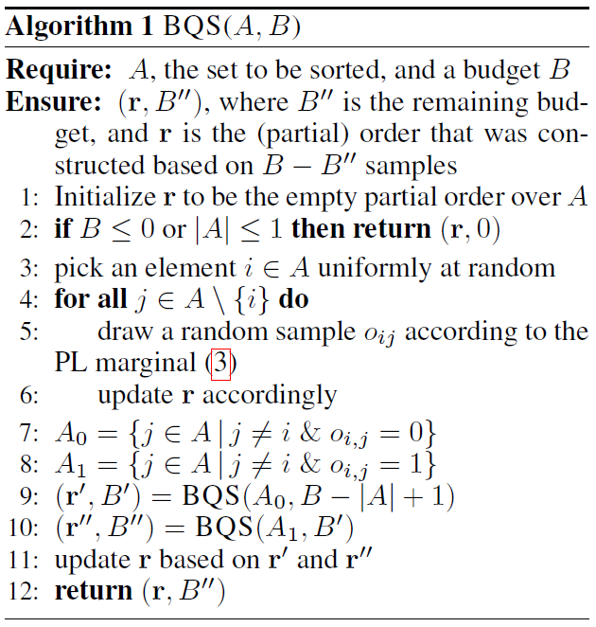
Budgeted QuickSort algorithm
Terminate as soon as the number of pairwise comparisons exceeds the budget $B$

Slide 18
Random tree of QuickSort algorithm
BQS($A,∞$) recovers the original QuickSort algorithm
A run of BQS($A,∞$) presented as a random tree $τ$
Such tree determines a ranking, denoted by $r_{τ}$
1 2 3 4 6 7 8 9
1 2 3 4
7 8 9
9
9
1
3 4
4

Slide 19
Random tree of Budgeted QuickSort
For $B>0$, denote the tree returned by BQS($A,B$) as $τ^{B}$
Let $Τ^{B}$ denote the set of all possible outcomes of $τ^{B}$
1 2 3 4 6 8 7 9
1 2 3 4
8 7 9
1
3 4
Suppose budget used up here
Item 8,7,9 are incomparable
in the ranking
We just know they are $>6$
4

Slide 20
Pairwise Stability of Budget QuickSort
BQS does not introduce any bias in the marginal
Let $Τ_{i,j}^{B}$ denote set of tree $T∈Τ^{B}$ in which $i$ and $j$ are incomparable in the associated ranking
Proposition 2: For any $B>0$, any set $A⊂I$ and any indices $i,j∈A$, the partial order $r=r_{τ^{B}}$ generated by BQS($A,B$) satisfies $ℙ\left(i≻_{r}j | τ^{B}∈Τ^{B}\right)=\frac{v_{i}}{v_{i}+v_{j}}$
i.e. whenever two items $i$ and $j$ are comparable by the partial ranking r generated by BQS, $i≻_{r}j$ with probability exactly $\frac{v_{i}}{v_{i}+v_{j}}$.

Slide 21
Proof sketch of Proposition 2
Proposition 2: For any $B>0$, any set $A⊂I$ and any indices $i,j∈A$, the partial order $r=r_{τ^{B}}$ generated by BQS($A,B$) satisfies $ℙ\left(i≻_{r}j | τ^{B}∈Τ^{B}\right)=\frac{v_{i}}{v_{i}+v_{j}}$
Conditioned on the event that $i$ and $j$ are incomparable by $r$
$i≻_{r}j$ would have been obtained with probability $\frac{v_{i}}{v_{i}+v_{j}}$ in case execution of BQS has been continued
The results follows by combining this with Theorem 1

Slide 22
First Goal of learner: PAC-item
Optimal item referring to the Condorcet winner
An item $i^{∗}$ is a Condorcet winner if $P_{i^{∗},j}>1/2$ for all $i≠i^{∗}$
Difficult to determine an order between $i$ and $j$ when $P_{i,j}≈\frac{1}{2}$
Hence, we relax the goal to the find the PAC-item
An item $j$ is a PAC-item, if it is beaten by the Condorcet winner with at most an $ε$-margin:
$\left|p_{i^{∗},j}−\frac{1}{2}\right|<ε$

Slide 23
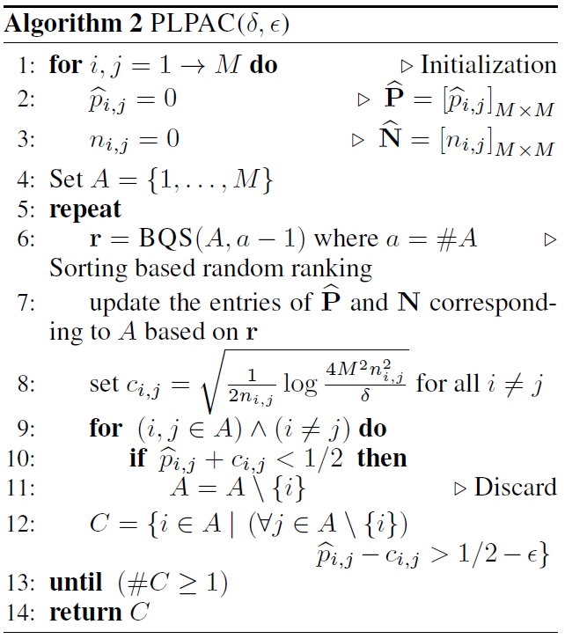
PLPAC Algorithm
Goal: Finding the PAC item
In each iteration,
Generate a partial ranking (line 6)
Translate ranking into pairwise
comparisons
Update the estimates of marginal

Slide 24
PLPAC Algorithm
Apply a elimination strategy:
Remove $i$ if it is significantly beaten
by another $j$
Terminates when
the PAC item set has
at least one item

Slide 25
Sample Complexity analysis of PLPAC
In each iteration,
partial orderings $r$ in line 6 defines a bucket order
Pairs are incomparable within a bucket
But pairs from different buckets are comparable
With budget $a−1$, the bucket order has only two buckets
After the first partition of BQS, it will use up all the budget $a−1$
4 1 3 2 6 8 7 9

Slide 26
Sample Complexity analysis of PLPAC
Observation:
The optimal arm $i^{∗}$ and an arbitrary arm $i(≠i^{∗})$ fall into different buckets “often enough”
Allow us to upper-bound the number of pairwise comparisons
Theorem 3: Set $Δ_{i}=\text{(1/2)}\text{max}\text{\{}ε\text{,}p_{i^{∗},i}−1\text{/2}\text{\}=(1/2)}$ $\text{max}\text{\{}ε\text{,}\frac{v_{i^{∗}}−v_{i}}{2(v_{i^{∗}}+v_{i})}\text{\}}$
for each index $i≠i^{∗}$. The total number of samples for PLPAC algorithm is $O(M\max_{i≠i^{∗}}{\frac{1}{Δ_{i}^{2}}}\log{\frac{M}{Δ_{i}δ}})$.
The dependence on $M$ is of order $M\log{M}$

Slide 27
Second goal of learner: AMPR
The most probable ranking, $r^{∗}= \underset{r∈𝕊_{M}}{arg max}{ℙ(r)}$
Difficult to determine an order between $i$ and $j$ when $P_{i,j}≈\frac{1}{2}$
Hence, difficult to find the most probable ranking
Relax the goal to find the Approximately Most Probable Ranking

Slide 28
Second goal of learner: AMPR
Find $r$ has the following property:
No pair of items $1≤i,j≤M$, such that
$r_{i}^{∗}<r_{j}^{∗},r_{i}>r_{j}$ and $p_{i,j}>\frac{1}{2}+ε$
Ranking $r$ is allowed to differ from $r^{∗}$ only for those items whose pairwise probabilities close to $1/2$
Any ranking $r$ satisfying this property is called an approximately most probable ranking (AMPR)

Slide 29
PLPAC-AMPR algorithm
The $r^{∗}$ of a PL model is the ranking that sorts items in decreasing order of their skill values:
$r_{i}<r_{j}$ iff $v_{i}>v_{j}$ for any $i≠j$
Moreover, since $v_{i}>v_{j}$ implies $p_{i,j}>1/2$,
We can also sort the items based on Copeland score
$$b_{i}=\#\{1≤j≤M|\left(i≠j\right)∧(p_{i,j}>1/2)\}$$
yields a most probable ranking $r^{∗}$
The PLPAC-AMPR algorithm is based on estimating the Copeland score of the items

Slide 30
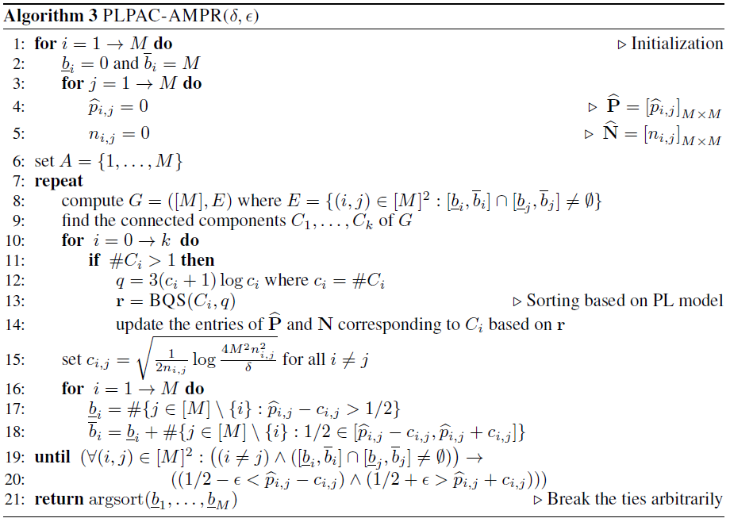
PLPAC-AMPR

Slide 31
PLPAC-AMPR algorithm
In each iteration,
Generates rankings based on sorting
Update pairwise probability estimates $\hat{P}$
Compute a lower and upper bound $\underline{b_{i}}$ and $\overline{b_{i}}$ for each scores $b_{i}$
$$\underline{b_{i}}=\#\{j∈[M]\backslash \{i\}|{\hat{p}}_{i,j}−c>1/2\}$$
Which is the number of items that are beaten significantly by item $i$ based on current estimates of pairwise marginal.
$\overline{b_{i}}=\underline{b_{i}}+s_{i}$, where $s_{i}=\#\{j∈\left[M\right]\backslash \{i\}|\frac{1}{2}∈[{\hat{p}}_{i,j}−c,{\hat{p}}_{i,j}+c]\}$
$s_{i}$ is the number of pairs for which cannot decided their order

Slide 32
PLPAC-AMPR algorithm
We don’t need to sort the whole item set $[M]$ in each iteration
Because if $\left[\underline{b_{i}},\overline{b_{i}}\right]∩\left[\underline{b_{j}},\overline{b_{j}}\right]=∅$,
then we already know the order of item $i$ and $j$
Consider the interval graph $G=(\left[M\right],E)$,
where $E=\{\left(i,j\right)∈{\left[M\right]}^{2}|\left[\underline{b_{i}},\overline{b_{i}}\right]∩\left[\underline{b_{j}},\overline{b_{j}}\right]≠∅\}$
Denote the connected components by $C_{1},…,C_{k}⊂[M]$
In each iteration, call the Budged Quick sort with the connected components

Slide 33
PLPAC-AMPR algorithm
The algorithm terminates if
There is no pair of item $i$ and $j$, for which the ordering has not been elicited yet, i.e. $\left[\underline{b_{i}},\overline{b_{i}}\right]∩\left[\underline{b_{j}},\overline{b_{j}}\right]≠∅$
and their pairwise probabilities is close to ½, i.e., $\left|p_{i^{∗},j}−\frac{1}{2}\right|<ε$

Slide 34
Sample Complexity Analysis of PLPAC-AMPR
Concentration property of the performance of QuickSort
No pair of items falls into the same bucket “too often” in the partial order returned by BQS
Allows us to upper-bound the number of pairwise comparisons with high probability
Theorem 4: Set $Δ_{(i)}^{′}=\text{(1/2)}\text{max}\text{\{}ε\text{,}\frac{v_{(i+1)}−v_{(i)}}{2(v_{(i+1)}+v_{(i)})}\}$ for each $1≤i≤M$, where $v_{(i)}$ denotes the i-th largest skill parameters. The total number of samples for PLPAC-AMPR algorithm is $O((M\log{M})\max_{1≤i≤M−1}{\frac{1}{{\left(Δ_{\left(i\right)}^{′}\right)}^{2}}}\log{\frac{M}{Δ_{\left(i\right)}^{′}δ}})$.
The dependence on $M$ is of order $M\log^{2}{M}$

Slide 35
Experiments – The PAC-item Problem
Compare with other preference-based online algorithms applicable in our setting, including:
1. INTERLEAVED FILTER (IF) [Yue et al., 2012]
2. BEAT THE MEAN [Yue et al., 2011]
3. MALLOWSMPI [Busa-Fekete et al., 2014]
Setting the parameters of PL to $v_{i}=1/(c+i)$ with $c=\{0, 2, 5\}$
$c$ controls the complexity of the rank elicitation task
The larger the value of $c$, the more difficult to determine the order between two items $i$ and $j$

Slide 36
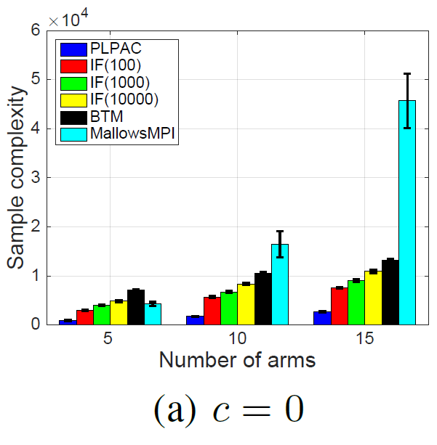
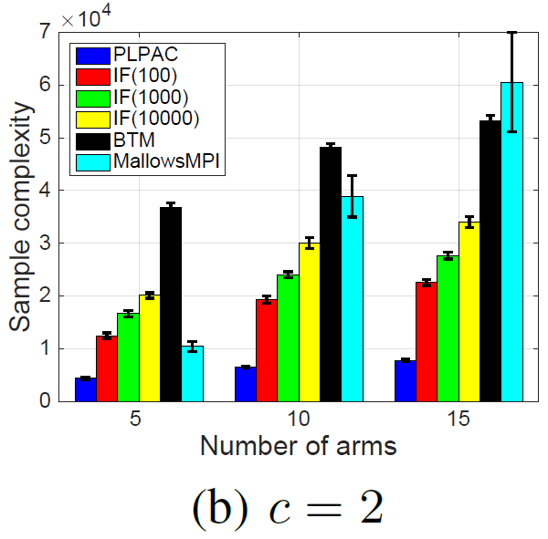
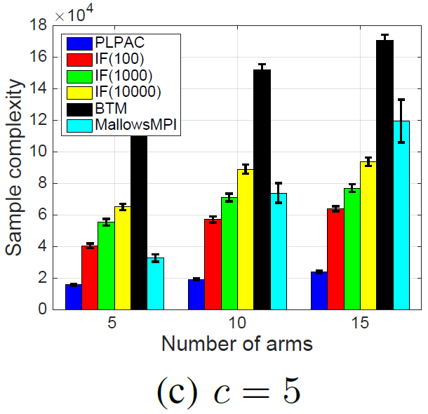
Experiments – The PAC-item Problem
The sample complexity for M $∈$ {5, 10, 15}, $δ$ = 0.1, $ε$ = 0. The results are averaged over 100 repetitions.

Slide 37
Experiment – The AMPR Problem
RankCentrality algorithm[Negahban et.al-2012] is taken as base line
Setting the parameters of PL to
$v_{i}=1/(c+i)$ with $c=\{0, 2, 5\}$

Slide 38
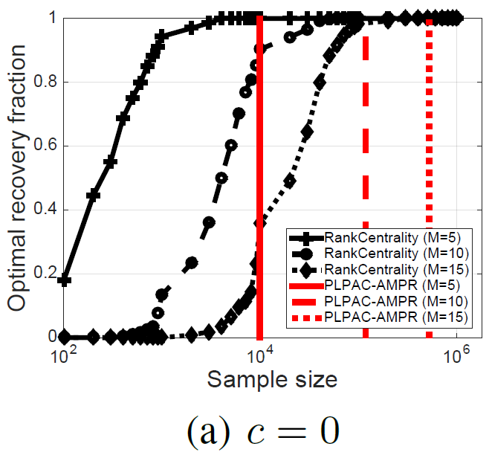
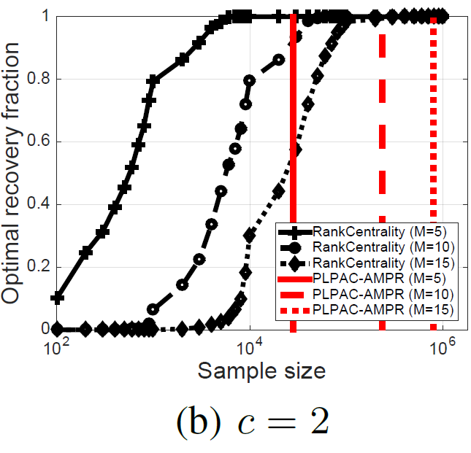
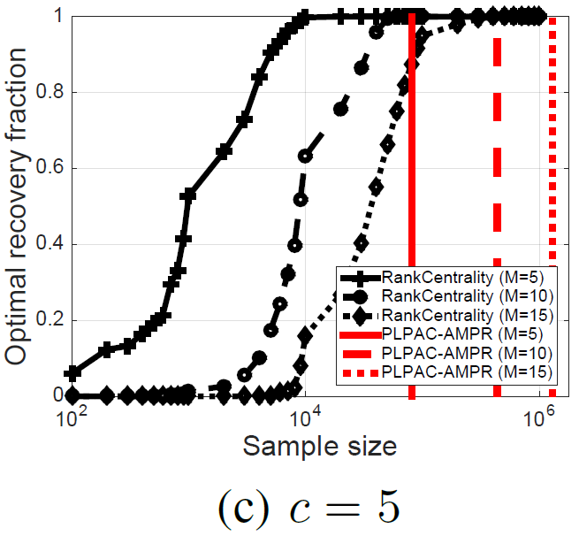
Experiment – The AMPR Problem
Sample complexity for M $∈$ {5, 10, 15}, $δ$ = 0.1, $ε$ = 0. The results are averaged over 100 repetitions.

Slide 39
Conclusion
In the setting of dueling bandits under the PL model assumption
We consider two task:
Find the approximate best arm
Find the approximate most probable ranking
We propose algorithms for both tasks based on a budgeted quick sort algorithm by exploiting the pairwise stability of quick sort algorithm
We also give a sample complexity bound for both algorithms:
$O(M\log{M})$
$O(M\log^{2}{M})$

