Slide 1
Factorization Machine: model, optimization and applications
Yang LIU
Email: yliu@cse.cuhk.edu.hk
Supervisors: Prof. Andrew Yao Prof. Shengyu Zhang

Slide 2
Outline
Factorization machine (FM)
A generic predictor
Auto feature interaction
Learning algorithm
Stochastic gradient descent (SGD)
…
Applications
Recommendation systems
Regression and classification
…

Slide 3
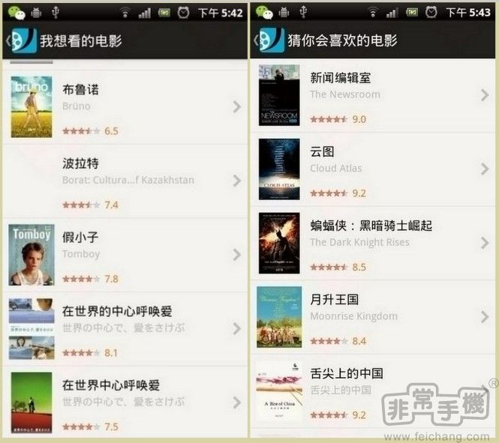
DouBan movie

Slide 4
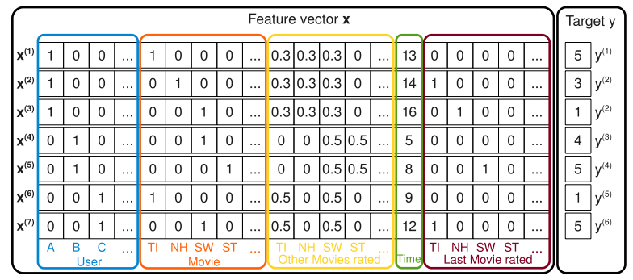
Prediction Task
e.g. Alice rates Titanic 5 at time 13
?
?
Notes:
Add circles on the corresponding entries

Slide 5
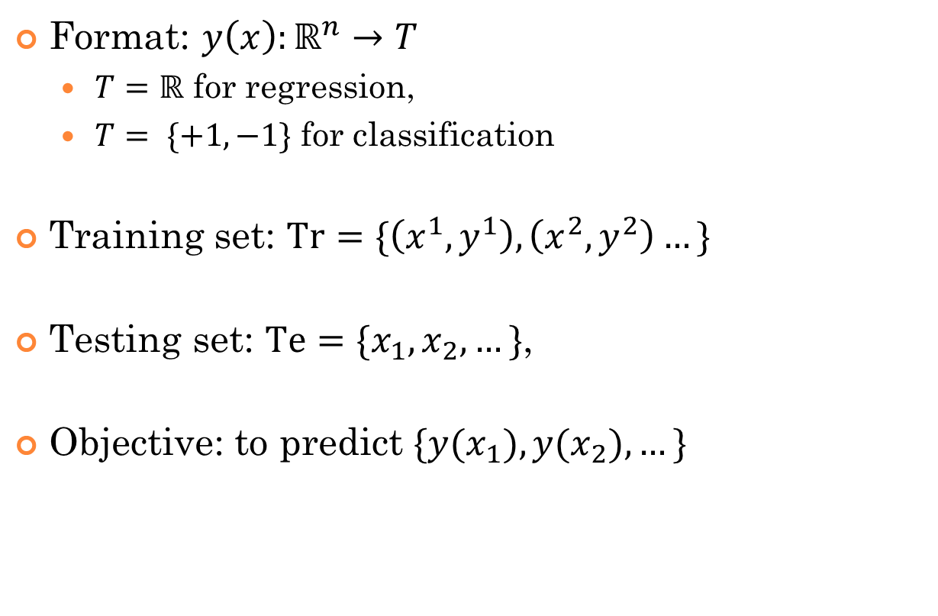
Prediction Task
Format: $y\left(x\right):ℝ^{n}→T$
$T=ℝ$ for regression,
$T= \{+1,−1\}$ for classification
Training set: $Tr=\{\left(x^{1},y^{1}\right),\left(x^{2},y^{2}\right)…\}$
Testing set: $\text{Te}=\{x_{1},x_{2},…\}$,
Objective: to predict $\{y(x_{1}),y(x_{2}),…\}$

Slide 6
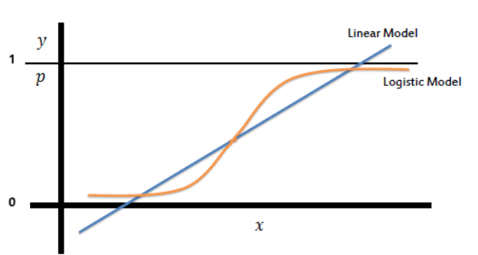
Linear Model – Feature Engineering
Linear SVM
Logistic Regression
$\hat{y}\left(x\right)=w_{0}+w^{T}x$
$$\hat{y}\left(x\right)=\frac{1}{1+w_{0}exp(−w^{T}x )}$$

Slide 7
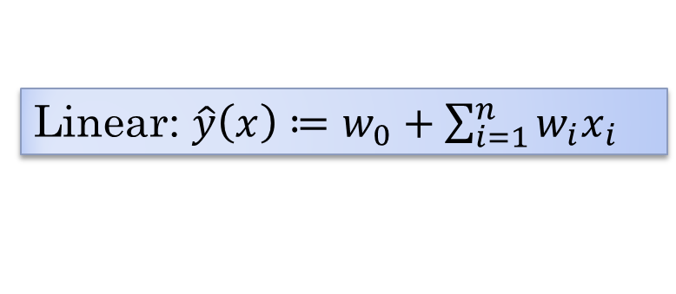
Factorization model
Model parameters $Θ=\left\{w_{0},w_{1},…w_{n},v_{1},…,v_{n}\right\}$
$v_{i}∈ℝ^{k},i=1,…,n$, where
$k$ is the inner dimension
Linear: $\hat{y}\left(x\right)≔w_{0}+\sum_{i=1}^{n}{w_{i}x_{i}}$
FM: $\hat{y}\left(x\right)≔w_{0}+\sum_{i=1}^{n}{w_{i}x_{i}}+\sum_{i=1}^{n}{\sum_{j=i+1}^{n}{〈v_{i},v_{j}〉x_{i}x_{j}}}$
Interaction between variables

Slide 8
Interaction matrix
$$w_{i,j}=〈v_{i},v_{j}〉$$
W
Notes:
Page numbers…

Slide 9
Interaction matrix
$$w_{i,j}=〈v_{i},v_{j}〉$$
W

Slide 10
Interaction matrix
$$w_{i,j}=〈v_{i},v_{j}〉$$
W
?

Slide 11
Interaction matrix
$$w_{i,j}=〈v_{i},v_{j}〉$$
W
V
V^{T}
=
k

Slide 12
Interaction matrix
$$w_{i,j}=〈v_{i},v_{j}〉$$
W
V
V^{T}
=
k
$\hat{y}\left(x\right)≔w_{0}+\sum_{i=1}^{n}{w_{i}x_{i}}+\sum_{i=1}^{n}{\sum_{j=i+1}^{n}{〈v_{i},v_{j}〉x_{i}x_{j}}}$

Slide 13
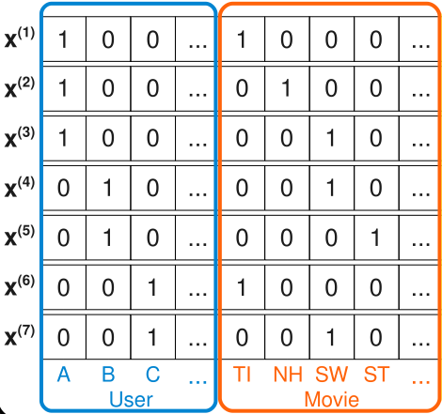
Interaction matrix
$$w_{i,j}=〈v_{i},v_{j}〉$$
W
V
V^{T}
=
$\hat{y}\left(x\right)≔w_{0}+\sum_{i=1}^{n}{w_{i}x_{i}}+\sum_{i=1}^{n}{\sum_{j=i+1}^{n}{〈v_{i},v_{j}〉x_{i}x_{j}}}$

Slide 14
Interaction matrix
$$w_{i,j}=〈v_{i},v_{j}〉$$
W
V
V^{T}
=
$$=v_{A}^{T}v_{TI}$$
$\hat{y}\left(x\right)≔w_{0}+\sum_{i=1}^{n}{w_{i}x_{i}}+\sum_{i=1}^{n}{\sum_{j=i+1}^{n}{〈v_{i},v_{j}〉x_{i}x_{j}}}$
Notes:
Try to distinguish x^{(i)} and x_i.

Slide 15
Interaction matrix
$$w_{i,j}=〈v_{i},v_{j}〉$$
W
V
V^{T}
$$w_{ij}$$
$$v_{i}^{T}$$
$$v_{j}$$
=
Factorization
$\hat{y}\left(x\right)≔w_{0}+\sum_{i=1}^{n}{w_{i}x_{i}}+\sum_{i=1}^{n}{\sum_{j=i+1}^{n}{〈v_{i},v_{j}〉x_{i}x_{j}}}$

Slide 16
Interaction matrix
$$w_{i,j}=〈v_{i},v_{j}〉$$
W
V
V^{T}
$$w_{ij}$$
$$v_{i}^{T}$$
$$v_{j}$$
=
Machine
Factorization
$\hat{y}\left(x\right)≔w_{0}+\sum_{i=1}^{n}{w_{i}x_{i}}+\sum_{i=1}^{n}{\sum_{j=i+1}^{n}{〈v_{i},v_{j}〉x_{i}x_{j}}}$

Slide 17
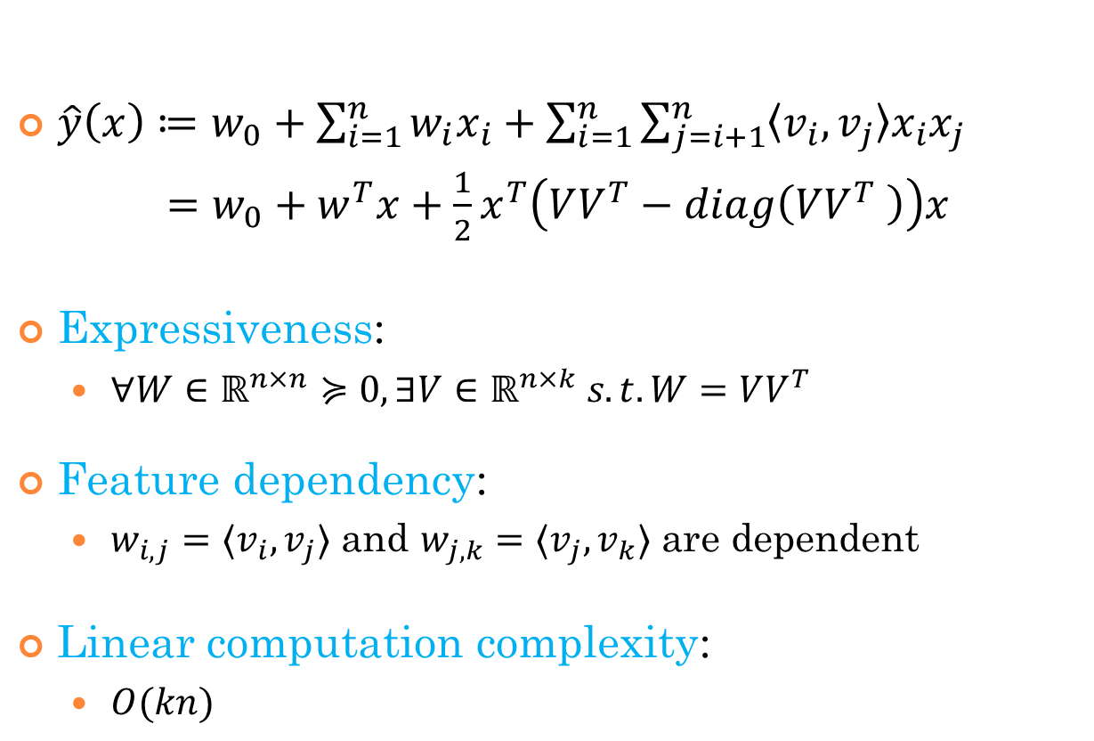
FM: properties
$\hat{y}\left(x\right)≔w_{0}+\sum_{i=1}^{n}{w_{i}x_{i}}+\sum_{i=1}^{n}{\sum_{j=i+1}^{n}{〈v_{i},v_{j}〉x_{i}x_{j}}}$
$=w_{0}+w^{T}x+\frac{1}{2}x^{T}\left(VV^{T}−diag\left(VV^{T} \right)\right)x$
Expressiveness:
$∀W∈ℝ^{n×n}≽0,∃V∈ℝ^{n×k} s.t. W=VV^{T}$
Feature dependency:
$w_{i,j}=〈v_{i},v_{j}〉$ and $w_{j,k}=〈v_{j},v_{k}〉$ are dependent
Linear computation complexity:
$O(kn)$

Slide 18
Optimization Target
Min ERROR
Min ERROR + Regularization
$\text{OPT}\text{ = }\underset{Θ}{argmin}\left(\sum_{\left(x,y\right)∈Tr}{l\left(\hat{y}\left(x | Θ\right),y\right)+\sum_{θ∈Θ}{λ_{θ}θ^{2}}}\right)$
Loss function
$l\left(y_{1},y_{2}\right)={\left(y_{1}−y_{2}\right)}^{2}$
$l\left(y_{1},y_{2}\right)=\ln{(1+exp⁡(−y_{1}y_{2}))}$

Slide 19
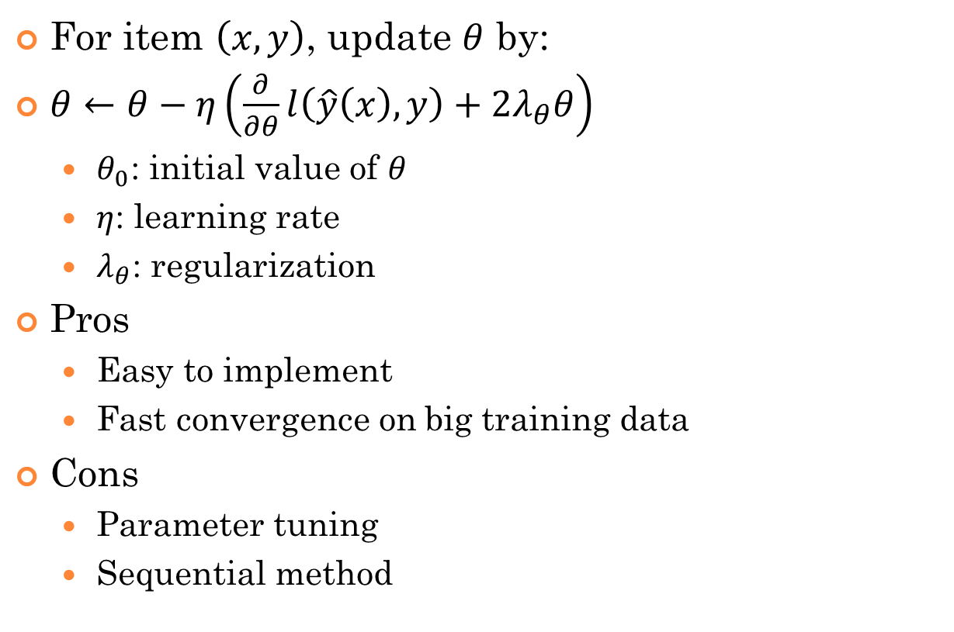
Stochastic Gradient Descent (SGD)
For item $\left(x,y\right)$, update $θ$ by:
$θ←θ−η\left(\frac{∂}{∂θ}l\left(\hat{y}\left(x\right),y\right)+2λ_{θ}θ\right)$
$θ_{0}$: initial value of $θ$
$η$: learning rate
$λ_{θ}$: regularization
Pros
Easy to implement
Fast convergence on big training data
Cons
Parameter tuning
Sequential method

Slide 20
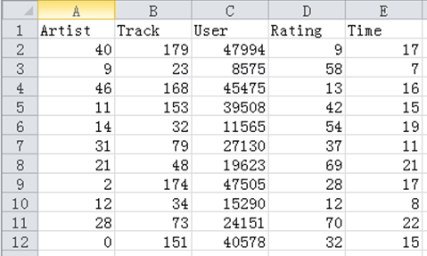
Applications
EMI Music Hackathon 2012
Song recommendation
Given:
Historical ratings
User demographics
# features: 51K
# items in training: 188K
?

Slide 21
Results for EMI music
FM: Root Mean Square Error (RMSE) 13.27626
Target value [0,100]
The best (SVD++) is 13.24598
Details
Regression
Converges in 100 iterations
Time for each iteration: < 1 s
Win 7, Intel Core 2 Duo CPU 2.53GHz, 6G RAM

Slide 22
Other applications
Ads CTR prediction (KDD Cup 2012)
Features
User_info, Ad_info, Query_info, Position, etc.
# features: 7.2M
# items in training: 160M
Classification
Performance:
AUC: 0.80178, the best (SVM) is 0.80893

Slide 23
Other applications
HiCloud App Recommendation
Features
App_info, Smartphone model, installed apps, etc.
# features: 9.5M
# items in training: 16M
Classification
Performance:
Top 5: 8%, Top 10: 18%, Top 20: 32%; AUC: 0.78

Slide 24
Summary
FM: a general predictor
Works under sparsity
Linear computation complexity
Estimates interactions automatically
Works with any real valued feature vector
Thanks!

