Slide 1
Structure Extraction from Texture via Relative Total Variation
Li Xu, Qiong Yan, Yang Xia, Jiaya Jia
The Chinese University of Hong Kong

Slide 2
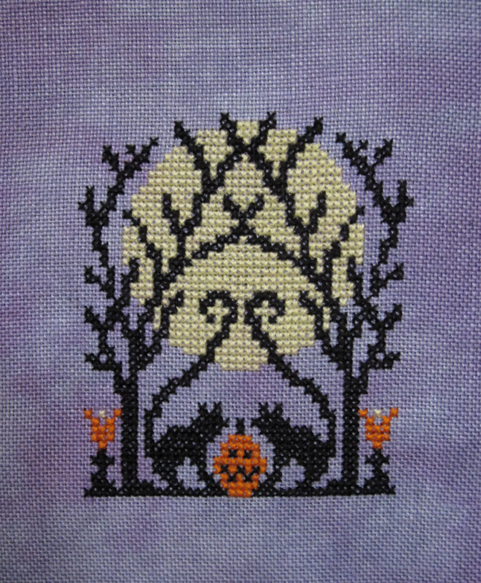
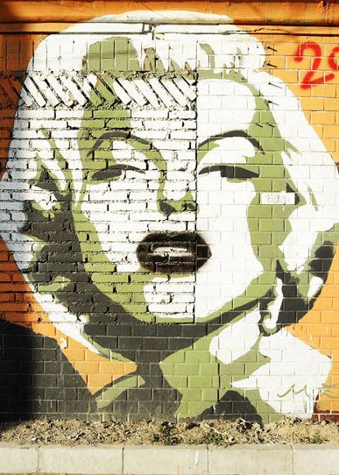
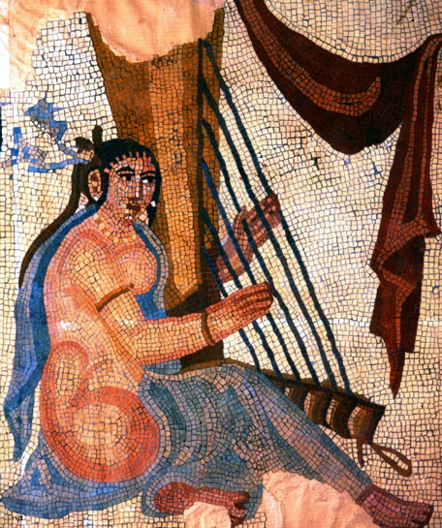
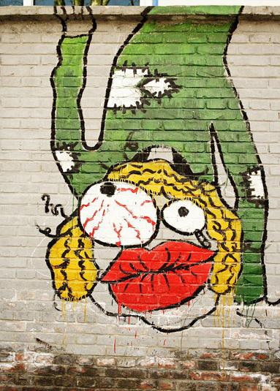
A ubiquitous representation
Structure on Texture

Slide 3
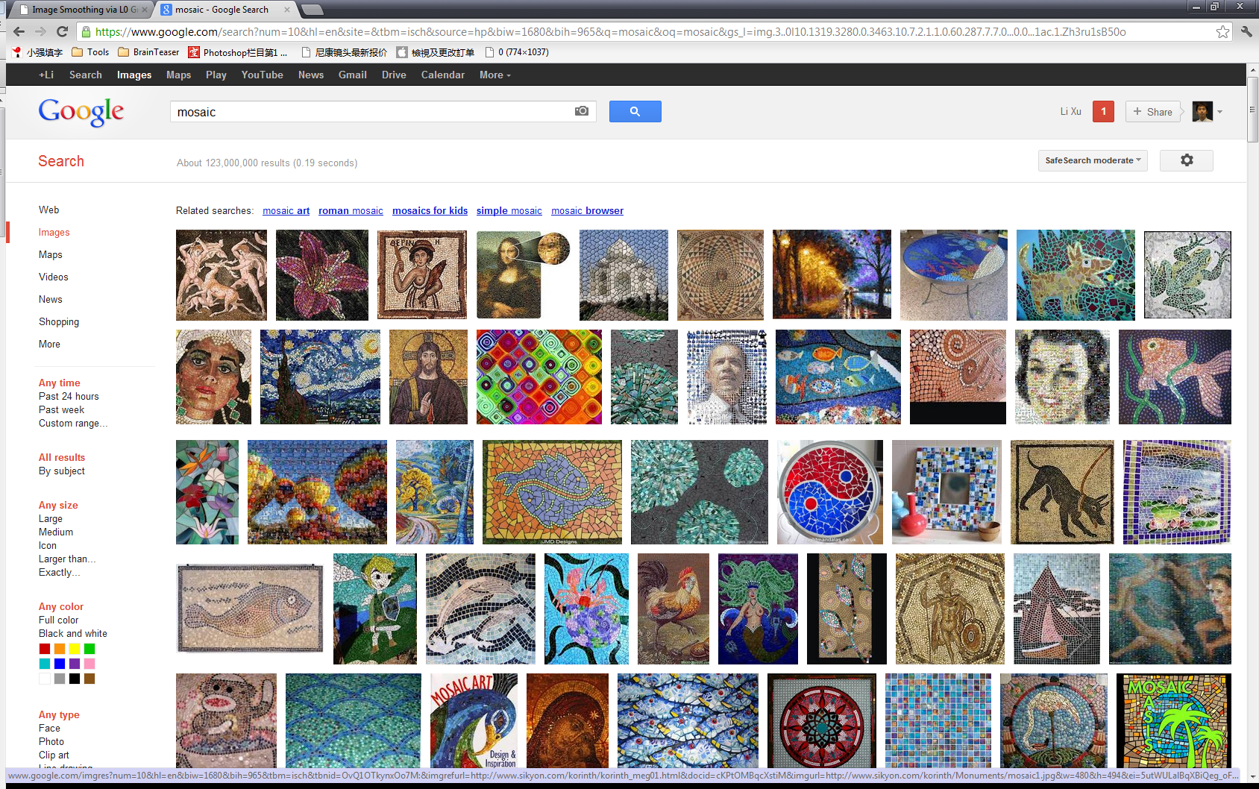
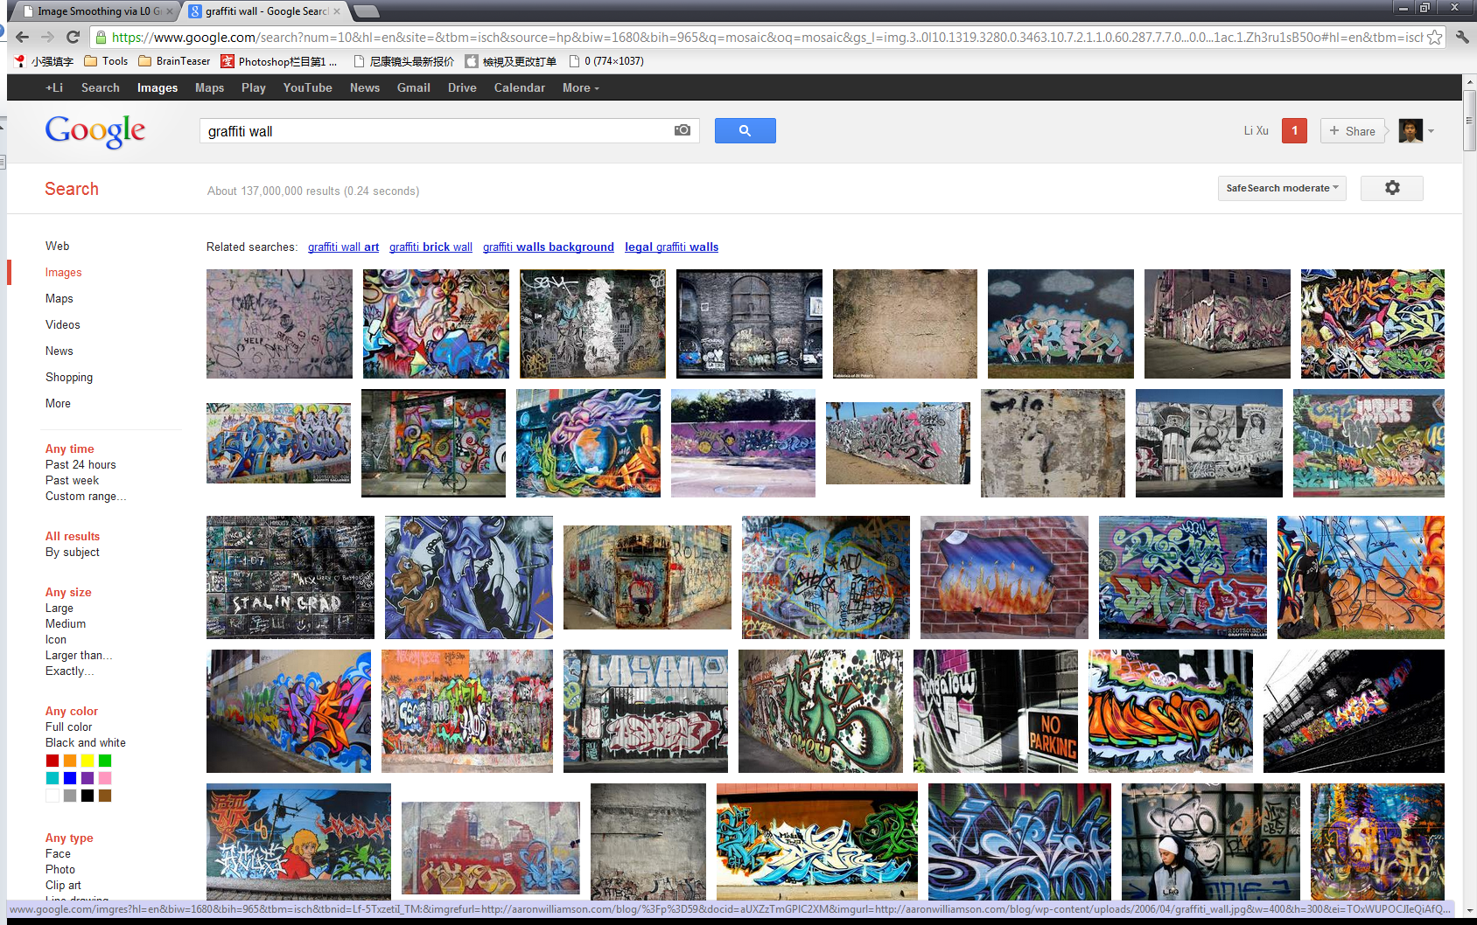
A ubiquitous representation
Search “Graffiti” and “Mosaic”
[Millions of images!

Slide 4
Previous Work - Texture Analysis
Near-regular texture
[Liu et al. 2003; Hays et al. 2006; Liu et al. 2008]
Detection-classification-inpainting

Slide 5
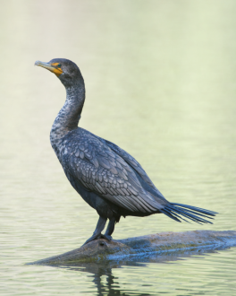
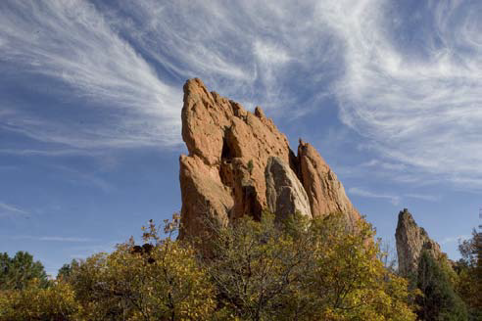
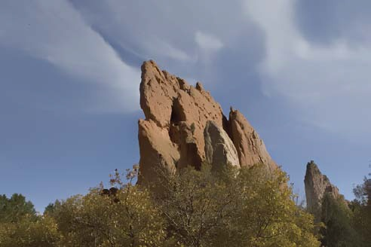
Image Smoothing
[Durand and Dorsey 02]
Local Filters
Bilateral Filter [Durand and Dorsey 02 …]
Dominant/Closet Mode Filter [Kass and Solomon 10]
Local Laplacian Filter (LLC) [Sylvain et al. 11]
A large number of variants and acceleration methods [Gastal et al. 12]
...
[Kass and Solomon 10]
[Sylvain et al. 11]

Slide 6
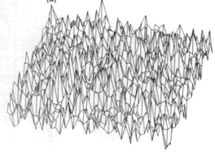
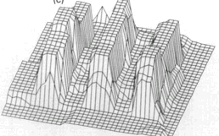
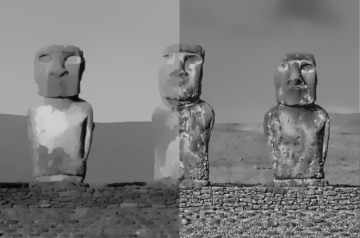
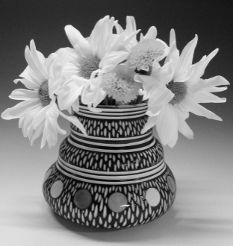
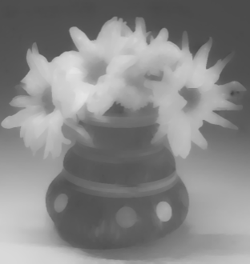
Image Smoothing
[Durand and Dorsey 02]
Global Approaches
TV-based [Rudin et al. 1992; Meyer 2001; Yin et al. 2005; Aujol et al. 2006; ...]
WLS [Farbman et al. 08]
Envelop Extraction [Subr et al. 09]
L0 Gradient Smoothing [Xu et al. 11]
[Kass and Solomon 10]
[Sylvain et al. 11]
[Rudin et al. 92]
[Farbman et al. 08]
[Subr et al. 09]
[Xu et al. 12]

Slide 7
Difficulties
Pattern
Complex and even irregular texture patterns.
Contrast
Texture patterns are with strong local contrast.

Slide 8
Our Solution
Find inherent difference between textural and structural edges
textural edges
structural edges

Slide 9
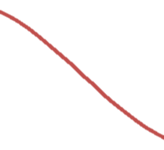
Our Solution
Windowed Total Variation (TV)

Slide 10
Our Solution
Windowed Inherent Variation (IV)

Slide 11
Our Solution
Relative Total Variation (RTV)
Significant difference in RTV!

Slide 12
RTV Verification
2 million+ patches
Patches with structural edges
Pure Texture Patches

Slide 13
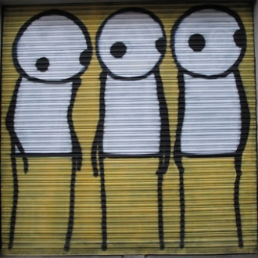
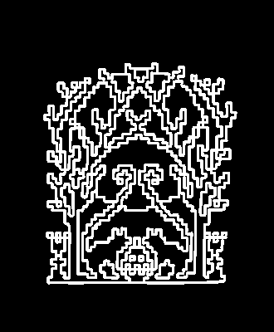
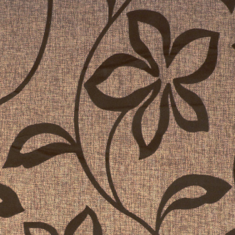
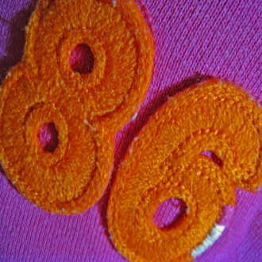
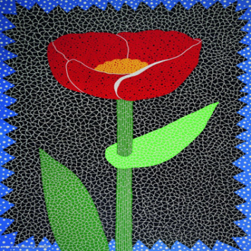
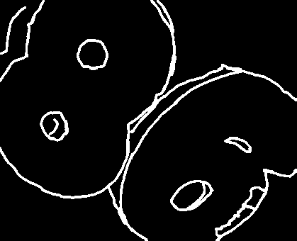

Slide 14
RTV Verification

Slide 15
RTV Verification

Slide 16
RTV Verification

Slide 17
ROC-Curve

Slide 18
Objective Function
Non-convexity in the new regularizer

Slide 19
Numerical Solution

Slide 20
Numerical Solution
Our new solver converges in 4 iterations

Slide 21
Iteration
Input

Slide 22
Iteration #1
Notes:
Iteration 1

Slide 23
Iteration #2
Notes:
2

Slide 24
Iteration #3
Notes:
In only 3 iterations, most textures are removed while structural edges are preserved.

Slide 25
Iteration #4
Notes:
We found that 3-4 iterations are enough to achieve visually pleasing results.

Slide 26
Parameter Tuning
determines the smoothing strength
Notes:
We now show how varying the smoothing weight influences the result.

Slide 27
Smoothing Strength
Input
Notes:
Same input

Slide 28
Smoothing Strength
Notes:
With a small smoothing weight lambda, many details can be retained.

Slide 29
Smoothing Strength
Notes:
We increase the strength

Slide 30
Smoothing Strength
Notes:
See the difference

Slide 31
Smoothing Strength
Notes:
Stronger smoothing leads to removal of more details.

Slide 32
More Results

Slide 33
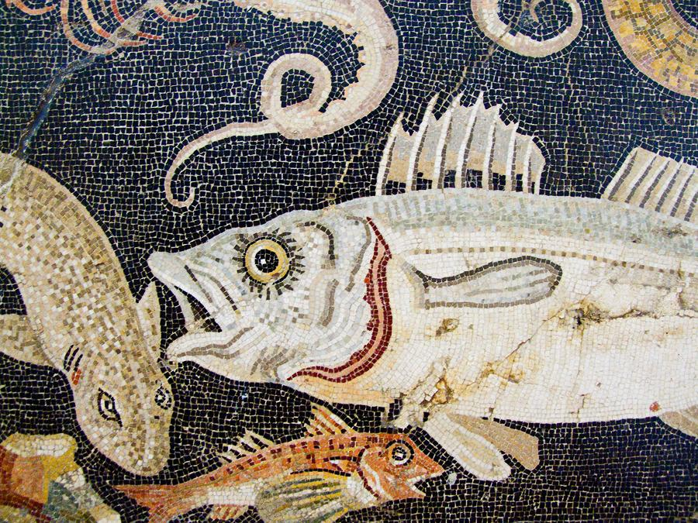
Input
Notes:
This is an ancient mosaic from pompeii city.

Slide 34
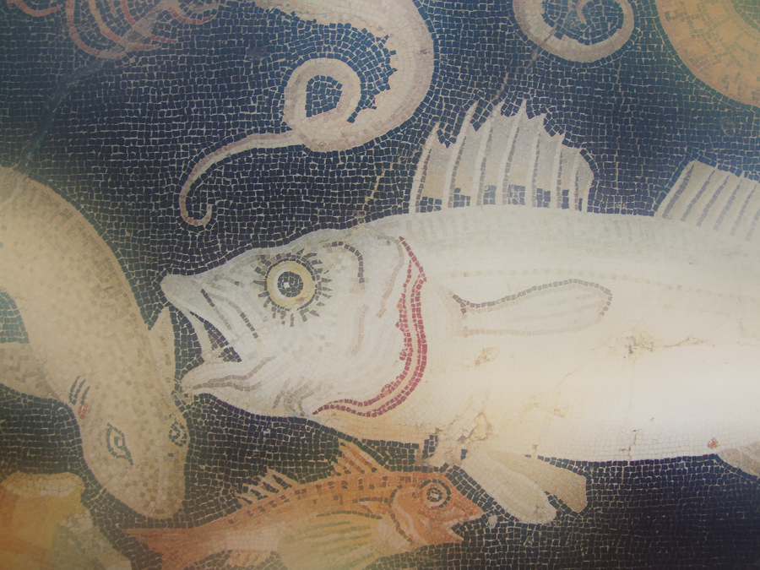
Bilateral filtering

Slide 35
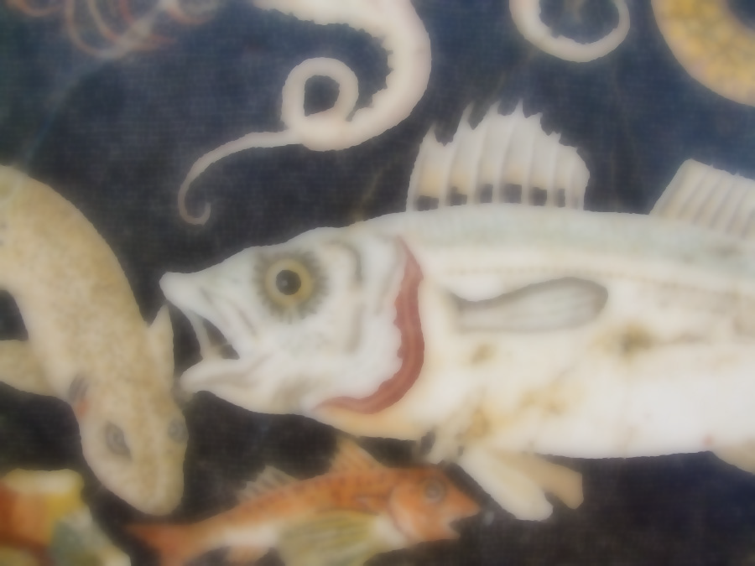
Total Variation

Slide 36
Weighted Least Square

Slide 37
Subr et al. 09

Slide 38
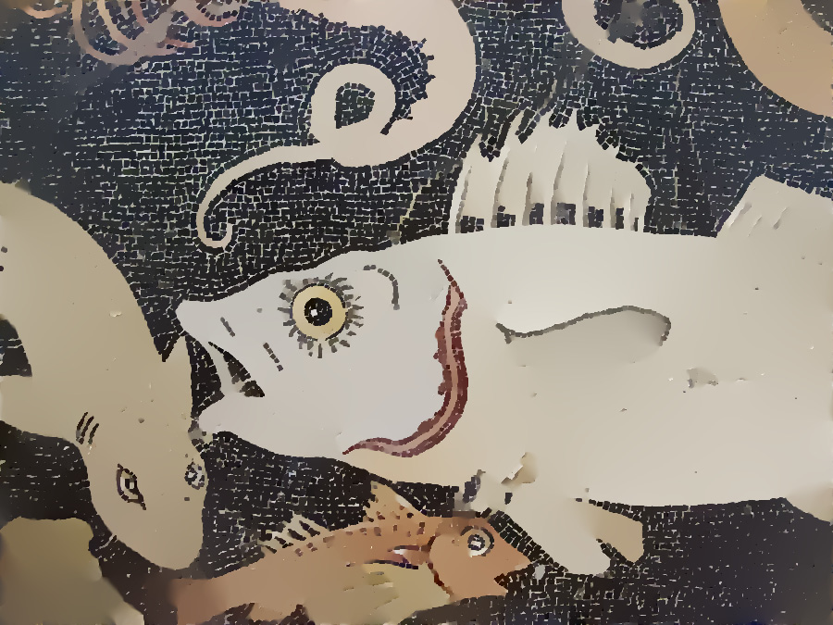
L0 Smoothing
Notes:
L0

Slide 39
Ours
Notes:
Our method works well to extract the structural part of the mosaic.

Slide 40
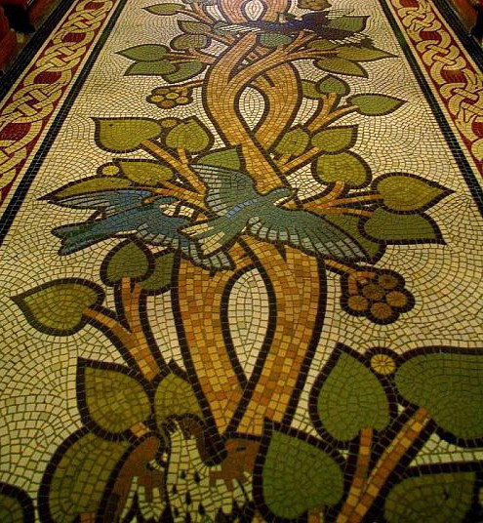
Input

Slide 41
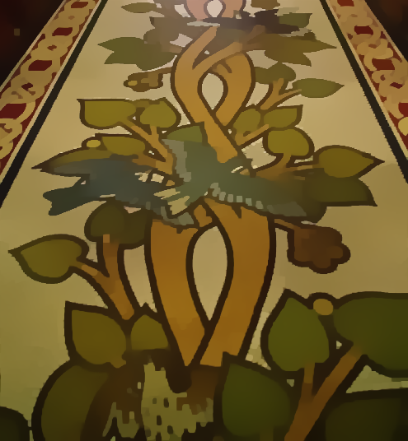
Ours

Slide 42
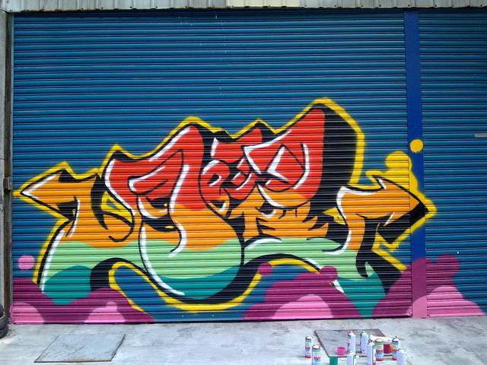
Input
Notes:
Our method naturally applies to different types of texture because we do not rely on the regularity of the texture pattern. Here is a graffiti example.

Slide 43
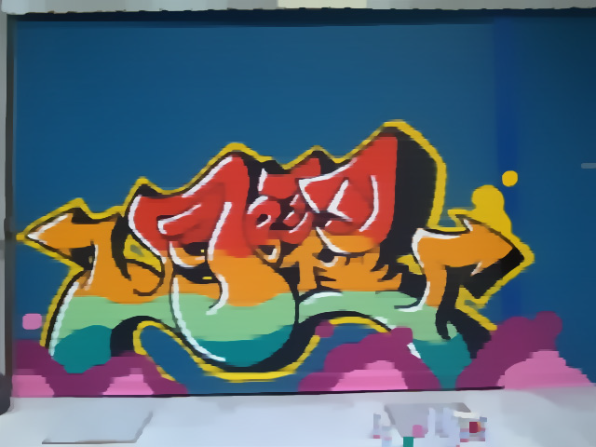
Ours
Notes:
The output.

Slide 44
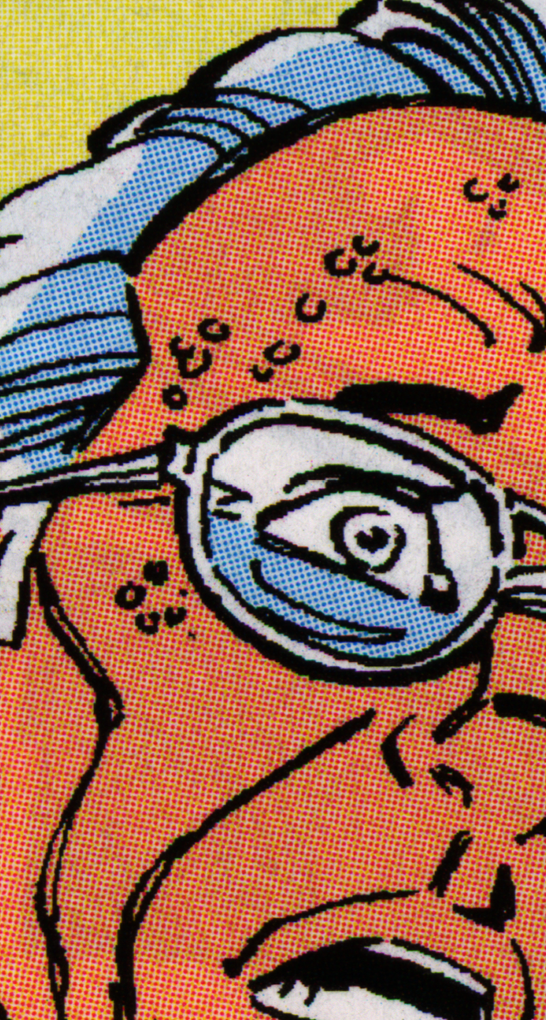
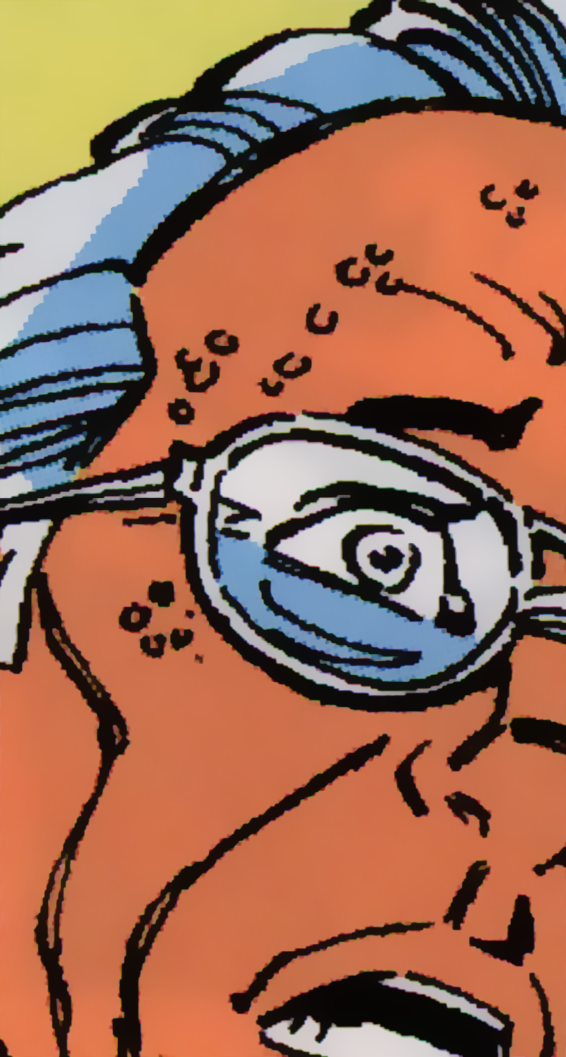
Color Comic from [Kopf and Lischinski 12]

Slide 45
Input

Slide 46
Ours

Slide 47
Input

Slide 48
Ours

Slide 49
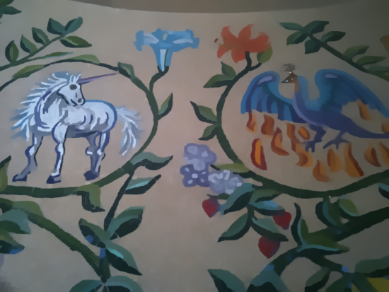
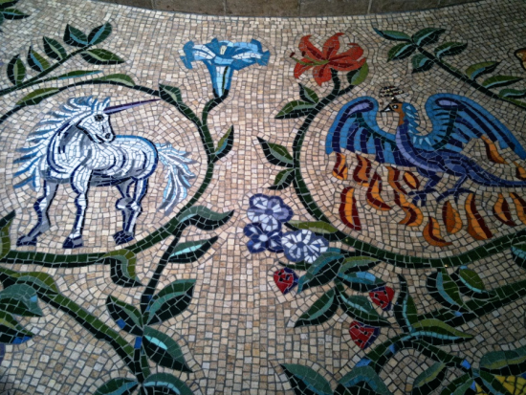
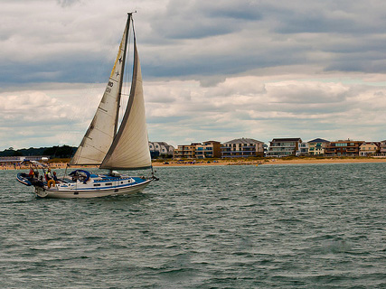
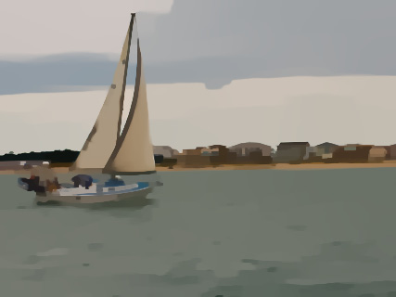
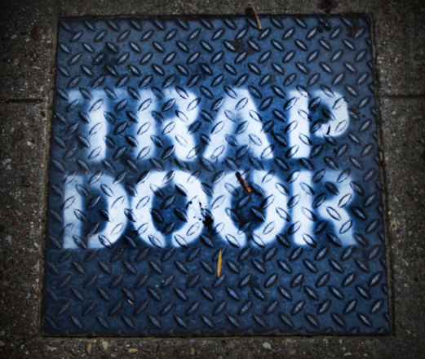
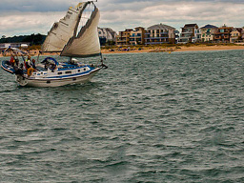
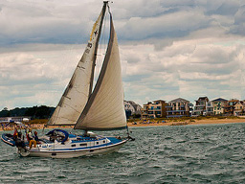
Image Vectorization
Texture Manipulation
Applications
Content-aware Resizing
Image Composition

Slide 50
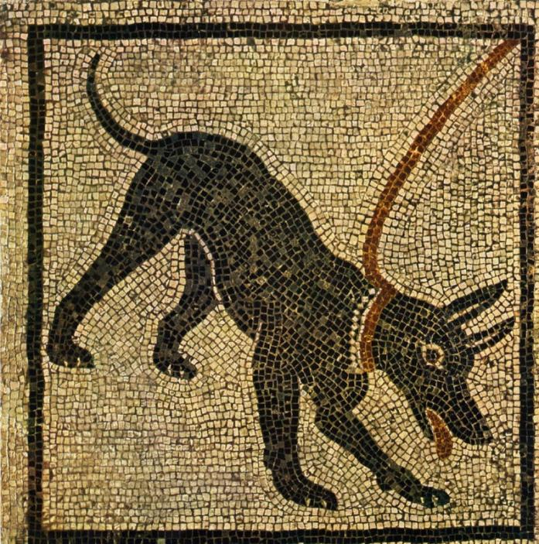
Edge Simplification
Input

Slide 51
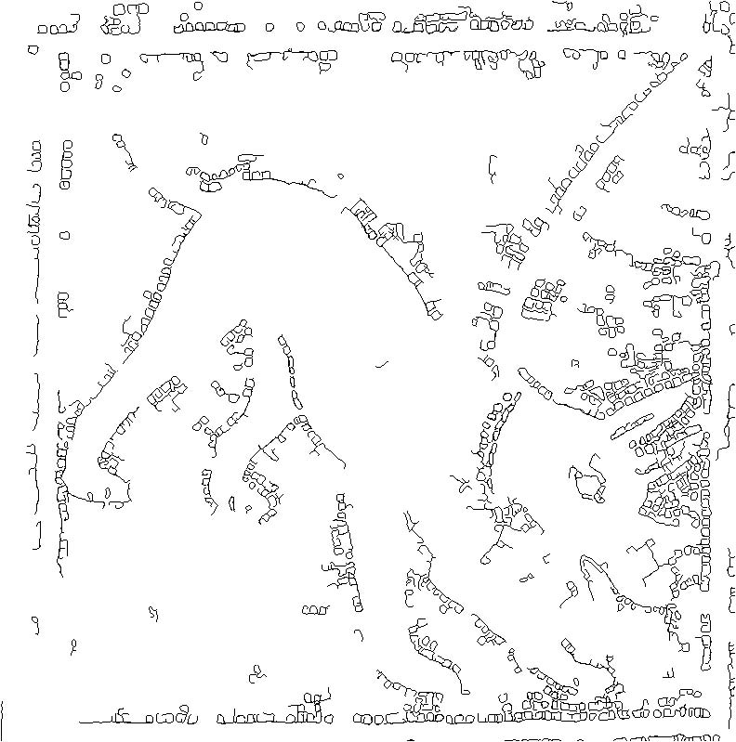
Edge Simplification
Extracted Edge

Slide 52
Edge Simplification
Structure map

Slide 53
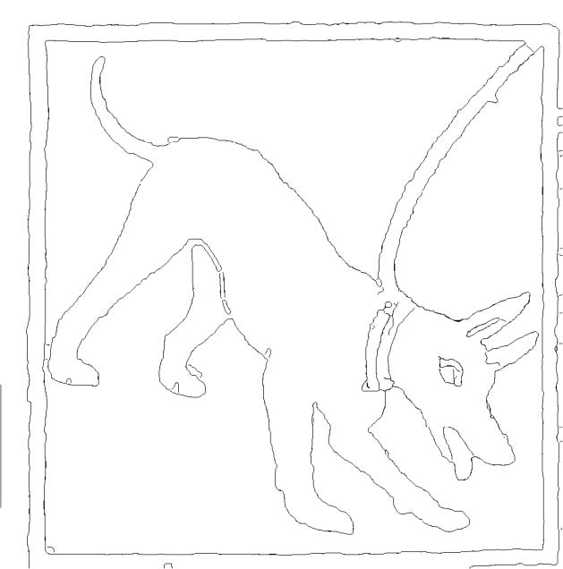
Edge Simplification
Extracted Edge

Slide 54
Edge Simplification
Extracted Edge

Slide 55
Edge Simplification
Input

Slide 56
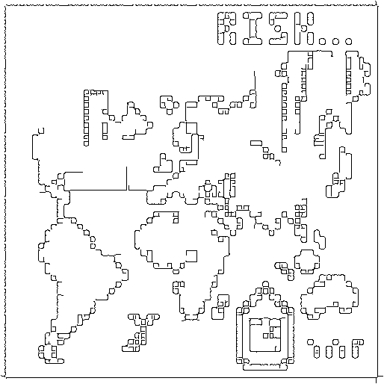
Edge Simplification
Extracted Edge

Slide 57
Edge Simplification
Structure map

Slide 58
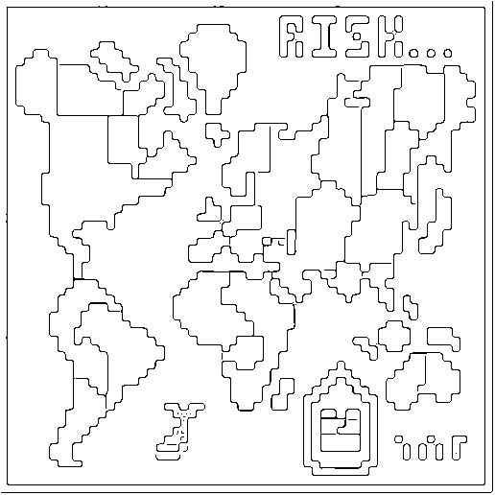
Edge Simplification
Extracted Edge

Slide 59
Image Vecorization

Slide 60
Vector Magic Result (8x)

Slide 61
Structure Image

Slide 62
Our Result (8x)

Slide 63
Our Result with Detail (8x)

Slide 64
Original Vectorization Result

Slide 65
Our Result with Detail (8x)

Slide 66
Input Image

Slide 67
Structure Image

Slide 68
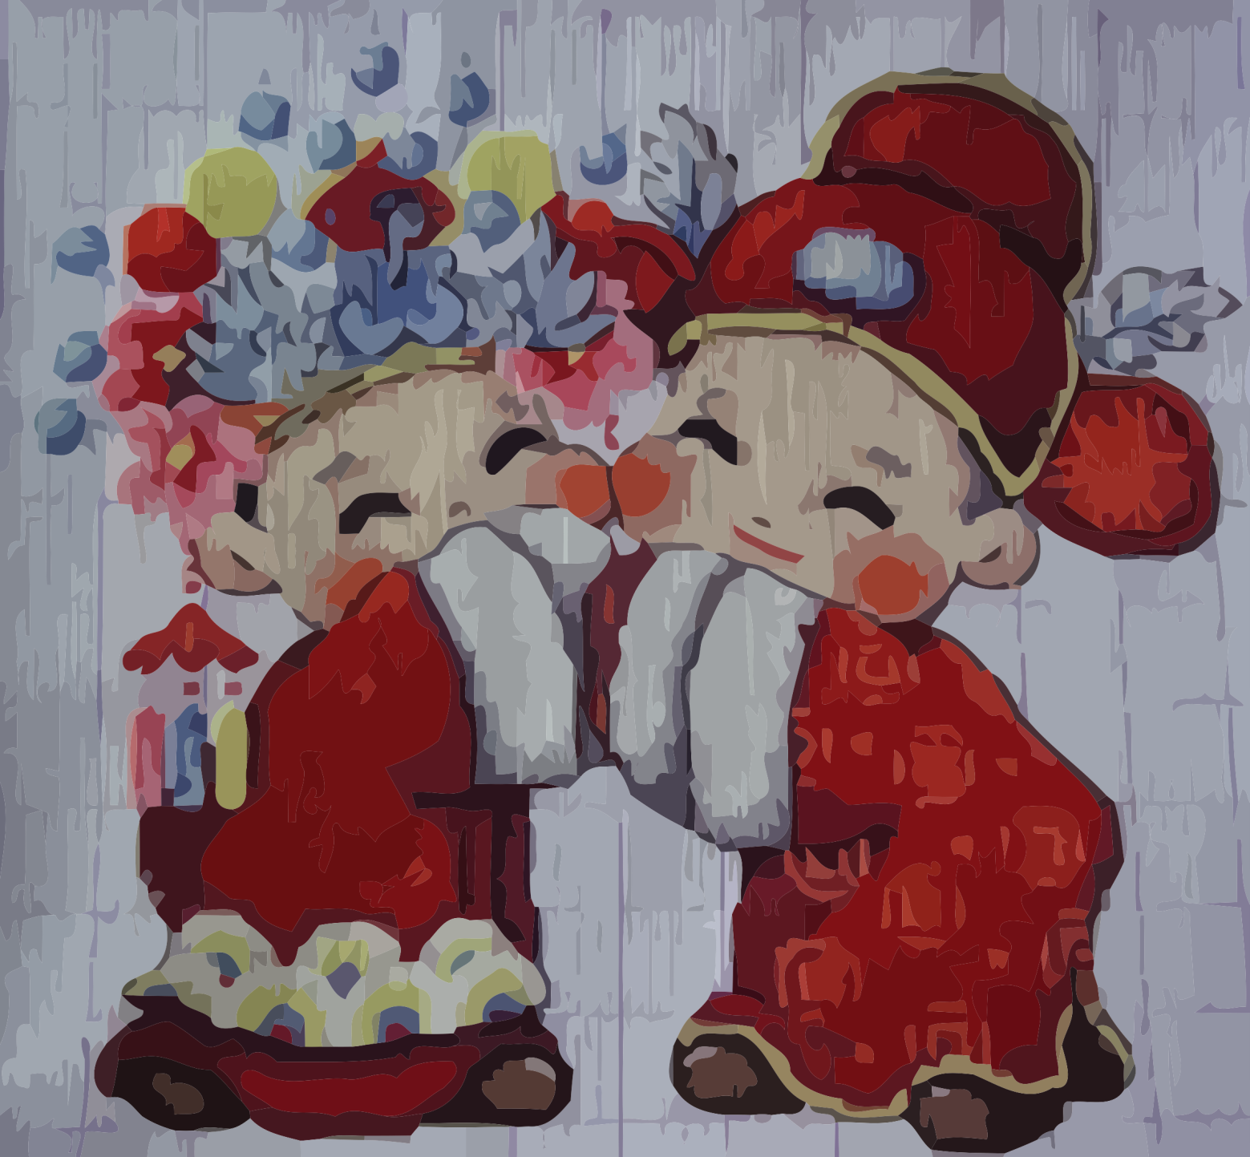
Vector Magic Result (8x)

Slide 69
Our Result (8x)

Slide 70
Our Result with Detail (8x)

Slide 71
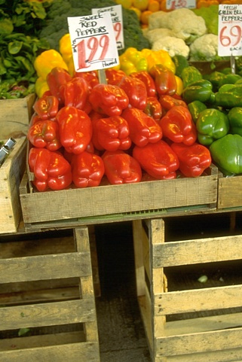
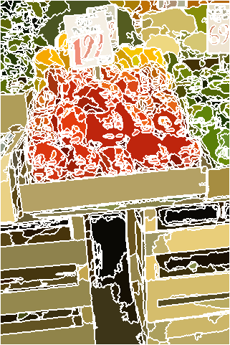
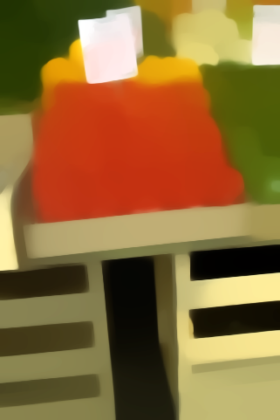
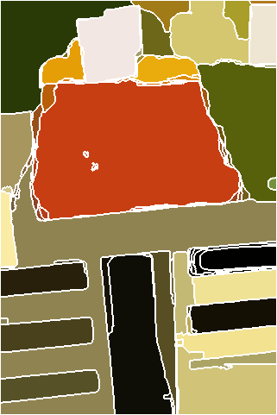
Segmentation

Slide 72
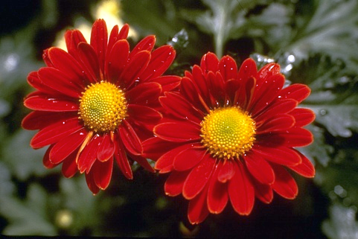
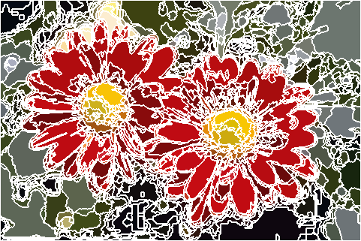
Segmentation
Notes:
Another example. Without our method applied in prior, many segments are produced, complicating the following analysis and operation.

Slide 73
Segmentation
Notes:
Our result can greatly simplify this process.

Slide 74
Segmentation
Notes:
Another example for segment comparison.
The tree leaves in the left are with high contrast. It is thus difficult to segment the tree as a whole.

Slide 75
Segmentation
Notes:
Our method easily achieves this goal by removing the textures, largely simplifying segmentation

Slide 76
Saliency Detection
Notes:
Finally, our method can also benefit greatly saliency detection, a fundamental problem in computer vision and graphics.
Texture in natural images such as tree leaves would make the background clutter. It is therefore harmful for salient object detection.
We show that the same detector has much larger responses on the body of tiger, after the removal of background texture.

Slide 77
Saliency Detection
Notes:
Another example of a flower. Our method helps remove textures in the cluttered background, making the flower more conspicuous even for human perception.

Slide 78
Saliency Detection
Before
After
Notes:
One more example.

Slide 79
Saliency Detection
Notes:
Note that our method works as a pre-processer, which could benefit almost all salient object detection methods, to increase their performance. This has been validated on a dataset with 1000+ images. A 5% - 10% performance increase has been observed on the dataset, only by applying our structure extraction in a pre-process.

Slide 80
Implementation
Matlab implementation
3s for an 800x600 color image
Matlab source code available
www.cse.cuhk.edu.hk/~leojia/projects/texturesep
Notes:
Our method is ready for use. It takes only 3s to process a 800x600 color image, on a standard desktop PC.
We have released the matlab source code, as well as a large number of structure+texture image dataset.

Slide 81
Conclusion
A novel relative total variation measure
Distinguish between texture and structure
Global energy function with RTV regularizer
Efficient numerical solver
Possible extensions
Video/image coding and decoding
Image understanding
Geometry/mesh processing

Slide 82
The End

