Slide 1
Deep Automatic Portrait Matting
Xiaoyong Shen, Xin Tao, Hongyun Gao, Chao Zhou, Jiaya Jia
The Chinese University of Hong Kong
Notes:
Morning everyone. I am Xiaoyong Shen from the Chinese University of Hong Kong. In this spotlight presentation, we propose the deep automatic portrait matting.

Slide 2
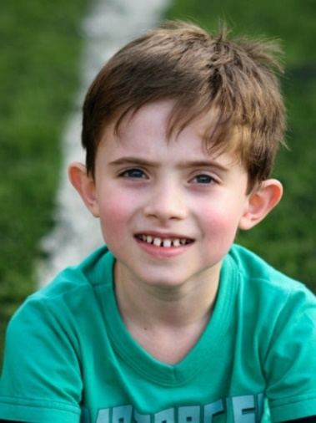
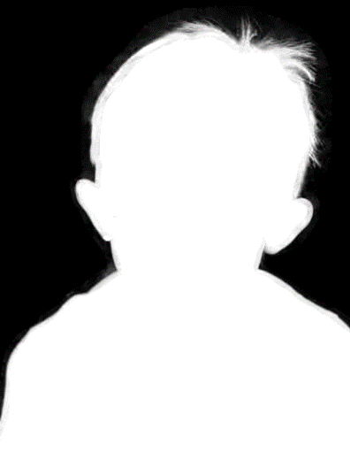
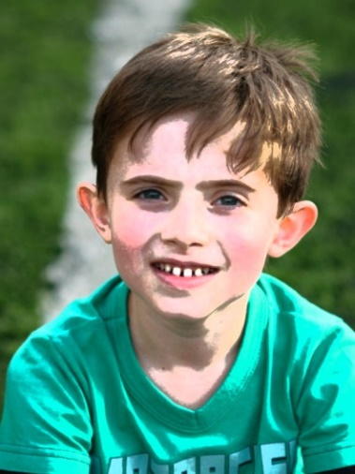
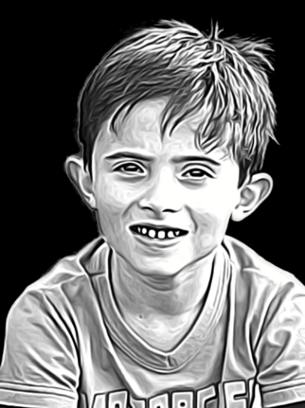
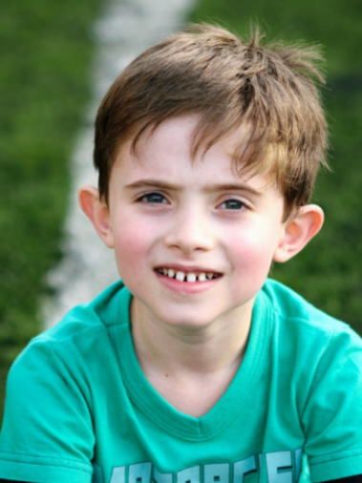
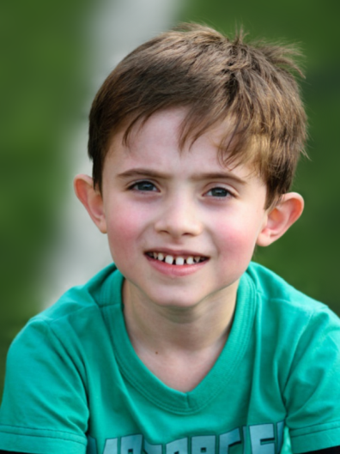
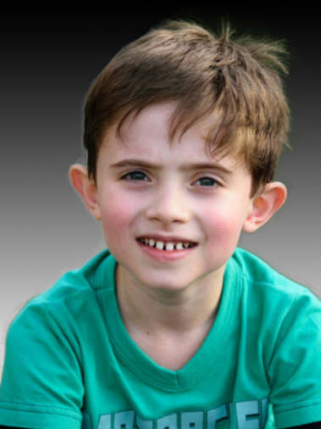
Portrait Matting
Input Image
Alpha Matte
Stylization
Cartoon
Color Transform
Depth-of-field
Portrait
Background Edit
Notes:
[press]
Portrait matting extracts the foreground and plays important role for portrait post-processing.
[press]
For example, we need to extract the foreground to do stylization and the depth-of-field effect to stand out the person or do some background editing.

Slide 3
Matting Problem
Image
Alpha Matte
$$I=$$
$$αF+\left(1−α\right)B$$
Foreground
Background
Ill-posed problem
--seven unknowns should be estimated for each pixel.
Notes:
Simply put, image matting decompose an image into background and foreground,
[press]
Which are linearly combined by an alpha matte.
It is easy to know that matting is an ill-posed problem since there are seven unknowns for each pixel.

Slide 4
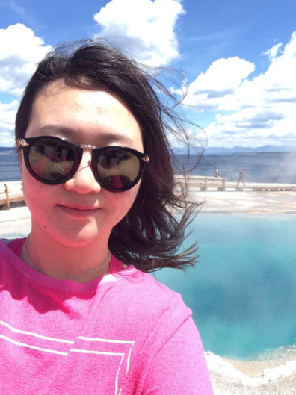
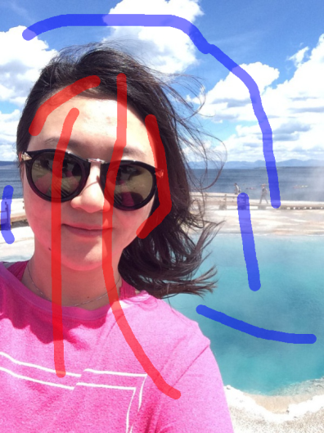
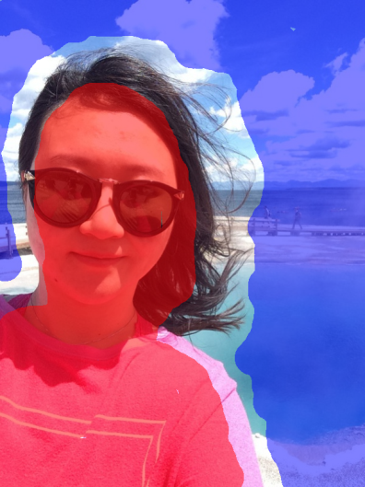
Image Matting
User interactions are needed
Input
Strokes
Trimap
Notes:
To make matting problem tackable, matting approaches need user specified foreground and background.
[press]
Generally, they are masked by strokes or trimap.

Slide 5
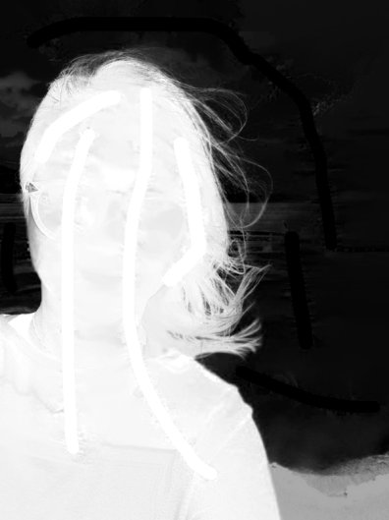
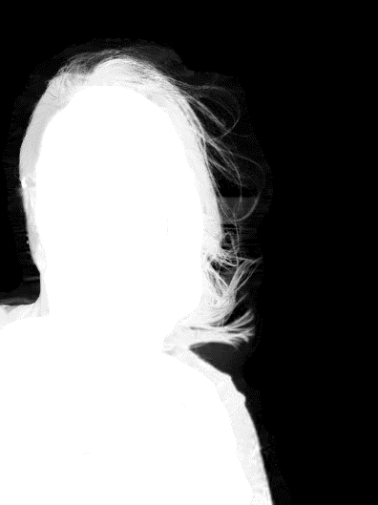
Issues
User specified strokes or trimap are difficult to meet the algorithm requirements
Notes:
Unfortunately, user specified strokes or trimap are very hard to meet the algorithm requirements.
[press]
For example, even with such complex strokes, the closed form matting is still not satisfactory.
[press]
Similarly, it is also very difficult to label a trimap to achieve good matting result.

Slide 6
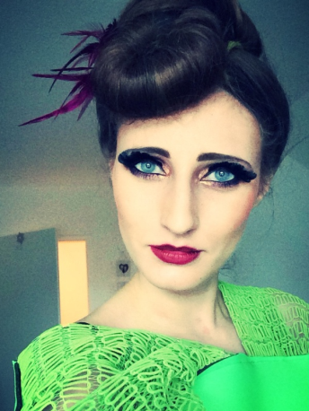
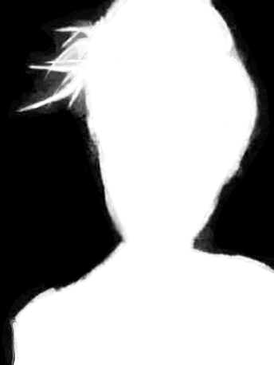
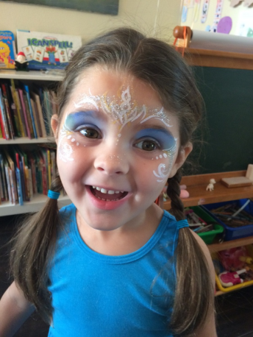
Tedious interaction is involved to produce these trimaps.
Notes:
To further illustrate the difficulties, we take the trimap specification as an example.
[press]
For these two input portraits, in order to achieve such matting results,
[press]
The users needs to label such trimaps which are with complex structures.
[press]
There is no doubt that tedious interactions are required even for professional users.

Slide 7
Deep Automatic Portrait Matting End-to-end CNNs
Notes:
To address the tedious interaction issue, we proposed the deep automatic portrait matting by well defined convolutional neural networks.

Slide 8
Deep Automatic Matting
Notes:
Our CNNs are end-to-end network, which takes a portrait as input and directly predict the matte.

Slide 9
Trimap Labeling
Input: RGB image
Output: trimap representation
Network: FCN [Long et al. 2015]
Notes:
Our network mainly includes two parts.
[press]
The first part is the trimap labeling process, which takes a color image as input and outputs the trimap representation by a FCN structure.

Slide 10
Image Matting Layer
Input: trimap representation
Output: alpha matte
Newly-designed layers
Notes:
[press]
The second part is the image matting layer with the former predicted trimap representation as inputs and estimates the final alpha matte.
[press]
It is our novel-designed CNN layer with newly defined functions.

Slide 11
Image Matting Layer
Feed-Forward
$$min λA^{T}BA+λ{\left(A−1\right)}^{T}F(A−1) +A^{T}LA$$
Back-Forward
$$\begin{matrix}\frac{∂f}{∂B}=−λD^{−1}diag(D^{−1}F) \\ \frac{∂f}{∂F}=\frac{∂f}{∂B}+D^{−1} \\ \frac{∂f}{∂λ}=−λD^{−1}diag\left(F+B\right)D^{−1}F\end{matrix}$$
Notes:
Here we show its feed-Forward and back-forward formulas.

Slide 12
Learning Data Collection
We create a 2,000 portraits dataset for training and testing
1,700 for training and 300 for testing
Large variations in age, gender, pose, hairstyle, background, camera type, etc.
The matting ground truth is estimated by human well labeled trimap
Notes:
[press]
To make the network training and testing possible, we collect a 2,000 portrait dataset where the data is with large variations.
[press]
For each portrait, we get its matting ground truth by closed form matting under the human well labeled trimap.
Here we show some examples in our dataset.

Slide 13
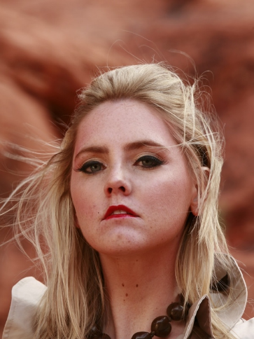
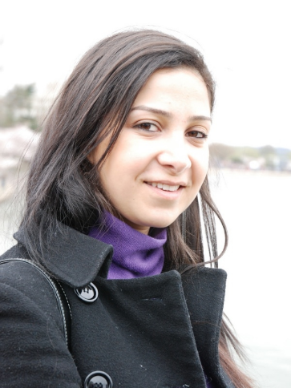
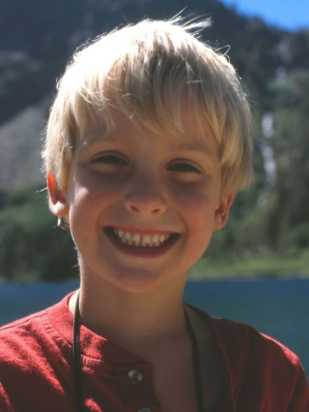
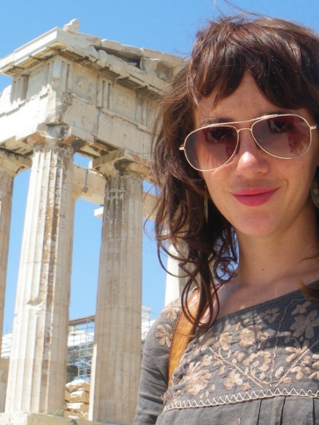
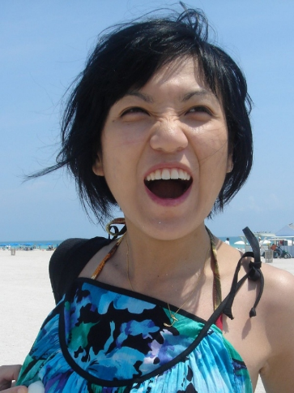
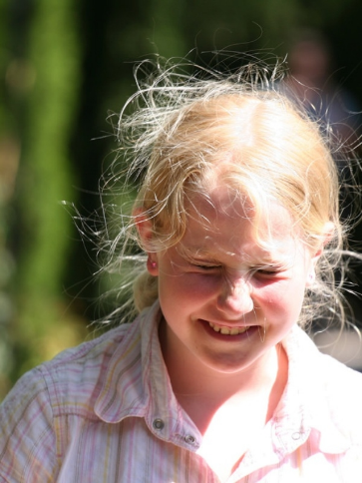
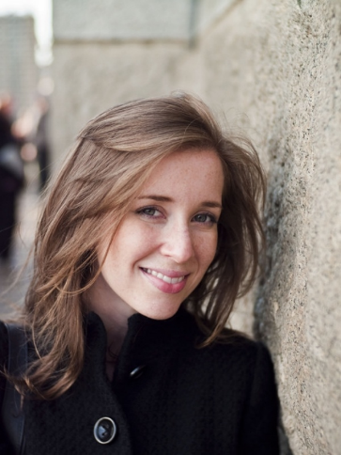
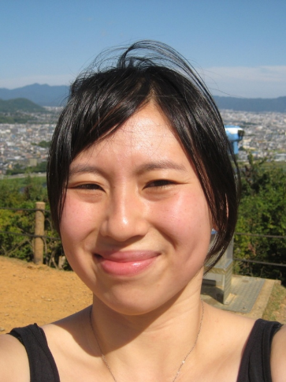
Data Examples
Notes:
The portrait images

Slide 14
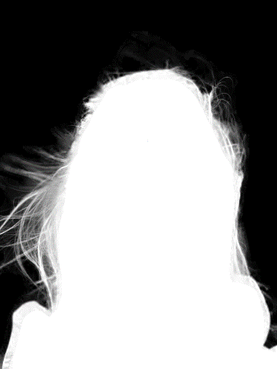
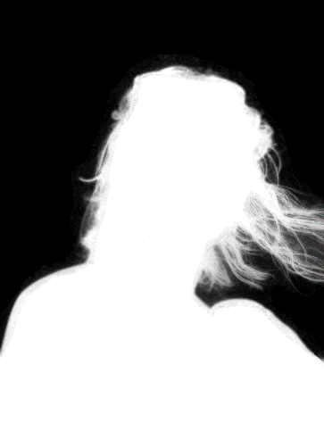
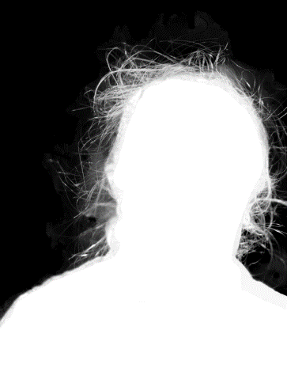
Labeled Mattes
Notes:
And our labeled matting ground truth.

Slide 15
Experiments
Running Time
Training: 20k iterations, one day on Titan X GPU
Testing: 0.6s for 600×800 color image
Comparisons
Automatic segmentation to trimap approaches
Direct trimap labeling methods
Notes:
[press]
Our method is efficient in training and testing, which needs one day for training and 0.6s for testing.
[press]
To evaluate its performance, we compare our approach with automatic segmentation to trimap approaches and the direct trimap labeling methods.

Slide 16
Evaluation
Methods | Grad. Error ($×10^{−3}$) | Conn. Error ($×10^{−4}$)
Graph-cut Trimap | 4.93 | 7.73
AutoTrimap | 4.61 | 7.63
Trimap by FCN | 4.14 | 7.61
Trimap by DeepLab | 3.91 | 7.52
Trimap by CRFasRNN | 3.56 | 7.39
Ours without Shape Mask | 3.11 | 6.99
Ours | 3.03 | 6.90
Notes:
Here we show the comparisons.
[press]
Ours achieved the best performance.

Slide 17
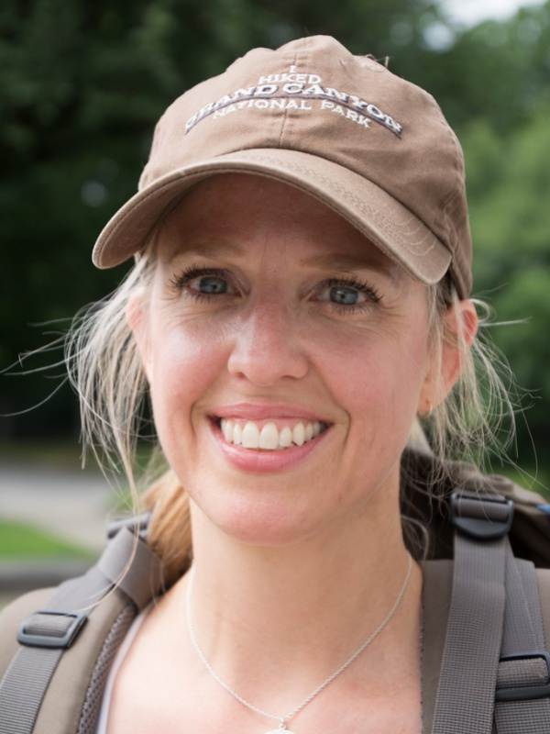
Input
Notes:
For this input portrait with complex hair,

Slide 18
Graph-cut Trimap
Notes:
The matting result from graph-cut segmentation based trimap fails estimating the correct matte in hair areas.

Slide 19
FCN Trimap
Notes:
Directly labelling the trimap using FCN also fails extracting the hair.

Slide 20
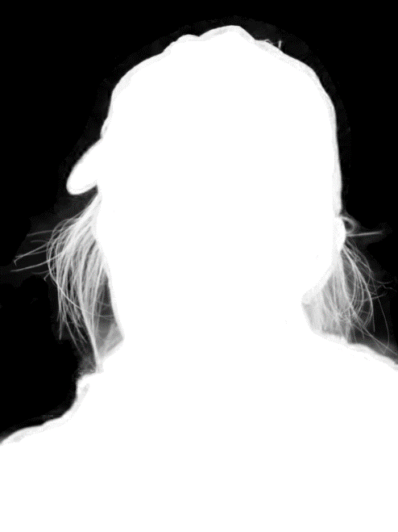
Ours
Notes:
Ours achieved satisfactory result with clear matte details.

Slide 21
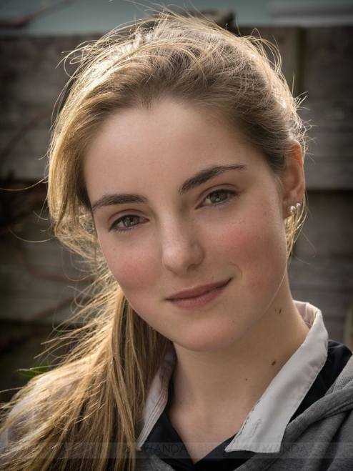
Input
Notes:
Here is another example,

Slide 22
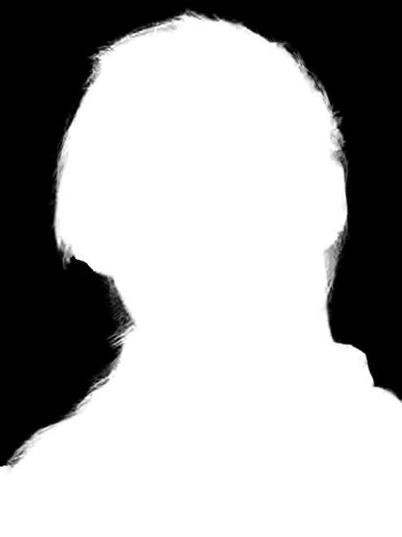
Graph-cut Trimap
Notes:
The trimap estimation from Graph-cut cannot generate correct matting result.

Slide 23
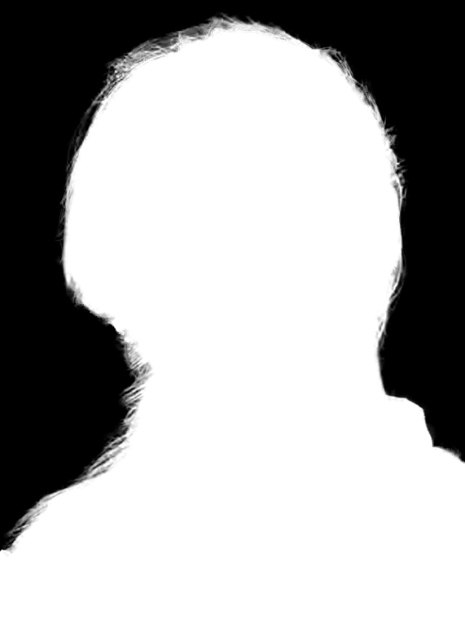
FCN Trimap
Notes:
The matting result from FCN labeled trimap is better.

Slide 24
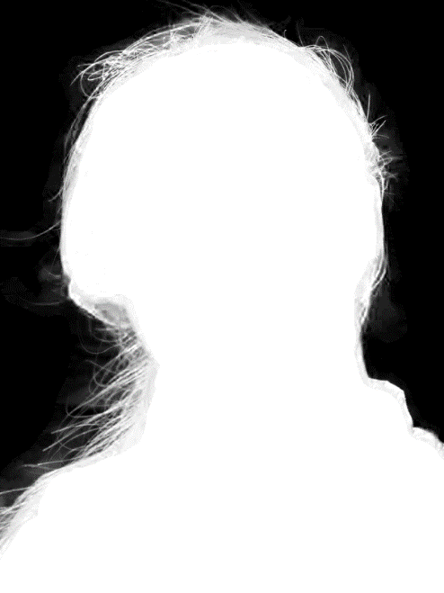
Ours
Notes:
Ours achieved the high performance result with enough hair details.

Slide 25
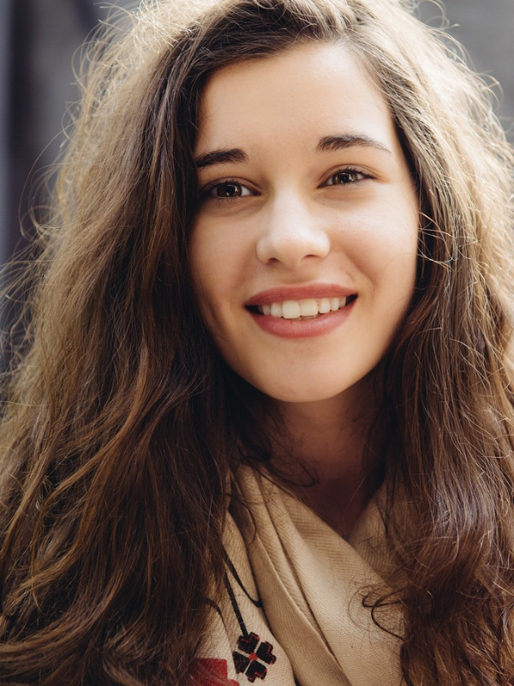
More Results
Notes:
For this complex hair and lighting example,
[press]
our automatic matting result is also with high accuracy.

Slide 26
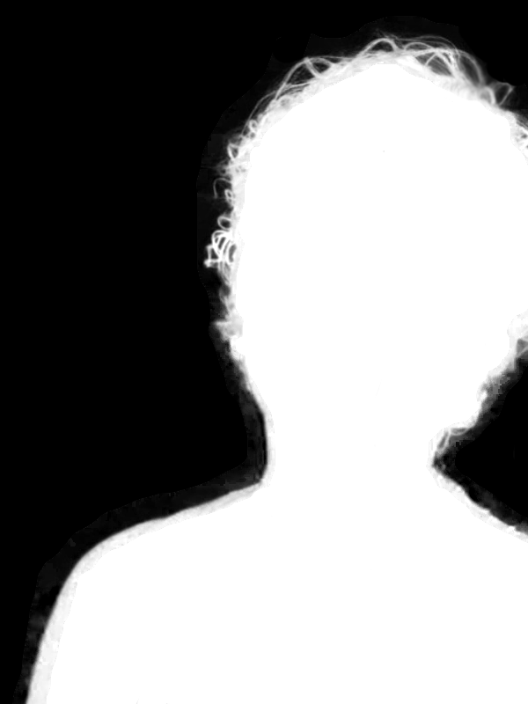
More Results
Notes:
Here is another portrait,
[press]
Our approach well extracts the hair structures.

Slide 27
Conclusion
We proposed the deep automatic portrait matting
An end-to-end matting CNNs framework
Novel matting layer
A matting dataset with 2,000 portraits
Future work
Video portrait matting
Person matting
General object matting
Notes:
[press]
In conclusion, we proposed the deep automatic portrait matting approach under an end-to-end matting CNNs framework
##with novel matting layers. A 2000 portrait matting dataset is created for training and testing.
[press]
In the future, we are interested to extend our framework to video, person, general object matting.

Slide 28
Thanks
Notes:
Thanks very much and welcome to our poster.

