Slide 1
Stem6: smart farming DIY
K.H. Wong
CUHK
Web: http://www.cse.cuhk.edu.hk/~khwong/
Email: khwong@cse.cuhk.edu.hk

Slide 2
Introduction
What is smart farming?
Open space
Lab/factor based
How to build a smart farming lab?
Equipment
Techniques
Cost
Open sources
Training
Conclusion

Slide 3
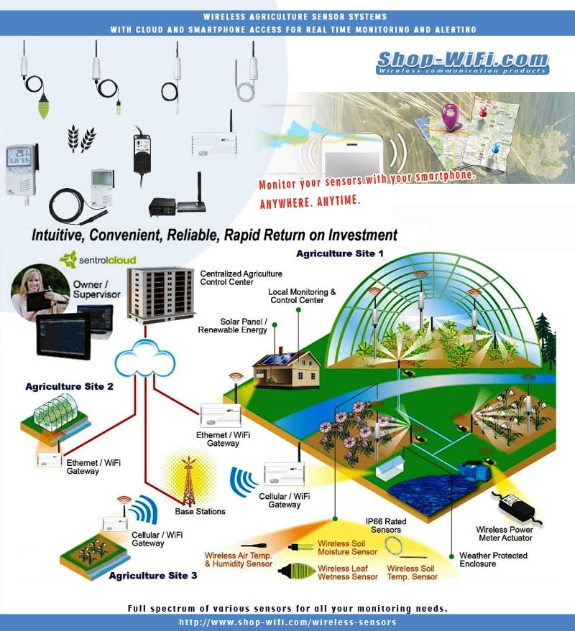
Use of Wifi/Internet
Centralize smart sensing and control
http://www.shop-wifi.com/wireless-sensors/wireless-agriculture

Slide 4
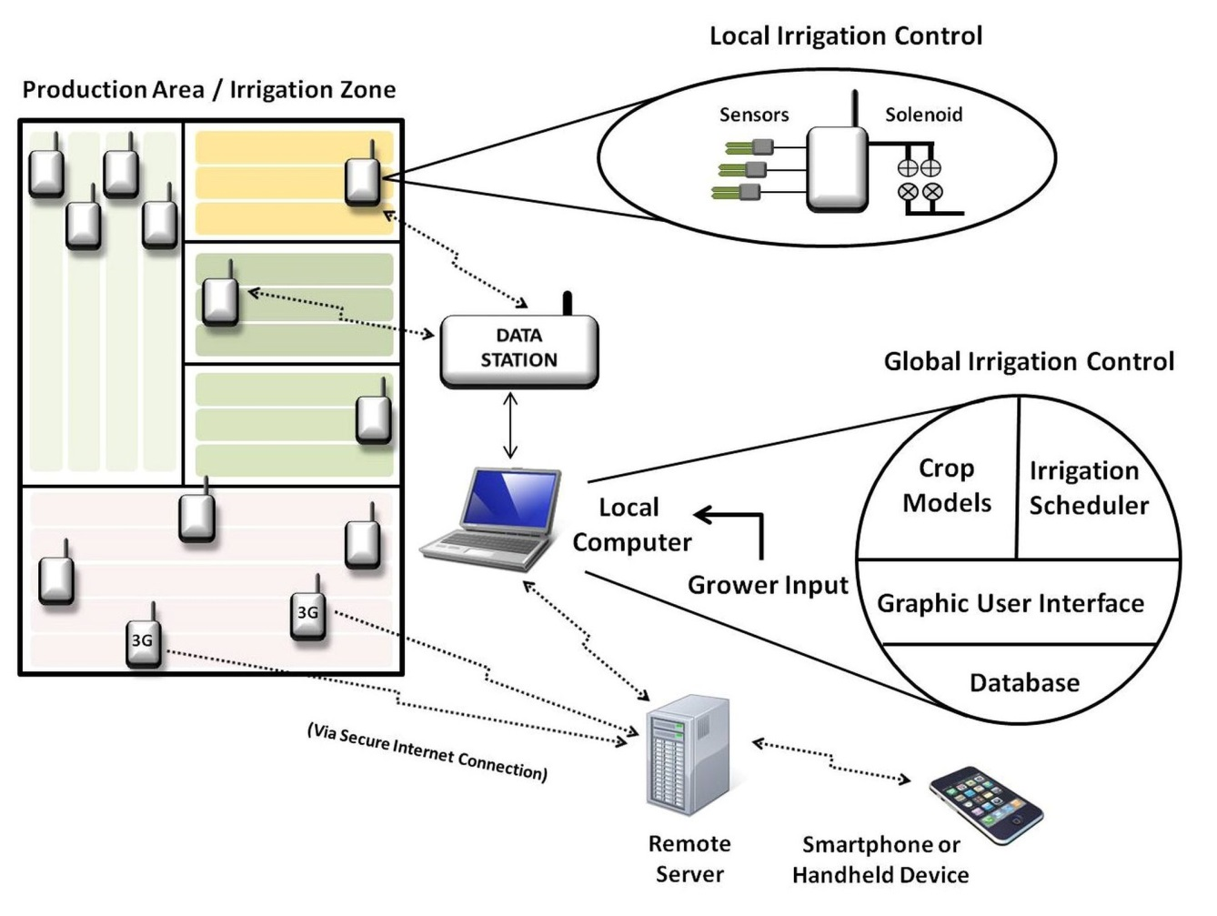
Case study 1
Saving water, increasing efficiency and reducing the environmental impacts of ornamental plant production practices!
http://www.smart-farms.net/

Slide 5
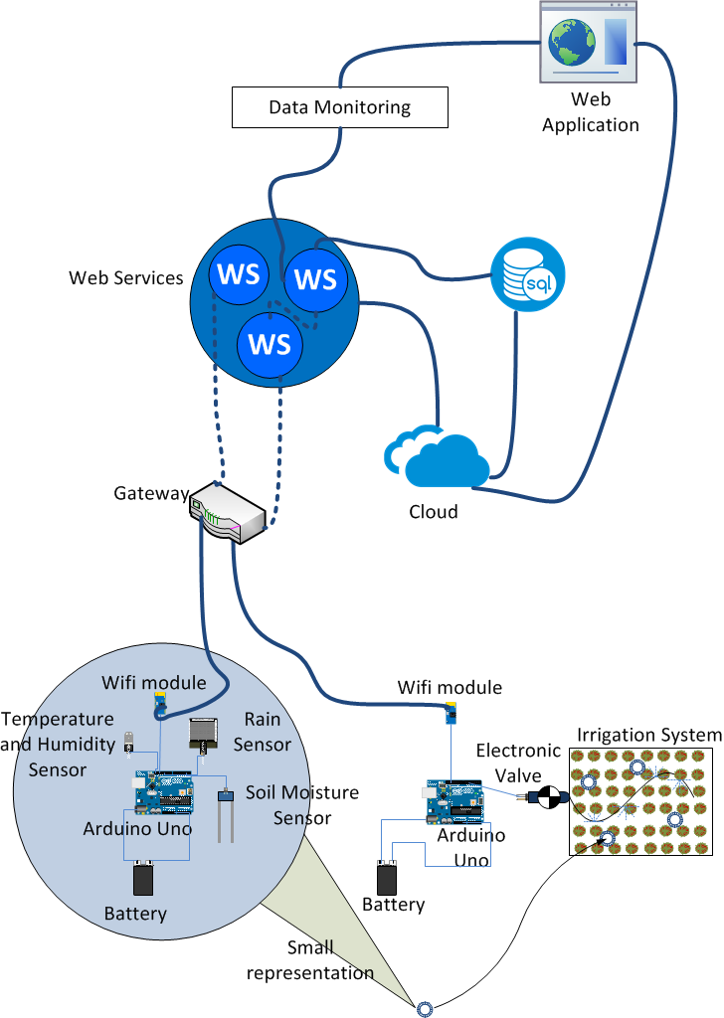
Case study 2
Use of
Ardunio
Sensors: Rain ,soil moisture
Electronic valve
To a feedback system
https://aisel.aisnet.org/isd2014/proceedings2017/ISDevelopment/7/

Slide 6
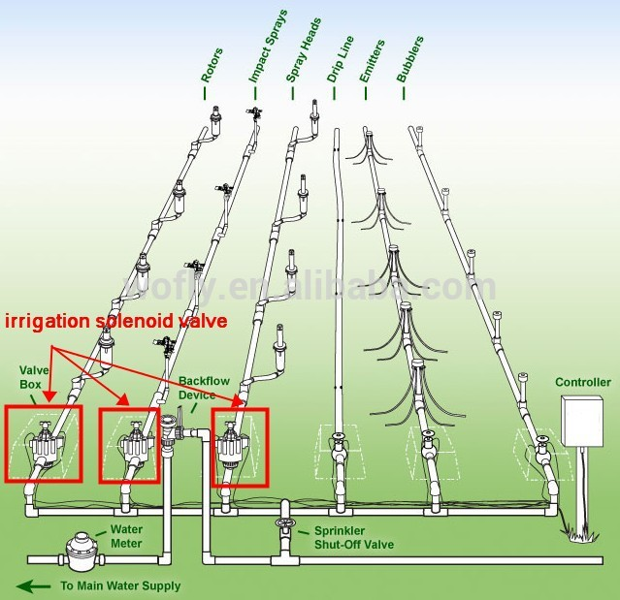
Equipment: water drip irrigation
farm water drip irrigation 6v dc solenoid valve
https://www.alibaba.com/product-detail/farm-water-drip-irrigation-6v-dc_60255165815.html

Slide 7
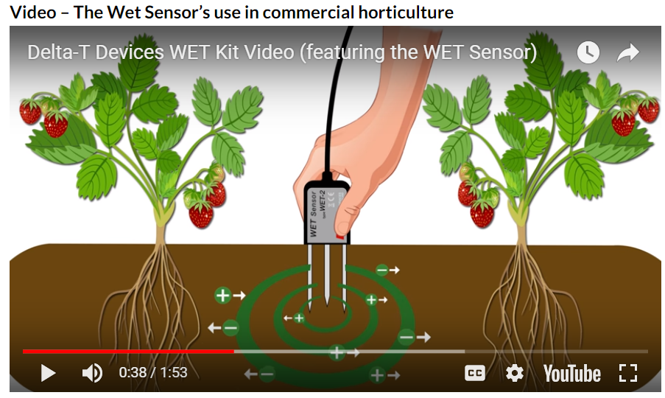
Equipment: Moisture sensor
Moisture and nutrient status in the root zone
Rapid monitoring of growing conditions
Calibrations for many soils and substrates
Click for video
https://www.delta-t.co.uk/product/wet-2/

Slide 8
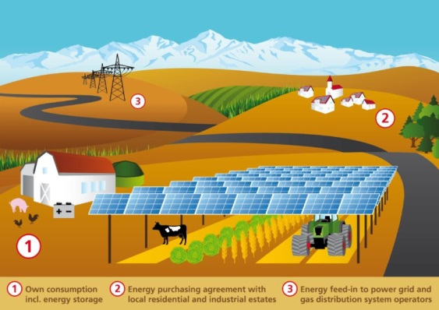
Combine Solar power with farming
Saving space and fossil fuel
https://cleantechnica.com/2017/11/24/combining-solar-panels-agriculture-makes-land-productive/

Slide 9
Lab/factory based
http://emag.directindustry.com/article-long/smart-farming-the-cloud-brings-more-than-rain-to-japanese-farmers/

Slide 10
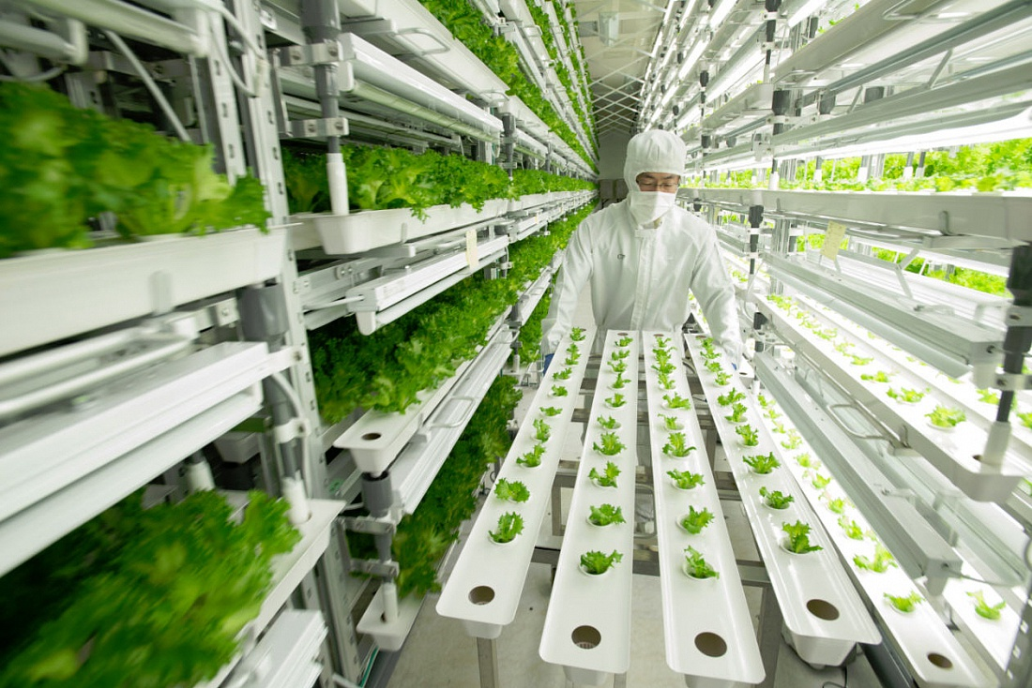
Lab/factory based: vertical farming
Vertical farming is becoming important
http://emag.directindustry.com/article-long/smart-farming-the-cloud-brings-more-than-rain-to-japanese-farmers/
https://spectrum.ieee.org/energy/environment/the-green-promise-of-vertical-farms

Slide 11
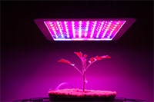
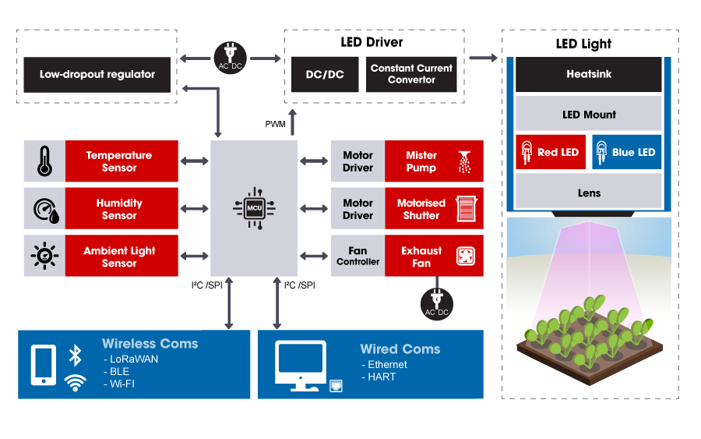
LED based farming
LED (Light-emitting diode)
https://sg.rs-online.com/web/generalDisplay.html?id=i/led-lighting

Slide 12
How to build a smart farming lab?
Equipment
Techniques
Cost
Open sources

Slide 13
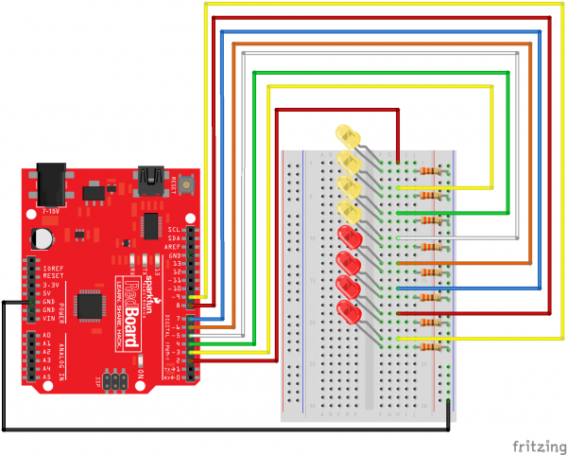
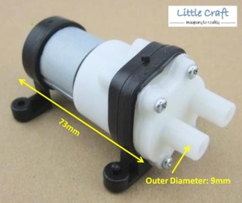
Equipment
Sensors
Moisture sensor
LED
Use of Arduino
Bump
Computer Arduino
https://www.delta-t.co.uk/product/wet-2/
Arduino and LEDs
https://learn.sparkfun.com/tutorials/sik-experiment-guide-for-arduino---v32/experiment-4-driving-multiple-leds
https://www.lelong.com.my/mini-diaphragm-water-pump-2l-min-6-to-12v-iot-arduino-littlecraft-183609909-2019-10-Sale-P.htm
https://en.wikipedia.org/wiki/Arduino

Slide 14
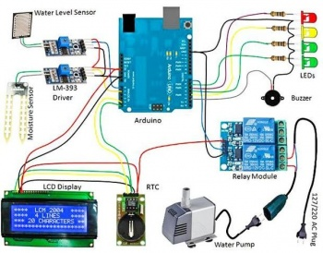
Case study 1: Hacker farm
Hacker farm
https://hackerfarm.jp/event/hackerfarm-agriculture-tech-series-vol-2-urban-farming/

Slide 15
Training
Learn Arduino software
Learn Arduino hardware interface
Learn control methods (algorithms)

Slide 16
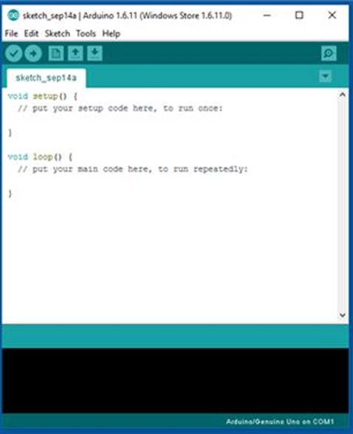
Arduino software
Easy to program , C-like
Important steps:
For loop
void loop() { for (int i=0; i <= 255; i++){ analogWrite(PWMpin, i); delay(10); } }
Input/output
analogWrite(PWMpin, i);
Use “Delay” to control timing
delay(10);
https://www.arduino.cc/en/Main/Software
With tutorial

Slide 17
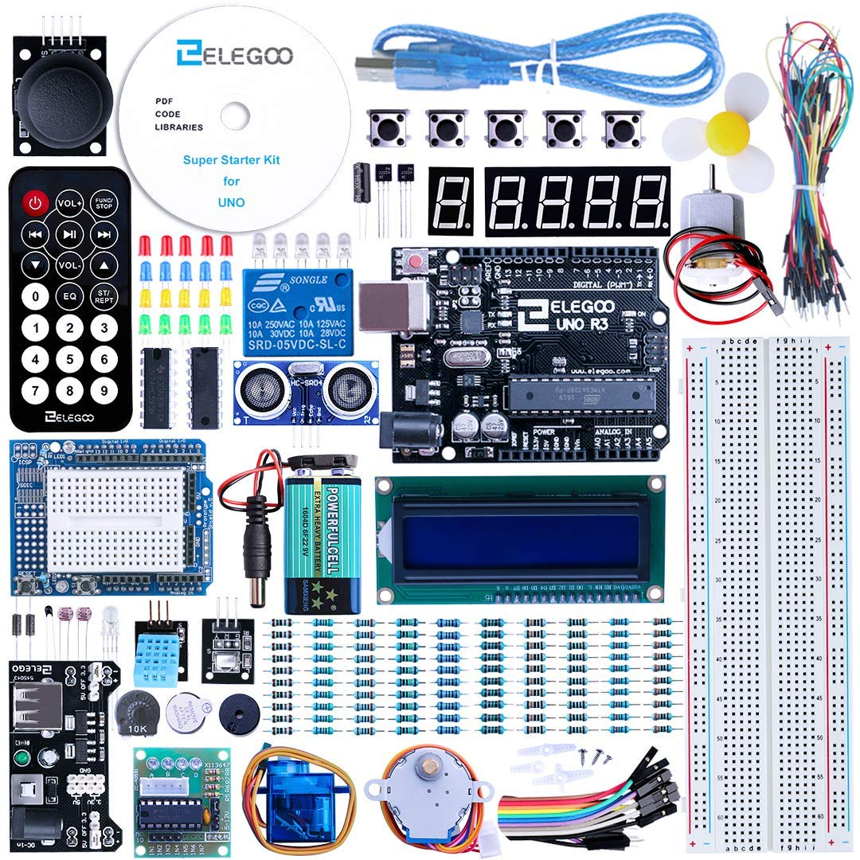
Arduino hardware
Use the development kit to learn hardware/software ,35 USD only (can be cheaper in Taobo)
Use of Breadboard
https://www.amazon.com/Arduino-Ultimate-Starter-Circuit-Learning/dp/B00BT0NDB8

Slide 18
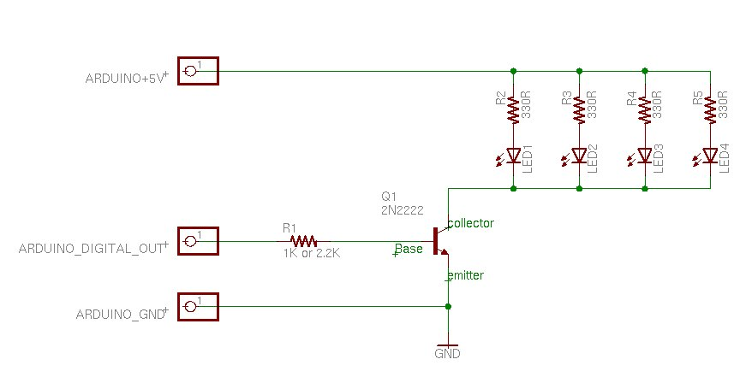
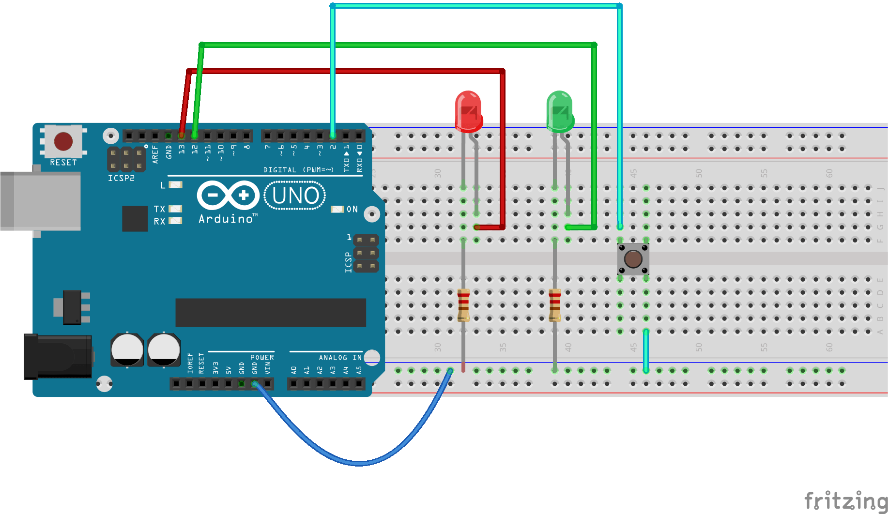
Arduino driving multiple LEDs
resistor
LED
One Arduino computer can driving many LEDs using transistors.
Need to tune the colors to achieve the best farming result
Transistor
Breadboard

Slide 19
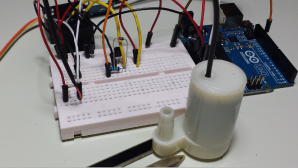
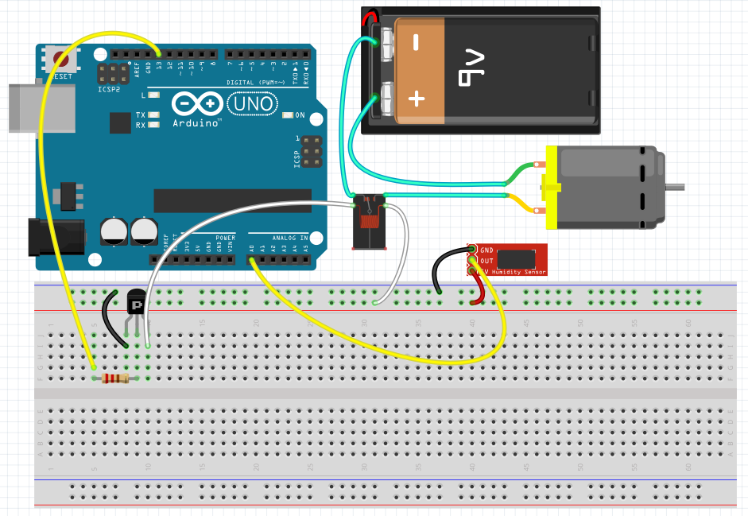
Arduino driving a water bump
driving a motorized water bump
A water bump
https://eeenthusiast.com/arduino-plant-watering-drip-feed-system/

Slide 20
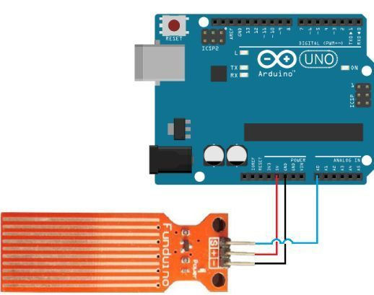
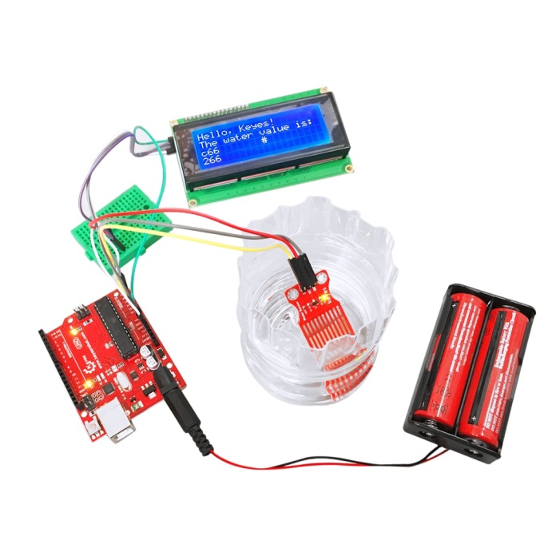
Arduino sensor: Water level sensor
Liquid Level Controller Module Water Level Detection Sensor
Circuit Diagram of water level detector
https://www.banggood.com/
http://microcontrollerslab.com
https://www.dhgate.com/

Slide 21
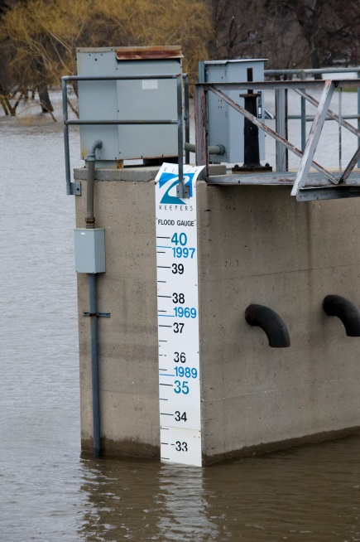
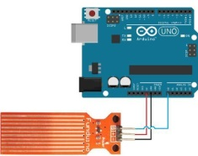
Control theory
Feedback control theory
E.g,. Control water level
Error
Err= R-S
Arduino water bump control
Motorized bump
Required
Water level
R
Water level sensor: S
https://en.wikipedia.org/wiki/Control_theory

Slide 22
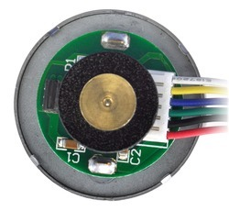
Example for speed control: PID (proportional-integral-derivative) control
integral control
Igain* leftErr dt
Motor
&
Required speed=
leftRPMset
wheel
Speed
encoder
leftPWM
Proportional control
Pgain*leftErr
generates PWM
for driver L293
+
-
leftErr
sum
Derivative control
Dgain*[d(leftErr)/dt]
leftPWM
LeftRPM
Integration in software = addition of two sequential values
Derivation in software = subtraction of two sequential values
leftRPM
http://www.cse.cuhk.edu.hk/~khwong/www2/ceng2400/2400_16_pid.pptx

Slide 23
Introduction
Control for better performance
Use PID, choose whatever response you want
Too much overshoot/undershoot, not stable
Motor speed (w)
Good performance
Criteria depends
on users and
applications
required
Response too slow
time

Slide 24
Exercise 2: Values to evaluate a control system
Describe the terms in the following diagram
Do you want them to be large or small?
Steady
state
error
overshoot
Target
value
Typically
value=10%
Depends
on application
undershoot
0
Settling time
time
Rise time

Slide 25
Choosing a computer
Arduino
Raspberry pie

Slide 26
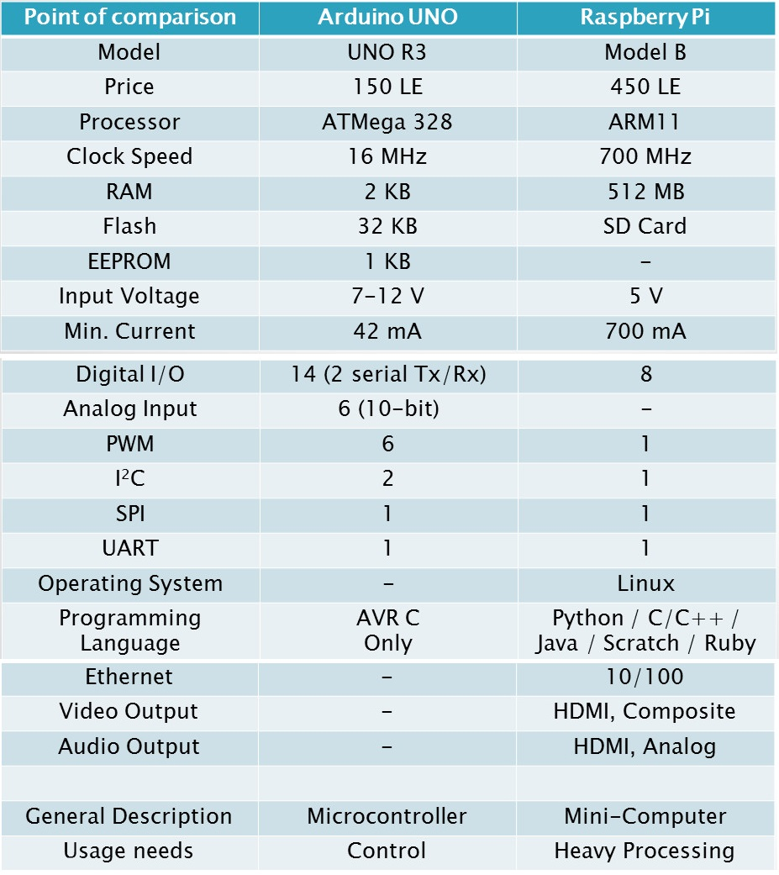
Choosing a computer
Arduino Raspberry Pie
Simple student starter projects, use Arduino
More serious projects use Raspberry pie
New Raspberry 3 has Wifi and Blue tooth
Prices of these products are similar
Arduino
has more interface channels
TV
monitor
https://www.instructables.com/id/Arduino-Vs-Raspberry-Pi-Which-Is-Better-For-You/
https://hk.element14.com
For simple computing
For heavy computing

Slide 27
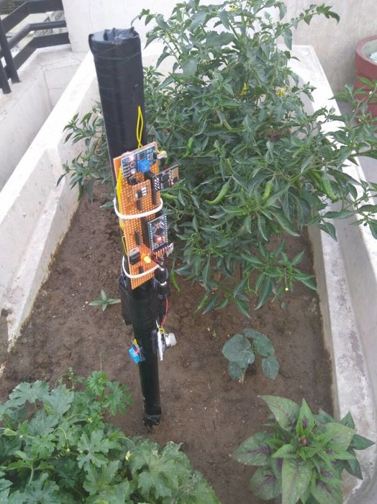
Open DIY Projects
Smart farming based agriculture IoT stick is regarded as IoT gadget focusing on live monitoring of environmental data in terms of temperature, moisture and other types depending on sensors integrated with it. Agricultural IoT stick provides the concept of "plug & sense" in which farmers can directly implement smart farming by as such putting the stick on the field and getting live data feeds on various devices like smartphones, tablets etc. and data generated via sensors can be easily shared anywhere and viewed by agriculture consultants remotely via cloud computing technology.
Smart monitoring only
Give enough construction steps
s://www.instructables.com/id/IoT-Based-Smart-Farming-Stick-Using-Arduino-and-Cl/

Slide 28
Other DIY projects
https://www.kickstarter.com/projects/sunair/smartplant-pi-smart-garden-with-your-raspberry-pi
https://create.arduino.cc/projecthub/projects/tags/agriculture
https://www.banggood.com/
2pcs Automatic Drip Irrigation Water Seepage Device Watering System Sprinklers Self Watering
Intelligent Automatic Flowers Watering Timer House Garden Water Timer
DIY 12V Automatic Watering Module Kit Soil Moisture Sensor With Time Delay (HKD25)

Slide 29
Suggestions from https://www.amazon.com/
Learn Arduino
E.g. Elegoo EL-KIT-008 Mega 2560 Project The Most Complete Ultimate Starter Kit w/TUTORIAL for Arduino UNO Nano (from or raspberry pie
E.g. reenove Ultimate Starter Kit for Raspberry Pi | Beginner Learning | Model 3B+ 3B 2B 1B+ 1A+ Zero W | Python, C, Java, Processing | 57 Projects, 401 Pages Detailed Tutorials, 220+ Components
Many comparable products elsewhere and may be cheaper
Learn basic electronics: Ohms law (Voltage = Current X Resistor), power, have a good sense of current and power relation.
Follow the tutorial study how to use them
Warning: safe when using batteries, be careful if you are using the 220V main power.

Slide 30
Suggested projects
Build a moisture monitor system
Generate plots of data vs time
Build an irrigation system
Grow something using solid or water
Build an LED based smart farming system
Change LED color composition (mixing 3 different color LEDs (Red, green, blue) by using pulse-width-modulation PWM method) and see the farming results.

Slide 31
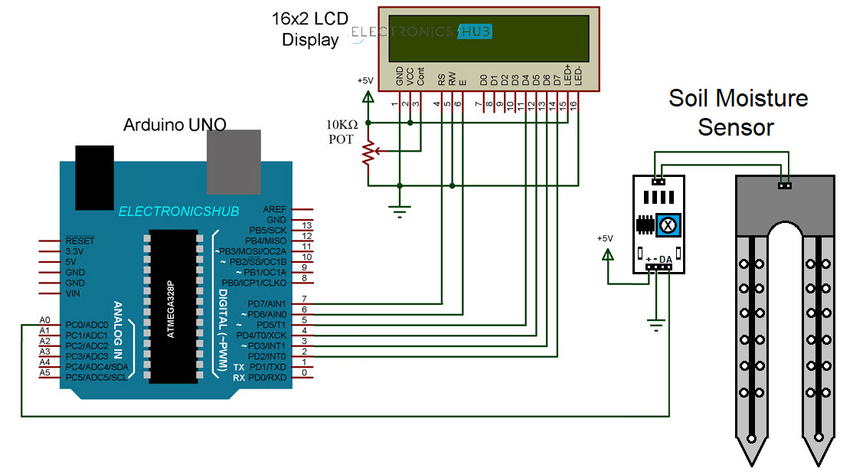
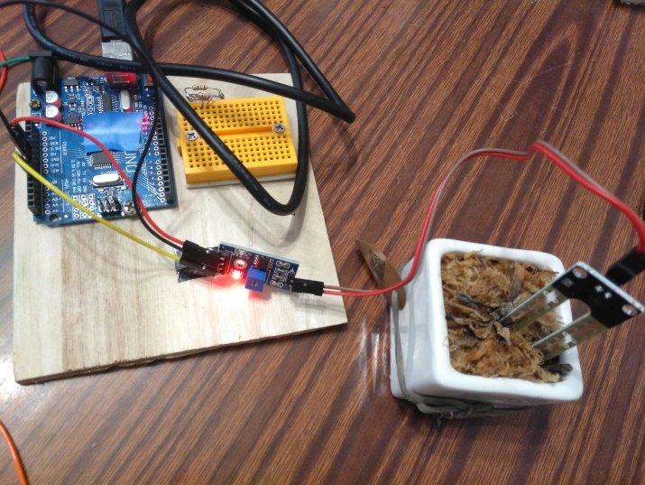
Experiments test6.1 Soil Moisture Sensor
// test6.1.ino
#include <LiquidCrystal.h> //2020.6.17 khw
//lcd display is optional, use serial com to monitor outout
///https://www.electronicshub.org/interfacing-soil-moisture-sensor-with-arduino/
const int rs = 7, en = 6, d4 = 5, d5 = 4, d6 = 3, d7 = 2;
LiquidCrystal lcd(rs, en, d4, d5, d6, d7);
int j=0;
int prev=0;
int pres=0;
void setup()
{
lcd.begin(16, 2);
lcd.setCursor(0,0);
lcd.print(" Soil Moisture ");
Serial.begin(9600);
}
void loop()
{
j=analogRead(A0);
j=map(j,0,982,148,0);
pres=j;
if(j>100)
j=100;
else if(j<0)
j=0;
lcd.setCursor(6,1);
lcd.print(j);
lcd.print("% ");
prev=j;
Serial.println(j);
delay(500);
}

Slide 32
End
Thank you!

