Slide 1
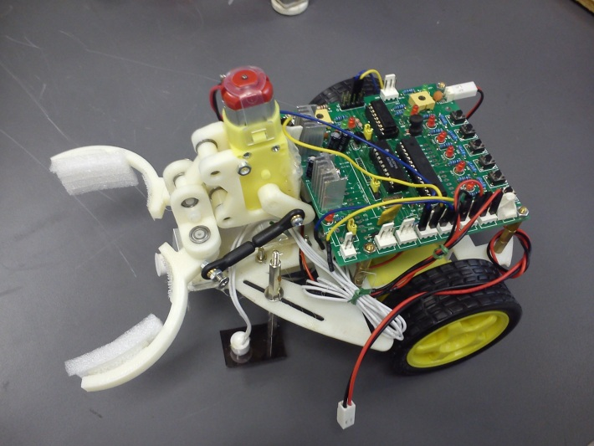
ERGM 1413 Programming and Playing with Intelligent Robots
Prof. K.H. Wong

Slide 2
Overview: ERGM 1413 Programming and Playing with Intelligent Robots
The CUHK Summer Institute 2014 (SI 2014),
Offered by the Department of Computer Science and Engineering
Instructor: Prof. Wong Kin Hong
Date: 15 - 18 July, 21 – 22 July 2014 Time: Morning session (9:30am-12:00noon) Venue: SHB 102
Course notes and materials can be downloaded from
http://www.cse.cuhk.edu.hk/~khwong/www2/ERGM1413/ERGM1413.rar
Demo1: https://www.youtube.com/watch?v=hoHrZmSfvts
Demo2: https://www.youtube.com/watch?v=e2rGzJq5ISo

Slide 3
Overview
ERGM 1413 is based on the teaching materials of a first year engineering course ENGG1100 (Introduction to Engineering Design 1) which is compulsory for all first year students admitted to the Engineering Faculty. In ERGM 1413, students of the summer institute will learn how to build intelligent robots, and the purpose is to arouse their interest in Engineering and to give them a taste of university education at CUHK.

Slide 4
Schedule
Day | Lecture notes | Lab sheet manual | Lab sheet report
1 | lecture 4- sensors and actuators | ENGG1100_Lab4 | ENGG1100_Lab4_LabSheet
2 | ENGG1100_lect_logic1_v3e2 | ENGG1100_Lab 5 | ENGG1100_Lab 5_LabSheet
3 | ENGG1100_lect_logic2_v3h-131028 | lab6_manual_310b-131027 | lab6_record__310b-131027
4 | ENGG1100_lect_logic3_v3h_131027 | Projects
5 | Projects
6

Slide 5
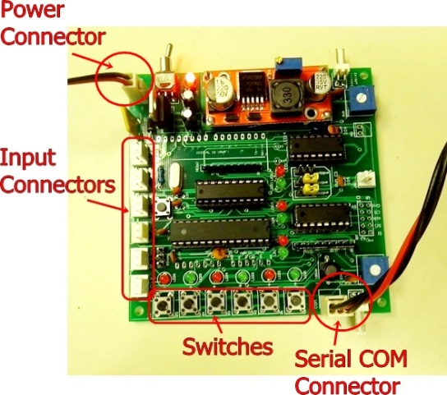
What to learn
Sensors
Motor control
Use of a micro-controller
Learn to integrate a full system: software, hardware, processor, input/output etc.
Learn to program the system and the robot
A microcontroller board: Arduino

Slide 6
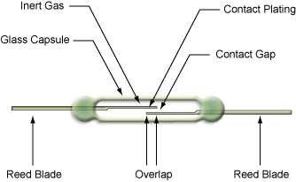
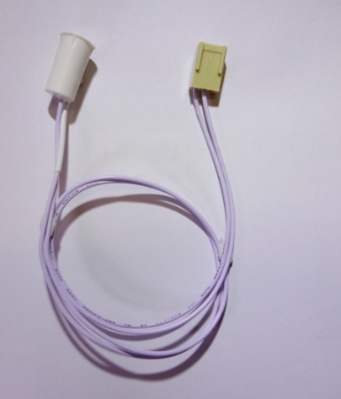
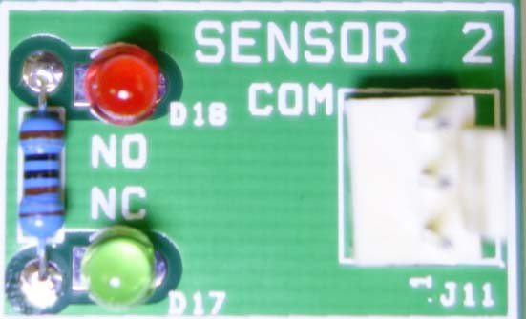
Learn to use sensors
Sensors
How the robot sees the world
We will learn how to use magnetic sensors
And see how the system reads these sensors
Magnet
Sensor interface circuit
Reed relay structure
Magnetic sensor

Slide 7
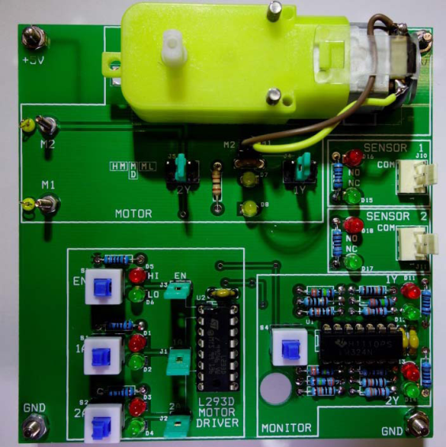
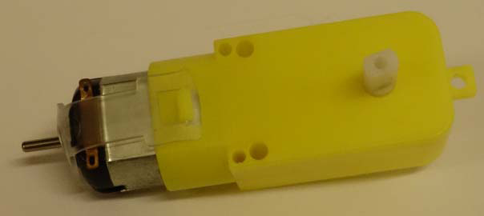
Learn to use motors
Direct current (D.C.) Motors
They are the arms and legs of a robot
How to connect the processor to motors
Processor board:
Arduino
The current output is too small to driver motors, so a driver is needed
Motor driver
L293D board
L293D board
D.C. Motor

Slide 8
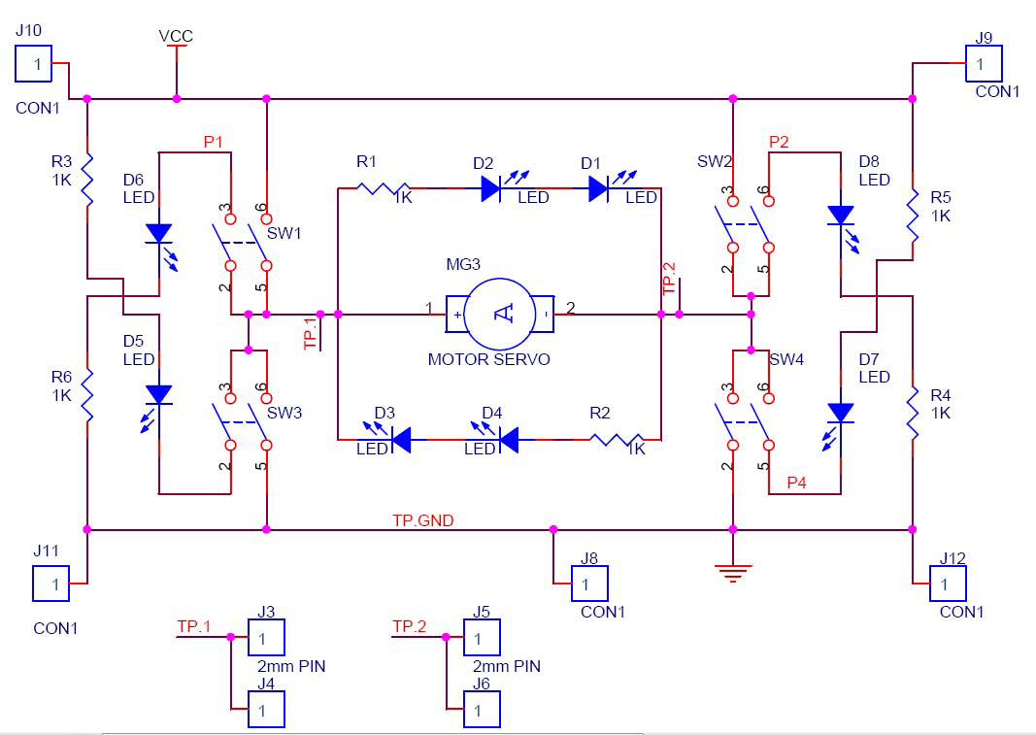
The H‐Bridge driver board The L293D (H‐Bridge driver) has this function

Slide 9
The microcontroller
Many choices:
Arduino (our choice)
Intel (8051)
Raspberry pie (ARM11)

Slide 10
Programming
Learn logic functions
Our program model is the Finite State Machines (FSM)

Slide 11
Summary
We will learn the operations of a robot system with
Sensors
Motors
Programs
Have fun!

Slide 12
END
Q &A

