Slide 1
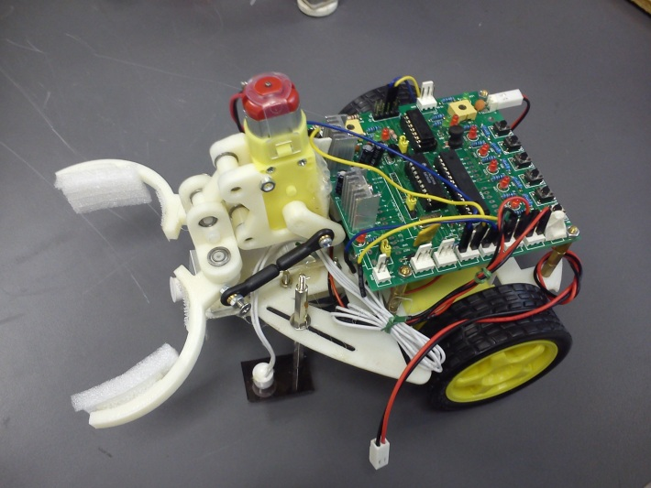
ENGG1100 Ch7: Introduction To Engineering Design (Digital Logic)
Part 3 of digital logic
KH WONG

Slide 2
Part3
Use a finite state machine to control the robot

Slide 3
Overview
Understanding finite state machines
3a) A simple finite state machine (no sensor)
E.g.: The dancing robot
3b) An finite state machine uses 2 sensors
E.g. The robot that follows the magnetic strip
3c) A finite state machine uses 3 sensors
E.g. Follow the magnetic strip, find the CAN and stop

Slide 4
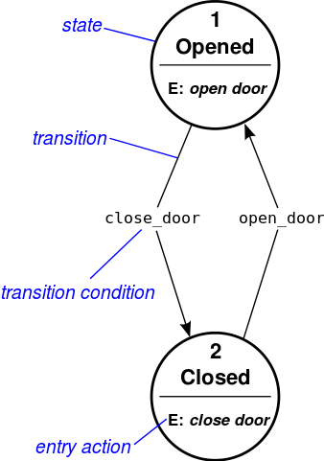
Understanding finite state machines
Example of a door
State
Transition
Transition condition
Entry action
http://en.wikipedia.org/wiki/State_diagram

Slide 5
Example in life
State of a student at CUHK
Start: go to state 1
State 1=Year 1:
entry action: register 12 courses
Transition: go to state 2 after 1 year
State 2=Year 2:
entry action: register 12 courses
Transition: go to state 3 after 1 year
State 3=Year 3:
entry action: register 12 courses
Transition: go to state 4 after 1 year
State 4=Year 4:
entry action: register 8 courses and Final_year_project
Transition: go to stop after 1 year
Stop: Graduation

Slide 6
3a) The simple state machine (no transition condition )
The robot that dances with a pattern
Forward 2 seconds, turn left 2 seconds and turn right 2 seconds, stops and repeat the pattern again
Video demo:
http://youtu.be/iyakbVyoafI

Slide 7
Simple finite state machine for (3a) : No sensor input (no transition condition)
Entry actions
Start
Transition
Output: LM1,LM2,RM1,RM2=1010
State1
Entry action:
Move
Forward
Transition: After 2 seconds
Transition: After 2 seconds
State2
State4
E: Turn
Left
E:Stop
Output: LM1,LM2,RM1,RM2=0000
After 2 seconds
After 2 seconds
Output: LM1,LM2,RM1,RM2=0010
State3
E:Turn
Right
Output: LM1,LM2,RM1,RM2=1000
Flow diagram
Baisc form

Slide 8
Implementation of the finite state machine for (3a)
Use of DELAY:
DELAY_TIME=2000
motors(LM1,LM2,RM1,RM2,SPEED,SPEED,DELAY_TIME);
Part of the sample source code is shown below:
switch(state)
{
case STATE1:
LM1=1;LM2=0;RM1=1;RM2=0;SPEED=200; //entry action
DELAY_TIME=2000; // transition :delay 2 seconds
motors(LM1,LM2,RM1,RM2,SPEED,SPEED,DELAY_TIME);
state=STATE2; // next state will be state2
break; //end of the current state
case STATE2:
LM1=0;LM2=0;RM1=1;RM2=0;SPEED=200;DELAY_TIME=2000; // delay 2 seconds
motors(LM1,LM2,RM1,RM2,SPEED,SPEED,DELAY_TIME);
state=STATE3; //next state will be state3
break; //end of the current state
// to be continued on next page
Set motor to run forward with speed=200
System call to ask the motor to work
Exercise: explain the meaning of state 2

Slide 9
Continue from last page
case STATE3:
LM1=1;LM2=0;RM1=0;RM2=0;DELAY_TIME=2000;
motors(LM1,LM2,RM1,RM2,SPEED,SPEED,DELAY_TIME);
state=STATE4;
break;
case STATE4:
LM1=0;LM2=0;RM1=0;RM2=0;SPEED=200;DELAY_TIME=2000;
motors(LM1,LM2,RM1,RM2,SPEED,SPEED,DELAY_TIME);
state=STATE1;
break;
default: //none of above will be forced to run state4
state=STATE4;
break;
}
Exercises: explain the meaning of state 3 and 4

Slide 10
3b) A finite state machine uses 2 sensors (with transition condition)
E.g. The robot that follows the magnetic strip

Slide 11
Example in life (with transition condition : study hard)
State of a student at CUHK
Start：go to state1
State 1=Year 1:
entry action: register 12 courses
Transition: if (study hard) promote to state2 (year2) else go back to state 1
State 2=Year 2:
entry action: register 12 courses
Transition: if (study hard) promote to state3 (year3) else go back to state 2
State 3=Year 3:
entry action: register 12 courses
Transition: if (study hard) promote to state4 (year4) else go back to state 3
State 4=Year 4:
entry action: register 12 courses
Transition: if (study hard) promote to stop(graduation) else back go to state4
Stop: Graduation

Slide 12
Demo 3b) An finite state machine uses 2 sensors
The robot can follow the magnetic strip
Video Demo:
http://youtu.be/NWHjWrq_VoY
Please refer to the program of demo 3c, Demo 3b and demo3c are using the same program.

Slide 13
3c) A finite state machine uses 3 sensors E.g. Follow the magnetic strip, find the CAN and stop
Video Demo : http://youtu.be/JEQkuax7lKE
The robot finds the CAN using the magnetic strip placed under the testing board and stops
End point
S1
Obstacle
LM1,LM2
S3
S2
Start point
RM1,RM2

Slide 14
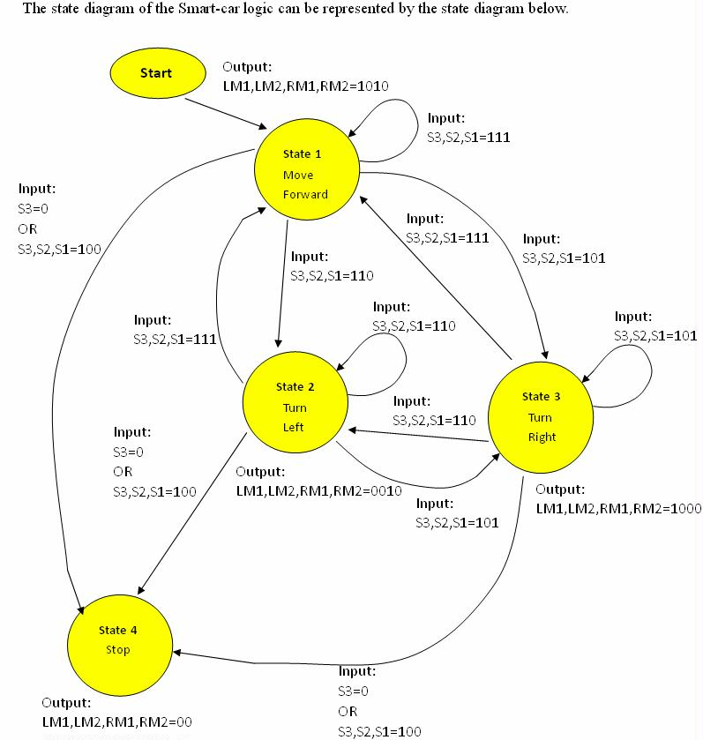
Finite state machine using 3 sensors (s1, s2, s3)with transition conditions for (3c)
Flow diagram
Basic form

Slide 15
Program 3c (S1, S2, S3 are used) S1, S2 for following the magnetic strip S3 for detecting the CAN
The sample source code (program_segment3) is shown below:
switch(state)
{
case STATE1: // forward for 1 second
LM1=1;LM2=0;RM1=1;RM2=0;
SPEED=200;DELAY_TIME=10;
motors(LM1,LM2,RM1,RM2,SPEED,DELAY_TIME);
//
if ( S3()==1 && S2()==1 && S1()=0 ) state=STATE2;
else if(S3()==1 && S2()==0 && S1()=1) state=STATE3;
else if((S3==0) || (S3()==1 && S2()==0 && S1()=0)) state=STATE4;
break;
case STATE2: //robot turns left
LM1=0;LM2=0;RM1=1;RM2=0;SPEED=200;DELAY_TIME=10;
motors(LM1,LM2,RM1,RM2,SPEED,DELAY_TIME);
//
if ( S3()==1 && S2()==1 && S1()=1 ) state=STATE1; //back to state 1
else if(S3()==1 && S2()==0 && S1()=1) state=STATE3;
else if((S3==0) || (S3()==1 && S2()==0 && S1()=0)) state=STATE4;
break;
Move forward for 1 second
If S3=0, a CAN is detected, next state is state4
Robot Deviated right, goto state 2
Robot Deviated left
goto state 3

Slide 16
case STATE3: //robot turns right
LM1=1;LM2=0;RM1=0;RM2=0;
SPEED=200;DELAY_TIME=10;
motors(LM1,LM2,RM1,RM2,SPEED,DELAY_TIME);
//
if ( S3()==1 && S2()==1 && S1()=1 ) state=STATE1;
else if(S3()==1 && S2()==1 && S1()=0) state=STATE2;
else if((S3==0) || (S3()==1 && S2()==0 && S1()=0)) state=STATE4;
break;
case STATE4: //stop
LM1=0;LM2=0;RM1=0;RM2=0;
SPEED=200;DELAY_TIME=10;
motors(LM1,LM2,RM1,RM2,SPEED,DELAY_TIME);
break;
default: //none of above states
state=STATE4;
LM1=0;LM2=0;RM1=0;RM2=0;
SPEED=200;DELAY_TIME=10;
motors(LM1,LM2,RM1,RM2,SPEED,DELAY_TIME);
break;
}
If S3=0,a CAN is detected
Next state is state4
State4 is the stop state, the robot stops

Slide 17
Summary
In digital logic part 1,2 & 3, we learned
What is digital logic
Digital logic operations represented by
Digital logic formula method
Truth table method
Their implementation methods using programs
Final state machines
Theory and implementations
Use the above to control a robot for specific tasks

Slide 18
End

