Slide 1
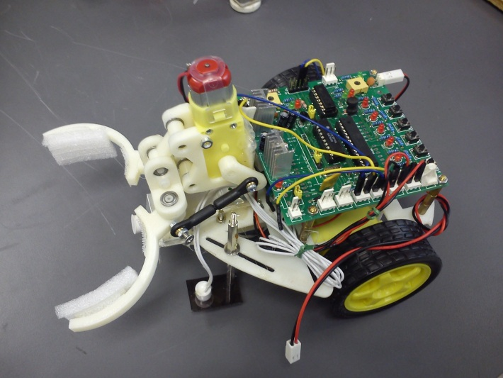
ENGG1100 Ch6: Introduction To Engineering Design (Digital Logic)
Part 2 of digital logic
KH WONG

Slide 2
Part 2
Implementations of logic functions in programs
Method1: Logic Formula (use of IF-Then-Else)
Method2: Truth table (Use of Switch-case)
Examples
**For both methods, you don’t need to write the full programs, you only need to understand and modify the examples given.
Video link http://www.youtube.com/channel/UCjlkiXFReY2Ubv6WX8m4F8A?feature=watch

Slide 3
Method 1: to implement logic operations in a program using
Logic Formula (use of IF-Then-Else)

Slide 4
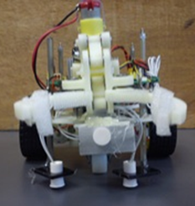
Sensors of our robot
The robot is facing you
Sensors
S1,S2,S3 each can be ‘1’ or ‘0’
Magnetic field detected =>Si=0
No Magnetic field detected =>Si=1
S2 S3 S1
4

Slide 5
Motors of our robot
The robot is facing you
Motors: LM1, LM2, RM1 and RM2
Instruction LM1(0) sets LM1 to be 0
Instruction LM1(1) sets LM1 to be 1
Motor control method
{LM1=1 and LM2=0}=> Left-motor moves forward
{LM1=0 and LM2=1} => Left-motor moves backward
{LM1=0 and LM2=0} => Left-motor stops
Similar for the right-motor
RM1
RM2
LM1
LM2
5

Slide 6
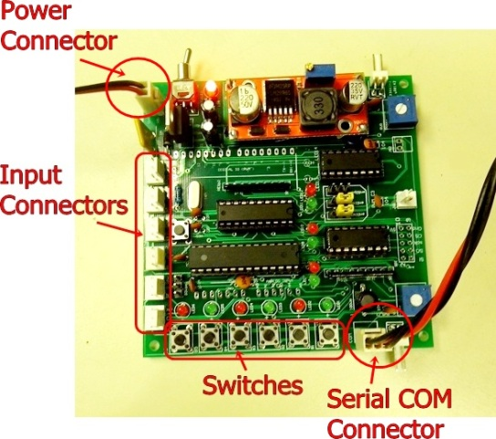
In the lab : use switches to simulate sensors; use LEDs to simulate motors
Testing hardware setup in our robot system
LM1 is an output for a Light Emitting Diode LED
When LM1=1 it is on
When LM1=0 it is off
Same for LM2,RM1 and RM2 etc
S1 is a switch
When depressed S1=0
When released S1=1
Same for S2,S3 and S4
Simulate
Motors
LM1,LM2
RM1,EM2
Simulate sensors S1,S2 etc

Slide 7
Programing procedures
Details in the document
“Document B: A tutorial of how to use the controller board”, of Engg1100 Lab manual 5 from elearninghttps://elearn.cuhk.edu.hk/webapps/login/
Edit program
Compile
Download to the SMART-car-board
Run the program
Demo video in http://www.youtube.com/channel/UCjlkiXFReY2Ubv6WX8m4F8A?feature=watch

Slide 8
Method 1 (Use of If-then-else): This program will enable the robot to follow the magnetic path
The program segment:
Void loop()
{
LM1(0);LM2(0);RM1(0);RM2(0);
//comment :LM1 =S1 AND S2
If (S1()==1 && S2()==1) LM1(1);
Else LM1(0);
//comment :LM2 = S3 OR S4
If (S3()==1 || S4()==1) LM2(1);
Else LM2(0);
}
Notations used in the program
Void Loop= repeated the execution of the lines
LM1(0) sets the digital output LM1 to 0
LM1(1) sets the digital output LM1 to 1
== means condition
&&= logic operation AND
|| = Logic OR
// comment, for you to put in notes
RM1
RM2
LM1
LM2
S2 S1

Slide 9
How to use “If” in a program
IF (condition) then output is result 1, else output is result 2
Example1: //just to illustrate the idea, not a runnable program
If (“you_eat” and “you_drink”) you _can_live;
Else “you_die”;
Example2: // && means “AND”
If (S1()==1 && S2()==1) LM1(1);
Else LM1(0);
The above program means if S1 is 1 AND S2 is 1, the LM1 will be 1 else LM1 is 0
Example3: // || means “OR”
If (S3()==1 || S4()==1) LM2(1);
Else LM2(0);
The above program means if S3 is 1 OR S4 is 1, the LM2 will be 1 else LM2 is 0

Slide 10
Exercise1
//LM2 = S3 OR S4
If (S3()==1 || S4()==1) LM2(1);
Else LM2(0);
If (S4()==0 && S1()==1) LM1(0);
Else LM1(1);
Explain in English the meaning of the above statements
??

Slide 11
Method 2 : to implement logic operation in a program using
truth table (Use of Switch-Case)

Slide 12
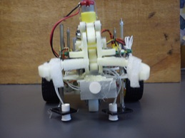
Using two sensors S2,S1 to follow a magnetic stripe
Sensors: S2 S1
Terminal
Magnetic sensors
S1, S2
12
S2 S1

Slide 13
Robot specifications of the sensor input and motor outputs
Inputs:
S1 S2 are magnetic sensors
S1 =‘1’ if it detects no magnetic material
S1 =‘0’ if it detects magnetic material
Outputs for left motor (similar to right motor) :
LM1, LM2=“10” left motor moves forward
LM1, LM2=“01” left motor moves backward
LM1, LM2=“00” or “11” left motor stops
Terminal
Magnetic sensors
S1, S2
Robot car
Magnetic stripe

Slide 14
Motor control
Motor control outputs for both motors
Robot forward: LM1, LM2, RM1, RM2=“1010”
Robot turns right: LM1, LM2, RM1, RM2=“1000”
Robot turns left: LM1, LM2, RM1, RM2=“0010”

Slide 15
Exercise2: Truth table example to make our robot follow the magnetic strip
Case
S2=1, S1=1 (on both sides of magnetic strip): Robot should move forward
S2=0, S1=1 (robot on the left side of the magnetic strip): Robot should turn right
S2=1, S1=0 (robot on the right side of the magnetic strip): Robot should turn left
S2=0,S1=0 (robot reaches the terminal) : Robot should stop
Magnetic strip
Robot
Fill in the table
S1 S2
Case | Inputs |  | Outputs
 | S2 | S1 | LM1 | LM2 | RM1 | RM2
1) | 1 | 1 | 1 | 0 | 1 | 0
2) | 0 | 1 | ?__ | ?__ | ?__ | ?__
3) | 1 | 0 | ?__ | ?__ | ?__ | ?__
4) | 0 | 0 | ?__ | ?__ | ?__ | ?__
S1 S2
S1 S2
forward:LM1, LM2, RM1, RM2=“1010”
turn right:LM1, LM2, RM1, RM2=“1000”
turn left:LM1, LM2, RM1, RM2=“0010”
S1 S2

Slide 16
Add another sensor at the front to detect the target object
Sensors: S2 S1 facing the ground for following the to follow the magnetic stripe
S3 is used to detect the target object
S3=1 if no object is detected
S3=0 if an object is detected
Magnetic sensors
S1, S3 S2
16
S2 S3 S1

Slide 17
Use of “Switch – case” in a program
You may treat it as a table lookup method
In English it means:
If INPUT is code1, result 1 will occur
If INPUT is code2, result 2 will occur
If INPUT is code3, result 3 will occur
Etc……
switch (INPUT)
{
case code1 : result 1;
break;
case code2 : result 2;
break;
case code3 : result 3;
break;
:
}

Slide 18
Program example for our robot You only need to edit the program to change the desired truth table
The program segment that produces the truth table on the right
void LogicTable()
{
// S4,S3,S2,S1 are the least significant 4 bits of IN_sensor in the program
switch (IN_sensor) // 0b00FEDCBA
{
case 0bxxxxxx11 : LM1(1);LM2(0);RM1(1);RM2(0);
break;
case 0bxxxxxx10 : LM1(1);LM2(0);RM1(0);RM2(0);
break;
case 0bxxxxxx01 : LM1(0);LM2(0);RM1(1);RM2(0);
break;
default : LM1(0);LM2(0);RM1(0);RM2(0);
break;
}
}
Inputs |  | Outputs
S2 | S1 | LM1 | LM2 | RM1 | RM2
0 | 0 | 0 | 0 | 0 | 0
0 | 1 | 0 | 0 | 1 | 0
1 | 0 | 1 | 0 | 0 | 0
1 | 1 | 1 | 0 | 1 | 0
Magnetic sensors
S1, S3 S2
S2 S3 S1

Slide 19
To be done in the lab : Lab5.ino from https://elearn.cuhk.edu.hk/webapps/login/
Experiment 1.3: Fill in the truth table of the AND logic function after you completed the following procedures. (Hardware experiment is required for this and the following exercises)
//program segment in the main loop of Lab5.ino
void loop()
{ // Experiment 1.3 OUT1=S1 AND S3
if(Din1() && Din3()) Out1(1);
else Out1(0);
:
}
LED to represent OUT1()
Inputs |  |  |  | Outputs Q
S3 | S1 | LED3 | LED1 | LED7 | Out1
0 | 0 | ON | ON
0 | 1 | ON | OFF
1 | 0 | OFF | ON
1 | 1 | OFF | OFF
Din1 () , Din(3)

Slide 20
Appendix1: Answer for the exercise1
//LM2 = S3 OR S4
If (S3()==1 || S4()==1) LM2(1);
Else LM2(0);
If (S4()==0 && S1()==1) LM1(0);
Else LM1(1);
Explain in English the meaning of the above statements
?? ans: if S3 is 1 OR S4 is 1 LM2 is 1, else LM2 is 0
ans: if S4 is 0 AND S1 is 1 LM1 is 0, else LM2 is 1

Slide 21
Appendix2: Answer: Exercise 2:Truth table example to make our robot follow the magnetic strip
Case
S2=1, S1=1 (on both sides of magnetic strip): Robot should move forward
S2=0, S1=1 (robot on the left side of the magnetic strip): Robot should turn right
S2=1, S1=0 (robot on the right side of the magnetic strip): Robot should turn left
S2=0,S1=0 (robot reaches the terminal) : Robot should stop
Magnetic strip
Robot
Fill in the table
S1 S2
Case | Inputs |  | Outputs
 | S2 | S1 | LM1 | LM2 | RM1 | RM2
1) | 1 | 1 | 1 | 0 | 1 | 0
2) | 0 | 1 | 1 | 0 | 0 | 0
3) | 1 | 0 | 0 | 0 | 1 | 0
4) | 0 | 0 | 0 | 0 | 0 | 0
S1 S2
S1 S2
forward:LM1, LM2, RM1, RM2=“1010”
turn right:LM1, LM2, RM1, RM2=“1000”
turn left:LM1, LM2, RM1, RM2=“0010”
S1 S2

Slide 22
Appendix 3: Reference Main loop of experiment5(lab5.ino) from https://elearn.cuhk.edu.hk/webapps/login/
void loop()
{
// Experiment 1.3 OUT1=S1 AND S3
if(Din1() && Din3()) Out1(1);
else Out1(0);
// Experiment 1.4 OUT3=S1 OR S3
if(Din1() || Din3()) Out3(1);
else Out3(0);
// Experiment 2.1 OUT2=(S2 AND S3) AND S4
if((Din2() && Din3()) && Din4()) Out2(1);
else Out2(0);
// Experiment 2.2 OUT4=(S2 AND S3) OR S4
if((Din2() && Din3()) || Din4()) Out4(1);
else Out4(0);
}

Slide 23
Appendix 4 Truth table example to make our robot follow the magnetic strip
Inputs |  |  |  | Outputs
S4 | S3 | S2 | S1 | LM1 | LM2 | RM1 | RM2
0 | 0 | 0 | 0
0 | 0 | 0 | 1
0 | 0 | 1 | 0
0 | 0 | 1 | 1
0 | 1 | 0 | 0
0 | 1 | 0 | 1
0 | 1 | 1 | 0
0 | 1 | 1 | 1
1 | 0 | 0 | 0
1 | 0 | 0 | 1
1 | 0 | 1 | 0
1 | 0 | 1 | 1
1 | 1 | 0 | 0
1 | 1 | 0 | 1
1 | 1 | 1 | 0
1 | 1 | 1 | 1
Table 1: Truth Table of Smart car control logic

