Slide 1
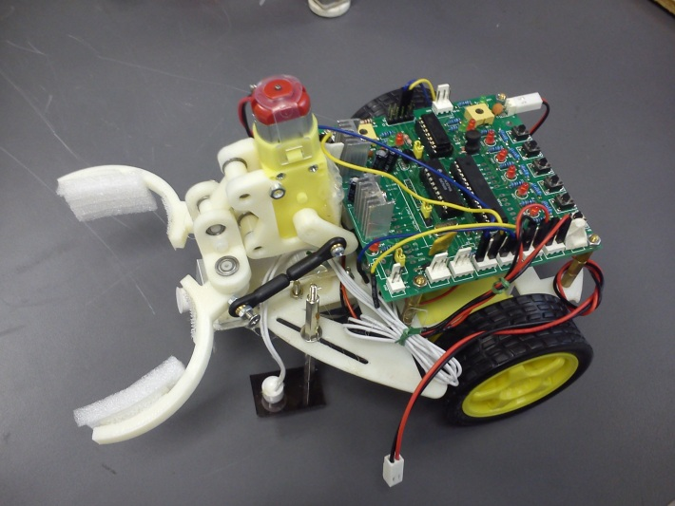
ENGG1100 Ch5: Introduction To Engineering Design (Digital Logic)
Part 1 of digital logic
KH WONG

Slide 2
Reminder: Major Programme Talks (Session 1 & Session 2)
Please attend both session:
Oct 31 & Nov 7, 2013 (Thursdays)
6:45 pm – 8:15 pm
VENUE: SESSION 1: LT1, YIA
- Computer Science
- Computer Engineering
- Information Engineering
- Mathematics & Information Engineering
- Systems Engineering & Engineering Management
SESSION 2: LT2, YIA
- Biomedical Engineering
- Electronic Engineering
- Energy Engineering
- Mechanical & Automation Engineering
Major Allocation Process
Oct – Mar
Major Programme Talks and Academic Counselling for Students

Slide 4
Mid-term Demo
Date: 28/10/2013 (next Monday)
Venue/time: the same place and hours
Task1: Your robot is able to communicate with a computer so testing programs can be downloaded to the system, and all the LEDs and switches are functioning properly (The test program will be provided);
Task2: Your robot is able to run in a straight line at a constant speed for at least 30 cm under the control of the given test program.
Video link (Mid-term demo, demo1 and demo2)
http://www.youtube.com/channel/UCjlkiXFReY2Ubv6WX8m4F8A?feature=watch
If necessary, ask your tutors to help during this week.

Slide 5
Mid term quiz
Dear ENGG1100A students,
Please note that you will have Quiz 1 during the lab session period of ENGG1100A on next Monday. The location will be in the same teaching laboratory or additional classroom, if any. Please follow the instructions from the lab technician. The start time of the Quiz will be 11:35amSHARP.
For this Quiz 1, you have to answer 12 multiple-choice questions in 15 minutes. All answers should be written on the question paper and submit it to the instructor after the quiz. The coverage of Quiz 1 will be the content covered from Lectures 1 to 4. This quiz is an easy one, don't worry. Please spare some time to read through the lecture notes. This quiz is a close-book exam.
Good Luck.

Slide 6
Overview
Part 1: Introduction
1.1 What is Digital logic?
1.2 Digital operations (AND, OR, NOT)
1.3 Truth table

Slide 7
Motivations and plans
The brain of our robot is a set of digital logic functions
We will introduce three techniques in digital logic design in this course
Logic formula
Truth table
Finite state machine
We will use a program in a Micro-controller system to implement these techniques

Slide 8
Example
How to keep the robot to move forward? Method:
If the robot deviates to the left, turn right
If the robot deviates to the right, turn left
The above are logic functions and operations.
Terminal
Magnetic sensors
S1 S2

Slide 9
1.1 What is digital logic ?
Understanding the difference between Digital and Analog operations

Slide 10
Analog and digital signals
Analog signals: the signal can be any values within the valid range
Example: Range =0 → 10 Volts
E.g. The signal can be 1.356 Volts or 2.432 Volts
Digital signals: It can only be high (or called ‘1’ )or low (or called ‘0’). Examples:
In TTL Transistor-transistor-logic standard:
High=‘1’ ≈ 5 volts
Low=‘0’ ≈ 0 Volt
Voltage
10 V
0 V
1
Time (ms)
Voltage
5 V
0 V
1
Time (ms)

Slide 11
What is the meaning of digital logic?
A signal is represented by ‘1’ or ‘0’
In some digital electronics:
High=‘1’ ≈ 5 volts
Low=‘0’ ≈ 0 Volt
Advantages:
Easy to be implemented in a circuit.
Less likely to be interfered by noise, temperature and radiation.

Slide 12
1.2 Digital Operations
AND
OR
NOT

Slide 13
Digital operations
We want to find the results of the operations of some digital inputs
In arithmetic operation: 2 Add 3= 5, result is 5
In digital operation: we need a truth table to see the result
3 popular digital operations you will learn here
AND
OR
NOT (Negation )
Digital
Input1
Digital
Input2
Digital operation
Digital
Output

Slide 14
Exercises
Multiple choice questions
Are these values digital or analog?
Temperature (Yes or No) , Ans: _________?
Humidity (Yes or No) , Ans: _________?
Are you a Chinese Univ. student?Ans___? Is the answer Analog or digital? : Ans:_________?
Do you have a mobile phone in your pocket? Ans:___? Is the answer Analog or digital? Ans: ________?
What is the temperature in this room? Ans:___? (Analog or digital) Ans: ________?

Slide 15
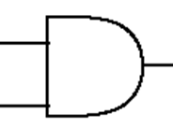
Example of AND in real life
You get a Degree from CUHK if you take 123 units and your GPA is greater than 1.5
You may write a formula
(X=take 123 units) AND (Y=GPA>1.5) then you can get a degree from CUHK ()
You must eat and drink in order to live
You may write a formula
(X=eat ) AND (Y=drink) then you can live (W)
Notation
X
Y
W=X AND Y

Slide 16
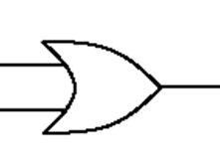
Example of OR in real life
If you live in Mongkok, you either take a bus or train to come to the university
You may write a formula
(X=take bus) or (Y=take train) then you can go to the University (W)
You can ride on a bus if you pay cash or pay using octopus
You may write a formula
(X=pay by cash) or (Y=pay by octopus) then you can ride on the bus (W)
Notation
X
Y
W=X OR Y

Slide 17
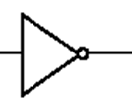
Example of NOT in real life
I don’t love you = Not (I love you)
You may write a formula
NOT (X=I love you) means I don’t love you (W)
You are not rich = NOT (you are rich)
You may write a formula
NOT(X=you are rich) that means you are poor (W)
Notation
X
W=NOT X

Slide 18
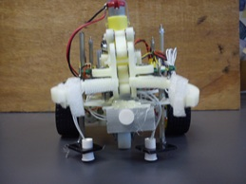
Exercise for robot control to follow the magnetic path
Terminal
Sensors: S2 S1
If S2 detects the magnetic strip, but not S1, is the robot deviate to the right or left of the path:
Answer (right or left) : ______?
Magnetic sensors
S1 S2
18
S2 S1

Slide 19
1.3 Truth table
A method to represent logic functions for digital signals

Slide 20
Truth table
The idea is to have all different combinations of inputs arranged in a table
Each combination gives one output
For n digital inputs , there will be 2^{n} different combinations
The truth table has 2^{n} rows
Example:
n=2 (X and Y as inputs), so there are 2^{n}=4 rows
You can see that no two rows have the same combination of inputs
Example
Input: X | Input: Y | W= Output For the operation
0 | 0 | ?
0 | 1 | ?
1 | 0 | ?
1 | 1 | ?
? = depends on the operation

Slide 21
Truth table example for “AND” operation
X
Y
W=
X AND Y
X , Y are 2 digital input signals
We can use a “Truth table” to find the output
Because there are n=2 inputs: X,Y
So there are 2^{n}=4 rows in the truth table
Steps to fill in the table
Fill in Y: 0,1,0,1 (from top)
Fill in X: 0,0,1,1
Fill in the outputs
Output=1 only when
both inputs are 1
Input : X=eat | Input: Y=drink | Output W= X AND Y =live
0 | 0 | 0
0 | 1 | 0
1 | 0 | 0
1 | 1 | 1

Slide 22
Truth table example for “OR” operation
X
Y
W=
X OR Y
X , Y are 2 digital input signals
We can use a “Truth table” to find the output
Because there are n=2 inputs: X,Y
So there are 2^{n}=4 rows in the truth table
Steps:
Fill in Y: 0,1,0,1(from top)
Fill in X: 0,0,1,1
Fill in the outputs
Output=1 only when
either input is 1
Input: X(pay by cash) | Input: Y (pay by Octopus) | Output W= X OR Y= (ride on a bus)
0 | 0 | 0
0 | 1 | 1
1 | 0 | 1
1 | 1 | 1

Slide 23
NOT (or called negation)
W=
NOT X
X is a digital input signal
We can use a “Truth table” to find the output
Because there are n=1 input: X
So there are 2^{n}=2 rows in the truth table
Step:
Fill in X: 0,1
Fill in the outputs
Output=Reverse the input
X
X= you are rich | NOT X (you are not rich)
0 | 1
1 | 0

Slide 24
Exercises
How many rows are required in the truth table for 3 inputs?
Give examples of
AND
OR
NOT

Slide 25
Combinational logic (Combine NOT , AND , OR)
X , Y , Z are 3 digital input signals
We can use a “Truth table” to find the output
Because there are n=3 inputs: X,Y,Z
So there are 2^{n}=8 rows in the truth table
Fill in Z: 0,1,0,1,0,1,0,1
Fill in Y: 0,0,1,1,0,0,1,1
Fill in X: 0,0,0,0,1,1,1,1
W

Slide 26
Truth table
W
We want to find : W=X OR (NOT (Y) AND Z)
X | Y | Z |  |  | W=X OR (NOT ( Y) AND Z)
0 | 0 | 0 |  |  | ?
0 | 0 | 1 |  |  | ?
0 | 1 | 0 |  |  | ?
0 | 1 | 1 |  |  | ?
1 | 0 | 0
1 | 0 | 1
1 | 1 | 0
1 | 1 | 1

Slide 27
We can solve it step by step
Step1
W
X | Y | Z | NOT(Y)
0 | 0 | 0 | 1
0 | 0 | 1 | 1
0 | 1 | 0 | 0
0 | 1 | 1 | 0
1 | 0 | 0 | 1
1 | 0 | 1 | 1
1 | 1 | 0 | 0
1 | 1 | 1 | 0
Produce NOT (Y)
From Y first.
X,Z are not used in this step.
input
output

Slide 28
We can solve it step by step
Step2
W
X | Y | Z | NOT(Y) | Z AND (NOT(Y))
0 | 0 | 0 | 1 | 0
0 | 0 | 1 | 1 | 1
0 | 1 | 0 | 0 | 0
0 | 1 | 1 | 0 | 0
1 | 0 | 0 | 1 | 0
1 | 0 | 1 | 1 | 1
1 | 1 | 0 | 0 | 0
1 | 1 | 1 | 0 | 0
Then, produce
[Z AND (NOT (Y))].
X , Y are not used directly in this step.
input
input
output

Slide 29
We can solve it step by step
W=X OR (Z AND (NOT(Y)))
Step3
X | Y | Z | NOT(Y) | Z AND (NOT(Y) | W=X OR (Z AND (NOT(Y)))
0 | 0 | 0 | 1 | 0 | 0
0 | 0 | 1 | 1 | 1 | 1
0 | 1 | 0 | 0 | 0 | 0
0 | 1 | 1 | 0 | 0 | 0
1 | 0 | 0 | 1 | 0 | 1
1 | 0 | 1 | 1 | 1 | 1
1 | 1 | 0 | 0 | 0 | 1
1 | 1 | 1 | 0 | 0 | 1
input
input
output

Slide 30
Exercise:
Use truth table to find the output of
NOT( X AND Y ) OR Z

Slide 31
Exercise: NOT( X AND Y ) OR Z
Fill the blanks in X,Y, Z columns
X | Y | Z | X AND Y | NOT (X AND Y) | W=(NOT (Z AND Y)) OR Z
0 |  | 0
 |  | 1
 |  | 0
 |  | 1
 |  | 0
 |  | 1
 |  | 0
 |  | 1

Slide 32
Exercise: NOT( X AND Y ) OR Z
Fill the blanks
X | Y | Z | X AND Y | NOT (X AND Y) | W=(NOT (Z AND Y)) OR Z
0 | 0 | 0
0 | 0 | 1
0 | 1 | 0
0 | 1 | 1
1 | 0 | 0
1 | 0 | 1
1 | 1 | 0
1 | 1 | 1

Slide 33
End

Slide 34
Appendix: ANSWER: W=(NOT( X AND Y )) OR Z
Fill the blanks
X | Y | Z | X AND Y | NOT (X AND Y) | W=(NOT (X AND Y)) OR Z
0 | 0 | 0 | 0 | 1 | 1
0 | 0 | 1 | 0 | 1 | 1
0 | 1 | 0 | 0 | 1 | 1
0 | 1 | 1 | 0 | 1 | 1
1 | 0 | 0 | 0 | 1 | 1
1 | 0 | 1 | 0 | 1 | 1
1 | 1 | 0 | 1 | 0 | 0
1 | 1 | 1 | 1 | 0 | 1

