Slide 1
ENGG1100 Introduction to Engineering Design I
ENGG 1100
Introduction to Engineering Design
Lecture-4
Sensors and Actuators
Prof. Calvin CK CHAN
Department of Information Engineering
Oct. 7, 2013

Slide 2
Outline
What are Sensors and Actuators?
Categories of Sensing
Types of Sensors and Examples
Sensor/Control System
Specifications of Sensors

Slide 3

Sensors and Actuators
Sensor
Actuator
An actuator is a type of motor for moving or controlling a mechanism or system. It is operated by a source of energy (air, fluid, electricity) and converts into motion. An actuator is the mechanism by which a control system acts upon an environment.
A sensor is a converter that measures a physical quantity and converts it into a signal which can be read by an observer or by an (mostly electronic) instrument.
Transducer
A transducer is a device that converts a signal in one form of energy to another form of energy. Energy types include (but are not limited to) electrical, mechanical, electromagnetic (including light), chemical, acoustic or thermal energy.

Slide 4
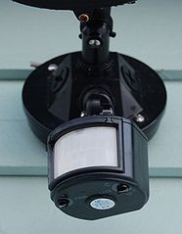
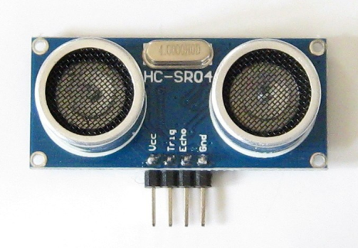
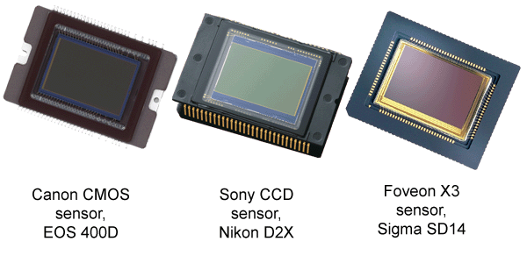
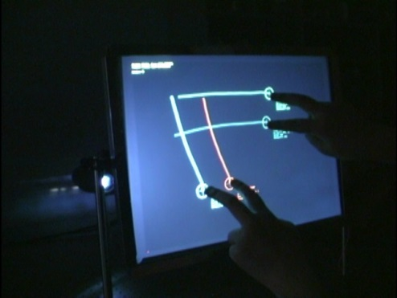
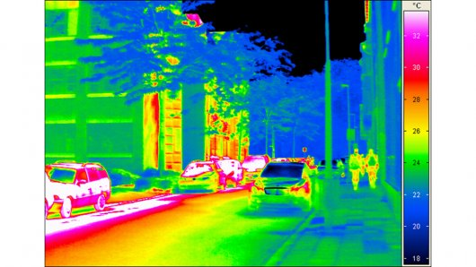

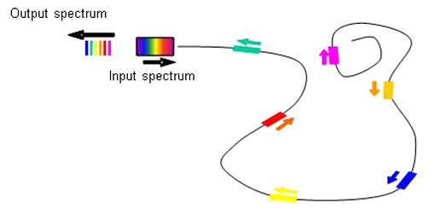

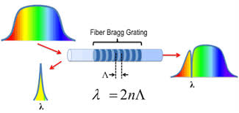

Examples of Sensors
Motion detector
Ultrasonic displacement sensor
Image sensors for cameras
Multi-touch display
http://en.wikipedia.org/wiki/Motion_detector
http://www.kiatronics.com/ultrasonic-sensors/ultrasonic-distance-sensor-module-code-70316.html
http://www.trustedreviews.com/opinions/digital-photography-tutorial-camera-sensors
Accelerometer as orientation sensor
http://www.brainnew.com.tw/Article/ra2006/10mar/F_031006.htm
Infrared thermo imaging
Optical fiber sensors
Proximity sensor: air gesture
http://www.gizmag.com/uncooled-long-wave-infrared-camera/15637/
http://www.iphone-gear.org
Thermometer
http://aim2.dlr.de/measurement-techniques/fiber-bragg-grating-method-fbg/
http://www.samsungupdate.com/android-how-to/how-to-use-air-gestures-on-samsung-galaxy-s4
http://en.wikipedia.org/wiki/Medical_thermometer

Slide 5
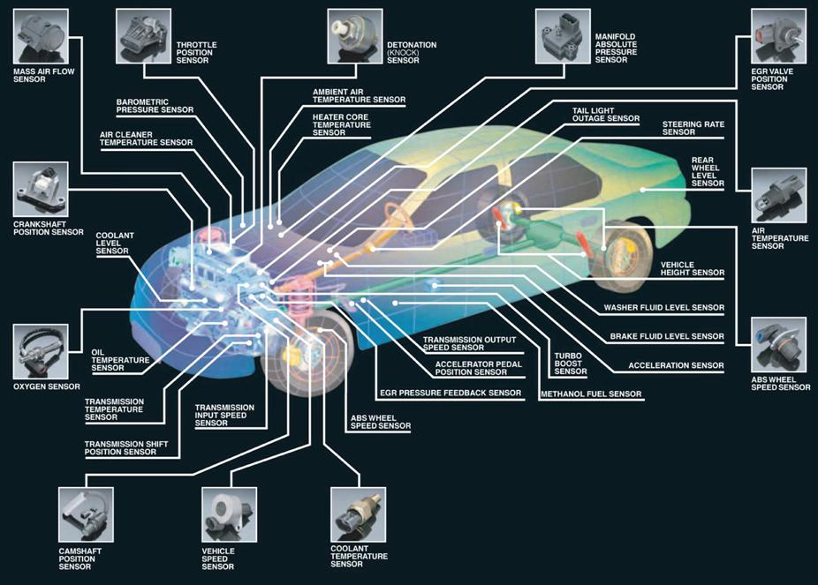
Sensors in Motion Vehicles
http://www.wintersauto.com/services/advanced-computer-diagnostics/

Slide 6
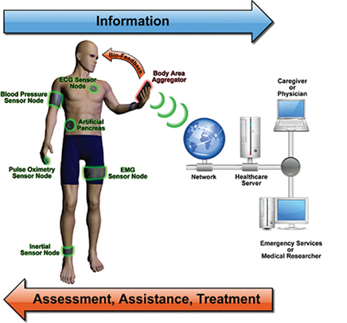
Sensors for Healthcare
Electrocardiography (ECG) is a transthoracic interpretation of the electrical activity of the heart over a period of time, to measure the rate and regularity of heartbeats, as well as the size and position of the chambers, the presence of any damage to the heart, etc.
Pulse oximetry is a non-invasive method for monitoring a patient's O₂ saturation.
Electromyography (EMG) is a technique for evaluating and recording the electrical activity produced by skeletal muscles
Inertial sensors are accelerometers and gyroscopes to detect human movements & orientations
http://www.designworldonline.com/sensors-advance-medical-and-healthcare-applications/

Slide 7
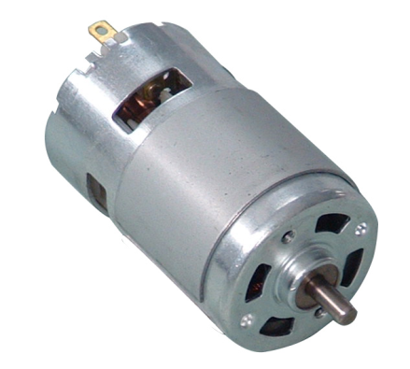
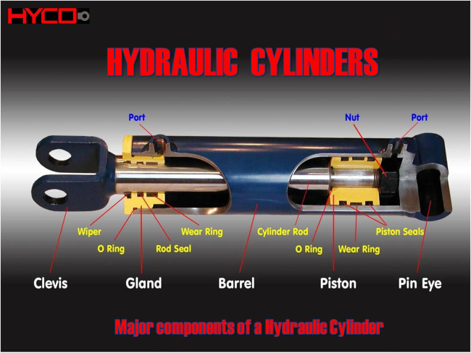
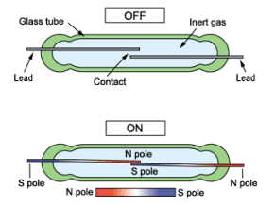
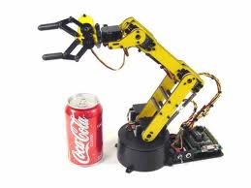
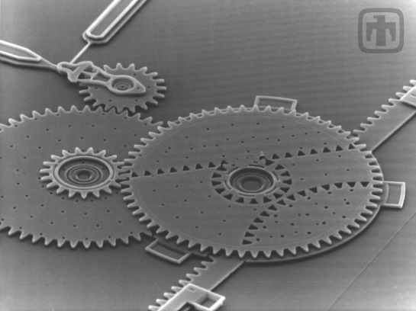
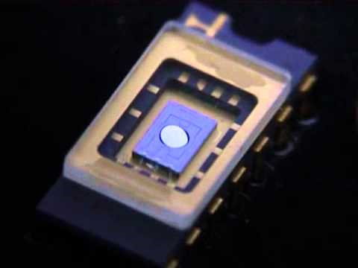
Examples of Actuators
Electric motor
Hydraulic cylinders
Reed switch
http://www.tarad2u.com/_files/prakard/2012_07_18_230902_1_Drqqneea.jpg
http://livethinline.blogspot.hk/2010/12/some-cgm-results-and-how-to-fix-your.html
http://www.hycocanada.com/cylinderintro.php
Robotic arm
MEMS gears
MEMS microscanner
http://mems.sandia.gov
https://www.youtube.com/watch?v=ypAEsXvmKQU
ie35int.blogspot.com
http://mems.sandia.gov/gallery/movies/6gear.avi

Slide 8
Categories of Sensing
Mechanical quantities:
  displacement, strain, rotation velocity, acceleration, pressure, force/torque, twisting, weight, flow, density
Thermal quantities:
  temperature, heat, thermal conductivity
Electromagnetic quantities:
  voltage, current, frequency, phase, magnetic field/flux, resistance, inductance, capacitance
Optical quantities:
  refractive index, absorption, reflection, polarization
Acoustic quantities:
  wave (amplitude, frequency, phase, polarization), spectrum, velocity
Chemical quantities:
  moisture, pH value, concentration, viscosity

Slide 9
Types of Sensors
Ref: http://www.electronics-tutorials.ws/io/io_1.html)
Physical Property | Sensors
Temperature | Thermocouple Thermistor Thermostat Resistive temperature detectors (RTD)
Light | Light Dependant Resistor (LDR) Photodiode Photo-transistor Solar Cell
Wind speed | Anemometer
Pressure | Strain Gauge Pressure Switch Load Cells
Radiation | Geiger Counter

Slide 10
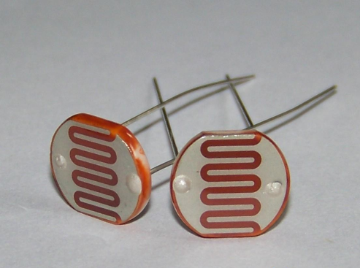
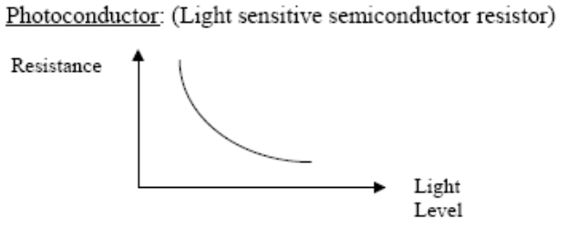
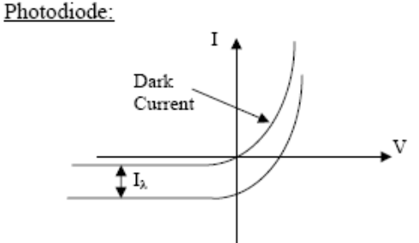
Example: Light Sensors
The light sensor is also known as the light dependent resistor (LDR).
Typically, the resistance of the light sensor will decrease when the ambient light intensity increases.
A photodiode can convert the light into current
http://www.made-in-china.com

Slide 11

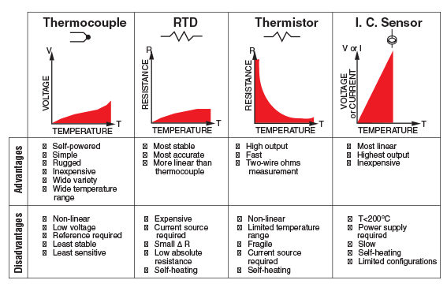
Example: Temperature Sensors
Resistance Temperature Detectors (RTDs)
  Platinum, Nickel, Copper metals are typically used
  positive temperature coefficients
Thermistors (“thermally sensitive resistor”)
  formed from semiconductor materials, not metals
    often composite of a ceramic and a metallic oxide (Mn, Co, Cu or Fe)
  typically have negative temperature coefficients
Thermocouples
  based on the Seebeck effect:
  dissimilar metals at diff. temps
  → potential difference
http://www.omega.com/prodinfo/Integrated-Circuit-Sensors.html

Slide 12
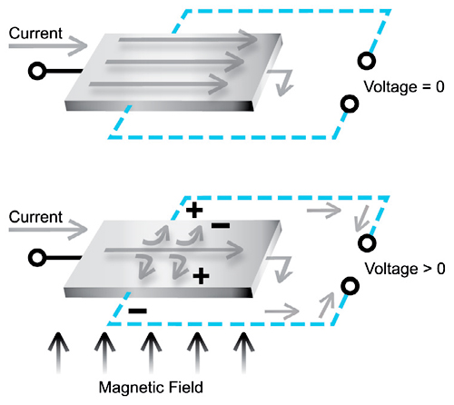
Example: Hall Effect Sensors
Hall Effect Sensors are devices which are activated by an external magnetic field.
When there is no magnetic field. No voltage is measured at the sensor’s output.
When a magnetic field is applied, the magnetic flux lines exert a force on the conductor (current-carrying) which deflects the charges (electrons) to either side of the conductor, thus induces a potential difference across it.
The sensor’s output voltage varies according to the magnetic field.
They can be used to sense proximity, position, speed, etc.
http://www.designworldonline.com/

Slide 13
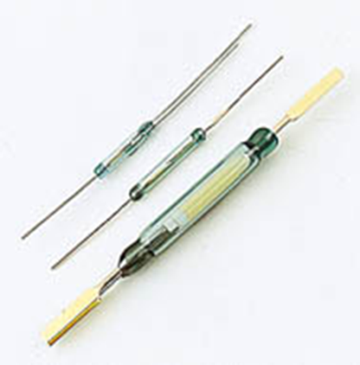

Example: Reed Switch
The reed switch consists of a pair of flexible reeds made of a magnetic material, and sealed in a glass tube filled with inert gas
The reeds are overlapped but separated by a small gap. The contact area of each reed is plated with a noble metal, such as Rhodium or Ruthenium, to provide the switch with stable characteristics and long life
Application of a magnetic field, generated by a permanent magnet or a coil, to the reed switch causes both reeds to be magnetized. This produces an N-pole at the contact area of one reed, and an S-pole at that of the other reed, as shown in the figure.
If the magnetic attracting force overcomes the resistive force caused by elasticity of the reed, the reeds come in contact i.e., the circuit is closed. Once the magnetic field is removed, the reeds are separated again by the effect of elasticity of the reed i.e., the circuit is opened.
Reed switches are a class of proximity sensor which are used to detect the presence of a magnetic field.

Slide 14
Electronic Sensor/Control System
Measurement output:
interaction between a sensor and the environment surrounding the sensor
compound response of multiple inputs
response time, accuracy, resolution, repeatability, sensitivity
Measurement errors:
System errors: imperfect design of the measurement setup and the approximation, can be corrected by calibration
Random errors: variations due to uncontrolled variables. Can be reduced by averaging.
Measurement System
real
world
intelligent
feedback
system
sensor
actuator
Motion Control System
Motion control input:
control signal adjustment based on signal processing of the measured data from sensors
response time, accuracy, resolution, range, repeatability, stability,

Slide 15
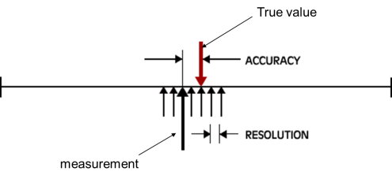
Specifications of Sensors
Accuracy: error between the result of a measurement and the true value being measured.
Resolution: the smallest increment of measure that a device can make.
Sensitivity: the ratio between the change in the output signal to a small change in input physical signal. Slope of the input-output fit line.
Repeatability/Precision: the ability of the sensor to output the same value for the same input over a number of trials.
Dynamic Range: the ratio of maximum recordable input amplitude to minimum input amplitude, i.e. D.R. = 20 log (Max. Input Ampl./Min. Input Ampl.) dB
Linearity: the deviation of the output from a best-fit straight line for a given range of the sensor.
Transfer Function (Frequency Response): The relationship between physical input signal and electrical output signal, which may constitute a complete description of the sensor characteristics.
Bandwidth: the frequency range between the lower and upper cutoff frequencies, within which the sensor transfer function is constant gain or linear.
Noise: random fluctuation in the value of input that causes random fluctuation in the output value

Slide 16
Choosing a Sensor
Environmental Factors | Economic Factors | Sensor Characteristics
Temperature range | Cost | Sensitivity
Humidity effects | Availability | Range
Corrosion | Lifetime | Stability
Size |  | Repeatability
Overrange protection |  | Linearity
Susceptibility to EM interferences |  | Error
Ruggedness |  | Response time
Power Consumption |  | Frequency response
Self-test capability

Slide 17
Signal-to-Noise Ratio (SNR)
SNR is an important concept for signal detection and communications.
It is the SNR, not the signal level, that really matters.
Q: How to increase SNR?
↑signal or ↓noise
In other words, if you can reduce the noise, you can detect an extremely small signal (e.g. the sound of pin-drop or your own heartbeat).
Increasing signal level is not always beneficial. (Why?)
Think about the conversations in a crowded restaurant. (Your signal is noise to the people at other tables. )

Slide 18
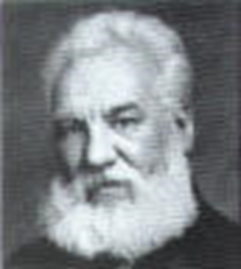
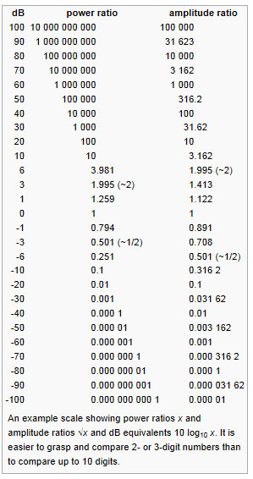


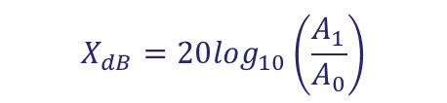
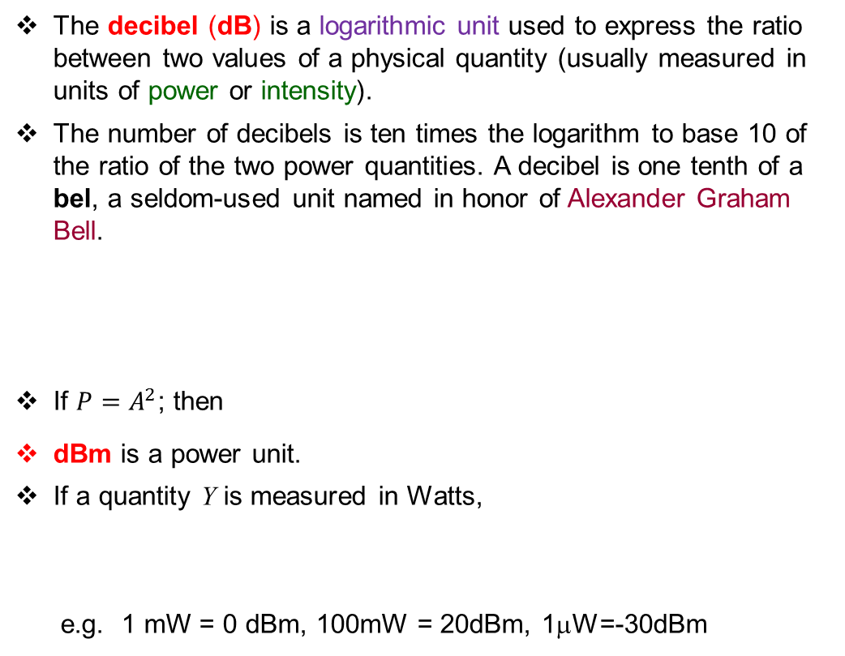

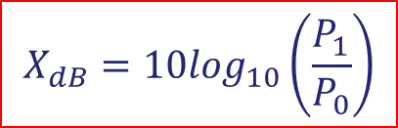
dB (Decibel) – commonly used unit
The decibel (dB) is a logarithmic unit used to express the ratio between two values of a physical quantity (usually measured in units of power or intensity).
The number of decibels is ten times the logarithm to base 10 of the ratio of the two power quantities. A decibel is one tenth of a bel, a seldom-used unit named in honor of Alexander Graham Bell.
If $P=A^{2}$; then
dBm is a power unit.
If a quantity Y is measured in Watts,
e.g. 1 mW = 0 dBm, 100mW = 20dBm, 1μW=-30dBm
$$X_{dB}=10\log_{10}\left(\frac{P_{1}}{P_{0}}\right)$$
$$P_{1}=P_{0}{10}^{\left(\frac{X_{dB}}{10}\right)}$$
or
$$X_{dB}=20\log_{10}\left(\frac{A_{1}}{A_{0}}\right)$$
$$Y_{dBm}=10\log_{10}\left(Y in Watts×1000\right)$$
Y in mW

Slide 19
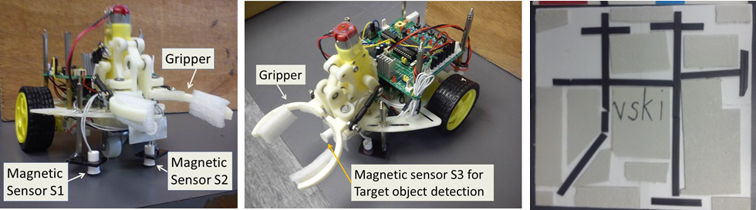
Project – Automatic Guided Vehicle
Magnetic sensor: reed switch as ON/OFF switch to detect the magnetic rail / object and control the rotation direction of the motor (wheel control, and gripper control)
L293D motor driver

