Slide 1
ENGG 1100 Introduction to Engineering Design
Lecture 3: Basic Electronic Circuits & Instrumentation
Prof. Wing-Kin (Ken) Ma
Department of Electronic Engineering
Acknowledgement:
Mr. Hoi-To Wai , previously with Department of Systems Engineering
and Engineering Management and Department of Electronic
Engineering
September 30, 2013

Slide 2
Objectives
To understand basic circuits concepts;
To introduce to you instrumentation commonly seen in electronics, particularly, how voltage and current are measured.
Note that
these concepts are relevant to Labs 2-3;
you may have learnt these basic concepts in secondary school physics courses, but you need to better understand them in this course (or perhaps you might have never truly understood them).

Slide 3
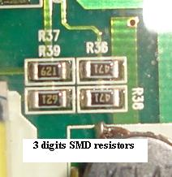
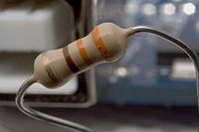
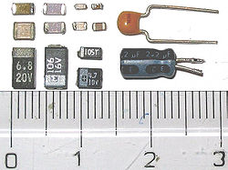
Some Electronic Components
Resistors – providing resistance (actually every matter on earth is a resistor)
Capacitors – storehouse for charges
Source:
http://en.wikipedia.org/wiki/Resistor
Source:
http://www.electronicrepairguide.com/smd-resistor-code.html
Source:
http://en.wikipedia.org/wiki/Capacitor

Slide 4
Electronic Component Symbols
Electronic components are represented using standardized symbols:

Slide 5
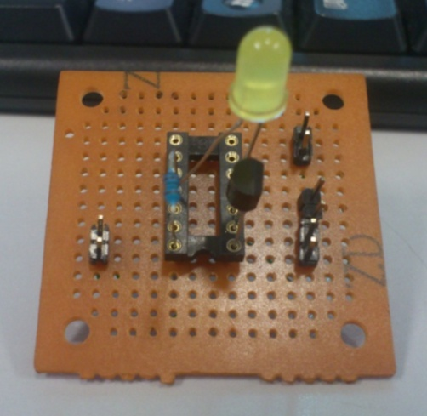
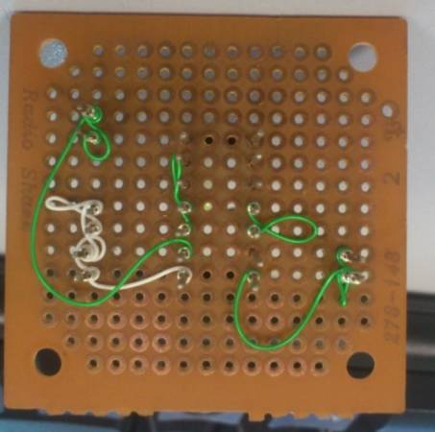
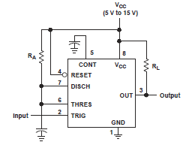
Circuits & Schematics
What do the real circuits & schematics look like…
Note that the above pictures involve other components (e.g., transistors, diodes, ICs).

Slide 6
Making Connections
We make connections using electric wires.
More complex circuits or connections can be done by PCB and breadboards; this will be introduced later.
The rule of thumb -- connections are made by contacting metal parts of the components

Slide 7
VOLTAGE, CURRENT AND RESISTORS

Slide 8
A Circuit
The famous Ohm’s Law:

Slide 9
A Circuit and its water analogy
Note: do not take these analogies too far…
Water level – Voltage (V)
Slit/opening – Resistance (R)
Water – Charge (Q)
Stream – Current (I)
The famous Ohm’s Law:

Slide 10
Voltage, Current and Resistance
Current
describes the flow of positive charges through the circuit
measured in units of Amperes (A)
is, by theory, defined as
where I is the current, and Q is the charge, in Coulombs (C).

Slide 11
Voltage, Current and Resistance
Voltage
describes the potential for current to flow in the circuit
measured in units of Volts (V)
Voltage is related to energy, measured in Joules.
The energy required to move a particle with Q Coulombs from a place of 0 V to a place with V V is
where E represents the energy (in Joules).

Slide 12
Voltage, Current and Resistance
Resistor
is a device that resists the flow of current
allows current to flow, but the amount depends on the value of the resistor and the voltage applied
The value of the resistor, or simply resistance, is measured in units of Ohms (Ω)
By Ohm’s law, we have
where R represents the resistance (in Ω).

Slide 13
Voltage, Current and Resistance
Power
is the rate of energy dissipation with respect to time
is in units of Joules per second, or Watts (W)
is given by
where P represents the power (in W).
By Ohm’s law, we have

Slide 14
Units and dimensions
International System of Units (SI) takes the convenience of the base 10 (decimal) system. A prefix may be added to a unit to produce a multiple (powers of ten) of the original unit.
Name | deca- | hecto- | kilo- | mega- | giga- | tera- | peta-
Symbol | da | h | k | M | G | T | P
Factor | 10¹ | 10² | 10³ | 10⁶ | 10⁹ | 10¹² | 10¹⁵
Name | deci- | centi- | milli- | micro- | nano- | pico- | femto-
Symbol | d | c | m | μ | n | p | f
Factor | 10⁻¹ | 10⁻² | 10⁻³ | 10⁻⁶ | 10⁻⁹ | 10⁻¹² | 10⁻¹⁵
Example 1: 10 mA = 10 x 10⁻³ A = 0.01A
Example 2: 0.3 MΩ = 0.3 x 10⁶ Ω = 300 000 Ω

Slide 15
Basic Rules
RULE #1 – a circuit must contain a closed loop
Without a closed loop, a circuit is said to be open
An open circuit cannot function as there is no returning path for current

Slide 16
Basic Rules
RULE #2 – a circuit (usually) contains a power source
The power source provides power to make the circuit functions
Showing different ways of representing a power source

Slide 17
Basic Rules
RULE #3 – electronic components are connected to a node
The lines in a schematic serve only one purpose – to make connections between components
Three seemingly different schematics.
They are actually describing the same circuit.

Slide 18
Basic circuit analysis
The Ohm’s law
Don’t be afraid of the equations

Slide 19
Resistors in series
We have
Equivalent resistance:

Slide 20
Resistors in parallel
Voltage on each resistor = the same:
Current coming in = current coming out:
Equivalent resistance

Slide 21
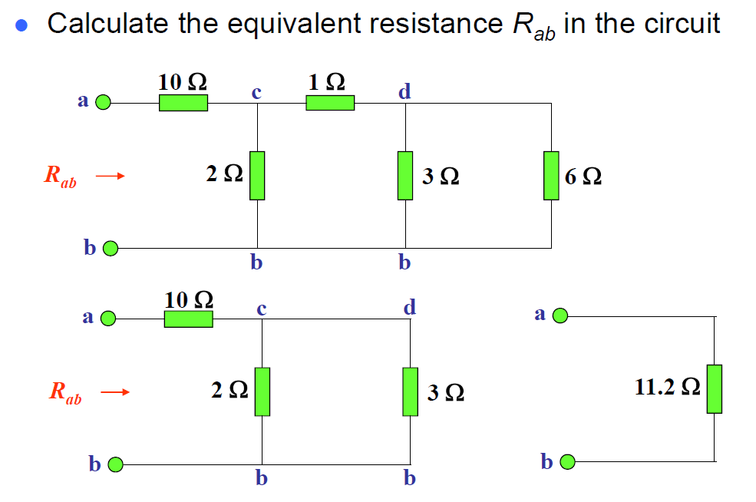
Example

Slide 22
Kirchhoff’s circuit laws
Make sure that you can remember the equivalent resistance, voltage divider calculations by heart.
Two important theorems for circuit analysis
Kirchhoff’s current law (KCL)
Kirchhoff’s voltage law (KVL)
Net current entering a node = 0
Net voltage in a loop = 0
(CAUTION: mind the direction/sign of current and voltage)

Slide 23
Application -- voltage divider
We probably don’t need something as complex as the last example
Consider the resistors in series again: (let N=2)
The supplied voltage V is divided into two parts
This principle is called the Voltage Divider

Slide 24
Application – current divider
Consider the resistors in parallel : (let N=2)
The current I is divided into two parts
More current flows in the branch with less resistance
This principle is called the Current Divider

Slide 25
CAPACITORS

Slide 26
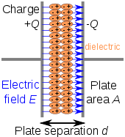
Capacitor
Capacitor is an electronic component whose function is store charges (Q)
Utilities:
Store and release energy
Smooth things out
Types: ceramic capacitor, electrolytic capacitor
Source: http://en.wikipedia.org/wiki/Capacitor

Slide 27
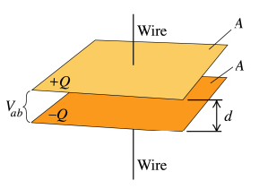
Capacitor – cont’d
Capacitance (C) is measured in Farads (F)
A simple metal plate capacitor
Conductor
Insulator (e.g., vacuum, ceramic, etc.)

Slide 28
Capacitor in series and parallel
Capacitors (C) in series
Capacitors (C) in parallel

Slide 29
R-C network – water analogy
battery
Vc
Energy source
Charging

Slide 30
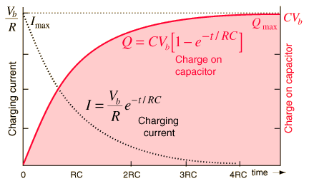
R-C network – Charging up
Voltage -- V=0 at t=0; slowly rise to V_{s}
Current -- I=V/R at t=0; slowly drop to 0
Source:
http://hyperphysics.phy-astr.gsu.edu/hbase/electric/capchg.html

Slide 31
R-C network – Charging up
By basic laws of R and C, we write
a first-order ordinary differential equation!
Assume that V_{C} (t) = 0 at t=0. The solution is
Time constant = RC

Slide 32
R-C network – water analogy
resistor
I
Vc
Load to consume energy
Discharging

Slide 33
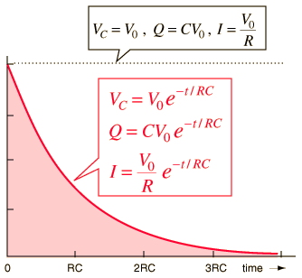
R-C network – Discharging
Voltage – V=V₀ at t=0; slowly drop to 0
Current – I=V₀/R at t=0; slowly drop to 0

Slide 34
R-C network – Discharging
By the same circuit analysis as before
(note the sign of current)
Assume V_{C} (t) = V₀ at t=0. The solution is

Slide 35
Effects of capacitor in circuits
If V = constant → I = 0 → Open circuit!
The voltage over a capacitor cannot be changed suddenly (otherwise, dV/dt = infinity → Current = infinity!)

Slide 36
MULTIMETER

Slide 37
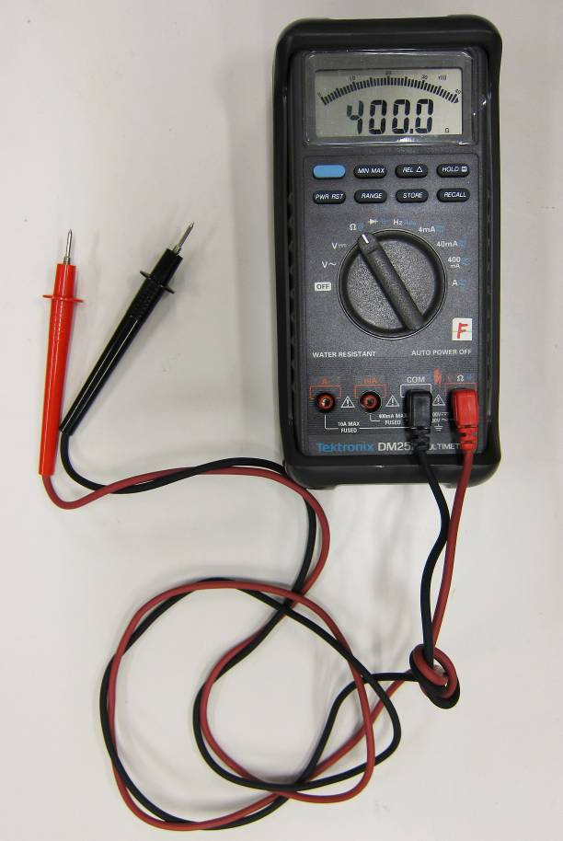
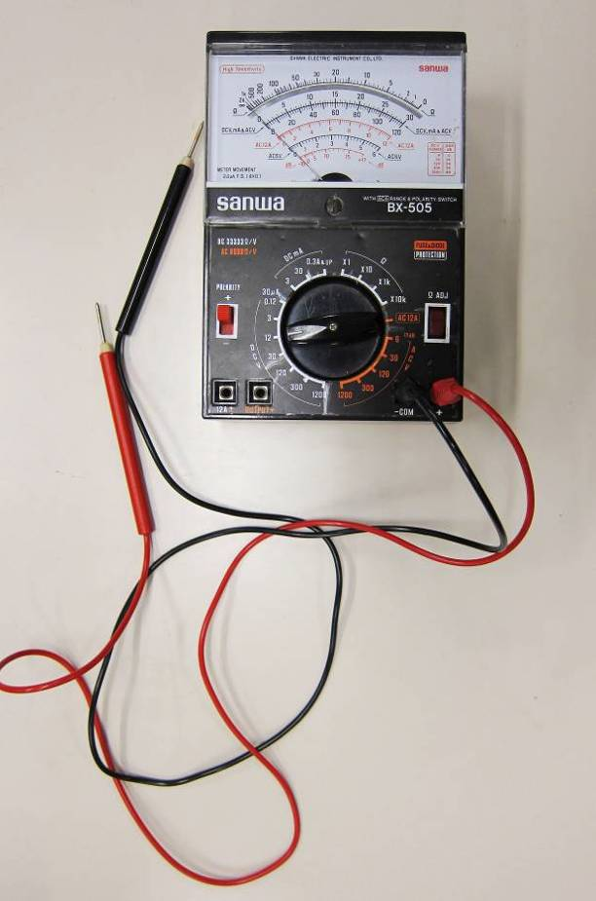
Measurement of Voltage and Current
Multimeters are all-in-one devices that measure different electrical quantities
Current (I), voltage (V), resistance (R) in one device

Slide 38
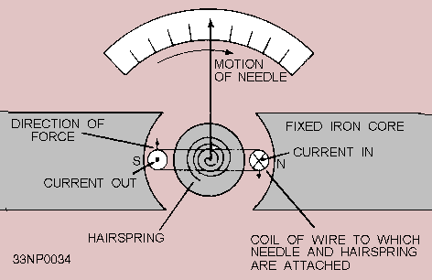
Application -- ammeter
Ammeters are devices that measure the Current (I)
Galvanometer (found in the analog ammeters)
The needle movement is proportional to the current I
Typical range: from 0A to 1mA
Source:
http://www.tpub.com/neets/book16/68.htm

Slide 39
Application -- ammeter
Using an ammeter to measure current at a point:
“Break” the circuit and insert the ammeter
Equivalent model of an ammeter
-- the internal resistance of
the galvanometer
-- can be adjusted for range selection
(current divider)

Slide 40
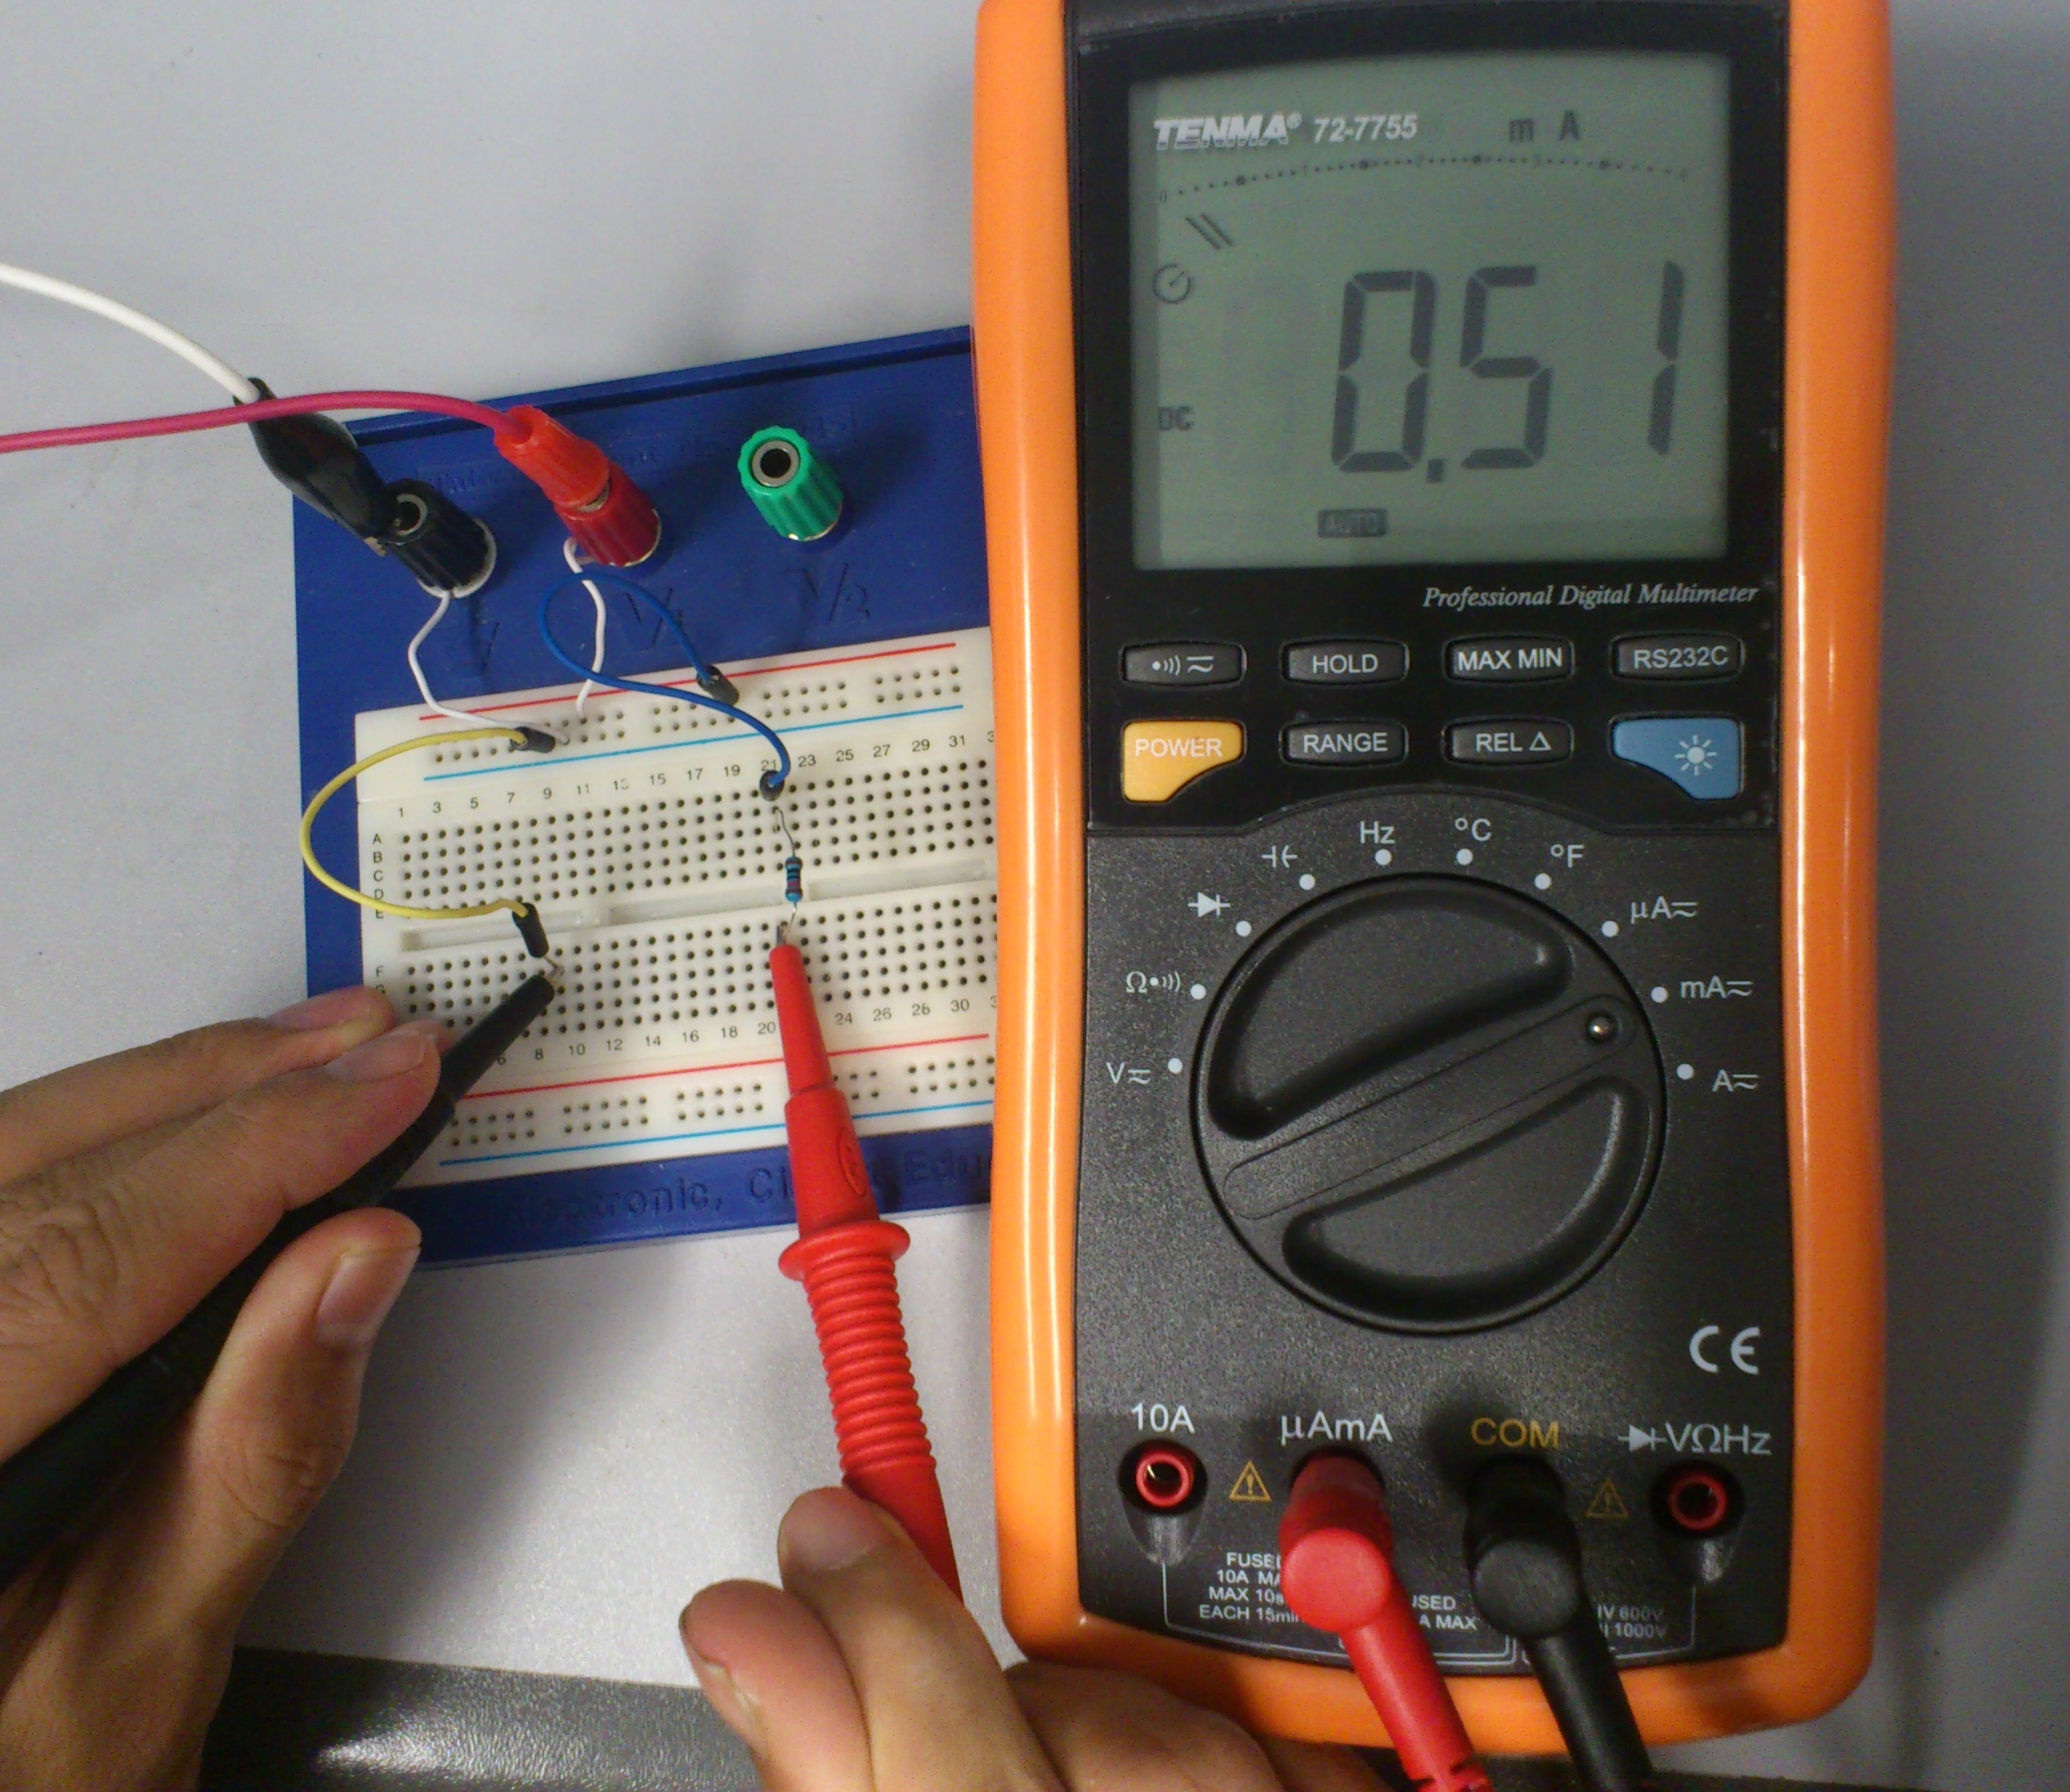
Application -- ammeter
The current reading is 0.51 mA
Circuit connected in series

Slide 41
Application -- voltmeter
Voltmeters are devices that measure the Voltage (V):
Voltage is defined relatively → must be measured “between two points”
Equivalent model of a voltmeter
Very large, typical range = 200k Ω - 1M Ω
only a small current will flow through
the voltmeter (current divider)
can be adjusted to select the range

Slide 42
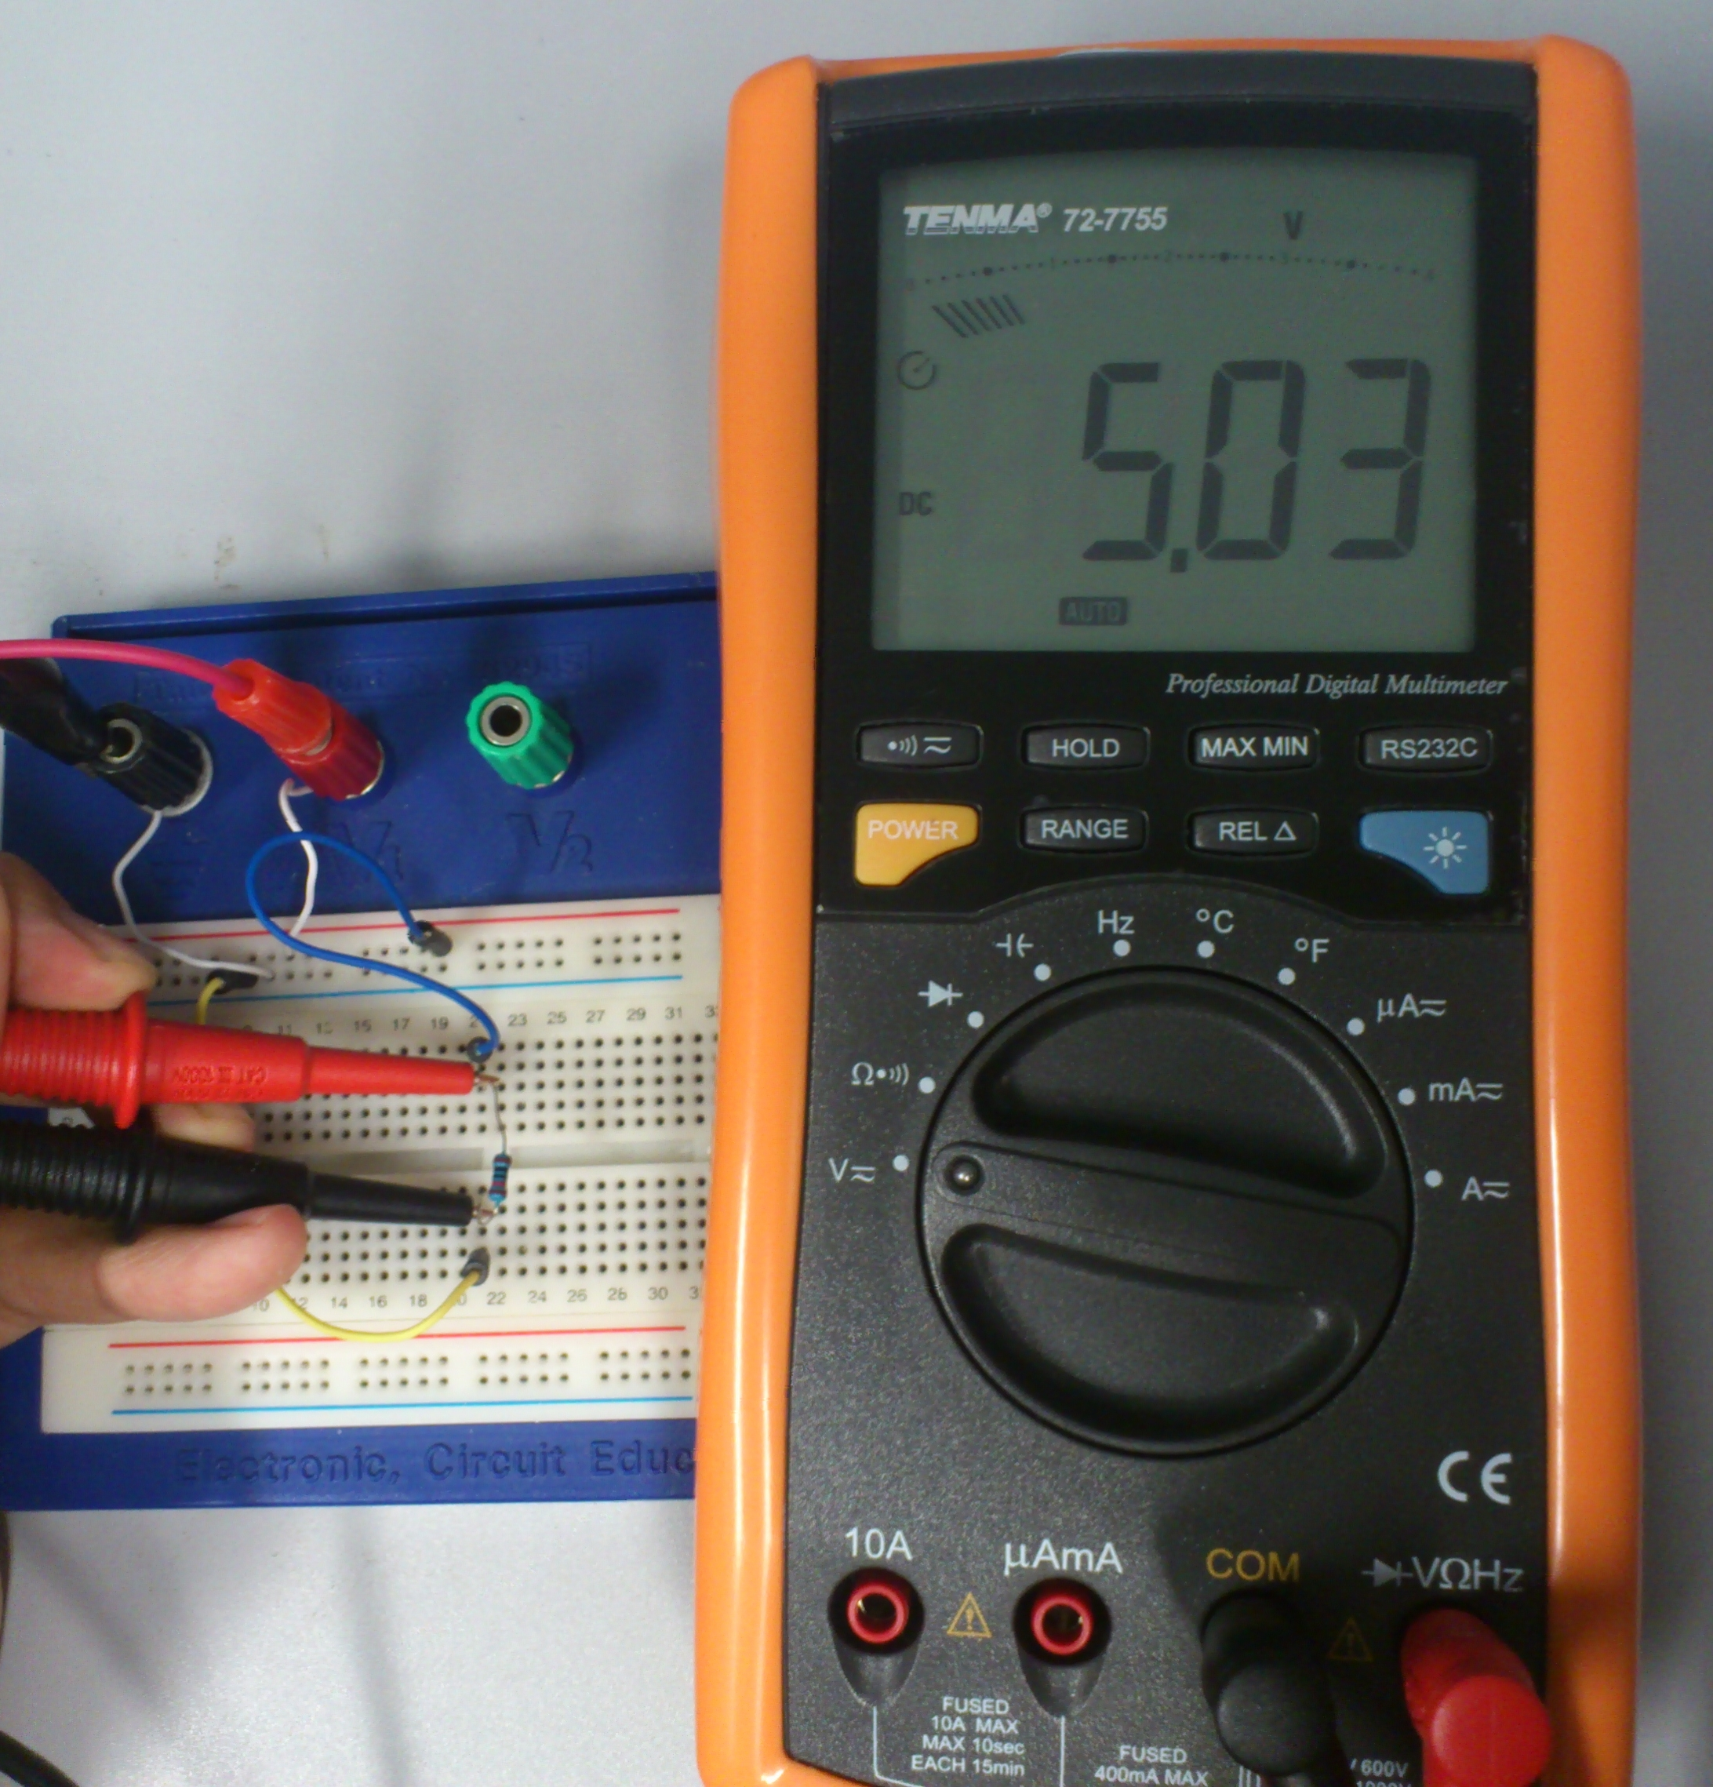
Application -- voltmeter
The voltage reading is 5.03 V
Circuit connected in parallel

Slide 43
Application -- ohmmeter
Ohmmeters are devices that measure the Resistance (R):
Resistance is also defined between two points
Just like the voltmeter
An ohmmeter = an ammeter + battery
From Ohm’s Law,
Equivalent model of an ohmmeter

Slide 44
MEASUREMENTS OF ELECTRICAL SIGNALS BY OSCILLOSCOPE

Slide 45
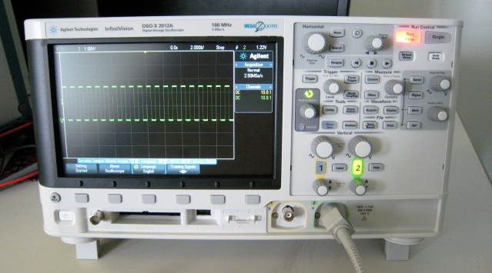
Oscilloscope
The oscilloscope measures voltage
connected like your voltmeters
used for visualizing time varying voltage signals
Electrical signals can be observed
using an oscilloscope

Slide 46
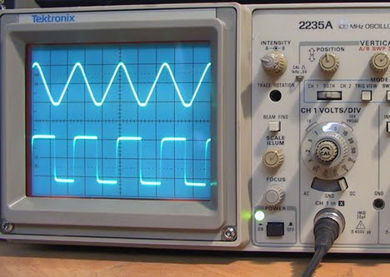
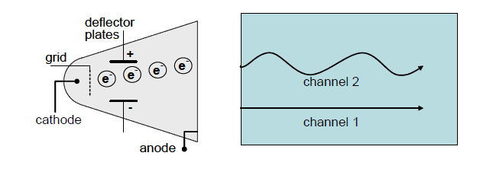
Oscilloscope – working principle
Cathode Ray Oscilloscope (CRO)
used since 1950s / 1960s
sometimes called the
“analog oscilloscope”
Working principle:
The deflector plates are connected to the circuit.
The +ve plate attracts the electrons emitted from an electron gun.
Electrons are accelerated to hit the phosphor screen to produce the trace.
Source:
http://www.veenakumari.in/?q=node/22
Source:
http://engg1000.ee.unsw.edu.au/lecture_notes.html

Slide 47
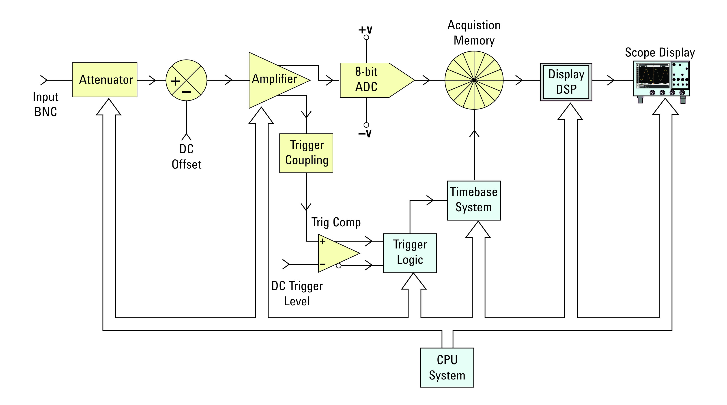
Oscilloscope – working principle
Digital Storage Oscilloscope (DSO)
involves more sophisticated circuits
requires digital signal processing
Source:
“Oscilloscope Fundamentals” by Agilent Technology

Slide 48
PRINTED CIRCUIT BOARD & SOLDERING

Slide 49
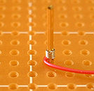
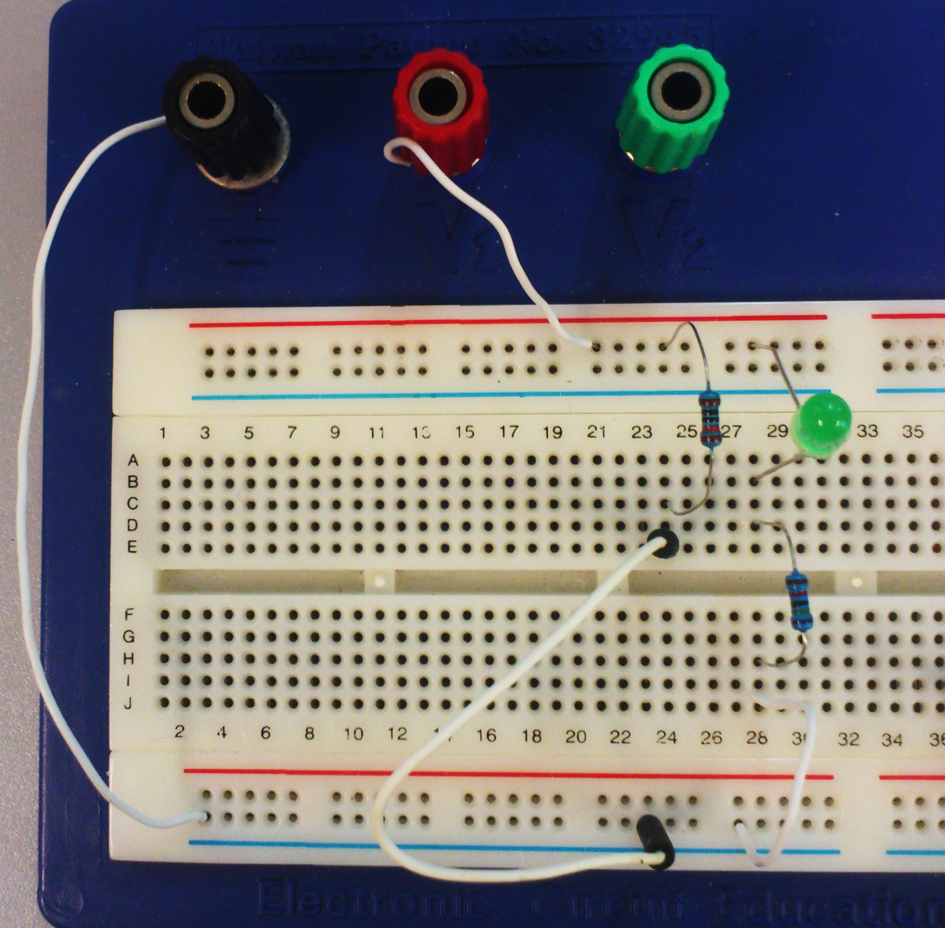
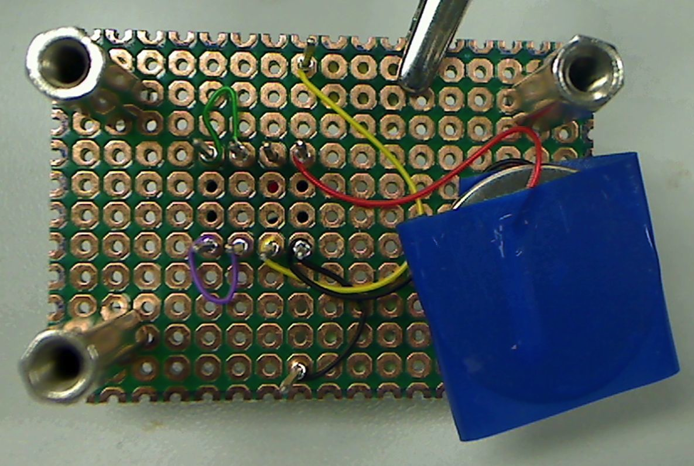
Techniques for circuit assembling
Breadboard & wire-wrapping
Convenient for small-scale circuits
Not robust enough
Breadboard
Wire-wrapping

Slide 50
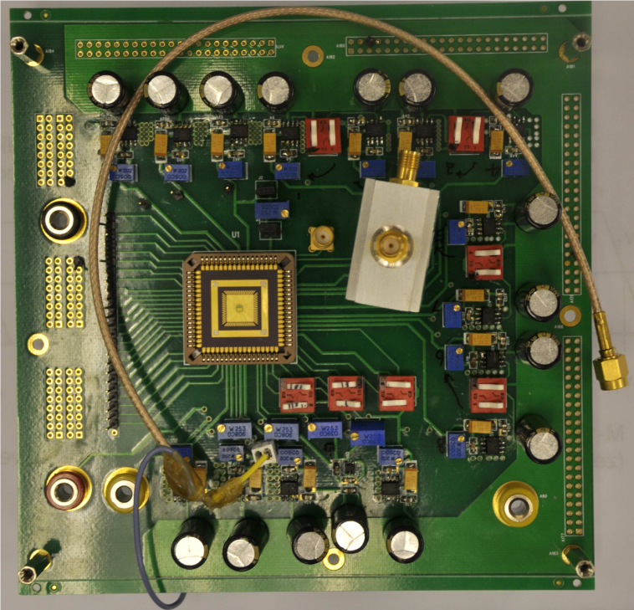
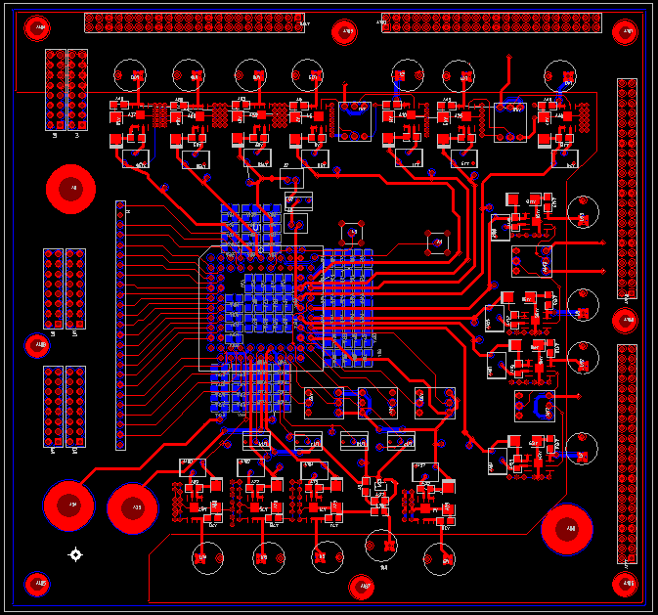
Techniques for circuit assembling
Printed Circuit Board (PCB) & soldering
Highly robust, can realize more complicated circuits
May take longer time to design, but can be fabricated & soldered in a short time
A PCB Layout (designed with software)
A photo of the fabricated PCB with components soldered on it

Slide 51
Printed Circuit Board (PCB)
A PCB usually consists of
Copper foil for the conducting layers
Soldering mask (usually green) for insulation
Parts on a PCB:
Components
Pads
Trace
Vias
Metal layers

Slide 52
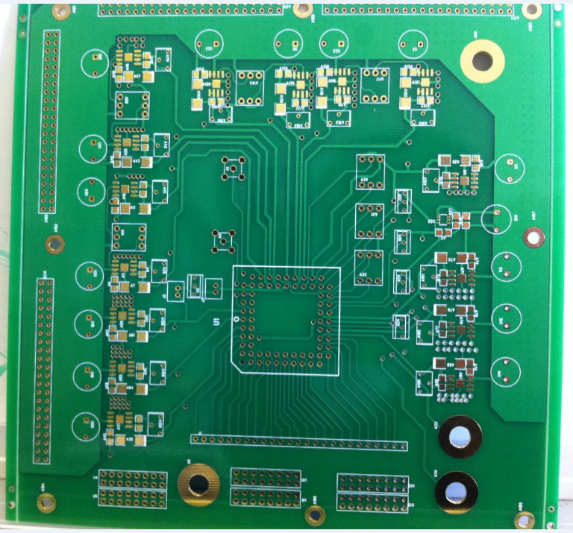
Parts on a PCB
Pads:
locations that components are soldered
Traces:
“wires” for connecting pads together
Similar metal layers can be found on both side of the PCB

Slide 53
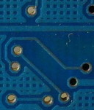
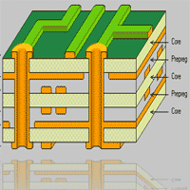
Other features on a PCB
Vias -- connecting traces from one layer to another
Multilayer PCB – for making more
complicated circuits
Via

Slide 54
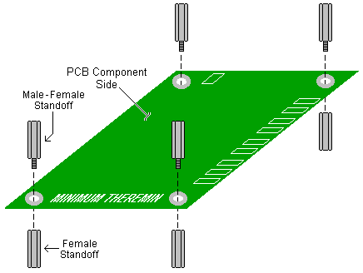
Designing a PCB
Some concerns in PCB design
Component size
Input & output
Mounting points
Computer software
Eagle (Freeware, http://www.cadsoftusa.com)
Power PCB (http://www.pads.com)

Slide 55
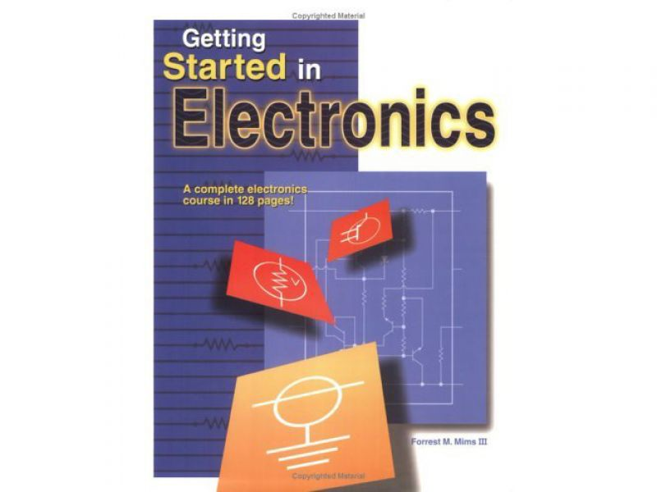
References
An optional, very friendly, reference:
Forest M. Mims III, Getting Started in Electronics

