Slide 1
AI Artificial intelligence Demos
KH Wong

Slide 2
Tools
MATLAB online , COLAB, Colab_tutorial, keras_examples ,
SKLEARN, anaconda HKObs.

Slide 3
Introduction
MNIST Optical character Recognition
Decision tree
Object recognition Yolo
FCN fully convolution neural net for segmentation

Slide 4
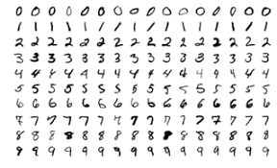
MNIST Optical character Recognition
https://keras.io/examples/vision/mnist_convnet/
View in colab

Slide 5
Decision tree
Download the code and data from https://github.com/m4jidRafiei/Decision-Tree-Python- Unzip and you will find the necessary files “Main.py” and “playtennis.csv”.
Your experiment in COLAB:
Use COLAB “+code” at the top of the COLAB right-window to install these:
!pip install p-decision-tree # to install the tool if necessary, updated version
!pip install graphviz #to install the tool if necessary
!pip install pandas #to install the tool if necessary
Edit the data file playtennis.csv downloaded and change according to the table shown below, the change is to update the item heighted in red. Save as playtennis_new.csv
Upload the file "playtennis_new.csv" to Colab “files\content\”, the “files”-icon is at the left margin of the COLAB window. When you mouse over \content\, click on the “3vertical dots” icon and select upload. Then upload the file.
Edit the lines in “Main.py” downloaded:
data = pd.read_csv('playtennis_new.csv') # to read the playtennis_new.csv file
Un-comment the line display( dot )#display the decision tree on screen
Copy and paste the revised “Main.py” code to Colab “+code” .
Run the code. You will get the result and the diagram of the decision tree.
Count the number of nodes and leaves. If L=the total number leaves , N= the total number of nodes. Write the value of L+N in the answer box. There is no need to submit your code.

Slide 6
result

Slide 7
Object recognition-by YOLO
This exercise shows how to use Google‘s Colab for object detection based on “YOLO – you only look once”.
Test 1 (basic test)
Use a browser (e.g. chrome, sign in with a gmail and google drive account) to open the link
https://colab.research.google.com/github/ultralytics/yolov3/blob/master/tutorial.ipynb#scrollTo=zR9ZbuQCH7FX
At the top of the screen click on “+code” then you will receive a message “ Cannot save changes”, but you are allowed to “Save a copy in drive”. Select this option.
After selecting “copy to drive”, then you will be transferred to your google-drive account, and the data will be copied to your google drive.
Run the complete Colab-jupyter-notebook code as you can see on the screen, and make observations to learn the basic operations of yolo.
Note: Move your cursor over to the left margin of the Colab window, you can see the [files] icon. Clock on the icon, then you can see the directories of the whole system. Your project should be under \content\yolov5. Please noted that the source images to be detected are in \content\yolov5\data\images\ and the resulting output images should be stored in \content\yolov5\runs\detect\exp\.

Slide 8
Test 2 (detect your own uploaded image)
Rerun the first procedure of the “colab-jupyter_notebook”—“Setup”.
Move the mouse over the left margin of the Colab window, you can see the [files] icon. Clock on the icon , then you can see the directories of the whole system. You project should be under \content\yolov5.
Please download the following image to be detected to your computer
http://www.cse.cuhk.edu.hk/%7Ekhwong/www2/cmsc5711/car3.jpg
Navigate to directory \content\yolov5\data\images, mouse over “images” you can see the “3 vertical dots” icon, click that and select “upload” to upload the image to the system.
Then run the step “detect” again in the “Colab-jupyter notebook”.
Note: After you run the step "!python detect.py"
Check the message box and see exactly which image files you are executing.
There may be multiple subdirectories under /yolov5. Example:
if you run it many times, you may be using the file under
image 1/3 /content/yolov5/yolov5/yolov5/yolov5/.....
The result should be inside \content\yolov5\runs\detect\exp(n), whereas (n)=number of testes performed. Mouse over the directory \exp and use the “3 vertical dots” to download the resulting image to your computer.
You don’t need to submit the code but just answer the following question.
How many cars with probability over 0.45 has the system detected?

Slide 10
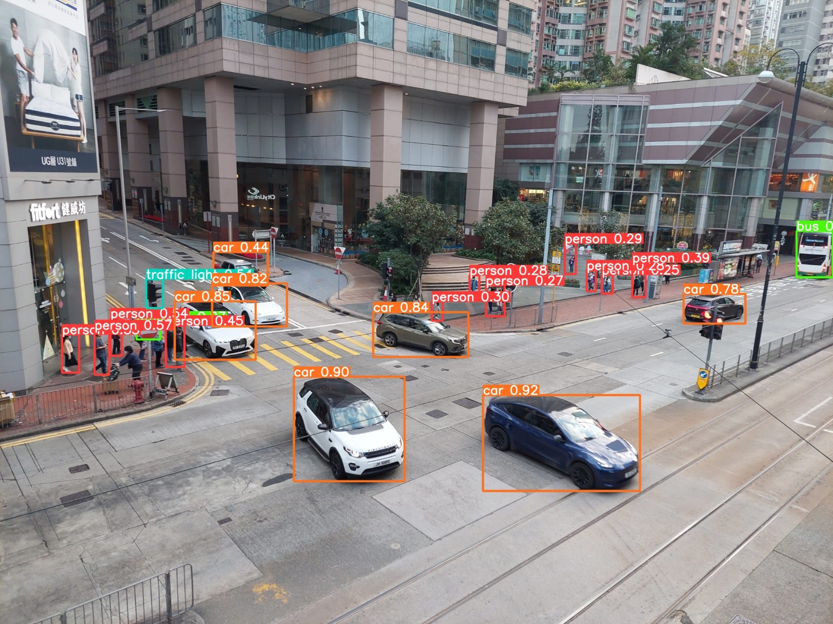

Slide 11
FCN fully convolution neural net
This exercise shows how to use Google‘s Colab for image segmentation based on the FCN (Fully convolution network) model. Procedure: 1) Use a browser (e.g., chrome) to open the following link. View in Colab. https://keras.io/examples/vision/oxford_pets_image_segmentation/ 2) Run the code, and the training steps may take about 30 minutes. The result may not be perfect because the epoch setting of only 50 may be too small.
3) You should test other images (from i=1 to 9) again by changing the values of i in the step “ Visualize predictions”. You don’t to submit the code. Just answer the following question. Which image index i will produce the following result?

Slide 12
Answer: 6 . Some students complain that they cannot find the correct match. The reasons may be due to the number of epochs used or system configuration. Hence, I remove this question from the grading list , that is the mark is set to 0.

Slide 13
Conclusion/discussion
Shown various AI tools and applications
Students can explore more demos using the links given to find out how AI works in the real world.

