Slide 1
Pose estimation methods
By KH Wong

Slide 2
Overview
Introduction
Problem definition
Linear techniques
Iterative techniques
Comparisons
Implementation issues
Conclusion

Slide 3
Introduction
What is Pose estimation?
What is pose estimation used for?

Slide 4
Problem definition
What is pose?

Slide 5
Pose estimation techniques
POSIT
Epnp (solve pnp in opencv)
P3P
P4P
P7P
Linear methods
P3P
Power4 methods

Slide 6
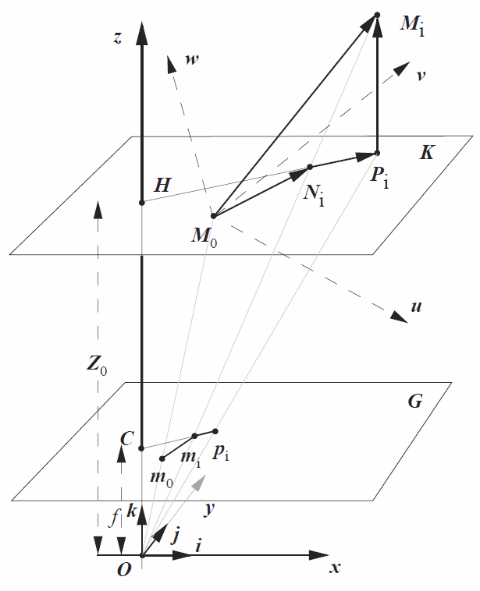
POSIT

Slide 7
POSIT

Slide 8
POSIT Algorithm

Slide 9
POSIT
Because the camera model is SOP scaled orthographic, it is an approximated camera
POSIT is based on POS but add a few iteration to improve the result.

Slide 10
EPnP: Efficient Perspective-n-Point Camera Pose Estimation
[1] Barycentric coordinate system https://en.wikipedia.org/wiki/Barycentric_coordinate_system
[2] Vincent Lepetit · Francesc Moreno-Noguer · Pascal Fua, "EPnP: An Accurate O(n) Solution to the PnP Problem", International Journal of Computer Vision , February 2009
Control point j
World corrd. sys
Camera
Coord.
sys

Slide 11
Application of Epnp (solvepnp in opencv Aruco pose tracker https://docs.opencv.org/3.4.0/d5/dae/tutorial_aruco_detection.html
From //https://github.com/njanirudh/Aruco_tracker
Download project.zip ,
unzip to a dir. e.g. \Aruco_Tracker-master
Copy Aruco_Tracker-master\calib_images\checkerboard\*.jpg to Aruco_Tracker-master\calib_images
change line 6 of aruco_tracker.py to :
cap = cv2.VideoCapture(0).
Run it
conda>>pythonaruco_tracker.py
Print the 6x6 aruco marker (in \Aruco_Tracker-master\images\marker_66.jpg) and show to the camera, it will be tracked
https://youtu.be/IsXWrcB_Hvs?t=6
https://www.youtube.com/watch?v=sV7vOTvUCx8

Slide 12
Barycentric coordinate system https://en.wikipedia.org/wiki/Barycentric_coordinate_system [1]
Any 3D world feature (or called model) point P_{i}^{w} ( ) can be represented by N(e.g. N=4) 3D world control points ( ) C_{j}^{w}_{=1,2,3,4} using the formula below
=3D feature point P^{w}_{i=1,2,3,4} in world coord.
=3D Control point C_{j}^{w}_{=1,2,3,4} in world coord.
World
Coord.
sys
Our pose estimation task is to find Rotation (R), Translation (T) between the world and camera coord. Systems if model points (P_{i}^{w}) and their image points U_{i}=[u,v]_{i}^{T} are given
Choose the center of the model points as one of the control points
Camera
Coord.sys

Slide 13
The Barycentric coordinate parameter calibration If you are given P^{w}_{i=1,2,..,n} and c^{w}_{i=1,2,3,4} you may recover α_{ij}

Slide 14
Barycentric coordinate parameter calibration If you are given P^{w}_{i=1,2,..,n} and c^{w}_{i=1,2,3,4} you may recover all α_{ij}

Slide 15
EPnP problem setting

Slide 16
EPnP basic formulation

Slide 17
EPnP : Our plan to find the pose between the camera and world: find P^{c}_{j=1,2,..,n,} then compute Rotation (R_{(3x3)}), Translation(T_{(3x1)})

Slide 18
EPnP continue to find P^{c}_{j=1,2,3,4}

Slide 19
EPnP continue to find P^{c}_{j=1,2,3,4}

Slide 20
EPnP : what to do next after V is found

Slide 21
How to recover β ? Case: N=1

Slide 22
How to recover β ? Case: N=2

Slide 23
How to recover β ? Case: N=2(Continue)

Slide 24
How to recover β ? Case: N=2(Continue)

Slide 25
How to recover β ? Case: N=2(Continue)

Slide 26
Verify which case is better
Use image projection to judge which case (N=1 or 2) can generate the best result with minimum re-projection error
If the re-projection error is still large, Use case N=3 and 4 to find the scaling factors. Details can be found in [2] and the program in [3].

Slide 27
Re-projection error https://en.wikipedia.org/wiki/Reprojection_error

Slide 28
Epnp references and program
[1] Barycentric coordinate system https://en.wikipedia.org/wiki/Barycentric_coordinate_system
[2] Vincent Lepetit · Francesc Moreno-Noguer · Pascal Fua, "EPnP: An Accurate O(n) Solution to the PnP Problem", International Journal of Computer Vision , February 2009 web-ink
[3] https://www.epfl.ch/labs/cvlab/software/multi-view-stereo/epnp/
https://www.epfl.ch/labs/cvlab/wp-content/uploads/2018/08/EPnP_matlab.zip
[4] Aruco tracker https://docs.opencv.org/trunk/d5/dae/tutorial_aruco_detection.html

Slide 29
References
POSIT: POSE estimation
Daniel F. Dementhon,Larry S. Davis, “Model Based Object Pose in 25 Lines of Code ”, http://home.in.tum.de/~grembowi/ar2004_05/3dPoseEstimation_presentation.pdfPOSIT, International Journal of Computer Vision June 1995, Volume 15, Issue 1–2, pp 123–141
the original paper
Sebastian Grembowietz , “3D Pose Estimation” http://home.in.tum.de/~grembowi/ar2004_05/3dPoseEstimation_elaboration.pdf a tutorial on pose estimation methods: 3pt , p4+p, POSIT, linear method, perspective p7p,
Thomas Petersen , “A comparison of 2D-3D Pose Estimation Methods” Aalborg University 2008 http://www.haowuhw.com/pose/report.pdf a report on POS, POSIT
Daniel Grest,Thomas Petersen,Volker Krüger, “A Comparison of Iterative 2D-3D Pose Estimation Methods for Real-Time Applications”, Scandinavian Conference on Image Analysis, SCIA 2009: Image Analysis pp 706-715
Tutorial ppt
Sebastian Grembowietz, “Algorithms for Augmented Reality 3D Pose Estimation”, 2004 nov 19, http://home.in.tum.de/~grembowi/ar2004_05/3dPoseEstimation_presentation.pdf
Epnp
Vincent Lepetit · Francesc Moreno-Noguer · Pascal Fua, "EPnP: An Accurate O(n) Solution to the PnP Problem", International Journal of Computer Vision , February 2009 https://pdfs.semanticscholar.org/6ed0/083ff42ac966a6f37710e0b5555b98fd7565.pdf
Khwong
http://www.cse.cuhk.edu.hk/%7Ekhwong/j2004_IEEE_chang_MM_xlowe_draft.pdf
Code
http://people.rennes.inria.fr/Eric.Marchand/pose-estimation/tutorial-pose-dementhon-opencv.html
http://www.cfar.umd.edu/~daniel/Site_2/Code.html (posit matlab , c++ etc)

Slide 30
appendix
https://math.stackexchange.com/questions/180418/calculate-rotation-matrix-to-align-vector-a-to-vector-b-in-3d
https://stackoverflow.com/questions/5188876/rotation-matrix-given-angle-and-point-in-x-y-z

Slide 31
POS,POSIT (alternative formulation) A simplified model , focal length =f, o_{x}=o_{y}=0 K_{int}= intrinsic parameters, K_{ext}=extrinsic parameters, projection=Kint*kext
Ref :Thomas Petersen , “A comparison of 2D-3D Pose Estimation Methods” Aalborg University 2008 http://www.haowuhw.com/pose/report.pdf a report on POS, POSIT

Slide 32
POS Algo

