Slide 1
Rotation averaging
KH Wong

Slide 2
Overview
What is rotation averaging?
Why we study rotation averaging?
Define the problem and formulations
What are the metric, and cost function?
What are the measurement methods: L1, L2
What are the algorithms?

Slide 3
What is rotation averaging
To find the mean of many given rotation
Single rotation averaging
Multiple rotation averaging
Conjugate rotation averaging

Slide 4
Why we learn the methods
Because it can be applied to SfM
Applications
SfM
IMU averaging
Mirror

Slide 5
Define the problem and formulations
What are the representation methods of rotation matrices
Euler angle?
Axis-angles
Quaternions

Slide 6
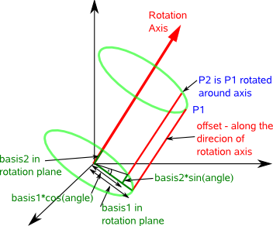
Theory: 3D Rotation using axis-angle representation
Definition: R is a 3x3 matrix that transforms a vector P1 to P2 such that P2=R*P1.
axis=Rotation axis is a unit vector (u) of vector n
angle=Angle of rotation θ
n
Rn(θ)_{(3x3)} =I+Nsinθ+N²(1-cosθ) , where N=[u]_{x}, []_{x}=skew symmetric matrix, u is the unit vector of n
http://www.memphys.sdu.dk/~besold/INDEX/axis-angle.pdf
http://www.euclideanspace.com/maths/geometry/rotations/conversions/angleToMatrix/
https://en.wikipedia.org/wiki/Rotation_matrix

Slide 7
Axis-angle representation
Rn(θ)_{(3x3)} =I+N_{(3x3)}sinθ+N²_{(3x3)} (1-cosθ) , where N=[u]_{x}
θ = an angle which is a scalar, N is a 3x3 matrix
The above equation can be expressed as a power series described by an Exponential function EXP( ), hence
Rn(θ)_{(3x3)}=Exp(θ⋅N_{(3x3)})=Exp(θ⋅[u]_{x})=I+Nsinθ +N²(1-cosθ) .
Rn(θ) is the rotation matrix to rotate a vector P1 to P2, such that P2=Rn(θ)*P1. The rotational axis is the vector n (the unit vector of n is u), and the rotation is θ around the circle perpendicular to u (see the picture in the previous slide). So
Log[Rn_{3x3}(θ)]=θ⋅N_{3x3} , (θ is a scalar) or
Rn_{3x3}(θ)=exp(θ⋅N_{3x3})
In matlab exponential of a matrix can be found by Expm(). Use >>help expm in matlab to find out more. E.g. expm(A_{3x3})= B_{3x3}

Slide 8
The geometric median problem
First suggested by Pierre de Fermat
Problem definition: Give a set of points $x_{i}$ in some metric space, find mean($\overline{x}$) that the sum of distance $d()$ from $x_{i}$to $\overline{x}$ is a minimum
$\overline{x}=\underset{x}{argmin}{\sum_{i=1}^{n}{d(x,x_{i})}}$
No simple direct solution , can be solved by
Weiszfeld algorithm (To be discussed)

Slide 9
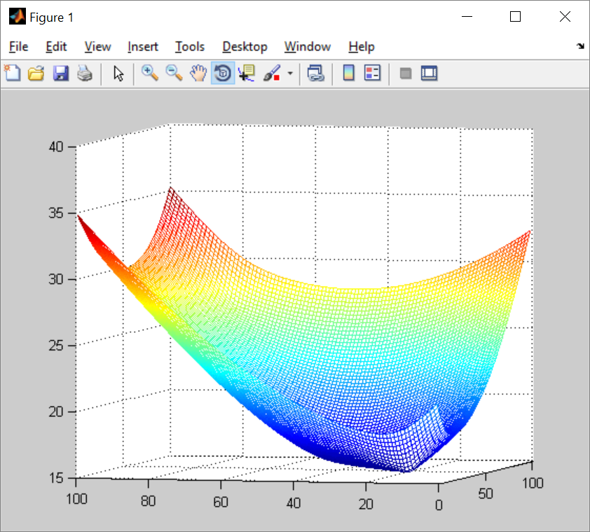
Matlab code to show geometric median is not easy to find
function demo_gmedian
%geomtric median
%a=[2 3 6 8
% 2 3.2 4 9]
a=[4.1 1.02 1.13 8
5.1 1.02 1.03 9]
for x=1:100
for y=1:100
d(x,y)=dist(a,[x/10 y/10]') ;%two point distance
end
end
min(min(d))
figure(1)
clf
%image(d)
mesh(d)
function d=dist(a,b)
[rows,col]=size(a);
tmp=0;
for j=1:col
tmp=tmp+norm(a(:,j)-b);
end
d=tmp;
return

Slide 10
Matlab code to show geometric median is not easy to find
It shows when you change the numbers, the median solution is unpredictable. However, the Weiszfeld algorithm provide an iterative solution [2]
function demo_gmedian
%geomtric median
%a=[2 3 6 8
% 2 3.2 4 9]
a=[4.1 1.02 1.13 8
5.1 1.02 1.03 9]
for x=1:100
for y=1:100
d(x,y)=dist(a,[x/10 y/10]') ;%two point distance
end
end
min(min(d))
figure(1)
clf
%image(d)
mesh(d)
function d=dist(a,b)
[rows,col]=size(a);
tmp=0;
for j=1:col
tmp=tmp+norm(a(:,j)-b);
end
d=tmp;
return

Slide 11
What are the metrics?
Distance between two rotations in SO3
d(SR1,SR2)=d(R1,R2)=d(R1S,R2S)
For all S and Ri rotations.[1]
Give S,R, there are 3 types of distances
Distance 1: Angular distance (geodesic distance)
θ =d∠(S,R)=||log(SR^{T})||₂
Distance 2: Chordal distance
d_{chord}=||S-R||_{F}=2*sqrt(2)*sin(θ/2),where =||⋅||_{F}=Frobenius norm
Distance 3: Quaternion Distance
d_{quat}=2*sin(θ/4)

Slide 12
Distance 1:Angular distance (geodesic distance)
If S,R are given
θ =d∠(S,R)=d(SR^{T,}I)=||log(SR^{T})||₂
If Quaternions representation of R,S are given
If r,s are quaternions of R, and S resp.
θ= d∠(S,R) then
θ =2arccos(|c|) where (c,v)=s^{-1⋅}r. c is ??, r is ??

Slide 13
Distance 2 : Chordal Distance
d_{chord}(S,R)=||S-R||_{F}
Since d_{chord}(S,R)²=||S-R||_{F}²=||SR^{T}-I||_{F}
=2{sin²(θ)+[1-cos(θ)]²}
=8sin²(θ/2), hence
d_{chord}(S,R)=2*sqrt(2)*sin(θ/2)

Slide 14
Distance 3:Quaternion Distance
Quaternion Distance
d_{quat}=2*sin(θ/4)

Slide 15
Rotation mean
We can find the mean R of given rotations R_{i=1},R_{i=2}…R_{1=n} using the following methods.
Geodesic Mean (angular mean)
L2-mean: Min{C(R)=∑^{n}_{i=1} d∠(R,Ri)²}
L1-mean: Min{C(R)=∑^{n}_{i=1} d∠(R,Ri)} , use Weiszfeld Alg.
Chordal Mean
L2-mean: Min{d_{chord}(S,R)²}, see[1]
L1-mean: Min{d_{chord}(S,R)}, see [1]
Quaternion Mean
L2-mean:, see[1]
L1-mean:, see[1]

Slide 16
Compare L1 and L2
www.academia.edu/3371194/The_comparison_of_L1_and_L2-norm_minimization_methods
L2:
error convex,
maybe unstable
L1:
error non-convex
More stable
???

Slide 17
Rotation averaging methods
Geodesic Mean (angular mean)
L2-mean: Min{C(R)=∑^{n}_{i=1} d∠(R,Ri)²}
Geodesic Mean (angular mean)

Slide 18
Geodesic L2 Mean (angular mean)
L2-mean: Min{C(R)=∑^{n}_{i=1} d∠(R,Ri)²}

Slide 19
Geodesic L1 Mean (angular mean)
L1-mean: Min{C(R)=∑^{n}_{i=1} d∠(R,Ri)} , use Weiszfeld Alg.

Slide 20
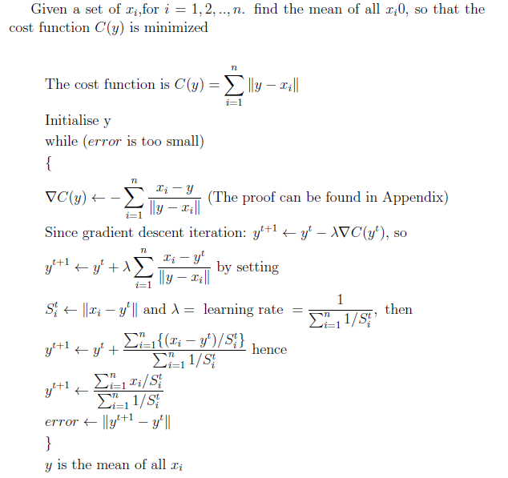
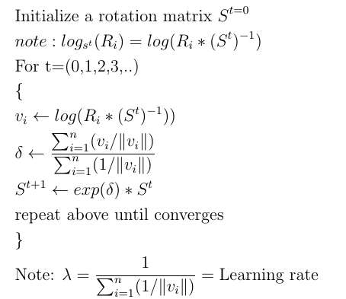
The original Weiszfeld algorithm with explanation [2]
The algorithm with explanation
The actual algorithm
Notes:
%http://www.sciweavers.org/free-online-latex-equation-editor
\documentclass[12pt]{article}
\usepackage{amsmath, enumitem}
\begin{document}
Given a set of $x_i$,for $i=1,2,..,n$. find the mean of all $x_i0$, so that the cost function $C(y)$ is minimized\\
\begin{align*}
&\text{The cost function is } C(y)=\sum_{i=1}^{n}\| y-x_i\| \\
%&C(y)=\sum_{i=1}^{i=n}\| y-x_i\|\\
&\text{Initialise y}\\
&\text{while ($error$ is too small)}\\
&\{\\
&\nabla C(y)= -\sum_{i=1}^{n} \frac{x_i-y}{\| y-x_i\|} \text{ (The proof can be found in Appendix)}\\
&\text{Since gradient descent iteration: } y^{t+1}=y^{t} - \lambda \nabla C(y^t) \text{, so}\\
&y^{t+1}=y^{t}+ \lambda \sum_{i=1}^{n} \frac{x_i-y^t}{\| y-x_i\|} \text { by setting}\\
&S_{i}^{t}=\| x_i-y^t \| \text{ and } \lambda =\text { learning rate }=\frac{1}{\sum_{i=1}^{n}{1}/{S_i^t}}, \text{ then }\\
&y^{t+1}=y^t+\frac{\sum_{i=1}^{n}\{(x_i-y^t)/S_i^t\}}{\sum_{i=1}^{n}{1}/{S_i^t}} \text{ hence }\\
%&y^{t+1}=\frac{\sum_{i=1}^{n} {x_i}/{S_i^t}} {{\sum_{i=1}^{n}({1}/{S_i^t})}}
%&y^{t+1}=\frac{ \sum_{i=1}^{n} {x_i}/{S_i^t} } { {\sum_{i=1}^{n}({1}/{S_i^t})} }
%&y^{t+1}=\frac{ \sum_{i=1}^{n} {x_i}/{S_i^t} } { 2}
&y^{t+1}=\frac{\sum_{i=1}^{n} {x_i}/{S_i^t}}{{\sum_{i=1}^{n}{1}/{S_i^t}}}\\
&error=\| y^{t+1}-y^{t}\|\\
&\}\\
& y \text{ is the mean of all } x_i\\
\end{align*}
\end{document}
&error=\| y^{t+1}-y^{t}\|\\
&\}\\
& y \text{ is the mean of all } x_i\\
\end{align*}
\end{document}
%http://www.sciweavers.org/free-online-latex-equation-editor
\documentclass[12pt]{article}
\usepackage{amsmath, enumitem}
\begin{document}
Given a set of $x_i$,for $i=1,2,..,n$. find the mean of all $x_i0$, so that the cost function $C(y)$ is minimized\\
\begin{align*}
&\text{The cost function is } C(y)=\sum_{i=1}^{n}\| y-x_i\| \\
%&C(y)=\sum_{i=1}^{i=n}\| y-x_i\|\\
&\text{Initialise y}\\
&\text{while ($error$ is too small)}\\
&\{\\
%&\nabla C(y)= -\sum_{i=1}^{n} \frac{x_i-y}{\| y-x_i\|} \text{ (The proof can be found in Appendix)}\\
%&\text{Since gradient descent iteration: } y^{t+1}=y^{t} - \lambda \nabla C(y^t) \text{, so}\\
%&y^{t+1}=y^{t}+ \lambda \sum_{i=1}^{n} \frac{x_i-y^t}{\| y-x_i\|} \text { by setting}\\
%\text{ and } \lambda =\frac{1}{\sum_{i=1}^{n}{1}/{S_i^t}}, \text{ then }\\
%&y^{t+1}=y^t+\frac{\sum_{i=1}^{n}\{(x_i-y^t)/S_i^t\}}{\sum_{i=1}^{n}{1}/{S_i^t}} \text{ hence }\\
&S_{i}^{t}=\| x_i-y^t\| \\
&y^{t+1}=\frac{\sum_{i=1}^{n} {x_i}/{S_i^t}}{{\sum_{i=1}^{n}{1}/{S_i^t}}}\\
&error=\| y^{t+1}-y^{t}\|\\
&\}\\
& y \text{ is the mean of all } x_i\\
\end{align*}
\end{document}

Slide 21
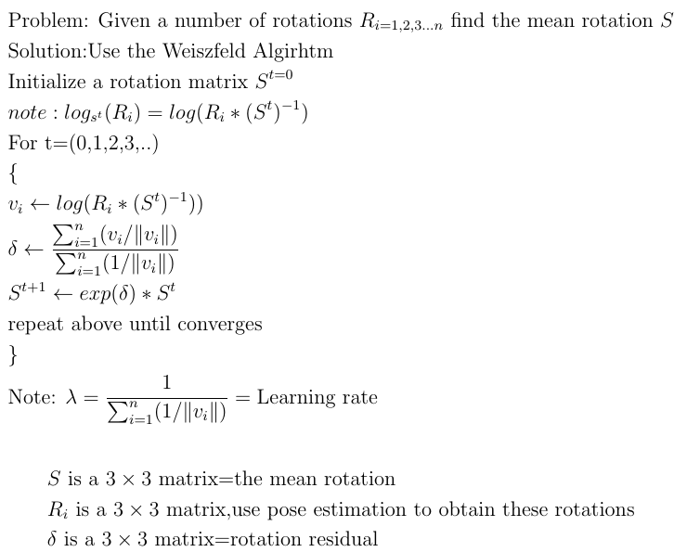
Find the average rotation using the Weiszfeld algorithm (geometric median)
Note use expm to find the exponentials of matrices
>>help expm in matlab to find out more.
E.g. expm(A_{3x3})= B_{3x3}
Also: if A is a rotation matrix B is a 3x3 real matric, otherwise B may contain complex values.
%Testing matlab code
r_rand=rand(3,3)
r_rotate=rpymat([1,2,3])
v_rand=logm(r_rand)
v_rotate=logm(r_rotate)
Cost function
Notes:
%http://www.sciweavers.org/free-online-latex-equation-editor
\documentclass[12pt]{article}
\usepackage{amsmath, enumitem}
\begin{document}
\begin{align*}
&\text{Problem: Given a number of rotations } R_{i=1,2,3...n} \text{ find the mean rotation } S\\
&\text{Solution:Use the Weiszfeld Algirhtm}\\
&\text{Initialize a rotation matrix } S^{t=0}\\
& note: log_{s^t}(R_i) = log(R_i*(S^t)^{-1})\\
&\text{For t=(0,1,2,3,..)}\\
&\{\\
&v_i \gets log(R_i*(S^t)^{-1})) \\
&\delta \gets \frac{\sum_{i=1}^{n}( v_i/\| v_i\|)} {\sum_{i=1}^{n} (1/\| v_i\|)} \\
&S^{t+1} \gets exp(\delta )* S^t \\
&\text{repeat above until converges }\\
&\}\\
&\text{Note: } \lambda=\frac{1} {\sum_{i=1}^{n} (1/\|v_i\|)}= \text{Learning rate}
\end{align*}
%%%%%%%%%%%%%%%%%%%%%%%%%%%%%%%%%%%%
\begin{align*}
&S \text{ is a } 3 \times 3 \text{ matrix=the mean rotation}\\
&R_i \text{ is a } 3 \times 3 \text{ matrix,} \text{use pose estimation to obtain these rotations}\\
&\delta \text{ is a } 3 \times 3 \text{ matrix=rotation residual}\\
\end{align*}
\end{document}

Slide 22
Further explanation of the algo.
To show the cost function C(R_{i})=
Please refer to equation 23 of
Huynh, Du Q. "Metrics for 3D rotations: Comparison and analysis." Journal of Mathematical Imaging and Vision 35.2 (2009): 155-164.
Notes:
%http://www.sciweavers.org/free-online-latex-equation-editor
\documentclass[12pt]{article}
\usepackage{amsmath, enumitem}
\begin{document}
\begin{align*}
\| \log_s(R_i)\|=\| \log(R_i,S^{-1}) \|
\end{align*}
\end{document}

Slide 23
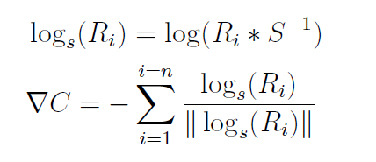
Explanation 1
Using the metric C(R_{i})=
The proof is in the next slide
When ∇C is found we can use the similar treatment in the original Weiszfeld algorithm to find δ (derivation to be added)
Weiszfeld algorithm for mean rotation
Notes:
%http://www.sciweavers.org/free-online-latex-equation-editor
\documentclass[12pt]{article}
\usepackage{amsmath, enumitem}
\begin{document}
\begin{align*}
&\log_s(R_i)=\log(R_i*S^{-1})\\
&\nabla C=-\sum_{i=1}^{i=n} \frac{\log_s(R_i)}{\|\log_s(R_i)\|}
\end{align*}
\end{document}
%http://www.sciweavers.org/free-online-latex-equation-editor
\documentclass[12pt]{article}
\usepackage{amsmath, enumitem}
\begin{document}
\begin{align*}
&\log_s(R_i)=\log(R_i,S^{-1})
\end{align*}
\end{document}
%http://www.sciweavers.org/free-online-latex-equation-editor
\documentclass[12pt]{article}
\usepackage{amsmath, enumitem}
\begin{document}
\begin{align*}
&\text{Problem: Given a number of rotations } R_{i=1,2,3...n} \text{ find the mean rotation } S\\
&\text{Solution:Use the Weiszfeld Algirhtm}\\
&\text{Initialize a rotation matrix } S^{t=0}\\
&\text{For t=(0,1,2,3,..)}\\
&\{\\
&v_i=log_{s^t}(R_i)=log(R_i*(S^t)^{-1})\\
&\delta=\frac{\sum_{i=1}^{n}( v_i/\| v_i\|)} {\sum_{i=1}^{n} (1/\| v_i\|)} \\
&S^{t+1}=exp(\delta )* S^t \\
&\text{repeat above until converges }\\
&\}\\
&\text{Note: } \lambda=\frac{1} {\sum_{i=1}^{n} (1/\|v_i\|)}= \text{Learning rate}
\end{align*}
%%%%%%%%%%%%%%%%%%%%%%%%%%%%%%%%%%%%
\begin{align*}
&S \text{ is a } 3 \times 3 \text{ matrix=the mean rotation}\\
&R_i \text{ is a } 3 \times 3 \text{ matrix,} \text{use pose estimation to obtain these rotations}\\
&\delta \text{ is a } 3 \times 3 \text{ matrix=rotation residual}\\
\end{align*}
\end{document}

Slide 24
http://math.stackexchange.com/questions/84331/does-this-derivation-on-differentiating-the-euclidean-norm-make-sense

Slide 25
Explanation 2
Using the metric
Assume you have selected a guess S, your measurement is log_{s}(R_{i})
Using the Weiszfeld algorithm your next guess is s^{t+1}
Because in the metric space (cost function)
log(s^{t+1} (s^{t})⁻¹)=δ, hence
(s^{t+1} (s^{t})⁻¹) =exp(δ)
S^{t+1}=exp(δ) (s^{t}) (to be proved in the next slide)
Weiszfeld algorithm for mean rotation
Notes:
%http://www.sciweavers.org/free-online-latex-equation-editor
\documentclass[12pt]{article}
\usepackage{amsmath, enumitem}
\begin{document}
\begin{align*}
&\log_s(R_i)=\log(R_i*S^{-1})
\end{align*}
\end{document}
%http://www.sciweavers.org/free-online-latex-equation-editor
\documentclass[12pt]{article}
\usepackage{amsmath, enumitem}
\begin{document}
\begin{align*}
&\text{Problem: Given a number of rotations } R_{i=1,2,3...n} \text{ find the mean rotation } S\\
&\text{Solution:Use the Weiszfeld Algirhtm}\\
&\text{Initialize a rotation matrix } S^{t=0}\\
&\text{For t=(0,1,2,3,..)}\\
&\{\\
&v_i=log_{s^t}(R_i)=log(R_i*(S^t)^{-1})\\
&\delta=\frac{\sum_{i=1}^{n}( v_i/\| v_i\|)} {\sum_{i=1}^{n} (1/\| v_i\|)} \\
&S^{t+1}=exp(\delta) * S^t \\
&\text{repeat above until converges }\\
&\}\\
&\text{Note: } \lambda=\frac{1} {\sum_{i=1}^{n} (1/\|v_i\|)}= \text{Learning rate}
\end{align*}
%%%%%%%%%%%%%%%%%%%%%%%%%%%%%%%%%%%%
\begin{align*}
&S \text{ is a } 3 \times 3 \text{ matrix=the mean rotation}\\
&R_i \text{ is a } 3 \times 3 \text{ matrix,} \text{use pose estimation to obtain these rotations}\\
&\delta \text{ is a } 3 \times 3 \text{ matrix=rotation residual}\\
\end{align*}
\end{document}

Slide 26
Explanation 3: to proof the update rule: S_{t+1} =exp(δ) *S_{t}
Starring from Tayler series expansion, by definition
f(x)=f(x0)+f’(x0)(x-x0) ---(i)
In (i) x0 is the guess, x is the next better guess, f()=cost, f’=df()/dx
If we set f(x)=cost, and ∇C =f’(x)(x-x0)=f’(x) λ =δ, where f’(x) =gradient of f(), and λ=step size (or learning rate) =(x-x0), so
from (i) we get an iterative procedure cost C_new=C_old+∇C---(ii)
Since cost is a log function log(S) here, where cost=log(S_{t}), from (ii)
log(S_{t+1})-log(S_{t})=log(S_{t+1}/S_{t})=δ--(iii)where S_{t}=quess rotation at iteration t.
Take exponential on both sides
S_{t+1} /S_{t} =expm(δ) or S_{t+1} =exp(δ) *S_{t} (proved)
Notes:
Since δ is a matrix , note: we use expm( ) instead of exp in MATLAB
For rotation S_{t} , the rotation axis is u, hence [u]_{x}=N, θ_{t}is the angle of rotation such that S_{t} =exp(θ_{t}*[u]_{x})=exp(θ_{t}*N)

Slide 27
Implementation: Demo program
Demo program in the attached ppt note
need functions (all in the attached notes)
rpyAng
rpymat
axis_angle2R
unit_vector
Notes:
Ri %just to show what we get
% set some values close to the truth. ?? may need to find a better selection
%[R_init,anxyz]=axis_angle2R(axis_angle+0.05,[axis_x+0.01,axis_y+0.02,axis_z+0.03])%small
[R_init,anxyz]=axis_angle2R(axis_angle+0.5,[axis_x+0.01,axis_y+0.02,axis_z+0.03])%small
R=R_init
err=10000,n_loop=0
max_loop=100
%while(err<0.01 && n_loop <max_loop)%repeat until err is small
while(err>0.001 & n_loop < max_loop)%repeat until err is small
for i=1:n %n measurements of mirror positions.
[eig_vec,eig_val]=eig(R'*Ri(:,:,i))
Ri(:,:,i)
ni(:,i)=eig_vec(:,1) %??should find the eig_vector correspond to -1 eign value
%pause
end %end_for
clear delta temp1 temp2 temp3 temp4
delta=zeros(3,3)
temp3=zeros(3,3)
temp4=0
for i=1:n %n measurements of mirror positions.
temp1= logm(R'*Ri(:,:,i)*(eye(3)-2*ni(:,i)*ni(:,i)'))
temp2= norm(temp1)
temp3= temp3 + (temp1/temp2)
temp4= temp4 + (1/temp2)
end %end_for
delta=temp3/temp4
R_old=R
R=expm(delta)*R %new guessed R
err=norm(R*R_old' - eye(3)) %error should be close to eye(3)
%err=norm(logm(R*R_old'))
n_loop=n_loop+1
pause
end %while
'done--------------------------------'
'R found'
R
'R_true'
R_true

Slide 28
Ago.1:Rotation averaging for paper5
Rjk_old=Rjk;
Rjk=Rjk*expm(delta); %new guessed R
err=norm(Rjk*Rjk_old' - eye(3))
n_loop=n_loop+1
err
end %while
Rjk
end
while(err>1*10^-3 && n_loop < max_loop)%repeat until err is small
clear delta temp1 temp2 temp3 temp4
delta=zeros(3,3);
temp3=zeros(3,3);
temp4=0
for i=1:n %
temp1= logm(Rjk'*Rj(:,:,i)*Rk(:,:,i));
temp2= norm(temp1);
temp3= temp3 + (temp1/temp2);
temp4= temp4 + (1/temp2);
end %end_for
delta=temp3/temp4;

Slide 29
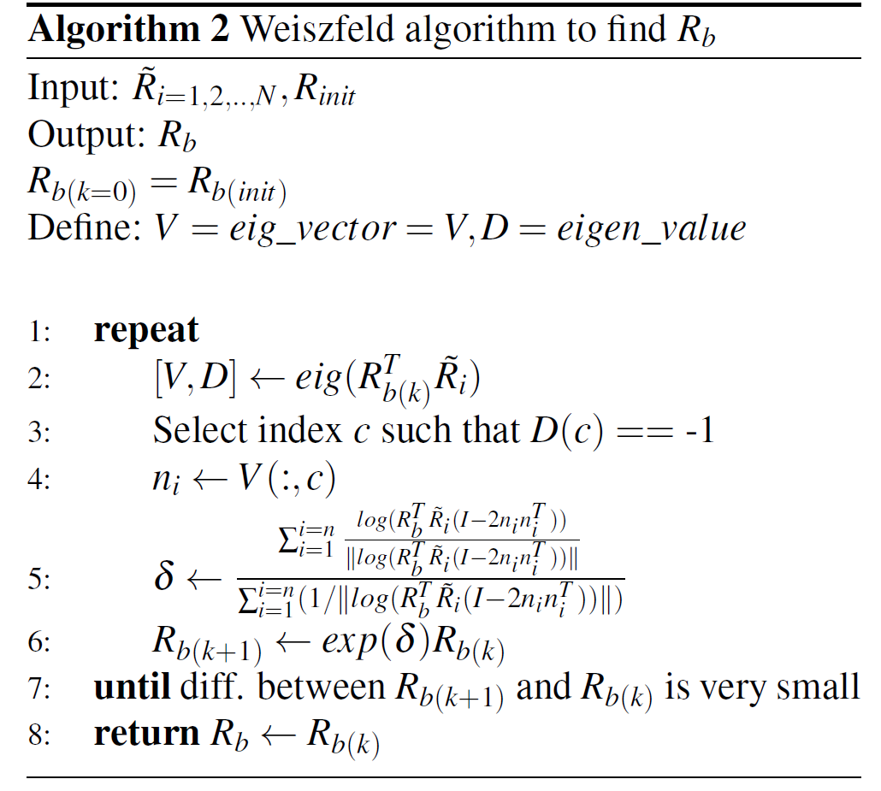

Slide 30
Algo2: Rotation averaging with mirror (paper1)
while(err>1*10^-4&& n_loop < max_loop)%repeat until err is small
clear ni rr cc
for i=1:n %n measurements of mirror positions.
%--inside Algo 1---------------------------
[eig_vec,eig_val]=eig(R'*Ri(:,:,i));
clear rr cc
[rr,cc]=find(eig_val < -0.5);
ni(:,i)=eig_vec(:,cc(1)); %
end %end_for
clear delta temp1 temp2 temp3 temp4
delta=zeros(3,3);
temp3=zeros(3,3);
temp4=0;
for i=1:n %n measurements of mirror positions.
temp1= …
logm(R'*Ri(:,:,i)*(eye(3)- 2*ni(:,i)*ni(:,i)'));
temp2= norm(temp1);
temp3= temp3 + (temp1/temp2);
temp4= temp4 + (1/temp2);
end %end_for
delta=temp3/temp4;
R_old=R;
R=R*expm(delta); %new guessed R
err=norm(R'*R_old - eye(3)) ;%error ≈eye(3)
n_loop=n_loop+1
end %nn_noise

Slide 31
References
Hartley, Richard, et al. "Rotation averaging." International journal of computer vision 103.3 (2013): 267-305.
Long, Gucan, et al. "Simplified Mirror-Based Camera Pose Computation via Rotation Averaging." Proceedings of the IEEE Conference on Computer Vision and Pattern Recognition. 2015.
Hartley, Richard, Khurrum Aftab, and Jochen Trumpf. "L1 rotation averaging using the Weiszfeld algorithm." Computer Vision and Pattern Recognition (CVPR), 2011 IEEE Conference on. IEEE, 2011.
Aftab, Khurrum, Richard Hartley, and Jochen Trumpf. "Generalized Weiszfeld algorithms for Lq optimization." Pattern Analysis and Machine Intelligence, IEEE Transactions on 37.4 (2015): 728-745.
Huynh, Du Q. "Metrics for 3D rotations: Comparison and analysis." Journal of Mathematical Imaging and Vision 35.2 (2009): 155-164.
http://www.academia.edu/3371194/The_comparison_of_L1_and_L2-norm_minimization_methods
Rui Rodrigues, João P. Barreto,Urbano Nunes, “Camera Pose Estimation Using Images of Planar Mirror Reflections”, ECCV 2010

Slide 32
Demo (require rpyMat.m)
%This demos shows the angle of logm(r1^T*r2), and the angle of logm(r2^T*r1) are same'
r1=rpymat([1.1 2.1 3.1])
r2=rpymat([3.2 2.2 1.3])
dr1=logm(r1'*r2)
vrrotmat2vec(dr1)
axis_angle1=vrrotmat2vec(dr1)
angle1=axis_angle1(4)
dr2=logm(r2*r1')
axis_angle2=vrrotmat2vec(dr2)
angle2=axis_angle2(4)
'show result, the axis may not the same'
axis_angle1
axis_angle2
disp('its shows the angle of logm(r1^T*r2), and the angle of logm(r2^T*r1) are same')
angle1
angle2
% Author: Rodrigo Carceroni
% Disclaimer: This code comes with no guarantee at all and its author
% is not liable for any damage that its utilization may cause.
%khw added 3.3002 , input angs is a 1x3 matrix,
% angs(1) is yaw angle about x-axis
% angs(2) is pitch angle about y-aixs
% angs(3) is roll angle about z-axis
%then X'=RX+T; X,T are 3X1 matrixes for [X,Y,Z]' 3D corrd. and translations.
function R = rpyMat (angs)
% Return the 3x3 rotation matrix described by a set of Roll, Pitch and Yaw
% angles.
cosA = cos (angs(3));
sinA = sin (angs(3));
cosB = cos (angs(2));
sinB = sin (angs(2));
cosC = cos (angs(1));
sinC = sin (angs(1));
cosAsinB = cosA .* sinB;
sinAsinB = sinA .* sinB;
R = [ cosA.*cosB cosAsinB.*sinC-sinA.*cosC cosAsinB.*cosC+sinA.*sinC ;
sinA.*cosB sinAsinB.*sinC+cosA.*cosC sinAsinB.*cosC-cosA.*sinC ;
-sinB cosB.*sinC cosB.*cosC ];

