Slide 1
Using jupyter
KH Wong

Slide 2
Introduction
How to install
https://sites.google.com/site/hongslinks/1-tensor_windows-installation-through-anaconda3
How to run
**Remember to "Restart and clear output" the "Kernel" - at the top menu everything you run a jupter notebook file.
Tests:
MNMIST for OCR
MNIST for fashion design
Colab

Slide 3
How to install?
Install anaconda and then
Jupter 6.4.11

Slide 4
Ho to run

Slide 5
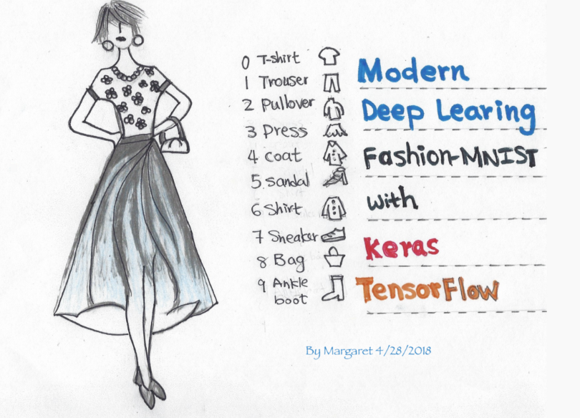
MNIST Demo for fashion design: tested on Jupiter 6.4.11 under tensorflow 2
Fashion-MNIST with tf.Keras. Deep Learning for Everyone | by Margaret Maynard-Reid | TensorFlow | Medium

Slide 6
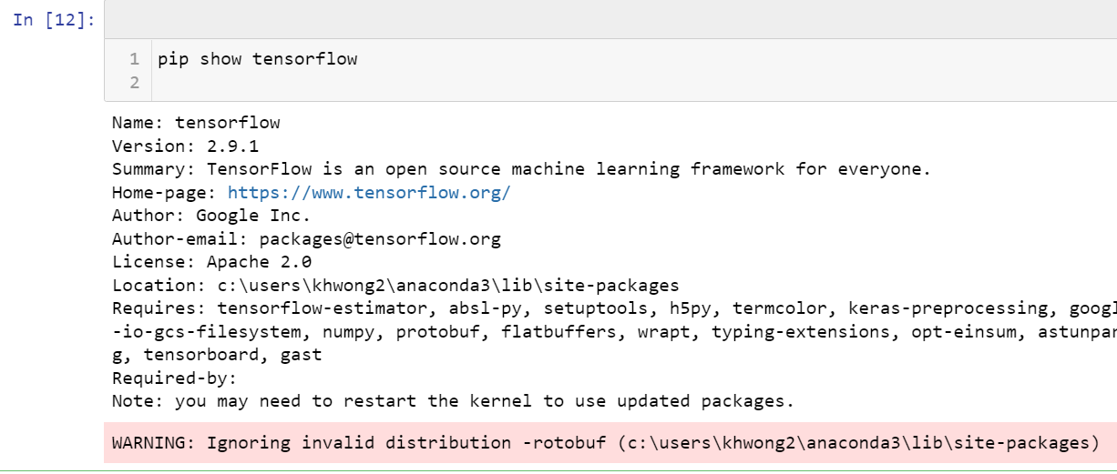
After running
Run this to show TensorFlow version. The result is tensorflow 2.91

Slide 7
Colab examples
CNN with MNIST dataset | Chan`s Jupyter (goodboychan.github.io)

