Slide 1
Recurrent neural network RNN
KH Wong

Slide 2
Ch. 11 :Introduction to RNN, LSTM
RNN (Recurrent neural network)
LSTM (Long short-term memory)
KH Wong

Slide 3
Overview
Introduction
Concept of RNN (Recurrent neural network) ?

Slide 4
Introduction
RNN (Recurrent neural network) is a form of neural networks that feed outputs back to the inputs during operation
Materials are mainly based on links found in https://www.tensorflow.org/tutorials

Slide 5
Concept of RNN (Recurrent neural network)
concept

Slide 6
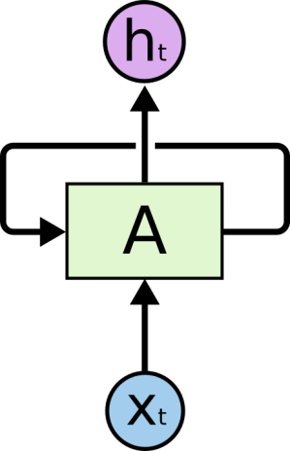
RNN Recurrent neural network
X_{t}= input at time t
h_{t}= output at time t
A=neural network
The loop allows information to pass from t to t+1
reference:
http://colah.github.io/posts/2015-08-Understanding-LSTMs/

Slide 7
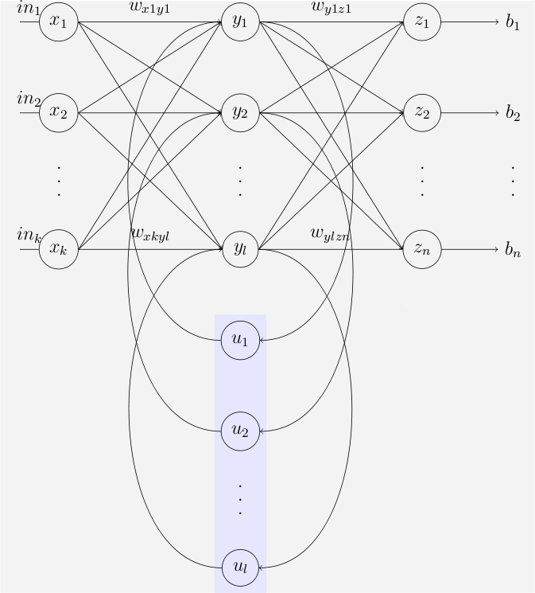
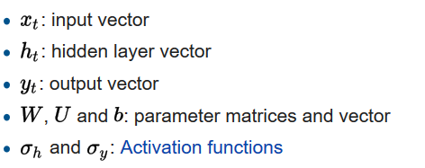
The Elman RNN network
An Elman network is a three-layer network (arranged horizontally as x, y, and z in the illustration), with the addition of a set of "context units" (u in the illustration). The middle (hidden) layer is connected to these context units fixed with a weight of one.^{[25]} At each time step, the input is fed-forward and then a learning rule is applied. The fixed back connections save a copy of the previous values of the hidden units in the context units (since they propagate over the connections before the learning rule is applied). Thus the network can maintain a sort of state, allowing it to perform such tasks as sequence-prediction that are beyond the power of a standard multilayer perceptron
https://en.wikipedia.org/wiki/Recurrent_neural_network

Slide 8
RNN unrolled But RNN suffers from the vanishing gradient problem, see appendix)
Unroll and treat each time sample as an unit.
An unrolled RNN
Problem:
Learning long-term dependencies with gradient descent is difficult , Bengio, et al. (1994)
LSTM can fix the vanishing gradient problem

Slide 9
Different types of RNN
(1) Vanilla mode of processing without RNN, from fixed-sized input to fixed-sized output (e.g. image classification).
(2) Sequence output (e.g. image captioning takes an image and outputs a sentence of words).
(3) Sequence input (e.g. sentiment analysis where a given sentence is classified as expressing positive or negative sentiment).
(4) Sequence input and sequence output (e.g. Machine Translation: an RNN reads a sentence in English and then outputs a sentence in French).
(5) Synced sequence input and output (e.g. video classification where we wish to label each frame of the video).
http://karpathy.github.io/2015/05/21/rnn-effectiveness/
Output layer
Hidden layer
(recurrent layer)
Input
layer
(1) (2) (3) (4) (5)

Slide 10
A simple RNN (recurrent Neural network) for sequence prediction
Predict the next character game
First: define the characters. The dictionary has 4 characters, one-hot representation
If PIG→ is received, the prediction is S
This mechanism can be extended to machine translation
One hot | P | I | G | S
X1 | 1 | 0 | 0 | 0
X2 | 0 | 1 | 0 | 0
X3 | 0 | 0 | 1 | 0
X4 | 0 | 0 | 0 | 1

Slide 11
A simple RNN (recurrent Neural network) for sequence prediction
Unroll an RNN: If PIG→ is received, the prediction is S
Tanh(Whx*X + Whh(1)*h_{t-1}(1) + bias(1))=h_{t}(1)
Tanh(Whx*X + Whh(2)*h_{t-1}(2) + bias(2))=h_{t}(2)
Tanh(Whx*X + Whh(3)*h_{t-1}(3) + bias(3))=h_{t}(3)
A is an RNN with 3 neurons : enter PIG step by step to X_{t} at each time t , h_{t} will give S automatically
Note:
For softmax, see
http://www.cse.cuhk.edu.hk/~khwong/www2/cmsc5707/5707_likelihood.pptx
External output
‘I’
‘G’
‘S’
Output layer
(Softmax)
Output layer
(Softmax)
Output layer
(Softmax)
Output layer
(Softmax)
h_{t=1}
Time-unrolled diagram of the RNN
h_{t}
h_{t=2}
h_{t=3}
Hidden
(recurrent)
layer
A
=
tanh
tanh
tanh
Input layer
X_{t}
h_{t-1}
X_{t=1}=
‘P’
X_{t=2}=
‘I’
X_{t=3}=
‘G’
https://www.analyticsvidhya.com/blog/2017/12/introduction-to-recurrent-neural-networks/

Slide 12
Inside A : 3 neurons at time t
Whx=[Whx(1),Whx(2),Whx(3),Whx(4)]
X=[X(1), X(2), X(3), X(4)]’
Whh=[Whh(1),Whh(2),Whh(3)]’
Bias=[bias(1),bias(2),bias(3)]’
h_{t-1}(3)
h_{t}(3)
Whh(3)
Tanh(Whx*X+Whh(3)*h_{t-1}(3)+bias(3))=h_{t}(3)
Whx(1)
Whx(2)
Whx(3)
Whx(4)
X(1)
X(2)
X(3)
X(4)
h_{t-1}(2)
h_{t}(2)
Whh(2)
Tanh(Whx*X+Whh(2)*h_{t-1}(2)+bias(2))=h_{t}(2)
Whx(1)
Whx(2)
Whx(3)
Whx(4)
X(1)
X(2)
X(3)
X(4)
h_{t-1}(1)
h_{t}(1)
Whh(1)
Tanh(Whx*X+Whh(1)*h_{t-1}(1)+bias(1))=h_{t}(1)
Whx(1)
Whx(2)
Whx(3)
Whx(4)
X(1)
X(2)
X(3)
X(4)

Slide 13
Exercise RNN1a: Numerical examples
whx=[0.287027 0.84606 0.572392 0.486813
0.902874 0.871522 0.691079 0.18998
0.537524 0.09224 0.558159 0.491528]
why=[0.37168 0.974829459 0.830034886
0.39141 0.282585823 0.659835709
0.64985 0.09821557 0.332487804
0.91266 0.32581642 0.144630018]
bias=0.567001*[1 1 1]' %random init. val
whh=0.427043*[1 1 1]'%random init. val
ht(:,1)=[0 0 0]' %init val, assume zero
ht(:,t+1)=tanh(whx*in(:,t)+whh.*ht(:,t)+bias)
===== to verify========== for the first nueron , t=1
ht(1,t+1)=tanh([0.287027 0.84606 0.572392 0.486813]*[1 0 0 0]'+0*0.427043+0.567001)
= 0.6932
ht(2,t+1)=tanh([0.902874 0.871522 0.691079 0.18998]*[1 0 0 0]'+0*0.427043+0.567001)
=0.8996
Exercise 8a, find ht(3,t+1)=_____? ht(1,t+2)=_____? ht(2,t+2)= _____?
Exercise 8b, find output of the output layer at time t

Slide 14
Matlab demo: Answer RNN1a
%rnn2.m
%https://stackoverflow.com/questions/50050056/simple-rnn-example-showing-numerics
%https://www.analyticsvidhya.com/blog/2017/12/introduction-to-recurrent-neural-networks/
clear
in_P=[1 0 0 0]'
in_I=[0 1 0 0]'
in_G=[0 0 1 0]'
in_S=[0 0 1 0]'
in=[in_P,in_I,in_G, in_S]
whx=[0.287027 0.84606 0.572392 0.486813
0.902874 0.871522 0.691079 0.18998
0.537524 0.09224 0.558159 0.491528]
why=[0.37168 0.974829459 0.830034886
0.39141 0.282585823 0.659835709
0.64985 0.09821557 0.332487804
0.91266 0.32581642 0.144630018]
bias=0.567001*[1 1 1]' %random init val
whh=0.427043*[1 1 1]'%random init val
ht(:,1)=[0 0 0]' %init val, assume zero
for t = 1:length(in)-1 %
t
ht(:,t+1)=tanh(whx*in(:,t)+whh.*ht(:,t)+bias) %recuurent layer
y_out(:,t+1)=why*ht(:,t+1)
softmax_y_out(:,t+1)=softmax(y_out(:,t+1)) %output layer
end
'print result ==================='
ht
y_out
softmax_y_out
print result ===================
ht =
0 0.6932 0.9365 0.9120
0 0.8996 0.9491 0.9307
0 0.8021 0.7623 0.8958
y_out =
0 1.8003 1.9061 1.9898
0 1.0548 1.1378 1.2111
0 0.8055 0.9553 0.9819
0 1.0417 1.2742 1.2651
softmax_y_out =
0 0.4324 0.4198 0.4332
0 0.2052 0.1947 0.1988
0 0.1599 0.1622 0.1581
0 0.2025 0.2232 0.2099
>>
Time
%https://stackoverflow.com/questions/50050056/simple-rnn-example-showing-numerics
%https://www.analyticsvidhya.com/blog/2017/12/introduction-to-recurrent-neural-networks/
Answer8: find ht(3,t+1)= 0.8021, ht(1,t+2)= 0.9365, ht(2,t+2) =0.9491.

Slide 15
Answer RNN1b
why=[0.37168 0.974829459 0.830034886
0.39141 0.282585823 0.659835709
0.64985 0.09821557 0.332487804
0.91266 0.32581642 0.144630018]
y_out(:,t+1)=why*ht(:,t+1)
ht =
0 0.6932 0.9365 0.9120
0 0.8996 0.9491 0.9307
0 0.8021 0.7623 0.8958
y_out =
0 1.8003 1.9061 1.9898
0 1.0548 1.1378 1.2111
0 0.8055 0.9553 0.9819
0 1.0417 1.2742 1.2651
softmax_y_out =
0 0.4324 0.4198 0.4332
0 0.2052 0.1947 0.1988
0 0.1599 0.1622 0.1581
0 0.2025 0.2232 0.2099
Softmax(y_out)_{i=1,2,3,4}
The
output
layer
Y_out_{i=1,2,3,4}
Weights: Why (4x3)
h_{t}(1)
h_{t}(2)
h_{t}(3)
Time 0 1 2 3

Slide 16
Output layer: softmax
Prediction is archived by seeing which y_out is biggest after the softmax processor of the output layer
softmax_y_out =
Time= 0 1 2 3
P 0 0.4324 0.4198 0.4332
I 0 0.2052 0.1947 0.1988
G 0 0.1599 0.1622 0.1581
S 0 0.2025 0.2232 0.2099
From the above result the last prediction is the ‘P’ which is not correct, because the weights are just randomly initialized. After training, the production should be fine.
y
softmax_y_out
See appendix

Slide 17
How to training an RNN
After unroll the RNN, it becomes the following neural network structure.
Training is the same as a common neural backpropagation
Input sequence is “PIG”, output sequence is “IGS”
After training when you enter “PIG”, it will output S at t=3
The same method can be extended to learn different patters, i.e. Add “S_” or ‘ES’ to nouns. For example: prepare training samples:- Type1: PIGS, FEES_, COWS_, CUPS_,…. Type2: BUSES, TAXES, . After training “S_” or “ES” will be automatically added
‘_’=space added to make word size=5
=‘I’
=‘G’
=‘S’
=‘_’
h = O_{t}= encoder hidden vector is generated after a sequence is entered. You will see that it will be used for machine translation later
h_{t}
Softmax
Softmax
Softmax
Softmax
h_{t=1}
h_{t=2}
h_{t=3}
h_{t=4}
A
=
tanh
tanh
tanh
tanh
X_{t}
h_{t-1}
X_{t=1}=
‘P’
X_{t=2}=
‘I’
X_{t=3}=
‘G’
X_{t=4}=
‘S’
Time-unrolled diagram of the RNN

