Slide 1
Music genre classification using a hierarchical long short term memory (LSTM) model
For the paper: Chun Pui Tang, Ka Long Chui, Ying Kin Yu, Zhiliang Zeng, Kin Hong Wong, "Music Genre classification using a hierarchical Long Short Term Memory (LSTM) model", International Workshop on Pattern Recognition IWPR 2018 ,University of Jinan, Jinan, China, May 26-28, 2018.

Slide 2
Introduction

Slide 3
What we have done
Built a Neural Network Model to classify 10 different music genres
The project can divided into 3 parts
Data collection
Preprocessing
Building and training the neural network

Slide 4
Motivation
Why we need music genre classification
A huge amount of music on the Internet
People are more likely to browse or search music by genre
Why choosing this topic
Machine learning is the hotest topic recently
Less studied than others types of media

Slide 5
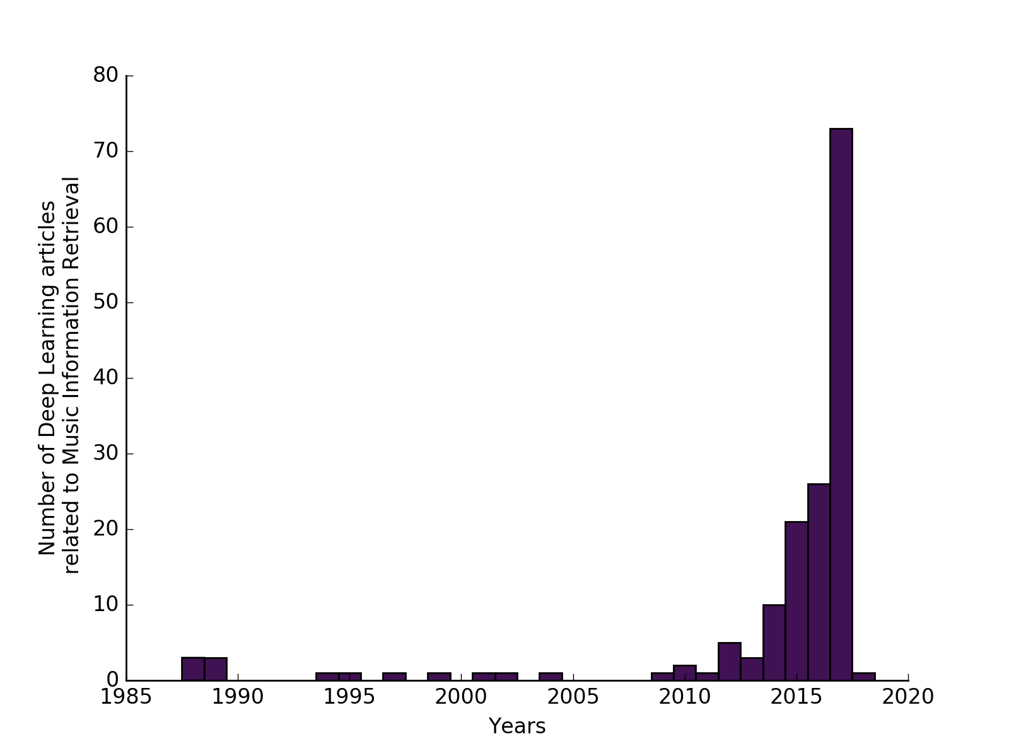
Deep learning Projects Related to Music
Increase number of projects related to music in recent years
Figure 4 - Number of articles per year (DL4M) (Yann Bayle, 2017)

Slide 6
Data set

Slide 7
Dataset
GTZAN Genre Collection (by George Tzanetakis)
Typically representative of the styles of that genre
 | Duration | Number of Genre | Number of soundtrack | Format
GTZAN data set | 30 Seconds | 10 | 100/genre | 22050Hz Mono 16bit audio file in wave format
Genre: Classic, Hip-hop, Jazz, Metal, Pop, Reggae, blues, Rock, Country Folk, Disco

Slide 8
Music sample
Hip-hop | hiphop_001.au | Jazz | .au
Metal | .au | Blues | .au
Pop | .au | Country Folk | .au
Reggae | .au | Disco | .au
Rock | .au | Classic | .au
Notes:
Add the music sample later click and then will play the corresponding music

Slide 9
Grouping
 | Present
Training | 75/genre
Testing | 25/genre
Because of small size of dataset(1000)
We only define the dataset into training set and testing set (without validation set)
Larger training set -> Provide better accuracy
Larger testing set -> Result have higher reliability

Slide 10
Preprocessing

Slide 11
Why we need to do preprocessing
Example to explain to importance of preprocessing
Result: also apply to music

Slide 12
Mel-Frequency Cepstral Coefficient(MFCC)
Represent sound by approximate human auditory system
MFCC (Mel-frequency cepstrum) popular for Speech recognition
Also used in Music genre classification and Similarity measurement

Slide 13
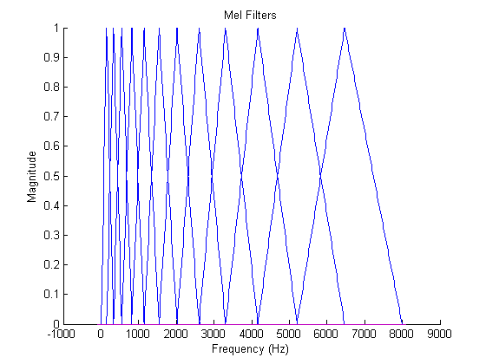
Mel filter bands (found by psychological and instrumentation experiments)
Freq. lower than 1 KHz has narrower bands (and in linear scale)
Higher frequencies have larger bands (and in log scale)
More filter below 1KHz
Less filters above 1KHz
Filter
output
http://instruct1.cit.cornell.edu/courses/ece576/FinalProjects/f2008/pae26_jsc59/pae26_jsc59/images/melfilt.png

Slide 14
Cepstrum
C(n)=IDFT[log₁₀ |S(w)|]=
IDFT[ log₁₀{|E(w)|} + log₁₀{|H(w)|} ]
In C(n), you can see E(n) and H(n) at two different positions
Application: useful for (i) glottal excitation removal (ii) vocal tract filter analysis
X(n)
X(w)
Log|x(w)|
S(n)
windowing
DFT
Log|x(w)|
IDFT
C(n)
N=time index
w=frequency
I-DFT=Inverse-discrete Fourier transform

Slide 15
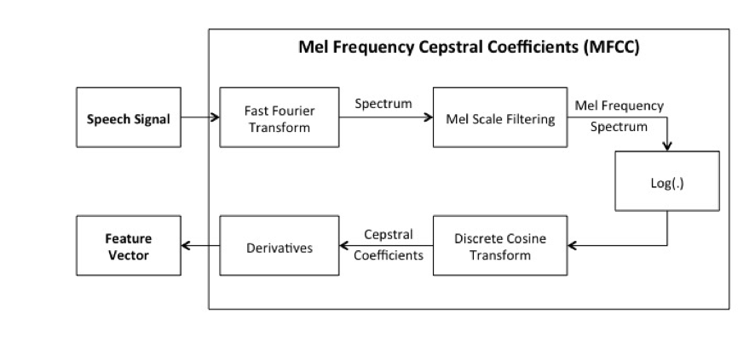
To compute Mel-Scale Cepstral Coef. MFCC We modified the original cepstrum calculation by using (1) Mel scale filter and (2) (Inverse) Discreet Cosine Transform instead of IDFT
Block Diagram of MFCC alogorithm (Michael Lutter,2014)

Slide 16
Extracted Feature
 | Features
Typical Number of MFCCs | 13 Use C1-C12 (C0 not used)

Slide 17
Neural network model
A brief introduction

Slide 18
Common types of Neural Network
CNN (convolution neural net)
Recurrent neural network
A form of RNN : LSTM (Long short-term memory)
Notes:
CNN, RNN and the model we are using

Slide 19
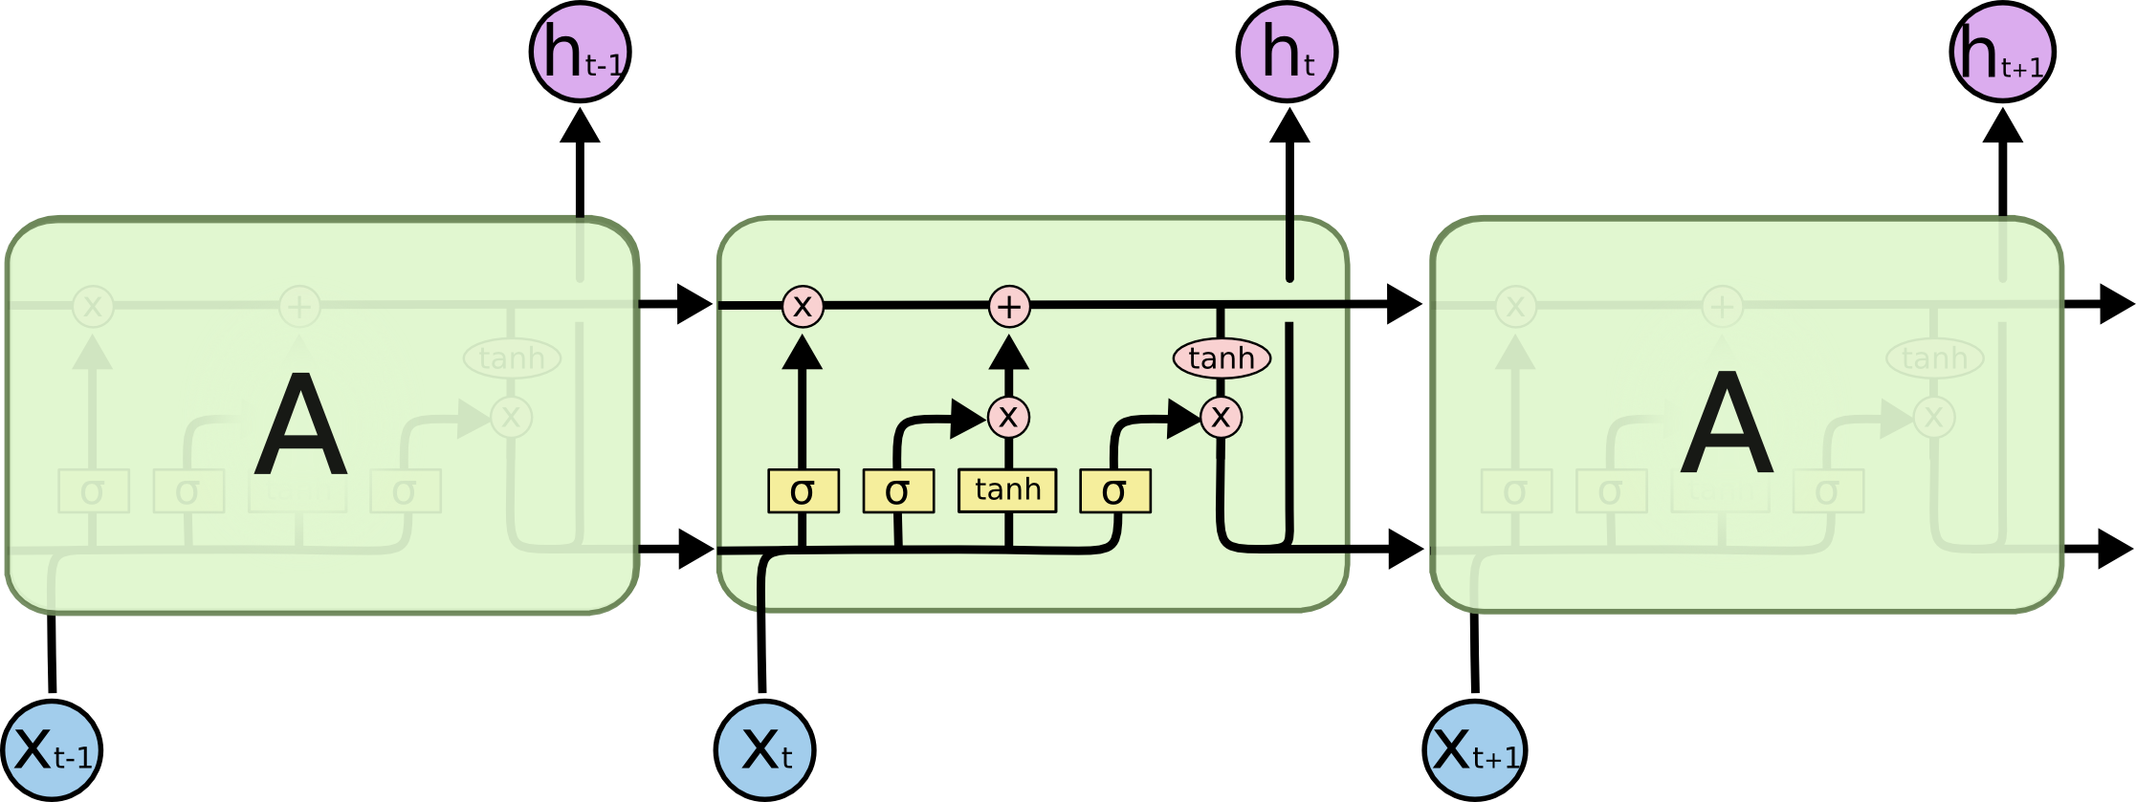
Long Short-Term Memory(LSTM) Network
http://colah.github.io/posts/2015-08-Understanding-LSTMs/

Slide 20
Forget Gate
Update Gate

Slide 21
Do the forget and update Action
Filter the Cell state,
Deceide what to output

Slide 22
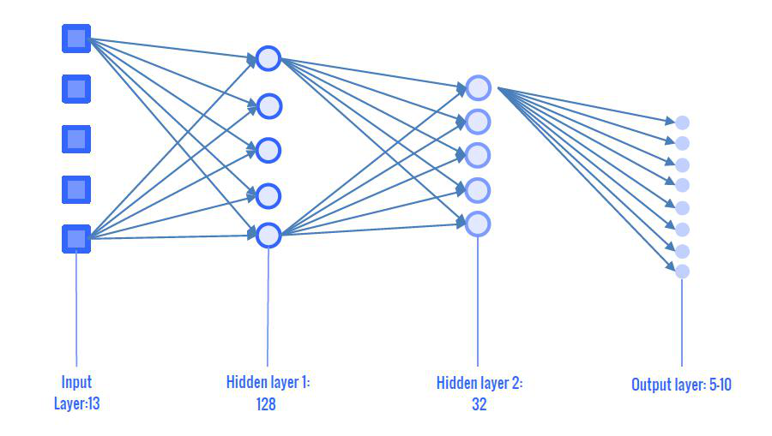
Our LSTM model
2 LSTM layer with density of 128 and 32
Output : 10 genres(one-hot)
Notes:
I will draw a better picture for the model later

Slide 23
LSTM
Long short term memory

Slide 24
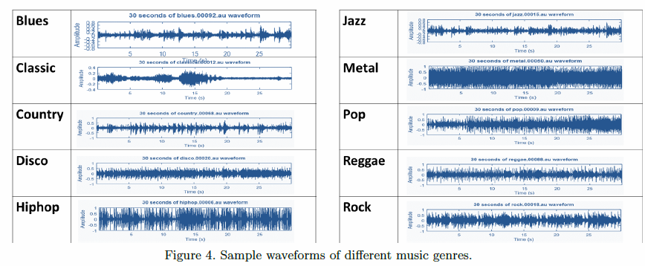
10 different genres

Slide 25
Music sample
Hip-hop | hiphop_001.au | Jazz | .au
Metal | .au | Blues | .au
Pop | .au | Country Folk | .au
Reggae | .au | Disco | .au
Rock | .au | Classic | .au
Notes:
Add the music sample later click and then will play the corresponding music

Slide 26
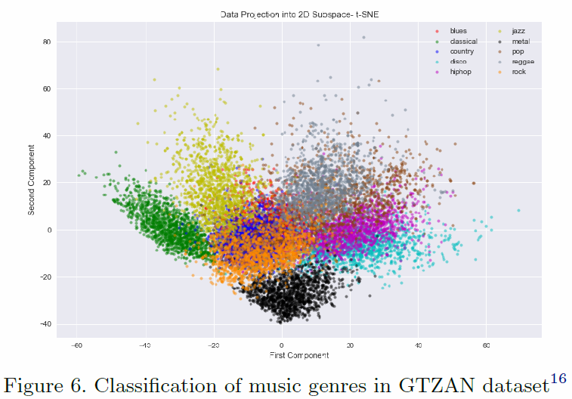
Classification of music genres in GTZAN dataset

Slide 27
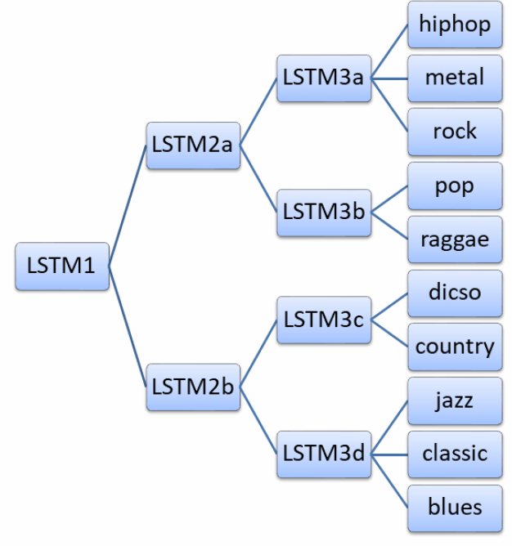
7 LSTM(Divide and Conquer)
 | Input | Output | To
LSTM1 | 750(All in training set) | strong or mild | 2a,2b
LSTM2a | 375(Strong) | strong 1 or 2 | 3a,3b
LSTM2b | 375(Mild) | mild 1 or 2 | 3c,3d

Slide 28
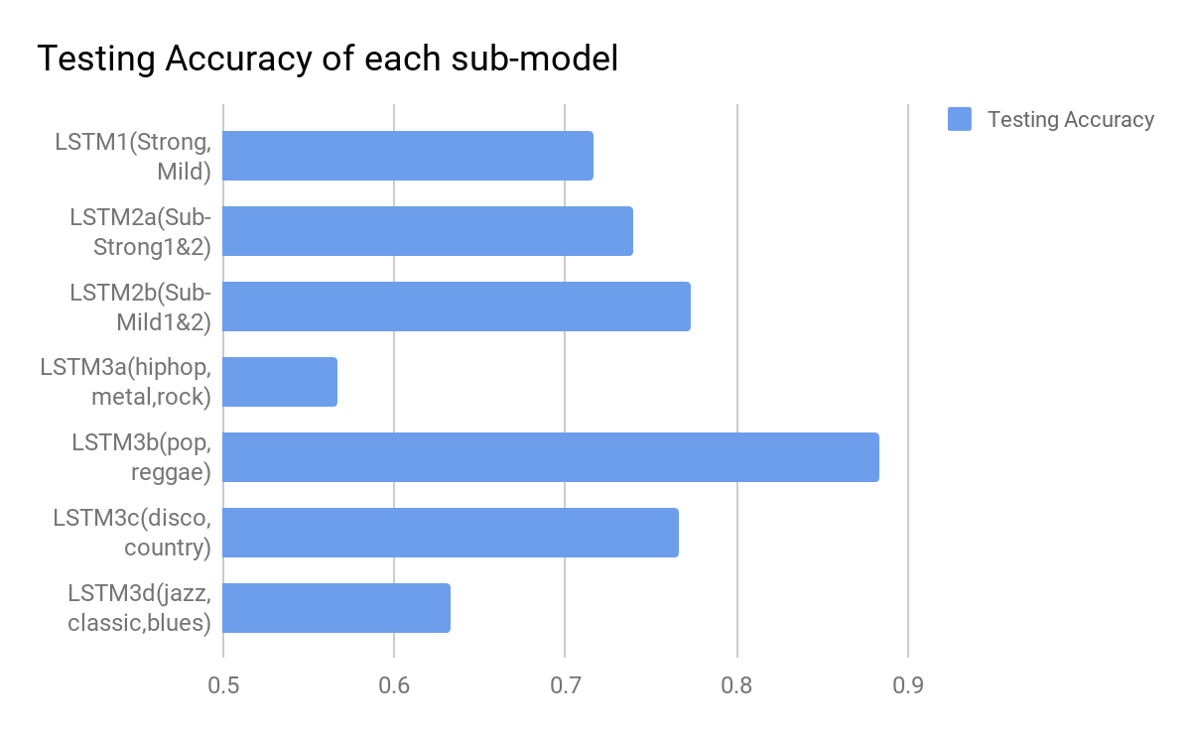
Result in Early stage
The result in LSTM3a indicates there is some problem we have missed

Slide 29
Arrange the dataset
 | Before | After
Testing | 0-29 | 4,8,12,16…(Multiple of 4)
Training | 30-99 | The rest
The reason that LSTM3a performs way worse than others
The consecutive soundtracks are often perform by the same singer
Original method to divide the dataset might have biased

Slide 30
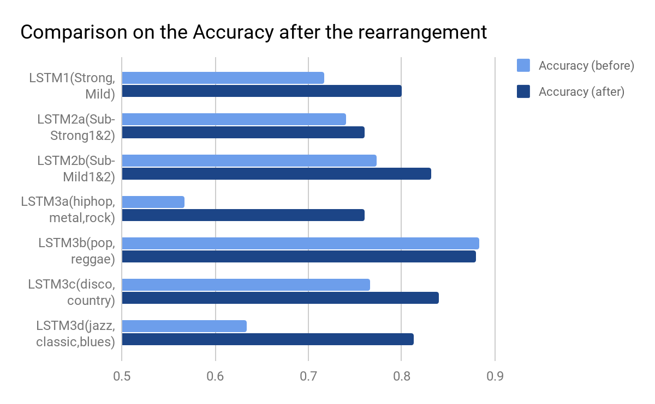
Discussion: Result after rearrangement
Increase accuracy in most of the genres
Great improve can be seen in LSTM3a and LSTM3d

Slide 31
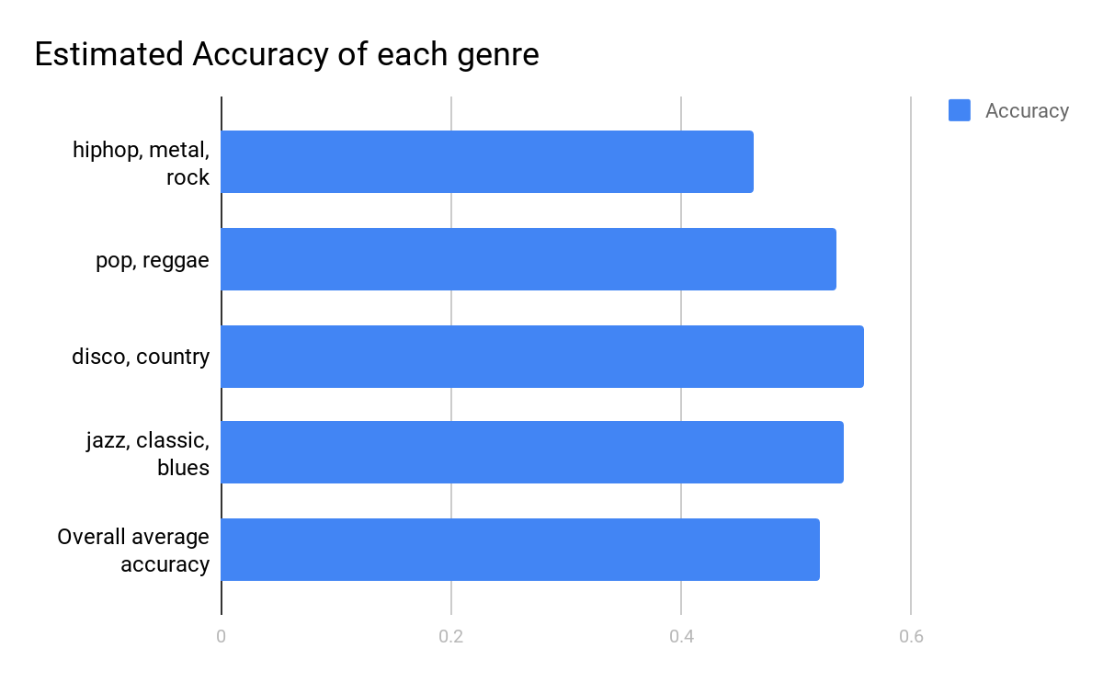
Result of Approach 1
Accuracy: 50%

Slide 32
Discussion

Slide 33
Reflection on 7 LSTM
The reason that affect 7 LSTM accuracy:
The division of the group Strong and Mild is rough
for instance disco is assigned to the Mild group, but it included song with strong and mild
Too many layer
more layer imply accuracy will further decrease, if the accuracy of each layer is not high enough
Classify among similar songs

Slide 34
Bigger data set
Million song dataset(25 genres):
Big Band, Blues Contemporary, Country Traditional, Dance, Electronica, Experimental, Folk International, Gospel, Grunge Emo, Hip Hop Rap, Jazz Classic, Metal Alternative, Metal Death, Metal Heavy, Pop Contemporary, Pop Indie, Pop Latin, Punk, Reggae, RnB Soul, Rock Alternative, Rock College, Rock Contemporary, Rock Hard, Rock Neo Psychedelia
50000 labelled examples (2000 per genre) are provided for training, with a further 10000 unlabelled examples (400 per genre) used for testing
The highest accuracy achieved was 35.34% (2017 Kaggle)

Slide 35
Network Structure
Possibility of using other network structure
CNN-LSTM
Auto-encoder
2. Adding other new features
Chroma feature, Spectral Central

Slide 36
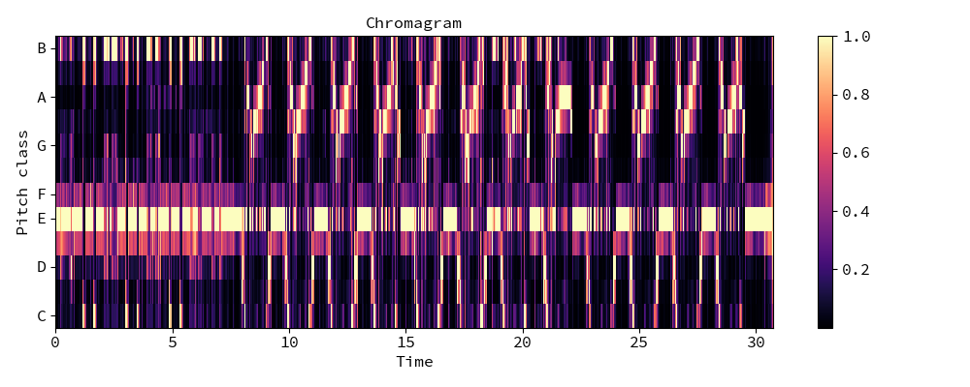
Chroma features
Represent a music audio into 12 distinct semitones of the musical octave

Slide 37
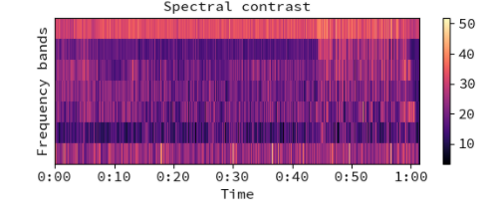
Spectral Contrast
Provide better performance than MFCC in music genre classification
the spectral contrast is calculated as the difference between the maximum and minimum magnitudes in the spectrum

Slide 38
Conclusion
Developed a 10 music Genres classification system.
Accuracy is 50% which is comparable to the state-of-that resulsts.

Slide 39
The End
Q & A

