Slide 1
Word representation and sequence to sequence processing
KH Wong

Slide 2
Overview
Introduction
Part1: Word representation (word embedding) for text processing
  Integer mapping
  BOW (Bag of words)
  TF-IDF (term frequency-inverse document frequency, popular)
  Word2vec (accurate and popular)
Part2: Sequence to sequence machine learning (seq2seq)
  Machine translation (MT) systems
Appendix
Part3: Transformer ( a new word embedding method) – in appendix

Slide 3
Part1: Word representation
(Word embedding)
For text processing
Basic ideas

Slide 4
Word embedding (representation)
https://medium.com/@japneet121/introduction-713b3d976323
Three approaches to represent words by numbers
Integer mapping (simple, not too useful)
BOW : (Bag of words)
TF-IDF : term frequency-inverse document frequency
Word2vec : This is popular, will be discussed in detail
  Word2vec relies on either skip-grams or continuous bag of words (CBOW) to create neural word embedding

Slide 5
1. Integer mapping example
#interger_maaping.py, khw 1906, python using tf-gpu
line="test :map a text string into a dictionary.”
word_list={} #dictionary to hold the words
counter=0 #initialize the counter for words
for word in line.lower().split():#iterate over words
if word not in word_list: #check if word is in dict
word_list[word]=counter
counter+=1 #update the counter
print(word_list)
''‘ run python (tf-gpu), interger_maaping.py
{'this': 0, 'a': 1, 'test': 2, 'to': 3, 'find': 4, 'out': 5, 'how': 6, 'map': 7, 'text': 8, 'string': 9, 'into': 10, 'dictionary.': 11, 'we': 12, 'can': 13, 'us': 14, 'eit': 15, 'fro': 16, 'machine': 17, 'translation': 18, 'etc.': 19}'''

Slide 6
2. Bag of words (BoW) https://en.wikipedia.org/wiki/Bag-of-words_model#CBOW
“The bag-of-words model is commonly used in methods of document classification where the (frequency of) occurrence of each word is used as a feature for training a classifier^{[2]}.”
Sentence examples (our entire corpus of documents)
  (1) John likes to watch movies. Mary likes movies too.
  (2) John also likes to watch football games.
Show the word and number of occurrence (“word”:n)
  BoW1 = {"John":1,"likes":2,"to":1,"watch":1,"movies":2,"Mary":1,"too":1};
  BoW2 = {"John":1,"also":1,"likes":1,"to":1,"watch":1,"football":1,"games":1};

Slide 7

CMSC5707, Ch12. Seq2Seq Exercise 1:
Bag of words (BoW) https://en.wikipedia.org/wiki/Bag-of-words_model#CBOW
Sentence examples (corpus of documents)
  (3) Tom loves to play video games, Jane hates to play video games.
  (4) Billy also likes to eat pizza, drink coke and eat chips.
Show the word and number of occurrence
  (Ex.1b) MC question: BoW3 =
{“Tom":1,"loves":2,"to":2,“play":2,“video":2,“games":2,”Jane”:1, “hates":1};
{“Tom":1,"loves":1,"to":1,“play":2,“video":2,“games":2,”Jane”:1, “hates":1};
{“Tom":1,"loves":1,"to":2,“play":2,“video":2,“games":2,”Jane”:1, “hates":1} ;
{“Tom":1,"loves":1,"to":2,“play":1,“video":2,“games":2,”Jane”:1, “hates":1};
  (Ex.1b) MC question: BoW4 =
1) BoW4 = {“Billy":1,"also":1,"likes":2,"to":1, “eat":2, “pizza":1,drink":1,“coke":1, “and":1 ,“chips":1};
2) BoW4 = {“Billy":1,"also":1,"likes":1,"to":2, “eat":2, “pizza":1,drink":1,“coke":1, “and":1 ,“chips":1};
3) BoW4 = {“Billy":1,"also":1,"likes":1,"to":1, “eat":1, “pizza":1,drink":1,“coke":1, “and":1 ,“chips":1};
4) BoW4 = {“Billy":1,"also":1,"likes":1,"to":1, “eat":2, “pizza":1,drink":1,“coke":1, “and":1 ,“chips":1} ;

Slide 8
CMSC5707, Ch12. Seq2Seq Exercise ANS:1
Bag of words (BoW) https://en.wikipedia.org/wiki/Bag-of-words_model#CBOW
Sentence examples (corpus of documents)
  (3) Tom loves to play video games, Jane hates to play video games.
  (4) Billy also likes to eat pizza, drink coke and eat chips.
Show the word and number of occurrence
  (Ex.1b) MC question: BoW3 =
{“Tom":1,"loves":2,"to":2,“play":2,“video":2,“games":2,”Jane”:1, “hates":1};
{“Tom":1,"loves":1,"to":1,“play":2,“video":2,“games":2,”Jane”:1, “hates":1};
{“Tom":1,"loves":1,"to":2,“play":2,“video":2,“games":2,”Jane”:1, “hates":1}; (3 is correct)
{“Tom":1,"loves":1,"to":2,“play":1,“video":2,“games":2,”Jane”:1, “hates":1};
  (Ex.1b) MC question: BoW4 =
1) BoW4 = {“Billy":1,"also":1,"likes":2,"to":1, “eat":2, “pizza":1,drink":1,“coke":1, “and":1 ,“chips":1};
2) BoW4 = {“Billy":1,"also":1,"likes":1,"to":2, “eat":2, “pizza":1,drink":1,“coke":1, “and":1 ,“chips":1};
3) BoW4 = {“Billy":1,"also":1,"likes":1,"to":1, “eat":1, “pizza":1,drink":1,“coke":1, “and":1 ,“chips":1};
4) BoW4 = {“Billy":1,"also":1,"likes":1,"to":1, “eat":2, “pizza":1,drink":1,“coke":1, “and":1 ,“chips":1}; (choice 4 is correct)

Slide 9
BOW explained (word sequence is not used) https://machinelearningmastery.com/gentle-introduction-bag-words-mo
1. Collect data (by Charles Dickens)
It was the best of times
it was the worst of times,
it was the age of wisdom,
it was the age of foolishness,
2. Design vocabulary
“it”
“was”
“the”
“best”
“of”
“times”
“worst”
“age”
“wisdom”
“foolishness”
3. Create document vector
Since there are 10 words,
So, the representation vector is 10x1
E.g., first sentence, sentence (a)
“it” = 1
“was” = 1
“the” = 1
“best” = 1
“of” = 1
“times” = 1
“worst” = 0
“age” = 0
“wisdom” = 0
“foolishness” = 0
(a) It was the best of times =>
So, the vector is [1, 1, 1, 1, 1, 1, 0, 0, 0, 0]

Slide 10

Exercise 2:
BOW explained (word sequence is not used) https://machinelearningmastery.com/gentle-introduction-bag-words-mo
Collect data (corpus)
a) It was the best of times
b) it was the worst of times,
c) it was the age of wisdom,
d) it was the age of foolishness,
3. Create vector
Create Document Vectors
Since there are 10 words,
So, the representation for each sentence is a vector of size 10x1. Which choice is correct?
sentence
MC question
a
b
c
d: Choice 1
d: Choice 2
d: Choice 3
d: Choice 4
1 | 2 | 3 | 4 | 5 | 6 | 7 | 8 | 9 | 10
It | was | the | best | of | times | worst | age | Wisdom | Foolishness
1 | 1 | 1 | 1 | 1 | 1 | 0 | 0 | 0 | 0
1 | 1 | 1 | 0 | 1 | 1 | 1 | 0 | 0 | 0
1 | 1 | 1 | 0 | 1 | 0 | 0 | 1 | 1 | 0
1 | 1 | 1 | 0 | 1 | 0 | 0 | 1 | 0 | 1
1 | 1 | 1 | 1 | 0 | 0 | 1 | 1 | 0 | 1
1 | 1 | 1 | 0 | 1 | 0 | 0 | 1 | 0 | 1
1 | 1 | 1 | 0 | 1 | 0 | 0 | 1 | 0 | 0

Slide 11
Answer 2:
BOW explained (word sequence is not used) https://machinelearningmastery.com/gentle-introduction-bag-words-mo
3. Create vector
Create Document Vectors
Since there are 10 words,
So, the representation for each sentence is a vector of size 10x1
Collect data
a) It was the best of times
b) it was the worst of times,
c) it was the age of wisdom,
d) it was the age of foolishness,
sentence
a
b
C
d(choice 3 is correct
1 | 2 | 3 | 4 | 5 | 6 | 7 | 8 | 9 | 10
It | was | the | best | of | times | worst | age | wisdom | Foolishness
1 | 1 | 1 | 1 | 1 | 1 | 0 | 0 | 0 | 0
1 | 1 | 1 | 0 | 1 | 1 | 1 | 0 | 0 | 0
1 | 1 | 1 | 0 | 1 | 0 | 0 | 1 | 1 | 0
1 | 1 | 1 | 0 | 1 | 0 | 0 | 1 | 0 | 1

Slide 12
BOW: cleaning
If the vocabulary is too large, cleaning is needed.
such as:
Ignoring case
Ignoring punctuation
Ignoring frequent words that don’t contain much information, called stop words, like “a,” “of,” etc.
Fixing misspelled words.
Reducing words to their stem (e.g., “play” “plays” “playing” are considered as the same) using stemming algorithms.

Slide 13
2. TF-IDF (term frequency-inverse document frequency)
tf–idf or TFIDF, is a numerical statistic method to reflect the importance of a word is in a document
If a word appears frequently in a document, that means it is important. Result in a high score.
But if a word appears in many documents, it is not a unique identifier. Result in a low score.
It can be used to rank web pages https://www.geeksforgeeks.org/tf-idf-model-for-page-ranking/
Therefore,
  common words such as "the“, "for" “this” which appear in many documents, TFIDf will be scaled down.
  Words that appear frequently in a single document TFIDF, will be scaled up.

Slide 14
TF-IDF : Formulation https://ishwortimilsina.com/calculate-tf-idf-vectors/ https://zh.wikipedia.org/wiki/Tf-idf
TF: Term Frequency, which measures how frequently a term occurs in a document.
  (Number of times term t appears in a document)
  TF(t) =------------------------------------------------------------
  (Total number of terms in the document).
IDF: Inverse Document Frequency, if a word appears in many documents, it is not a unique identifier. Result in a low score.
  IDF(t) =log₁₀{ (Total number of documents)/ (Number of documents with term t in it) }.

Slide 15
TF-IDF Example
  (Number of times term t appears in a document)
  TF(t) =--------------------------------------------------------------------
  (Total number of terms in the document).
IDF(t)=log(total no. of documents/no. of document with this term t)
To find TF: A document containing 100 words
The word ‘car’ appears 5 times.
TF (t=car)= (5 / 100) = 0.05.
To find IDF: There are 1 million documents
The word ‘Car’ appears in 100 documents
Idf(t)= log₁₀(1,000,000 / 100) = 4.
TF-IDF =TF*IDF= 0.05 * 4 = 0.2
Use log₁₀ or log_{e}, in IDF? It is all the same : as long as you use it consistently
https://stackoverflow.com/questions/56002611/when-to-use-which-base-of-log-for-tf-idf

Slide 16
Similarity between two documents
We can use
  Normalized BOW (Bag Of Words)
  TF-IDF
Example1 : forget about grammar, since enjoy=enjoys by word stemming, https://en.wikipedia.org/wiki/Stemming
d1: The best Italian restaurant enjoy the best pasta
d2: American restaurant enjoy the best hamburger
d3: Korean restaurant enjoy the best noodles
d4: the best the best American restaurant

Slide 17
Example1 : Similarity using BOW
Here, the representation for each sentence is a vector of size 10x1
https://www.youtube.com/watch?v=hc3DCn8viWs
words | d1 | d2 | d3 | d4
Italian | 1 | 0 | 0 | 0
Restaurant | 1 | 1 | 1 | 1
enjoy | 1 | 1 | 1 | 0
The | 2 | 1 | 1 | 2
Best | 2 | 1 | 1 | 2
pasta | 1 | 0 | 0 | 0
American | 0 | 1 | 0 | 1
hamburger | 0 | 1 | 0 | 0
Korean | 0 | 0 | 1 | 0
noodles | 0 | 0 | 1 | 0
Raw BOW data vector

Slide 18
Example : Cosine similarity between normalized BOW of sentence d1 and d4

Slide 19
Matlab
%Matlab code: Cosine similarity between
normalized BOW of sentence s1 and s4
s1=[1 1 1 2 2 1 0 0 0 0]'
s4=[0 1 0 2 2 0 1 0 0 0]'
cosine_s1_s4=s1'*s4/(sqrt(s1'*s1)*sqrt(s4'*s4))
cosine_s1_s4 = 0.8216

Slide 20
Similarity between two documents
using TF-IDF

Slide 21
Similarity between sentences using TF-IDF
TF(t) = (Num. of times term t appears in a doc.) /(Total num. of terms in the doc.)
IDF=Log₁₀(total no. of documents/no. of document with this term)
Total documents=4, this word appears in 4 documents
words | TF |  |  |  | IDF | TF*IDF
words | d1 | d2 | d3 | d4 | (Log based 10) | d1 | d2 | d3 | d4
Italian | 1/8 |  |  |  | Log(4/1)=0.6 | 0.075
Restaurant | 1/8 | 1/6 | 1/6 | 1/6 | Log(4/4)=0
enjoy | 1/8 | 1/6 | 1/6 |  | Log(4/3)=0.13 | 0.016 | 0.02 | 0.02
The | 2/8 | 1/6 | 1/6 | 2/6 | Log(4/4)=0
Best | 2/8 | 1/6 | 1/6 | 2/6 | Log(4/4)=0
pasta | 1/8 |  |  |  | Log(4/1)=0.6 | 0.075
American |  | 1/6 |  | 1/6 | Log(4/2)=0.3 |  | 0.05 |  | 0.05
hamburger |  | 1/6 |  |  | Log(4/1)=0.6 |  | 0.1
Korean |  |  | 1/6 |  | Log(4/1)=0.6 |  |  | 0.1
noodles |  |  | 1/6 |  | Log(4/1)=0.6 |  |  | 0.1
(blank=0)
This sentence has 6 words
Total documents=4, this word appears in 1 document
This sentence has 8 words

Slide 22
Exercise 3: TF-IDF cosine similarity of d1,d2,d3,d4 with d4 can be used to build a document search engine. I.e. find in a sentence in a corpus (document set) that is similar to your input question.1214
MC choices : (1) =0; (2) =0.5; (3) =0.8; (4) =1
 | TF-IDF | Cosine similarity with d4
d1: the best Italian restaurant enjoy the best pasta | d1=[0.075,0,0.016,0,0,0.075,0,0,0,0] | d1*d4’/ (|d1|*|d4|)= ANS____?
d2: American restaurant enjoy the best hamburger | d2=[0,0,0.02,0,0,0,0.05,0.1,0,0] | (d2*d4’)/ (|d2|*|d4|)=? ANS____ ?
d3: Korean restaurant enjoy the best noodles | d3=[0,0,0.02,0,0,0,0,0,0.1,0.1] | (d3*d4’)/ (|d3|*|d4|)=? ANS____?
d4: the best the best American restaurant | d4=[0,0,0,0,0,0,0.05,0,0,0] | (d4*d4’)/ (|d4|*|d4|)=? ANS____?
https://www.youtube.com/watch?v=hc3DCn8viWs

Slide 23
Can be used to build a document search engine. Find in a sentence in a corpus that is similar to you input question. TF-IDF cosine similarity of d1,d2,d3,d4 with d4
Answer MC choices : (1) =0; (2) =0.5; (3) =0.8; (4) =1
 | TF-IDF | Cosine similarity with d4
d1: the best Italian restaurant enjoy the best pasta | d1=[0.075,0,0.016,0,0,0.075,0,0,0,0] | d1*d4’/(|d1|*|d4|)=0 Choice 1 is correct
d2: American restaurant enjoy the best hamburger | d2=[0,0,0.02,0,0,0,0.05,0.1,0,0] | |d2|=sqrt(0.02^2+0.05^2+0.1^2)= 0.11 |d4|=sqrt(0.05^2)=0.05 -------------------------- (d2*d4’)/(|d2|*|d4|)= (0.05*0.05)/(0.11*0.05) =0.5. Choice 2 is correct
d3: Korean restaurant enjoy the best noodles | d3=[0,0,0.02,0,0,0,0,0,0.1,0.1] | d3*d4’/(|d3|*|d4|)=0 Choice 1 is correct
d4: the best the best American restaurant | d4=[0,0,0,0,0,0,0.05,0,0,0] | d4*d4’/(|d4|*|d4|)=1 Choice 4 is correct

Slide 24
Word2vec
A popular way for word representation in natural language processing
Advantage: two related words in meaning will give similar code (e.g. 30 neuron outputs, or dimensions)
Reference, download pertained word2vec dataset
https://mccormickml.com/2016/04/12/googles-pretrained-word2vec-model-in-python/
https://drive.google.com/file/d/0B7XkCwpI5KDYNlNUTTlSS21pQmM/edit?usp=sharing

Slide 25
First, we have to understand
N-gram, Skip-gram
Because Word2vec relies on either
N-gram or Skip-gram

Slide 26
N-gram, Skip-gram (sequence used) https://en.wikipedia.org/wiki/N-gram#Skip-gram
An n-gram is a contiguous sequence of n items from a given sequence of text.
N-gram : Example; "dog that barks does not bite", the n-grams are:
  unigrams (n=1): dog, that, barks, does, not, bite
  bigrams (n=2): dog that, that barks, barks does, does not, not bite
  trigrams (n=3): dog that barks, that barks does, barks does not, does not bite etc. https://www.quora.com/What-is-the-relationship-between-N-gram-and-Bag-of-words-in-natural-language-processing
skip-grams are a generalization of n-grams in which the components (typically words) need not be consecutive in the text under consideration, but may leave gaps that are skipped over
  For example, in the input text:
    the rain in Spain falls mainly on the plain
  The set of 1-skip-2-grams includes all the bigrams (2-grams), and in addition the subsequences:
    the in, rain Spain, in falls, Spain mainly, falls on, mainly the, and on plain.

Slide 27
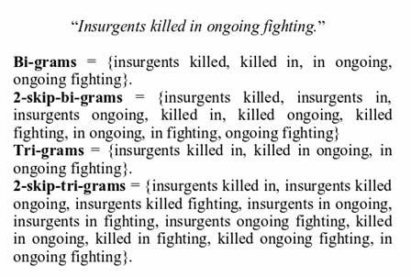
Skip-gram examples
https://i.redd.it/0s0wh7rys0l11.png

Slide 28
Exercise 4 N-gram, Skip-gram (sequence used) https://en.wikipedia.org/wiki/N-gram#Skip-gram
In the fields of computational linguistics and probability, an n-gram is a contiguous sequence of n items from a given sequence of text or speech.
N-gram : Example; "dog that barks does not bite", the n-grams are:
  unigrams (n=1): dog, that, barks, does, not, bite
  bigrams (n=2): dog that, that barks, barks does, does not, not bite
  trigrams (n=3): dog that barks, that barks does, barks does not, does not bite etc. https://www.quora.com/What-is-the-relationship-between-N-gram-and-Bag-of-words-in-natural-language-processing
skip-grams are a generalization of n-grams in which the components (typically words) need not be consecutive in the text under consideration, but may leave gaps that are skipped over
For example, in the input text: “the rain in Spain is heavy.”
MC: which one contains element(s) that is not in the set of 1-skip-3-grams?
1) the rain spain, rain in spain, Spain is heavy, The in Spain, rain Spain is, in is heavy
2) the rain in, rain in spain, in Spain is, Spain is heavy, The in Spain, rain Spain is, in is heavy
3) the rain in, rain in spain, in Spain heavy, Spain is heavy, The in Spain,rain Spain is, the is heavy
4) the rain in, rain in spain, in Spain is, Spain is heavy, The in Spain, rain Spain is, in is heavy

Slide 29
ANSWER 4: N-gram, Skip-gram (sequence used) https://en.wikipedia.org/wiki/N-gram#Skip-gram
In the fields of computational linguistics and probability, an n-gram is a contiguous sequence of n items from a given sequence of text or speech.
N-gram : Example; "dog that barks does not bite", the n-grams are:
  unigrams (n=1): dog, that, barks, does, not, bite
  bigrams (n=2): dog that, that barks, barks does, does not, not bite
  trigrams (n=3): dog that barks, that barks does, barks does not, does not bite etc. https://www.quora.com/What-is-the-relationship-between-N-gram-and-Bag-of-words-in-natural-language-processing
skip-grams are a generalization of n-grams in which the components (typically words) need not be consecutive in the text under consideration, but may leave gaps that are skipped over
  For example, in the input text:
    the rain in Spain is heavy.
MC: which one contains element(s) that is not in the set of 1-skip-3-grams?
1) the rain spain, rain in spain, Spain is heavy, The in Spain, rain Spain is, in is heavy
2) the rain in, rain in spain, in Spain is, Spain is heavy, The in Spain, rain Spain is, in is heavy
3) the rain in, rain in spain, in Spain heavy, Spain is heavy, The in Spain,rain Spain is, the is heavy
4) the rain in, rain in spain, in Spain is, Spain is heavy, The in Spain, rain Spain is, in is heavy
In (3) the is heavy should not be in the set of 1-skip-3-grams?, therefore choice (3) is correct

Slide 30
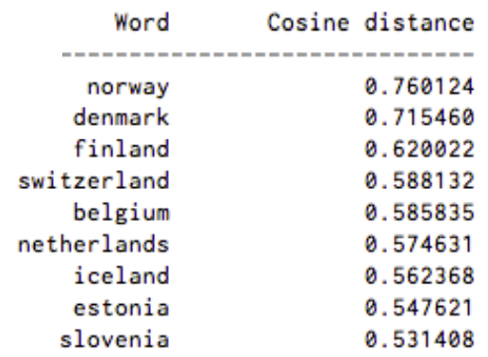
Exercise 5: word2vec for word embedding
(Similar meaning words have similar code)
Represent a word by a vector of numbers
It allows words with similar meaning to be used by machine learning algorithms.
Similar input words will have similar codes as the output
In a search engine: Probability of (Sweden + Norway) using cosine distance between 2 vectors
If Sweden ice-Leland is used, what is the score? ? Answer: _0.562368___
If Sweden Estonia is used, what is the score?
MC question
(1)0.547621 ; (2) 0.562368;
(3)0.531408; (4) 0.585835
For example: Here’s a list of words associated with “Sweden” using Word2vec, in order of proximity:
Probability of the relation with “Sweden”:
https://www.guru99.com/word-embedding-word2vec.html
https://skymind.ai/wiki/word2vec

Slide 31
ANSWER: Exercise 5 word2vec for word embedding
Represent a word by a vector of numbers
It allows words with similar meaning to be used by machine learning algorithms.
Similar input words will have similar codes as the output
In a search engine: Probability of (Sweden + Norway) using cosine distance between 2 vectors
If Sweden ice-Leland is used, what is the score? Answer: _0.562368___
If Sweden Estonia is used, what is the score?
MC question
(1)0.547621 is correct; (2) 0.562368;
(3)0.531408; (4) 0.585835
For example: Here’s a list of words associated with “Sweden” using Word2vec, in order of proximity:
Probability of the relation with “Sweden”:
https://www.guru99.com/word-embedding-word2vec.html
https://skymind.ai/wiki/word2vec

Slide 32
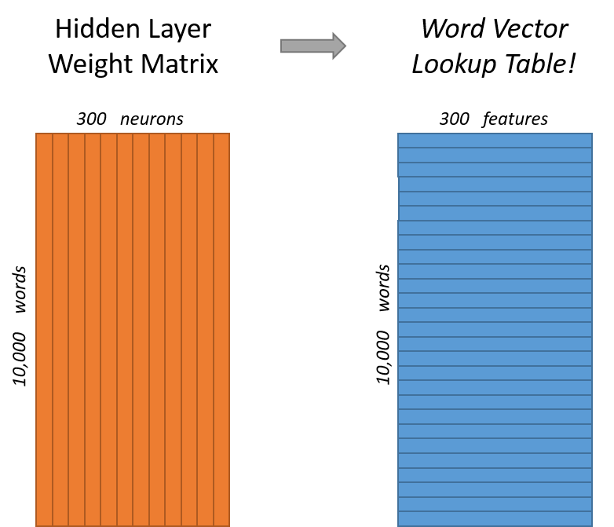
How to get Word2vec ?: The task is to represent the words: Word Embedding
The task is to represent an input word using a code. E.g., for a corpus (dictionary) of 10,000 vocabulary, you have to train the network by backpropagation .
Input: 1 word , e.g., fish, the raw representation is a one-hot approach. I.e., one bit on, other bits off in a vector of 10,000 bits for a word e.g., ‘fish’.
Internal representation: 300 neurons
Word2vec Output: 300 floating point numbers
Algorithms: e.g., Word2vec, this will train the weights of the neural network to perform word embedding
300 neurons
300 features
Neural network
(the hidden layer)
10,000 words
10,000 words
10000x1 bit input vector
One hot: one bit on other bits off
Word2vec neural network: Weights to be trained.
Dimension=
300 neurons
During training Word vector Output has 10,000x1 outputs (same as input)
https://github.com/tensorflow/nmt#embedding

Slide 33
Use of word2vec http://mccormickml.com/2016/04/19/word2vec-tutorial-the-skip-gram-model/
After training
A word → e.g., 300 numeral values (a vector 300 of dimensions)
Similar words will have similar output vectors
A word (10000-bit one hot), e.g.
Tree, train, cycling, eat
Word vector Output: A 300-dimension vector for an input.
Word embedding
(Word2vec)
Neural network
(hidden layer)
10000-bit (one hot input)

Slide 34
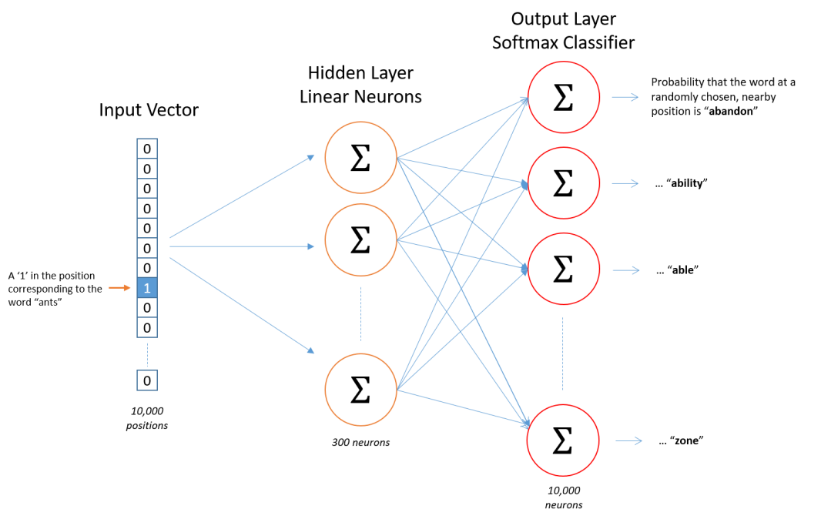
Graphic view
300 neurons
300 features for each word
Neural network
(the hidden layer)
How to train a word2vec
network
10,000 words
10,000 words
Vocabulary=10,000
Softmax
10,000-probility outputs.
Each for a word in the vocabulary
input =10,000-bit
one-hot
300 neurons
In hidden layer
34
Output layer =10,000-bit
(dimension same as input)

Slide 35
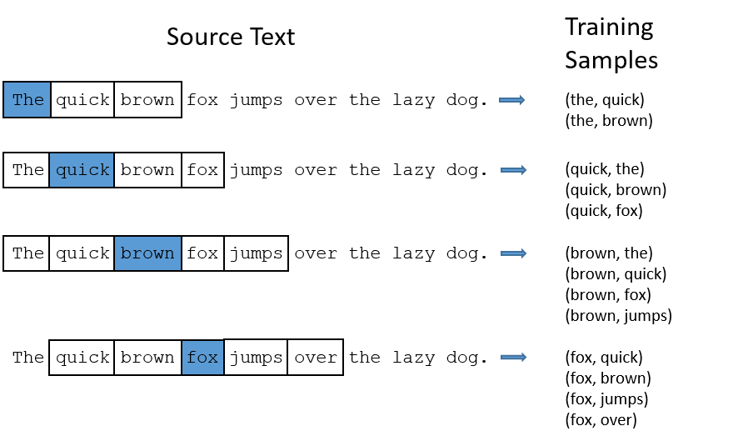
Why word embedding? It allows words with similar meaning to have similar codes, it is useful in machine learning algorithms.
How to train it:
The network has 10,000 x1 bit input. 10,000 floating point outputs. And one hidden layer of 300 neurons.
Pick 2 related words by a randomly selected neighbor scheme. I.e., for each sentence, select randomly (or using 1-skip2-grams.) an input word (‘the’) and output word (‘quick’). See training samples in diagram.
Feed the first word (‘the’ one-hot) to the input and the second word (‘quick’ one-hot) to the output. Repeat for many pairs.
After training by backpropagation, when you feed a one-hot input to the network, the word2vec output is the 300 vector ( floating point numbers) of the hidden layer.
word2vec
Softmax
Vocabulary=10,000
10,000-probility outputs.
Each for a word in the vocabulary
Hidden layer
300 neurons
Word2vec output
input =10,000-bit
one-hot
Output layer
=10,000-bit

Slide 36
How to choose input/output during word2vec training
Assume the library has 10,000 words. Each word is represented by a 10,000-bit one hot vector.
During training by backpropagation, use a pair of words (e.g., from 1-skip-2-grams): 10,000-bit for input, and 10,000-floating point numbers.
After training, use the hidden layer (a 300 floating point vector) only. The output layer is not used after training ), each input will give a 300 floating point vector. It can be in seq-2-seq applications such as machine translation.
Softmax
Vocabulary=10,000
10,000-probility outputs.
Each for a word in the vocabulary
input =10,000-bit
one-hot
Hidden layer
300 neurons
Word2vec output
Output layer =10,000-bit
(not used after training)

Slide 37
Exercise 6 :Sketch the diagram if there are 5000 words, 160 hidden neurons. Show Input/output/hidden layers.
During training by backpropagation, use a pair of words : X-bit (one-hot) for input, Y neurons for hidden layer and Z outputs.
After training, use the hidden layer only, each input will give a Y floating point vector for the seq-2-seq application.
Vocabulary=5,000 words
Softmax
MC question which is correct?
(1) X=5000,Y=5000; Z=160
(2) X=5000,Y=160; Z=5000
(3) X=160;Y=5000; Z=160
(4) X=160,Y=5000; Z=5000
Z-probability outputs.
Each for a word in the vocabulary.
=========
Z-Target bits ,1-bit for each output
input =X-bit
one-hot
Y neurons
output =
Z-floating point numbers

Slide 38
Answer6 :Sketch the diagram if there are 5000 words, 160 hidden neurons. Show Input/output/hidden layers.
During training by backpropagation, use a pair of words : X-bit for input, and Z outputs.
After training, use the hidden layer only, each input will give a Y floating point vector for the seq-2-seq application.
Vocabulary=5,000 words
Softmax
MC question which is correct?
(1) X=5000,Y=5000; Z=160
(2) X=5000,Y=160; Z=5000 (correct)
(3) X=160;Y=5000; Z=160
(4) X=160,Y=5000; Z=5000
Z-probability outputs.
Each for a word in the vocabulary.
=========
Z-Target bits ,1-bit for each output
input =5000-bit
one-hot
160
neurons
output =5000
floating point numbers

Slide 39
There are two possible schemes to select words for training : CBOW (Continuous Bag of words) or Skip-gram
Xi-2
CBOW: Use x_{i-2}, x_{i-1,} x_{i+1,} x_{i+2} to guess x_{i}
Skip gram : Use x_{i} to guess x_{i-2,} x_{i-1,} x_{i+1,} x_{i+2}
Which model to choose?
CBOW is faster and has better representations for more frequent words.
Skip Gram works well with small amount of data and is found to represent rare words well. (more popular)
Xi-1
Sum
x_{i}
Xi+1
Xi+2
1)Continuous Bag of Word Model, window size=2
Select
switch
Xi-2
Xi-1
xi
Xi+1
Xi+2
2) Skip-Gram Model
window size=2
https://www.guru99.com/word-embedding-word2vec.html

Slide 40
How to choose words to be placed at input and output during training: CBOW (continuous Bag of words), or Skip-gram model
Each link represents many weights
Xi-2
Xi-1
Sum
Xi
Xi+1
Continuous Bag of Word Architecture
window size=2
Xi+2
i=index of the position of the word (x) in the sentence
If CBOW is used for selecting words for training : From x_{i-2}, x_{i-1,} x_{i+1,} x_{i+2} to guess x_{i}.
During backpropagation training of the network:
Add the vectors {X_{i-2} + X_{i-1} + X_{i+1} + X_{i+2} } as input and Xi as output , i.e.
Add the vectors {X_{i-2} + X_{i-1} + X_{i+1} + X_{i+2} } → input, X_{i}→ output (run backpropagation training)
Training :(use Sum {X_{i-2} + X_{i-1} + X_{i+1} + X_{i+2} } ) → target word, only once, (so it is fast)

Slide 41
How to choose words to be placed at input and output during training: use Skip-gram model
Select
switch
Xi-2
Xi-1
xi
Xi+1
Xi+2
Skip-Gram Model, window size=2
Apply Skip-gram model: Uses x_{i,} to predict x_{i-2}, x_{i-1,} x_{i+1,} x_{i+2} during backpropagation training of the network, run the following steps:
X_{i-2} → input, X_{i}→ output (run backpropagation training)
X_{i-1} → input, X_{i}→ output (run backpropagation training)
X_{i+1} → input, X_{i}→ output (run backpropagation training)
X_{i+2} → input, X_{i}→ output (run backpropagation training)
Training one pair by one pair (so it is slow, accurate, popular)

Slide 42
Skip-gram (window size=2) example:
The quick brown fox jumps over the lazy dog.
During training
Target sentence |  |  |  |  |  |  |  |  |  | input | output
The | quick | brown | fox | jumps | over | the | Lazy | dog |  | the | quick
 |  |  |  |  |  |  |  | → |  | the | brown
The | quick | brown | fox | jumps | over | the | Lazy | dog |  | quick | the
 |  |  |  |  |  |  |  | → |  | quick | Brown
 |  |  |  |  |  |  |  |  |  | quick | fox
The | quick | brown | fox | jumps | over | the | Lazy | dog |  | brown | the
 |  |  |  |  |  |  |  |  |  | brown | quick
 |  |  |  |  |  |  |  | → |  | brown | fox
 |  |  |  |  |  |  |  |  |  | brown | jumps
The | quick | brown | fox | jumps | over | the | Lazy | dog |  | fox | quick
 |  |  |  |  |  |  |  |  |  | fox | brown
 |  |  |  |  |  |  |  | → |  | fox | jumps
 |  |  |  |  |  |  |  |  |  | fox | over

Slide 43

Exercise 7: (Skip gram)
2 possible architectural choices for word2vec : CBOW (Continuous Bag of Word) vs Skip gram to be used in training by backpropagation https://www.guru99.com/word-embedding-word2vec.html
Select
switch
Xi-2
Skip-gram : window size=2, Use x_{i} to predict x_{i-2}, x_{i-1,} x_{i+1,} x_{i+2}
MC question:
For this diagram, what is the window size M?
Choices M=__?: 1,2,3,4
Xi-1
xi
Xi+1
Xi+2
Skip-gram window size=2
Xi-3
Select
switch
Xi-2
Xi-1
xi
Xi+1
Xi+2
Skip-gram window size=M
Xi+3
43

Slide 44
Answer 7: (Skip gram)
2 possible architectural choices for word2vec : CBOW (Continuous Bag of Word) vs Skip gram to be used in training by backpropagation https://www.guru99.com/word-embedding-word2vec.html
Select
switch
Xi-2
Skip-gram : window size=2, Use x_{i} to predict x_{i-2}, x_{i-1,} x_{i+1,} x_{i+2}
Answer: windows size =3
Xi-1
xi
Xi+1
Skip-gram window size=2
Xi+2
Xi-3
Select
switch
Xi-2
Xi-1
xi
Xi+1
Xi+2
Skip-gram window size=3
Xi+3
44

Slide 45
Training of word2vec by backpropagation https://towardsdatascience.com/word2vec-made-easy-139a31a4b8ae https://nearist.ai/word2vec-tutorial%E2%80%8A-%E2%80%8Athe-skip-gram-model
Mikolov, Tomas, et al. "Distributed representations of words and phrases and their compositionality." Advances in neural information processing systems. 2013.
When training this network on word pairs (input and target word) (selected by skip-gram or CBOW-- Continuous Bag of Word), the input is a one-hot vector representing the input word
During training, the target word (also a one-hot presentation) is placed at the output.
After word2vec training completes, when an unknown word is presented to the word2vec input, you only use the output of the hidden layer (300x1 floating point vector) for sub-sequent processing, e.g., machine translation.

Slide 46
Training word2vec steps using skip-gram https://towardsdatascience.com/an-implementation-guide-to-word2vec-using-numpy-and-google-sheets-13445eebd281
Data Preparation — Define corpus, clean, normalize and tokenize words
Hyper-parameters — Learning rate, epochs, window size, embedding size
Generate Training Data — Build vocabulary, one-hot encoding for words, build dictionaries that map id to word and vice versa
Model Training — Pass encoded words through forward pass, calculate error rate, adjust weights using backpropagation and compute loss
Inference — Get word vector and find similar words

Slide 47
1) Data Preparation — Define corpus, clean, normalize and tokenize words
.. text data are unstructured and can be “dirty”. Cleaning them will involve steps such as removing stop words, punctuations, convert text to lowercase (actually depends on your use-case), replacing digits, etc
normalize , Word Tokenization:
https://web.stanford.edu/~jurafsky/slp3/slides/2_TextProc.pdf
https://towardsdatascience.com/word-subword-and-character-based-tokenization-know-the-difference-ea0976b64e17

Slide 48
2) Hyper-parameters
Parameters and values used in this example
Window size=2, how many neighboring words
n=10, dimension of the output vector
Epochs=50, training cycles
Learning rate =0.01, control update rate in backpropagation
Vocabulary =9 (a small toy example)

Slide 49
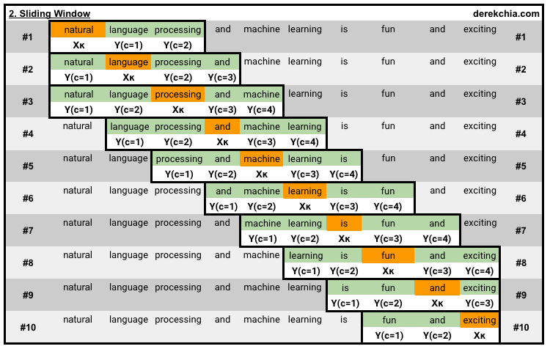
Example of window size =2 of a sentence https://towardsdatascience.com/an-implementation-guide-to-word2vec-using-numpy-and-google-sheets-13445eebd281
Using 1-skip-3-grams : see https://www.reddit.com/r/learnmachinelearning/comments/9e4ihs/kskipngram/
using skip-gram
10 windows, window#1 --> window#10

Slide 50
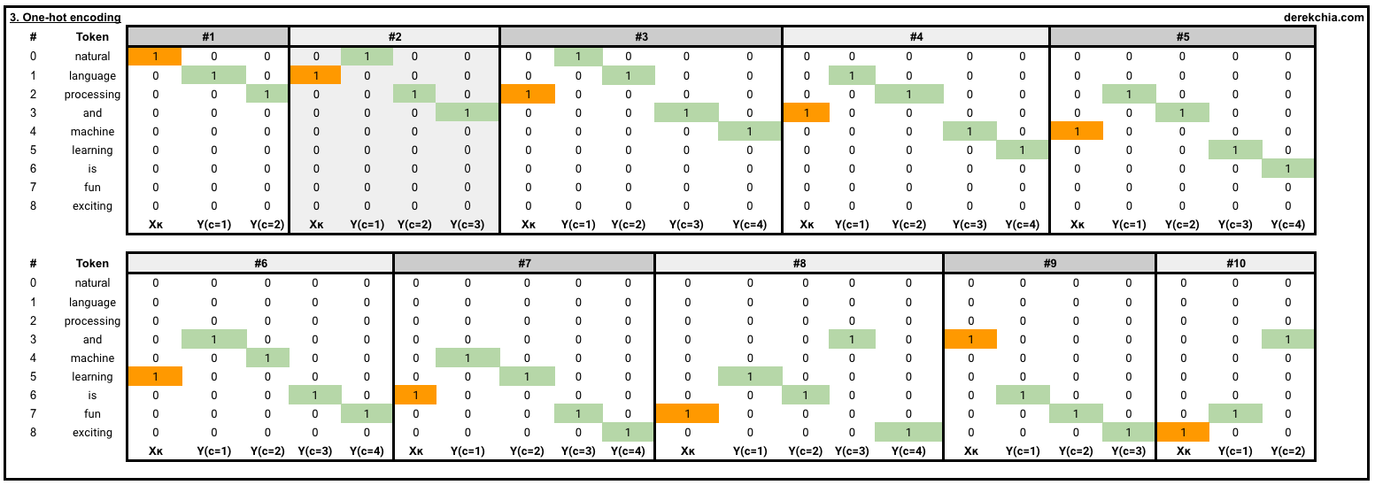
Another view : One-hot encoding for each target word and its context words
10 windows: Each window consists of both the target word and its context words, highlighted in orange and green respectively. (example: window size=2)
# 1 [Target (natural)], [Context (language, processing)]
[list([1, 0, 0, 0, 0, 0, 0, 0, 0])
list([[0, 1, 0, 0, 0, 0, 0, 0, 0], [0, 0, 1, 0, 0, 0, 0, 0, 0]])]
using skip-gram

Slide 51
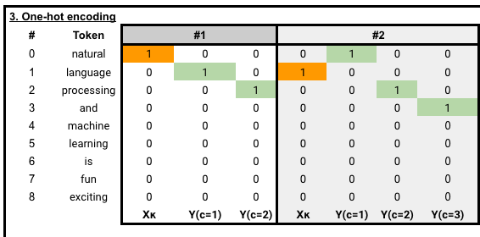
3) Generate Training Data
One–hot representation and selection of training data
Each training cycle needs a pairs of input word and prediction(target) word, e.g. {natural language}, {natural, processing}, {language, processing} etc. (based on 1-skip-3-grams) https://www.reddit.com/r/learnmachinelearning/comments/9e4ihs/kskipngram/
and more

Slide 52
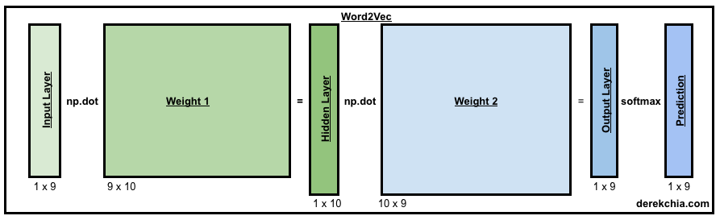
4) Model Training
Vocabulary =9 words, output vector dimension=10
Each training cycle needs a pairs of inputs :input word and prediction word, e.g. {natural language}, {natural, processing}, {language, processing} etc.
Learn the weight matrices : W1(9x10) and W2(10x9)
Training algorithm to generate the 2 weigh matrices: iterate forward / backward propagations until “loss” is small enough

Slide 53
Example (10,000 words, 300 floating point output, redraw the diagram, describe training procedure and what is the final outputs
4) Model Training
Vocabulary =9 words, output vector dimension=10
Each training cycle needs a pairs of inputs :input word and prediction(target) word, e.g. {natural language}, {natural, processing}, {language, processing} etc.
Learn the weight matrices : W1(9x10) for the hidden layer, and W2(10x9) for the output layer
Training algorithm to generate the 2 weigh matrices: iterate forward / backward propagations until “loss” is small enough
W1
W2

Slide 54
5) Inference
After training for 50 epochs, both weights (w1 and w2) are found.
We can inference words from the input.
we look up the vector for the word “machine”. The result is :
  > print(w2v.word_vec("machine"))
  [ 0.76702922 -0.95673743 0.49207258 0.16240808 -0.4538815 -0.74678226 0.42072706 -0.04147312 0.08947326 -0.24245257]
  We can find similar words of “machine”:
    w2v.vec_sim("machine", 3) # select the top 3
    machine 1.0
    fun 0.6223490454018772
    and 0.5190154215400249

Slide 55
Summary
Word2Vec is useful and popular
Advantage: two related words in meaning will give similar code (e.g. 300 neuron outputs, or dimensions)
It is a good representation of word by number (vectors)
It is useful for machine translation and CHATBOT

Slide 56
Part 2: Sequence to sequence processing and machine translation
Seq2seq: Theory and implementation

Slide 57
Introduction to seq2seq
Neural Machine translation
  Learn by training. E.g. English-French translator development . Need a lot of English – French sentence pairs as training data (1 million pairs)
Training steps
  Embedding—represent the words
  Encoding --- encode the input English sentence input into an intermediate representation
  Decoding ---decode the representation into French
  Loss calculation
  Gradient computation
  Loop back to minimize Loss

Slide 58
Application of Seq2seq https://towardsdatascience.com/attn-illustrated-attention-5ec4ad276ee3
We can translate one sequence to another (e.g. machine translate)
Use RNN (Recurrent neural Network) to encoder input sequence to a vector and decode output using another RNN
Revise the notes on RNN and LSTM first.
Problem: But if the input sequence is long, error occurs
Input sequence → hidden vector → output sequence

Slide 59
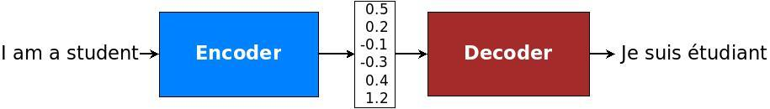
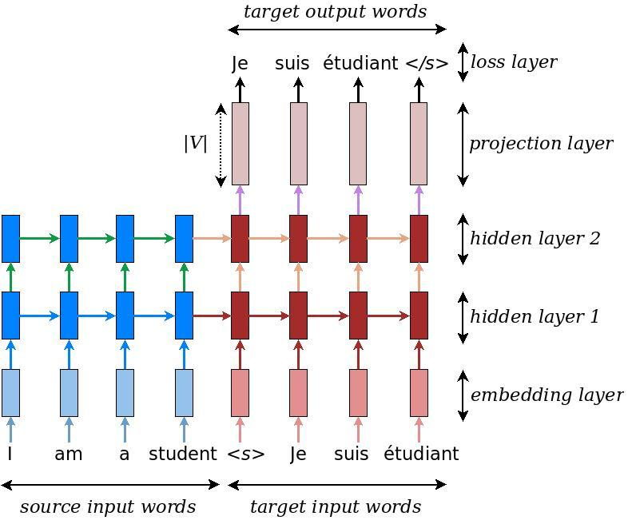
Basic idea of seq2seq approach
(English to French example)
RNN or LSTM
RNN or LSTM
source embedding code. Ie, pretrained word2vec English
Target embedding code. I.e, pretrained word2vec French or Chinese
O_{t}=Encoder vector
https://github.com/tensorflow/nmt#inference--how-to-generate-translations
Pretrained word2vec tables(English, Chinese etc.) https://radimrehurek.com/gensim/intro.html or
https://github.com/Embedding/Chinese-Word-Vectors or
https://wikipedia2vec.github.io/wikipedia2vec/pretrained/

Slide 60
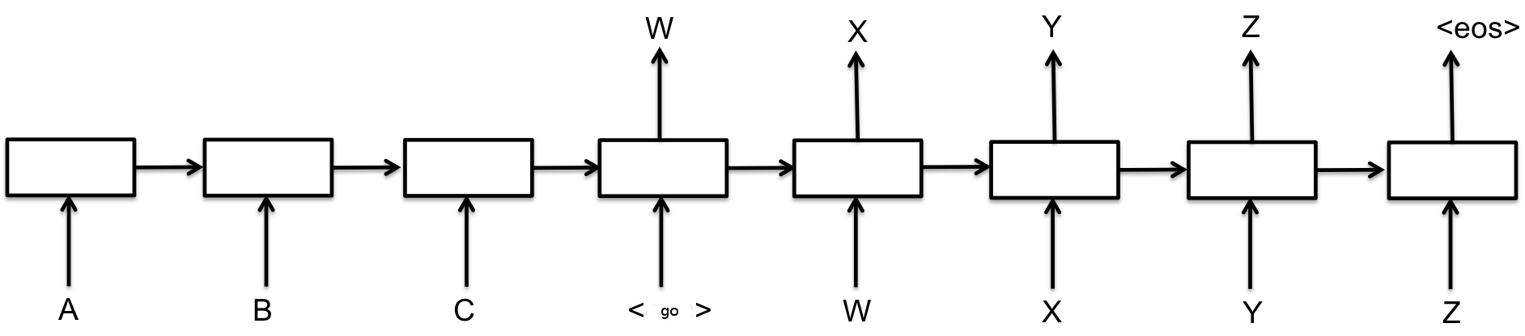
Sequence to sequence basics
Used for machine translation
E.g. translate sequence A,B,C → W,X,Y,Z
E.g. I am fine → 我很好
That means, if the input is A,B,C <go>, it will generate the output W,X,Y,Z
<GO>
“Each box in the picture above represents a cell of the RNN, most commonly a GRU cell or an LSTM cell (see the RNN Tutorial for an explanation of those). Encoder and decoder can share weights or, as is more common, use a different set of parameters. Multi-layer cells have been successfully used in sequence-to-sequence models too, e.g. for translation Sutskever et al., 2014 (pdf).” https://www.tensorflow.org/tutorials/seq2seq

Slide 61
Basic model for translating A,B,C to W,X,Y,Z,
O_{t} encoder vector
Many to one RNN/LSTM
o_{t}
h_{t+2}
h_{t+3}
h_{t+1}
<GO>
One to many RNN/LSTM
Overall is : many to many RNN/LSTM
Encoder (input sequence):
  Input A,
  Input B, ……..
  we have a output vector (fixed size n_{y}) : O_{t} encoder vector (context vector)
  which represents the sequence A,B,C
Decoder Training:
  Input O_{t}, and W (W= start of sentence), target X
  Input h_{t+1}, and X, target Y
  Input h_{t+2}, and Y, target Z
  Input h_{t+3}, and Z, target EOS (end of sentence)
Zero padding for unequal source target sequence sizes if sentence lengths are too short or not equal)
Good animation demo : https://zhanghanduo.github.io/post/attention/

Slide 62
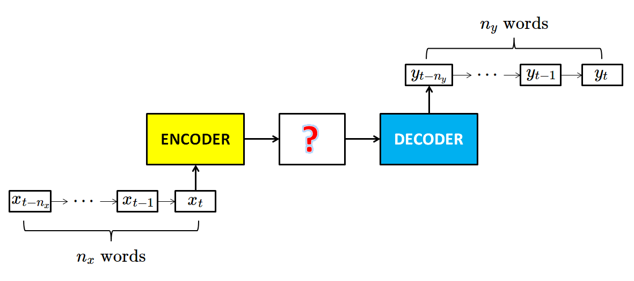
General Encoder-Decoder model
2 LSTMs, one for Encoder (many to one RNN/LSTM), one for Decoder(one to many RNN/LSTM)
O_{t} encoder vector
O_{t}
Encode
From: https://chunml.github.io/ChunML.github.io/project/Sequence-To-Sequence/

Slide 63
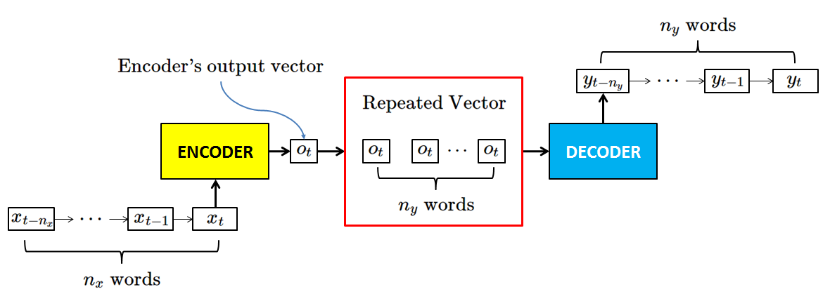
Encoder-Decoder model
Example: [Guo18]
English dictionary has 80,000 words
Each word is represented by word2vec
n_{y}=15
x_{t}=256 numbers
n_{x}=15
Pad zeros to make ever sentence the same=15.
During training, many pairs of sentences are given, use the unrolled LSTM (RNN) model to train the encoder/encoder by backpropagation as usual.
[Guo18]:Guo Changyou, English to Chinese translation model, CMSC5720 CUHK MSc project report, 4.2018

Slide 64
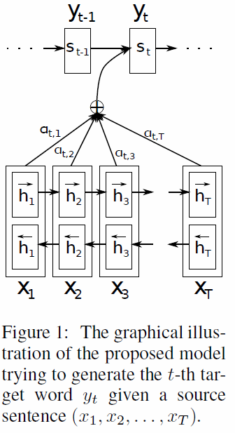
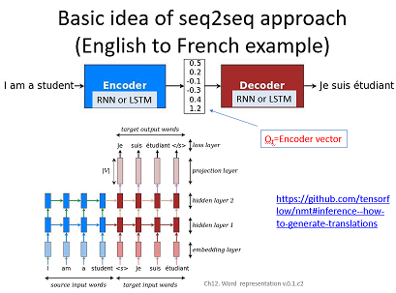
Advanced idea : The attention idea
Make relevant words more important than others
In machine translation, without attention, the source language (English here) is translated to an encoder (or context) vector code (Ot) and then generate the destination language (French here ) based on that Ot code. Each step generates h(t), and affect h(t+1) and so on till it reaches the encoder vector code (Ot)
With attention, the source codes is translated to encoder vector code (Ot), but Ot is generated from a combination for all time steps output h(t). Each step generates h(t) and the encoder (or context) code (now called y_{t}) is a combination of α_{t}*al h(t) from time=1,2,..,t till it reaches the encoder vector. α_{t} is the normalization weight factor.
No attention used
Ref: NEURAL MACHINE TRANSLATION BY JOINTLY LEARNING TO ALIGN AND TRANSLATE by Dzmitry Bahdanau
https://arxiv.org/pdf/1409.0473.pdf
https://lilianweng.github.io/lil-log/2018/06/24/attention-attention.html
https://medium.com/swlh/a-simple-overview-of-rnn-lstm-and-attention-mechanism-9e844763d07b
attention used

Slide 65
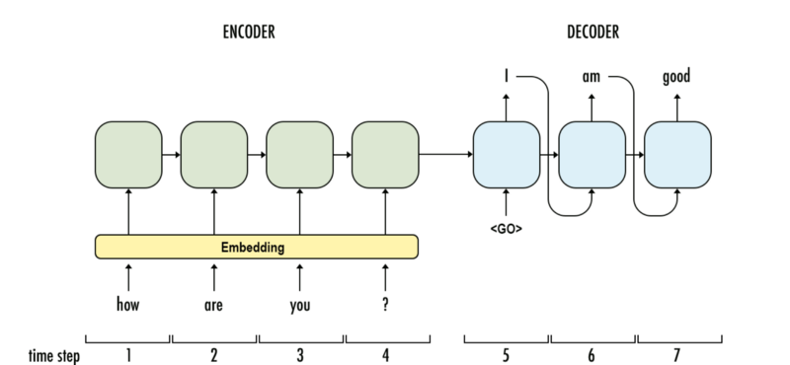
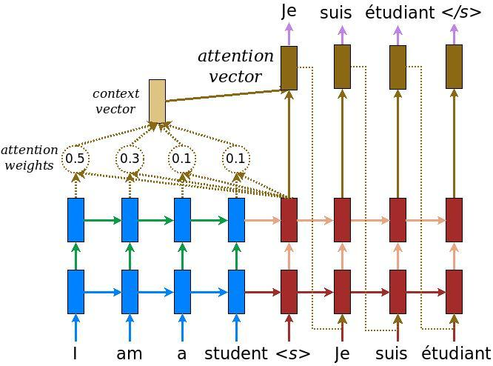
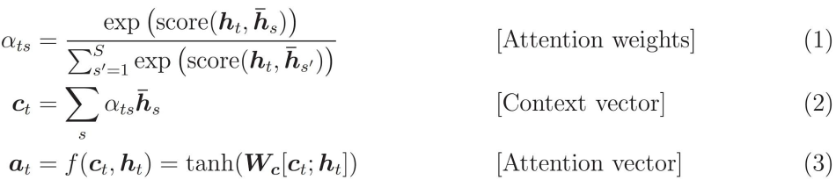
Attention example
https://medium.com/syncedreview/a-brief-overview-of-attention-mechanism-13c578ba9129

Slide 66
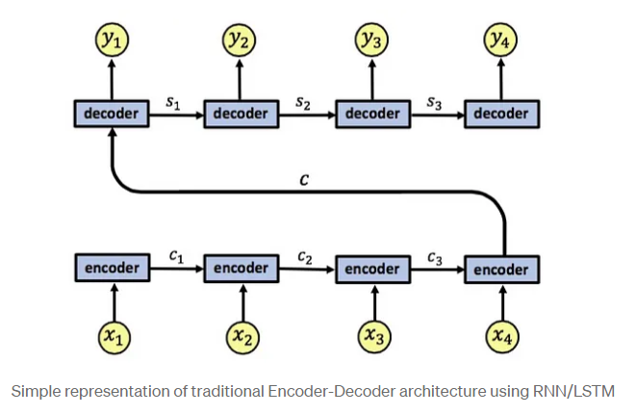
A tutorial on attention
Without Attention
https://medium.com/swlh/a-simple-overview-of-rnn-lstm-and-attention-mechanism-9e844763d07b

Slide 67
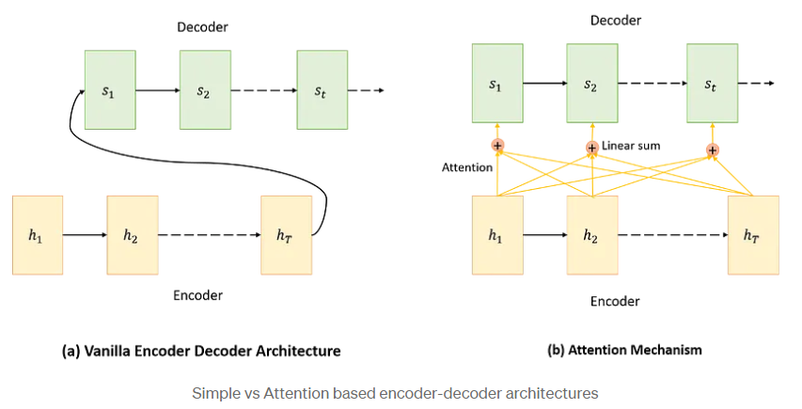
Without and with attention

Slide 68
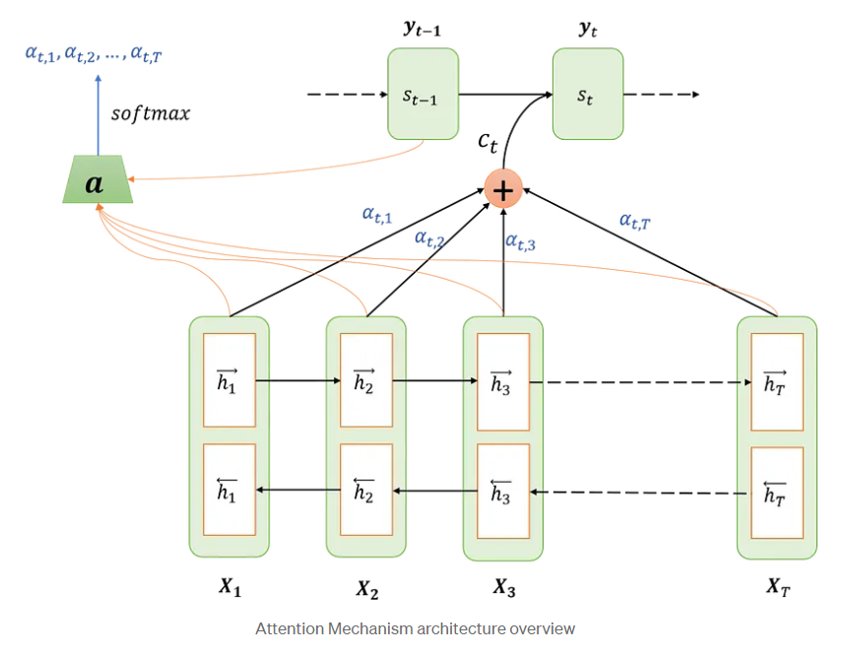
To update the state

Slide 69
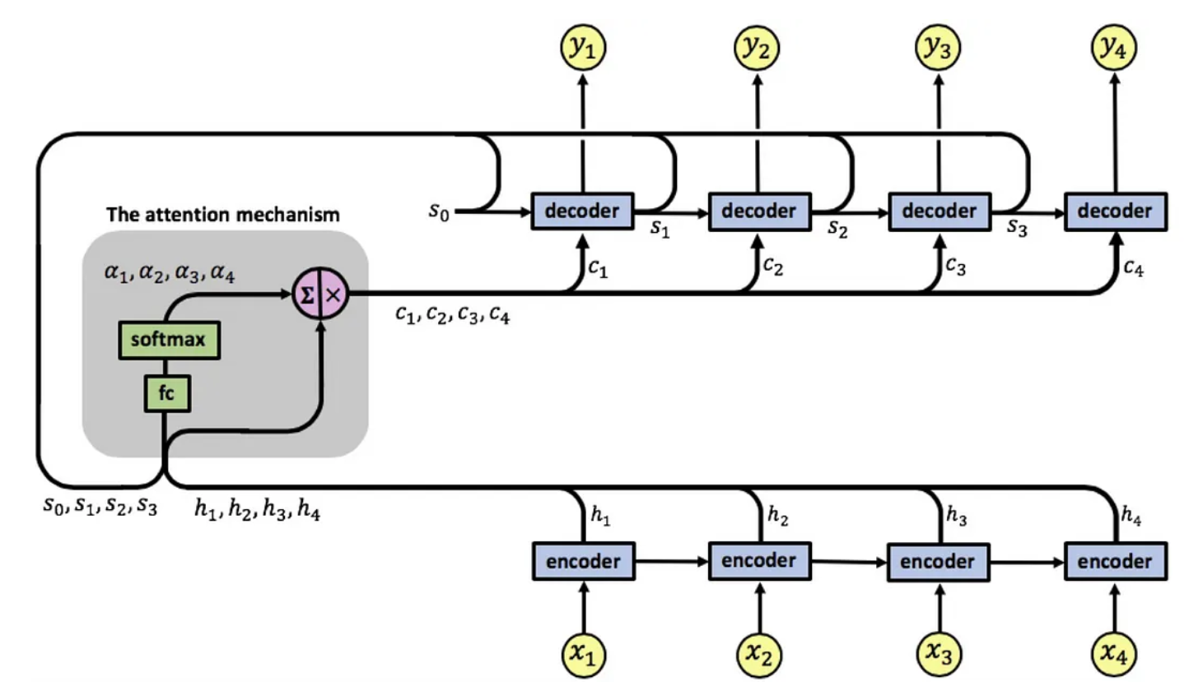
Overall mechanism
e
FC=Fully connected neural net

Slide 70
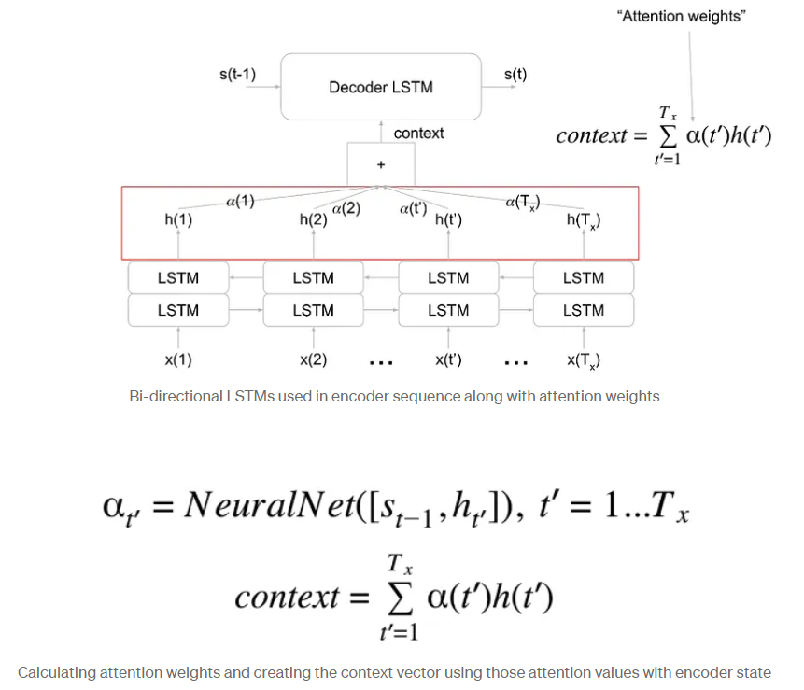
Train attention using neural net

Slide 71
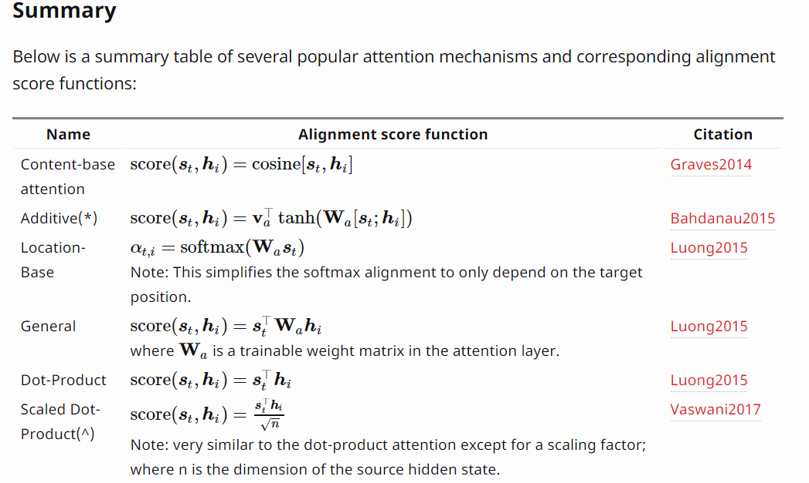
Various attention mechanisms
https://lilianweng.github.io/lil-log/2018/06/24/attention-attention.html

Slide 72
Machine Translation (MT) evaluation BLEU
BLEU (bilingual evaluation understudy) is an algorithm for evaluating the quality of text which has been machine-translated from one natural language to another.
BLEU ranges from 0(lowest) to 1(highest)
Some literature use 0-1, or 0-100. (simply scale up). Reference:
  Paper :- BLEU: a Method for Automatic Evaluation of Machine Translation by Kishore Papineni, etal. https://www.aclweb.org/anthology/P02-1040.pdf
  Wiki:- https://en.wikipedia.org/wiki/BLEU

Slide 73
BLEU test example
On a test corpus of about 500 sentences (40 general news stories), a human translator scored 0.3468
A good machine translator can achieve 0.3 or above.
The work “Sequence to Sequence Learning with Neural Networks” by Ilya Sutskever etal, at Google achieves BLEU=34.8 (meaning 0.348)
https://papers.nips.cc/paper/5346-sequence-to-sequence-learning-with-neural-networks.pdf

Slide 74
Conclusion
Studied word representation and word2vec
Introduced the basic concepts of RNN for sequence prediction
Show how to use RNN (LSTM) for machine translation.
Discussed machine translation evaluation index BLEU (bilingual language understudy)

Slide 75
Appendix 1 : Negative sampling https://analyticsindiamag.com/how-to-use-negative-sampling-with-word2vec-model/
Negative sampling addresses this by modifying only a small percentage of the weights, rather than all of them, in each training sample. This is how it goes. Note that the network’s “label” or “correct output” is a one-hot vector when training it on the word pair (“fox”, “quick”). That is, the output neuron associated with “quick” should output a 1, whereas the rest of the hundreds of output neurons should produce a 0.
Instead, with negative sampling, we’ll pick a small number of “negative” words (let’s say 5) at random to update the weights. (A “negative” term is one for which we want the network to output a 0 in this context.) We’ll also continue to update the weights for our “positive” term (in this case, the word “quick”). As a result, just the weights relating to them will be updated, and the loss will only be propagated back for them.
Pre-trained word and phrase vectors (Word2vec)
  Google is publishing pre-trained vectors trained on part of Google News dataset (about 100 billion words). The model contains 300-dimensional vectors for 3 million words and phrases. The archive is available here: GoogleNews-vectors-negative300.bin.gz. https://code.google.com/archive/p/word2vec/

Slide 76
How to Select Negative Samples
The negative samples (the 5 output words that will be trained to output 0) are chosen using a unigram distribution, with more frequent words being more likely to be chosen as negative samples.
Assume you have your whole training corpus as a list of words and choose your 5 negative samples at random from that list. In this scenario, the probability of selecting “monitor” is equal to the number of times “monitor” appears in the corpus divided by the total number of words that occur in the corpus. According to the authors’ study, they attempted a number of variations on this equation, and the one that worked best was to increase the word counts to 3/4 power.

Slide 77
https://mccormickml.com/2017/01/11/word2vec-tutorial-part-2-negative-sampling/
When training the network on the word pair (“fox”, “quick”), recall that the “label” or “correct output” of the network is a one-hot vector. That is, for the output neuron corresponding to “quick” to output a 1, and for all of the other thousands of output neurons to output a 0.
With negative sampling, we are instead going to randomly select just a small number of “negative” words (let’s say 5) to update the weights for. (In this context, a “negative” word is one for which we want the network to output a 0 for). We will also still update the weights for our “positive” word (which is the word “quick” in our current example).

Slide 78
Appendix 2
The transformer model , see
https://www.cse.cuhk.edu.hk/%7Ekhwong/www2/cmsc5707/transformer_model.pptx

Slide 79
References for transformer
[PDF] Attention is all you need , A Vaswani, N Shazeer, N Parmar… - Advances in neural …, 2017 - papers.nips.cc
https://jalammar.github.io/illustrated-transformer/
https://towardsdatascience.com/transformers-explained-visually-part-1-overview-of-functionality-95a6dd460452
https://towardsdatascience.com/transformers-explained-visually-part-2-how-it-works-step-by-step-b49fa4a64f34
https://towardsdatascience.com/transformers-explained-visually-part-3-multi-head-attention-deep-dive-1c1ff1024853
Pre-trained bert can be downloaded from
https://huggingface.co/

Slide 80
References
Deep Learning Book.
http://www.deeplearningbook.org/
Papers:
Fully convolutional networks for semantic segmentation by J Long, E Shelhamer, T Darrell
Sequence to sequence learning with neural networks by I Sutskever, O Vinyals, QV Le -
tutorials
http://colah.github.io/posts/2015-08-Understanding-LSTMs/
https://github.com/terryum/awesome-deep-learning-papers
turtorial:
https://theneuralperspective.com/tag/tutorials/
RNN encoder-decoder
https://theneuralperspective.com/2016/11/20/recurrent-neural-networks-rnn-part-3-encoder-decoder/
sequence to sequence model
  https://arxiv.org/pdf/1703.01619.pdf
  https://indico.io/blog/sequence-modeling-neuralnets-part1/
  https://medium.com/towards-data-science/lstm-by-example-using-tensorflow-feb0c1968537
  https://google.github.io/seq2seq/nmt/
  https://chunml.github.io/ChunML.github.io/project/Sequence-To-Sequence/
  parameters of lstm
    https://stackoverflow.com/questions/38080035/how-to-calculate-the-number-of-parameters-of-an-lstm-network
    https://datascience.stackexchange.com/questions/10615/number-of-parameters-in-an-lstm-model
    https://stackoverflow.com/questions/38080035/how-to-calculate-the-number-of-parameters-of-an-lstm-network
    https://www.quora.com/What-is-the-meaning-of-%E2%80%9CThe-number-of-units-in-the-LSTM-cell
    https://www.quora.com/In-LSTM-how-do-you-figure-out-what-size-the-weights-are-supposed-to-be
    http://kbullaughey.github.io/lstm-play/lstm/ (batch size example)
  feedback
    https://medium.com/@aidangomez/let-s-do-this-f9b699de31d9
  Numerical examples
    https://blog.aidangomez.ca/2016/04/17/Backpropogating-an-LSTM-A-Numerical-Example/
    https://karanalytics.wordpress.com/2017/06/06/sequence-modelling-using-deep-learning/
    http://monik.in/a-noobs-guide-to-implementing-rnn-lstm-using-tensorflow/

Slide 81
References
https://github.com/tensorflow/nmt#inference--how-to-generate-translations
https://pytorch.org/tutorials/intermediate/seq2seq_translation_tutorial.html
http://mccormickml.com/2016/04/19/word2vec-tutorial-the-skip-gram-model/

Slide 82
Appendix 3
Advanced topics on text analysis
IMDB Review Dataset
for sentiment classification
Text generation
Reuters newswire topic classification task
Attention
https://medium.com/ai-society/jkljlj-7d6e699895c4
GloVe: Global Vectors for Word Representation by Jeffrey Pennington, etal., https://towardsdatascience.com/glove-research-paper-clearly-explained-7d2c3641b8a6
  https://nlp.stanford.edu/projects/glove/ (Download pre-trained word vectors, e.g. glove.6B.50d.txt)
  https://towardsdatascience.com/light-on-math-ml-intuitive-guide-to-understanding-glove-embeddings-b13b4f19c010
  https://towardsdatascience.com/understanding-feature-engineering-part-4-deep-learning-methods-for-text-data-96c44370bbfa
  https://medium.com/sciforce/word-vectors-in-natural-language-processing-global-vectors-glove-51339db89639
  http://text2vec.org/glove.html

Slide 83
Appendix 4
BLEU (bilingual language understudy)
Reference:
  Paper :- BLEU: a Method for Automatic Evaluation of Machine Translation by Kishore Papineni, etal. https://www.aclweb.org/anthology/P02-1040.pdf
  Wiki:- https://en.wikipedia.org/wiki/BLEU

Slide 84
BLEU -Background
Example 1: Precision measurement (PM) (standard unigram precsion)
Example 1. The words in candidates not found in references will be underlined
References: translated by human for reference
Candidate : translated by human or machine (PM finds out how good they are)
Candidate 1: It is a guide to action which ensures that the military always obeys the commands of the party. (words found in reference =17, total words in candidate=18) Precision measurement (PM )for Candidate 1: 17/18
Candidate 2: It is to insure the troops forever hearing the activity guidebook that party direct. (words found in reference =8, total words in candidate=14) Modified Precision measurement (PM) for Candidate 2: 8/14
-------------------------------------------------------------------------------------------------------
Reference 1: It is a guide to action that ensures that the military will forever heed Party commands.
Reference 2: It is the guiding principle which guarantees the military forces always being under the command of the Party.
Reference 3: It is the practical guide for the army always to heed the directions of the party.

Slide 85
Modified Unigram Precision calculation
https://www.aclweb.org/anthology/P02-1040.pdf
Precision measurement (standard unigram precision): The cornerstone of our metric is the familiar precision measure. To compute precision, one simply counts up the number of candidate translation words (unigrams) which occur in any reference translation and then divides by the total number of words in the candidate translation.
Test1:
Candidate: the the the the the the the.
Reference 1: The cat is on the mat.
Score=word counts in candidate appear in reference/total words in candidate=7/7. Obviously, this precision measurement is not accurate.
Modified unigram precision: To compute this, one first counts the maximum number of times a word occurs in any single reference translation.
Next, one clips the total count of each candidate word by its maximum reference count, adds these clipped counts up, and divides by the total (unclipped) number of candidate words. So in Test1: 2/7, because the first ‘the’ is clipped, and also the second the. After that the has no effect. Hence the result is 2/7.
7 words here
The maximum of “the” occur 2 times

Slide 86
Modified Unigram Precision calculation example 2
Example 2:
Candidate: the the the the the the the.
Reference 1: The cat is on the mat.
Reference 2: There is a cat on the mat.
Modified Unigram Precision = 2/7.
the modified unigram precision = Countclip/total word counts in candidate. In Example, it is 2/7, even though its standard unigram precision is 7/7 (method in previous slide). Note: the first two “the” are clipped away. So count clip is 2, total word counts in candidate is 7 .
Countclip = min(Count,Max Ref Count). In other words, one truncates each word’s count, if necessary, to not exceed the largest count observed in any single reference for that word.
As a guide to the eye, we have underlined the important words (the the in the candidate) for computing modified precision.

Slide 87
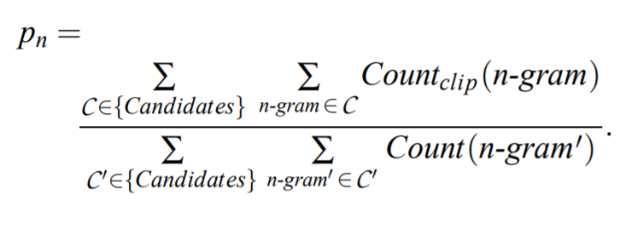
Modified n-gram precision on blocks of text
How to compute modified unigram precision:
  counts the maximum number of times a word occurs in any single reference translation
  one clips the total count of each candidate word by its maximum reference count
  adds these clipped counts (i.e., Countclip) up, and divides by the total (unclipped) number of candidate words.
we add the clipped n-gram counts for all the candidate sentences and divide by the number of candidate n-grams in the test corpus to compute a modified precision score, p_{n}, for the entire test corpus, C can be 1,2,3,4-gram.
Add all test
candidates
Add all
n=1,2,3,4 gram
https://zhu45.org/posts/2018/Mar/28/bleu-a-method-for-automatic-evaluation-of-machine-translation/

Slide 88
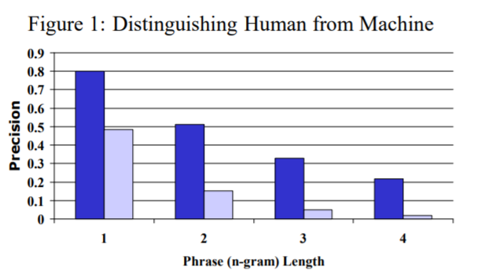
Modified n-gram precision of human and machine
plot
Human, machine of p_{n}

Slide 89
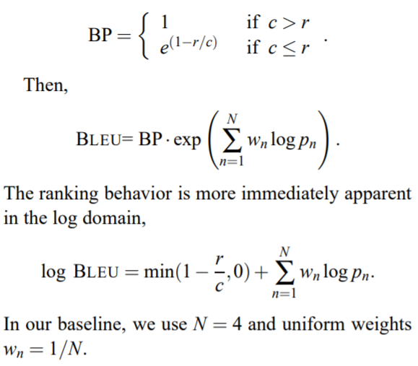
BLEU calculation
modified precision score
p_{n}
n=1,2,3,4-gram
r= corpus’ effective reference length, by summing the best match lengths for each candidate sentence in the corpus.
brevity penalty (BP)= exponential in r/c, where c is the total length of the candidate translation corpus.
If candidate sentence length >reference length, then BP=1
If the candidate sentence is shorter than reference:
  c ≤ r, BP < exp(-ve) <1 ( a penalty)
https://zhu45.org/posts/2018/Mar/28/bleu-a-method-for-automatic-evaluation-of-machine-translation/

Slide 90
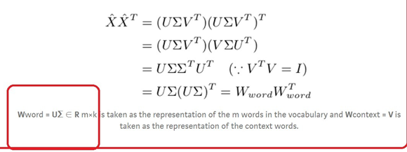
Appendix 5
Glove
GloVe: Global Vectors for Word Representation by Jeffrey Pennington, etal., https://towardsdatascience.com/glove-research-paper-clearly-explained-7d2c3641b8a6
https://towardsdatascience.com/art-of-vector-representation-of-words-5e85c59fee5
From the corpus build the co-occurrence matrix X, then find W_{word}, see below

Slide 91
Appendix 6
Idea of positional encoding(PE)
The intuition
You may wonder how this combination of sines and cosines could ever represent a position/order? It is actually quite simple, Suppose you want to represent a number in binary format, how will that be?
You can spot the rate of change between different bits. The LSB bit is alternating on every number, the second-lowest bit is rotating on every two numbers, and so on.
But using binary values would be a waste of space in the world of floats. So instead, we can use their float continous counterparts - Sinusoidal functions. Indeed, they are the equivalent to alternating bits. Moreover, By decreasing their frequencies, we can go from red bits to orange ones.

Slide 92
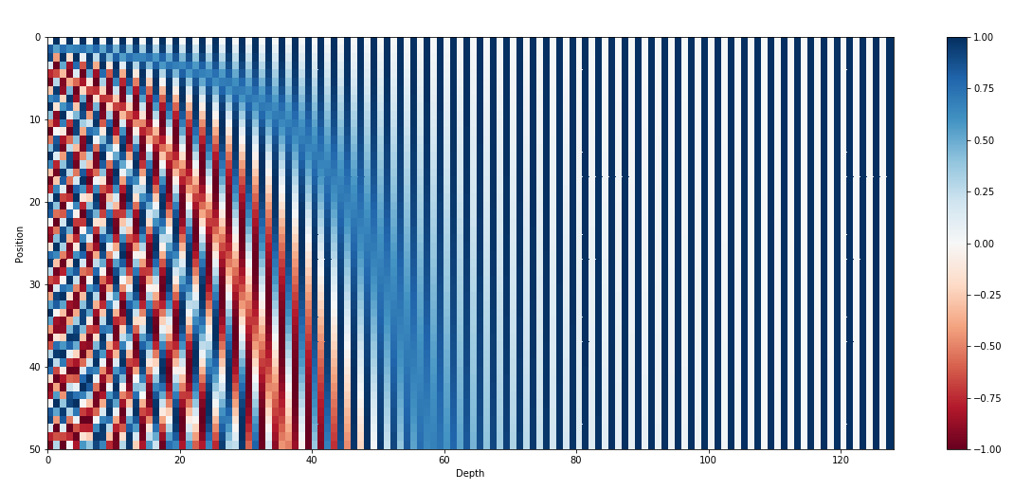
Idea of positional encoding(PE)
The intuition

Slide 93
Idea of positional encoding(PE)
The intuition
You may wonder how this combination of sines and cosines could ever represent a position/order? It is actually quite simple, Suppose you want to represent a number in binary format, how will that be?
You can spot the rate of change between different bits. The LSB bit is alternating on every number, the second-lowest bit is rotating on every two numbers, and so on.
But using binary values would be a waste of space in the world of floats. So instead, we can use their float continous counterparts - Sinusoidal functions. Indeed, they are the equivalent to alternating bits. Moreover, By decreasing their frequencies, we can go from red bits to orange ones.

Slide 94
Idea of positional encoding(PE)
The intuition

Slide 95
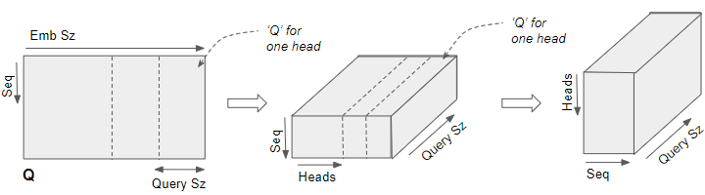
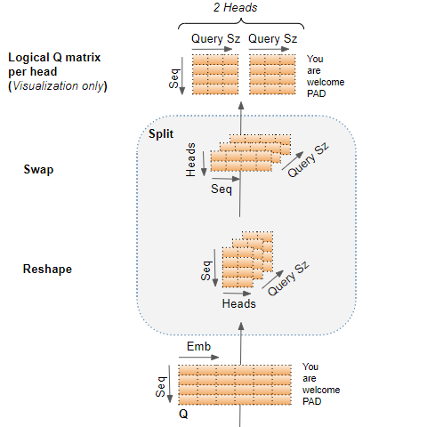
Appendix 7
Multi-head (Seq=4,Emb_Sz=6,word length(Seq)=4, heads=2, Query Sz=3)
6
c
4
4
2
3
4
3
Show how to form multi-heads
2
6
4

Slide 96
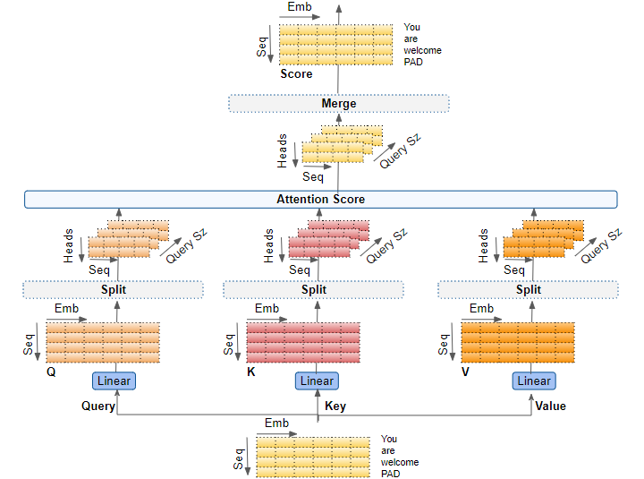
Multi-head in a diagram
Parallelized multi-head and merge to become output of encoder1

Slide 97
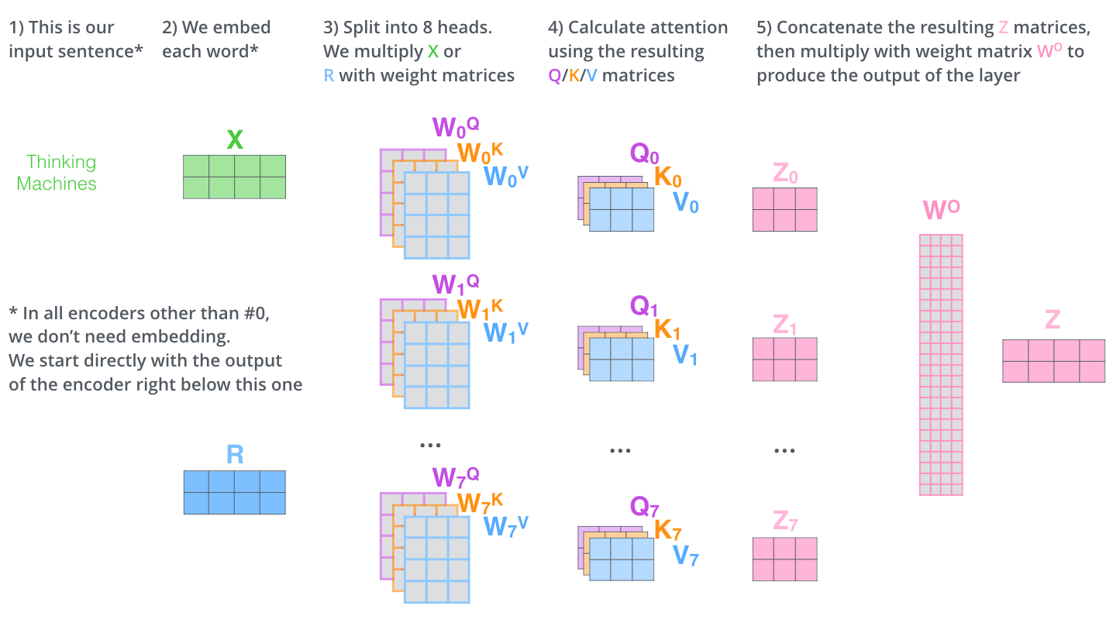
Now, for this example, Seq=2, Emb=512, heads=8, 512/8=64
Multi head attention system (assume 8 heads)
E.g., each head output Zi=0,1,..7 is 1x64, Z=1x512
Z=Output size (transformer hidden state size)
Concatenate multi-head outputs (Z_{i=0,1,2,..7}) to become the encoder output (Z)
X(2x512)
W(512x64)
K(2x64)
Concatenate Zi into Z
Stack words of a sentence into a matrix
X=2x512
K,Q,V are of same size
(2x64)
(64x512)
Z(2x512)
(2x64)
R (residual output).
In all encoders other encoder #0, R (output from the encoder below) is the input
Q=X*W, W is trainable weight matrix
Zi=(softmax(QK^{T})/sqrt(d))*V
(2x64)

Slide 98

Appendix 8
Wordpiece algorithm
Initialize the word unit inventory with all the characters in the text.
Build a language model on the training data using the inventory from 1.
Generate a new word unit by combining two units out of the current word inventory to increment the word unit inventory by one. Choose the new word unit out of all the possible ones that increases the likelihood on the training data the most when added to the model.
Goto 2 until a predefined limit of word units is reached or the likelihood increase falls below a certain threshold.
A 30Kwordpiece table (30kx1) is shown in
https://huggingface.co/bert-base-uncased/resolve/main/vocab.txt
Each row is a word , there are 30K words, the row number is the token_ID . Some parts of the table are shown on the right, note:## are subwords.
genetically
nuremberg
calder
209
bonn
outdoors
paste
suns
urgency
vin
restraint
tyson
##cera
##selle
barrage
bethlehem
kahn
##par
mounts

