Slide 1
Chapter 6
Examples of Finite State Machines (FSMs)
Counters and pattern generators

Slide 2
Counters and pattern generators
Up/down counters: generate a sequence of gradually increasing or decreasing counting patterns according to the clock and inputs. (E.g. digital clock, 1,2,3,4..)
Pattern generators: generate any patterns of finite states. Use state diagrams to design. (E.g. traffic light,red,green, yellow..)

Slide 3
Up/down counters are FSMs
Asyn.clock -more delay among outputs, less logic
  the output of one state register is the clock of another state register.
Syn. clock -less delay among outputs, more logic
  all clock inputs of state registers (flip-lops) are connected.
Examples here are all Moore machines (output depends on state registers.)

Slide 4
Two design methods
Asynchronous clock design
  Easier to design
  More delay at outputs
Synchronous clock design
  More complex
  Less time delay at outputs

Slide 5
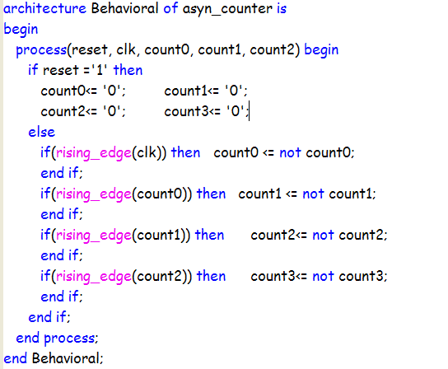
4-bit Asynchronous clock down counter (Moore)
CLK: in STD_LOGIC;
RESET: in STD_LOGIC;
COUNT0, COUNT1 , COUNT2 , COUNT3 : inout STD_LOGIC;
Asynchronous clocks
Each line is
an Flip-Flop
A 4-bit down counter

Slide 6
library IEEE; --(vivado 2014.34 ok)
use IEEE.std_logic_1164.all;
entity asyn_counter is
port( clk: in std_logic;
reset: in std_logic;
count0,count1, count2, count3: inout std_logic);
end asyn_counter;
architecture Behavioral of asyn_counter is
begin
process(reset, clk, count0, count1, count2) begin
if reset ='1' then
count0<= '0'; count1<= '0';
count2<= '0'; count3<= '0';
else
if(rising_edge(clk)) then count0 <= not count0;
end if;
if(rising_edge(count0)) then count1 <= not count1;
end if;
if(rising_edge(count1)) then count2<= not count2;
end if;
if(rising_edge(count2)) then count3<= not count3;
end if;
end if;
end process;
end Behavioral;

Slide 7

Exercise on 6.1, 4-bit Asyn.
Clock Counter. Plot count, and check delay
Student ID: __________________
Name: ______________________
Date:_______________
(Submit this at the end of the lecture.)
Write the port declaration.
Plot Q(1),Q(2),Q(3) including delays
Count(0)
Count(1)
Count(2)
Count(3)
D(0)
D(1)
D(2)
D(3)
FF
FF
FF
FF
clock
Q(0)
ck
ck
Q(2)
ck
Q(3)
ck
Q(1)
δt= time delay at one FF
reset
clock
Q(0)
Q(1)
Q(2)
Q(3)
δt

Slide 8
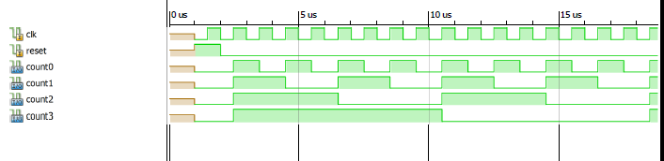
Simulation result

Slide 9
Synchronous clock counter design
More difficult to design
Less delay at outputs (more precise)

Slide 10
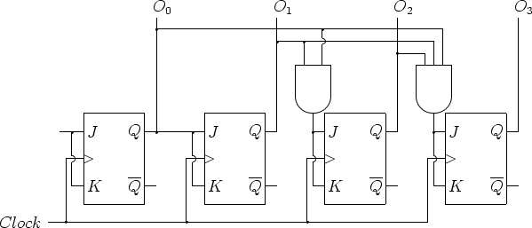
4-bit synchronous counter
More complicated than asynchronous design
from http://web.cs.mun.ca/~paul/cs3724/material/web/notes/img191.png

Slide 11
A counter with load, reset, dir.
(E,g a clock that can be preset)
Load: for setting output to some value
DIR: for up/down control
CE: count or not count control
reset
16-bit
din (data in)
Load
DIR
16-bit
count output
CE
clock

Slide 12
Exercise on 6.2
Synchronous clock counter
  Advantage:?
  Disadvantage:?
Asynchronous clock counter
  Advantage:?
  Disadvantage:?
Synchronous reset counter
  How to write a synchronous reset input in VHDL?
Asynchronous reset counter
  How to write an asynchronous reset input in VHDL?

Slide 13
A 4-bit counter
RESET=Asynchronous
reset
CLK=Synchronous clock
library IEEE;
use IEEE.std_logic_1164.all;
use IEEE.std_logic_arith.all;
use IEEE.std_logic_unsigned.all;
entity test1xa is
port (
-- 4-bit parallel load counter, asynchronous reset
CL, RESET: in STD_LOGIC;
CE, LOAD, DIR: in STD_LOGIC;
DIN: in STD_LOGIC_VECTOR(3 downto 0);
COUNT: inout STD_LOGIC_VECTOR(3 downto 0));
end test1xa;
architecture Behavioral of test1xa is
begin
process (CLK, RESET) begin
if RESET='1' then COUNT <= "0000";
elsif CLK='1' and CLK'event then
if LOAD='1' then COUNT <= DIN;
else if CE='1' then
if DIR='1' then
COUNT <= COUNT + 1;
else
COUNT <= COUNT - 1;
end if;
end if;
end if;
end if;
end process;
end Behavioral;
Counting here

Slide 14
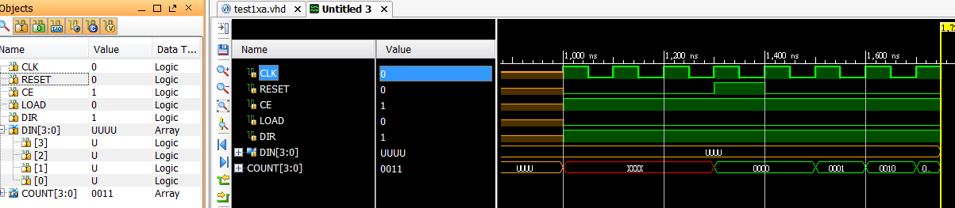
Simulation result

Slide 15
library IEEE; --(Vivado 2014.4 &ISE ok)
use IEEE.std_logic_1164.all;
use IEEE.std_logic_arith.all;
use IEEE.std_logic_unsigned.all;
entity syn_counter is
port (
CLK: in STD_LOGIC;
RESET,CE, load, DIR: in STD_LOGIC;
DIN: in std_logic_vector(3 downto 0);
COUNT: inout std_logic_vector(3 downto 0));
end syn_counter;
architecture Behavioral of syn_counter is
begin
process( reset, clk) begin
if(reset = '1') then COUNT <= "0000";
else
if(clk'event and clk = '1') then
if(load = '1') then COUNT <= din;
else
if(ce = '1') then
if( dir = '1') then
count <= count + 1;
else
count <= count -1;
end if;
end if;
end if;
end if;
end if;
end process;
end Behavioral;

Slide 16
Pattern generators (finite state machines)
Generate any pattern you desire.
E.g. CPU,
Memory controller etc.

Slide 17
Pattern generators
Irregular pattern counter examples: traffic light, memory read/write patterns.
The control unit of a computer is a pattern generator.
Or the whole digital computer is a pattern generator counting according to the clock and inputs (keyboard, memory, disk etc.)

Slide 18
Binary and one-hot encoding for state machine design.
Binary encoding:
  using N flip-flops to represent 2^{N} states.
  Use less flip-flops but more combinational logics
One-hot encoding:
  Using N flip-flops for N states.
  Use more flip-lops but less combination logic.
Xilinx default is one-hot. choose at XILINX foundation_project_ manager→ synthesis → options.
http://www.xilinx.com/itp/xilinx4/data/docs/sim/vtex9.html

Slide 19
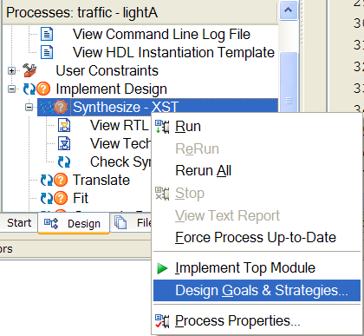
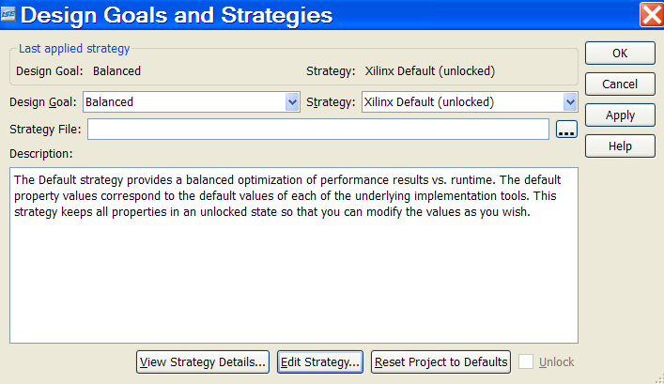
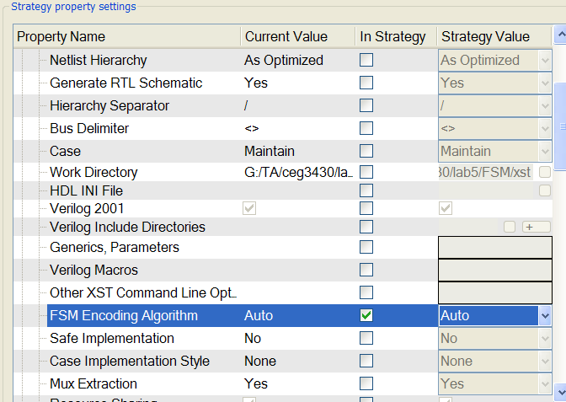
Change FSM coding styles in Xilinx-ISE
In Implementation view, right click Synthesize, choose Design goals…
Choose
Edit Setting
Tune the coding style.
Or keep as default

Slide 20
Exercise 6.3, State concepts
How many states can a 4-bit counter have?
How many bits for the state registers (using binary encoding) are required if you need
  4 states?
  9 states?
  21 states?
Repeat the above question if you use one-hot encoding.

Slide 21
Pattern generator design steps
Step 1. Identify the states
Step 2. Connect the states with certain conditions.

Slide 22
State type (enumeration type)
You may declare your state types using:
1 architecture
2 type traffic_state_type is (s0, s1,s2,s3);
3 signal L_state: traffic_state_type;
4 begin...
process
So you don’t have to worry about how many FFs you need , the VHDL compiler will decide for you.

Slide 23
(liga0_nr) Example to generate traffic light patterns
R
out_light(0) red
out_light(1) yellow
out_light(2) green
Y
“_nr” stands for no reset, only the input clock
red(s0) -> red-yellow(s1) -> green(s2) -> yellow(s3) -> red(s0): 4 states
G
L_stateA =
s0
s1
s2
s3
R
R
Y
Y
G

Slide 24
State diagram notations
Each circle is a state; each arc is a transition after a rising clock edge
E.g. if it is at state s0 the next state (after a rising clock) will be at s1 etc.
The arc can be labeled to show state switch conditions. If unlabeled, it is unconditional.
L_stateA =
s0
s1
s2
s3
R
R
Y
Y
G

Slide 25
Design flow
Process1(p1): -- clocked sequential process
  define state transitions(current sta.=>next sta.)
Process2(p2) : -- combinational process
  from states to output (--> lights)

Slide 26
1 Architecture lightA of traffic is
2 type traffic_state_type is (s0, s1,s2,s3);
3 signal L_stateA: traffic_state_type;
4 out_light signal: std_logic_vector(2 downto0);
Liga0_nr.vhd
5 p1:Process -- exec. Once when clock rises
6 begin -- sequential process
7 wait until clock=‘1’;
8 case L_stateA is
9 when s0 => L_stateA <= s1;
10 when s1 => L_stateA<= s2;
11 when s2 => L_stateA<= s3;
12 when s3 => L_stateA<= s0;
13 end case
14 end process --to be continued , see next page

Slide 27
15 -- convert L_statesA to out_light
16 p2:process(L_stateA) -- combin. process
17 begin case (L_stateA) is
18 when s0 => out_light <= “100”;
19 when s1 => out_light <= “110”;
20 when s2 => out_light <= “001”;
20 when s3 => out_light <= “010”;
22 end case
23 end process
24 end light1
R
R
Y
G
Y

Slide 28
library IEEE; -- Traffic light "liga0_nr.vhd full listing" ,
-- synthesized ok (vivado 2014.4),
use IEEE.std_logic_1164.all;
entity traffic is
port (out_light :out std_logic_vector( 2 downto 0);
-- out_light mode= type out ,no feedback requirement
clock: in std_logic);
end traffic;------------------------------------------------
Architecture lightA of traffic is
type traffic_state_type is (s0, s1,s2,s3);
signal L_stateA: traffic_state_type;
begin
----------------------continue next page----------------------

Slide 29
p1:process -- exec. Once when clock rises
begin wait until clock=‘1’; --s sequential process
case L_stateA is
when s0 => L_stateA <= s1;
when s1 => L_stateA<= s2;
when s2 => L_stateA<= s3;
when s3 => L_stateA<= s0;
end case;
end process; --to be continued , see next page
---- convert L_statesA to out_light
p2:process(L_stateA) -- combin. process
begin case (L_stateA) is
when s0 => out_light <="100";
when s1 => out_light <="110";
when s2 => out_light <="001";
when s3 => out_light <="010";
end case;
end process;
end lightA;

Slide 30
Programming hints:
No reset here?
In practice, lig0_nr.vhd does not have a reset/set for sequential flip-flops, i.e. (L_stateA).
Warning: In the design tool, the timing simulator may not know how to initialize L_stateA, hence does not know how to begin the simulation.
So we have to modify the program.

Slide 31
Exercise 6.4 on the traffic light program
Draw the flow diagram of of liga0_nr.vhd.
Why is it classified as a Moore machine?

Slide 32
Advanced example with inputs, see the labels of the arcs
This is your dream: If you press the button on the light post, the light will become green (state S2) at the next state. (syn. or asyn input?)
Based on lightA, we modify case statements
s0
s1
s2
s3
L_stateA =
InB=‘1’
inB=‘1’
InB=‘1’
InB=‘0’
R
R
inB=‘0’
Y
Y
reset
G
InB=‘0’

Slide 33
Liga1_sr.vhd
Add synchronous reset
programming

Slide 34
--example 1: liga1_sr syn. reset based on lightA.vhd
library IEEE; -- ok for foundation1.5
use IEEE.std_logic_1164.all;
entity traffic is
port (out_light :out std_logic_vector( 2 downto 0);
-- out_light uses type out because no feedback requirement
inB: in std_logic ;----------*********
clock: in std_logic);
end traffic;------------------------------------------------
Architecture lightA of traffic is
type traffic_state_type is (s0, s1,s2,s3);
signal L_stateA: traffic_state_type;
begin
----------------------continue next page----------------------

Slide 35
This is the flow diagram
Answer the question in the next slide
s0
s1
s2
s3
L_stateA =
InB=‘1’
inB=‘1’
InB=‘1’
InB=‘0’
R
R
inB=‘0’
Y
Y
reset
G
InB=‘0’

Slide 36
-- Exercise. 6.5A -- Syn. reset --fill in__?– in liga1.vhd
p1:process -- wait-until-clock type process;
--exec. once when clock rises; sensitivity list is empty
--it implies only the clock will trigger the process
--inB is only an syn. reset governed by clock.
begin
wait until clock='1'; --edged-clock trigger point
if inB=‘__?' -- syn. reset
then L_stateA <=__?;
else case L_stateA is
when s0 => L_stateA<=s1;
when s1 => L_stateA<=__?;
when s2 => L_stateA<=__?;
when s3 => L_stateA<=__?;
end case;
end if; end process; --to be continued , see next

Slide 37
--Exercise 6.5B -output-- in liga1_sr.vhd -
---- convert L_statesA to out_light
p2:process(L_stateA) -- combin. process
begin
case (L_stateA) is
when s0 => out_light <=“100”;--RYG
when s1 => out_light <=“___?";
when s2 => out_light <=“___?";
when s3 => out_light <=“___?";
end case;
end process;
end lightA;
--- end of program

Slide 38
Liga2_ar.vhd
Add asynchronous reset
programming

Slide 39
--example 2, liga2_ar.vhd, with asyn reset
-- use "if" for clock sensing instead of wait-until
-- clocked process with asyn input
library IEEE; -- Traffic light "lightA" ,-- synthesized ok.
use IEEE.std_logic_1164.all;
entity traffic is
port (out_light :out std_logic_vector( 2 downto 0);
-- out_light uses type out because no feedback requirement
inB: in std_logic ;----------*********
clock: in std_logic);
end traffic;
Architecture lightA of traffic is
type traffic_state_type is (s0, s1,s2,s3);
signal L_stateA: traffic_state_type;
begin
----------------------continue next page----------------------

Slide 40
-- Exercise.6.6—Ayns. Reset -- inside liga2_ar .vhd-
p1:process(inB , clock)– sens. list has 2 elements
begin --asyn reset; put before sensing clock
if (inB =__?)
then L_stateA<= __?;
elsif( clock=___________________?) then
case L_stateA is
when s0 => L_stateA<=s1;
when s1 => L_stateA<= s2;
when s2 => L_stateA<= s3;
when s3 => L_stateA<= s0;
end case; end if;end process; --to be continued , see next page
Asyn. reset

Slide 41
---- inside liga2_ar.vhd ---------
---- convert L_statesA to out_light
p2:process(L_stateA) -- combin. process
begin case (L_stateA) is
when s0 => out_light <="100";
when s1 => out_light <="110";
when s2 => out_light <="001";
when s3 => out_light <="010";
end case;
end process;
end lightA;
----end of program

Slide 42
Further exercises
Liga3_ar.vhd: Rewrite liga2_ar using only one process; combine the two processes.

Slide 43
Liga3_ar.vhd
Based on liga2_ar.vhd combine two processes (p1+p2) into one.

Slide 44
--example 3: lig3a_ar.vhd 00-10-28 foundation 1.5 ok;
--same as lig2a_ar.vhd but combined into 1 process
-- inb force it goes to state s2, asyn. input
library IEEE;
use IEEE.std_logic_1164.all;
entity traffic is
port ( inb: in bit;
out_light :out bit_vector( 2 downto 0);
-- out_light uses type out because no feedback requirement
clock: in bit);
end traffic;------------------------------------------------
Architecture lightA of traffic is
type traffic_state_type is (s0, s1,s2,s3);
signal L_stateA: traffic_state_type;
begin
-------- continue next page ---------------

Slide 45
------ inside liga3_ar.vhd ---------------
P1:process(clock,inB) -- combined process
Begin --exec. Once when clock rises
if inB='1' then L_stateA <= s2;
else
if( clock'event and clock='1‘) then --s sequential process
case L_stateA is --replace 8 of lightA from here
when s0 => out_light <="100"; L_stateA <= s1;
when s1 => out_light <="110"; L_stateA <= s2;
when s2 => out_light <="001"; L_stateA <= s3;
when s3 => out_light <="010"; L_stateA <= s0;
when others=> null;
end case ;
end if;
end if;
end process; end lightA; -- end of progam.

Slide 46
State and transitions
A State is the fundamental element of the machine. Each state represents a certain status of the machine, including values of its ports and signals.
A Transition connects 2 states and describes the sequence of states. Transitions are also used for connections with the reset and entry/exit (for hierarchical states).

Slide 47
Other issues in state machine design
Time delay
Use of case-when
More examples

Slide 48
Timing issues of a Flip-Flop.
D
Q
Clk
Clk
FF
T_{su}= input setup time before clock edge
T_{h}=Hold time for input to be stable after the clock edge
T_{p}= Propagation delay of the Flip-Flop
T_{sk}(clock skew)= difference of arrival times of the clock reaching different synchronous Flip-flops.
D
T_{h}=hold time
T_{sk}
T_{su}=setup time
D₁
Q₁
FF
Q
T_{p}=propagation delay

Slide 49
Use of time delay “after”in VHDL
Think clearly whether your design can work or not for the given hardware implementation.
At each clock rising edge, will an input receive a signal with enough hold time?
Use delay if necessary, e.g.
X <= (not (A) or B) after 23ns.--delay inserted
In XILINX delays are quantized (e.g. 20ns, 50ns), values depend on devices.

Slide 50
Example and exercise for “after”
The requirement for a job in a company is you have to have a degree two years before you apply. So the setup time is 2 years, i.e.
job_application<= (graduation) after two_years;

Slide 51
Example and exercise for “after”
Is the following statement correct if Di and CLk rise_edge change at the same time?
if rising_edge(clk) then
  Q <= Di end if;
No. Change it to
if rising_edge(clk) after (Td plus margin) then
Q <= Di end if; -- you need to find out the margin yourself – empirical or by experience
Di
D_{d}
Delay=T_{d}
Q
FF
clk

Slide 52
(More Examples)
(5) vending machine example
(6) lift controller

Slide 53
Example 6.7: Design a vending machine for 8 types of drinks
Drop $5, select drink by 8 switches
= “0000 0001”--> coke
= “0000 0010”--> 7-up
Ignore insufficient stock case
$5
7-up

Slide 54
Exercise. 6.7:The Vending machine signals
Drop $5, select drink by 8 switches
= “0000 0001”--> coke
= “0000 0010”--> 7-up
$5
7-up
Switches
(in_select(7:0))
LEDs
(out_led(7:0))
In_money
$5
Stock
of drinks
(In_stock(7:0))
Drink
dispatched
(in_dispatched)
7-up
(Out_drink(7:0))

Slide 55
What input/outputs do you need?
Inputs:
  clk
  in_money: $5 passed got a pulse(L-H-L)
  in_stock (7 downto 0): in -- =1 has stock
  in_select (7 downto 0):
  in_dispatched
Outputs:
  out_led(7 downto 0)
  out_drink(7 downto 0)

Slide 56
What states do you need?
S_wait_for_m (money)
s_show_stock
s_out_drink

Slide 57
Exercise 6.7 A
Draw arcs (arrows) with labels in the flow diagrams
S_show_stock
action:show_led
S_out_drink
action:out_drink
S_wait_m
reset

Slide 58
Exercise 6.7 B :Flow diagram fill in _?
In_dispatched =‘__?’
In_money=‘__?’
In_select /=”____ ____ ?”
In_money=‘__?’
S_show_stock
action:show_led
S_out_drink
action:out_drink
S_wait_m
In_select=”____ ____?”
In_dispatched =‘_?’
reset

Slide 59
Exercise 6.7 C: Write the port declaration of the vending machine
--vend1.vhd : vending machine example
library IEEE;
use IEEE.std_logic_1164.all;
entity vend1 is
port (
)
end vend1;

Slide 60
Exercise 6.7 D: Fill in the blanks
architecture vend1_arch of vend1 is
type vend_state_type is -- list the states
signal state_vend: vend_state_type;
begin
P1:process (clk,reset) -- exec. Once when clock rises
begin if reset='1' then -- show how to reset the signals
elsif (clk='1' and clk'event) then --s sequential process
--(architecture, to be filled in the next slide)
end vend1_arch;

Slide 61
Exercise 6.7 E: Fill in the blanks
elsif (clk='1' and clk'event) then --s sequential process
case
when s_wait_for_m =>
when s_show_stock =>
when s_out_drink =>
when others =>
end case ;end if; end process;-- to be continued----
end vend1_arch;

Slide 62
--Ans: Write the port declaration of the vending machine
--vend1.vhd : vending machine (Vivado2014 .4 & ISE ok)
library IEEE;
use IEEE.std_logic_1164.all;
entity vend1 is
port (
clk,in_money, reset: in STD_LOGIC;
in_stock: in STD_LOGIC_VECTOR (7 downto 0);
in_select: in STD_LOGIC_VECTOR (7 downto 0);
in_dispatched: in STD_LOGIC;
out_drink: out STD_LOGIC_VECTOR (7 downto 0);
out_led: out STD_LOGIC_VECTOR (7 downto 0));
end vend1;
architecture vend1_arch of vend1 is
type vend_state_type is (s_wait_for_m , s_show_stock,s_out_drink);
signal state_vend: vend_state_type;
begin
P1:process (clk,reset) -- exec. Once when clock rises
begin if reset='1' then
state_vend<=s_wait_for_m ;
out_drink<="00000000";
out_led<="00000000";
elsif (clk='1' and clk'event) then --s sequential process
case state_vend is --replace 8 of lightA from here
when s_wait_for_m =>
if in_money ='0' then
state_vend<= s_wait_for_m;
else state_vend<=s_show_stock; end if;
when s_show_stock =>
out_led<= in_stock;
if in_select = "00000000" then
state_vend<= s_show_stock;
else state_vend<=s_out_drink; end if;
when s_out_drink =>
out_led<=in_select;
out_drink<=in_select;
if in_dispatched ='0' then
state_vend<= s_out_drink;
else state_vend<=s_wait_for_m; end if;
when others => state_vend<=s_wait_for_m;
end case ;end if; end process;-- to be continued----
end vend1_arch;

Slide 63
--vend2.vhd : vending machine example
library IEEE;
use IEEE.std_logic_1164.all;
entity vend1 is
port ( clk,in_money, reset: in STD_LOGIC;
in_stock: in STD_LOGIC_VECTOR (7 downto 0);
in_select: in STD_LOGIC_VECTOR (7 downto 0);
in_dispatched: in STD_LOGIC;
out_drink: out STD_LOGIC_VECTOR (7 downto 0);
out_led: out STD_LOGIC_VECTOR (7 downto 0));
end vend1;
architecture vend1_arch of vend1 is
type vend_state_type is (s_wait_for_m , s_show_stock,s_out_drink);
signal state_vend: vend_state_type;
begin -- to be continued ----------------

Slide 64
P1:process (clk,reset) -- exec. Once when the clock rises
begin if reset='1' then
state_vend<=s_wait_for_m ;
out_drink<="00000000";
out_led<="00000000";
elsif (clk='1' and clk'event) then --s sequential process
-- to be continued ----------------

Slide 65
case state_vend is --replace 8 of lightA from here
when s_wait_for_m =>
if in_money ='0' then
state_vend<= s_wait_for_m;
else state_vend<=s_show_stock; end if;
when s_show_stock =>
out_led<= in_stock;
if in_select = "00000000" then
state_vend<= s_show_stock;
else state_vend<=s_out_drink; end if;
when s_out_drink =>
out_led<=in_select;
out_drink<=in_select;
if in_dispatched ='0' then
state_vend<= s_out_drink;
else state_vend<=s_wait_for_m; end if;
when others => state_vend<=s_wait_for_m;
end case ;end if; end process; end vend1_arch; -- end-------

Slide 66
--vend1.vhd : vending machine example (Vivado 2014 .4 & ISE ok)
library IEEE;
use IEEE.std_logic_1164.all;
entity vend1 is
port (
clk,in_money, reset: in STD_LOGIC;
in_stock: in STD_LOGIC_VECTOR (7 downto 0);
in_select: in STD_LOGIC_VECTOR (7 downto 0);
in_dispatched: in STD_LOGIC;
out_drink: out STD_LOGIC_VECTOR (7 downto 0);
out_led: out STD_LOGIC_VECTOR (7 downto 0));
end vend1;
architecture vend1_arch of vend1 is
type vend_state_type is (s_wait_for_m , s_show_stock,s_out_drink);
signal state_vend: vend_state_type;
begin
P1:process (clk,reset) -- exec. Once when clock rises
begin if reset='1' then
state_vend<=s_wait_for_m ;
out_drink<="00000000";
out_led<="00000000";
elsif (clk='1' and clk'event) then --s sequential process
case state_vend is --replace 8 of lightA from here
when s_wait_for_m =>
if in_money ='0' then
state_vend<= s_wait_for_m;
else state_vend<=s_show_stock; end if;
when s_show_stock =>
out_led<= in_stock;
if in_select = "00000000" then
state_vend<= s_show_stock;
else state_vend<=s_out_drink; end if;
when s_out_drink =>
out_led<=in_select;
out_drink<=in_select;
if in_dispatched ='0' then
state_vend<= s_out_drink;
else state_vend<=s_wait_for_m; end if;
when others => state_vend<=s_wait_for_m;
end case ;end if; end process;-- to be continued----
end vend1_arch;

Slide 67
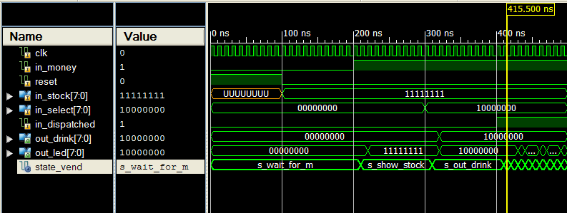
reset
In_select
drink
Drink
dispatched
In_Money

Slide 68
Issues in VHDL design
Use of case-when
1 type traffic_state_type is (s0, s1,s2,s3);
2 signal L_state1: traffic_state_type;
3 out_light signal: std_logic_vector( 2 downto0);
4 process
5 begin
6 case L_state1 is
7 when s0 => out_light<=“001”;
8 when s1 => out_light<=“010”;
9 end case;
What's wrong?

Slide 69
Use of case-when
process
begin
case L_state1 is
when s0 => out_light<=“001”;
when s1 => out_light<=“010”;
when others => null; end case;
end process
to cater for all other cases: s2,s3

Slide 70
Appendix
Another example to think about

Slide 71
Design a lift controller.
Floors: G,1,2,3
motor
3
Up/down
2
In_outside_buttons
Floor display
1
Inside buttons
in_inside_buttons
G

Slide 72
Design a lift controller.
Floors: G,1,2,3
Input_outside: in_outside_button(3 downto 0),
Input_inside: in_inside_button(3 downto 0),
position_sensor(7 downto 0) --fine measurement
Outputs:up_down,stop_go,door_open_close, display(3 downto 0)
additional input/outputs: over_weight, beep
How many states, processes do you need?
Draw the state transition diagram.
Write VHDL code.

Slide 73
Hints for the Smart lift controller
4 +3 states used, for 4 floors and gaps in between.
One process(clock) -- input-to-states: to handle floor/state changes, “up/down” commands etc.
One process(floor states) -- states-to-outputs: to handle “stop”, “door” etc.
Case for “One request only”
  If lift is lower than request, up. Otherwise down.

Slide 74
Would this work?
Floor is the internal status(signal)
1 process (CLK)--process 1 of 2 , all inputs are asyn.
2 begin -- generates up, stop, floor
3 if CLK='1' and CLK'event then
4 if (position/some_constant < in_button)
5 then up<=‘1’ else up<=‘0’ end if;
6 if (position/some_constant = in_button)
7 then (stop<=‘1’) else (stop<=‘0’) end if;
8 if (stop = ‘0’ and up=‘1’) then (floor<=floor + 1)
9 elsif (stop = ‘0’ and up=‘0’) then (floor<=floor - 1)
10 end if;
11 end if;
12 end process;

Slide 75
Lift VHDL continues
13 process (floor,stop,in_button) -- process 2 of 2
14 begin -- generates display,door_open
15 if (floor= in_button and stop=‘1’)
16 then door_open<=‘1’ end if
17 display<=floor;
:
:-- but how to close the door????:
:
end process;

Slide 76
Quick revision
You should know
  The difference between synchronous clock and asynchronous clock counters
  How to use the enumeration type of signals
  How to design finite state machines

Slide 77
Appendix:
library IEEE; -- successfully compiled and tested. In Xilinx, init. signals cannot be done
use IEEE.STD_LOGIC_1164.all; -- so use reset to set them to init values
use IEEE.std_logic_arith.all;
use IEEE.std_logic_unsigned.all;
entity some_entity is
port ( clk : in STD_LOGIC;
reset : in STD_LOGIC;
sportsum: out integer);
end some_entity;
Architecture sig_arc of some_entity is
signal t1, t2, t3 : integer; -- In Xilinx, ini. Signals cannot be done
begin -- t1 is just after the first clk, etc
--with clk, without clk, with s1234, in sen. list or not
process(clk,reset) -- clocked process, syn. input can be in or not in the sensitivity list
-- begin wait on clk;-- t1 t2 t3 t4
begin if reset = '1’ then -- use reset to set them to init values
t1 <= 1;
t2 <= 2;
t3 <= 3;
sportsum <= 0;
elsif clk='1' and clk'event then
t1<=t2+t3; -- s1=
t2<=t1; --s2=
t3<=t2; --s3=
sportsum <= t1+t2+t3; -- sum= 6, 8, 9, 14 after each clock edge
end if; end process; end sig_arc;

