Slide 1
VHDL 4
Building blocks of a computer

Slide 2
VHDL 4
Building blocks of a computer
Combinational circuit and sequential circuit
Building blocks of a computer.
Control units are state machines, which have Flip-flops, decoders, multiplexers etc.
Beware that , there are usually more than one way to design the same digital system in VHDL

Slide 3
Combinational Vs. Sequential ciruits
Combinational circuit, it has no memory
  Example: decoder, encoder, inverter
Sequential circuit, it has memory
  Circuits that change state and output according to some conditions, (input or clock)
Examples:
Sequential
  Latch, Flip-flops (FFs) with asynchronous or synchronous reset;
Combinational
  tri state buffer; decoder; multiplexer, bi-directional buffer,

Slide 4
A typical
CPU
Control Unit
State machine
FFs=Flip-flops
A state machine
contains FFs
Registers
(FFs)
Address bus
(latches)
I/O control logic
(state machine)
data-bus
Transceivers
(bi-directional buffers )
ALU
(state machine)
Memory

Slide 5
Use VHDL to make digital system building blocks
1) latch,
2) flipflop with asynchronous reset,
3) flipflop with synchronous reset,
4) tri state buffer,
5) decoder,
6) multiplexer,
7) bi-directional buffer,

Slide 6
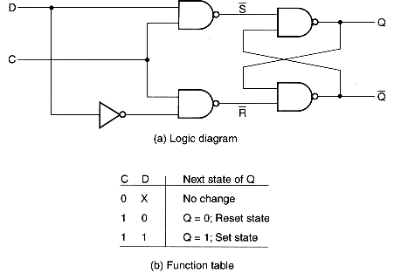
VHDL Exercise 4
1) Latch: when gate=1, output follows input (level sensitive)
Latch
1-bit memory
in1
D Q
C
out1
gate
library IEEE;--(ok vivado 2014.4)
use IEEE.STD_LOGIC_1164.ALL;
entity latch_ex is
port (gate, in1 : in std_logic;
out1 : out std_logic);
end latch_ex;
architecture latch_ex_arch of latch_ex is
begin
process (gate,in1)
begin
if (gate = '1') then
out1 <= in1;
end if;
end process;
end latch_ex_arch;
sensitivity list
http://faculty.kfupm.edu.sa/COE/ashraf/RichFilesTeaching/COE022_200/Chapter4_1.htm, or P.72 Advanced Digital Design with the Veriolog HDL by M.D. Ciletti
The process executes once
when ‘gate’ or ‘in1’ changes

Slide 7
Exercise 4.1 on latch: draw q
In1
Latch
q
gate
in1
gate
q

Slide 8
2) Edge-triggered Flip-flop with asyn. reset : reset before clock statement
asyn_reset
library IEEE;--(ok vivado 2014.4)
use IEEE.STD_LOGIC_1164.ALL;
entity dff_asyn is
port (in1,clock, asyn_reset: in std_logic;
out1 : out std_logic);
end dff_asyn;
architecture dff_asyn_arch of dff_asyn is
begin
process(clock, asyn_reset)
begin
if (asyn_reset = '1') then
out1 <= '0';
elsif clock = '1' and clock'event then
out1 <= in1;
end if;
end process;
end dff_asyn_arch;
Edge (50%)
Clock triggered
FF
in1
Q
sensitivity list
clock
Explain the meaning
of “50 % clock trigger” for a Flip Flop.
edge triggered clock or
rising_edge(clock)
Asyn_reset is 0
clock
in1
Draw (out1)

Slide 9
Exercise 4.3 on architecture dff_asyn_a
When will line 9 be executed?
Which is more powerful: clock or reset?
library IEEE;--(ok vivado 2014.4)
use IEEE.STD_LOGIC_1164.ALL;
entity dff_asyn is
port (in1,clock, asyn_reset: in std_logic;
out1 : out std_logic);
end dff_asyn;
architecture dff_asyn_arch of dff_asyn is
begin
process(clock, asyn_reset)
begin
if (asyn_reset = '1') then
out1 <= '0';
elsif clock = '1' and clock'event then
out1 <= in1;
end if;
end process;
end dff_asyn_arch;
For asynchronous reset flipflop
asyn_reset and clock
must be in the sensitivity list

Slide 10
3) Flip-flop with syn. reset: clock before reset statement
library IEEE;--(ok vivado 2014.4)
use IEEE.STD_LOGIC_1164.ALL;
entity dff_syn is
port (in1,clock, syn_reset: in std_logic;
out1 : out std_logic);
end dff_syn;
architecture dff_syn_arch of dff_syn is
--begin process(clock,syn_reset) -- 'syn_reset' can be removed,
begin process(clock) -- 'syn_reset' can be removed,
begin
if clock = '1' and clock'event then
if (syn_reset = '1') then
out1 <= '0';
else
out1 <= in1;
end if;
end if;
end process;
end dff_syn_arch;
edge triggered clock
syn_reset
out1
in1
D
clock
Discuss why syn_reset is not needed in the sensitivity list

Slide 11
Difference between
Syn. & Asyn. RESET flip-flops (FF)
The order of the statements inside the process determines Syn. or Asyn. reset
if clock = '1' and clock'event then
if (reset = '1') then
if (reset = '1') then
q <= '0';
elsif clock = '1' and clock'event then
Syn. Reset Flip-Flop (check clock first)
Asyn. Reset Flip-Flop (check reset first)

Slide 12
Exercise 4.4 on different flip-flops
**In our course, by default all flip-flops are treated as 50% edge triggered flip-flops.
What is the difference between
  synchronous reset (syn-reset) flip-flops and
  asynchronous reset (asyn-reset) flip-flops?
Discuss the difference between a latch and a flip flop.

Slide 13
4) Tri state buffer: using when-else
(Use capital letter big Z for float, Z is a reserved character)
remember: Z is a scissor
library IEEE;--(ok vivado 2014.4)
use IEEE.STD_LOGIC_1164.ALL;
entity tri_ex is
port (in1, control : in std_logic;
out1 : out std_logic);
end tri_ex;
architecture tri_ex_arch of tri_ex is
begin
out1 <= in1 when control = '1' else 'Z';
end tri_ex_arch;
control
out1
in1
Z=float

Slide 14
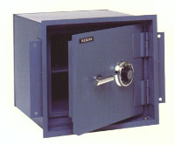
A decoder (N bits --> 2^{N} bits)
Picture from: http://www.safesdirect.com/safes/meilink/safes.html

Slide 15
5) Decoder: using if statements
sensitivity list
library IEEE;--(ok vivado 2014.4)
use IEEE.STD_LOGIC_1164.ALL;
entity decoder_ex is
port (in1,in2 : in std_logic;
out00,out01,out10,out11 : out std_logic);
end decoder_ex;
architecture decoder_ex_arch of decoder_ex is
begin
process (in1, in2)
begin
if in1 = '0' and in2 = '0' then
out00 <= '1';
else
out00 <= '0';
end if;
if in1 = '0' and in2 = '1' then
out01 <= '1';
else
out01 <= '0';
end if;
in='1' and in2='0', open the safe
out00
in1
out10
case 1
out11
in2
out01
case 2

Slide 16

(contin.)Decoder
if in1 = '1' and in2 = '0' then
out10 <= '1';
else
out10 <= '0';
end if;
if in1 = '1' and in2 = '1' then
out11 <= '1';
else
out11 <= '0';
end if;
end process;
end decoder_ex_arch;
case 3 (open the safe)
case 4

Slide 17
6) Multiplexer (2^{N} bits --> N bits)
(the reverse of decoder)
library IEEE;--(vivado 2014.4 tested ok)
use IEEE.STD_LOGIC_1164.ALL;
entity mux is
port (in1,in2, ctrl : in std_logic;
out1 : out std_logic);
end mux;
architecture mux_arch of mux is
begin
process (in1, in2, ctrl)
begin
if ctrl = '0' then
out1 <= in1;
else
out1 <= in2;
end if;
end process; end mux_arch;
in1
out1
in2
crtl
in1
out1
Mux
in2
crtl

Slide 18
Note:7) Bi-directional bus: using data flow concurrent statements
library IEEE;--(ok vivado 2014.4)
use IEEE.STD_LOGIC_1164.ALL;
entity inout_ex is
port (io1, io2 : inout std_logic;
ctrl : in std_logic);
end inout_ex;
architecture inout_ex_arch of inout_ex is
begin
io1 <= io2 when ctrl = '1' else 'Z';
io2 <= io1 when ctrl = '0' else 'Z';
end inout_ex_arch;
ctrl
io2
io1
concurrent statements

Slide 19
Exercise 4.5 for Bi-directional bus
Crt=1, “io1” follows “io2_in”
Crt=0, “io2” follows “io1_in”
Plot io1 io2
ctrl
io2
io1
Io1_in
io1
Io2_in
Io2
Io2_in
Io1_in
R=10K
R=10K
ctrl

Slide 20
Exercise 4.6
List whether the following circuits are sequential or combinational and discuss the reasons
Circuit name | Sequential or combinational | Condition for state change if sequential | discussion
latch
Flip flop
tri state buffer
Decoder
Multiplexer,
Bi-directional buffer

Slide 21
(ANSWER ) Exercise 4.6
List whether the following circuits are sequential or combinational and discuss the reasons
Circuit name | Sequential or combinational | Condition for state change if sequential | discussion
latch | Sequential | Input state | Has memory
Flip flop | Sequential | Clock edge | Has memory
tri state buffer | combinational | N.A. | No memory
Decoder | combinational | N.A. | No memory
Multiplexer, | combinational | N.A. | No memory
Bi-directional buffer | combinational | N.A. | No memory

Slide 22
Quick revision
You should know how to design
  asynchronous , synchronous reset flip-flops
  tri state buffers,
  Combination logics
    decoders,
    multiplexers,
    bi-directional buffers,

Slide 23
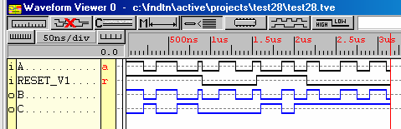
Appendix: do variables in processes have memory. (Good practice: Initialize variables before use; assign values to variables from input first)
library IEEE;
use IEEE.std_logic_1164.all;
entity test is port (a,reset_v1: in std_logic;
b ,c: out std_logic); end test;
architecture test_arch of test is
begin
label_proc1: process (a,reset_v1)
variable v1 : std_logic;
begin
if reset_v1 ='1' then
v1:= not a;
end if;
b<=a;
c<=v1;
end process label_proc1;
end test_arch;
**The answer is yes. That means after a process is called, the state of a variable will be stored for the next time the process is being run again.
V1 stays at two different levels depending on previous result

Slide 24
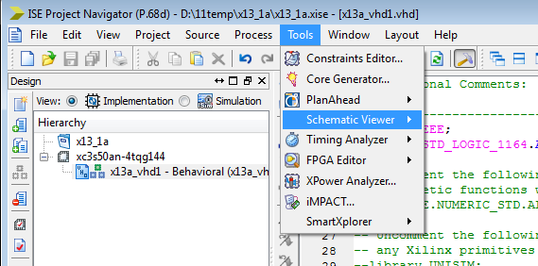
Turn VHDL into schematic
Use Schematic viewer in ISE project navigator

Slide 25
How to represent binary and hex numbers
Type Standard logic( with initialized values):
  signal code_bit : std_logic := ‘1’; --for one bit , init to be ‘1’, or ‘0’
  signal codex : std_logic_vector (1 downto 0) :=“01”; -- 2-bit
  signal codey : std_logic_vector (7 downto 0) :=x“7e”; --8-bit hex 0x7e

