Slide 1
VHDL1
INTRODUCTION TO VHDL
(VERY-HIGH-SPEED-INTEGRATED-CIRCUITS HARDWARE DESCRIPTION LANGUAGE)
KH WONG (w2 begins)
(Some pictures are obtained from FPGA Express
VHDL Reference Manual, it is accessible from the machines in the lab at
/programs/Xilinx foundation series/VDHL reference manual)

Slide 2
You will learn
Basic structure: the Entity contains two parts
  Entity
    declaration :
      Define the signals to be seen outside externally
        E.g. Connecting pins of a CPU, memory
    Architecture: define the internal operations of the device

Slide 3
Resource & references
Book
  Digital Design: Principles and Practices, 4/E John F. Wakerly, Prentice Hall.
  High-Speed Digital Design: A Handbook of Black Magic by Howard W. Johnson and Martin Graham Prentice Hall.
  BOOKBOON (Free text books)
Online resource , software in the lab.

Slide 4
Web resource on VHDL (plenty)
*Courses and tools
  http://equipe.nce.ufrj.br/gabriel/vhdlfpga.html
VHDL Quick Reference
  http://www.doulos.co.uk/hegv/

Slide 5
What is an entity?
Overall structure of a VHDL file
Entity
Library
declaration
Entity
declaration
Architecture
body

Slide 6
What are they?
A VHDL file
Library declaration,e.g.IEEE library as follows
library IEEE;
use IEEE.std_logic_1164.all;
use IEEE.std_logic_arith.all;
use IEEE.std_logic_unsigned.all;
Defines Input/Output pins
Entity
Entity declaration
Architecture
Body: defines
the processing
Architecture body

Slide 7
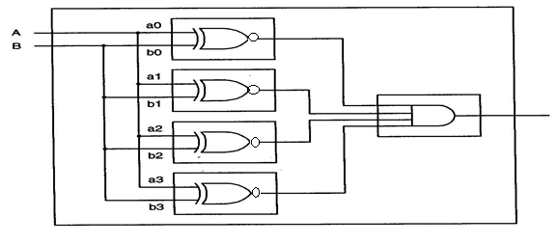
An example a comparator in VHDL
a=[a3,a2,a1,a0]
b=[b3,b2,b1,b0]
equals
VHDL for programmable logic, Skahill, Addison Wesley
a3
a2
a1
a0
The comparator
chip: eqcomp4
b3
b2
b1
b0
Equals
(Equals=1 when a=b)

Slide 8
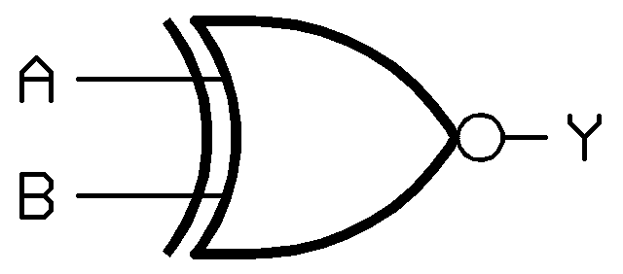
Exclusive nor (XNOR)
Exclusive nor (XNOR)
  When a=b, Output Y = 0
  Otherwise Y =1
a | b | Output : Y
0 | 0 | 1
0 | 1 | 0
1 | 0 | 0
1 | 1 | 1
a
b

Slide 9
An example of a comparator
--the code starts here , “a comment”
library IEEE;
use IEEE.std_logic_1164.all;
entity eqcomp4 is
port (a, b: in std_logic_vector(3 downto 0 );
equals: out std_logic);
end eqcomp4;
architecture dataflow1 of eqcomp4 is
begin
equals <= '1' when (a = b) else '0’;
-- “comment” equals is active high
end dataflow1;
Library
declaration
Entity
declaration
Entity declaration: defines IOs
Architecture
body
Architecture
Body: defines
the processing

Slide 10
How to read it?
Entity enclosed by the entity name –
eqcomp4 (entered by the user)
Port defines the I/O pins.
--the code starts here
library IEEE;
use IEEE.std_logic_1164.all;
entity eqcomp4 is
port (a, b: in std_logic_vector(3 downto 0 );
equals: out std_logic);
end eqcomp4;
architecture dataflow1 of eqcomp4 is
begin
equals <= '1' when (a = b) else '0’;
-- “comment” equals is active high
end dataflow1;
A bus, use downto to define it.
E.g. in std_logic_vector(3 downto 0);
Entity
declaration
Architecture
body

Slide 11
Exercise 1.1
Student ID: __________________
Name: ______________________
Date:_______________
(Submit this at the end of the lecture.)
In the eqcomp4 VHDL code:
  How many Input / Output pins?
    Answer: _______
  What are their names and their types?
    Answer: ___________
    ___________________
  What is the difference between std_logic and std_logic_vector?
    Answer: __________
    __________________
1 entity eqcomp4 is
2 port (a, b: in std_logic_vector(3 downto 0 );
3 equals: out std_logic);
4 end eqcomp4;
5
6 architecture dataflow1 of eqcomp4 is
7 begin
8 equals <= '1' when (a = b) else '0’;
9-- “comment” equals is active high
10 end dataflow1;

Slide 12
Entity declaration: define the IO pins of the chip
entity eqcomp4 is
port (a, b: in std_logic_vector(3 downto 0 );
equals: out std_logic);
end eqcomp4;
Two input buses (a3,a2,a1,a0) (b3,b2,b1,b0) and one output ‘equals’
a3
a2
a1
a0
The comparator
chip: eqcomp4
b3
b2
b1
b0
equals

Slide 13
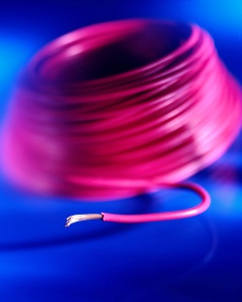
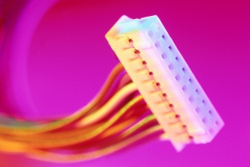
Concept of signals
A signal is used to carry logic information.
In hardware it is a wire.
A signal can be “in” or “out” ..etc.
There are many logic types of signals (wires)
  Bit (can only have logic 1 or 0)
  Std_logic can be 1, 0 , Z ..etc. ( Z=float.)
  Std_logic_vector is a group of wires (called bus).
    a, b: in std_logic_vector(3 downto 0); in VHDL
      means a(0), a(1), a(2), a(3) are std_logic signals
      Same for b.
(meaning
Standard logic,
an IEEE standard)

Slide 14
Exercise 1.2
1 entity test1 is
2 port (in1,in2: in std_logic;
3 out1: out std_logic) ;
4 end test1;
5
6 architecture test1arch of test1 is
7 begin
8 out1<= in1 or in2;
9 end test1_arch;
  Give line numbers of (i) entity declaration, and (ii) architecture? Also find an error in the code.
  _____________________________________________
  What are the functions of (i) entity declaration and (ii) architecture?
  _____________________________________________
  Draw the chip and names the pins. (Don’t forget the two most important pins)
  __________________________________________________
  Underline (or list) the words that are user defined in the above VHDL code.
  _________________________________________________

Slide 15
Exercise 1.3
Answer:
Rewrite code in example 1.2, with
  Entity name is not test1 but test1x
  Inputs are not in1 and in2 but a,b, resp.
  Output is not out1 but out1x
  Logic type is not std_logic but bit
  Architecture name is not test1arch but x_arch.

Slide 16
Entity declaration
Define Input/Output (IO) pins
Entity
Library
declaration
Entity
declaration
IN port declaration
declare modes(
In out, inout, buffer)
Architecture
body

Slide 17
More on Entity Declaration
entity do_care is port(
s : in std_logic_vector(1 downto 0);
y : buffer std_logic);
end do_care;
4 modes of IO pins in port
  in,
  out,
  inout (bidirectional)
  buffer (can be read back by the entity)
**User defined variables are in Italic.

Slide 18
Four modes of IO signals
Example:
entity do_care is port(
s : in std_logic_vector(1 downto 0);
y : buffer std_logic);
end do_care;
4 modes of IO pins in port
Declared in port declaration
IO Signal
Modes in port
Mode:
in
Mode:
out
Mode:
inout
Mode:
buffer

Slide 19
IN, OUT, INOUT, BUFFER modes
IN: data flows in, like an input pin
OUT: data flows out, just like an output. The output cannot be read back by the entity
INOUT: bi-directional, used for data lines of a CPU etc.
BUFFER: similar to OUT but it can be read back by the entity. Used for control/address pins of a CPU etc.

Slide 20
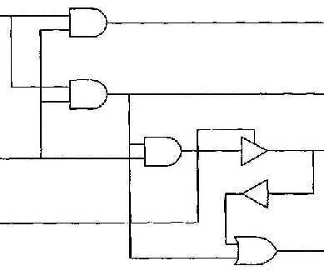

Exercise 1.4 :
On IO signal modes: IN, OUT, INOUT, BUFFER
State the difference between out and buffer.
Answer:__________________________________________
Based on the following schematic, identify the modes of the IO pins.
A
B
C
D
E
F
G
From
VHDL for
programmable
logic,
Skahill, Addison Wesley

Slide 21
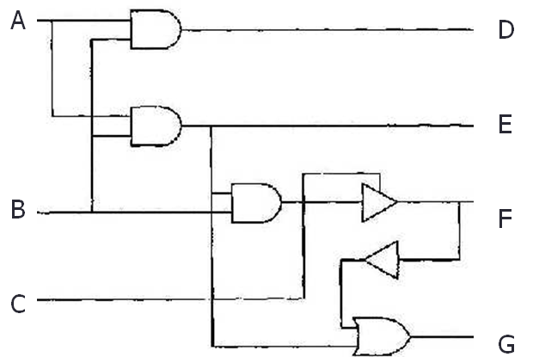
Difference between buffer and inout
Buffer= it is an output but the output signal can be read back internally. Note: It cannot act as an input from an external signal.
Inout: can be input or output at different times but not at the same time.
So why E is a buffer, F is an inout? Answer:
E is signal with mode buffer because
  Z=(A and B) drives E and E is an output but also at the same time X=(B and Z), this Z is feedback to the chip driving an internal signal. F cannot act as an input from an external signal.
F is signal with mode inout because
  If C is 1,X drives F, so F is an output at that time.
  However, when C is 0, F is an input that receives an input to drive Y at that time.
  Note: F can be ‘in’ or ‘out’ at different times but not at the same time.
A tri-state buffer
Z
x
y

Slide 22

The architecture body
Entity
Library
declaration
Entity
declaration
Architecture Body
Define the internal architecture/operation

Slide 23

Architecture body: defines the operation of the chip
Begin
…tells you the internal operation…..
……..
end
6 architecture dataflow1 of eqcomp4 is
7 begin
8 equals <= '1' when (a = b) else '0’;
9 -- “comment” equals is active high
10 end dataflow1;
Architecuture
body
Architecture
body

Slide 24
How to read it?
Architecture name -- dataflow1(entered by the user)
equals, a,b are I/O signal pins designed by the user in the entity declaration.
The operation: equals <= '1' when (a = b) else '0’;
“--” means comment
6 architecture dataflow1 of eqcomp4 is
7 begin
8 equals <= '1' when (a = b) else '0’;
9-- “comment” equals is active high
10 end dataflow1;

Slide 25
Exercise 1.5: Draw the schematic circuit
library IEEE;
use IEEE.STD_LOGIC_1164.ALL;
entity test2v is
port (in1 : in std_logic_vector (2 downto 0);
out1 : out std_logic_vector (3 downto 0));
end test2v;
architecture test_arch of test2v is
begin
out1(0)<=in1(1);
out1(1)<=in1(2);
out1(2)<=not (in1(0) and in1(1));
out1(3)<='1';
end test_arch ;

Slide 26
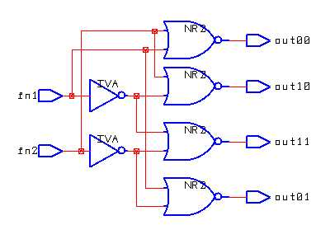
Exercise 1.6: Multiple choice question: What is this circuit? (a) encoder,(b) decoder,(c)multiplexer or (d) adder. Answer:____
Fill in the truth table of this circuit
Fill in the blanks of the program listed below for this circuit.
In1 | in2 | out00 | out10 | out11 | out01
0 | 0
1 | 0
1 | 1
0 | 1
1 entity test16 is
2 port (in1 , in2: in std_logic;
3 out00,out01,out10,out11 : out std_logic);
4 end test16;
5 architecture test16_arch of test16 is
6 begin
7 out00<=not (_______________________);
8 out10<=not (_______________________);
9 out11<=not (_______________________);
10 out01<=not (_______________________);
11 end test16_arch ;

Slide 27
Exercise 1.7:
Write a VHDL program that implement the formula
F= (/a+b)./c

Slide 28
Summary
learned
  Entity
  Entity declaration
  Use of port()
  Modes of IO signals
  Structure of the Architecture body of a simple VHDL program

