Slide 1
VHDL 0
Introduction to VHDL
K H Wong
khwong@cse
3943-8397,
Room 907 SHB-Engineering building
http://www.cse.cuhk.edu.hk/~khwong/www2/ceng3430/ceng3430.html

Slide 2


CENG3430 Rapid Prototyping of Digital Systems
You will learn:
  The hardware description language VHDL
  Techniques to build a Logic system e.g. building blocks of a Central Processing Unit (CPU)
  High speed logic circuits analysis: time delay estimation, testing, power supply stability, etc.
Example: A VHDL AND-gate Program
Write VHDL code, then
it will generate the hardware chip automatically
1 entity and2 is port (a,b : in std_logic;
2 c : out std_logic);
3 end and2
4 architecture and2_arch of and2
5 begin
6 c <=a and b;
7 end and2_arch
Notes:
In this course you will learn a language that can be used to develop hardware.
There are two most popular languages used in the industry, VHDL and Verilog. They are similar so if you know VHDL you can pick up Verilog easily.
VHDl is a powerful language, it can be used to develop CPU or embedded system devices.
Furthermore it can be used to model hardware, that is, finding out the time delay of certain signals.

Slide 3
A quick run through
Overview

Slide 4
Overview
What is VHDL used for?
To design
    Hardware systems (an industrial standard)
    Microprocessors: Arm7 etc.
    Design new Digital systems: e.g. mobile phone, camera chips
Notes:
VHDL has been used in the industry for companies to design hardware chips.
For example if a company wants to make a new LED TV, a new TV panel hardware is required, designing a new logic circuit is not easy, and it cannot be done by drawing schematics because too many gates are required. The system development work becomes easier if it is designed using a language to describe the hardware.

Slide 5
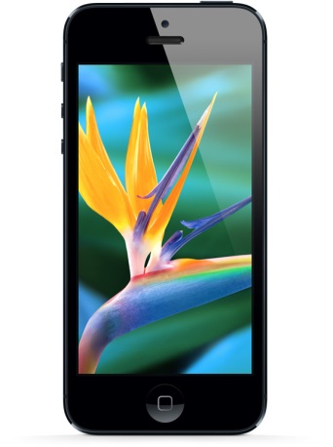

Motivations
Learn to design digital systems.
Provide knowledge for you to :
  Design products:
    Robots controllers, media players, portable games, mobile phones.
  Advanced examples
    Image processing
    Computer vision
    Super computer
  Start a business.
Notes:
There are design examples on the web including digital MP3 player, robot control systems, digital camera prototypes etc. More advanced examples are , image processing hardware, super-computer design etc.

Slide 6
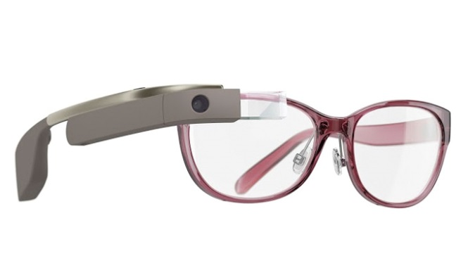
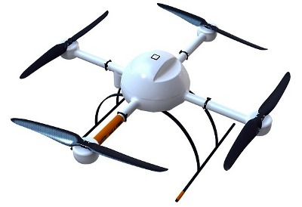
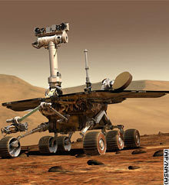
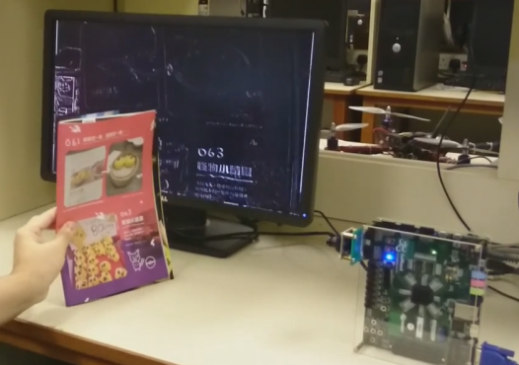
Examples of digital system design
Mass products
  Media players
  Mobile phones
Novel products
  Wearable computer
  Robots
Research
  Real time edge detection for computer vision
www.cnn.com/.../06/10/mars.rover/index.html

Slide 7
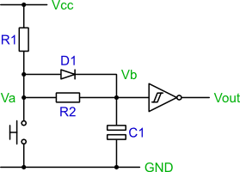

To learn
Design digital processing components using programmable logic
  Two existing Methods
    (a) Schematic, (too complicated
      But is suitable to describe the top level design like a data flow block diagram
    (b) Language (e.g. VHDL--Very-High-Speed-Integrated-Circuits Hardware Description Language): Each module in the schematic can be written in VHDL.
1 entity and2 is port (a,b : in std_logic;
2 c : out std_logic);
3 end and2
4 architecture and2_arch of and2
5 begin
6 c <=a and b;
7 end and2_arch

Slide 8
DIGITAL DESIGN
Work Flow

Slide 9


Digital Design Work Flow
1 entity and2 is port (a,b : in std_logic;
2 c : out std_logic);
3 end and2
4 architecture and2_arch of and2
5 begin
6 c <=a and b;
7 end and2_arch
Idea generation
Drafting on paper
Design the chip (use VHDL)
Test
Manufacturing production line design
Quality control

Slide 10
We use In our lab
Hardware: FPGA (Field Programmable Gate Array)
  The hardware can be reprogrammable , so you can change your design rapidly and easily with no additional hardware manufacturing cost.
Software: VHDL (Very-High-Speed-Integrated-Circuits Hardware Description Language)

Slide 11
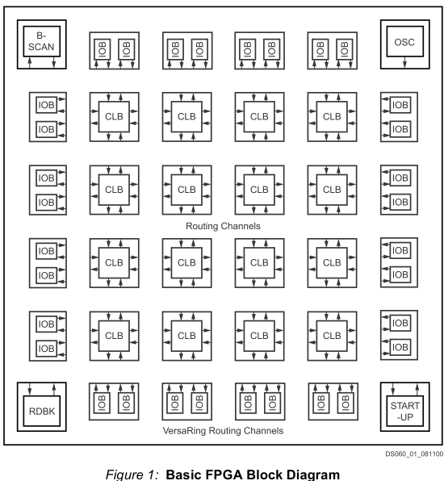
Re-programmable Hardware: FPGA Field Programmable Gate Array
So what is inside an FPGA
IOB=Input/Output block
CLB=Configurable Logic block (static ram based)
Change the CLBs to get the desired functions
From http://www.alldatasheet.co.kr/datasheet-pdf/pdf_kor/49173/XILINX/XCS10-3PC84C.html

Slide 12
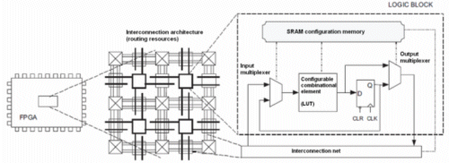
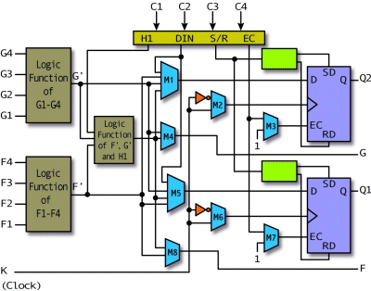
Inside a CLB (Configurable Logic block )
The CLB is a fixed design but you can change the logic function for generating output from input G1-G4 by reprogramming the bits in the logic function lookup table.
This will change the overall logic function of the CLB
Re-programming the logic table
CLB
FPGA CLB
(Configurable Logic block )
http://www.design-reuse.com/news_img/20100913_1.gif
http://pldworld.biz/html/technote/pldesignline/bobz-02.gif

Slide 13
Example:
Virtex-II Architecture
Block SelectRAM™
resource
I/O Blocks (IOBs)
Programmable interconnect
Dedicated multipliers
Configurable
Logic Blocks (CLBs)
Virtex™-II architecture’s core voltage
operates at 1.5V
Clock Management (DCMs, BUFGMUXes)
www.eece.unm.edu/course/ece338/Lectures/basic-fpga-arch-xilinx.ppt
Notes:
This is a graphical view of the resources of an FPGA (specifically, resources available for the Virtex™-II device).
The block SelectRAM™ resources are located between the CLBs, next to the dedicated multiplier. Programmable interconnect connects the CLBs. The CLBs contain combinatorial logic functions and sequential elements. Most, if not all, of the logic in a design is contained in CLBs.
The I/Os interface the FPGA with other devices on the system board. The core voltage of Virtex-II is 1.5V. The I/Os can operate at different voltages, depending on the I/O type you choose.

Slide 14
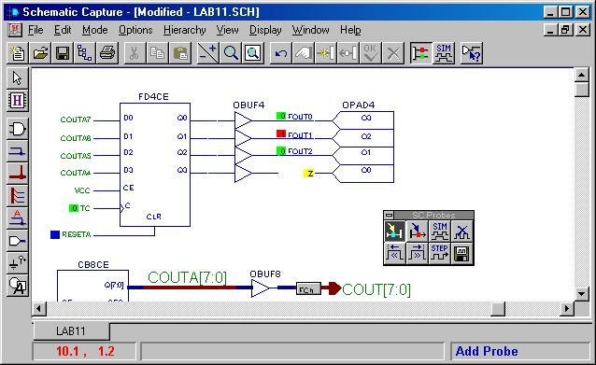
Software: to program an FPGA
Use a language VHDL (for each
module)
Use a schematic: (Top level design to merge modules)
1 entity and2 is port (a,b : in std_logic;
2 c : out std_logic);
3 end and2
4 architecture and2_arch of and2
5 begin
6 c <=a and b;
7 end and2_arch
or/and

Slide 15
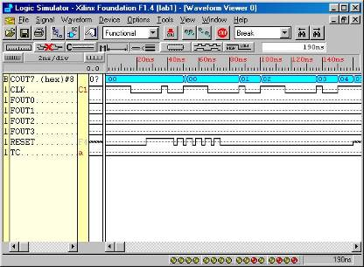
Development cycle
FPGA
development
VHDL language
Schematic (diagram)
1 entity and2 is port (a,b : in std_logic;
2 c : out std_logic);
3 end and2
4 architecture and2_arch of and2
5 begin
6 c <=a and b;
7 end and2_arch
Schematic /
VHDL
simulation

Slide 16
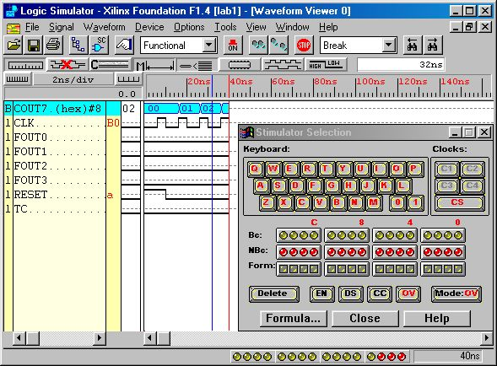
Test bench and timing simulation use simulation to see if your design is correct or not.
See the tutorial at http://www.cse.cuhk.edu.hk/~khwong/www2/ceng3430/CENG3430_1617_Tutorial_1_7a_test_bench.pptx
You create some input patterns and see if the outputs are behaving correctly or not
outputs
Inputs

Slide 17
Summary of VHDL
For hardware Design
Parallel language (not sequential)
Different! (not the same as C++ or Java)
VHDL is the industrial standard for CE.

Slide 18
An example: “And” gate in VHDL
Enitity
Entity declaration: define IOs
1 entity and2 is port (a,b : in std_logic;
2 c : out std_logic);
3 end and2
4 architecture and2_arch of and2
5 begin
6 c <=a and b;
7 end and2_arch
Architecuture
body: functional definition
a
C<=a and b
c
b
The chip

Slide 19
Computer Engineering Market
and VHDL

Slide 20
TSMC (Taiwan Semicon. Manufacturing Comp.)
台灣積體電路製造股份有限公司 http://www.tsmc.com
From Wiki:
  Has the largest asset in Taiwan stock market,
  One of the World's largest dedicated independent semiconductor foundry.
  Products: Apple iphone6 plus A8-cpu
Relation to VHDL
  Design idea→Write VHDL → TSMC→ chips

Slide 21
Huawei Technologies Co. Ltd http://www.huawei.com/en/
From wiki:
  Telecom equipment manufacture
  China large private company--http://money.163.com 500 (2011-08-25)
  Products: the second-largest supplier of mobile telecommunications infrastructure equipment in the world (after Ericsson).

Slide 22

References
See course web page
Digital Systems Design Using VHDL, Charles H. Roth (first or second edition)
Rapid Prototyping of Digital Systems, by Hamblen, James etal. Springer 2008. (read_online)
Digital Design: Principles and Practices, 4/E John F. Wakerly, Prentice Hall.
High-Speed Digital Design: A Handbook of Black Magic by Howard W. Johnson and Martin Graham Prentice Hall.
BOOKBOON (Free text books)
http://www.alldatasheet.com/

Slide 23
Appendix

Slide 24
Major companies , a comparison in 2011 (from wiki)
Company | Boeing | Nestle | Honda | Toyota | Ford | HSBC | Lenovo | BP | Sony
Revenue US Billion | 68.5 | 125 | 120 | 235 | 128 | 98.9 | 21.59 | 308.9 | 86.64
Asset | 64.3 | 126 | 125 | 370 | 166 | 2454 | 10.71 | 272.2 | 155.94
Profit US Billion | 3.3 | 39 | 1.39 | 5.07 | 6.56 | 13.15 | 0.273 | 3.3 | 2.96

Slide 25
(from wiki) Wiki: 2009年資本額約新台幣2,589.6億元,市值約1兆6,000億元，為台灣股市中市值最大的公司。http://money.163.com 中国民营企业500强榜单发布,华为第一 (2011-08-25)
Company | Apple | IBM | Microsoft | Intel | HP | TSMC 台灣積 體電路 (largest asset in Taiwan stock market) | Huawei 华为(Telecom equipm’t, China large private company)
Revenue US Billion | 65.23 | 99 | 69.94 | 43.6 | 99.87 | 13.98 | 21.8
Asset | 75.1 | 113.5 | 108.7 | 63.2 | 124.5 | 20.43 | Not known
Profit US Billion | 14.01 | 14 | 23.15 | 11.46 | 14.83 | 5.55 | 2.67

Slide 26
Tri-state Logic
A revision:’
The concept of tri-state logic is essential in computer design, so we want to revise these techniques before we move on.

Slide 27
Appendix 1:Tri-state logic
**At the float state, the wire is cut
Input
Output
Output
enable (OE)

Slide 28
Tri-state equivalent circuit
(using output connect/cut view)
Input
Output
Output
enable (OE)
Same as
Input
Output
Output
enable (OE)
OE=1, switch close
OE=0, switch open

Slide 29
Alternatively: we can treat the Tri-state equivalent circuit using the Rout impedance view
Input
A tri-state circuit diagram
Output
Output
enable (OE)
Same as
Tri-state equivalent circuit :
Rout impedance view
to explain the concept of tri-stat
OE (output enable)
controls the value
of Rout
Rout
Output
Input
Output
enable (OE)
When OE=1, Rout= small, (e.g. 50 Ω )
When OE=0, Rout=infinity (e.g. 10 MΩ)

Slide 30
Student ID: ___________,Date:_____________
Name: _______________
Exercise0.1:Tri-state logic with pull up resistor
10KΩ
5V
Input1
Output
Output-Enable (OE)
**At float the wire
is cut

Slide 31
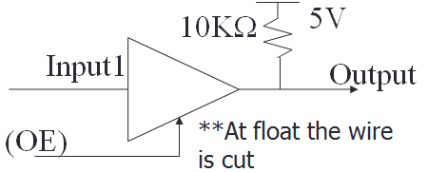
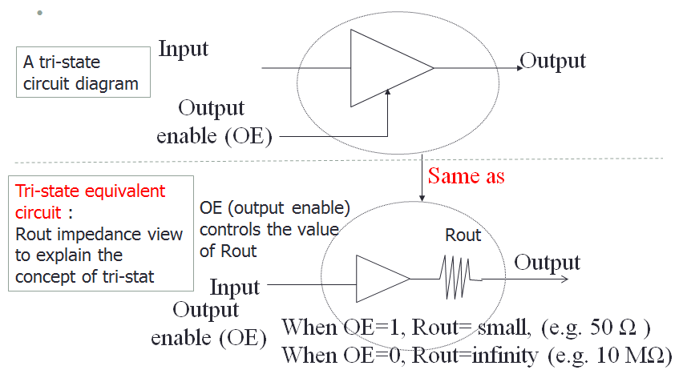
Exercise0.2: Use Rout ( Impedance view) to explain the result of exercise 0.1
Resistance view

Slide 32
Exercise 0.3
Application 1 of Tri-state logic:
Input/Output pin
OE1 controls the traffic.
Fill in the cells with ‘?’.
A
B
Directional
control(OE1)

Slide 33
Exercise 0.4
Application 2 of Tri-state logic:
Transceivers for I/O data pins
When T =1, A->B; T controls the traffic,
when /OE=1, IO pins A,B are disabled
Fill in the cells with ‘?’.
A
T
B
/OE

Slide 34
All data-lines are transceiver buffers
A good controller will enable the CPU to
read/write RAM, and read ROM
CPU data lines
/OE3,
T3
transceivers
/OE1, T1
RAM
data
lines
/OE2, T2
ROM
data
lines
transceivers
transceivers

Slide 35
Exercise 0.5 : List OE1,2,3 and T1,2,3 for the followings cases
a) CPU writes to RAM:
  /OE1=___ , /OE2___, /OE3=___, T1___, T2=____, T3_____
b) CPU reads from ROM
  /OE1=___ , /OE2___, /OE3=___, T1___, T2=____, T3_____
c) CPU reads from RAM
  /OE1=___ , /OE2___, /OE3=___, T1___, T2=____, T3_____
CPU data lines
A
B
/OE3,
T3
transceivers
/OE1, T1
RAM
data
lines
/OE2, T2
ROM
data
lines
A
B
transceivers
transceivers
B
A

Slide 36
Exercise 0.6
Application 3 of Tri-state logic:
Selection of control signal (resolved logic)
Output depends on Input_A if OE is _?___
Output depends on Input_B if OE is _?___
Discuss the operation of this circuit.
Input_A
Output
Input_B
OE

Slide 37
Exercise 0.7
Fill in ‘?’. Is it a “nor-gate” or an “or-gate”?
Discuss the operation of this circuit.
Answer :
5V
10KΩ
Output
0V
OE1
0V
OE2

