Slide 1
Tutorial 2: Introduction to ISE 14.6 (revised by khw)
CENG 3430

Slide 2
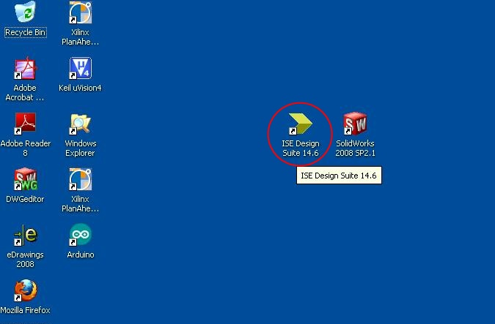
Step 1: Start up the software
Double click the ISE icon in the desktop
Or start from the Start Menu

Slide 3
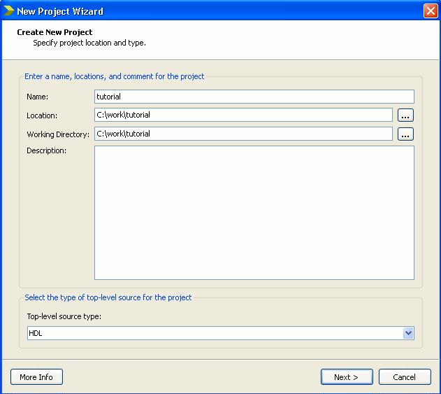
Step 2: Create a new project
Click File->Select New Project->Type ‘tutorial’->Click Next->Fill in the properties->Click Next->Click Finish
♦ Evaluation Development Board: None Specified
♦ Product Category: All
♦ Family: Spartan3A and Spartan3AN
♦ Device: XC3S50AN
♦ Package: TQ144
♦ Speed: -4
♦ Top-Level Source Type : HDL
♦ Synthesis Tool: XST (VHDL/Verilog)
♦ Simulator: ISim (VHDL/Verilog)
♦ Preferred Language: VHDL

Slide 4
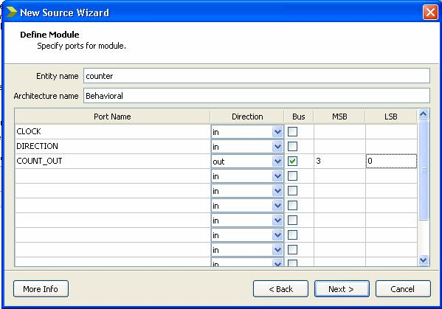
Step 3: Create a VHDL Source
Left-top (view= Implementation)
Right-click xCs50an-4tqg144
->Select New source->Select VHDL Module->Type ‘counter’->Click Next->Fill in port information->Click Next->Click Finish

Slide 5
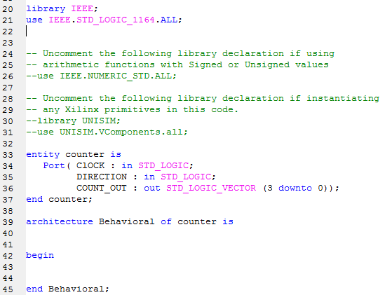
Step 4: Add your code
use IEEE.STD_LOGIC_ARITH.ALL;
use IEEE.STD_LOGIC_UNSIGNED.ALL;
signal count_int : std_logic_vector(3 downto 0) := "0000";
process (CLOCK)
begin
if CLOCK='1' and CLOCK'event then
if DIRECTION='1' then
count_int <= count_int + 1;
else
count_int <= count_int - 1;
end if;
end if;
end process;
COUNT_OUT <=count_int;

Slide 6
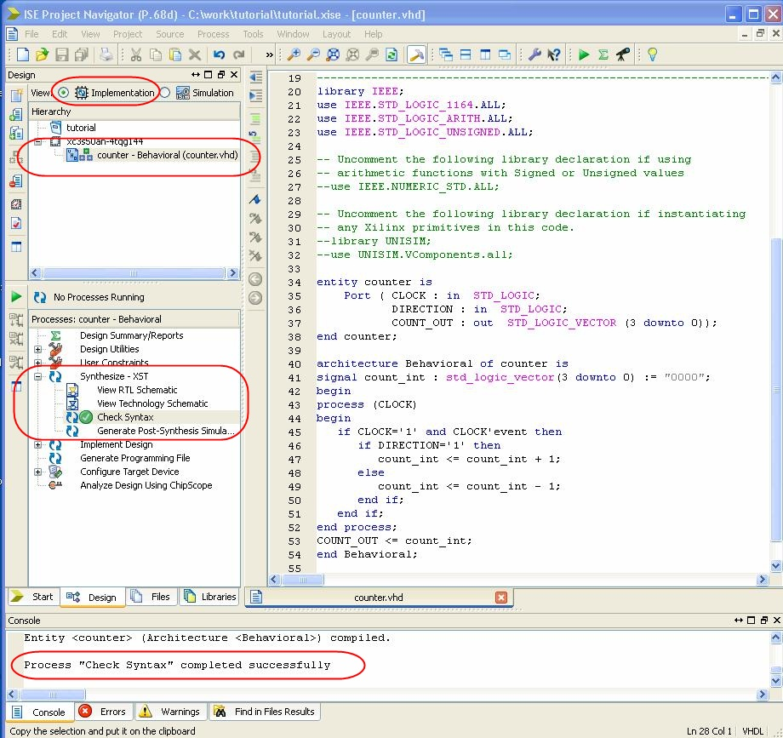
Step 5: Check the syntax
Select Implementation->Select counter source file->Select Synthesize->Double click the Check Syntax

Slide 7
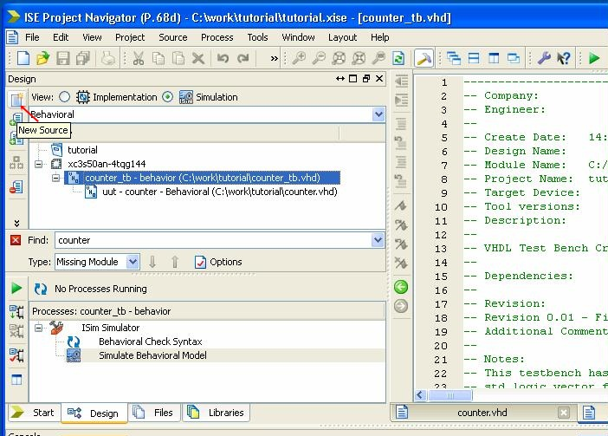
Step 6: Create a test bench
Click Simulation->Select Project->Select New Source->Select VHDL Test Bench->Type ‘counter_tb’->Click Next->Click Next->Click Finish

Slide 8
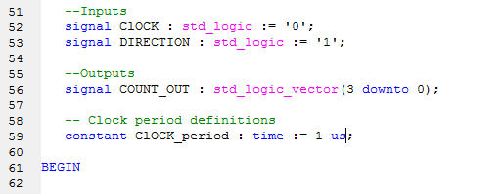
Step 7: Enter your code
Modify the code and save
Set DIRECTION to be ‘1’
Set CLOCK_period to be ‘1 us’

Slide 9
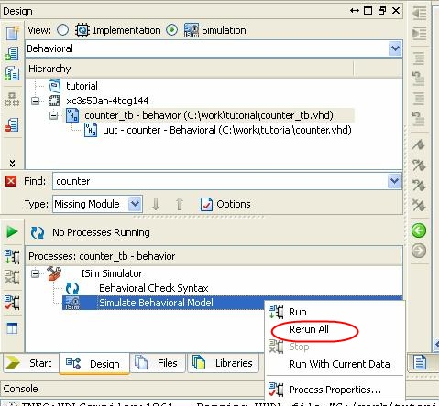
Step 8: Run the simulation
Select counter_tb->Right click Simulate Behavioral Model->Click Rerun All

Slide 10
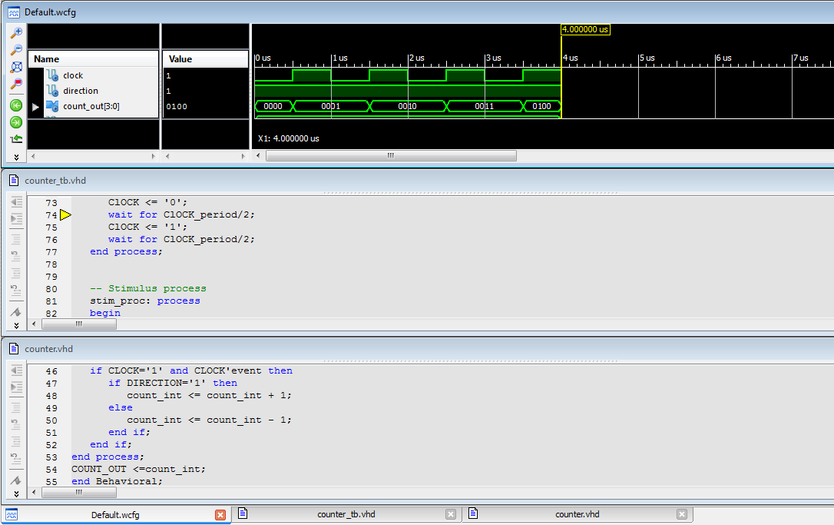
Step 8: Run the simulation
Press F11 3 times->Select Window->Select Tile Horizontally

Slide 11
Step 8: Run the simulation
Select Restart->Press F11 10 times->Use Zoom in and Zoom out to adjust the scale

Slide 12
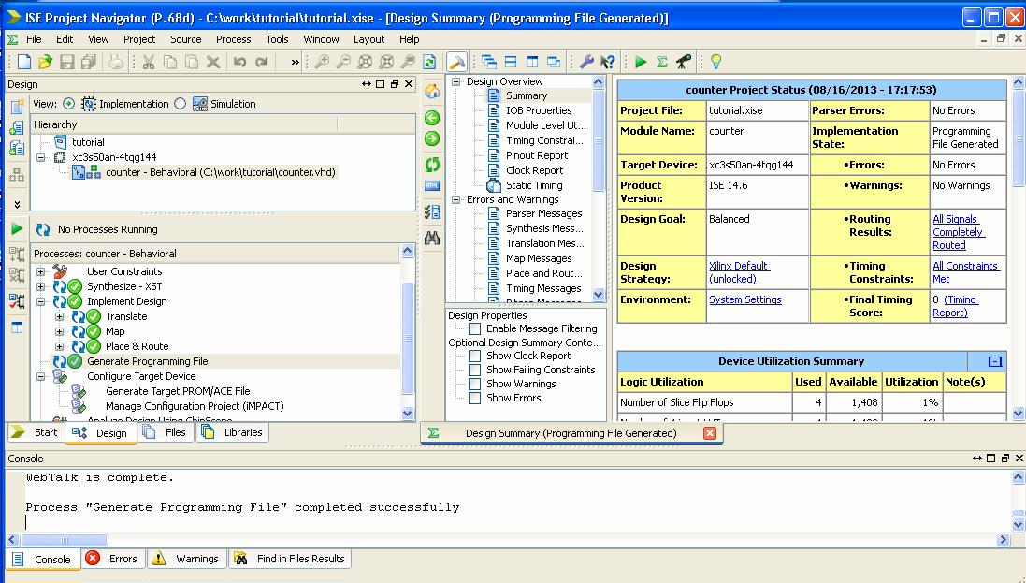
Step 9: Implement Design
Select Implementation->Double click the generate Programming File

Slide 13
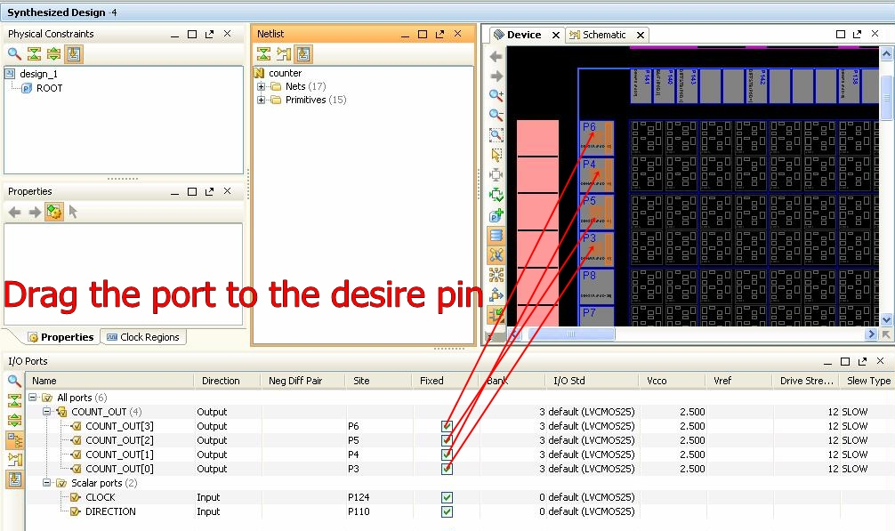
Step 10: Pin Assignment
Click User Constraints->Double click the Floorplan Area/IO/Logic->Press ‘yes’->Press ‘close’->Click the ‘+’ next to the COUNT_OUT
COUNT_OUT[0] → P3
COUNT_OUT[1] → P4
COUNT_OUT[2] → P5
COUNT_OUT[3] → P6
CLOCK → P124
(make sure you use the correct pin for the clock)
DIRECTION → P110

Slide 14
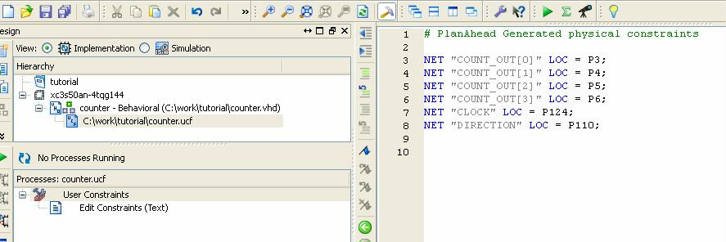
Step 10: Pin Assignment
Select File->Select Save constraints->Close the PlanAhead Window->
(left top window : View – implementation)
Double Click the counter.ucf->
Top-left window : Mouse over counter-Behavioral (counter.vhd)
Bottom-left window: mouse over/right click Generating Programming File (rerun all)

Slide 15
Step 11: Download to the board
Refer to the Tutorial 1 (appendix) and finish this step
A revision of tutorial 1. The required voltage of USB JTAG is 3.3V but that of parallel is 5V.

Slide 16
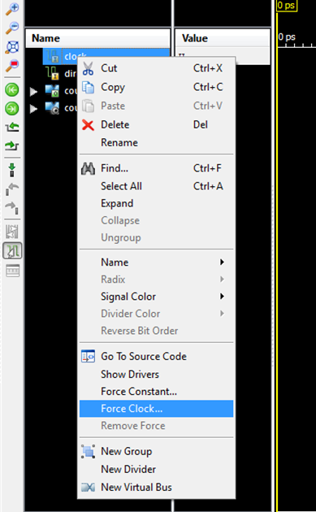
Run simulation without test bench
Force Clock

Slide 17
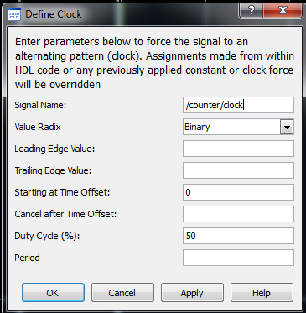
Run simulation without test bench
Force Clock
Leading Edge: the start value
Trailing Edge: the end value
e.g. Leading = 0, Trailing = 1 will make a
Remember to enter the UNIT
e.g. 50 ns, 0.5us, 1ms

Slide 18
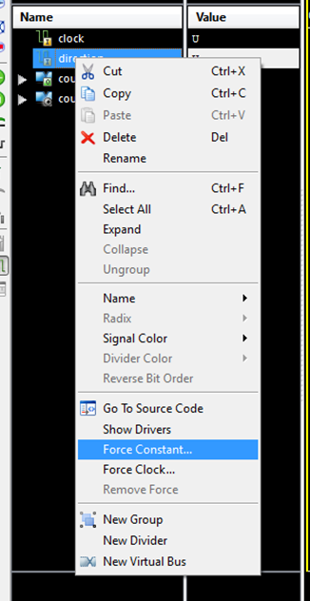
Run simulation without test bench
Force Constant

Slide 19
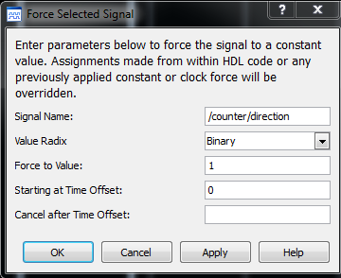
Run simulation without test bench
Force Constant

Slide 20
Appendix

Slide 21
Introduction to FPGA Board
Ceng 3430

Slide 22
Collect your board
Come to collect your board
CUHK CSE FPGA Board 2013
Xilinx USB JTAG Cable
DC 9V Adapter
Don’t forget to tick your name in the list form when collecting your board

Slide 23
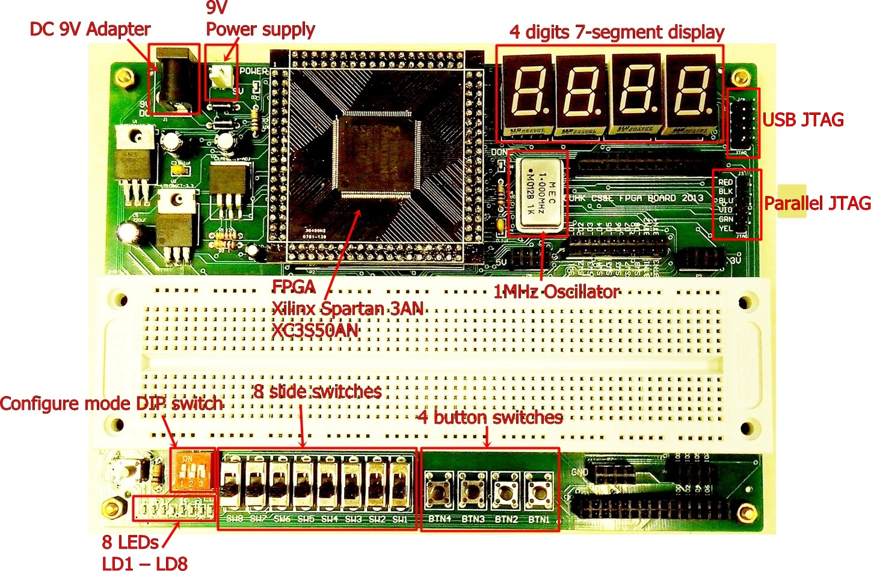
Overview diagram

Slide 24
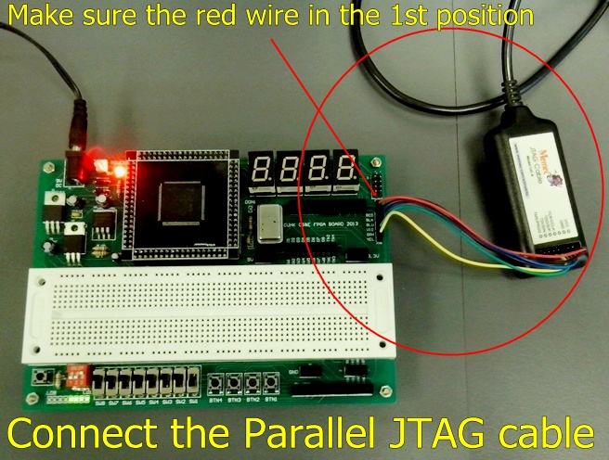
A test to your board: Step 1
Connect your board with PC using the USB JTAG cable

Slide 25
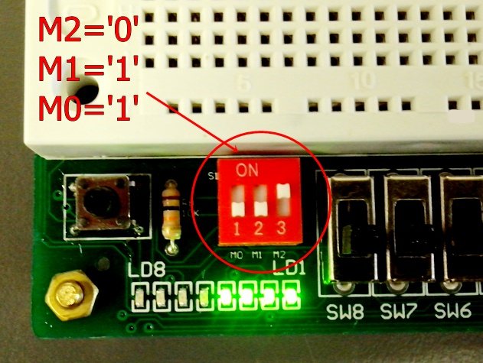
Step 2
Configure DIP switch as follows

Slide 26
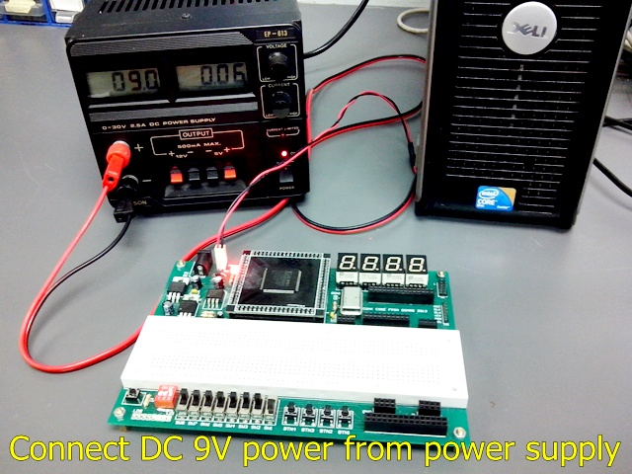
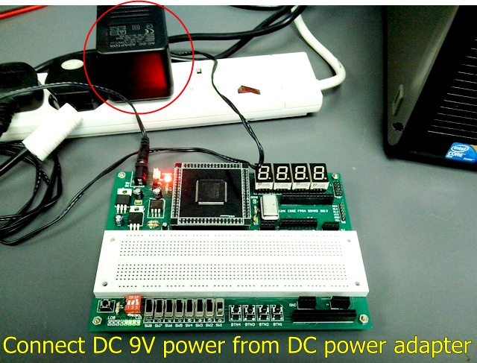
Step 3
Connect your board with power

Slide 27
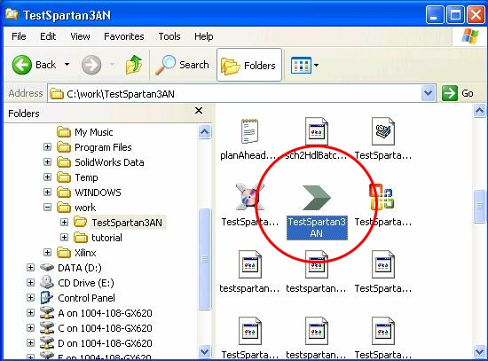
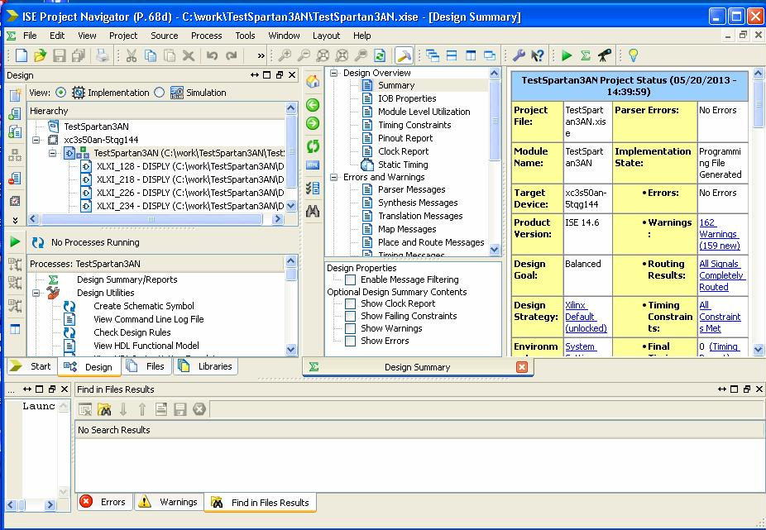
Step 4
Double click the TestSpartan3AN.xise file icon in the TestSpartan3AN folder to open the TestSpartan3AN project.

Slide 28
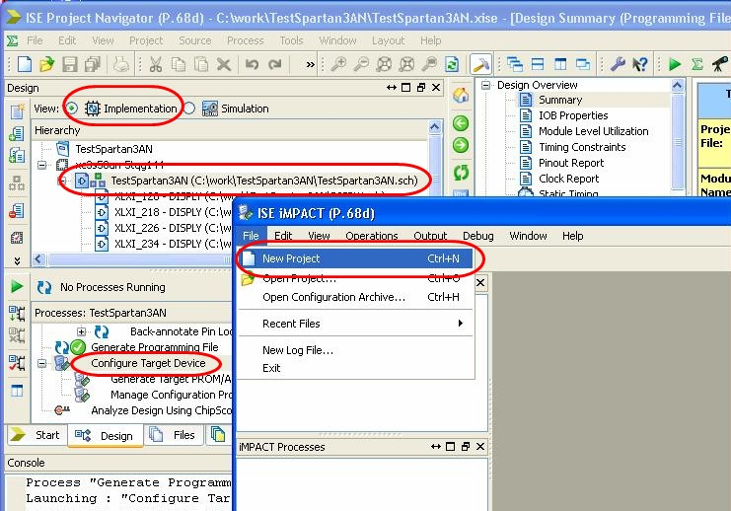
Step 5
Open iMPACT
Implementation -> TestSpartan3AN -> double-click the Configure Target Device -> iMPACT -> File -> New Project

Slide 29
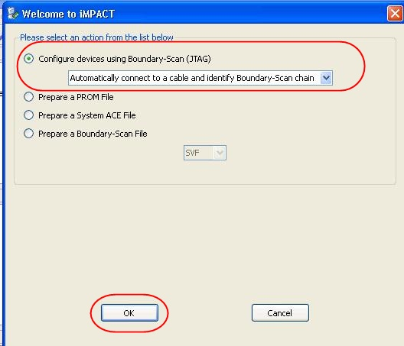
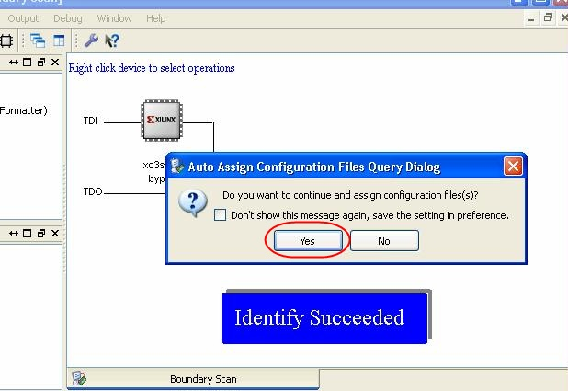
Step 6
Build a new iMPACT project

Slide 30
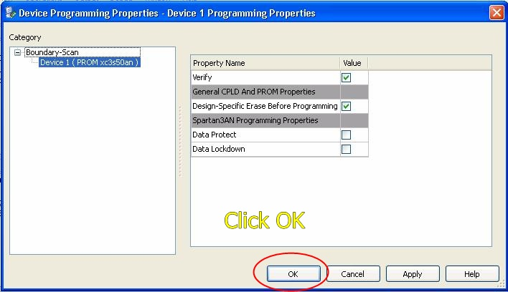
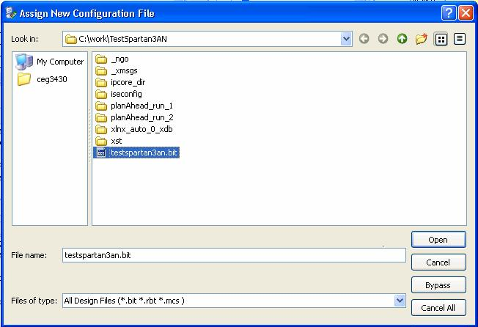
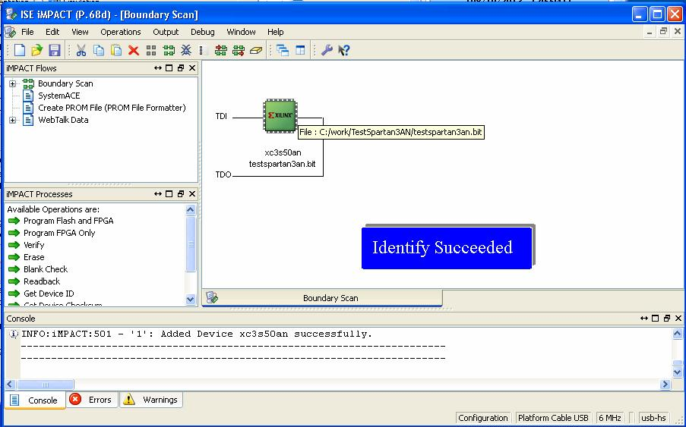
Step 7
Select testspartan3an.bit

Slide 31
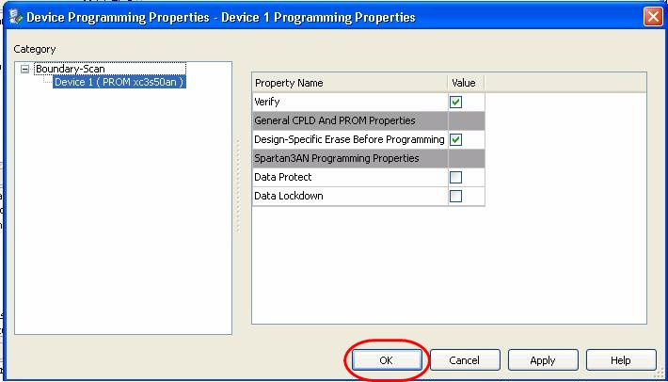
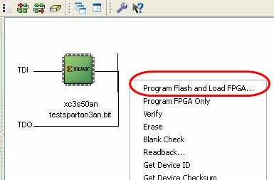
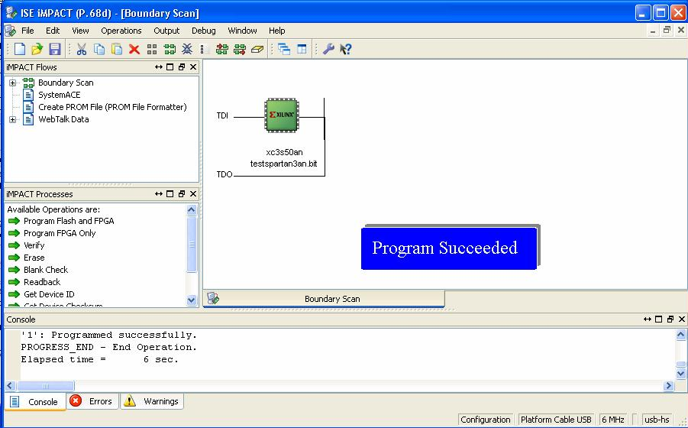
Step 8
Program flash and Load FPGA
Right-click on the xc3s50an device image, and select Program Flash and Load FPGA

Slide 32
Result
4 seven segment displays are lit and counting from ‘0’ to ‘F’

Slide 33
End
Download the materials from Blackboard system.

