Slide 1
High Speed Logic
Transmission lines

Slide 2
Transmission lines overview
(1) Characteristics of and applications of Transmission lines
(2) Reflections in transmission lines and methods to reduce them
Appendix1
  Mathematics of transmission lines

Slide 3
(1) Characteristics of and applications of Transmission lines
Advantages:
  Less distortion, radiation (EMI), cross-talk
Disadvantage
  More power required.
Applications, can hanlde
  Signals traveling in long distance in Printed-circuit-board PCB
  Signals in a cables, connectors (USB, PCI).

Slide 4
Advantage of using transmission lines:
Reduce Electromagnetic Interference (EMI) in point-to-point wiring
Wire-wrap connections create EMI.
Transmission lines reduce EMI because,
  Current loop area is small, also it constraints the return current (in ground plane) closer to the outgoing signal path, magnetic current cancel each other.

Slide 5
Transmission line problem (Ringing)
Ring as wave transmit from source to load and reflected back and forth.
Solution: Source termination method
or load termination method(see later)
Load
end
Source
end
Source
termination
Long transmission line
Load
termination

Slide 6
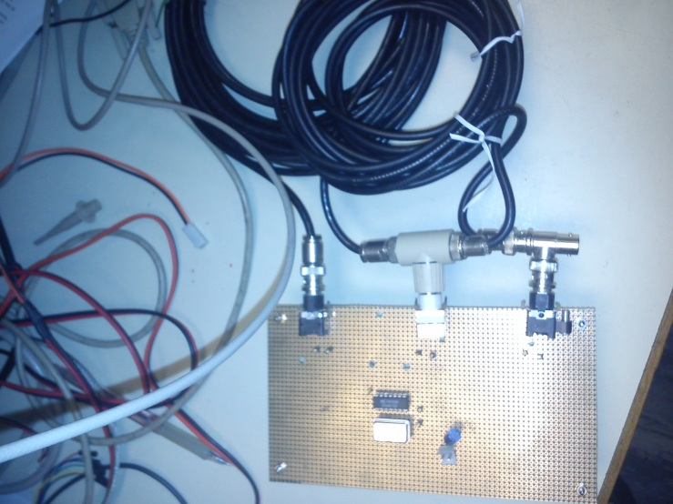
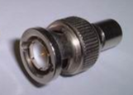
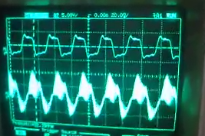
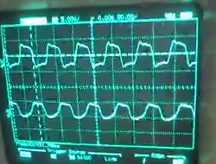
Demo
The testing board
http://youtu.be/ezGrGXSV3-s
Source
32MHz square wave
Source
Load
When R=50 Ω
(Matched load)
When R=∞ (open circuit)
Long transmission line (50 Ω)
Load
R=50 Ω
Source

Slide 7
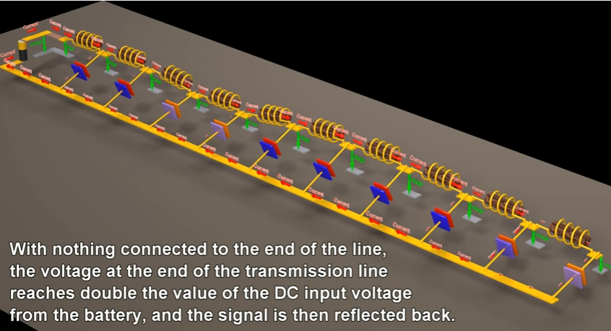
Demo
https://www.youtube.com/watch?v=ozeYaikI11g

Slide 8
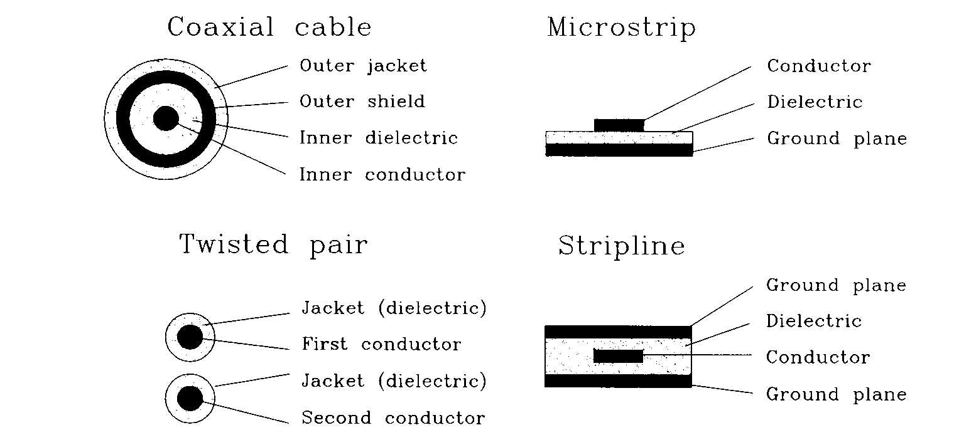
Cross sections of transmission lines to show how constant capacitance and inductance per unit length are maintained

Slide 9
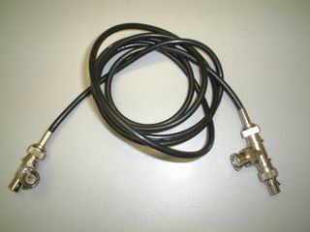
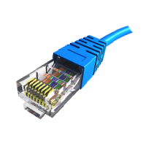

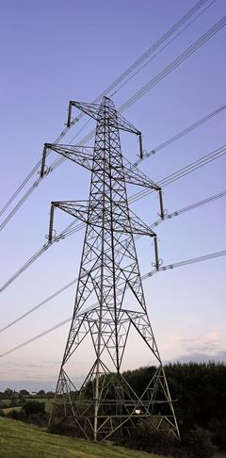
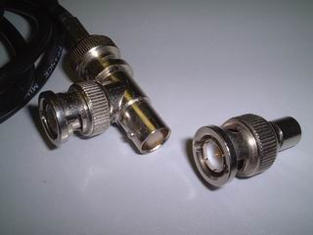
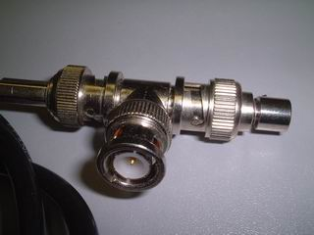
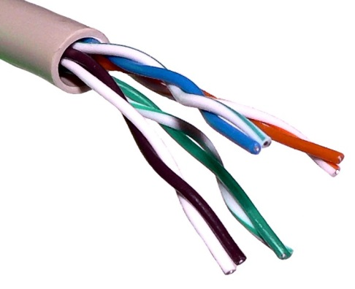
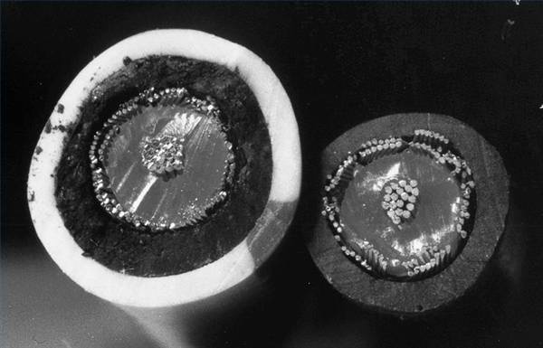
Examples of transmission lines
Transmission line for cable TV
High voltage Power lines: 115 kV or above, typical characteristic impedance 300 Ω
Connector and 50Ω terminator
Typical Ethernet Cat-5 cable: characteristic impedance 100 Ω,
Can carry up to 1GHz of signal
https://en.wikipedia.org/wiki/Category_5_cable
https://en.wikipedia.org/wiki/Electric_power_transmission
Cross section of
Coaxial transmission
http://i.ehow.com/images/GlobalPhoto/Articles/5194840/284225-main_Full.jpg

Slide 10
Characteristic of a transmission line
A transmission line has a Characteristic impedance of Z₀
Typically 50 Ohms for a coaxial cable
That means no matter where ( a distance of x meters from the source) you measure the voltage Vx over current Ix at a line is Vx/Ix=50 Ohms
Source
Zs
Load
Z_{L}
At x,
Z₀=Vx/Ix=50 Ohms

Slide 11
(2) Reflections in transmission lines and methods to reduce them
Signals inside the line
(assume the signal frequency ω is a constant)

Slide 12
Define voltages/ functions of the line
A=Vi/Vs= Input acceptance function
T= Vt/Vi=Output transmission function
R₂ =Vr/Vi=load-end reflective coefficient
R₂ =Vr/Vi
T=Vt/Vi
A=Vi/Vs
Ii
Ir
It
Rs
Vr
Vt
Z_{L}=
Load
Vs
Z₀
R₁
Vi
Source end
Load end

Slide 13
Exercises for
Transmission lines
Exercise 1
Student ID: __________________
Name: ______________________
Date:_______________
(Submit this at the end of the lecture.)
Assume a transmission line has a characteristic impedance of 50 Ohms and 10 meters long.
What is the definition of an impedance at a certain point of a circuit ?
At the source end, what is the impedance looking into the transmission line?
At a point X meters away from the source end inside the line, what is the impedance looking at that point? (Give your answers for (i) X=3.2 , and (ii) X=7.6.)
At the load end, what is the impedance looking into the transmission line?

Slide 14
Load-end reflection
Load-end reflective coefficient R₂
Output transmission function T

Slide 15
Find Load-end reflective coefficient R₂=Vr/Vi
R₂
Vt=Vi+Vr
Vi=Ii Z₀
Ii- Ir =It (kircoff law)
Vi/Z₀-Vr/Z₀=Vt/Z_{L}
Vi/Z₀-Vr/ Z₀ =Vi/ Z_{L} +Vr/Z_{L}
Vr/ Z₀+Vr/ Z_{L} = Vi/ Z₀-Vi/Z_{L}
after rearrangement, hence
R₂=Vr/Vi= [Z_{L}- Z₀ ]/ [Z_{L} + Z₀ ]
T
Ir
It
Ii
Vi
Z₀
Vr
Vt
Load
Z_{L}

Slide 16
Exercise 2
R₂=Vr/Vi= [Z_{L}- Z₀ ]/ [Z_{L} + Z₀ ]
Assume a transmission line has a characteristic impedance of Z0=50 Ohms and 10 meters long. The source impedance is RS=5 Ohms, and load impedance is RL=70 Ohms.
Draw the diagram of this circuit.
What is the meaning of Load-end reflective coefficient (R2) in English?
Calculate the value of R2 of this circuit.

Slide 17
R₂ in different types of Z_{L}
(case 1) Open circuit at load Z_{L} =∞
R₂=[1-Z0/ ∞]/[1+Z0/ ∞]=1
(*The output is doubled; used in PCI bus)
(case 2) Shorted circuit at load, Z_{L} =0
R_{2,}= -1 (phase reversal)
(case 3) Matched line Z_{L} = Z₀ =characteristic impedance
R_{2,}= 0 (no reflection) (perfect!!)
(1) Output doubled
Z_{L} =∞
(2) Signal reflect back
To source
Z_{L} =0
(3) Perfect
Z₀

Slide 18
Exercise 3
Assume a transmission line has a characteristic impedance of Z0=50 Ohms and 10 meters long. The source impedance is RS=5 Ohms, and load impedance is RL=70 Ohms.
If the load end is open,
  what is the value of RL?
  What is the value of the Load-end reflective coefficient (R2)?
  What does this value R2 tell you?
If the load end is closed,
  what is the value of RL?
  What is the value of the Load-end reflective coefficient (R2)?
  What does this value R2 tell you?
If the load end is matched,
  what is the value of RL?
  What is the value of the Load-end reflective coefficient (R2)?
  What does this value R2 tell you?

Slide 19
Load-end transmission
Output transmission function T

Slide 20
Derivation for T(ω): At load-end
(Junction between the line and load)
R₂
T
Ir
It
Ii
Define
Vt=Vi+Vr
Vt/Vi=1+Vr/Vi
and
T= Vt/Vi=Output transmission function
=Voltage input at load end/ voltage output to load at load end =Vt/Vi
=1+Vr/Vi=1+ load-end reflective coefficient (R₂)
Hence 1+ R₂=T
Vi
Z₀
Vr
Vt
Load

Slide 21
Output transmission function T=Vt/Vi
R₂=Vr/Vi
T=Vt/Vi
A=Vi/Vs
Ii
Ir
It
Rs
1+R₂=T=Vt/Vi and
R₂=Vr/Vi=[Z_{L}- Z₀ ]/[Z_{L} + Z₀ ]
Rearranging terms
T=Vt/Vi=1+R₂= 2 Z_{L}
[Z_{L} +Z₀ ]
Vr
Vt
Load
Vs
Z₀
R₁
Vi

Slide 22
Summary of Load-end
Output transmission function T
T=Voltage inside line/voltage at load
T=2 Z_{L} /[Z_{L} +Z₀ ]
Also 1+R₂=T
Finite length
Characteristic impedance = Z₀
Rs
T
source
Z₀
Z_{L}≠Z₀

Slide 23
Exercise 4
Output transmission function T
T=Vt/Vi=2 Z_{L} /[Z_{L} +Z₀ ]
Assume a transmission line has a characteristic impedance of Z0=50 Ohms and 10 meters long. The source impedance is RS=5 Ohms, and load impedance is RL=70 Ohms.
What is the definition of Output transmission function T?
If the load end is open,
  what is the value of the Output transmission function T?
  What does this T value tell you?
If the load end is closed,
  what is the value of the Output transmission function T?
  What does this value T tell you?
If the load end is matched,
  what is the value of the Output transmission function T.
  What does this value T tell you?

Slide 24
Source-end reflection
Source-end reflective coefficient R₁
Input acceptance function A

Slide 25
Source-end (R₁) reflective coefficient
Source end reflective coefficient =R₁
By reversing the situation in the load reflective coefficient case
R₁ =[Z_{s} - Z₀ ]/[Z_{s} + Z₀ ]
Finite length
Characteristic impedance = Z₀
A
Rs
T
source
R₁
R₂
Z_{L}≠Z₀

Slide 26
Source-end
Input acceptance function A
A=Vi/Vs=Voltage transmitted to line/source voltage
A=Z₀ /[Z_{s} +Z₀ ] , A Voltage divider
Finite length
Characteristic impedance = Z₀
A
Zs
T
source
R₂
R₁
Z_{L}≠Z₀

Slide 27
Exercise 5
Source-end Input acceptance function A
A=Vi/Vs=Z₀ /[Z_{s} +Z₀ ]
Assume a transmission line has a characteristic impedance of Z0=50 Ohms and 10 meters long. The source impedance is RS=5 Ohms, and load impedance is RL=70 Ohms.
What is the definition of the Source-end Input acceptance function ?
If the source end is 5 Ohms,
  what is the value of Source-end Input acceptance function A?
  What does this A value tell you?
If the source end is matched,
  what is the value of RS?
  What is the value of Source-end Input acceptance function A?
  What is the advantage of this setting (RS= characteristic impedance of the line Z0)?

Slide 28
Reflections on un-matched transmission lines
Reflection happens in un-terminated transmission line .
Ways to reduce reflections
  End termination eliminates the first reflection at load.
  Source reflection eliminates second reflection at source.
  Very short wire -- 1/6 of the length traveled by the edge (lumped circuit) has little reflection.

Slide 29
A summary
A= Input acceptance func=Z₀ /[Z_{s} +Z₀ ].
T=Output transmission func.= 2Z_{L}/[Z_{L}+Z₀]= 1+ R₂
R2=load-end reflective coef.=[Z_{L} - Z₀ ]/ [Z_{L} + Z₀ ]
R1=source-end reflective coef.=[Z_{s} - Z₀ ]/[Z_{s} + Z₀ ]

Slide 30
An example
A= Input acceptance func.
T=Output transmission func.
R2=load-end reflective coef.
R1=source-end reflective coef.
A=Z₀ /[Z_{s}+Z₀ ]=50/59=0.847
T=2Z_{L}/[Z_{L}+Z₀]=2x75/125=1.2
R₂=[Z_{L}-Z₀]/[Z_{L}+Z₀)]
= load-end reflective coef.=75-50/125=0.2
R₁=[Z_{S}-Z₀ ]/[Z_{S}+Z₀]
=Source-end reflective coef.=9-50/59= -0.695
H=Line transfer characteristic≈0.94 (some loss for many reasons: such as resistance and frequency responses)
9Ω
A
15 in. Z₀=50 Ω
T
Transmission line
1V step
75 Ω
R₁
R₂

Slide 31
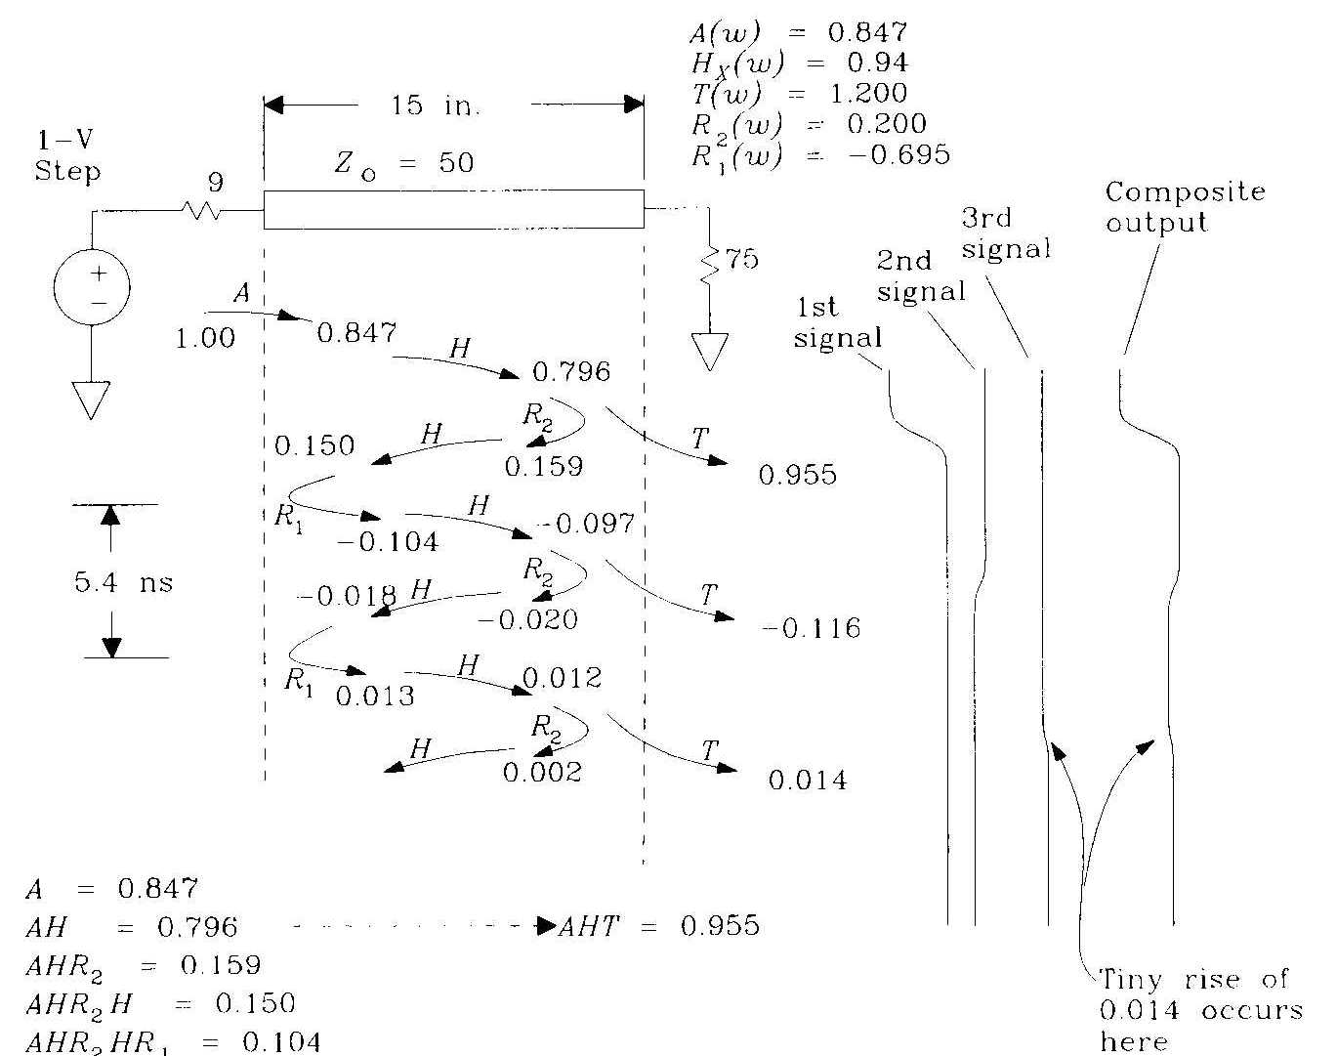
Delay=Tp=180ps/in
15in => T_{delay}= 2700ps
From [1]

Slide 32
Exercise 6 : Calculate the following values, plot the figure similar to that in the previous example.
A=Z₀ /[Z_{s}+Z₀ ]=?
T=2Z_{L}/[Z_{L}+Z₀]=?
R₂=[Z_{L}-Z₀]/[Z_{L}+Z₀)]
= load-end reflective coef.=?
R₁=[Z_{S}-Z₀ ]/[Z_{S}+Z₀]
=Source-end reflective coef.=?
H=Line transfer characteristic≈0.95(some loss for many reasons: such as resistance and frequency responses)
A= Input acceptance func.
T=Output transmission func.
R2=load-end reflective coef.
R1=source-end reflective coef.
15Ω
A
15 in. Z₀=75 Ω
T
Transmission line
1V step
100 Ω
R₁
R₂

Slide 33
Ways to reduce reflections
End termination -- If Z_{L}=Z₀, no first reflective would be generated. Easy to implement but sometimes you cannot change the load impedance.
Source termination -- If Z_{s}=Z₀ The first reflective wave arriving at the source would not go back to the load again. Easy to implement but sometimes you cannot change the source impedance.
Short (lumped) wire: all reflections merged when
  Length << T_{rise}/{6 (LC) }
  But sometimes it is not possible to use short wire.

Slide 34
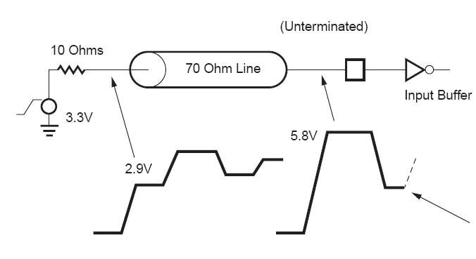
Application to PCI bus from 3.3 to 5.8V
http://direct.xilinx.com/bvdocs/appnotes/xapp311.pdf
Z_{L}=un-terminated=∞
T=2Z_{L}/[Z_{L}+Z₀ ]=2
So 2.9*2=5.8V
Line is short (1.5 inches) so
Line transfer characteristic P=1.
Vin*A=
3.3*70/(10+70)
=2.9V

Slide 35
From: http://direct.xilinx.com/bvdocs/appnotes/xapp311.pdf
[The PCI electrical spec is defined in such a way as to provide open termination incident wave switching across a wide range of board impedances. It does this by defining minimum and maximum driving impedances for the ICs output buffers. The PCI specification also stipulates mandatory use of an input clamp diode to VCC for 3.3V signaling. The reason for this is to ensure signal integrity at the input pin by preventing the resultant ringing on low-to-high edges from dipping below the switching threshold. To see this, consider the unclamped case, which is shown in Figure 3. A 3.3V output signal from a 10 ohm source impedance1 into a 70 ohm transmission line will generate an incident wave voltage of 5.8V at the receiving end. After two flight delays, a negative reflected wave will follow, getting dangerously close to the upper end of the input threshold2.]

Slide 36
Exercise 7
Input= 1 V step
Length L = 10 inches.
Characteristic impedance Z0= 75Ω.
Source impedance RS= 5Ω.
Load impedance RL= 120Ω.
Line transfer characteristic P = 0.9.
Time delay per inch of the line Tp= 160 ps/in.
Sketch the waveform of the signal at the load between the time is 0 and the time when the signal is reflected back to the load end the second time. Mark clearly the time and voltage levels when the signal reaches the load the first time and the second time.
How do you change the values of RL and RS if you want to have a 0.5 V voltage step at the output without ripples?
What is the highest output voltage for all possible RL and RS?
How do you change the values of RL and RS if you want to have a peak of 1.3 V voltage at the output (ripples are allowed)?
Describe with explanation two methods to reduce reflections in a transmission line.

Slide 37
Answer of Exercise 7 (included for reference)
Similar to the example discussed.
How do you change the values of RL and RS if you want to have a 0.5 V voltage step at the output without ripples? (answer: two methods (i) set Rs=Z0 for no source reflection, RL=93.75 Ohms. (ii) set RL=75 Ohms , no load reflection, Rs =60 Ohms)
What is the highest output voltage for all possible RL and RS? ANS:(RS=0, RL=infinity) Vout=p*T_{max}=0.9*2V
How do you change the values of RL and RS if you want to have a peak of 1.3 V voltage at the output (ripples are allowed)? ANS: p*T=0.9*2*RL/(Z0+RL)=1.3, (Rs=0, RL=195). You may use a smaller value for RS similar to the PCI bus, say 10 Ω.

Slide 38
Conclusion
Studied Characteristics of transmission lines.
Studied ways to terminate the line to avoid reflection.

Slide 39
References
[1]Chapter4 of High speed digital design , by Johnson and Graham
[2] Kreyszig, Advanced Engineering maths, edition 6, Page 74
[3] Buckley, Transmissions networks and circuits , The Macmillan press. Page 1
[4]http://direct.xilinx.com/bvdocs/appnotes/xapp311.pdf (For PCI application)

Slide 40
Appendix 1

Slide 41
Mathematics of transmission lines

Slide 42
Main formulas (for proof, see appendix 1)
If γ = [(R+ j ω L)(G+j ω C)]
V=Ae^{-γx} +Be^{γx} ----------------------(13)
I=(A/Z₀)e^{-γx} - (B/Z₀)e^{γx} ------------(14)
Z₀= [(R+j ω L)/(G+j ω C)]=characteristic impedance

Slide 43
Incident and reflective waves
Source
termination
Long transmission line (characteristic impedance Zo, typically = 50 Ohms)
Load
termination
V_{x}=Ae^{-γx} +Be^{γx}
I_{x}=(A/Z₀)e^{-γx} -(B/Z₀)e^{γx}
γ = [(R+ j ω L)(G+j ω C)]
Z₀= [(R+j ω L)/(G+j ω C)]=characteristic impedance
x
Vx=voltage at X
Ix=current at X
Reflective wave
Incident wave

Slide 44
Characteristics of ideal Transmission lines
Ideal lossless transmission lines
  infinite in extent
  signals on line not distorted/ attenuated
  but it will delay the signal measured as picoseconds/inch, this delay depends on C and L per unit length of the line. (by EM wave theory)
  Delay (ps/in)=10⁺¹² [(L per in)*(C per in)]
  Characteristic impedance = [L per in/C per in] Ω

Slide 45
Appendix 1
Math of transmission lines

Slide 46
Characteristics of ideal Transmission lines
Ideal lossless transmission lines
  infinite in extent
  signals on line not distorted/ attenuated
  but it will delay the signal measured as picoseconds/inch, this delay depends on C and L per unit length of the line. (by EM wave theory)
  Delay (ps/in)=10⁺¹² [(L per in)*(C per in)]
  Characteristic impedance = [L per in/C per in] Ω

Slide 47
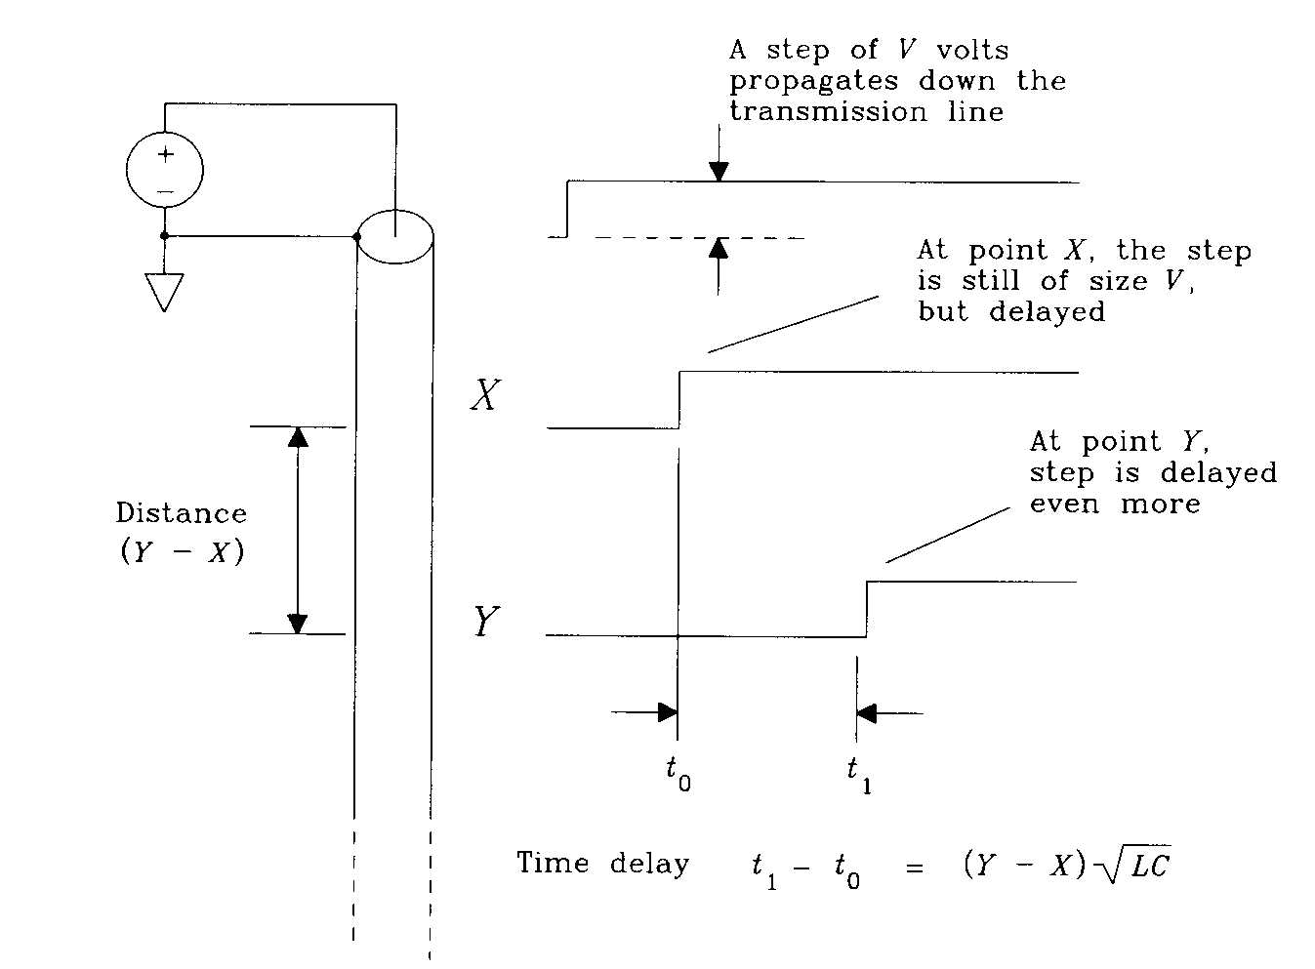
Step response of transmission lines
(by EM wave theory)

Slide 48
Delay and impedance of ideal transmission lines
Step (V) input to an ideal trans. line (X to Y) with C _{per in} =2.6pF/in, L _{per in} =6.4nH/in .
C_{xy}=(C _{per in})(Y-X)
Charge held (Q)= C_{xy} V=(C _{per in})(Y-X)V
Per unit length Time delay (T)=(Y-X) [(L _{per in})(C _{per in})]
Current=I=Q/T
I= (C per in)(Y-X)V = V* (C/L)
{(Y-X){[(L _{per in})(C _{per in})]}^{1/2}
Z₀=V/I= (L _{per in} /C _{per in} ) =⁽6.4 nH/2.6 pF) ^{1/2} =50Ω
By EM wave theory

Slide 49
A quick reference of the important transmission line formulas
V= Ae^{-γx} + Be ^{+γx}
I ⁼ ⁽A/Z₀)e^{-γx} - (B/Z₀)e ^{+γx}
Where A, B are constants.
Z₀ =characteristic impedance is real.
γ ⁼ propagation coefficient is complex
Derivations will be shown later

Slide 50
A small segment
For a small segment δx
A long transmission line
R=resistance; G=conductance; C=capacitance; L=inductance. All unit length values.
Δv
R δx L δx
i
v
G δx
C δx
δx

Slide 51
For the small segment of wire
--(horizontal voltage loop)
-(∂v/ ∂x) δx=R δx i + L δx (∂ i/ ∂ t)
--(vertical current loop)
-(∂i/ ∂x) δx=G δx v + C δx (∂ v/ ∂ t)
-(∂v/ ∂x)=Ri+L(∂ i/ ∂ t) ------------------(1)
-(∂i/ ∂x)=Gv+C(∂ v/ ∂ t) ------------------(2)
Applying phasor equations, I,V depend on x only , not t
v=Ve^{j ω t} --------------------------------------(3)
i=Ie^{j ω t} ----------------------------------------(4)

Slide 52
Applying phasor equations, I,V depend on x only, not t
But v,i depend on t and x v = Ve^{j ω t} ---------------------------------------(3) i = Ie^{j ω t} ----------------------------------------(4)
Hence from (3) and (4)
(∂v/ ∂x)= e^{jω t}(d V / d x) --------------------(5) (∂v/ ∂t)= j ω V e^{jω t}--------------------------(6)
(∂i/ ∂x)= e^{jω t}(d I / d x) ----------------------(7)
(∂i/ ∂t)= j ω I e^{jω t}----------------------------(8)
Since in general, ∂ e^{kt} / ∂t = k e^{kt}

Slide 53
Put 5,4,8 into 1
-(∂v/ ∂x)=Ri+L(∂ i/ ∂ t) -------------(from 1)
-(dV /d x )e^{jω t} = R I e^{jω t} + L j ω I e^{jω t}
-(dV /d x ) = (R+j ω L)I --------------------(9)
=> -(d²V/dx²)=(R+j ω L)dI/dx
= -(R+j ω L)(G+j ω C)V
(d²V/dx²) = +γ²V --------------------------(11)
where γ = [(R+ j ω L)(G+j ω C)]
(5)
(8)
(4)
(10, see next page)

Slide 54
Put 7,3,6 into 2
-(∂i/ ∂x)=Gv+C(∂ v/ ∂ t) ------------(from 2)
-(dI /d x )e^{jω t} = G V e^{jω t} + Cj ω V e^{jω t}
-(dI /d x ) = (G+j ω C)V-----------------(10)
=> -(d²I/dx²)=(G+j ω C)dv/dx
= -(G+j ω C)(R+j ω L)I
(d²I/dx²) = + γ² I --------------------------(12)
where γ = [(R+ j ω L)(G+j ω C)]
(7)
(3)
(6)
(9, see previous page)

Slide 55
From the wave equation form
(see [2] , Homogeneous 2nd order differential equations, also see appendix2,3)
(d²V/dx²) = γ²V -------(11)
(d²I/dx²) = γ² I ---------(12)
where γ = [(R+ j ω L)(G+j ω C)]
Solution is
V=Ae^{-γx} +Be^{γx} ----------------------(13)
Differentiate (13) and put into (9), see appendix 2
I=(A/Z₀)e^{-γx} - (B/Z₀)e^{γx} ------------(14)
Z₀= [(R+j ω L)/(G+j ω C)]=characteristic impedance

Slide 56
Different transmission lines
(Case 1) Infinite transmission line; impedance looking from source is the characteristic impedance Z_{0.}
(Case2) Matched line (finite line with load connected to Z₀) has the same property as an infinite transmission line
(Case3) unmatched line : reflection will occur

Slide 57
(Case1) Infinite transmission line
For Infinite line, the impedance is the characteristic impedance Z₀
Characteristic impedance = Z₀
Impedance
looking
from
source=
Z₀
∞

Slide 58
Infinite transmission line: characteristic impedance= Z₀
V_{s} is driving an infinite length trans. Line
Since V_{x}=Ae^{-γx} +Be^{γx}
At x=0, V₀=V_{s}= Ae⁰ +Be⁰=A+B
AT x= ∞,V ∞ = Be∞ =0 (so B =0, meaning no reflection occurs at infinite line)
X=0
∞
Vs
V₀
At x= ∞, V ∞ =0

Slide 59
Infinite transmission line: characteristic impedance= Z₀
V_{s} is driving an infinite length trans. line
At source position X=0,V=Vs=Ae⁰+Be⁰
At X=infinity, V→0 voltage is completely attenuated. 0=Ae^{-γx}+Be ^{+γx},
The only solution is B=0, A=V_{s}(no reflection)
Hence V=V_{s}e^{-γx} , I= (V_{s}/Z₀)e^{-γx,}
V/I= V_{s}e^{-γx} / (V_{s}/Z₀)e^{-γ}x = Z₀=characteristic impedance (a constant)

Slide 60
(Case 2) Matched line (no reflection)
A finite length line with characteristic impedance Z₀ is connected to a load of Z₀. It has the same property as an infinite transmission line (**no reflection)
Finite length
Characteristic impedance = Z₀
Same as
infinite line:
Impedance
looking
from
source=
Z₀
Z₀

Slide 61
Matched line, characteristic impedance= Z₀ (Same as infinite line, no reflection)
Matched line
  Infinite line input impedance = Z₀
  A finite length line terminated by Z₀ is matched line, it also has the same property as infinite lines. Therefore V=V_{s}e^{-γx} , I= (V_{s}/Z₀)e^{-γx,}
un-matched line is different, it has reflections inside.
Z₀
Z_{o}
Z_{o}
l
l
Infinite line

Slide 62
Appendix2: 2nd order homogenous differential equation
Page 74 of [2], use ()’=d /dx
y’’+ay’+by=0 ------(i)
Put y=e^{λx} ,hence (1) becomes
(λ²+a λ+b) e^{λx} =0,
The solutions for the equation (λ²+a λ+b) are
λ1=(-a+[a²-4b]^{1/2})/2 and λ2=(-a-[a²-4b]^{1/2})/2
The solutions to (1) are y₁=e ^{λ1x} and y₂=e ^{λ2x}
The general solution is y=Be ^{λ1x} +Ae ^{λ2x ,} find constants B,A from boundary conditions.

Slide 63
Appendix2 continue: Our transmission line equation
The standard form is y’’+ay’+by=0 ------(i)
Our equation is (d²V/dx²) = +γ²V
Solutions for (λ²+a λ+b) or (λ² -γ²)=0,
where a=0, b= -γ²
λ1=(-a+[a²-4b]^{1/2})/2 =(-0+[0²+4γ²]^{1/2})/2= γ
λ2=(-a-[a²-4b]^{1/2})/2 =(-0-[0²+4γ²]^{1/2})/2= -γ
The solutions to (i) are
y₁=e^{γ x} and y₂=e ^{-γx}
The general solution is y=Be^{γx} +Ae^{-γx,} find B,A from boundary conditions.

Slide 64
Appendix 3, from ref. [3]
-(dV /d x ) = (R+j ω L)I --------------------(9)
V=Ae^{-γx} +Be^{γx} ----------------------(13)
Differentiate (13) w.r.t. dx
dV/dx=-γAe^{-γx} + γ Be^{γx}, put this into (9), hence
(R+j ω L)I= γAe^{-γx} - γ Be^{γx}
I= (γAe^{-γx} - γ Be^{γx})/ (R+j ω L)
I=(A/Z₀)e^{-γx} - (B/Z₀)e^{γx}
Since γ = [(R+ j ω L)(G+j ω C)]^{1/2} and
Z₀= [(R+j ω L)/(G+j ω C)]^{1/2}

