Slide 1
Arm board tutorial
Part 1
Using the ARM board
And start working with C
Tutorial 5 and 6

Slide 2
Outline
Software
Hardware
Download the program to the board
The ARM7 board test program

Slide 3
Materials distributed
Materials will be distributed:
  NXP LPC2131 x 1
  FT232BL x 1
  Power adapter x 1
  USB cable x 1
Please use them CAREFULLY
You MUST return all the materials at the end of this semester
  30 marks will be deduced if you lose or don’t return anyone of them

Slide 4
Hints for the exercises
The User manual (UM10120.pdf) and the Schematic of the board are VERY usefully
You may need to check the lecture notes

Slide 5
Software
Setup the uVision project …

Slide 6
Start working with C
New Project
  Project → New μVision Project…
  Find somewhere to save you project
  choose NXP → LPC2131
  with Startup.s
  Edit Startup.s
    comment the line 430

Slide 7
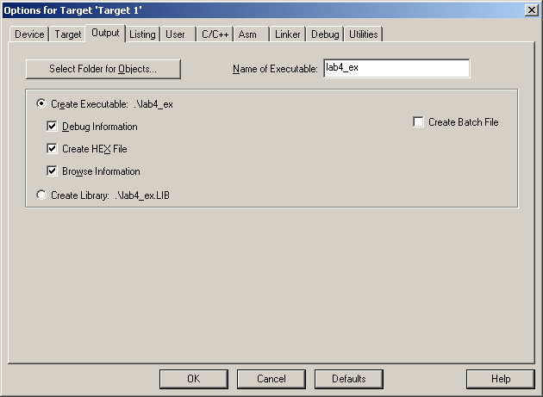
Start working with C
Project → Options for target1
  At "Linker" tab
    select “Use Memory Layout from Target Dialog”
  At "Output" tab
    select “Create HEX File”

Slide 8
Start working with C
Create a C file
  File → New…
  File → Save
  Find a good place to save your code
    e.g. same folder as the project file
  End the file name with ".c"
    Some examples : main.c, test_c.c
    Bad examples: a.c, asd.c

Slide 9
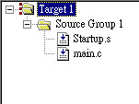
Start working with C
Add the code into your project
  Project → Manage → Components, Environment and Books → Add files
  Locate the C file you just saved
  Your project should look like this:

Slide 10
Start working with C
Paste the following template to your code:
#include <lpc213x.h>
int main(){
while(1);
return 0;
}

Slide 11
Start working with C
#include <lpc213x.h>
  tell the compiler to use the header file "lpc213x.h"
  lpc213x.h defines all the register address for the devices in LPC213x family
    IOPIN0 for GPIO0, U0THR for UART0

Slide 12
Start working with C
int main(){
while(1);
return 0;
}
  the function "main" is the entry point of your program after the running the instructions in "Startup.s"
  "while(1);" is an infinite loop which keeps the processor busy

Slide 13
Hardware
Introduction to the CUHK ARM7 board 2012

Slide 14
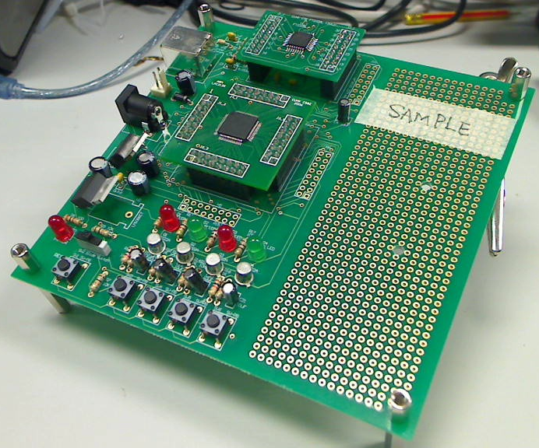
CUHK ARM Board 2012
The latest version of the board

Slide 15
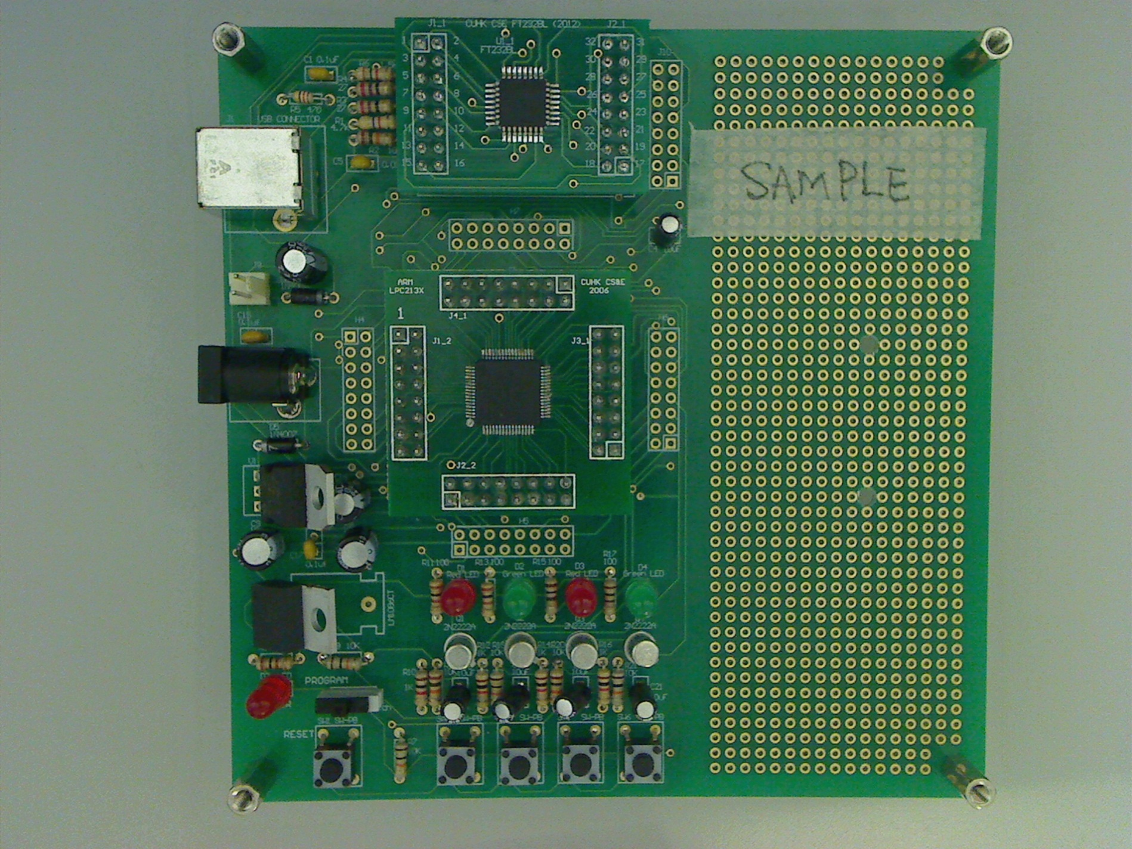
CUHK ARM7 board 2012
Serial ↔ USB IC
A simple prototype board
Connect to computer
Power
NXP LPC2131
Reset

Slide 16
CUHK ARM7 board 2012
Serial ↔ USB IC
A simple prototype board
Connect to computer
Use Power Supply (9V)
OR
Use power adapter
NXP LPC2131
A Slide switch
(Pull right is the programming mode; Pull left is the normal mode)
Always light up with power on
Press to reset

Slide 17
Install the Serial ↔ USB driver
After you power on and connect the board to computer, you may need to install the driver for the Serial ↔ USB chip
Please download the driver from BlackBoard, named “CDM20828_Setup.exe”
  You can also download the driver from this link
  http://www.ftdichip.com/Drivers/VCP.htm
Please install it, then, re-connect the board to computer
Now, go to Device Manager to check the board can be recognize by the computer or not

Slide 18
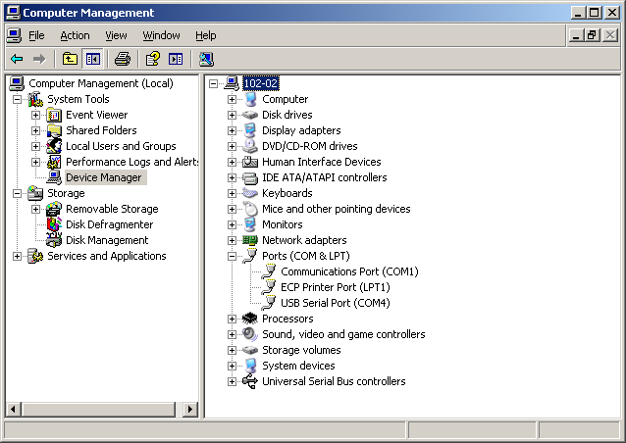
Install the Serial ↔ USB driver
Your board is ready to use if this appear

Slide 19
Flash the program to the board

Slide 20
Download to the Board
Create a HEX file
Use the Flash Tools by Philips(LPC21XX)
  You can install it in your own computer
  Please download “Philips Flash Utility Installation.exe” and install it if you needed

Slide 21
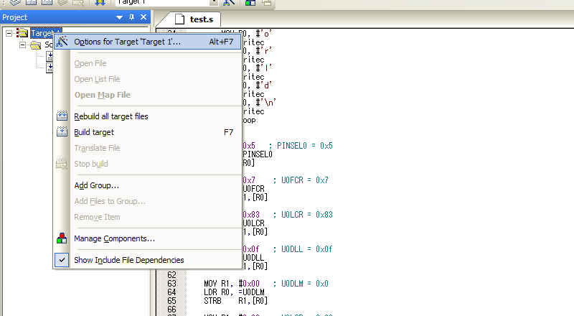
Check the project setting
Choose “Option for Target…”

Slide 22
Check the project setting
Make sure “Create Hex File” in Output tab is selected

Slide 23
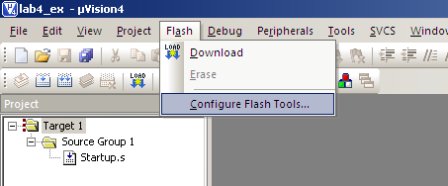
Configure the Flash Tool
Click “Flash”, select “Configure Flash Tools…”

Slide 24
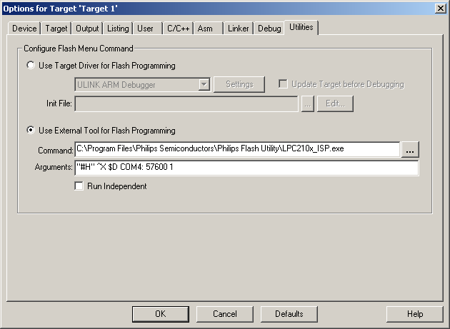
Configure the Flash Tool
Make sure this part is same as follow
(If you install the tool in your own computer, the path will be different. Please find it from your installed directory)
Make sure it is correspond to the COM device of the board (Mostly it is COM4)
You may need to check the Device Manager to confirm
Change to 57600

Slide 25
Check the Hardware connection
Connect the USB cable
Set the slide switch (SW2) to programming mode (Right)
Press the reset button
Please pull to Right

Slide 26
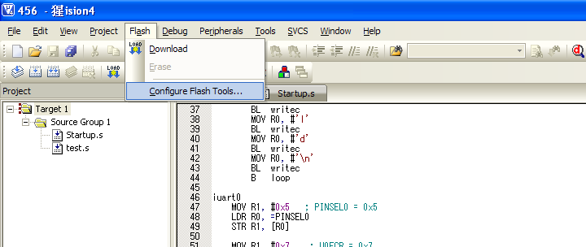
Download

Slide 27
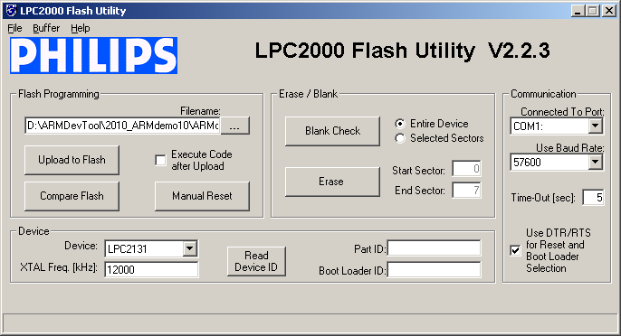
Upload
Click “Upload to Flash” if not start automatically
On error, please check:
  Any other program using the serial port?
  Make sure the switch is connected
  Push the reset button

Slide 28
Lab Exercise
Create a new project
  Please mark sure all the settings are correct
Download the “gpio.s” form BlackBoard
Add it to the project
Compile and download it to the board
Observe and test the result
Now, change the “BEQ” in line 23 to “BNE”
Compile and download to the board again
Observe the result, state the differences between the previous

Slide 29
Lab Exercise
Remove the “gpio.s” in the project
Create a new file, called “gpio.c” and add it to the project
Re-write the previous two “gpio.s” in C
  The original one and the modified one
Compile and download to the board
Can you re-produce the previous two results?

Slide 30
The ARM7 board Test program
You may use it to test out the board you make …

Slide 31
Test program of the board
You can download a test program, named “TestProg.hex” from BlackBoard to test out your board

Slide 32
To use this test program …
Connect the board to the computer
Pull the slide switch to the programming mode
Press the Reset button
Please go to “Start” -> “All Programs” -> “Philips Semiconductors” -> “Flash Utility” -> “Launch LPC210x_ISP.exe”
Click “Launch LPC210x_ISP.exe” to start the Flash Tool

Slide 33
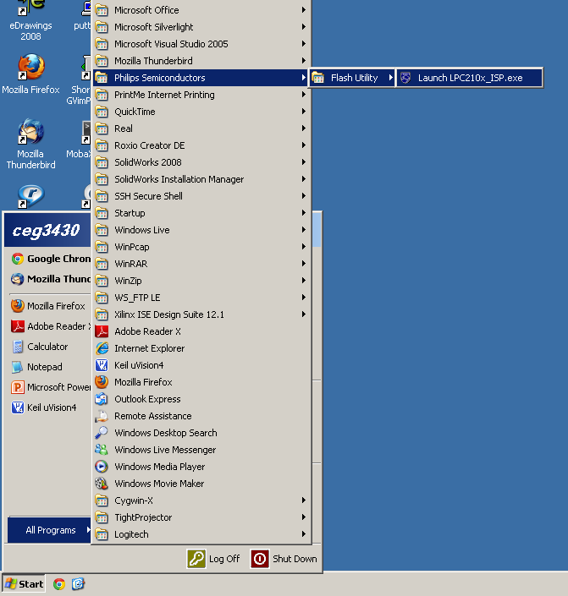

Slide 34
Setting the Flash Tool
Select the corresponding the COM port (Mostly is COM4). You may need to check it for Device Manager
Click this. Select the “TestProg.hex” file you downloaded
After the settings are finished, Click this to download the program to the board
Select 57600

Slide 35
To use this test program …
Wait the download process is finished
  If it is not success, please redo the pervious steps again
Pull the switch back to the normal mode
Press the Reset button
Now, the test program is running. You may observe the LEDs are blink. Also, you can turn on/off those LEDs using the push buttons

Slide 36
part 2

Slide 37
Building LDR module
Building LDR module

Slide 38
Supplementary…

Slide 39
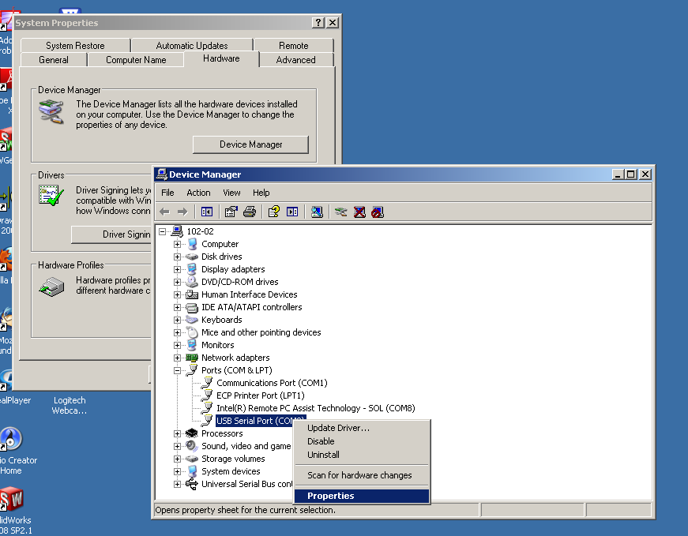
Change the COM Port Number
Select “Properties”

Slide 40
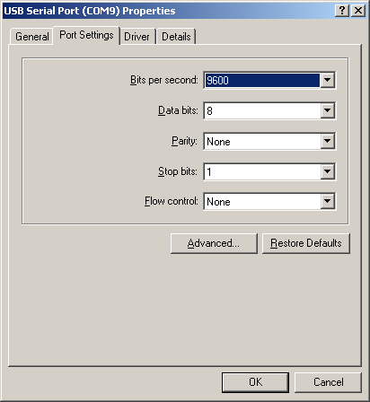
Change the COM Port Number
Click “Advanced…”

Slide 41
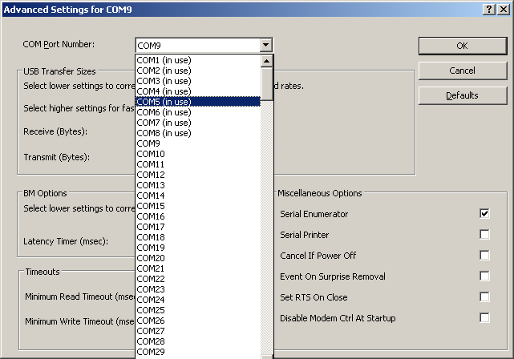
Change the COM Port Number
Select the COM Port Number which between COM2-COM5

Slide 42
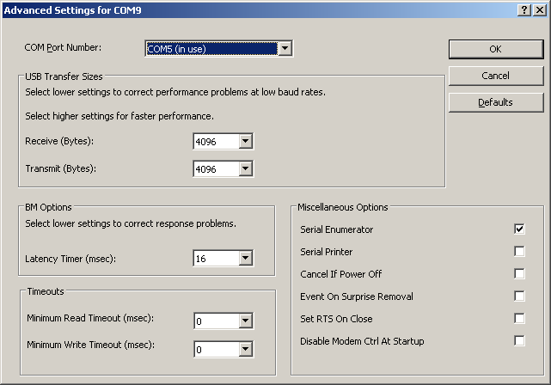
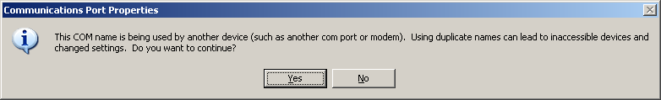
Change the COM Port Number
Click “Yes”

Slide 43

Change the COM Port Number
Click “OK”

Slide 44
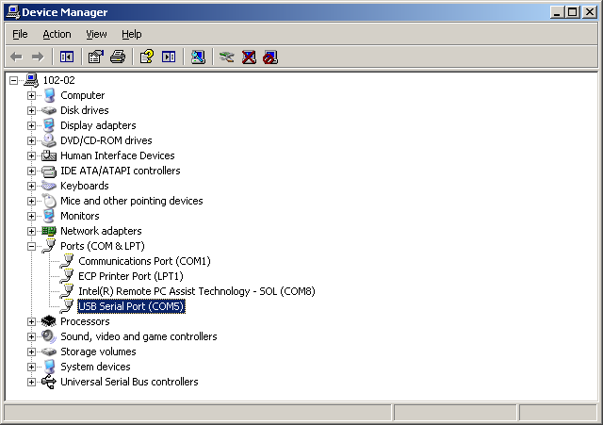
Change the COM Port Number
Now, the COM Port Number is changed

Slide 45
Using Hyper Terminal

Slide 46
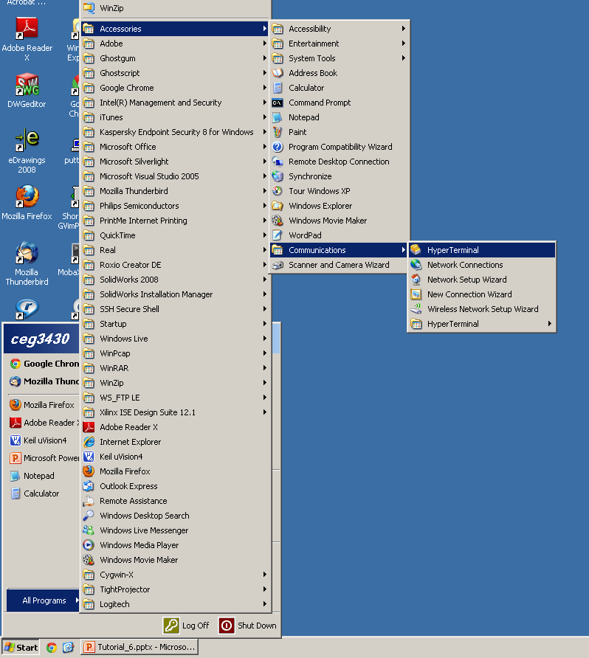
Using Hyper Terminal

Slide 47
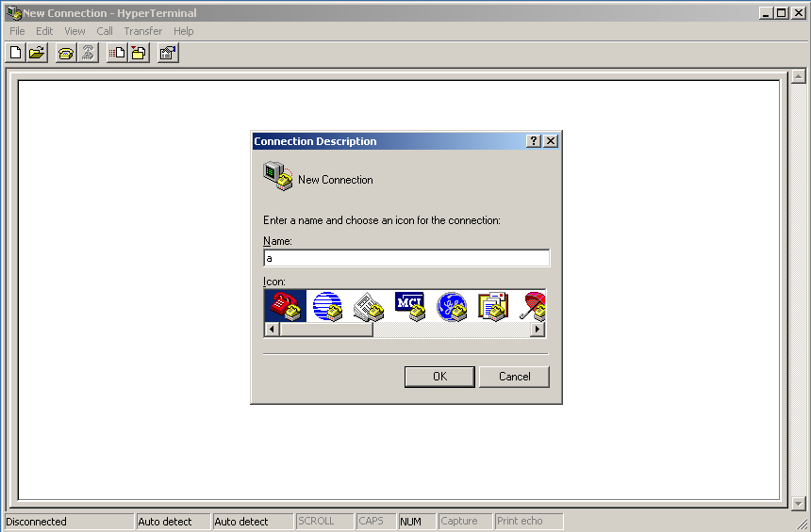
Using Hyper Terminal
Choose a name for your connection

Slide 48
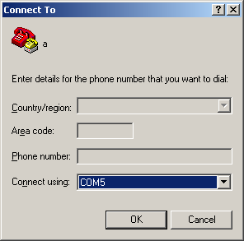
Using Hyper Terminal
Choose the com port connected to the device

Slide 49
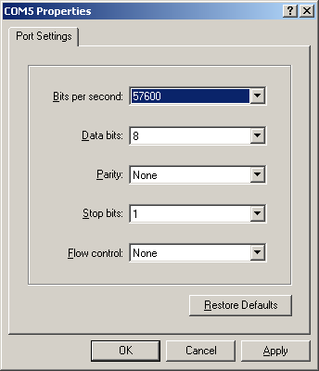
COM Properties
Choose a setting that match the board
  Baudrate
  Data Bit
    8
  Flow control
    None

Slide 50
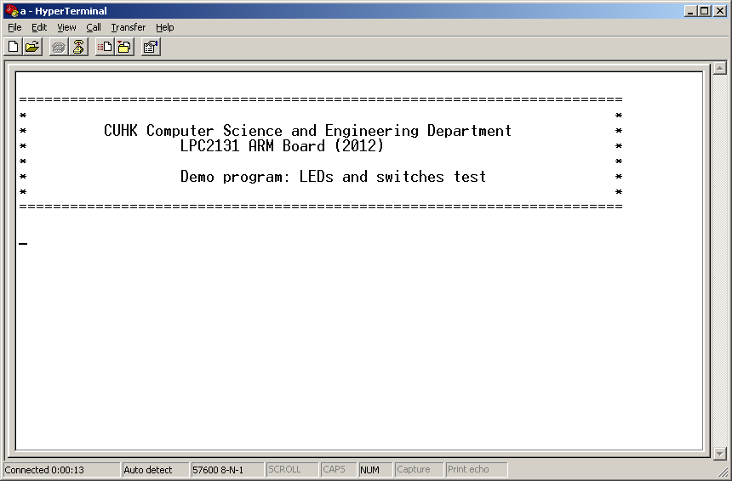
Communicate with ARM board
Connect
Disconnect

Slide 51
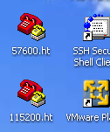
Other way to open Hyper Terminal
Double click the shortcut in Desktop, named by baudrate value
  E.g 57600.ht, 115200.ht

Slide 52
LDR Module

Slide 53
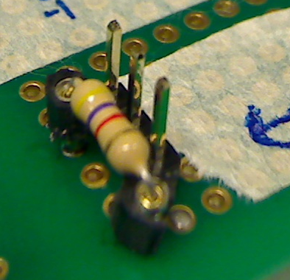
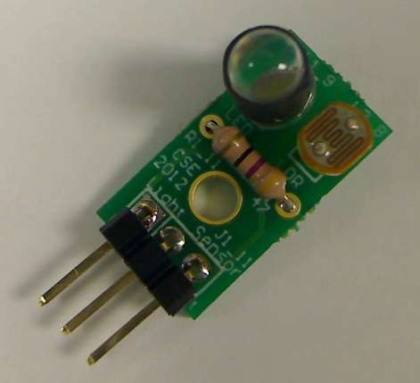
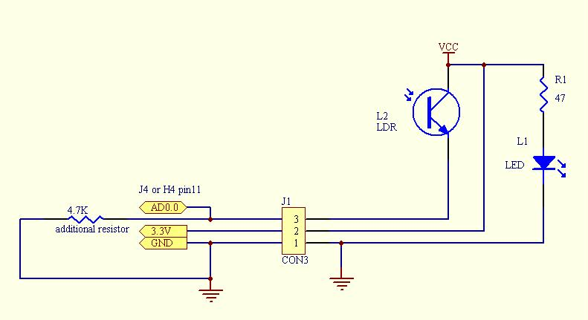
LDR Module
GND
47 ohm
Vcc
Vout
On the ARM board
Please don’t forget this resistor
Vout
GND
Vcc
LDR module

