Slide 1
Tutorial 2
IDE of Keil for the ARM 7 board(2)
Write Assembly using the IDE of Keil for the ARM 7 board

Slide 2
Outline
Introduce the Debug mode of uVision4

Slide 3
Build the project
“Project” > “Build target”
Success if no error

Slide 4
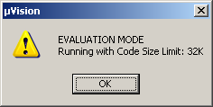
Start Debug mode
“Debug” > “Start/Stop Debug Session”
Click “OK”
Trial Version

Slide 5
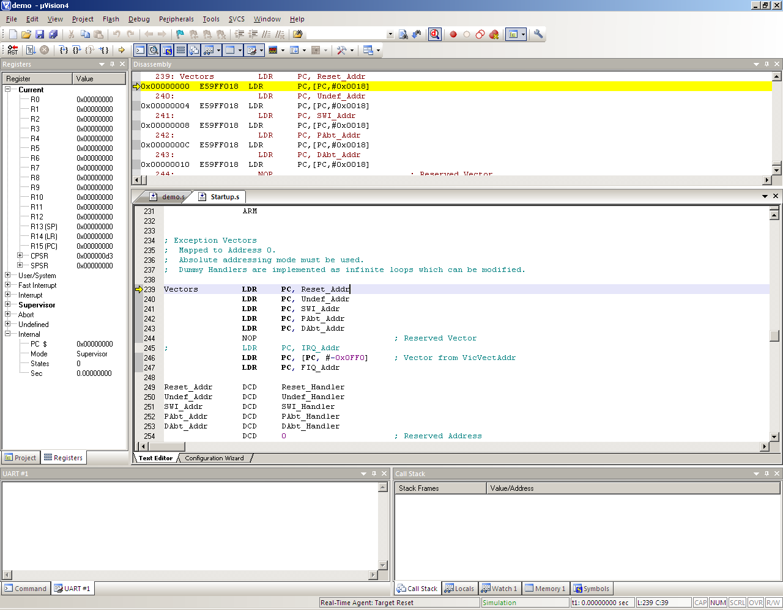
Debug Mode
Register
Machine running code
Your Assembly Code
Serial
Memory content

Slide 6
Display Window
If you don’t see those window, you can display them by clicking the following icon
Command
Disassembly
Registers
Serial (URAT)
Notes:
http://goo.gl/Ff64f

Slide 7
Running the program
You can use the following icon to run your assembly code
Reset
Step over the current line
Run
Step one line

Slide 8
Running the program
Next line to run (yellow arrow)
Notes:
You can also see the PC (R15) is updated

Slide 9
Run to cursor line
To go to the target line, you can select the line, then “right click”, click “Run to cursor line”

Slide 10
Insert a Breakpoint
A red square will appear when a breakpoint is inserted
You can insert/delete a breakpoint to the code by “double click” the target line OR “right click”, select “Insert/Remove Breakpoint”

Slide 11
Move to a register

Slide 12
Observe the R15 (PC)

Slide 13
Add R1 and R0
0x13c = 0x138 + 0x04

Slide 14
Observe the CPSR

Slide 15
After CMP
“Negative” So, not equal

Slide 16
Link Register (R14) set by BL
Save the address of next instruction after BL. Last PC + 4 = 144+4
PC save the address of next instruction

Slide 17
Run the code after BL

Slide 18
BX branch to the address in LR

