Slide 1
CENG2400 Tutorial 1
Keil IDE

Slide 2
Keil
Include C compilers
Assemblers
(uVision5) → Integrated Development Environment (IDE)
For ARM series
Notes:
~eclipse

Slide 3
uVision5 IDE
Installed on all the PCs in SHB102
How to install in your own PC?
Download MDK524A.exe
https://www.keil.com/demo/eval/arm.htm
Download legacy support for ARM7
http://www2.keil.com/mdk5/legacy

Slide 4
Open uVision5 IDE
Find this Shortcut from the desktop
Double click to open it
If you cannot find it
Go to “Start” → “All Programs” → “Keil uVision5”

Slide 5
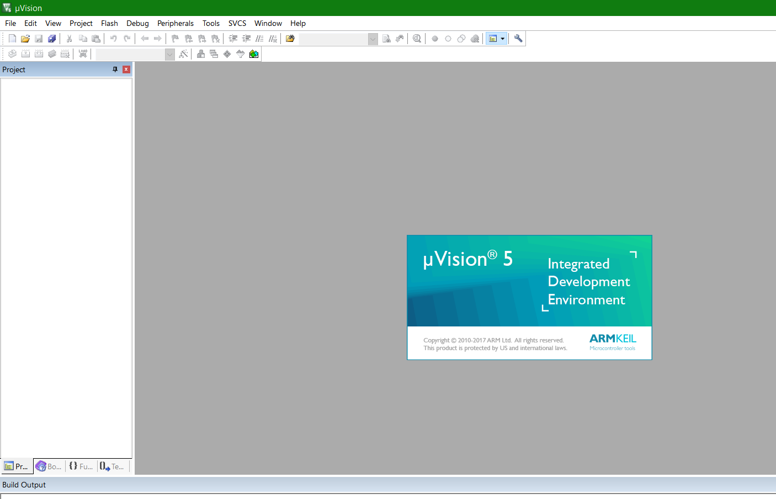
Open uVision5 IDE
You will see something like this

Slide 6
Project Setup

Slide 7
Create a new project
Select Project → New uVision Project

Slide 8
Project working directory
In the Pop up Window
Type the project name and select the working directory
Project Name

Slide 9
Choose the device
1. Select Legacy Device Database
2. Search LPC2131
3. Select NXP, LPC2131
4. Click “OK”

Slide 10
Create the startup file
Click “Yes”

Slide 11
Modify the Startup.s file
Open “Startup.s”

Slide 12
Modify the Startup.s file
Comment out the line 430
“;” consider as comment

Slide 13
Option
Right click “Target 1”in the project menu
Choose “Option for Target ‘Target 1’”

Slide 14
Option
Go to “Linker” Tab
Tick “Use Memory Layout from Target Dialog”

Slide 15
Program file

Slide 16
Create a new source code file
Click “File” → “New”

Slide 17
Create a new source code file
Enter the file name and click “save”
1. File Name
2. Click “Save”
Notes:
.s file → Assembly source code

Slide 18
Add the source code to your project
Click “Project” → “Manage” → “Project Items…”

Slide 19
Add the source code to your project
Click “Add Files…”

Slide 20
Add the source code to your project
Select the source code
2. Select the source code
1. Select “.s” file type

Slide 21
Add the source code to your project
Click “OK” if the file is added to your Project

Slide 22
Program code
Write some code

Slide 23
Build the Program
Press “F7” key on your keyboard
Or click “Project” → “Build Target”

Slide 24
Build the Program
Success if no error
Notes:
You are now successfully compile the program and ready to run

Slide 25
Using the Debug Mode

Slide 26
Debug Mode
Ctrl+F5, Run debug Mode
Or Click “Debug” → “Start/Stop Debug Session”

Slide 27
Debug Mode
Click “OK”

Slide 28
Debug your program
Test your code “line by line”

Slide 29
Debug your program
Select Any line you want to execute
Right Click and Click “Run to Cursor line”
Or Press “Ctrl+F10”

Slide 30
Debug your program
View the current status of the system
E.g. Register value, Program counter value

Slide 31
Debug your program
Execute the code “line by line” by pressing “F11”

Slide 32
Debug your program
The value of the Program Counter is changing

Slide 33
Small exercise
Run the given source code
Check the register values in debug mode
R0, R1, R2, PC(R15)

Slide 34
Program code
; User Initial Stack & Heap
AREA |.text|, CODE, READONLY
EXPORT __main
__main
; Add the code HERE
START
MOV R0, #0x1
MOV R1, #0x2
ADD R2, R0, R1
END

Slide 35
Useful Shortcut Key
Shortcut Key
F7, Build Project (Compile)
Ctrl+F5, Run debug Mode
Ctril+F10, Run to Current Cursor Line
F11, Next Step

