Slide 1

Chapter 14: System initialization
CEG2400 - Microcomputer Systems

Slide 2
System Control Block
Hardware initialization
  Reset circuit, reset code
  Crystal oscillator
  Phase locked loop PLL
A study of startup.s
  Memory space initialization

Slide 3
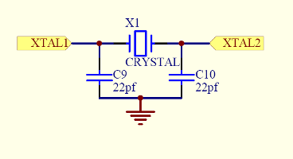
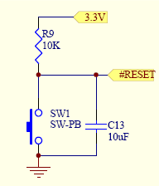
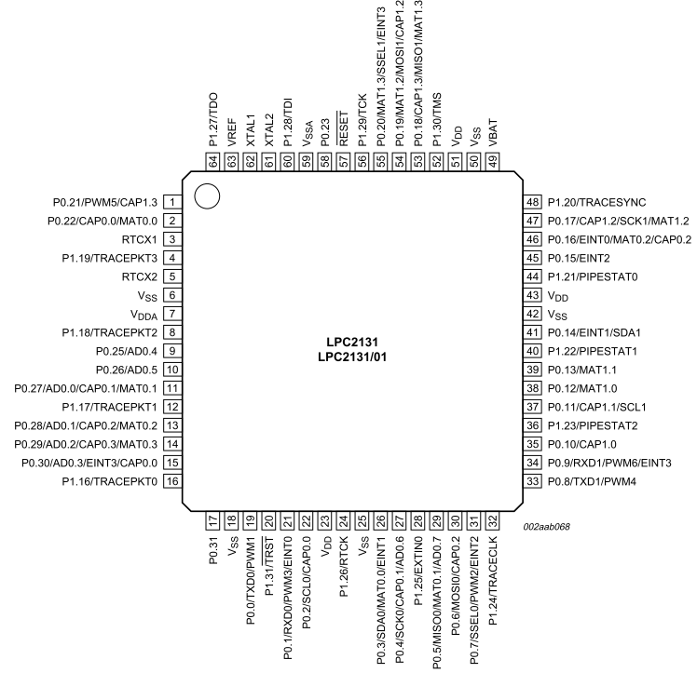
1) Reset Circuit, to begin
oscillator
After reset
Run code at 0x0000 0000

Slide 4
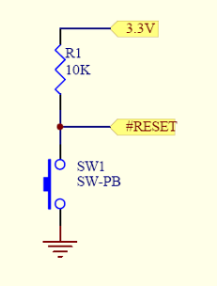
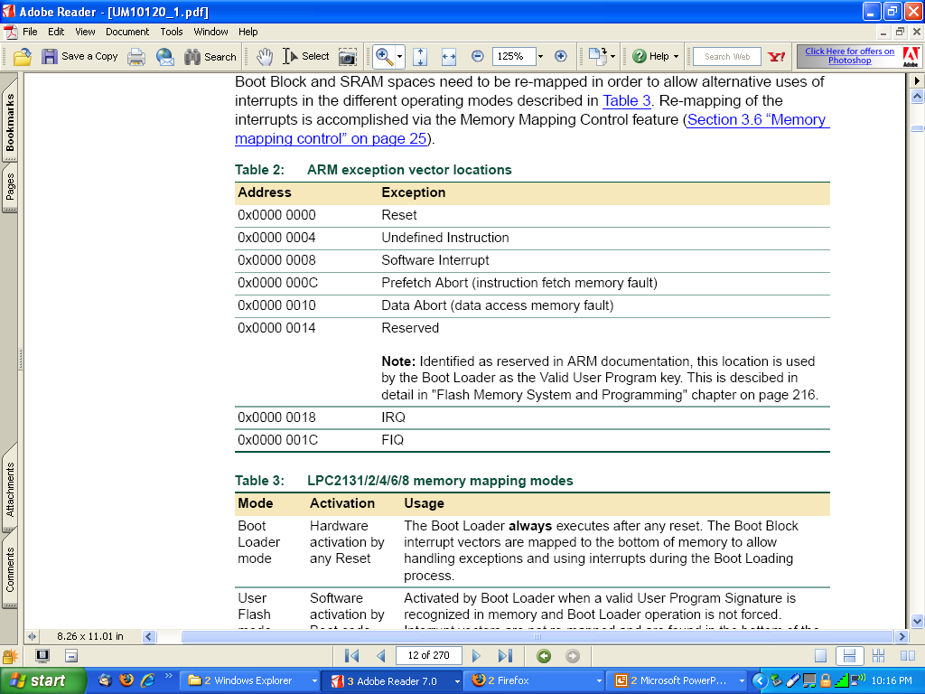
Reset Circuit
C13 is to keep reset-low for 10ms or more
#RESET goes low when you press SW1
Upon reset or powerup, ARM executes instruction at address 0x00000000

Slide 5
Reset Code see startup.s
AREA RESET, CODE, READONLY
ARM
Vectors LDR PC, Reset_Addr
LDR PC, Undef_Addr
…
; DCD=Define Constant Data (same as DCW)
Reset_Addr DCD Reset_Handler
…
EXPORT Reset_Handler
Reset_Handler
; initialise everything here

Slide 6

2) Oscillator
Crystal + caps connected to XTAL1 and XTAL2 pins to generate a clock
  A square wave can also be input to XTAL1
We use 11.0592MHz because it is a multiple of the baud rates we wish to use for the UARTs (11.0592MHz=57600x192)
http://thumbs.ebaystatic.com/
pict/270150155601_1.jpg

Slide 7
3) Phase locked loop (PLL)
one chip two systems

Slide 8
One chip two systems
Printed Circuit Board (PCB) cannot run too fast (11.0592 MHz)
LPC213x internal can run faster (60MHz)
PCB
Oscillator
11.0592 MHz
LPC213x
Runs faster
at 60MHz
PCB runs slow

Slide 9
But there is a synchronization problem
The solution is use a Phase Locked Loop PLL to lock the two frequencies.
Mother board
Printed Circuit Board (PCB)
Runs slower 11.0592MHz
MCU
LPC213x
Runs fasters 60MHz
F_{osc}
(11.0592MHz)

Slide 10
Phase locked loop
High frequency signals (55.296Mhz) are difficult to handle on a PCB due to the relatively long wires used. This is less of a problem on-chip.
We want a high frequency (55.296M) for high throughput, also we want a slow clock. frequency(11.0592MHz) for low power and less electromagnetic interference.
Many chips use a low frequency external clock and multiply on-chip to address these issues
  The synchronization problem is handled by a phase locked loop (PLL)

Slide 11
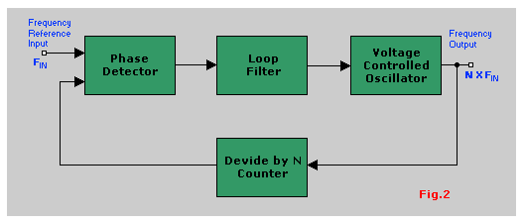
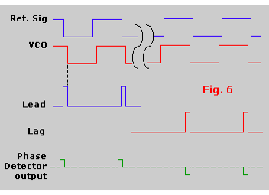
PLL - how it works
Feedback system used to multiply clock input clock frequency
Output of the loop filter sets voltage to VCO so the two frequencies at the phase detector are exactly the same
Once “locked”, Fout=N x Fin
Source: http://www.uoguelph.ca/~antoon/gadgets/pll/pll.html

Slide 12
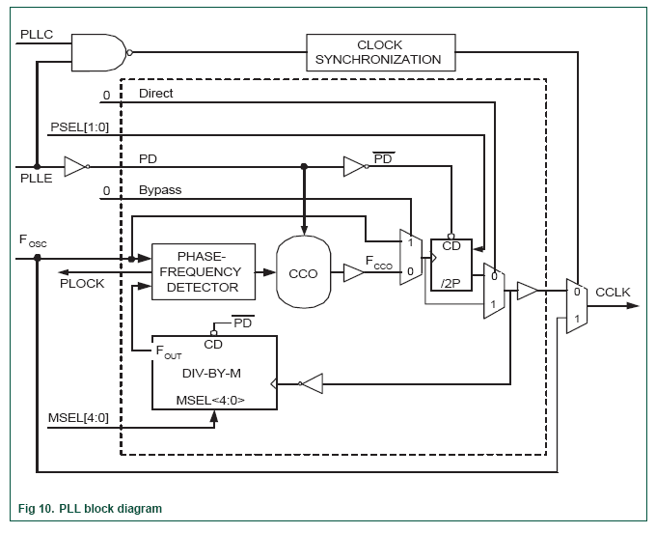
LPC21xx PLL
PLL
Connect
PLL
divider
PLL
Enable
F_{OSC}
CCLK
PLL
Multiplier
F_{CCO}
Current controlled oscillator

Slide 13
PLL
E.g.
MCU
LPX213x
CCLK=55.296M
F_{cco-}=221.184M
F_{osc}
(11.0592MHz)
input oscillator frequency =F_{OSC} by M to give CCLK
  CCLK = F_{OSC} x M
To do this, it uses a Current Controlled Oscillator at frequency
F_{CCO} = F_{OSC} x M x 2 x P
156MHz <F_{CCO} <320MHz, 10 M Hz <F_{OSC} <25MHz
example
M=5
xM
F_{OSC}
11.0592MHz
CCLK
CCLK for MCU
55.296MHz
P=2
Mx2xP
CCLK/4=PCLK
for peripherals
13.824MHz
F_{CCO} = 221.184MHz
Divide by 4

Slide 14
Summary of Clocks
One oscillator generates two outputs CCLK, PCLK
ARM-LPC213x
F_{OSC}x5=CCLK for MCU
55.296MHz
F_{OSC}
11.0592MHz
MCU
Internal use
CCLK/4=
PCLK =
for peripherals
13.824MHz
Peripherals use
For interfacing

Slide 15
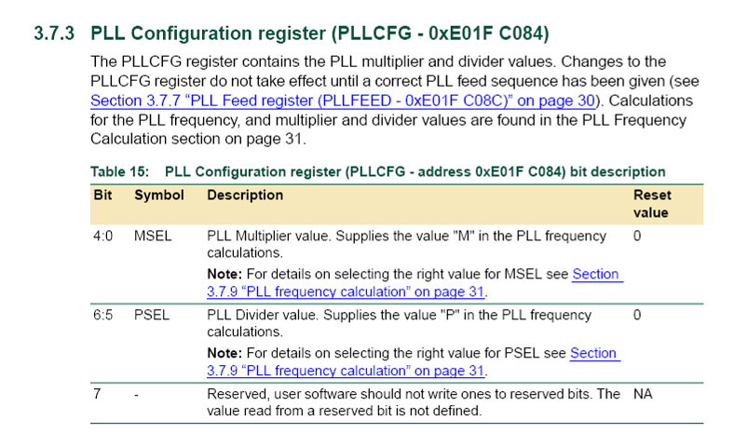
Config. Register: PLLCFG – 0xE01F C084

Slide 16
Formulas for M,P (e.g. M=5,P=2 ) recall that
CCLK = F_{OSC} x M= 11.0592MHz x 5=55.296MHz
F_{CCO} =P x(CCLK x 2)=2x55.296x2=221.184MHz
Ranges
  F_{OSC :}10-25MHz
  F_{CCO :}156-320MHz
Details see appendix

Slide 17
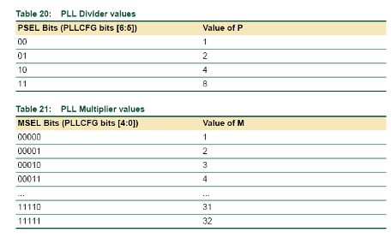
Setting M=5 and P=2 by
PLLCFG (0xE01F C084)
Choose desired F_{OSC} and CCLK (CCLK must be integer multiple)
Calculate M in range 1-32 (MSEL bits are M-1)
Calculate P so that F_{CCO} is in correct range (P must be 1,2,4 or 8. PSEL bits are P-1)
PLLCFG at
0xE01F C084=0x24=01,00100b
Select P=2, PSEL=01b
Select M=5, MSEL=00100b

Slide 18
Exercise 14.1
Student ID: ___________,Date:_____________
Name: _____________________________
Why CCLK( Internal clock of MCU) is faster than Fosc (crystal Oscillator frequency)
  ?___________________________________
If the crystal Fosc is 10Mhz, M=5, what is
  CCLK:?______
  PCLK:?_______
How to make CCLK and PCLK synchronized?
?____________________

Slide 19
Inside startup.s, PLL Definitions
; Phase Locked Loop (PLL) definitions
PLL_BASE EQU 0xE01FC080 ; PLL Base Address
PLLCON_OFS EQU 0x00 ; PLL Control Offset
PLLCFG_OFS EQU 0x04 ; PLL Configuration Offset
PLLSTAT_OFS EQU 0x08 ; PLL Status Offset
PLLFEED_OFS EQU 0x0C ; PLL Feed Offset
PLLCON_PLLE EQU (1<<0) ; PLL Enable
PLLCON_PLLC EQU (1<<1) ; PLL Connect
PLLCFG_MSEL EQU (0x1F<<0) ; PLL Multiplier
PLLCFG_PSEL EQU (0x03<<5) ; PLL Divider
PLLSTAT_PLOCK EQU (1<<10) ; PLL Lock Status
;// <e> PLL Setup
;// <o1.0..4> MSEL: PLL Multiplier Selection
;// <1-32><#-1>
;// <i> M Value
;// <o1.5..6> PSEL: PLL Divider Selection
;// <0=> 1 <1=> 2 <2=> 4 <3=> 8
;// <i> P Value
;// </e>
PLL_SETUP EQU 1
PLLCFG_Val EQU 0x00000024; What is M and P? What is F_{CCO}? CCLK?

Slide 20
PLL startup code
; Setup PLL
IF PLL_SETUP <> 0
LDR R0, =PLL_BASE
MOV R1, #0xAA
MOV R2, #0x55
; Configure and Enable PLL
MOV R3, #PLLCFG_Val ; 0x24
STR R3, [R0, #PLLCFG_OFS]
MOV R3, #PLLCON_PLLE
STR R3, [R0, #PLLCON_OFS]
STR R1, [R0, #PLLFEED_OFS]
STR R2, [R0, #PLLFEED_OFS]
So the PLLCFG is at
PLL_BASE+ PLLCFG_OFS
= 0xE01FC080+0x04
= 0xE01FC084

Slide 21
A study of startup.s
Memory space initialization

Slide 22
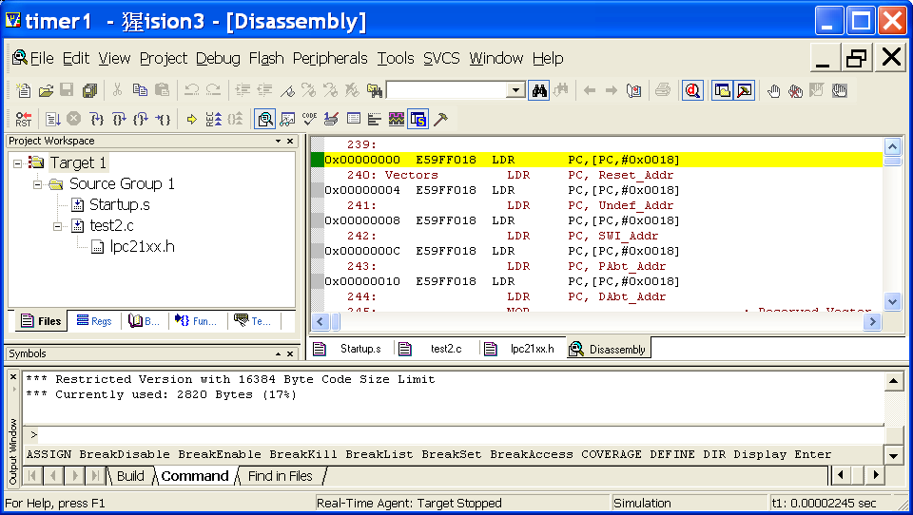
Uvision3(IDE--Interactive Development Environment) and startup.s startup.s is generated automatically.
Use debug/start to dis-assemble startup.s and see the machine code.

Slide 23
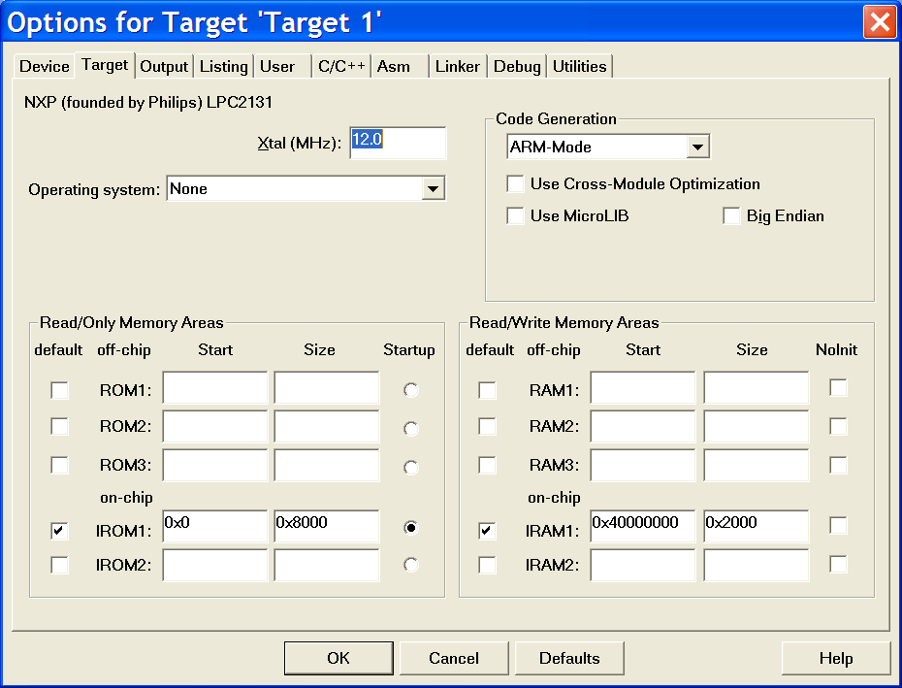
LPC213x :ROM base is R/O Base=0x0000 0000
RAM base is R/W base=0x4000 0000
AT Keil Flash/config_flash_tool

Slide 24
Overview for LPC213x memory
Address
RAM 8K:
Data= 0X4000 1FFFF
0x4000 0489
Heap_base=0x4000 0489
Stack= 0x4000 0488
0x4000 0000
ROM 32K:
program
0x0000 7FFF
0x0000 0000

Slide 25
Step1: Line 39-69
RAM space starts from 0x4000 0000 in LPC213x
Init symbols
Mode_USR EQU 0x10
Mode_FIQ EQU 0x11
Mode_IRQ EQU 0x12
Mode_SVC EQU 0x13
Mode_ABT EQU 0x17
Mode_UND EQU 0x1B
Mode_SYS EQU 0x1F
I_Bit EQU 0x80 ; when I bit is set, IRQ is disabled
F_Bit EQU 0x40 ; when F bit is set, FIQ is disabled
UND_Stack_Size EQU 0x00000000 ; not used here
SVC_Stack_Size EQU 0x00000008
ABT_Stack_Size EQU 0x00000000 ; not used here
FIQ_Stack_Size EQU 0x00000000 ; not used here
IRQ_Stack_Size EQU 0x00000080
USR_Stack_Size EQU 0x00000400
ISR_Stack_Size EQU (UND_Stack_Size + SVC_Stack_Size + ABT_Stack_Size + \
FIQ_Stack_Size + IRQ_Stack_Size)
Heap_base=0x4000 0489
Stack_top =0x4000 0488
Ram_base=0x4000 0000
User_stack
IRQ_stack
SVC_stack
0x4000 0000

Slide 26
Step2 : line70-87 create RAM space for stack/heap
  AREA STACK, NOINIT, READWRITE, ALIGN=3
Stack_Mem SPACE USR_Stack_Size
__initial_sp SPACE ISR_Stack_Size
Stack_Top
;// <h> Heap Configuration
;// <o> Heap Size (in Bytes) <0x0-0xFFFFFFFF>
;// </h>
Heap_Size EQU 0x00000000
AREA HEAP, NOINIT, READWRITE, ALIGN=3
__heap_base
Heap_Mem SPACE Heap_Size
__heap_limit
Assign space for stack and then heap
It is at 0x40000000, see uvision/flash/config_flash_tool./linker
R/W_base=0x40000000
Heap is used for malloc (memory allocation) in C, 0 here you may change it
Directive: SPACE=allocation of memory

Slide 27
Exercise 14.2 The result Rams/Rom space for LPC213x
Fill in “?___”
Address
0x4000 0488
User_stack :
size?________
:
0x4000 1FFF
Heap_base=0x4000 0489
Stack_top =0x4000 0488
Ram_base=0x4000 0000
On chip ram (8K)
0x4000 0000
IRQ_stack
size?________
:
:
SVC_stack
Size ?_______
0x4000 0000
0x0000 7FFF
On chip
Flash Rom
(32K)
For Code
User program:
Exception addresses=0x0000 0000
0x0000 0000
What are the sizes of the RAM for data excluding stacks?
Ans:?__________________________

Slide 28
Summary
learned some important steps for setting up a microcontroller

Slide 29
Appendices

Slide 30
Appendix 1
Memory Mapping Modes
Wish reset to be flexible
  download to flash (boot loader)
  execute our program in flash
  execute routine in RAM
Need some way to map different portions of memory to the ARM exception vectors
  Memory mapping control determines source of this data

Slide 31
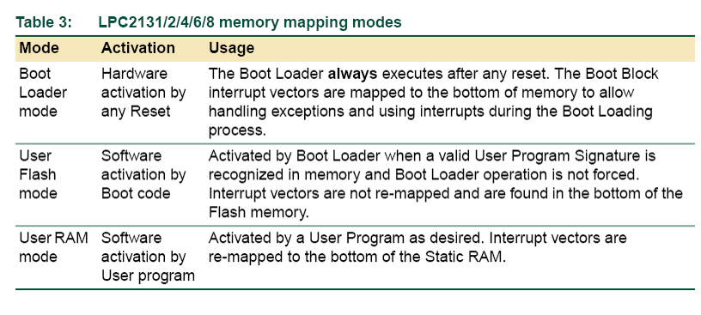
Memory Mapping modes

Slide 32
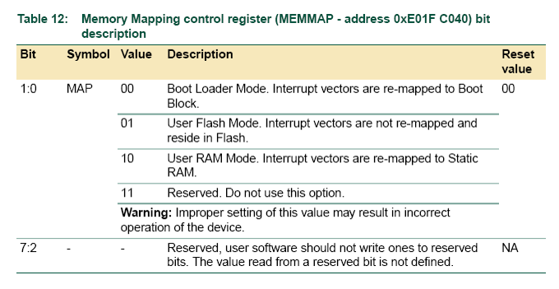
Memory mapping modes
So how does the bootloader know to execute your code?

Slide 33
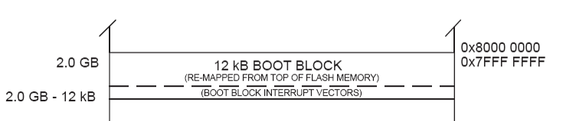
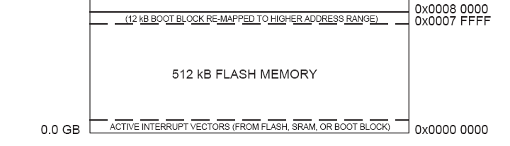
Memory mapping modes
12KB boot block remapped to high memory so it is at the same address for devices with different flash sizes

Slide 34
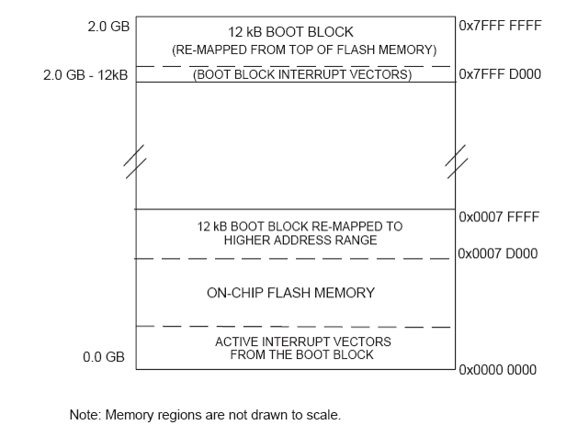
After reset

Slide 35
Details
Remapped area is
  32 bytes (size of interrupt buffer area)
  Additional 32 bytes (to store constants for jumping beyond range of branch instruction)
  Total 64 bytes
Same data can be read from both remapped and original locations

Slide 36
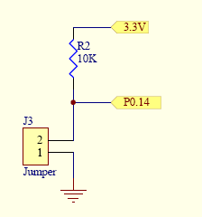
Boot loader
Always runs after reset
Allows programming of flash memory
  Low on P0.14 starts the in-system programming command handler (J3 inserted on our board)
  If high, looks for a valid user program and executes it
  P0.14 must be pulled high or low by external hardware

Slide 37
Valid user program
Reserved ARM interrupt vector location (0x0000 0014) should contain the 2’s complement of the check-sum of the remaining interrupt vectors.
  i.e. checksum of all vectors is 0.

Slide 38
Material Covered So Far
Memory system
  Organization, endianess, address space, alignment
ARM instructions
  Condition flags, instruction pipeline, conditional execution, branches, data processing instructions, barrel shifter, immediate values, multiplication, load/store, addressing modes, block transfers, stacks and subroutines
ARM assembly language
  Simple loops, subroutines, bit operations, pseudo instructions, macros
Interfacing
  Driving loads, reset, RS232 transceivers, crystal oscillator
  Initialization
  Peripherals: GPIO, UART, PLL (software and hardware)

Slide 39
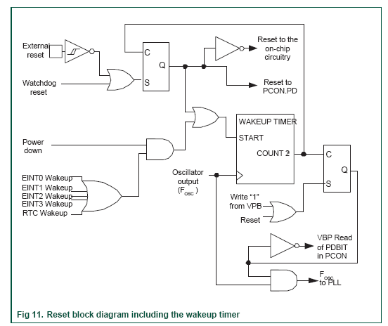
Appendix 2
Power on hardware internal
Wakeup timer ensures everything is stable and ready before allowing instructions to execute
When using external oscillator, RESET should be asserted for >10ms on powerup
  What is the RC time constant for the circuit in previous slide?

Slide 40
Appendix 3
Detailed example of setting PLL
F_{OSC}=11.0592 MHz requires CCLK = 55.296MHz
M = CCLK / Fosc = 55.296M / 11.0592 M = 5.
  M - 1 = 4 will be written as PLLCFG[4:0]
Value for P can be derived from P = F_{CCO} / (CCLK x 2), F_{CCO} must be 156-320 MHz. Assuming the lowest allowed frequency for F_{CCO} = 156 MHz, P = 156 MHz / (2 x 55.296 MHz) = 1.41... The highest F_{CCO} frequency criteria produces P = 2.8935… Only solution for P that satisfies both of these requirements and is listed in Table 20 is P = 2. Therefore, PLLCFG[6:5] = 1 will be used.

Slide 41
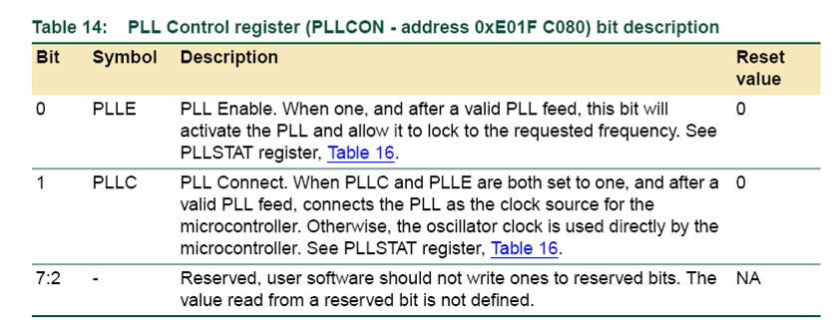
PLLCON

Slide 42
PLLFEED
Incorrect programming of the PLL will cause the uC to operate incorrectly
The PLL is only updated if a PLLFEED sequence is received
  Update PLLCFG & PLLCON registers
  Write 0xAA to PLLFEED
  Write 0x55 to PLLFEED

Slide 43
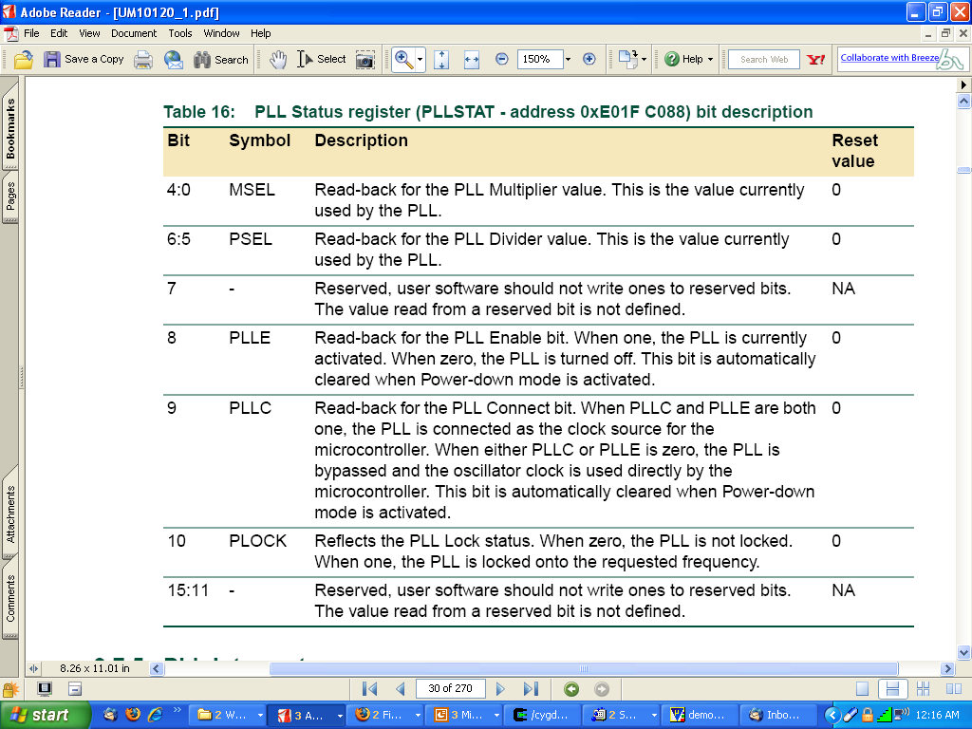
PLLSTATUS ( PLLSTAT_OFS )

Slide 44
PLL Definitions
; Phase Locked Loop (PLL) definitions
PLL_BASE EQU 0xE01FC080 ; PLL Base Address
PLLCON_OFS EQU 0x00 ; PLL Control Offset
PLLCFG_OFS EQU 0x04 ; PLL Configuration Offset
PLLSTAT_OFS EQU 0x08 ; PLL Status Offset
PLLFEED_OFS EQU 0x0C ; PLL Feed Offset
PLLCON_PLLE EQU (1<<0) ; PLL Enable
PLLCON_PLLC EQU (1<<1) ; PLL Connect
PLLCFG_MSEL EQU (0x1F<<0) ; PLL Multiplier
PLLCFG_PSEL EQU (0x03<<5) ; PLL Divider
PLLSTAT_PLOCK EQU (1<<10) ; PLL Lock Status
;// <e> PLL Setup
;// <o1.0..4> MSEL: PLL Multiplier Selection
;// <1-32><#-1>
;// <i> M Value
;// <o1.5..6> PSEL: PLL Divider Selection
;// <0=> 1 <1=> 2 <2=> 4 <3=> 8
;// <i> P Value
;// </e>
PLL_SETUP EQU 1
PLLCFG_Val EQU 0x00000024; What is M and P? What is F_{CCO}? CCLK?

Slide 45
PLL startup code
; Setup PLL
IF PLL_SETUP <> 0
LDR R0, =PLL_BASE
MOV R1, #0xAA
MOV R2, #0x55
; Configure and Enable PLL
MOV R3, #PLLCFG_Val ; 0x24
STR R3, [R0, #PLLCFG_OFS]
MOV R3, #PLLCON_PLLE
STR R3, [R0, #PLLCON_OFS]
STR R1, [R0, #PLLFEED_OFS]
STR R2, [R0, #PLLFEED_OFS]

Slide 46
Wait until ready & switch
; Wait until PLL Locked
PLL_Loop LDR R3, [R0, #PLLSTAT_OFS]
ANDS R3, R3, #PLLSTAT_PLOCK
BEQ PLL_Loop
; Switch to PLL Clock
MOV R3, #(PLLCON_PLLE:OR:PLLCON_PLLC)
STR R3, [R0, #PLLCON_OFS]
STR R1, [R0, #PLLFEED_OFS]
STR R2, [R0, #PLLFEED_OFS]
ENDIF ; PLL_SETUP

Slide 47
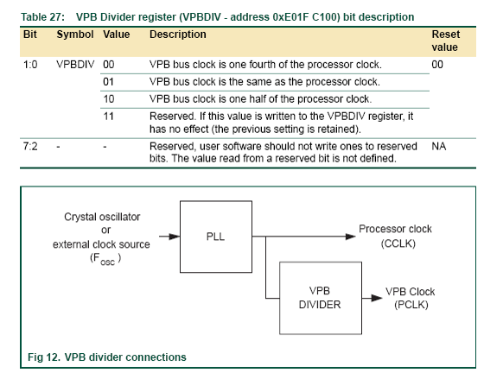
VPB
Clock
Processor uses CCLK and peripherals use PCLK (peripherals usually don’t run as fast as the processor)
VPB divider determines relation between them
  Startup code doesn’t change the default of / 4
What is PCLK in our system? See next slide

Slide 48
Answer : PLL setup of startup code*
PLLSTATUS ( PLLSTAT_OFS )
F_{OSC}= 11.0592MHz
PLLCFG_Val = 0x24
  MSEL=4 (M=MSEL+1=5)
  CCLK= M * Fosc=55.296MHz
P
  PSEL=1 i.e. P=2
  (low) P= 156 MHz / (2 x 55.296 MHz) =1.41
  (high) P= 320 MHz / (2 x 55.296 MHz) =2.89
PCLK=CCLK/4=13.824MHz (/4 is by default)
Psel
=2
Msel
=4
Bit | 6 5 | 4 0|

