Slide 1
Chapter 13 Peripherals-2 -- ARMdemo06.c
CEG2400 - Microcomputer Systems
References
http://www.nxp.com/acrobat_download/usermanuals/UM10120_1.pdf
Trevor Martins , The insider's guide to the Philips ARM7 based microcontrollers, www.hitex.co.uk

Slide 2
Introduction
Timer
Watchdog
Pulse Width Modulation PWM unit
Real time clock

Slide 3
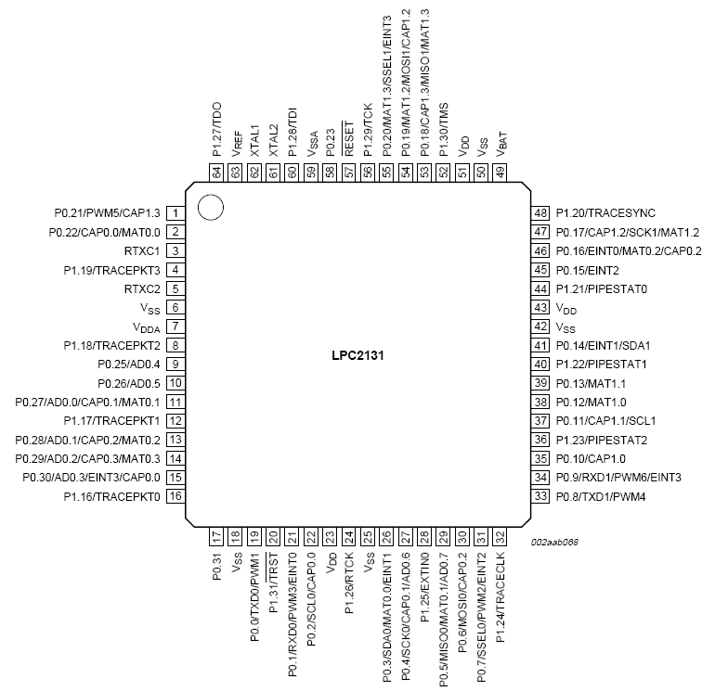
Pin assignments
LPC213x

Slide 4
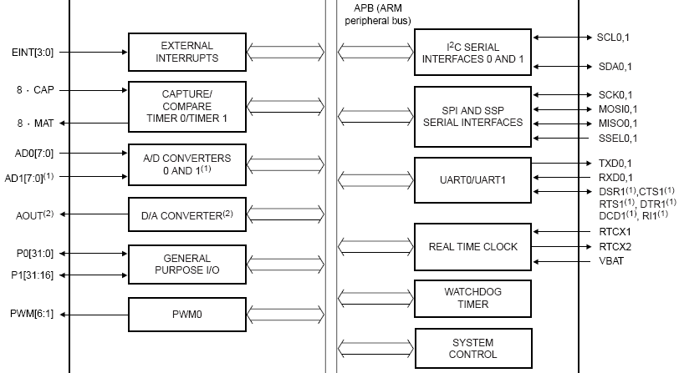
LPC2131 peripherals

Slide 5
1) Timer http://www.keilsoftware.com/dd/vtr/3735/8064.htm
Including these Features
  A 32-bit Timer/Counter with a programmable 32-bit Prescaler.
  Counter or Timer operation
  Four 32-bit match registers that allow:
    Set low on match, Set high on match, Toggle on match, Do nothing on match.
Applications
  Interval Timer for counting internal events.
  Pulse Width Demodulator via Capture inputs.
  Free running timer.

Slide 6
Part 1 of void init_timer_Eint() of EINT.c (interrupt rate =1KHz)
( for init timer , use VICVectAddr0
------------------------------RECALL-------------------------------------
/* Setup the Timer Counter 0 Interrupt */
void init_timer_Eint (void) {
T0PR = 0;
// set prescaler to 0
T0MR0 =13824; // set interrupt interval to 1mS
// since pclk/1KHz = (11059200 x 5)/(4 x 1000)=13824
T0MCR = 3; // Interrupt and Reset on MR0
T0TCR = 1; // Timer0 Enable
VICVectAddr0 = (unsigned long)IRQ_Exception;
// set interrupt vector in 0 (This becomes the highest priory interrupt)
VICVectCntl0 = 0x20 | 4; // use it for Timer 0 Interrupt
VICIntEnable = 0x00000010; // Enable Timer0 Interrupt
cclk=M*Fosc, M=5
pclk=cclk/4
Pclk=11059200*5/4

Slide 7

Summary of Clocks
One oscillator generates two outputs CCLK, PCLK
ARM-LPC213x
F_{OSC}x5=CCLK for MCU
55.296MHz
F_{OSC}
11.0592MHz
CCLK/4=
PCLK =
for peripherals
13.824MHz
PCLK=13.824MHz

Slide 8
Concept of the timer Operation
PCLK /freq_out=(11059200 x 5/4)/freq_out
=13.824MHz /freq_out
When timer counter (TC)=match reg0 (T0MR0), an pulse is generated, the the timer counter is reset
Match reg0
T0MR0 =13824
Timer
Counter
TC
When TC==T0MR0
a pulse is sent
The frequency generated =PCLK/T0MR0
=
PCLK=
13.824MHz
reset

Slide 9
Example of a 1KHz=freq_out interrupt generator
PCLK /freq_out= PCLK/1K=(11059200 x 5)/(4 )=13.824 MHz/1K=13824
When timer counter (TC)=match reg0 (T0MR0), an interrupt is generated
Match reg0
T0MR0 =13824
Divided by
(pre-scale+1)
Since pre-scale
=T0PR = 0
So divided by 1
Timer
Counter
TC
PCLK
Or
an input pin
CAPx.y
(See pin
assignment
of lpc2131)
=
Freq_out=
=PCLK/T0MR0
Interrupt request
or output pin (MATx.y)
(1KHz, every 1ms)

Slide 10
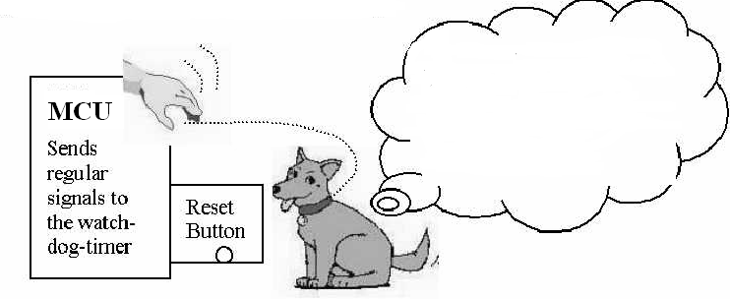
2) Watchdog timer
For implementing fail safe systems
If the system doesn’t give
me any signals for a period
of time (say 2 seconds), that
means it hangs, so I will
Press the reset bottom

Slide 11
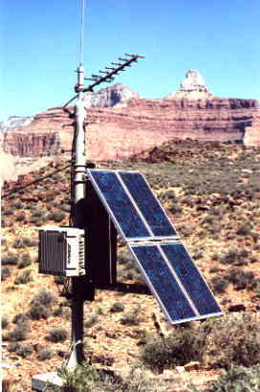
Example, solar power wireless telephone
(register setting , see appendix)
At remote area, maintenance is difficult
If the software does not operate properly (hangs)
  That means it sends no regular signals to the watch dog sensor
Then
  the watch-dog resets the system
If the system doesn’t give
me any signal for a period
of time (say 2 seconds), that
means it hangs, so I will
Press the reset bottom

Slide 12
Software
If the system doesn’t give
me any signal for a period
of time (say 2 seconds), that
means it hangs, so I will
Press the reset bottom
Main
{
  While(1)
  { Do_the _neccessary();
  Send_a_pulse_to_watch_dog();
  }
}
If the software hangs, it will not Send_a_pulse_to_watch_dog();
so the system is reset by the watch_dog_hardware

Slide 13
Example http://www.keil.com/download/docs/317.asp
void feed_watchdog (void) { /* Reload the watchdog timer */
WDFEED = 0xAA;
WDFEED = 0x55;
}
void sendhex (int hex) { /* Write Hex Digit to Serial Port */
if (hex > 9) sendchar('A' + (hex - 10));
else sendchar('0' + hex);
}
void sendstr (char *p) { /* Write string */
while (*p) {
sendchar (*p++);
}
}
/* just waste time here for demonstration */
void do_job (void) {
int i;
for (i = 0; i < 10000; i++);
}

Slide 14
Demo to see how watchdog action
int main (void) {
unsigned int i;
init_serial(); /* Initialize Serial Interface */
if( WDMOD & 0x04 ) { /* Check for watchdog time out */
sendstr("Watchdog Reset Occurred\n");
WDMOD &= ~0x04; /* Clear time out flag */
}
WDTC = 0x2000; /* Set watchdog time out value */
WDMOD = 0x03; /* Enable watchdog timer and reset */
for(i = 0; i < 50; i++) { /* for this 50 times do_job will run successfuly
do_job (); /* the actual job of the CPU */
feed_watchdog(); /*restart watchdog timer, for_loop will run until complete */
}
while (1) { /* Loop forever, but watch dog will rest the MCU */
do_job (); /*so do_job( ) will not run for_ever, MCU will soon be reset*/
/* no watchdog restart, watchdog reset will occur! */
}
}
void feed_watchdog (void) { /* Reload the watchdog timer */
WDFEED = 0xAA;
WDFEED = 0x55;
}

Slide 15
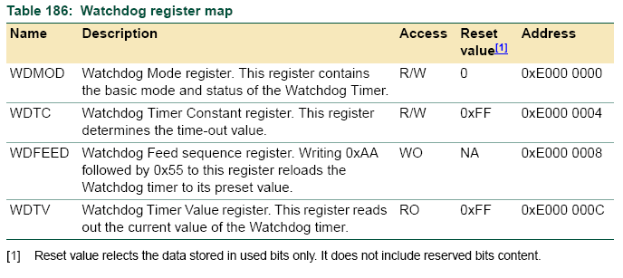
Watchdog Registers

Slide 16
Watch dog mode reg. WMOD

Slide 17
void feed_watchdog (void) { /* Reload the watchdog timer */
WDFEED = 0xAA; WDFEED = 0x55;
}
Watchdog
Block diagram

Slide 18

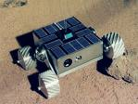
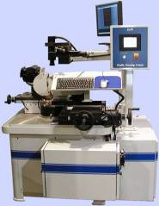
Applications of watchdog timers
Space robot
www.links9 99.net
Pay Telephone box
www.viewimages.com
Solar power wireless
emergency telephone
http://www.homepower.ca/
Industrial machine
http://www.maxengineering.us/img/machine1.jpg

Slide 19
Exercise 13.1
Describe how watch dog timers are used in the following examples.
Student ID:_________,Date:_________
Name: ____________________________
Space robot
www.links9 99.net
Pay Telephone box
www.viewimages.com
?______________________
?______________________
?______________________
?______________________
Solar power wireless
emergency telephone
http://www.homepower.ca/
Industrial machine
http://www.maxengineering.us/img/machine1.jpg

Slide 20


3) Pulse Width Modulation PWM unit
Use on-off time to control energy delivery
The DC motor speed is determined by the on/off time of the motor enable signal MLE
On/off (MEL)
Battery +
DC Motor

Slide 21
Timing diagrams of pulse width modulation
Comparing two pulse modulated signals S1,S2
T =Period 1ms
S1
S2
time
Toff1
Ton1
Toff2
Ton2

Slide 22
P
W
M
PWM5=
Right-motor
PWM-YOU-TUBE
Pin1=PWM5
Pin31=PWM2
PWM2=
Left-motor

Slide 23
In ARMdemo06.c
Setting up the PWM system
Define PWM frequency constant
  17) #define PWM_FREQ 276480 //set PWM frequency to 50 Hz, since timer is 13824KHz
Set up PWM pins
  97) PINSEL1 |= 0x00000400; // set p0.21 to PWM5-right motor
  98) PINSEL0 |= 0x00008000; // set p0.7 to PWM2-left motor
Enable PWM
  Setup 122) PWMPCR=0x0000 2000; // enable pwm5;(bit 13 is set to 1)
  123) PWMPCR|=0x0000 0400;// enable pwm2 ;(bit 10 is set to 1)
Setting match registers for PWM timer
  124) PWMMCR=0x0000 0002; (BIT 1 IS SET TO 1) //PWM match contr.reg.
Setup PWM frequency using PWM_FREQ defined earlier
  125) PWMMR0 = PWM_FREQ; //set PWM frequency to 50 Hz

Slide 24
In ARMdemo06.c
Use of PWM modules after setting up
Define motors full speeds for left/right motors
  127) //set robot to full speed
  128) leftPWM=PWM_FREQ;//set a value you prefer
  129) rightPWM=PWM_FREQ; //a value you prefer
Ask the left /right motors to run at full speed
  130) PWMMR2 = leftPWM;// left motor PWM to full speed
    // PWMMR2 = leftPWM/2 ; //will run at half speed, etc
  131) PWMMR5 = rightPWM;//right motor PWM to full speed
    // PWMMR5 = leftPWM/2 ; //will run at half speed, etc
Enable PWM
  132) PWMLER = 0x25; //enable match 0,2,5 latch to effective
  133) PWMTCR=0x09;

Slide 25
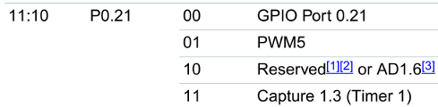
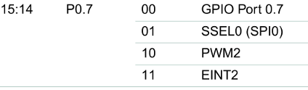
Code for Pulse Width Modulation PWM
ARM06demo.c (with line numbers)
PCLK =13.824MHz (see previous slide)
The formula: will set PWM frequency =
PCLK/PWM_FREQ=
13.824MHz/ 276480=50Hz
17) #define PWM_FREQ 276480 //set PWM frequency to 50 Hz, since timer is 13824KHz
//FREQ_of_PWM=13824000/276480=50
85) int main(void) {
…..
89)long leftPWM,rightPWM;
.....
// Initialize IO pin for PWM
97) PINSEL1 |= 0x00000400; // set p0.21 to PWM5-right motor
98) PINSEL0 |= 0x00008000; // set p0.7 to PWM2-left motor
.....
122) PWMPCR=0x2000; // enable pwm5
123) PWMPCR|=0x0400;// enable pwm2
124) PWMMCR=0x0002;
125) PWMMR0 = PWM_FREQ; //set PWM frequency to 50 Hz
PINSEL1=0xE002 C004
PINSEL0 =0xE002 C000
See http://www.nxp.com/acrobat_download/usermanuals/UM10120_1.pdf

Slide 26
Code for Pulse Width Modulation PWM
ARM06demo.c (refer to line numbers)
17) #define PWM_FREQ 276480 //set PWM frequency to 50 Hz,
……
122) PWMPCR=0x0000 2000; // enable pwm5;(bit 13 is set to 1)
123) PWMPCR|=0x0000 0400;// enable pwm2 ;(bit 10 is set to 1)
124) PWMMCR=0x0000 0002;
125) PWMMR0 = PWM_FREQ; //set PWM frequency to 50 Hz
Chapter 15 of http://www.nxp.com/documents/user_manual/UM10120.pdf

Slide 27
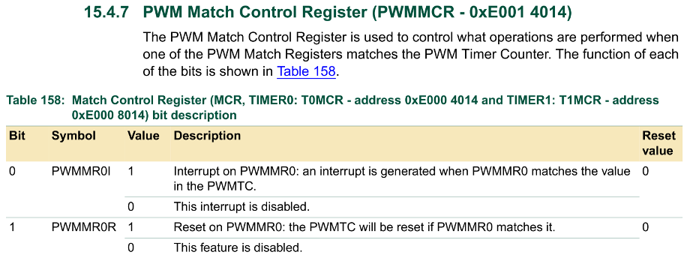
Code for Pulse Width Modulation PWM
ARM06demo.c (refer to line numbers)
17) #define PWM_FREQ 276480 //set PWM frequency to 50 Hz,
……
122) PWMPCR=0x0000 2000; // enable pwm5
123) PWMPCR|=0x0000 0400;// enable pwm2
124) PWMMCR=0x0000 0002; (BIT 1 IS SET TO 1) //PWM match contr.reg.
125) PWMMR0 = PWM_FREQ; //set PWM frequency to 50 Hz

Slide 28
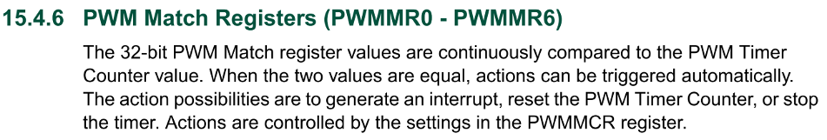
Code for Pulse Width Modulation PWM
ARM06demo.c (refer to line numbers)
17) #define PWM_FREQ 276480 //set PWM frequency to 50 Hz,
……
122) PWMPCR=0x0000 2000; // enable pwm5
123) PWMPCR|=0x0000 0400;// enable pwm2
124) PWMMCR=0x0000 0002;
125) PWMMR0 = PWM_FREQ; //set PWM frequency to 50 Hz
PCLK =13.824MHz (see previous slide)
The formula: will set PWM frequency =
PCLK/PWM_FREQ=
13.824MHz/ 276480=50Hz

Slide 29

Code for Pulse Width Modulation PWM
17) #define PWM_FREQ 276480
:
127) //set robot to full speed
128) leftPWM=PWM_FREQ;//set a value you prefer
129) rightPWM=PWM_FREQ; //a value you prefer
130) PWMMR2 = leftPWM;// left motor PWM width to full speed
131) PWMMR5 = rightPWM;//right motor PWM width to full
132) PWMLER = 0x25; //enable match 0,2,5 latch to effective
133) PWMTCR=0x09;
leftPWM
rightPWM

Slide 30
133) PWMTCR=0x09;//=0000 1001B, enable counter,PWM

Slide 31
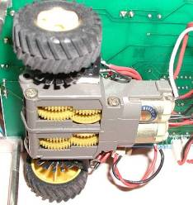
Use of the L293 H bright circuit
A chip for generating enough current to drive 2 motors controlled by 4 signals
2 (1A) 1Y(3)
1(EN1/2)
7(2A) (2Y)6
10(3A) (3Y)11
9(EN3/4)
15(4A) (4Y)14
PWMMR2
L_DIR
PWMMR5
R_DIR
Left-motor
Right-motor

Slide 32
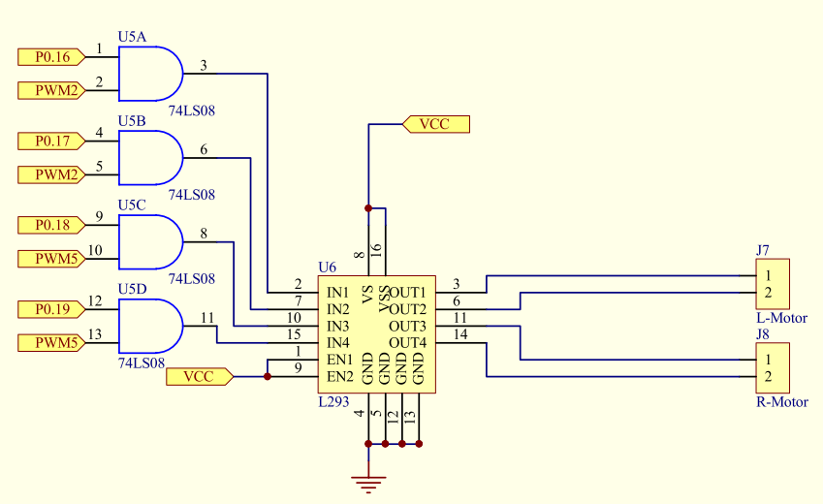
Exercise 13.2 Application– driving a robot
Fill in “?__”
Left-motor forward
P0.16 =L_DIR =?___
P0.17=L_DIRinv=?__
Left motor backward
P0.16 =L_DIR=?__
P0.17= L_DIRinv=?__
Left-motor speed
=PWMMR2
When IN1=1, IN2=0, L-motor forward
When IN1=0, IN2=1, L-motor backward
When IN3=1, IN4=0, R-motor forward
When IN3=0, IN4=1, R-motor backward
Right-motor forward
P0.18 = R_DIR =?__
P0.19= R_DIRinv=?__
Left motor backward
P0.18 = R_DIR=?__
P0.19= R_DIRinv=?__
Right-motor speed
=PWMMR5
L293 see next slide

Slide 33
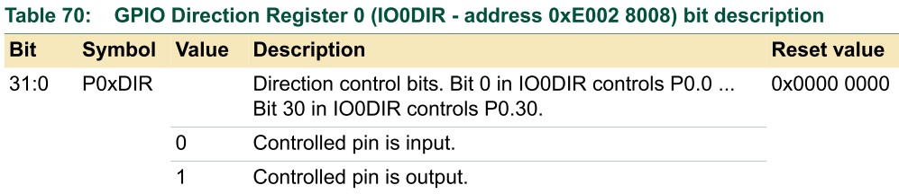
Setting drive direction pins
18) #define L_DIR 0x00010000 //set p0.16 left motor dir.
19) #define L_DIRinv 0x00020000 //set p0.17 inverted left motor dir.
20) #define R_DIR 0x00040000 //set p0.18 right motor dir.
21) #define R_DIRinv 0x00080000 //p0.19 inverted right motor dir.
22) #define TEST_PIN 0x00010000 //set p1.16 as Test pin
:
135) //set p0.16-p0.19 as output
136) IO0DIR|=L_DIR; //p0.16
137) IO0DIR|=L_DIRinv; //p0.17
138) IO0DIR|=R_DIR; //p0.18
139) IO0DIR|=R_DIRinv; //p0.19
140) IO1DIR|=TEST_PIN;// p1.16 as Outputs
Set p0.16-19 as output
pins

Slide 34
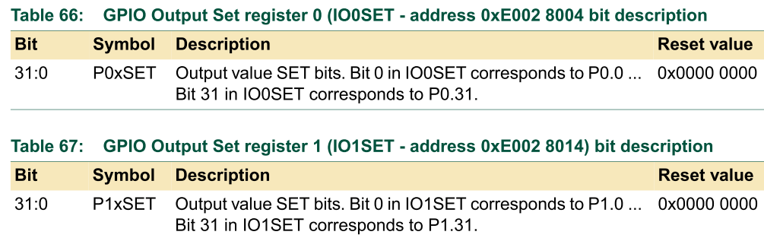
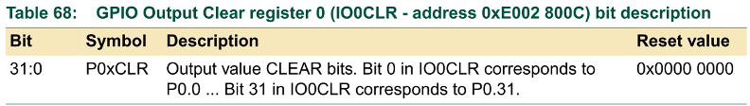
Four line (170-173) to start the robot move forward
170) IO0SET|=L_DIR;
171) IO0CLR|=L_DIRinv;
172) IO0SET|=R_DIRinv;
173) IO0CLR|=R_DIR;

Slide 35
sensors
wheel rotation sensors

Slide 36
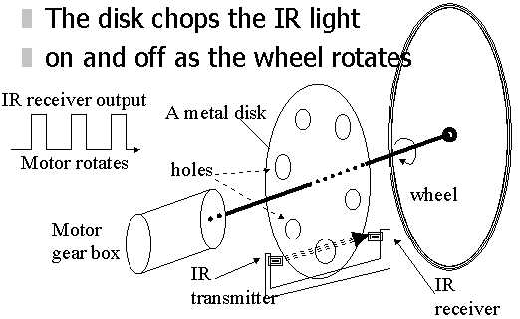
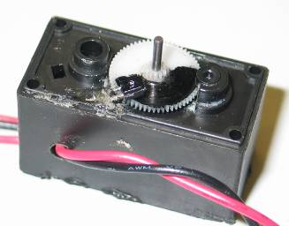
Left Wheel sensor – LWheelsen
(same for Right wheel sensor RWheelsen)
encoder-YOUTUBE
Our motor and
speed encoder
Each wheel rotation=
88 on/off changes
Darkened
part
blocks light
IR receiver
LWSensor
RWSensor
IR light source

Slide 37
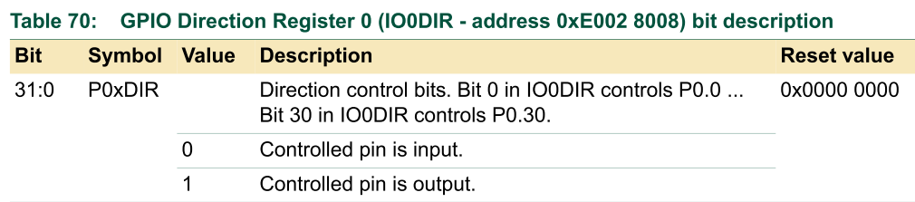
Setup for LWheelsen = p0.6 (LPC213-pin30),
Rwheelsen = p0.3(LPC213x-pin26)
// set p0.0 to TXD0, p0.1 to RXD0 and the rest to GPIO
//After power up (reset value) , all GPIOs are inputs
//So by default p0.6 (LWheelsen), p0.3(Rwheelsen) are inputs
91)PINSEL0 = 0x00000005;
:
23) #define LWheelSen 0x00000040 //p0.6 as left wheel sensor input
24) #define RWheelSen 0x00000008 //p0.3 as right wheel sensor input

Slide 38
Sensor connection
RWSensor
LWsensor

Slide 39
It uses a timer interrupt service routine programs
void init_timer (void)
  Setup 1000 timer interrupt for _IRQ exception()
_IRQ exception()
  Capture the rotation count, (each rotation 88 counts.)
  Result saved at lcount, rcount

Slide 40
Read wheel count (lcount, rcount) using interrupts
IR receiver
Speed Encoder
sensor
1000 interrupts per second
interrupts
time
Main( )
{
Setup( );
:
:
}
_IRQ exception() //1000Hz
{
:
read wheel speed
Update rcount
Update lcount
:
}

Slide 41
Read wheel count, result at lcount, rcount
23) #define LWheelSen 0x00000040
24) #define RWheelSen 0x00000008
265) void __irq IRQ_Exception() //timer interrupt running at 1000Hz
266) {
267) timeval++;
268) //generate square wave at test pin
269) if((timeval%2)==0) IO1SET|=TEST_PIN;
270) else IO1CLR|=TEST_PIN;
271) //=================
272)
273) //get the current wheel sensor values
274) lcur=IO0PIN & LWheelSen;
275) rcur=IO0PIN & RWheelSen;
276)
277) //count the number of switchings
278) if(lcur!=lold) {
279) lcount++;
280) lold=lcur;
281) }
282) if(rcur!=rold) {
283) rcount++;
284) rold=rcur;
285) }
286)
287) T0IR = 1; // Clear interrupt flag
288) VICVectAddr = 0; // Acknowledge Interrupt
289) }
P0.6 (left wheel) , or P0.3 (right wheel)
IR receiver
1000 interrupts per second
time
Left wheel: each interrupt checks if the wheel sensor
output has changed state . If yes, lcount++
lcount records the number of counts (number of times the IR light is chopped v=by the rotating disk) of the left wheel since the program starts
Same for rcount of the right wheel
CEG2400 Ch9 Peripherals V93b

Slide 42
Explanation1 , line265-271
For testing purpose
You can observe a waveform at this pin
265) void __irq IRQ_Exception()
266) {
267) timeval++;// increases at 1000 per second
268) //generate square wave at test pin
269) if((timeval%2)==0) IO1SET|=TEST_PIN;
270) else IO1CLR|=TEST_PIN;
271) //=================
:
:
:

Slide 43
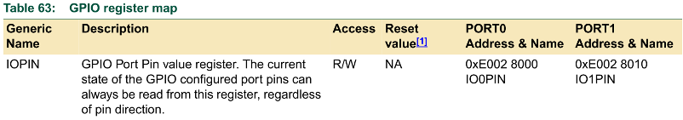
Explanation2, line 273-275
23) #define LWheelSen 0x00000040 //bit 6 is1, others 0, p0.6 as left wheel sensor input
:
273) //get the current wheel sensor values
274) lcur=IO0PIN & LWheelSen; // read left sensor
275) rcur=IO0PIN & RWheelSen; // read right sensor
Meaning: if LWSesnor is 1 //current status of LW sensor=1
  lcur=IO0PIN & LWheelSen =IO0PIN & 0x0000 0040 = 0x0000 0040
Meaning: if LWSesnor is 0 //current status of LW sensor=0
  lcur=IO0PIN & LWheelSen =IO0PIN & 0x0000 0040 = 0x0000 0000
LWSensor
Bit6 of IO0PIN
P0.6 of LPC213x

Slide 44
Exercise 13.3
IF Lwsensor is 25Hz, what is the value of lcount incremented in ¼ seconds?
ANS:?_______________________________
273) //Explanation3, line273-289// get the current wheel sensor values
274) lcur=IO0PIN & LWheelSen; // read left sensor
275) rcur=IO0PIN & RWheelSen; // read right sensor
276)
277) //count the number of switching
278) if(lcur!=lold) {
279) lcount++;
280) lold=lcur;
281) }
282) if(rcur!=rold) {
283) rcount++;
284) rold=rcur;
285) }
286)
287) T0IR = 1; // Clear interrupt flag
288) VICVectAddr = 0; // Acknowledge Interrupt
289) }
If there is change increment lcount
LWsenor
1000 interrupts per second
time
Left wheel: each interrupt checks if the wheel sensor
output has changed state . If yes, lcount++
CEG2400 Ch9 Peripherals V93b
44

Slide 45
Explanation4, line174-183
In main()
“ f ” command: Forward 100 steps and stop when lcount>100, stop left motor when rcount>100, stop right motor
Interrupt service routine
Running at 1000Hz
Update lcount and rocunt
As the wheels rotate
265) void __irq IRQ_Exception()
266) {
:
274)lcur=IO0PIN & LWheelSen;
275)rcur=IO0PIN & RWheelSen;
:
278)if(lcur!=lold) {
279) lcount++;
280) lold=lcur;
281)}
282)if(rcur!=rold) {
283) rcount++;
284) rold=rcur;
285)}
:
289) }
1000Hz
Interrupt
rate
Main()
:
174) if(cin=='f') {
175) lcount=0; //reset left step count
176) rcount=0; //reset right step count
177) //stop when stepcount reach 100 steps
178) while((lcount<=100)||(rcount<=100)) {
179) if(lcount>=100) {
180) IO0CLR|=L_DIRinv;//stop left motor
181) IO0CLR|=L_DIR;
182) lcount=0xff;
183) }
184) if(rcount>=100) {
stop right motor
similar to the left motor procedures above}
:}

Slide 46
Timer interrupt at 1KHz,interrupt service routine is at IRQ_Exception;
Refer to the notes on how to set timer interrupt
291) /* Setup the Timer Counter 0 Interrupt */ //1KHz
292) void init_timer (void) {
293) T0PR = 0; // set prescaler to 0
294) T0MR0 =13800; // set interrupt interval to 1mS
295) T0MCR = 3; // Interrupt and Reset on MR0
296) T0TCR = 1; // Timer0 Enable
297) VICVectAddr0 = (unsigned long)IRQ_Exception;//interrupt vector in 0
298) VICVectCntl0 = 0x20 | 4; // use it for Timer 0 Interrupt
299) VICIntEnable = 0x00000010; // Enable Timer0 Interrupt
300) }

Slide 47
Exercise 13.4
If the wheel is running very fast, say LWsensor is 400Hz , can you use the method to sample the wheel? Why?
ANS:?_____________________________
Discuss a method to measure the motor speed?
ANS:?______________________

Slide 48
4) Real time clock
Read time
and
set alarm

Slide 49
Summary
Studied peripherals of the LPC213x ARM processor.

Slide 50
Appendix

Slide 51
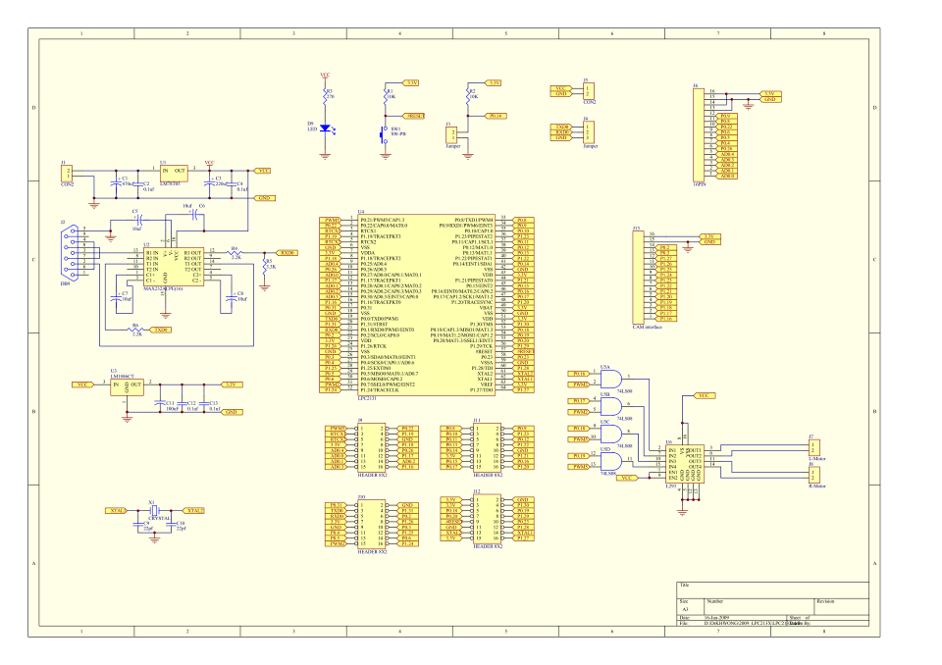
Our robot (ver12 – Old version)
Circuits of this chapter are from this design

Slide 52
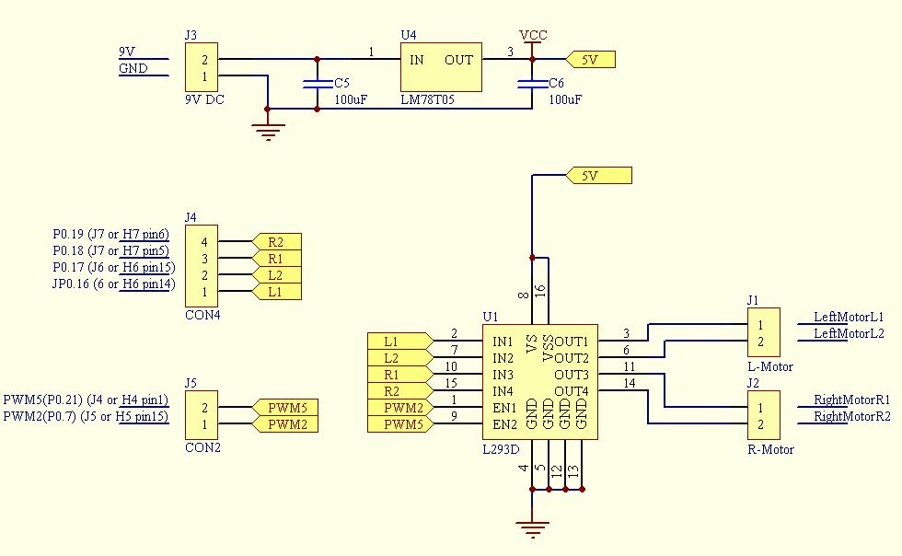
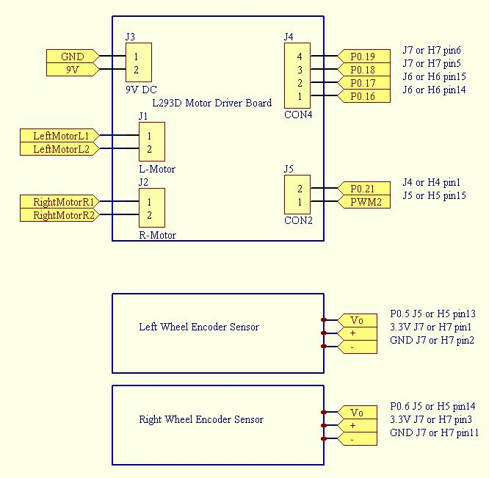
New robot drive circuit ver13.3

