Slide 1
CENG2400 Embedded System Design Chapter 0: Introduction
K H Wong
khwong@cse
3943-8397,
Room 907 SHB-Engineering building
http://www.cse.cuhk.edu.hk/~khwong/www2/ceng3430/ceng3430.html

Slide 2
Special announcement:
NO tutorial and lab on 5 Sept.2017
First ESTR2100-Elite_class meeting 5 Sept 4:30pm shb907

Slide 3
Course Outline for CENG2400 Embedded System Design
You will learn
Hardware systems: memory, data/address bus.
Software systems: control hardware using assembly and C languages.
Input / output (IO) interfaces: Interrupt, timer, parallel/ serial IO.
Applications.
Course webpage (see marking scheme)
http://www.cse.cuhk.edu.hk/~khwong/www2/ceng2400/ceng2400.html

Slide 4
Class exercises
Class exercise: In each lecture, a class exercise will be given to students, a student should complete the exercise and submit it to the professor/tutor at the end of the lecture. The total mark for class exercises is 10% of the whole course.

Slide 5
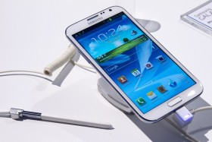
Learn to use the ARM processor
The ARM processor is the world most popular embedded system processor,
which is used in Android and i-Phone devices etc.
IPAD Air CPU: ARMv8, 1300MHz Cores=2
Samsung Galaxy Note 4 may use ARM Cortex A53
http://www.devicespecifications.com/en/model-cpu/ec552922
http://au.ibtimes.com/articles/556532/20140622/galaxy-note-4-samsung-release.htm#.U6jk1fmSyxU

Slide 6
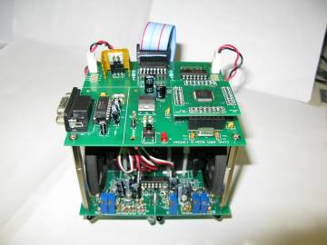
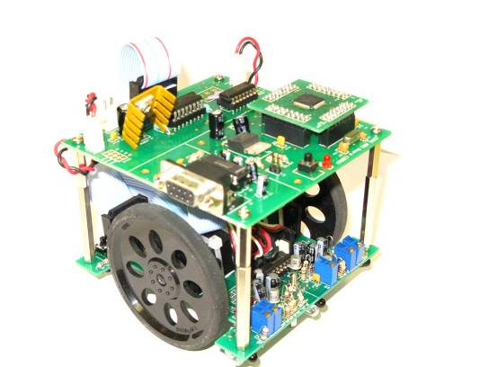
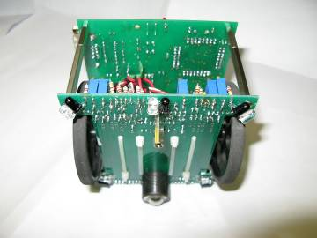
Lab exercise: Every student needs to build a working robot
Our CENG2400 robot
The ARM Processor
The wheel with speed encoder
Infrared Sensors

Slide 7
Class 2015-6
Monday (lecture) M4:30-6:15pm venue: ERB404
Tuesday (Tutorial and Lab) T5:30-7:15pm, venue: SHB102
Course tutors:
Zeng Ziliang
Lo sheung lai

Slide 8
Elite class ESTR2100 (if enough students are interested)
Format (Mirror)
Same timetable as CENG2400, i.e., shared teaching
Enrolled students would be given additional course work, and different assessments (e.g. a more difficult exam paper, more assignments and difficult projects)
Will take a different exam paper from CENG2400

Slide 9
Entrance Requirements to ESTR2100
Full-time students who have a cumulative GPA of 3.50 or above; AND
At least 2 terms from the expected graduation term
Those with extraordinary performance or contributions to the Faculty of Engineering or their Major Department may be considered

Slide 10
ESTR

Slide 11
Acknowledgment
Thanks to Drs. Philip Leong, Y.S. Moon,
O. Mencer, N. Dulay, P. Cheung for
some of the slides used in this course

Slide 12
Marking scheme
Part 1) Course Work (50%)
Weekly lab
In-class exercises
3 or 4 In-class Quiz (15%)
The questions are all quoted from the exercise set
We will make announcement if there is quiz on next lecture
Project (15%)
Detail will be released later (Late Oct)
Part 2: Final Exam (50%)
A student must gain at least 40% of the full marks in each part in order to pass the course.
20%

Slide 13
Some hardware project examples
Robot Avarta : https://youtu.be/hkLezd1pNMU
Car move : https://youtu.be/igDiBlEHlJw
Sensor head : https://youtu.be/6pa1ul5vits
Point cloud merging: https://youtu.be/TK7xbX1lsL8
Music robot
http://www.youtube.com/watch?v=NJ7wv2z8Wgk&feature=youtu.be

Slide 14
Important Notes (From the faculty 2016)
1. Be PUNCTUAL to class
2. Keep QUIET during class
(Unless you’re raising questions to course teachers or tutors or during in-class activities)
3. DON’T OVER-ENGAGE in extra-curricular activities or part-time jobs
(7 students have been dismissed because of this in 2015-16)

Slide 15
Academic Honesty
Zero Tolerance
Plagiarism, cheating, misconduct in test/exam will be reported to the Faculty Disciplinary Committee for handing.
Penalty
Zero marks for the concerned assignments/test/exam/whole course, reviewable demerits, non-reviewable demerits, suspension of study, dismissal from University.
University Guidelines to Academic Honesty
http://www.cuhk.edu.hk/policy/academichonesty/

Slide 16
ELITE Stream
All outstanding students, both new and current students are welcome!
Privileges
Exclusive ESTR courses, scholarships, overseas experiential trips, personal development trainings, etc….
Application and Enquiries
http://www3.erg.cuhk.edu.hk/erg/Elite
6/F, Faculty of Engineering, Ho Sin Hang Engineering Building

Slide 17
Student/Faculty Expectations
Let’s join hands to create a positive, respectful, and engaged academic environment inside and outside classroom.
Full version of Student/Faculty Expectations on Teaching and Learning
http://www.erg.cuhk.edu.hk/upload/StaffStudentExpectations.pdf

Slide 18
END

