Slide 1
Chapter 8 Peripherals-1-- ARMdemo06.c
CEG2400 - Microcomputer Systems
References
http://www.nxp.com/acrobat_download/usermanuals/UM10120_1.pdf
Trevor Martins , The insider's guide to the Philips ARM7 based microcontrollers, www.hitex.co.uk

Slide 2
Introduction
Parallel Port (GPIO)
Analog-to-Digital converter ADC
Digital-to-Analog converter DAC
Universal Asynchronous Receiver/Transmitter UART (serial port)

Slide 3
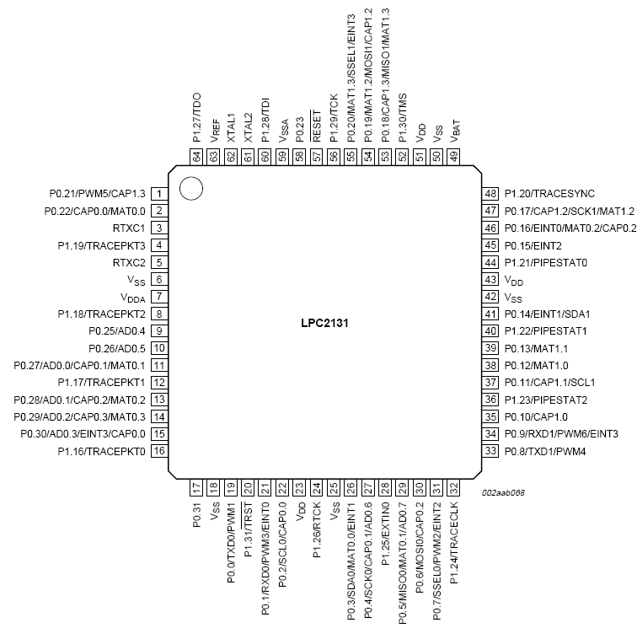
Pin assignments
LPC213x

Slide 4
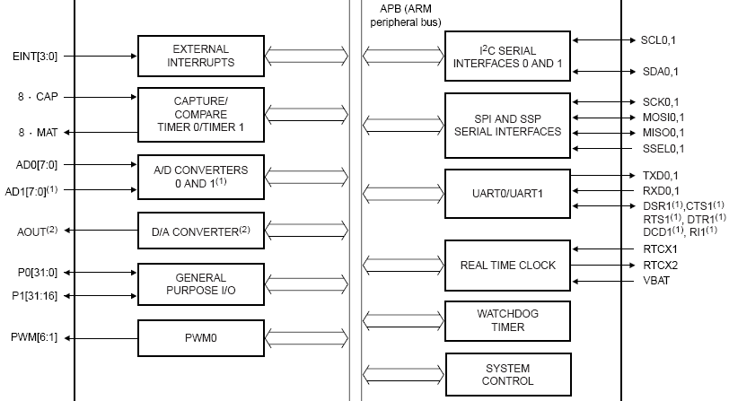
LPC2131 peripherals

Slide 5
1) General purpose Input Output (GPIO) http://www.nxp.com/acrobat_download/usermanuals/UM10120_1.pdf
LPC2131/x has two 32-bit General Purpose I/O ports.
  P0[31:0] except P0[31] is output only pin. Pin P0[24]is not available.
  P1[31:16] are IOs, P1[1:15] are not available.
Features
  Direction control of individual bits
  Separate control of output set and clear
  All I/O default to inputs after reset
Applications
  General purpose I/O
  Driving LEDs, or other indicators
  Controlling off-chip devices
  Sensing digital inputs

Slide 6
Exercise 1
What peripheral modules are available in LPC2131.
Ans: ?__________________
How many parallel input pins and output pins are available in LPC2131?
(i) : Inputs?________________
(ii) : outputs:?__________________
What are the states of the parallel input/output pins after reset: ? ________

Slide 7
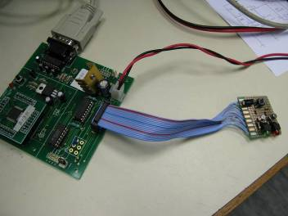
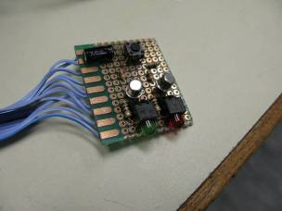
The experiment hardware
video
switch
Arm board
green led
red led
--We will show how to blink the red-led

Slide 8
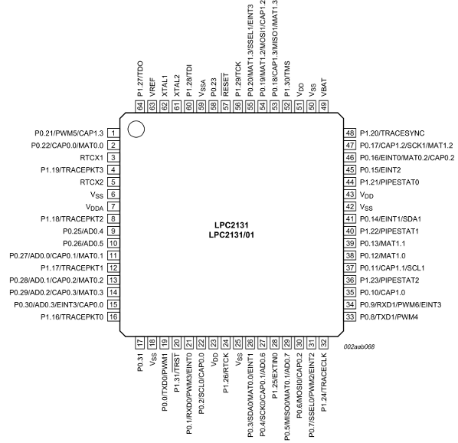
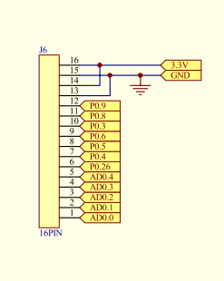
Our testing board connector p03(pin26) is input, p0.8(pin33),p0.9(pin34) are outputs

Slide 9
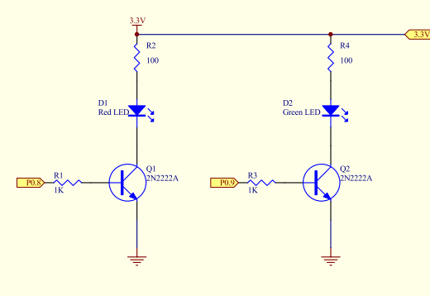


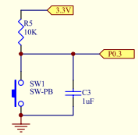
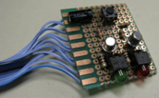


For 3.3V driving LEDs from a 3.3V system

Slide 10
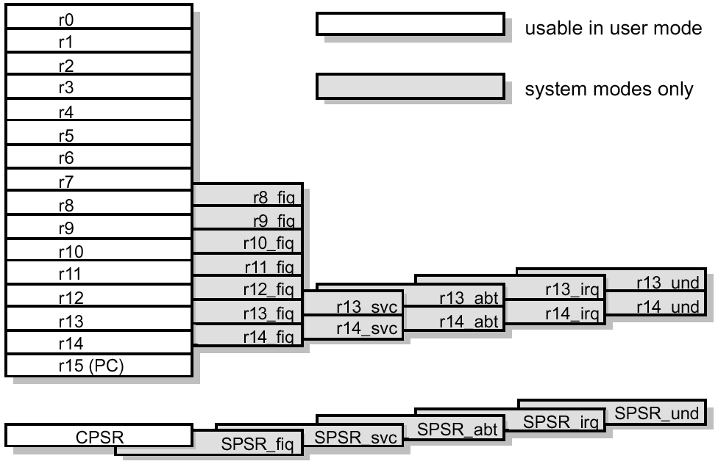
Remind you that
ARM has
32-bit memory addresses total 4-Gbytes
(0x0000 0000 to 0xFFFF FFFF)
:
; GPIO Port 0 Register address
IO0DIR EQU 0xE0028008; IO direction
IO0SET EQU 0xE0028004; turn on the bits
IO0CLR EQU 0xE002800C;turn off the bits
IO0PIN EQU 0xE0028000; pin assignment
  Registers (R0-R15) ..etc

Slide 11

Send data to GPIO registers
; GPIO Port 0 Register address
;
IO0DIR EQU 0xE0028008; IO direction
IO0SET EQU 0xE0028004; turn on the bits
IO0CLR EQU 0xE002800C;turn off the bits
IO0PIN EQU 0xE0028000; pin assignment

Slide 12
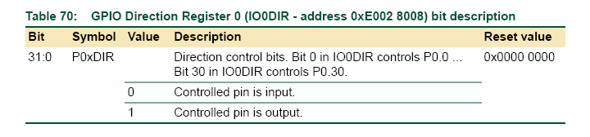
Explanation2 of GPIO.c (pure polling program) line 1-6
1) #include <lpc21xx.h> //define IO0PIN ,IO0DIR.. etc
2) #define RED_LED 0x00000100 //set p0.8 as RED LED
3) #define SW1 0x00000008 //set p0.3 as SW1
4) int main(void)
5) { long tmp; // variable for temp storage of port 0 status
//after power up by default all pins are GPIOs, same as PINSEL=0;
6)IO0DIR = RED_LED; // set p0.8 as output
//so IO0DOR=0000 0000 0000 0000 0000 0001 0000 0000
p0.8=output p0.3=input
// p0.8 is output (output), all pins are inputs (include p0.3),

Slide 13

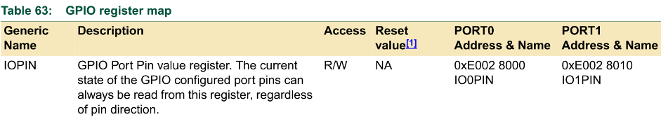
Explanation3 of GPIO.c (pure polling program) line 7-13
2) #define RED_LED 0x00000100 //set p0.8 as RED LED
3) #define SW1 0x00000008 //set p0.3 as SW1
:
7) while(1)
8) { tmp =IO0PIN & SW1;//read SW1(p0.3)depressed=0
9) if(tmp==0) ; What happens “if (tmp!=0)” is used?
10) IO0SET = RED_LED; //if SW1 pressed LED is on
11) else IO0CLR = RED_LED; // otherwise off the LED
12) }
13) }
Tmp=0x0000 0000 if SW1 is depressed because p0.3 is 0
Tmp=0x0000 0008 if SW1 is not depressed
P0.3
of LPC213x

Slide 14
Exercise 2: A simple C program GPIO.c
When SW1 is depressed, RED-LED is on
1) #include <lpc21xx.h> //define IO0PIN ,IO0DIR.. etc
2) #define RED_LED 0x00000100 //set p0.8 as RED LED
3) #define SW1 0x00000008 //set p0.3 as SW1
4) int main(void)
5) { long tmp; // variable for temp storage of port 0 status
6) IO0DIR = RED_LED; // set p0.8 as output
7) while(1)
8) { tmp =IO0PIN & SW1;//read SW1(p0.3)depressed=0
9) if(tmp==0) ; What happens “if (tmp!=0)” is used?
10) IO0SET = RED_LED; //if SW1 pressed LED is on
11) else IO0CLR = RED_LED; // otherwise off the LED
12) }
13) }
Question (a): What happens “if (tmp!=0)” is used in line 9?
Ans: ?____________________________________________
Question (b): If RED-LED is connected to p0.10, how to change the code?
Ans: ?______________________________________________
Question (c): If SW1 is connected to p0.4, how to change the code?
Ans: ?_______________________________________________________

Slide 15
Applications
Outputs
  Drive LED
  Drive motor
Inputs
  Read on/off switches
  Scan keyboard

Slide 16
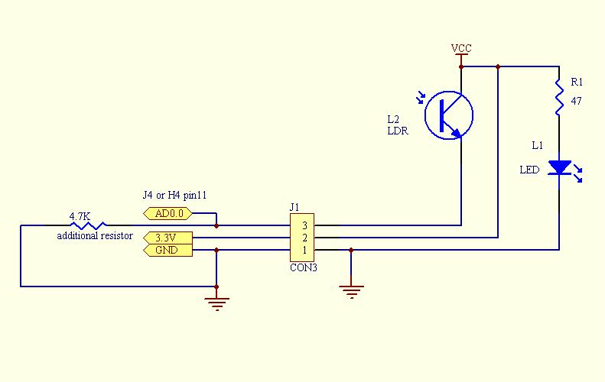
2) Analog-to-Digital converter ADC
Analog voltages
ADC
Light sensor0(IRS0)
Light sensor1(IRS1)
Light sensor2(IRS2)
Light sensor3(IRS3)
Light sensor4(IRS4)
Ad0.0
Ad0.1
Ad0.2
Ad0.3
Ad0.4
Program:
Use
read_sensor (int channel)
To read the data
Applications:
Light sensor (in robot car) ,
temperature sensor,
force sensor.
Video demo:
http://www.youtube.com/watch?v=Ol4xGSI51Ck&feature=youtu.be
Code: demo_adc.txt
http://www.cse.cuhk.edu.hk/%7Ekhwong/www2/ceng2400/demo_adc.txt

Slide 17
Exercise 3
Code for Analog-to-Digital ADC converter pin assignment for sensor pins
#include <lpc21xx.h>
#define ADCR (*((volatile unsigned long *) 0xE0034000))
#define ADDR (*((volatile unsigned long *) 0xE0034004))
int main(void) {
....
//From line 92 of ARMdemo06.c
// We must initialize the IO pin //before using ADC channel
94) PINSEL1 = 0x00400000; // set p0.27 to ad0.0
95) PINSEL1 |= 0x01000000; // set p0.28 to ad0.1
96) PINSEL1 |= 0x04000000; // set p0.29 to ad0.2
97) PINSEL1 |= 0x10000000; // set p0.30 to ad0.3
98) PINSEL1 |= 0x00040000; // set p0.25 to ad0.4
Question (a) : Write one instruction to replace of all instructions from line 94 to 98 . Answer: ? ______________________________________________
Question (b) :How to set the system to use ad0.5
Answer:? ________________________________________________

Slide 18
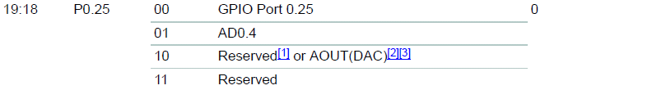
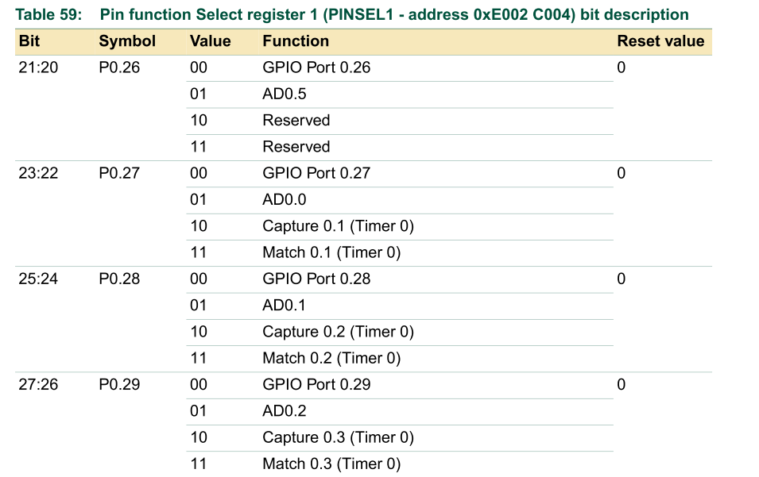
PINSEL1 Pin assignment for AD0.1
94) PINSEL1 = 0x00400000; // set p0.27 to ad0.0
PINSEL1 = xxxx 0000 0100 0xxx xxxx xxxx xxxx xxxx bit 31 27 23 19 15 11 7 3 0
Bit23:22
Bit23:22=01
Bit 19-27 for
ADC
Other bits are
For other
purposes
Ref: http://www.nxp.com/acrobat_download/usermanuals/UM10120_1.pdf
Volume 1: LPC213x User Manual UM10120

Slide 19
Exercise 4
What is the purpose of PINSEL1 register?
  ANS: ?____________________________
Where is the location of PINSEL1 register?
  ANS: ?____________________________
What is the pin number of P0.28
  ANS: ?____________________________
How to set P0.28 pin to be the function of ADC0.1?
  ANS: ?____________________________

Slide 20
PINSEL1 Pin assignment for AD0.1
94) PINSEL1 |= 0x010000000; // set p0.28 to ad0.1
PINSEL1 = 0000 0001 0000 0000 0000 0000 xxxx xxxx bit 31 27 23 19 15 11 7 3
Bit25:24
Bit25:24=01
Ref: http://www.nxp.com/acrobat_download/usermanuals/UM10120_1.pdf
Volume 1: LPC213x User Manual UM10120

Slide 21
Exercise 5: Fill in the blanks in the flow diagram of this program
Code for Analog-to-Digital ADC converter
In C:\Keil\ARM\INC\Philips\lpc21xx.h, ADCR=0xE0003 4000 ADCR=0xE0003 4000, ADDR=0xE0003 4004
Study ADCR (Analog to digital control reg)
and ADDR (Analog to digital Data reg)
here
Conversion not done
From line 71 of ARMdemo06.c
//(1) ADC interface
71) int read_sensor(int channel)
72) {
73) int temp;
74)
75) ADCR=0x1 << ________;//__select channel___ (see Appendix3)
76) ADCR|=_____________; // set up the control bits_
77)
78) while(((temp=ADDR)& ___________)==0); //MSB =1 meaning ADC is done
79) temp>>=6; //?________________________________(bit6->15: 10-bit conversion result)
80) temp&=0x3ff;//TEMP=output IS 0-3V PRESICION IS (10 bits: 2^10=1024 levels)
81)
82) return (temp*33); //?? Why temp*33__________________________
83) }
.....
Loop until
ADC is
done
Explanation ?_______________
Conversion Done
Return temp*scale

Slide 22
ADCR -- one (AD0) for lpc2131 line 75) ADCR=0x1<<_______(fill in the blank);//see Appendix 3 line 76) ADCR|=_______(fill in the blank);//operational,start convert
ADCR= 0000 0001 0010 0000 0000 0010 xxxx xxxx bit 31 27 23 19 15 11 7 3
Point to which
channel
Bit 15:8=10b=2
CLKDIV=2+1=3
Freq=13.824MHz/3=4.608MHz
Ref: http://www.nxp.com/acrobat_download/usermanuals/UM10120_1.pdf

Slide 23
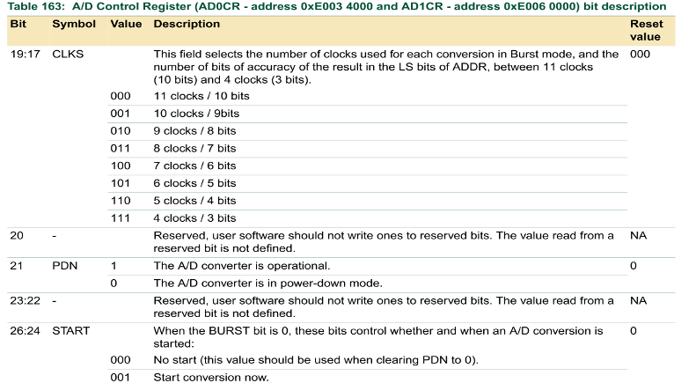
ADCR -- one (AD0) for lpc2131 line 75) ADCR=0x1<<________(fill in the blank); line 76) ADCR|=_________(fill in the blank);// operational, start convert
ADCR= 0000 0001 0010 0000 0000 0010 xxxx xxxx bit 31 27 23 19 15 11 7 3
Bit21=1 operational
Bit24=1
Ref: http://www.nxp.com/acrobat_download/usermanuals/UM10120_1.pdf

Slide 24
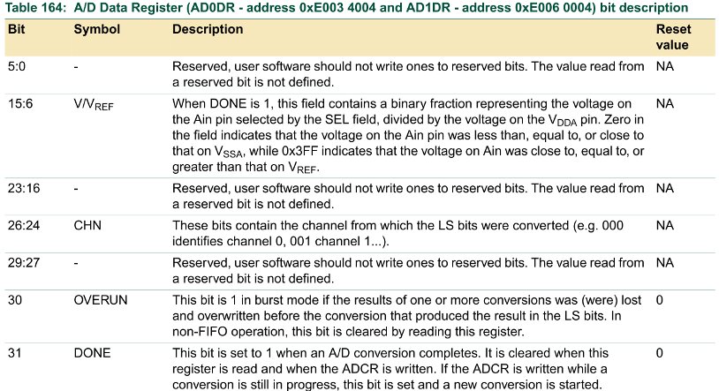
Polling for the completion of Analog-to-digital conversion
78) while(((temp=ADDR)&_________(fill in the blank))==0);
ADDR= 1000 0000 0000 0000 xxxx xxxx xx00 0000
//MSB =1 meaning ADC is done
//if bit 31 of ADDR is 1, it is done
//bit 15:6 contain the result
ADC result

Slide 25
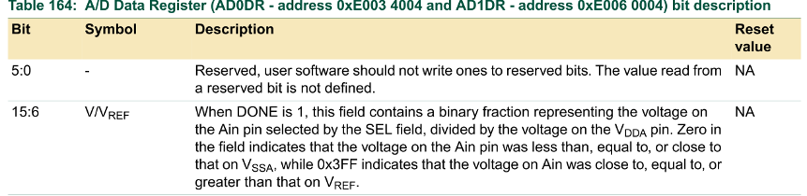
Find the Analog-to-digital converted result ADC result xx xxxx xxxx
ADDR= 1000 0000 0000 0000 xxxx xxxx xx00 0000
result
polling
78)while(((temp=ADDR)&0x80000000)==0);
79) temp>>=6;
temp>>6; = 0000 0010 0000 0000 00xx xxxx xxxx
80) temp&=0x3ff;//TEMP=output IS 0-3V PRESICION is 1024 (10bit ADC precision)
temp&=0x3ff;= 0000 0000 0000 0000 00xx xxxx xxxx
82) return (temp*33);// make it a full integer.
result

Slide 26
3)Digital-to-Analog converter DAC
Applications
  Sound generation, e.g. MP3 player
  Motor speed control use analog methods
Usage: Similar to Analog-to-Digital converter ADC
Digital-to-Analog converter DAC --
Convert digital codes into
an analog signal
Analog value

Slide 27
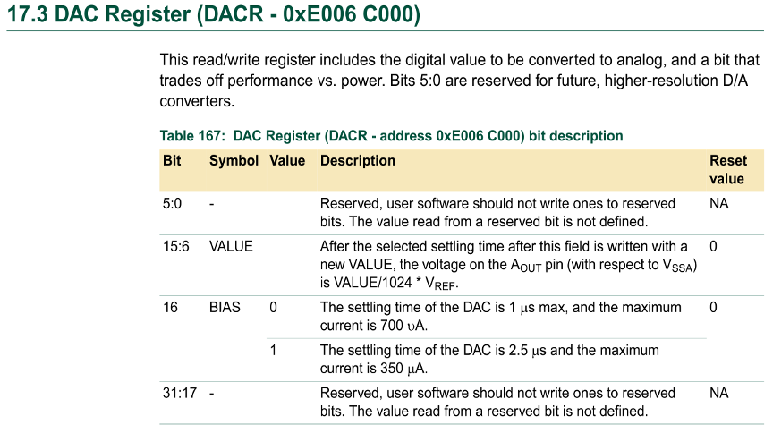
DAC reg. 10-bit

Slide 28
4) Universal Asynchronous Receiver / Transmitter UART (serial port)
//init UART0 setting
......
26) #define NEWLINE sendchar(0x0a); sendchar(0x0d)
33) void Init_Serial_A(void) {
34) U0LCR = 0x83; //8 bit length ,DLAB must be 1 to access
35) U0DLL = 0x0F; //Baud rate setting , part1
36) U0DLM = 0x00; //Baud rate setting , part 2
37) U0LCR = 0x03; //DLAB=0 to complete the setting
}
0x0a=New line , 0x0d=carriage return
in ARM06Demo.c, and www.nxp.com/acrobat_download/applicationnotes/AN10369_1.pdf

Slide 29
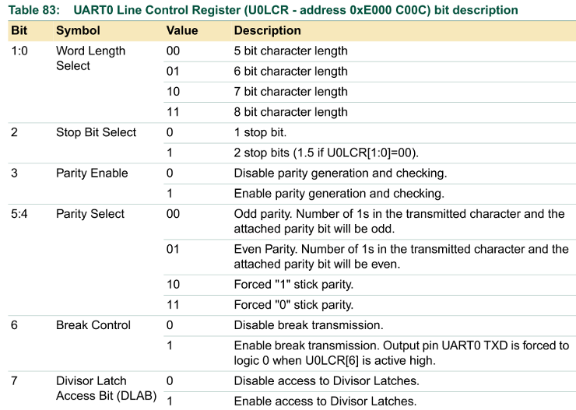
line34) U0LCR = 0x83; //8 bit length ,DLAB=1
//U0LCR = 1000 0011b

Slide 30

Exercise 6: Baud rate setting
35) U0DLL = 0x0F;//=15
36) U0DLM = 0x00;//=0
Because , PCLK=13.824MHz
UART0(baudrate)=PCLK/(16*(16*0+15))
=13.824MHz/3840=57600 is the baud rate
Exercise: Find U0DLL and U0DLM if the required baud rate is 19200.
Answer:?________

Slide 31
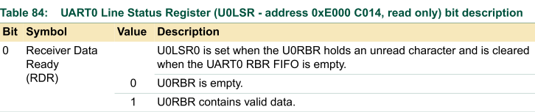
Getchar() in “C” polling method (not interrupt)
Polling
method
Yes
40) char getchar(void) {
41) volatile char ch = '0';
42)
43) while ((U0LSR & 0x1)==0)//wait until a byte is received
44) ;
45) ch = U0RBR;// receive character
//(U0RBR - 0xE000 C000,
46)
47) return ch;
48) }
Is bit1 of U0LSR==0?
(receive buffer empty?)
polling
No,
receive character

Slide 32
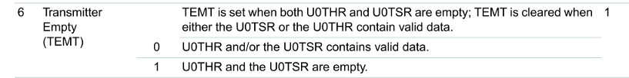
Sendchar() in “C” polling method (not interrupt)
Polling
method
49)///////////////////////////////
50)void sendchar(char ch) {
51) while( (U0LSR & 0x40)==0 );
52)
53) U0THR = ch;// Transmit next character
54) } // at 0xE000 C000 bit7:0
Is bit6 of U0TH==0?
(Transmitter contains
valid data, previous data
not sent yet?)
Yes
polling
No,
Transmit
Next character
Bit of U0LSR at 0xE000 C014

Slide 33
Print(), Print a string of characters on screen
56) int print(char *p) {
57) while(*p!='\0') { //’\0’ is end of text, = 0x03
58) sendchar(*p++); // if not end of text send characters of the string
59) }
60) return(0);
61)}
......
Example
print(“---Hello world---");NEWLINE;

Slide 34
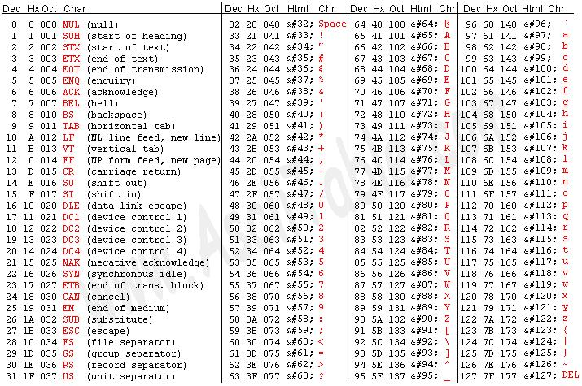
Ascii table from http://enteos2.area.trieste.it/russo/IntroInfo2001-2002/CorsoRetiGomezel/ASCII-EBCIDC_table.htm

Slide 35
Exercise 7: putint( int count) print an integer on screen
‘0’ is 0x30 (ASCII for number zero)
63) void putint(int count) {
64) sendchar('0' + count/10000);
65) sendchar('0' + (count/1000) % 10); //%=modulus
66) sendchar('0' + (count/100) % 10);
67) sendchar('0' + (count/10) % 10);
68) sendchar('0' + count % 10);
69)}
Question:
If “count” is “2597”, what hex numbers have been sent to the serial port?
Answer: ?_________________________
Print an ASCII character representing that digit at one time,

Slide 36
UART main print example
int main(void) {
......
// Initialize IO pin before using TXD0 and RXD0
PINSEL0 = 0x00000005; // set p0.0 to TXD0, p0.1 to RXD0 and the rest to
GPIO
.....
Init_Serial_A(); // Init COM port
......
NEWLINE;
print("================================================"); NEWLINE;
print("**"); NEWLINE;
print("* CUHK Computer Science and Engineering Department*"); NEWLINE;
print("* LPC2131 ARM Board (ver1.3) *"); NEWLINE;
print("**"); NEWLINE;
print("* I2C (Master Receiver) Test Program (ver1.3)*"); NEWLINE;
print("================================================"); NEWLINE;
NEWLINE;

Slide 37
Summary
Studied peripherals of the LPC213x ARM processor.

Slide 38
Appendix
ESTR2100 students should study this

Slide 39
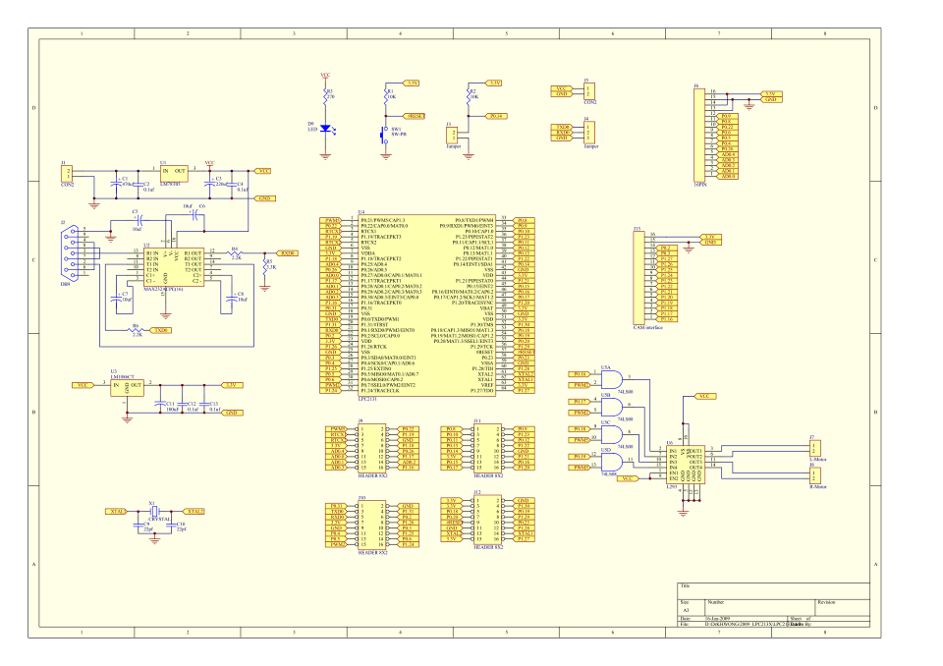
Appendix (1) Our robot
Circuits of this chapter are from this design

Slide 40
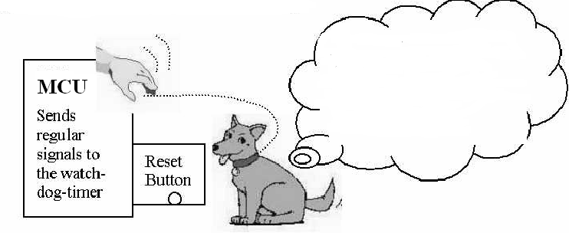
Appendix (1) Watchdog timer register setting
If the system doesn’t give
me any signals for a period
of time (say 2 seconds), that
means it hangs, so I will
Press the reset bottom

Slide 41
Example http://www.keil.com/download/docs/317.asp
void feed_watchdog (void) { /* Reload the watchdog timer */
WDFEED = 0xAA;
WDFEED = 0x55;
}
void sendhex (int hex) { /* Write Hex Digit to Serial Port */
if (hex > 9) sendchar('A' + (hex - 10));
else sendchar('0' + hex);
}
void sendstr (char *p) { /* Write string */
while (*p) {
sendchar (*p++);
}
}
/* just waste time here for demonstration */
void do_job (void) {
int i;
for (i = 0; i < 10000; i++);
}

Slide 42
Main and use of feed
int main (void) {
unsigned int i;
init_serial(); /* Initialize Serial Interface */
if( WDMOD & 0x04 ) { /* Check for watchdog time out */
sendstr("Watchdog Reset Occurred\n");
WDMOD &= ~0x04; /* Clear time out flag */
}
WDTC = 0x2000; /* Set watchdog time out value */
WDMOD = 0x03; /* Enable watchdog timer and reset */
for(i = 0; i < 50; i++) {
do_job (); /* the actual job of the CPU */
feed_watchdog(); /*restart watchdog timer, for_loop will run until complete */
}
while (1) { /* Loop forever */
do_job (); /* the actual job of the CPU */
/* no watchdog restart, watchdog reset will occur! */
}
}

Slide 43
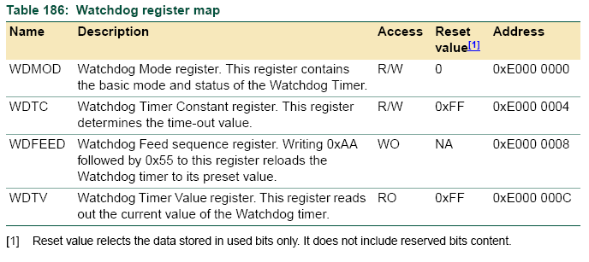
Watchdog Registers

Slide 44
Watch dog mode reg. WMOD

Slide 45
void feed_watchdog (void) { /* Reload the watchdog timer */
WDFEED = 0xAA; WDFEED = 0x55;
}
Watchdog
Block diagram

Slide 46
Appendix(3)
Alternative set bit method in “C”. The command “<<“ is a left shift instruction in the “C” language
Y=0x1<<21;//left shift 21 bits, this sets bit21=1 and other bits= 0
Example: Before shift
  Y=0x1=0000 0000 0000 0000 0000 0000 0000 0001 (Binary)
After shift
  Y= 0000 0000 0010 0000 0000 0000 0000 0000 (Binary)
    bit 31 bit 21 bit0
  Exercise: set bit 9 of register R to be 1, other bits to be 0.
  Answer=0x1<<9;
  So R=0000 0000 0000 0000 0000 0010 0000 0000 (Binary)
  =0x200
Bit9 =1

Slide 47
Answer 5 : Exercise 5: Fill in the blanks in the flow diagram of this program
Code for Analog-to-Digital ADC converter
In C:\Keil\ARM\INC\Philips\lpc21xx.h, ADCR=0xE0003 4000 ADCR=0xE0003 4000, ADDR=0xE0003 4004
Conversion not done
From line 71 of ARMdemo06.c
//(1) ADC interface
71) int read_sensor(int channel)
72) {
73) int temp;
74)
75) ADCR=0x1<<channel; //select channel
76) ADCR|=0x01200200; //operational, start convert
77)
78) while(((temp=ADDR)&0x80000000)==0); //MSB =1 meaning ADC is done
79) temp>>=6; //shift right 6 bits, remove unused bits
80) temp&=0x3ff;//TEMP=output IS 0-3V PRESICION IS 1024
81)
82) return (temp*33);
83) }
.....
Loop until
ADC is
done
78) while(((temp=ADDR)&0x80000000)==0);
//MSB =1 meaning ADC is done
Conversion Done
Return temp*scale

