Slide 1
Chapter 6: Serial Interface --
UART (universal asynchronous receiver transmitter )
CEG2400 - Microcomputer Systems
1

Slide 2
Overview
Introduction to the universal asynchronous receiver transmitter : UART.
UART Hardware Interface
UART Software Interface
Initialize the UART Hardware
Sending data using handshaking
2

Slide 3
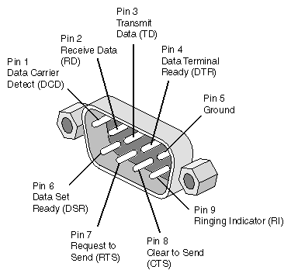
1) Introduction: Serial interface
(universal asynchronous receiver transmitter : UART)
RS232 standard and application, e.g.
RS232 standard
3 wires
+10 V=‘0’=SPACE
-10V=‘1’=MARK
Pin3
Pin2
pin5
Pin2
Pin3
pin5
RS232 port
(UART)
RS232 port
(UART)
3
http://docs.sgi.com/library/dynaweb_docs/hdwr/SGI_EndUser/books/IXbricAdd/sgi_html/figures/IXbrick.serialport.pinouts.gif

Slide 4



U _{Universal} A _{Asynchronous} R _{Receiver} T _{Transmitter}
_{UART for data communication}
Serial data transmission means sending data bits one by one using one wire.
Asynchronous transmission means a data (including one start bit , 8-bit data, and stop bits) can be sent at any time.
4

Slide 5
Universal asynchronous receiver transmitter : UART
RS232 is a serial communication standard
Since it is asynchronous, no external clock is needed, only 3 wires are required for the simplest RS232 connection {GND, tx(transmit), rx(receive)}
Bit 0 to 7 (least sig. bit first )→
+10V=Logic 0=space
-10V= Logic 1=mark
Start 0 1 2 3 4 5 6 7 stop
time
Exercise: Sketch Bit Patterns for character A and B
http://www.maxim-ic.com/app-notes/index.mvp/id/83/
5

Slide 6
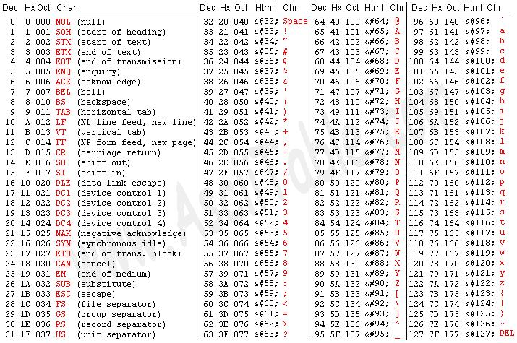
ASCII table http://www.cs.utk.edu/~pham/ascii_table.jpg
6

Slide 7
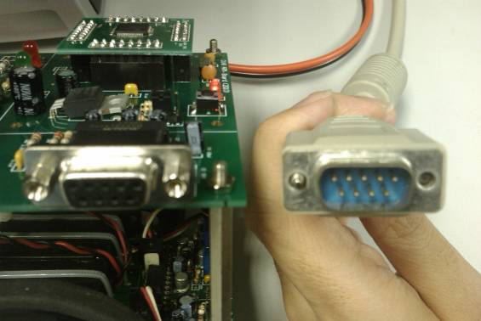
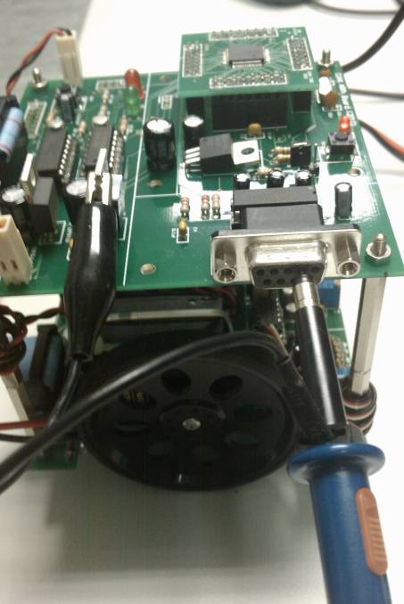
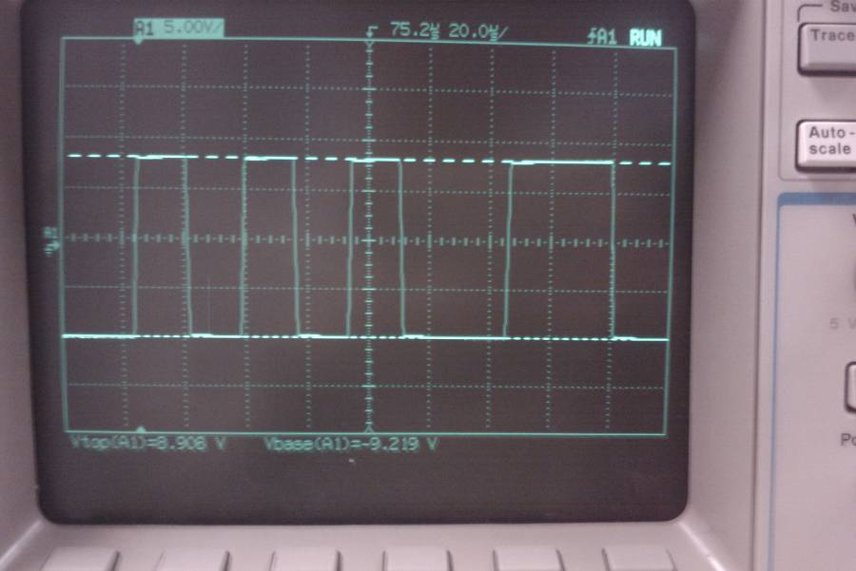
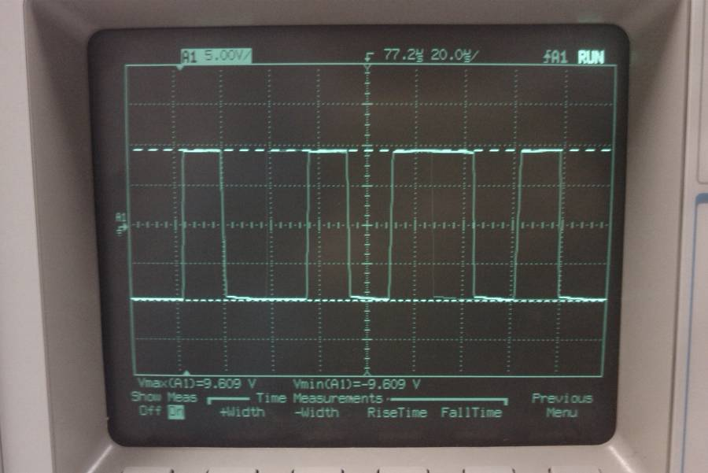
EXAMPLES
Sending ASCII
‘5’=0x35=0011 0101b
Oscilloscope
Probe
The whole ASCII serial character has 10 bits
(1 start+8 data + 1 stop bit)
Start bit=0
Stop bit=1
What is this code ?
T=bit period
=1/baud rate
10101100(stop bit=1)
Least Sign. Bit first
7

Slide 8
If the baud rate is 57600 bits per second
Define ‘bit period’ :the amount of time to transmit a logic 1 or 0. (bit period= 1/57600 seconds)
Each bit lasts for (1/Baud rate) seconds
bit period =
1/baud rate =(1 / 57600) seconds=17.4 us
Exercise: What is the “bit period” in seconds if the baud rate is 2400?
8

Slide 9
Hello world example/references
Manual: UM_LPC21XX_LPC22XX_2.pdf
  https://github.com/sgh/aos/blob/master/doc/processors/UM_LPC21XX_LPC22XX_2.pdf
Application Note: AN10369_1.pdf
  http://uglyduck.ath.cx/PDF/Philips/LPC2000/AN10369_1.pdf
from course/tutorial web page
  astartup.s
  ahello.s (appendix1)
9

Slide 10
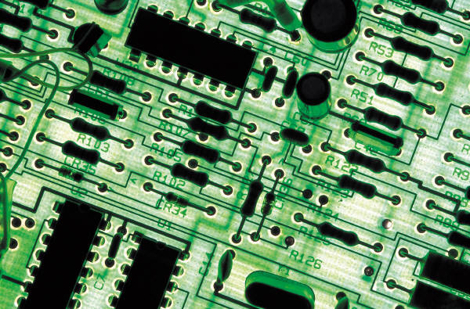
2) UART
Hardware Interface
10

Slide 11
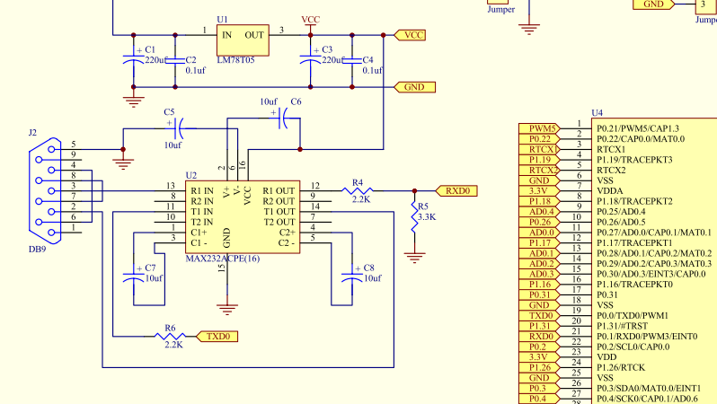
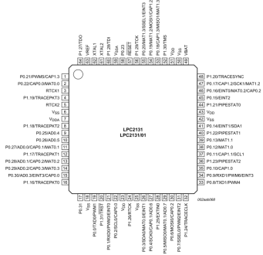
UART Hardware Interface
ARM7 output signals are 0->3.3V.
A MAX232 chip is needed to translate the 0->3.3V levels to the +/-10V RS232 levels (with power VCC=5V, the electronic circuit can do that!!)
11

Slide 12
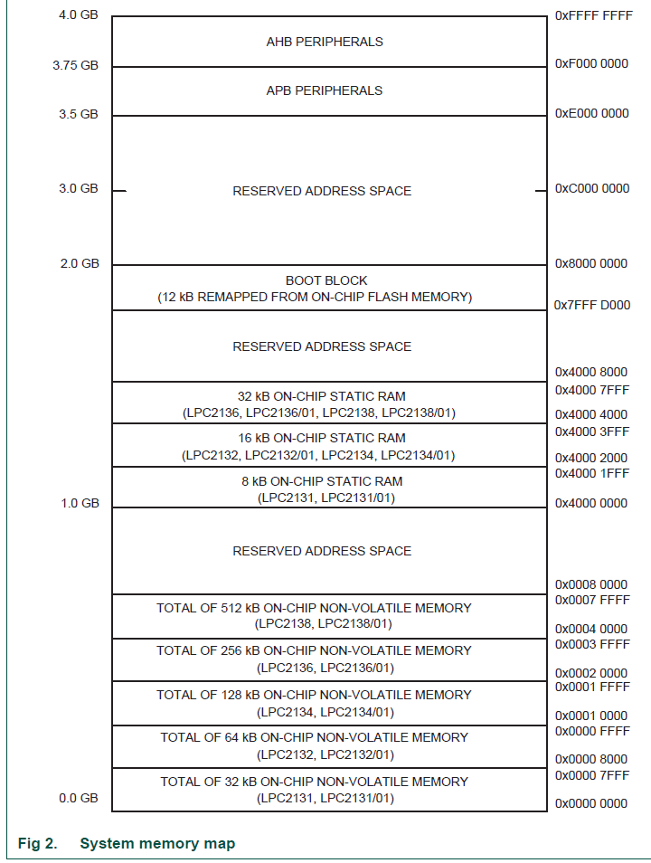
ARM system support for UART: Memory Map
Ref: page 9 of ARM7-LPC213x-user manual (Hardware Guide, UM10120)
http://www.nxp.com/documents/user_manual/UM10120.pdf
Software interface involves appropriately programming registers in the memory map to manipulate the hardware
i.e. from 0xE000 C000 to 0xE000 C030 for UART ports
12

Slide 13

Like office addresses for mail delivery
UART Office addresses from floor
  0xE000 C000 to
  0xE000 C030
Memory address space
13

Slide 14
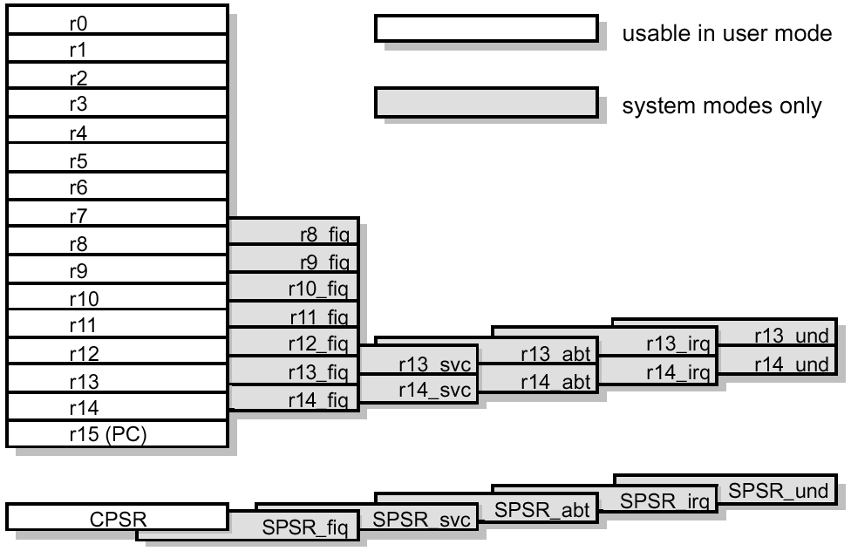
Reminded that
ARM7 has these registers and memory addresses
UART Office
addresses from floor
0xE000 C000 to
0xE000 C030
  Registers (R0-R15) ..etc
32-bit memory addresses (0x0000 0000 to 0xFFFF FFFF)
0xE000 C000 to
0xE000 C030

Slide 15
Revision
Name the usages of these memory locations in an ARM (LPC21xx) processor
0000 0000→0000 7FFFh ?_______
ROM, code
4000 0000→4000 FFFFh ?_______
RAM, data,Stack
E000 C000 →E000 C030 ?_______
(UART)

Slide 16
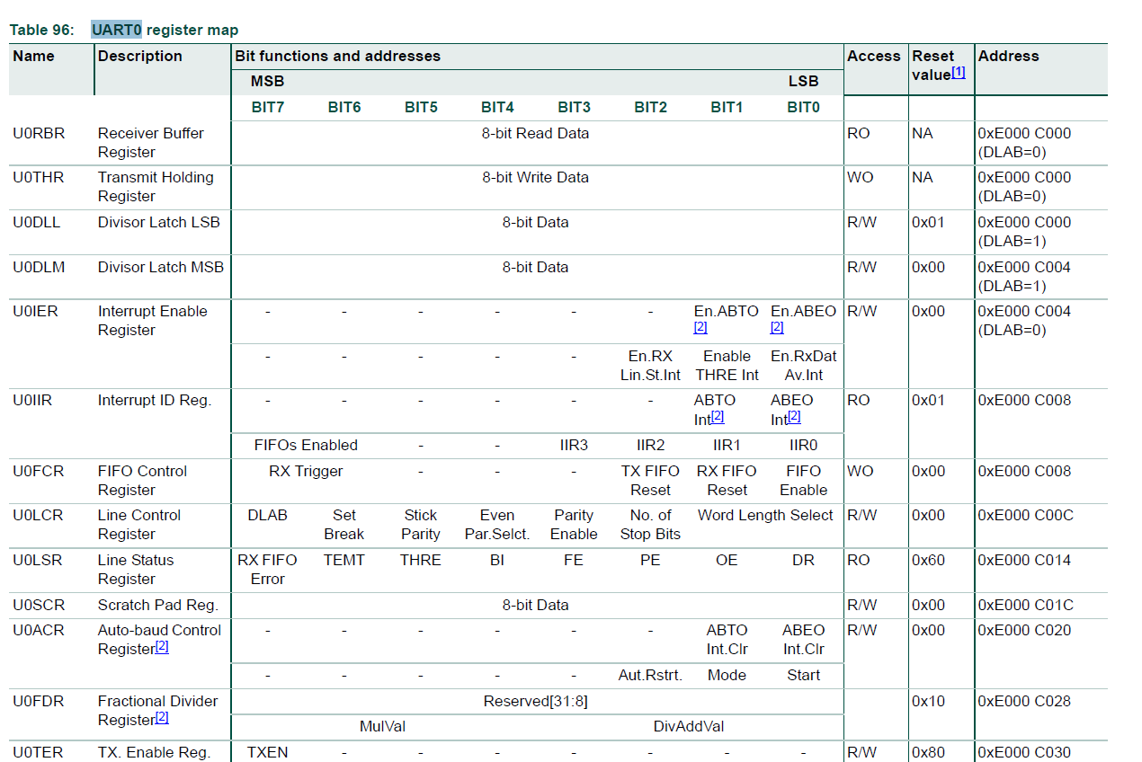
UART Register address map :
0xE000 C000 to 0xE000 C030
U0RBR (read only ) and U0THR (write only) share the same address
but have no conflict (because one is for “write” another is for “read”).
Ref: table 96 of ARM7-LPC213x-user manual (Hardware Guide, UM10120)
http://www.nxp.com/documents/user_manual/UM10120.pdf
DLAB=0
DLAB=1
16

Slide 17
3) UART
A general description of
the software Interface
ahello.s
http://www.cse.cuhk.edu.hk/%7Ekhwong/www2/ceng2400/ahello.s
17

Slide 18
Part1: define registers
Part3: subroutine to initialize uart0
File name : ahello.s
; UART0 registers
U0RBR EQU 0xE000C000
U0THR EQU 0xE000C000
U0IER EQU 0xE000C004
U0IIR EQU 0xE000C008
U0FCR EQU 0xE000C008
U0LCR EQU 0xE000C00C
U0LSR EQU 0xE000C014
U0SCR EQU 0xE000C01C
U0DLL EQU 0xE000C000
U0DLM EQU 0xE000C004
PINSEL0 EQU 0xE002C000
; User Initial Stack & Heap
AREA |.text|, CODE, READONLY
EXPORT __main
__main BL iuart0
loop MOV R0, #'H'
BL writec
MOV R0, #'e'
BL writec
MOV R0, #'l'
BL writec
MOV R0, #'l'
BL writec
MOV R0, #'o'
BL writec
MOV R0, #' '
BL writec
MOV R0, #'w'
BL writec
MOV R0, #'o'
BL writec
MOV R0, #'r'
BL writec
MOV R0, #'l'
BL writec
MOV R0, #'d'
BL writec
MOV R0, #'\n'
BL writec
B loop
iuart0
MOV R1, #0x5 ; PINSEL0 = 0x5
LDR R0, =PINSEL0
STR R1, [R0]
MOV R1, #0x7 ; U0FCR = 0x7
LDR R0, =U0FCR
STRB R1,[R0]
MOV R1, #0x83 ; U0LCR = 0x83
LDR R0, =U0LCR
STRB R1,[R0]
MOV R1, #0x0f ; U0DLL = 0x0f
LDR R0, =U0DLL
STRB R1,[R0]
MOV R1, #0x00 ; U0DLM = 0x0
LDR R0, =U0DLM
STRB R1,[R0]
MOV R1, #0x03 ; U0LCR = 0x03
LDR R0, =U0LCR
STRB R1,[R0]
BX R14 ; return from subroutine
writec LDR R1, =U0LSR
LDRB R1, [R1]
TST R1, #0x40
BEQ writec
LDR R1, =U0THR
STRB R0, [R1]
BX R14 ; return from subroutine
END
Part2: main
program
Part4: subroutine to write data
to serial port
18

Slide 19
Part 1 of ahello.s
;send hello to the serial line
Define the address locations of the UART0(Universal asynchronous receiver transmitter) registers
; UART0 registers
U0RBR EQU 0xE000C000
U0THR EQU 0xE000C000
U0IER EQU 0xE000C004
U0IIR EQU 0xE000C008
U0FCR EQU 0xE000C008
U0LCR EQU 0xE000C00C
U0LSR EQU 0xE000C014
U0SCR EQU 0xE000C01C
U0DLL EQU 0xE000C000
U0DLM EQU 0xE000C004
PINSEL0 EQU 0xE002C000
RS232 standard
3 wires
+10 V=‘0’=SPACE
-10V=‘1’=MARK
Pin3
Pin2
pin5
Pin2
Pin3
pin5
RS232 port
(UART)
RS232 port
(UART)
19

Slide 20
Define Uart Registers in assembly (in lpc21xx.h (ARM7) generated by uvision3 of the Keil assembler tool)
; UART0 registers
U0RBR EQU 0xE000C000
U0THR EQU 0xE000C000
U0IER EQU 0xE000C004
U0IIR EQU 0xE000C008
U0FCR EQU 0xE000C008
U0LCR EQU 0xE000C00C
U0LSR EQU 0xE000C014
U0SCR EQU 0xE000C01C
U0DLL EQU 0xE000C000
U0DLM EQU 0xE000C004
PINSEL0 EQU 0xE002C000
EQU Pseudo instruction
Define a constant
X EQU 2
This is an assembler directive that is used to give a value to a label name. In this example it assigns X the value 2. Thus when X is used elsewhere in the code, the value 2 will be substituted (similar to using a #define to set up a constant in the C language).
20

Slide 21
Part 2 of ahello.s
;send hello to the serial line
; User Initial Stack & Heap
AREA |.text|, CODE, READONLY
EXPORT __main
__main BL iuart0
loop MOV R0, #'H'
BL writec
MOV R0, #'e'
BL writec
MOV R0, #'l'
BL writec
MOV R0, #'l'
BL writec
MOV R0, #'o'
BL writec
MOV R0, #' '
BL writec
MOV R0, #'w'
BL writec
MOV R0, #'o'
BL writec
MOV R0, #'r'
BL writec
MOV R0, #'l'
BL writec
MOV R0, #'d'
BL writec
MOV R0, #'\n'
BL writec
B loop
In this program, it writes “hello world” to the serial line.
Print
hello
world

Slide 22
Part 3 of ahello.s, (subroutine iuart0: initialize uart0 registers)
iuart0
MOV R1, #0x5 ; PINSEL0 = 0x5
LDR R0, =PINSEL0
STR R1, [R0]
MOV R1, #0x7 ; U0FCR = 0x7
LDR R0, =U0FCR
STRB R1,[R0]
MOV R1, #0x83 ; U0LCR = 0x83
LDR R0, =U0LCR
STRB R1,[R0]
MOV R1, #0x0f ; U0DLL = 0x0f
LDR R0, =U0DLL
STRB R1,[R0]
MOV R1, #0x00 ; U0DLM = 0x0
LDR R0, =U0DLM
STRB R1,[R0]
MOV R1, #0x03 ; U0LCR = 0x03
LDR R0, =U0LCR
STRB R1,[R0]
BX R14
; return from subroutine
22

Slide 23
Part 4 of ahello.s (subroutine writec: write one character to the serial line)
writec LDR R1, =U0LSR
LDRB R1, [R1]
TST R1, #0x40
BEQ writec
LDR R1, =U0THR
STRB R0, [R1]
BX R14 ; return from subroutine
END
23

Slide 24

4) Detailed description of subroutines
“iuart0” in ahello.s
Initialize the UART Hardware
Setup data into UART registers
UART registers
0xE000 C000 to
0xE000 C030
24

Slide 25
Part 3 of ahello.s
Initialize uart0 (iuart0) in ahello.s (Appendix1)
step4
Step1:
setup pins
MOV R1, #0x0f
LDR R0, =U0DLL
STRB R1,[R0]
MOV R1, #0x00;
U0DLM = 0x0
LDR R0, =U0DLM
STRB R1,[R0]
iuart0
MOV R1, #0x5
LDR R0, =PINSEL0
STR R1, [R0]
MOV R1, #0x7
LDR R0, =U0FCR
STRB R1,[R0]
MOV R1, #0x83
LDR R0, =U0LCR
STRB R1,[R0]
step2
step3
25

Slide 26
Subroutine iuart0:
Software to initialize the UART in the LPC21xx (ARM7) chipset
inside iuart0
  Step 1: setup pins
    configure pin function select reg. i.e. pin 19=TXD
  Step 2
    configure FIFO control reg.
  Step 3
    configure line control reg. (start, stop bits)
  Step 4
    Configure baud rate
26

Slide 27

Step1 of iuart0: pin configuration=0x05
Configure the pin for serial interfaces
Arm7 pins are multi functions, depending on initialization.
E.g. configure pin-symbol “p0.0” (pin19 or p0.0) to be the serial transmission pin “TXD”
You must set Bit 1:0 of address 0xE002 C000=“01”.
27

Slide 28
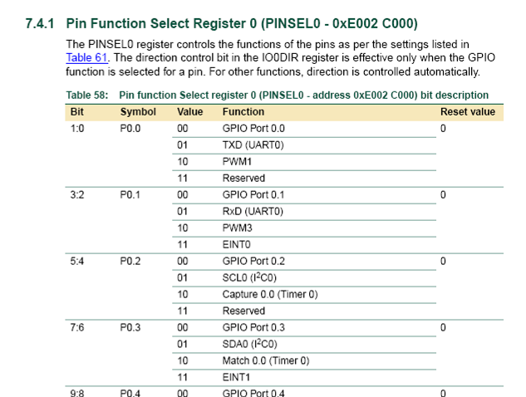
Exercise 6.1 : which pin (what Px,y) is RXD?
PINSEL0--pin function select reg.
[0XE002 C000]=0x05→ bit0, bit 2are 1
Somewhere inside there
Setup
Pin19 or
P0.0 to have
the function
of TXD
28

Slide 29
Exercise 6.1 : which pin (what Px,y) is RXD?
Answer: P0.1or pin21
PINSEL0--pin function select reg.
[0XE002 C000]=0x05→ bit0, bit 2are 1
Setup
Pin19 or
P0.0 to have
the function
of TXD
Answer: Setup
Pin21 or
P0.1 to have
the function
of RXD
29

Slide 30
Step2 of iuart0:—setup FIFO control
Step1:
setup pins
Step4
Set
Baud=
57600
iuart0
MOV R1, #0x5
LDR R0, =PINSEL0
STR R1, [R0]
MOV R1, #0x7
LDR R0, =U0FCR
STRB R1,[R0]
MOV R1, #0x83
LDR R0, =U0LCR
STRB R1,[R0]
MOV R1, #0x0f
LDR R0, =U0DLL
STRB R1,[R0]
MOV R1, #0x00;
U0DLM = 0x0
LDR R0, =U0DLM
STRB R1,[R0]
Step2:
setup First IN
First Out
( FIFO) control
step3
What do all of these values do?
30

Slide 31
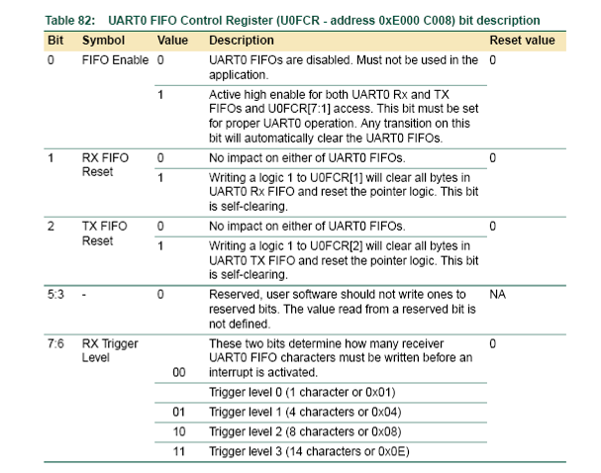
Step2:U0FCR--FIFO control set reg=0x07
[U0FCR]=0x07
Set all
bit0,1,2=“111”
for FIFO control
31

Slide 32
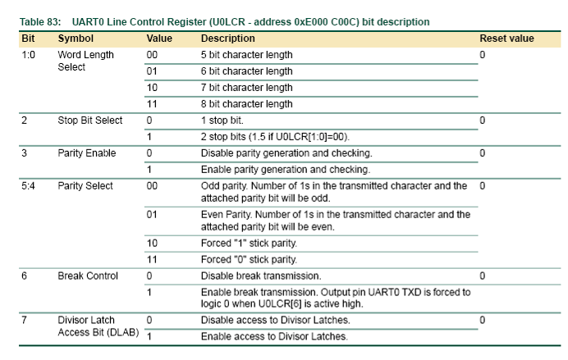
Step3 of iuart0:
Exercise 6.2, Circle which bits are set,discuss their functions.
U0LCR—line control set reg=0x83
[U0LCR]=0x83
32

Slide 33
Exercise 6.2a, which bits are set, and their functions.
Answer:8-bit character length, 1 stop bit, no parity, enable division latch
Step3:U0LCR—line control set reg=0x83, set reg [U0LCR]= =0x83=1000 0011B
[U0LCR]=
0x83=
1000 0011B
Exercise2b: Repeat exercise2a but 7bit data, 1 stop bit , no parity
Answer: U0LCR=10000010b=0x82
33

Slide 34

Step2 of iuart0:U0DLL—set baud rate=0x0F
[U0DLL]=0x0F, set Baudrate=576000
U0DLL = Fpclk / (16 * Baudrate)
If we want 57600 baud (Fpclk=13.824MHz) then U0DLL=15=0x0f (U0DLM_{(for msc)}=00;U0DLL_{(for lsb)}=15)
Check datasheet of how it should be set.
Exercise4a: How to set the baud rate to be 9600?
  Answer4: U0DLL₉₆₀₀ = Fpclk / (16 * Baudrate)
  =13.824MHz / (16 * 9600)=90
  Also U0DLM₉₆₀₀ =00
Exercise4b: How to set Baud rate = 2400?
Useful tool: http://www.binaryhexconverter.com/decimal-to-hex-converter
13824000/(16(16M+L))=2400
13824000/(16*2400)=360=16M+L
M=?_____, L=?_____
34

Slide 35

5) Detailed description of subroutines
“writec”
: Sending data using handshaking
35

Slide 36
Subroutine Writec:
Basic concept of sending a character using the serial port
The sending procedure is slower (e.g. only 57600 bits per second) than your program, so it needs to ask permission to send
Writec()
Sending rate (Baud rate)
is slower than your program can gen. data
True even for usb2
receiver
Send-buffer
Is transmitter
Buffer empty ?
no
yes
Send data

Slide 37
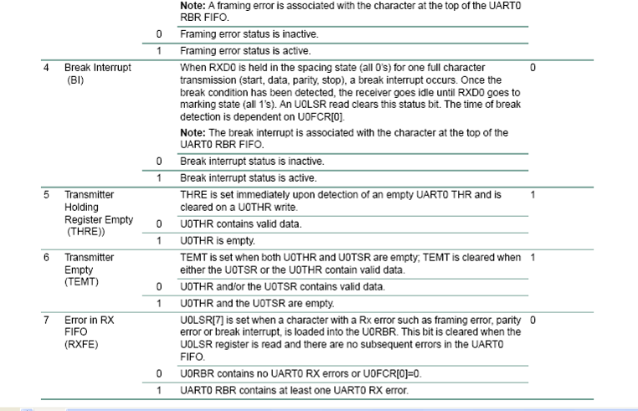
Read buffer status U0LSR(0xE000 C014)

Slide 38
U0LSR—line status at U0LSR(0xE000 C014) (if bit6=TEMT (transmitter empty)=1 you can send next data
Bit7 Bit0

Slide 39
Recall: TST and BEQ
TST
  Same as AND (logical AND) except result of operation is not stored.
  Only the condition code bits (cc) {N,Z,C,V} in CPSR are changed.
    updates the N and Z flags according to the result
    Does not affect the C or V flags.
BEQ
  Branch if result equal to zero (branch if Z=1)
39

Slide 40
Write character in R0 subroutine when TEMT=1
TEMT=0 meaning transmitter is not empty, not ready to send
TEMT=1 meaning transmitter is empty, ready to send
1)Writec ; subroutine to send data in R0 to serial out
2) LDR R1, =U0LSR; (line status reg)
3) LDRB R1, [R1]; get line status
TST R1, #0x40 ;TEMT(bit 6 of ;U0LSR=1=buffer_empty)=0→Z=1
5) BEQ writec ;if Z=1(buffer_not_empty),
;loop back writec to wait
6) LDR R1, =U0THR;U0THR=transmit reg
7) STRB R0, [R1]; send data out
8) BX R14 ; return from subroutine
TST : same as “AND”, but result is not saved , affect Z bit in cpsr

Slide 41
Flow diagram of Writec of ahello.s
TEMT=0 meaning transmitter is not empty, not ready to send
TEMT=1 meaning transmitter is empty, ready to send
Reason: The sending speed (Bit per second) is slower than your program, need to ask permission to send
Writec( ); write data in R0
4)TST R1, #0x40 ;TEMT=0 (buffer_not _empty: transmitter not ready) →Z=1
;TEMT=1 (buffer_empty: transmitter is ready) →Z=0
Brach if Z=1
5) BEQ writec
If Z=1
Is the transmitter buffer is not empty, loop back.
Because TEMT=0→ Z=1,
BEQ writec ;if Z=1,loop back to wait
Otherwise send data
If Z=0
6) LDR R1, =U0THR
7) STRB R0, [R1]; send data out

Slide 42
Summary
Studied serial interface in ARM
Studied handshaking in interfacing

Slide 43
End

