Slide 1
Chapter 3: Introduction to Assembly Language Programming
CEG2400 - Microcomputer Systems

Slide 2
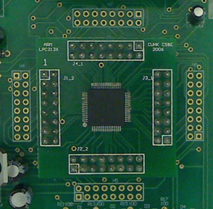
Objective
In this lecture, you will learn some basic assembly language operations for ARM7
In the laboratory session, we will use the microprocessor programmed with the assembly language.
The assembly architecture for Intel / ARM is different
You will learn the detail in CSCI3420

Slide 3
Overview
General introduction
Introduction to Assembly Language Programming
Study the Current Program Status Register (CPSR)
  N (negative) bit
  Z (zero) bit
  C (carry) bit
  V (overflow) bit
Study the Data processing operations
  Arithmetic operations (add subtract etc)
  Logical operations (and, or etc)
  Register MOVes (mov etc)
  Comparison Operations (cmp etc)

Slide 4
What is assembly language?
Very low level, the code that CPU understands
Very close to machine code
Every C++ / Pascal code can be translates to assembly
High level languages C++ ,Pascal
High level
Low level
Assembly code
Machine code
Hardware

Slide 5
1) General introduction – of ARM Features
Load-Store architecture
  Load (from memory to Central processing Unit CPU registers)
  Store (from CPU registers to memory)
Fixed-length (32-bit) instructions
  Each machine instruction is 32-bit, no more no less.
Conditional execution of ALL instructions
  The condition register (CPSR) holds the result condition: the result is +ve, -Ve, overflow, etc

Slide 6
Registers 暫存器
Registers in a CPU store temporary data in the processor
  Transfers to/from memory (i.e. Load/Store) are relatively slow
  Operations involving registers only are fast

Slide 7
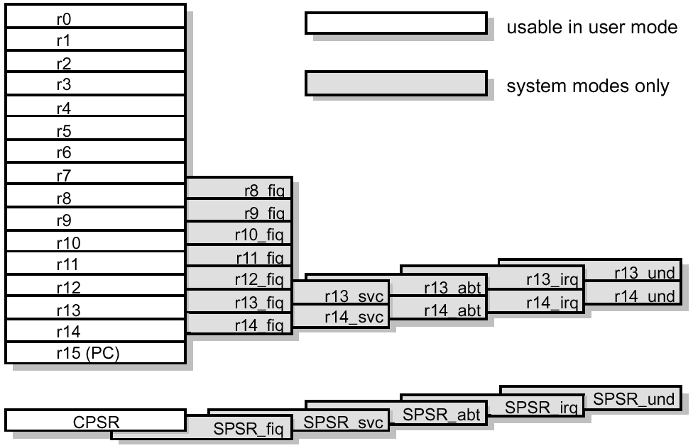
ARM Registers in the ARM CPU
32-bit
This shaded part is not
studied at the moment
Stack Reg.
Link Reg.
Program counter

Slide 8
Important registers at the moment
Register name | 32-bit wide/ usage
R0-R12 | General purpose registers
R14 | Link register (For calling subroutine)
R15 | Program counter (PC)

Slide 9
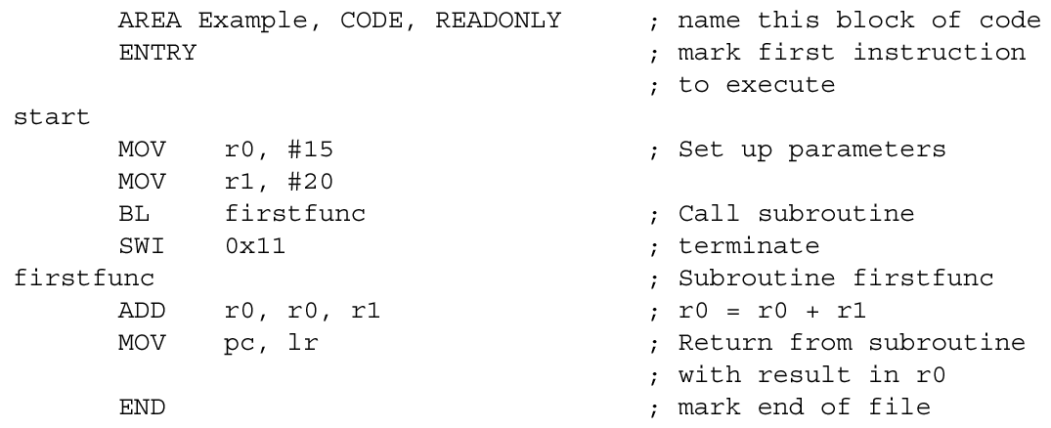
2) Introduction to assembly language programming
The following is a simple example which illustrates some of the core constituents of an ARM assembler module:
operands
label
opcode
The objects to be operate by opcode
comment

Slide 10
Assemble Instruction
One line of code - first : ADD r1,r2,r3
optional
opcode
Label
(optional)
Operand 1
Operand 2
Operand 3

Slide 11
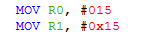
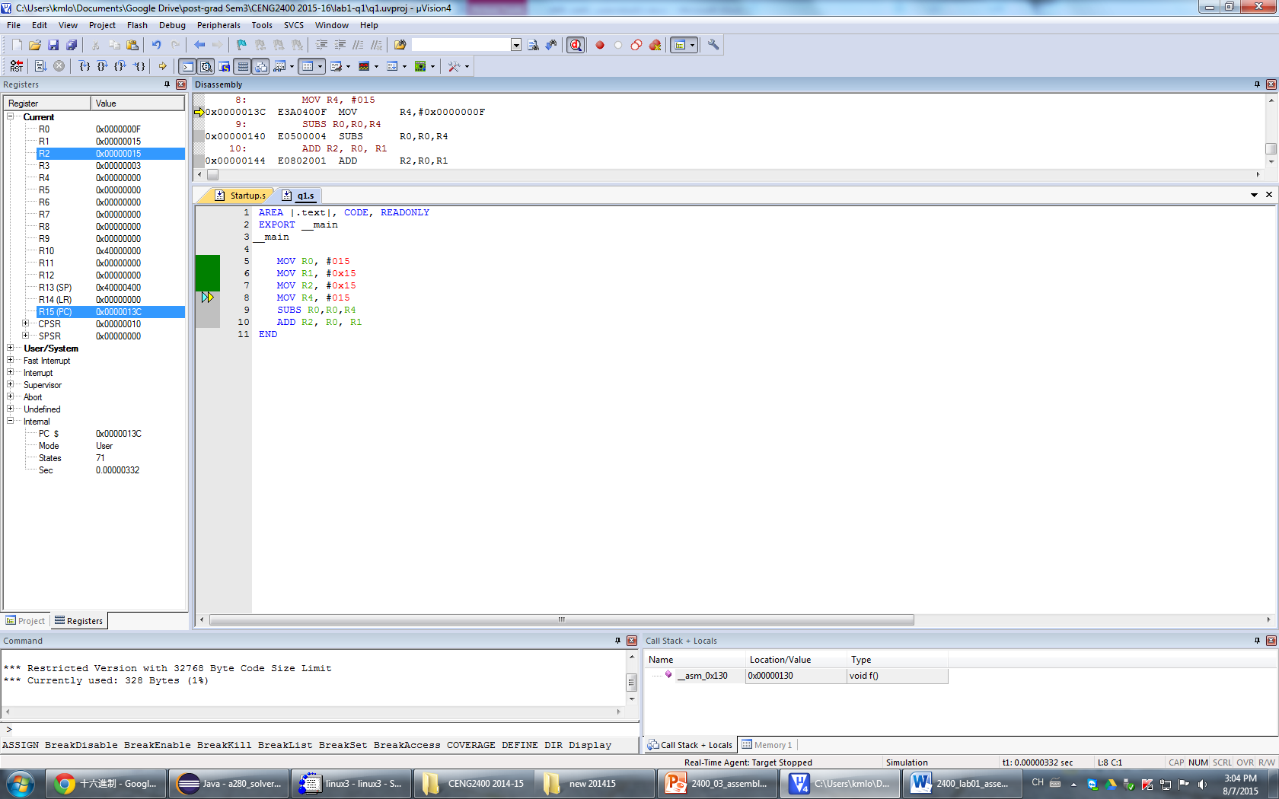
General purpose register R0-R12 usage
Put Data=15
Into the box (R0)
MOV r0,#15
Opcode : MOV Operands : r0,#15
In C++, you may write “int a= 15;”
Meaning : MOVe the value #15 (decimal) into register R0.
  “MOV” means “to move”
  R0 is register 0 (32-bit)
  # (hash) means it is an intermediate value, defined by a number following #.
  If you add ‘0x’ as suffix, the number is in hexadecimal
R0
Code :
In register:

Slide 12
Branch function (BL) is an instruction in ARM
BL = branch and link
When a subroutine (function) is needed to be called, BL is required.
It will run the instruction in another address first, and return to the address in link register afterwards.

Slide 13
Branch function (BL) is an instruction in ARM
Example:
  BL firstfunc ; In C++, you may write Firstfunc();
  this instruction means
  Content in R14 (link register) is replaced with content of R15(program counter=PC)+4.
  Content of PC is replaced by the address of firstfunc

Slide 14
Exercise 3.1
What is the function of Firstfun, and what is the address of Firstfunc? Fill in the shaded areas.
Address (H) |  |  | Comments | Before instruction is run |  |  | After instruction is run
PC | start | All registers are rest to 0 here |  | R14=link R15=PC | R0 | R1 | R14=link R15=PC | R0 | R1
0000 0000 |  | MOV r0,#15 | ;Set up parameter
 |  | MOV r1,#20 | ;Set up parameter
 |  | BL Firstfunc | ;Branch, call subroutine Firstfunc
 |  | SW1 | Meaning stop here : Software interrupt (will be discussed alter)
 | Firstfunc |  | ;subroutine
 |  | ADD r0,r0,r1 | ;Add r0+r1→r0
 |  | MOV pc, lr | Return from subroutine, to caller
 |  | end | ;end of file

Slide 15
Current Program Status Register (CPSR)
contains conditional flags and other status bits

Slide 16

ARM Programmer's
Model (con't)
R0 to R12 are general purpose registers (32-bits)
  R13 stack pointer, R14 link register, CPSR (may call it R16)
  Used by programmer for (almost) any purpose without restriction
R15 is the Program Counter (PC)
In p.6, the remaining shaded ones are system mode registers - used during interrupts, exceptions or system programming (to be considered in later lectures)
Current Program Status Register (CPSR) contains conditional flags and other status bits

Slide 17
ARM’s CPSR flags
From http://infocenter.arm.com/help/topic/com.arm.doc.dui0068b/DUI0068.pdf
The ALU status flags
    The CPSR contains the following ALU status flags:
    N Set when the result of the operation was Negative.
    Z Set when the result of the operation was Zero.
    C Set when the operation resulted in a Carry.
    V Set when the operation caused an overflow.
  C flag: A carry occurs if the result of an addition is greater than or equal to 2³², if the result of a subtraction is positive, or as the result of an inline barrel shifter operation in a move or logical instruction.
  V flag: Overflow occurs if the result of an add, subtract, or compare is greater than or equal to 2³¹, or less than –2³¹.

Slide 18
Condition codes
In order to do conditional branches and other instructions, some operations implicitly set flags
  Note: no need to use subtraction because in 2’s complement all operations can be treated as addition. Adding a positive number to a negative number is subtraction.
Question
  Give examples of arithmetic operations which will cause N,Z,C,V to be set to 1
N = 1 if MSB of (r1 - r2) is '1‘ (MSB of result is sign bit, 1 = negative)
Z=1 when the result is zero
C=1 when a binary addition generates a carry out; (for 32-bit integer 2’s complement addition, C is ignored, see appendix.)
V=1 (when result of add, subtract, or compare is >= 2³¹, or < –2³¹.). I.e.
  if two -ve numbers are added, the result is +ve (underflow), then V=1.
  if two +ve numbers are added, the result is -ve (overflow), then V=1
  If the two numbers are of different signs, no over/underflow, then V=0.

Slide 19
Overflow and Underflow will set V=1 http://www.khmerson.com/~eia213/binnum.ppt
http://en.wikipedia.org/wiki/Integer_(computer_science)
Overflow
  When two +ve numbers are added (MSB is 0) , the result is –ve (MSB is 1)
Underflow
  When two -ve numbers are added (MSB is 1) , the result is +ve (MSB is 0)
Note:
  If two numbers have different signs, no overflow/underflow will occur.
  MSB is the most significant bit
  IN 2’s compliment representation MSB is the sign bit (see appendix)

Slide 20
Overflow and Underflow http://www.khmerson.com/~eia213/binnum.ppt
Convert hex to decimal : http://easycalculation.com/hex-converter.php
http://en.wikipedia.org/wiki/Integer_(computer_science)
Overflow :When two +ve numbers are added(MSBs are 1), result is –ve (MSB is 1)
Underflow: When two -ve numbers are added(MSBs are 1), result is +ve (MSB is 0)
Bit 31 Bit 0
MSB=0 , the number is +ve.
MSB=1 , the number is –ve.
32-bit data
Range of
valid value
7FFF FFFF Hex=
+2,147,483,647
8000 0000 Hex=
-2,147,483,648
Value1 + value2 > +2,147,483,647
If the result is above the line, it is overflowed.
Overflow
-Value2
-Value1
0
-Value3
-Value4
Underflow
-Value3 - value4 < -2,147,483,648

Slide 21
Examples (see appendix for number systems)
Convert hex to decimal : http://www.rapidtables.com/convert/number/hex-to-decimal.htm http://easycalculation.com/hex-converter.php
N (negative)
  (-2)+(-5)= -7, in 2’s complement , the MSB=1, so N is set to 1.
Z (zero)
  10+(-10)=0, then Z=1
C (carry) c=1 if the result generates a carry, then setup the carry bit.
V (overflow),
  7FFFFFFF+1 will set V=1,because 0x0FFF FFFF in 2’s complement is the biggest 32-bit signed integer value possible (0x0FFF FFFF =decimal 2147483647 ), so add ‘1’ will overflow the 32-bit register.
  Note: (a 32-bit integer value is ranging from 0x1000 0000=-2,147,483,648 to 0x0111 1111=+2,147,483,647)
  V = 1: if two +ve numbers are added, the result is -ve then V will be set to 1 ( this is overflow)
Assembly method to clear the NZCV flag:
MSR CPSR_f, #0x00
see http://infocenter.arm.com/help/index.jsp?topic=/com.arm.doc.faqs/ka3724.html
http://en.wikipedia.org/wiki/Integer_(computer_science)

Slide 22
The general format of an assembly instruction
All instructions have this form:
op{cond}{S} Rd, Rn, Operand2
Op=“ mnemonic” representing the operation , e.g. mov, add , xor.
  The assembler convert this into a number called op-code
Cond(optional) : e.g. "EQ"=Equal to zero (Z=1), "HI" Unsigned higher. The instruction is executed only when the condition is satisfied.
  http://www.cse.cuhk.edu.hk/%7Ekhwong/www2/ceng2400/ARM_Instruction_quick_reference.doc
{S} (optional) : suffix: if specified, the result of the instruction will affect the status flags N,Z,C,V in CPSR, e.g.
  ADD r0, r1, r2 ; r0 := r1 + r2, ;CPSR (N,Z,C,V flags will not be affected)
  ADDS r0, r1, r2 ; r0 := r1 + r2, ;CPSR (N,Z,C,V flags will be affected)
Rd, Rn (optional ) are register numbers
Operand2 (optional) : additional operands

Slide 23
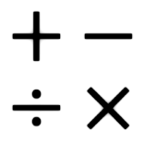
3) Data processing operations
Arithmetic operations
Logical operations (AND OR NOT etc.)
Register MOVes (MOV MVN)
Comparison Operations

Slide 24
Arithmetic operations
(see appendix for number systems)
Here are ARM's arithmetic (add and subtract with carry) operations:
Operands may be unsigned or 2's complement signed integers
'C' is the carry (C) bit in the CPSR - Current Program Status Reg
ADDS r0, r1, r2 ; r0 := r1 + r2
ADCS r0, r1, r2 ; r0 := r1 + r2 + C
SUBS r0, r1, r2 ; r0 := r1 - r2
SBCS r0, r1, r2 ; r0 := r1 - r2 + C - 1
If you add the ‘s’ suffix to an op-code, the instruction will affect the CPSR (N,Z,C,V flags)
e.g.
ADD r0, r1, r2 ; r0 := r1 + r2, CPSR (NZCV flags will not be affected)
ADDS r0, r1, r2 ; r0 := r1 + r2, CPSR (NZCV flags will be affected)

Slide 25
Exercise 3.2
Fill in the shaded areas.
Program counter PC =R15, #value = intermediate constant value
Current Program Status Register (CPSR)
Address (H) |  | Comments | After instruction is run
PC |  |  | PC (Hex) | C | R0(Hex) | R1(Hex) | R2 (Hex)
 | All registers R0-R2 are rest to 0 here |  |  | 0 | 0 | 0 | 0
0000 1000 | MOV r1,#15 | ;r1=15 | 0000 1004 | 0 | 0000 0000 | 0000 000f | 0
 | MOV r2,#0xffffffff | ;r2=#0xffffffff ;i.e. r2= -1
 | ADDS r0,r1,r2 | ;r0=r1+r2
 | ADCS r0,r1,r2 | ;r0=r1+r2+C
 | SUBS r0,r1,r2 | ;r0=r1-r2 Hint:
 | SBCS r0,r1,r2 | ;r0=r1-r2+C-1
Hints: r0=r1-r2=r1+ (negative of r2)=r1+ (2’s complement of r2)
turn the value into 2's complement representation first then add
2’s complement= reverse all bits and add1.

Slide 26
64 bits addition: see appendix for number systems
If 32 bits are not enough, extend the numbers to 64 bits, you need to use two registers to hold one number, i.e. [r1,r0] and [r3,r2]. But
Remember to convert the input into sign extended numbers before use.
    Positive num. – add 0’s to LHS e.g. 0000 0007h -> 0000 0000 0000 0007h
    Negative num. – add 1’s to LHS e.g. 8000 0010h ->FFFF FFFF 8000 0010h
  E.g. 64-bit addition in [r1,r0] to [r3 r2], save result in [r3,r2]
  Sign extend the numbers from 32-bit to 64-bit, see above
  ADDS r2,r2,r0; add low, save carry: (Reference, P156, [1])
    ;this is the addition of lower part of the 64-bit 2’s comp. num., we treat the addition as binary addition it is not a 2’comp. addition, the carry is useful
  ADC r3,r3,r1 ; add high with carry:
    ;this the high part of the 64-bit addition, we treat it as a 2’comp. addition, so the carry generated is ignored
  ;Range of a 64-bit number is from -2^(64-1) to +2^(64-1) - 1 , or from −9,223,372,036,854,775,808 to 9,223,372,036,854,775,807
[1] ARM system-on-chip architecture by Steve Furber Addison Wesley
[2] http://pages.cs.wisc.edu/~smoler/x86text/lect.notes/arith.int.html

Slide 27
Use of Carry C bit in the status flag
  ADDS r2,r2,r0; add low, save carry: (Reference, P156, [1])
    ;this is the addition of lower part of the 64-bit 2’s comp. num., we treat the addition as binary addition it is not a 2’comp. addition, the carry is useful
    Add data in r2 and data in r0, and save result in r2
  ADC r3,r3,r1 ; add high with carry:
    ;this the high part of the 64-bit addition, we treat it as a 2’comp. addition, so the carry generated is ignored
    Add data in r3 and data in r1, and save result in r3
  For binary addition: C is used.
  For 2’s complement, C is ignored. Since the Most Significant bit is the sign bit so the C bit is irrelevant, ,but you need to use the V bit to check if the arithmetic calculation (e.g. add, sub) is correct or not.

Slide 28
Logical operations (and, or, exclusive or bit clear)
N is set when the result is negative -- most significant bit is 1 when viewed as a two’s-compliment number (appendix 1).
Z flag is set if the result is 0.
The C and V flags are not affected.
BIC stands for 'bit clear', where every '1' in the second operand clears the corresponding bit in the first, (BICs r0, r1, r2) generates the following result:
  r1: 0101 0011 1010 1111 1101 1010 0110 1011
  r2: 1111 1111 1111 1111 0000 0000 0000 0000
  r0: 0000 0000 0000 0000 1101 1010 0110 1011
ANDS r0, r1, r2 ; r0 := r1 and r2 (bit-by-bit for 32 bits)
ORRS r0, r1, r2 ; r0 := r1 or r2
EORS r0, r1, r2 ; r0 := r1 xor r2
BICS r0, r1, r2 ; r0 := r1 and not r2
CPSR

Slide 29
Exercise 3.3
Fill in the shaded areas.
Program counter PC =R15, #value = intermediate constant value
Current Program Status Register (CPSR)
Address (H) |  | Comments | After instruction is run
PC |  |  | R0(Hex) | R1(Hex) | R2(Hex) | NZ
 | At the beginning |  | 0000 0000H | 0000 0055H | 0000 0061H | 00
0000 7000 | ANDS r0,r1,r2 | ;r0=r1 and r2 (bit by bit )
 | ORRS r0,r1,r2 | ;r0=r1 or r2
 | EORS r0,r1,r2 | ;r0=r1 xor r2
 | BICS r0,r1,r2 | ;r0=r1 and (not r2)
Hints:
R1=55H=0101 0101 b (b= binary)
R2=61H=0110 0001 b
9EH=1001 1110 b

Slide 30
Register MOVes
Here are ARM's register move operations:
MVN stands for 'move negated‘, MVN r0, r2
  if r2: 0101 0011 1010 1111 1101 1010 0110 1011
  then r0: 1010 1100 0101 0000 0010 0101 1001 0100
MOV r0, r2 ; r0 := r2
MVN r0, r2 ; r0 := not r2

Slide 31
Exercise 3.4
Fill in the shaded areas.
Program counter PC =R15, #value = intermediate constant value
Current Program Status Register (CPSR)
Address (H) |  | Comments | After instruction is run
PC |  |  | R0(Hex) | R1(Hex) | R2(Hex)
 | At the beginning |  | 0 | 0000 0003H | 0000 0007H
0000 8000 | MOV r2,#12 | ;r2=#12
 | MOV r0,r2 | ;r0=r2
 | MVN r1,r2 | ;r1= not r2
Hint : decimal 12=1100(Binary)=C (HEX)

Slide 32

Comparison Operation1: CMP
Here are ARM's register comparison operations:
Same as SUB (subtract) except result of subtraction is not stored.
Only the condition code bits (cc) {N,Z,C,V} in CPSR are changed
CMP r1, r2 ; set condition code on r1 - r2 (compare)
N = 1 if MSB of (r1 - r2) is '1‘ (MSB of result is sign bit, 1 = negative)
Z=1 when the result is zero
C=1 when a binary addition generates a carry out; (for 32-bit integer 2’s complement addition, C is ignored, see appendix.)
V=1 (when result of add, subtract, or compare is >= 2³¹, or < –2³¹.). I.e.
  if two -ve numbers are added, the result is +ve (underflow), then V=1.
  if two +ve numbers are added, the result is -ve (overflow), then V=1
  If the two numbers are of different signs, no over/underflow, then V=0.
read (page 129, ARM Assembly Language Programming. Peter Knaggs)

Slide 33
Exercise 3.5 , Fill in the shaded areas.
Address (H) |  | Comments | After instruction is run
PC |  |  | NZCV (binary) | R1 (Hex) | R2 (Hex)
 | All registers R0-R2=0 and NZCV=0000 (binary), here
0000 1000 | MOV r1,#0x11 | ;r1=0000 0011
 | MOV r2,#0x23 | ;r2=0000 0023
 | CMP r1, r2 | ; set cc on r1 - r2 (compare)
 | MOV r1,r2 | ; r1<=r2
 | CMP r1, r2 | ; set cc on r1 - r2 (compare)
N = 1 if MSB of (r1 - r2) is '1‘ (MSB of result is sign bit, 1 = negative)
Z=1 when the result is zero
C=1 when a binary addition generates a carry out; (for 32-bit integer 2’s comp. addition, C is ignored, see appendix.)
V=1 (when result of add, subtract, or compare is >= 2³¹, or < –2³¹.). I.e.
  if two -ve numbers are added, the result is +ve (underflow).
  if two +ve numbers are added, the result is -ve (overflow).
  If the two numbers are of different signs, no overflow/underflow.

Slide 34
Comparison Operation 2: TST
Here are ARM's register test operations:
Same as AND (logical AND) except result of operation is not stored.
Only the condition code bits (cc) {N,Z,C,V} in CPSR are changed.
  updates the N and Z flags according to the result
  Does not affect the C or V flags.
TST r1, r2 ; set cc on r1 and r2 (test bits)

Slide 35
Other comparison Operations
Here are ARM's register comparison operations:
Results of CMP (subtract), TST(AND) are NOT stored in any registers
Only the condition code bits (cc) {N,Z,C,V} in the CPSR are set or cleared by these instructions:
CMP r1, r2 ; set cc on r1 - r2 (compare)
CMN r1, r2 ; set cc on r1 + r2 (compare negative)
TST r1, r2 ; set cc on r1 and r2 (test bits)
TEQ r1, r2 ; set cc on r1 xor r2 (test equivalent)

Slide 36
Exercise 3.6
Fill in the shaded areas.
  TST updates the N and Z flags according to the result, It
  does not affect the C or V flags.
Address (H) |  | Comments | After instruction is run
PC |  |  | NZCV (binary) | R1 (Hex) | R2 (Hex)
 | All registers R0-R2=0 and NZCV=0000, here
0000 1000 | MOV r1,#15 | ;r1=15 decimal
 | MOV r2,#0240 | ;r2=0xF0 (0xf is 240 in decimal)
 | TST r1,r2 | ; set cc on r1 AND r2 (logical AND operation test bits)
 | TEQ r1,r2 | ; set cc on r1 xor r2 (test equivalent)
Convert hex to decimal :http://easycalculation.com/hex-converter.php
E.g. 0000 1111
And 0001 1000
---------------------------------
Result 0000 1000
E.g. 0000 1111
Xor 0001 1000
---------------------------------
Result 0001 0111

Slide 37
Exercise 3.7:Self revision exercises
Explain the purposes of having
  R14 (Link register) and R15 (PC program counter) in procedure calls
Explain how the N (negative) flag is affected by the ADDs operation.
Explain how the Z (zero) flag is affected by the ANDs operation.
Explain how the V (overflow) flag is affected by the CMP operation.
Assume there are some values in registers r0,r1,r2. Write a program to find the result of r0+r1-r2 and save the result in r3.

Slide 38
Self study programming exercise:;ex3_2400 ch3 of CENG2400. It is for your own revision purpose, no need to submit answers to tutors.
ex3_2b ;;;;;;;;;;;;;;;;;;;;;;;;;;;;;;;;;;
movs r0,#1 ; this clears N,Z
adds r0,#1 ; this clears C,V
mov r1,#0x7ffffffF ;=the biggest 32-bit 2's complement num. +2,147,483,647
mov r2,#0x1
ADDS r0,r1,r2;r0=0x80000000.
;Question2: explain the result in cpsr.
ex3_2c ;;;;;;;;;;;;;;;;;;;;;;;;;;;;;;;;;;
movs r0,#1 ; this clears N,Z
adds r0,#1 ; this clears C,V
;;;;;;;;;;;;;;;;;;;;;;;;;;;;;;
mov r1,#0x7ffffffE ;=the 2nd biggest 32-bit 2's complement num. +2,147,483,647-1
mov r2,#0x1
ADDS r0,r1,r2; ;
;Question3: explain the result in cpsr.
ex3_2D ;;;;;;;;;;;;;;;;;;;;;;;;;;;;;;;;;;
movs r0,#1 ; this clears N,Z
adds r0,#1 ; this clears C,V
;;;;;;;;;;;;;;;;;;;;;;;;;;;;;;
mov r1,#0xFffffffF ; THE VALUE IS -1 IN 2'S COMPLEMENT
mov r2,#0x1 ; IS 1
ADDS r0,r1,r2; ;
;Question4: explain the result in r0 and cpsr.
;http://www.cse.cuhk.edu.hk/%7Ekhwong/www2/ceng2400/ex3_2400_qst.txt ; ;declare variables
;Important: AREA starts from 2 or higher
AREA |.data|, DATA, READWRITE;s
Data1p DCD 0, 0, 0, 0, 0, 0, 0, 0, 0, 0
align;-----
; User Initial Stack & Heap
AREA |.text|, CODE, READONLY
EXPORT __main
__main LDR R0, =Data1p
;;;;;;;;;;;; CEG2400 ex3_2
loop_top
;clear flags
ex3_2a ;;;;;;;;;;;;;;;;;;;;;;;;;;;;;;;;;;
movs r0,#1 ; this clears N,Z
adds r0,#1 ; this clears C,V ;;;;;;;;;;;;;;;;;;
mov r1,#15 ;r1=15
mov r2,#0xffffffff ; in 2' complement it is -1.
ADD r0,r1,r2
ADC r0,r1,r2 ;r0=r1+r2+C
SUB r0,r1,r2 ;r0=r1-r2
SBC r0,r1,r2 ;r0=r1-r2+C-1
;Question1: explain the result in r0 and cpsr of the above steps .

Slide 39
ex3_3;;;;;;;;;;;; continue CEG2400 ex3_3
movs r0,#1 ; this clears N,Z
adds r0,#1 ; this clears C,V
;;;;;;;;;;;;;;;;;;;
mov r1,#0x55
mov r2,#0x61
and r0,r1,r2 ;
;Question5: explain the result in r0 and cpsr.
orr r0,r1,r2 ;r0=r1 or r2
EOR r0,r1,r2 ;
;Question6: explain the result in r0 and cpsr.
BIC r0,r1,r2;Question:
;Question7: explain the result in r0 and cpsr.
ex3_4 ;;;;;;;;;;;;;;;;;;;;;;;;;
movs r0,#1 ; this clears N,Z
adds r0,#1 ; this clears C,V;;;;;;;;;;;;;;;;;;;;;;;;;;;;
MOV r1,#0x3
MOV r2,#0x7
MOV r2,#12 ;r2=#12
MOV r0,r2 ;
;Question8: explain the result in r0 and cpsr.
MVN r1,r2 ;Quest: explain the result in cpsr.
;Question9: explain result in r0 and cpsr.
ex3_5 ;;;;;;;;;;;;;;;;;;;;;;;;;;;;;;;;;;;;;;;
movs r0,#1 ; this clears N,Z
adds r0,#1 ; this clears C,V ;;;;;;;;;;;;;;;;;
mov r1,#0x11 ;r1=0000 0011 (the LSB 8 bits)
mov r2,#0x23; r2=0000 0023
subs r3, r1, r2
;Question10: explain the result in r3 and cpsr.
movs r0,#1 ; this clears N,Z
adds r0,#1 ; this clears C,V
cmp r1,r2; ;
;Question11: explain the result in r0->r12 and cpsr.
mov r1,r2; ; r1<=r2
CMP r1, r2;
;Question12: explain result in r0->r12 and cpsr.
ex3_6a ; place ex6
movs r0,#1 ; this clears N,Z
adds r0,#1 ; this clears C,V
;;;;;;;;;;;;;;;;;;;;;;;;;;;;;;;;;;
mov r1,#15 ;r1=15 decimal=0xf=0000 1111 (lsb 8 bits)
mov r2,#24 ;r2=24 =0x18 =0001 1000 (lsb 8 bits)
TST r1,r2 ;
;Question13: explain the result in r0->r12 and cpsr.
;not saved to any registers) is neither nagative nor zero
; (bits c,v are not affected by tsts)
movs r0,#1 ; this clears N,Z
adds r0,#1 ; this clears C,V
TEQ r1,r2 ;
;Question14: explain the result in r0->r12 and cpsr.
ex3_6b ; place ex6
movs r0,#1 ; this clears N,Z
adds r0,#1 ; this clears C,V
;;;;;;;;;;;;;;;;;;;;;;;;;;;;;;;;;;
mov r1,#0x0f ;15=0x0f= 0000 1111 (the least significant 8 bits)
mov r2,#0xf0 ;r2=0xf0= 1111 0000 (the least significant 8 bits)
TST r1,r2 ;
;Question15: explain the result in r0->r12 and cpsr.
movs r0,#1 ; this clears N,Z
adds r0,#1 ; this clears C,V
TEQ r1,r2 ;
;Question16: explain the result in r0->r12 and cpsr.
END

Slide 40
End

Slide 41
Appendix 1
Numbers and Arithmetic Operations

Slide 42
Binary numbers
Binary numbers (0, 1) are used in computers as they are easily represented as off/on electrical signals
Different number systems are used in computers
Numbers represented as binary vectors
B=b_{n-1}…b₁b₀
Unsigned numbers are in range 0 to 2^{n}-1 and are represented by V(B)=b_{n-1}×2^{n-1} +…+b₁ ×2¹ +b₀ ×2⁰
MSB=Most significant bit (leftmost digit in a binary vector)
  E.g. 0010 0101 binary = 25H=2^5+2^2+2^0=32+4+1(decimal)=37(decimal), because b₅=1, b₂=1, b₀=1 (bit5 ,bit2 and bit 0 are 1).
LSB=Least significant bit (rightmost digit in a binary vector)

Slide 43
Negative Numbers
Sign-and-magnitude
  The most significant bit (the left most bit) determines the sign, remaining unsigned bits represent magnitude
1’s complement
  The most significant bit determines the sign. To change sign from unsigned to negative, invert all the bits
2’s complement
  The most significant bit determines the sign. To change sign from unsigned to negative, invert all the bits and add 1
  This is equivalent to subtracting the positive number from 2n
  See the following slide for examples.
  Advantage: Addition, subtraction can be operated in binary form, the sign will be taken care of automatically.

Slide 44
Number Systems
Convert hex to decimal : http://easycalculation.com/hex-converter.php http://www.rapidtables.com/convert/number/hex-to-decimal.htm
Binary | Decimal | Hex
0000 | 0 | 0
0001 | 1 | 1
0010 | 2 | 2
0011 | 3 | 3
0100 | 4 | 4
0101 | 5 | 5
0110 | 6 | 6
0111 | 7 | 7
1000 | 8 | 8
1001 | 9 | 9
1010 | 10 | A
1011 | 11 | B
1100 | 12 | C
1101 | 13 | D
1110 | 14 | E
1111 | 15 | F
B
V
alue represented
Sign and
b
3
b
2
b
1
b
0
magnitude
1'
s complement
2'
s complement
0
1
1
1
+
7
+
7
+
7
0
1
1
0
+
6
+
6
+
6
0
1
0
1
+
5
+
5
+
5
0
1
0
0
+
4
+
4
+
4
0
0
1
1
+
3
+
3
+
3
0
0
1
0
+
2
+
2
+
2
0
0
0
1
+
1
+
1
+
1
0
0
0
0
+
0
+
0
+
0
1
0
0
0
-
0
-
7
-
8
1
0
0
1
-
1
-
6
-
7
1
0
1
0
-
2
-
5
-
6
1
0
1
1
-
3
-
4
-
5
1
1
0
0
-
4
-
3
-
4
1
1
0
1
-
5
-
2
-
3
1
1
1
0
-
6
-
1
-
2
1
1
1
1
-
7
-
0
-
1

Slide 45
Addition (1-bit)
0
1
0
1
+
0
+
0
+
1
+
1
0
1
1
1
0
Carry-out

Slide 46
2’s Complement
2’s complement numbers actually make sense since they follow normal modulo arithmetic except when they overflow
Advantage: Addition, subtraction can be operated in binary form, the sign will be taken care of automatically.
Range is -2^{n-1} to 2^{n-1}-1
0
1111
0000
0001
N
-
1
1
N
-
2
2
1110
-
1
0
+
1
0010
1101
-
2
+
2
0011
-
3
+
3
1100
-
4
+
4
0100
-
5
+
5
1011
-
6
+
6
0101
1010
-
7
-
8
+
7
0110
1001
1000
0111
(a) Circle representation of integers mod N
(b) Mod 16 system for 2's-complement numbers

Slide 47
Convert decimal to binary (2’s complement)
Convert a negative number to 2’s complement
  Step1: Given a negative value ‘-a’, extract the absolute (positive) value first, |-a|=a
  Step2: From the positive value ‘a’, convert into binary value
  Step3: Reverse all bits and add 1
  Example: convert -5 into 2’ complement form
    Step1: extract the decimal positive value: |-5|=5
    Step2: convert the decimal positive value into binary:
      : 5 = 0000 0000 0000 0000 0000 0000 0000 0101b (binary )
    Step3: Reverse all bits, and add 1
      : reverse all bits, and add 1: 1111 1111 1111 1111 1111 1111 1111 1010b + 1
      := 1111 1111 1111 1111 1111 1111 1111 1011b
    So -5 (decimal) = 1111 1111 1111 1111 1111 1111 1111 1011b= FFFF FFFBH
Reverse all bit
32-bit: http://www.binaryconvert.com
64-bit: http://www.binaryhexconverter.com/decimal-to-binary-converter

Slide 48
Convert 2’s complement to decimal
If the first MSB is 0, convert binary to decimal as usual
If the first MSB is 1, it is negative, the value can be found by
  Subtract 1
  Reverse all bit and get the value
  Add –ve sign to the value, e.g.
    Convert 1011, it is negative because MSB is 1
    Subtract 1 from 1011 becomes 1010,
    Reverse all bits becomes 0101, so the value is 5
    Add –ve sign so the decimal value of the 2’s complement number 1011 is -5.
    Reference: Introduction to Computing Systems: From Bits and Gates to C and Beyond, By Yale N. Patt

Slide 49
Add/sub
X+Y : use 1-bit addition propagating carry to the next more significant bit
X-Y : add X to the 2’s complement of Y

Slide 50
Add/Sub (2’s comp)
Addition, subtraction can be operated in binary form, the sign will be taken care of automatically.
(a)
0 0 1 0
(
+
2
)
(b)
0 1 0 0
(
+
4
)
+
0 0 1 1
(
+
3
)
+
1 0 1 0
(
-
6
)
0 1 0 1
(
+
5
)
1 1 1 0
(
-
2
)
(c)
1 0 1 1
(
-
5
)
(d)
0 1 1 1
(
+
7
)
+
1 1 1 0
(
-
2
+
)
1 1 0 1
(
-
3
)
1 0 0 1
(
-
7
)
0 1 0 0
(
+
4
)
(e)
1 1 0 1
(
-
3
)
1 1 0 1
-
1 0 0 1
(
-
7
)
+
0 1 1 1
0 1 0 0
(
+
4
)
32-bit: http://www.binaryconvert.com
64-bit: http://www.binaryhexconverter.com/decimal-to-binary-converter
(f)
0 0 1 0
(
+
2
)
0 0 1 0
-
0 1 0 0
(
+
)
4
+
1 1 0 0
1 1 1 0
(
-
2
)
(g)
0 1 1 0
(
+
6
)
0 1 1 0
-
0 0 1 1
(
+
3
)
+
1 1 0 1
0 0 1 1
(
+
3
)
(h)
1 0 0 1
(
-
7
)
1 0 0 1
1 0 1 1
(
-
5
0 1 0 1
-
)
+
1 1 1 0
(
-
2
)
(i)
1 0 0 1
(
-
7
)
1 0 0 1
-
0 0 0 1
(
+
1
)
+
1 1 1 1
1 0 0 0
(
-
8
)
(j)
0 0 1 0
(
+
2
)
0 0 1 0
-
1 1 0 1
(
-
3
)
+
0 0 1 1
0 1 0 1
(
+
)
5

Slide 51
Sign Extension
32-bit: http://www.binaryconvert.com
64-bit: http://www.binaryhexconverter.com/decimal-to-binary-converter
Suppose I have a 4-bit 2’s complement number and I want to make it into an 8-bit number
The reason to extend the bits is to avoid overflow (see following slides)
Positive number – add 0’s to Left Hand Side (LHS)
  e.g. 0111(4-bit)-> 00000111(8-bit)
Negative number – add 1’s to LHS
  e.g. -6 (decimal)=1010b(4-bit binary, 2’s complement)->11111010 (8-bit binary in 2’complement )
  = 11111111 11111111 11111111 11111010b (32-bit)= 0xFFFFFFFA (32-bit hex)
  =1111111111111111111111111111111111111111111111111111111111111010b (64-bit)= 0xFFFFFFFF FFFFFFFA (64-bit hex)

Slide 52
Overflow and Underflow see http://www.khmerson.com/~eia213/binnum.ppt
Overflow
  When two +ve numbers are added (MSB is 0) , the result is –ve (MSB is 1)
Underflow
  When two -ve numbers are added (MSB is 1) , the result is +ve (MSB is 0)
Note:
  MSB is the most significant bit
  In 2’s complement representation MSB is the sign bit (see appendix)

Slide 53
Overflow
The result is too big for the bits
In 2’s complement arithmetic
  addition of opposite sign numbers never overflow
  If the numbers are the same sign and the result is the opposite sign, overflow has occurred (Range is -2^{n-1} to 2^{n-1}-1). Usually CPU overflow status bit will be setup and use software to deal with it.
  E.g. 0111+0100=1011 (but 1011 is -5)
  7 + 4= 12 (too large to be inside the 4-bit 2’s)
  Because 4-BIT 2’S complement range is only -2³ to 2³-1
  Or -8 to 7

Slide 54
Range of 2’s complement numbers
See http://en.wikipedia.org/wiki/Integer_(computer_science)
Previous examples are small numbers. In our usual programs they are bigger.
What is the range for a signed char type -- -- char (8-bit number)?
What is the range for a signed integer type -- int₃₂ (32-bit number)?
What will you do if the result is overflowed?
Answer: sign extension, see previous slides, e.g., turn a 4-bit number to 8-bit etc.
Positive number – add 0’s to LHS
  e.g. 0111 -> 00000111
Negative number – add 1’s to LHS
  e.g. 1010 ->11111010

Slide 55
Rules of using 2’s complement
For a 32-bit machine, range of an integer is from
  -2^(32-1) to +2^(32-1) - 1 , or
  8000 0000 H (-2,147,483,648 ) to 7FFF FFFF Hex (+2,147,483,647)
  Addition of two 32-bit integers: if the result is outside this range, the overflow bit in CPSR (V) will be set. E.g. adding two large +ve numbers or adding two –ve numbers.
  Adding one +ve and one –ve number never generates overflow.
  There is no need to look at the carry bit because it is not relevant. The 2’s complement number uses the MSB as the sign bit, the offset value encoded is only 31 bits long. Signs of the results are handled automatically.
  See http://en.wikipedia.org/wiki/Two's_complement

Slide 56
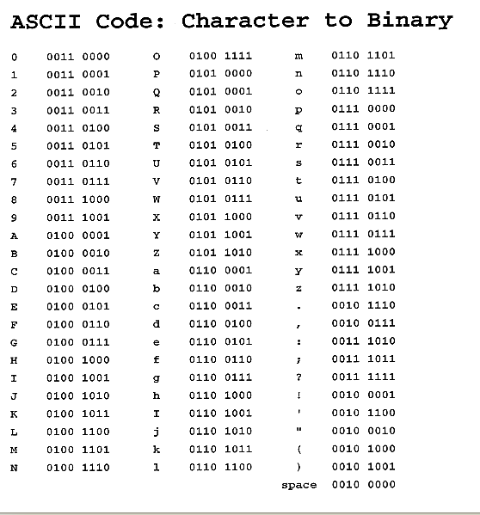
Characters
Typically represented by 8-bit numbers

Slide 57
Exercise
Assuming 4-bit 2’s complement numbers
  What is the binary for -2?
  Calculate 2+3
  Calculate -2-3
  Calculate 5+5
Assuming 5-bit numbers
  What is the largest 2’s complement number?
  What is the smallest 2’s complement number?
Convert 56 to unsigned binary
(http://www.wikihow.com/Convert-from-Decimal-to-Binary)
What is the decimal value of 10110101 in 2’s complement? What is the unsigned value of the same binary number?

Slide 58
Appendix from http://www.heyrick.co.uk/assembler/notation.html
&
The ampersand (&) is used to denote hexadecimal.
Thus,
0xF00D
hF00D
F00Dh
$F00D (see later comment on the use of $) &F00D are all identical, but using different ways to denote base 16. We shall be using the &F00D notion.

Slide 59
References
https://courses.cs.washington.edu/courses/cse378/02sp/sections/section4-5.html
http://www.davespace.co.uk/arm/introduction-to-arm/branch.html

