Slide 1
Public domain software support
KH Wong

Slide 2
Overview
Colab (python_notbook programming, by google)
Keras (TensorFlow library for neural networks )
Sklearn (machine learning python tools)
Opencv (computer vision python tools)
Anaconda (environment sklearn, tensorflow-kearas, opencv etc)
Octave (Free matlab code interpreter)

Slide 3
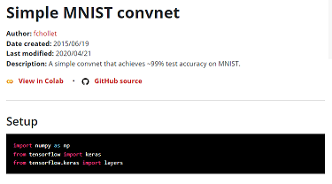
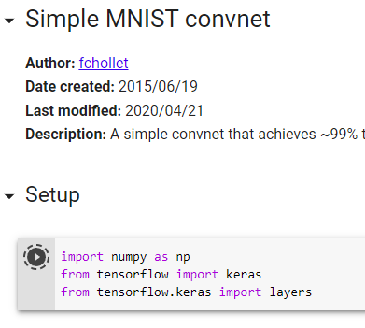
Colab (python_notbook programming, by google)
https://colab.research.google.com/
Use colab if you have a gmail account/google-drive
Click on colab link in libraries (e.g. keras) to begin
Example: https://keras.io/examples/vision/mnist_convnet/
Click-on to start
Then,
click- here
to continue

Slide 4
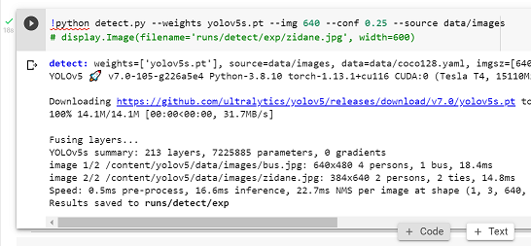
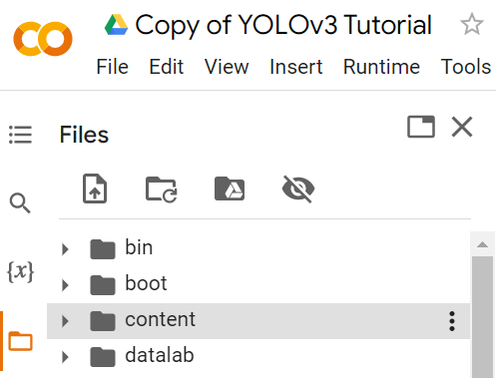
A tutorial of using colab
For every step click the arrow to execute it.
After it is completes, you will see this . It showed that it has run for 18seconds.
You may Mouse over this line , click on “+ Code” you may enter a line of code (e.g., Print(“hello world”) and run it.
Mouse over this icon (files), then you can see the dir. structure. Your code should be under “/content”
You may enter :“!xx” to run operating sys. commands under Jupyter. E.g. “!ls –l”, !cat” etc. Or the useful “%xx” magic commands
Ref: https://www.jcchouinard.com/google-colab-with-python/
https://www.tutorialspoint.com/google_colab/google_colab_magics.htm
https://buomsoo-kim.github.io/colab/2020/05/21/Colab-terminal-commands.md/

Slide 5
Useful Jupyter command (!) as and Colab magic commands*%)
!pwd #command finds out the currently working directory
!ls –l #command finds out the current subdirectories
%cd #change directory
!wget url_to_the_file #Download and open filesUse !unzip or !gunzip commands to unzip compressed files.
%matplotlib inline: draw the plots
%reload_ext autoreload, %autoreload 2: reloads all modules before executing a new line. So when a module is updated, you don’t need to rerun the import command.
https://buomsoo-kim.github.io/colab/2020/05/21/Colab-terminal-commands.md/

Slide 6
Keras (TensorFlow libraries for neural networks ) Can run under Colab
https://keras.io/examples/
Many good examples of how to use neural network liberates for neural networks. Examples:
Computer Vision
Image classification
Image classification from scratch
Simple MNIST convnet
Image classification with Vision Transformer
Image Classification using BigTransfer (BiT)
Image segmentation
Image segmentation with a U-Net-like architecture
Object detection
Object Detection with RetinaNet
Keypoint Detection with Transfer Learning
Object detection with Vision Transformers

Slide 7
Sklearn (machine learning python tools) Can run under Anaconda/Colab
https://scikit-learn.org/stable/
https://scikit-learn.org/stable/auto_examples/index.html

Slide 8
Opencv (computer vision python tools) Can run under Colab
https://opencv.org/
Many useful computer tools available to be used.
(1438) Top 10 OpenCV Projects in Python - With Source Code & Tutorial - Computer vision projects 2020 – YouTube

Slide 9
Anaconda (environment sklearn, tensorflow-kearas, opencv etc)
https://www.anaconda.com/
https://www.anaconda.com/products/distribution
The world’s most popular open-source Python distribution platform
Run on your own machine .
Support tensroflow-keras, opencv, sklearn etc.

Slide 10
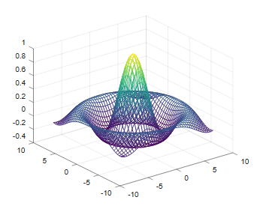
Octave (Free matlab code interpreter)
https://octave.org/
Matlab is excellent in providing math support for develop algorithms. But is is very expensive.
Octave is a poor man’s alternative.
Yet it can run most standard matlab code without much modifications.
It may be slower and sometime buggy.

Slide 11
Summary
Many Public domain software tools are available to help students to build and learn AI methods.
Most tools are free.
But you may enjoy better support (faster machines etc.) if you are willing to pay an additional price. E.g., Colab.

