Slide 1

ENGG1000 IT Foundation
Basic Skills and Applications of IT

Slide 2
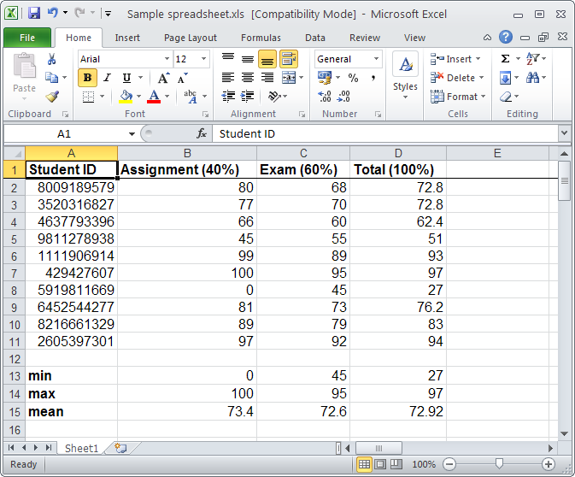
Selected Application: Spreadsheet
An application for entering, analyzing, and presenting numerical data
Usually displays a 2-D grid consisting of rows and columns
Provides "what-if" analysis
Download your free copy of Office 365 ProPlus:
http://www.cuhk.edu.hk/itsc/o365/proplus.html

Slide 3
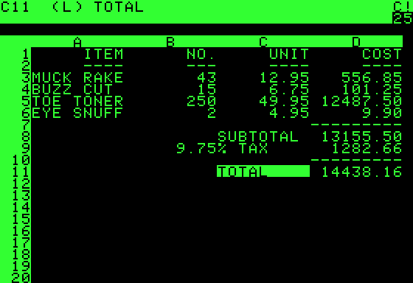
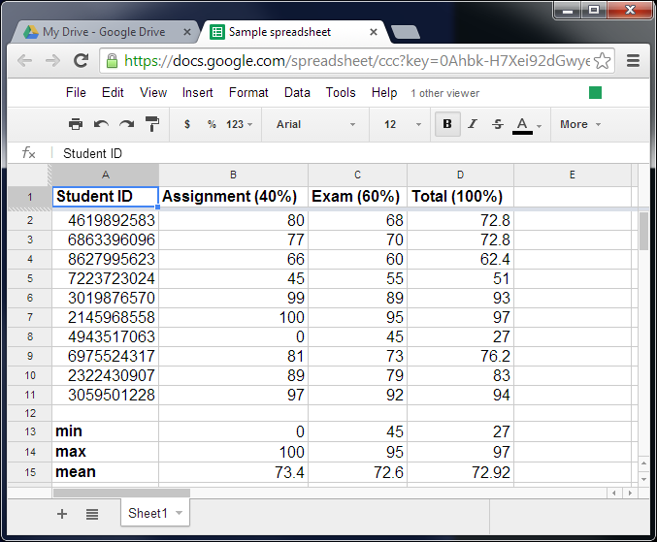
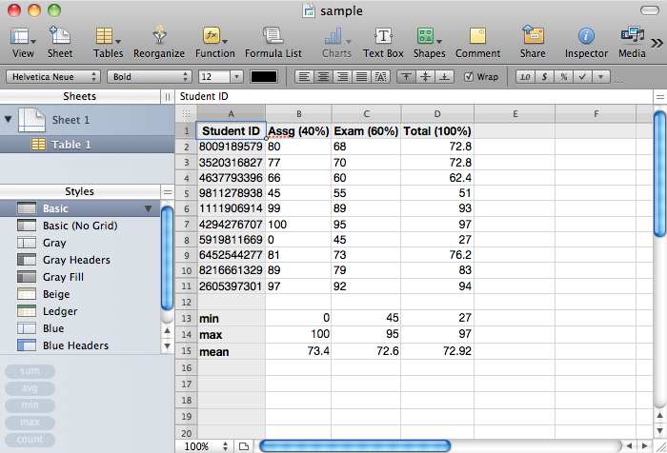
Spreadsheet ≠ Microsoft Excel
Microsoft
Excel
VisiCalc (The first
spreadsheet program)
Google
Docs
Apple
Numbers

Slide 4
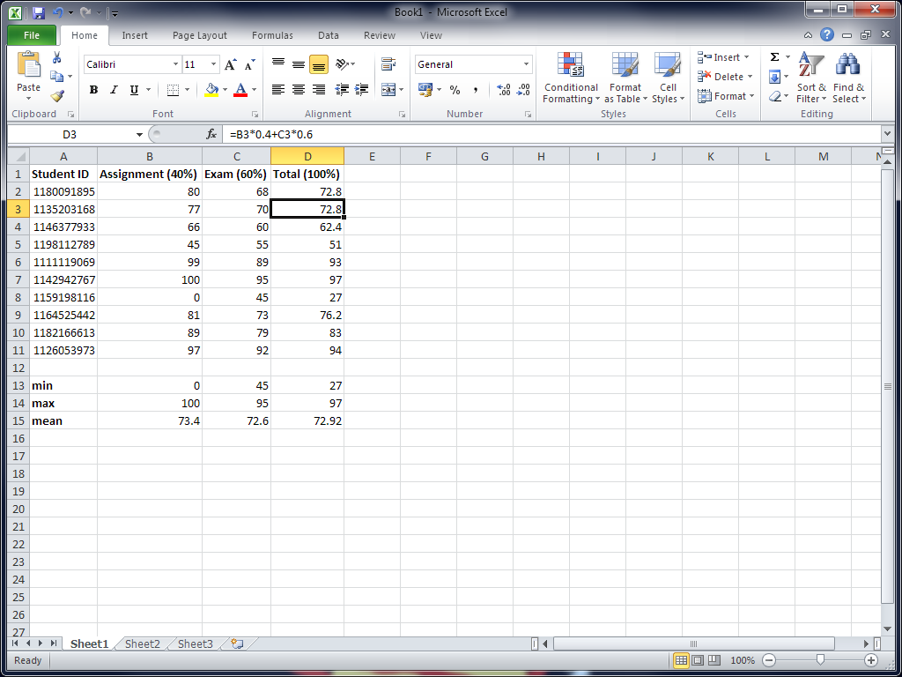
Spreadsheet: Concepts
Column A
Column B
…
Row 1
Row 2
The active cell
…
A cell address (or
reference) is the
combination of its row
and column. E.g., C8
One workbook can have multiple worksheets (i.e., multiple grids of cells)
A grid of cells

Slide 5
Spreadsheet: Concepts
Formula bar:
Shows the content
of the active cell
Cell content can be:
Text
Number
Date and time
Formula

Slide 6



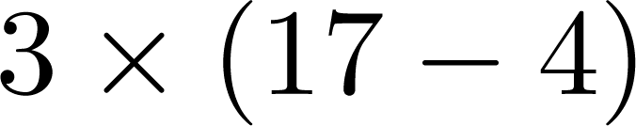

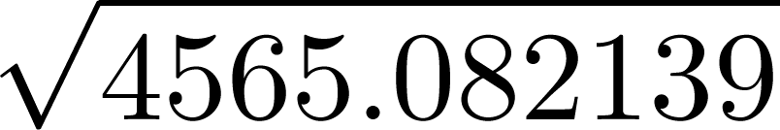
Formula
Enter
Identify the calculations needed to place the result in a cell
Start with the = sign
E.g.:
Cell | Formula | Meaning | Result
A1 | =2+5*3 |  | 17
B1 | =3*(A1-4) |  | 39
A2 | =B1^2.3 |  | 4565.082139
B2 | =sqrt(A2) |  | 67.56539158
Addition : + Multiplication : * Power : ^
Subtraction : - Division : /

Slide 7

Formula
+ - * / ^ are called operators
sqrt() is called a function
While the cell shows the calculation result, the formula bar shows the actual formula
  To edit a formula, do it in the formula bar

Slide 8
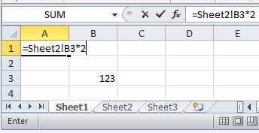
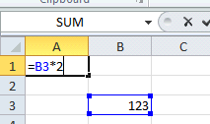
Formula and Address
MC_Ans:246
In a formula, a simple cell address, e.g., B3, denotes the address in the current (displaying) worksheet
MC question: choices: (1) 123, (2) 246
(3) 369, (4) 0
If A1 contains =B3*2, what is the ans=_?
To refer to a cell in another worksheet, use “!”
  E.g.: Sheet2!B3 means cell B3 of worksheet “Sheet2”

Slide 9
Function
Most spreadsheet programs provide many useful built-in functions
  Save you the need to "reinvent the wheel“
For example, instead of typing:
  =A1+A2+A3+A4+A5+A6+A7+A8+A9
  we can simply type: =sum(A1:A9)
Note: A1:A9 means the range
of cells A1, A2, …, A8, A9

Slide 10
Common Mathematical Functions
Function | Meaning
abs(…) | Absolute value
sqrt(…) | Positive square root
exp(…) | e raised to the power of a number
log(…) | Base-10 logarithm
ln(…) | Natural logarithm (i.e., ln in calculator)
sin(…), asin(…), cos(…), acos(…), tan(…), atan(…) | Trigonometry functions (in radians, i.e., )
pi()

Slide 11
Common Statistical Functions
Function | Meaning
min(…) | Find the minimum value among some values
max(…) | Find the maximum value among some values
average(…) | Compute the mean of some values
sum(…) | Give the sum of some values
stdevp(…) | Compute the standard deviation of some values
median(…) | Find the median of some values
List of all Excel functions with usage help:
http://office.microsoft.com/en-us/excel-help/excel-functions-by-category-HP010342656.aspx

Slide 12
MC question: =max(D2:D11)= ___?, choices:(1) 70; (2) 27; (3) 97; (4) 100
The data inside ( ) are called arguments.
=min(B2:B11)
=average(C2:C11)
MC_Ans: 97

Slide 13
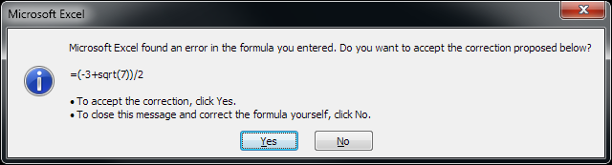
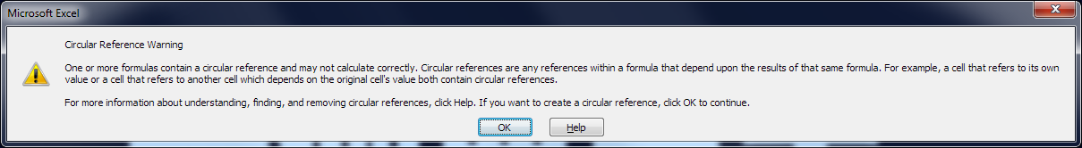
Common Errors when Using Formulas
Unmatched ( )
  E.g., =(-3 + sqrt(7)) / 2)
“Circular reference”:
  In A1: =A2 In A2: =A1

Slide 14
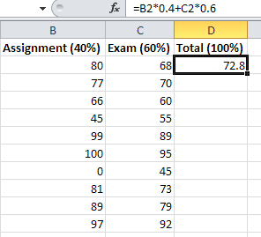
Copy and Paste a Formula
Sometimes we may want to apply essentially the same formula to different sets of data
To automate the process, a common practice is by “copy and paste”
Copy (Ctrl-C)
Paste (Ctrl-V)

Slide 15
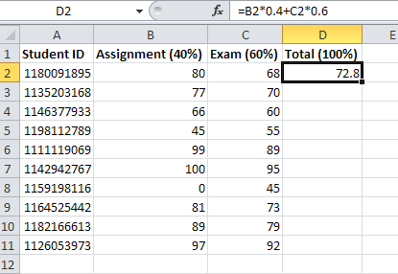
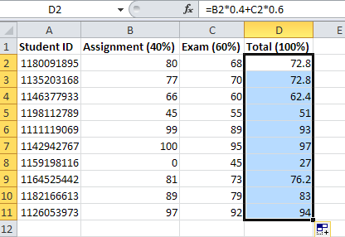
Copy and Paste a Formula
Besides the usual way of doing “copy and paste”, you can also do so by mouse dragging
1. Click and drag the bottom right corner of this cell
Result:
drag
2. Release mouse click here

Slide 16
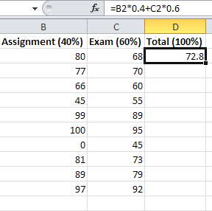
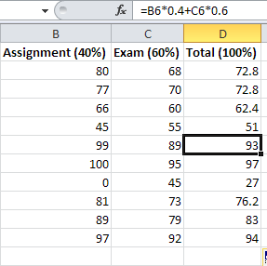
Copy and Paste a Formula
After copy and paste, the addresses in a formula may change
The change depends on the positional difference between the cells being copied and pasted
Addresses
changed!
E.g., copy D2 and paste to D6; positional difference is 4 rows.
So, B2 and C2 are changed to B6 and C6 respectively.

Slide 17
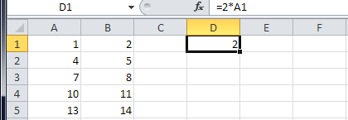
Exercise
MC_Ans: 8
Suppose:
What will be the results if we copy D1 and paste to:
  D2, …, D5?
  E1, …, E5?
  F1, …, F5?
  MC question: copy D1 and paste to D2
  Choices:(1)2; (2) 4; (3) 8; (4) 10

Slide 18
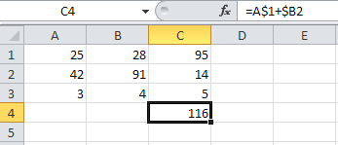
What if I don’t want address changes?
Use the $ sign in a cell address to affect what happens when a formula is copied to another cell
E.g., suppose:
  Try to copy C4 to E4, C6, and E6
=A$1+$B2

Slide 19
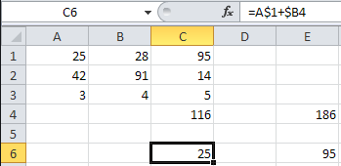
Relative vs Absolute Addressing
Copy
=A$1+$B2
Placing $ before a row/column name in a formula forces it not to change when the formula is pasted to another cell
=C$1+$B2
Paste
=A$1+$B4
=C$1+$B4
Paste
Paste
Using $ in an address in a formula
is called absolute addressing

Slide 20
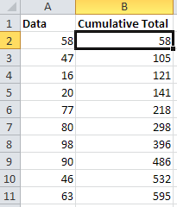
Relative vs Absolute Addressing
One practical usage of absolute addressing is to compute cumulative total of some values
=sum(A$2:A2)
Copy
=sum(A$2:A3)
Paste
=sum(A$2:A4)
Paste
=sum(A$2:A5)
Paste
…

Slide 21
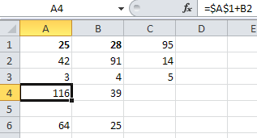
Relative vs
Absolute Addressing
MC Ans:(4)30
The $ sign can be added to both row and column name in an address
=$A$1+B2
=$A$1+C2
Copy this cell
Paste to here
Paste to here
Paste to here
MC question. Copy from A4 to B5. Choices:(1)0;(2)25;
(3)35; (4)30
=__?
=$A$1+B4

Slide 22
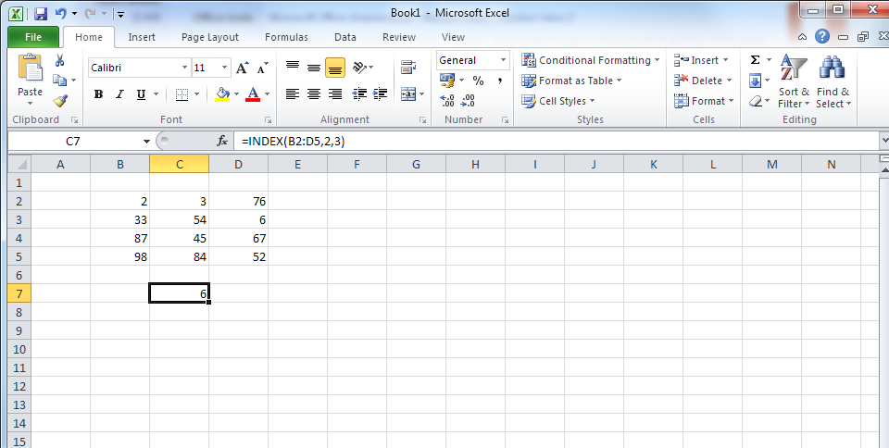
Some
Useful
Functions
MC question. The value of
=INDEX(B2:D5,2,2) is
33; (2)54; (3)87; (4)45
index(array, i, j)
  array is a range of cells
  i is a row number
  j is a column number
  Return the element in the i-th row and j-th column of array
Example:
This is a function with 3 arguments
Row 2 and
column 3
of B2:D5
=index(B2:D5,2,3)
MC_Ans:54

Slide 23
Some
Useful
Functions
MC question. The value of
=if(B2>C2,"oh no",D2) is
oh no; (2)76; (3)6; (4)67
if(test, t_value, f_value)
  test is a logical test (yielding true or false)
  Return t_value if test is true (yes)
  Return f_value if test is false (no)
Example:
=if(B2<=C2,"oh no",D2)
=if(B2<=C2,"oh no",D2)
Not
equal
Comparison operators:
< <= > >= = <>

Slide 24

Some Useful Functions
countif(data, criteria)
  Count the number of cells that satisfy some given criteria
  data is a range of cells
  criteria is the criteria to be satisfied
E.g.:
=countif(A1:A5,"<=50")
(Count the number of cells in B1:B5 that is less than or equal to 50)
MC question: Ans__?
Choices:1,2,3,4.
Detailed usage:
http://office.microsoft.com/en-us/starter-help/countif-function-HP010342346.aspx
[Self-study]
Mc_Ans=3

Slide 25

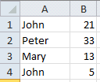
Some Useful Functions
sumif(range, criteria, [sum_range])
  Sums the values in range that meet criteria
E.g.: =sumif(A1:B3, ">=10")
  Sums all cells in A1:B3 that is >= 10 (Result is 12+32+31=75)
E.g.: =sumif(A1:A4, "John", B1:B4)
  Sums the values in B1:B4 where the corresponding cells in A1:A4 equal "John" (Result is 21+5=26)
Usage: http://office.microsoft.com/en-us/excel-help/sumif-function-HP010342932.aspx

Slide 26
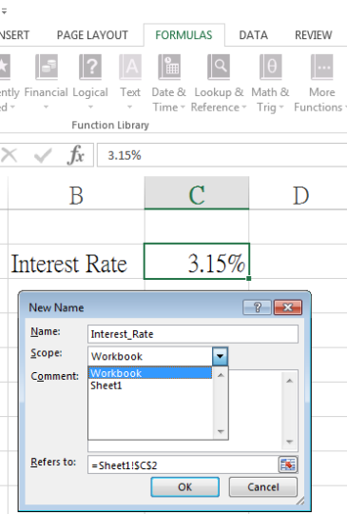
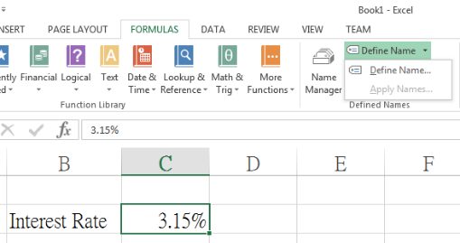
Define Name
Defining a Name allows us referring to a particular piece of data (at certain address) conveniently when working with formulas.

Slide 27
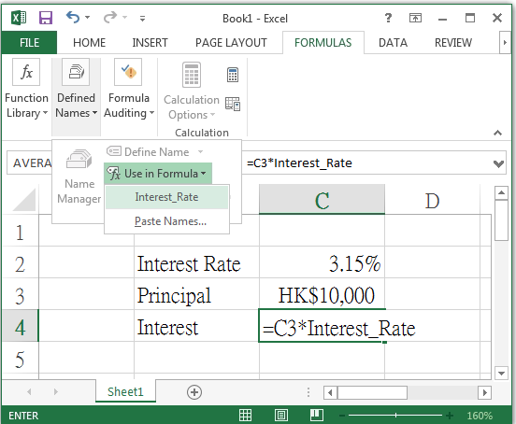
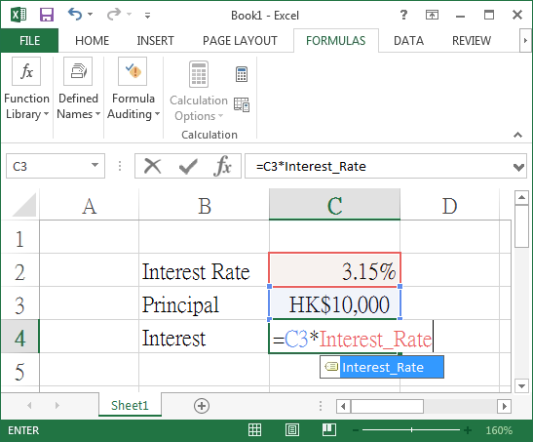
Using a Defined Name
To Apply a Defined Name, pick it from the menu OR simply
spell it explicitly in a formula!

Slide 28
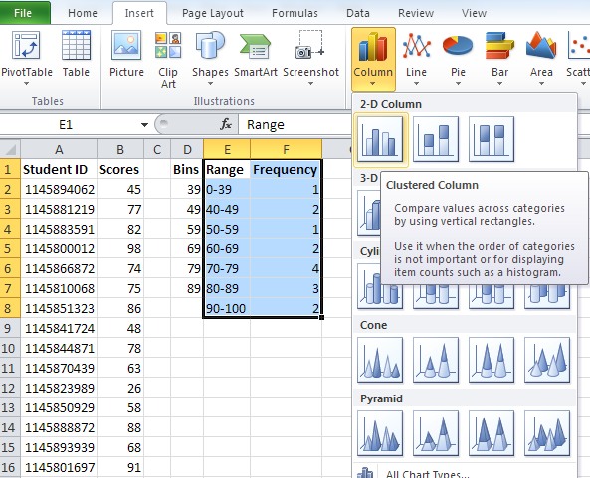
Plotting Chart
2
3
4
1
Select cells E1 to F8

Slide 29
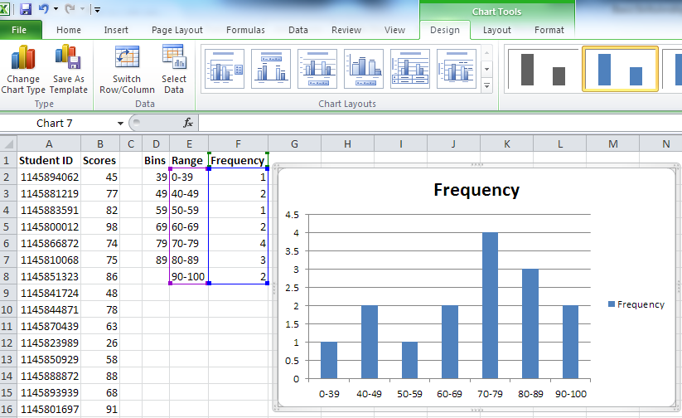
Plotting Chart
Try choosing other chart
types to see the difference!

Slide 30
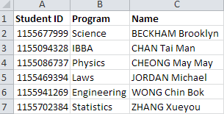
Some Useful Functions
vlookup(lookup_value, array, col, [range])
  Search the first column of a range of cells (array), and then return a value from any cell on the same row of array
E.g., try the following formula with this table
=vlookup(1155086737, A2:C7, 3, false)
Detailed usage: http://office.microsoft.com/en-us/starter-help/vlookup-function-HP010343011.aspx

Slide 31
vlookup()
MC Question: What will you get from
=vlookup(1155941269, A2:C7, 2, false)
Choices:
Engineering, (2) Wong Chin Bok
(3) IBBA (4) Chain tai Man
Searches 1155086737 in the first column of A2:C7 (i.e., col A)
Row 4 matches. So returns the third column of data in row 4 (i.e., C4)
The fourth argument, false, denotes “exact match”
=vlookup(1155086737, A2:C7, 3, false)
Will get “Cheong May May”
MC_Ans: Engineering

Slide 32
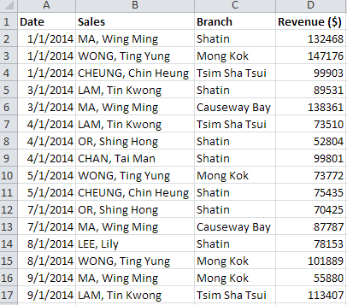
Data Filtering and Sorting
Filtering allows you to display only the rows of data that meets certain criteria that you specify.
E.g., what if I want to show only the data of one particular sales/branch?

Slide 33
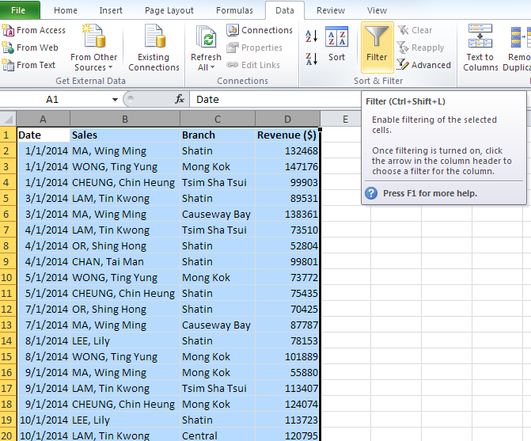
Creating Filters
2
3
1
Select columns A to D

Slide 34
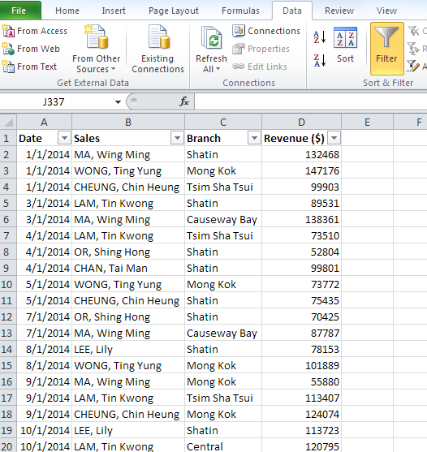
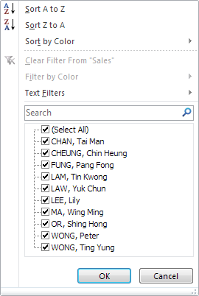
Using Filters
You can click on the filter icons . (Try clicking the one in column B)
You can sort the data according to the sales names.
You can choose to show only the data of one or more sales.

Slide 35
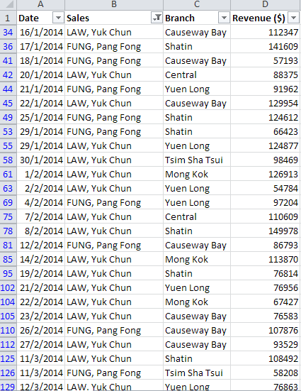
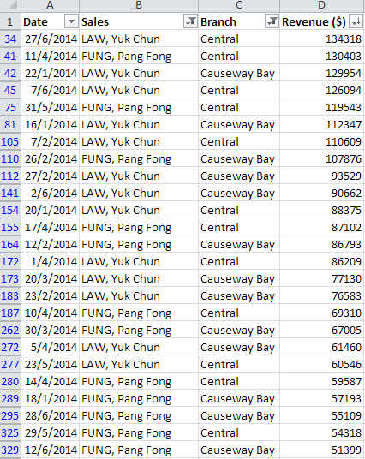
Using Filters
: filter applied
: values sorted
Shows data of:
  sales “LAW, Yuk Chun” or “FUNG, Pang Fong”; AND
  branches Central or Causeway Bay
Sorted in decreasing revenue
Shows data of sales “LAW, Yuk Chun” or “FUNG, Pang Fong” only

Slide 36
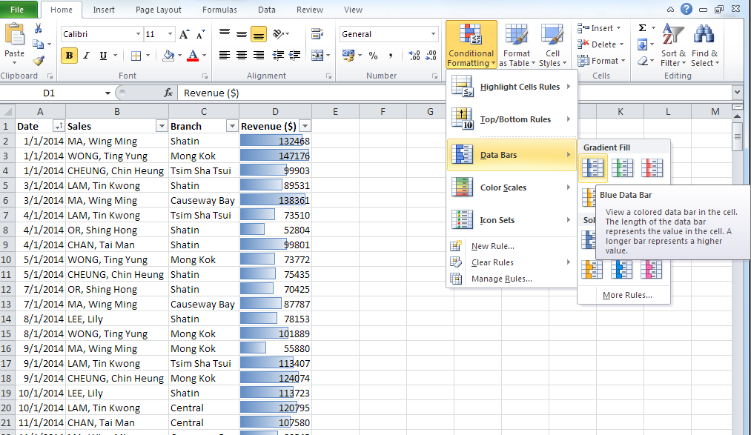
Conditional Formatting
[Self-study]
2
1
3
Allows adding special formatting effects to your data according to some specified criteria

Slide 37
Pivot Table
Excel provides a very useful data summarization and analysis tool, called PivotTable™.
Let’s begin with
  switching to a target worksheet;
  clicking on the top-left cell of the data table to be analyzed.

Slide 38
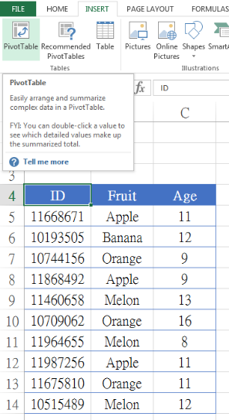
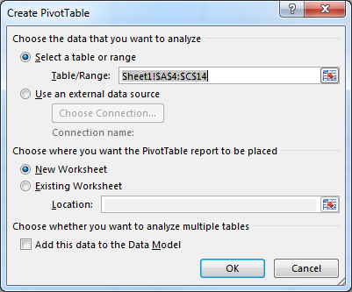
INSERT → PivotTable

Slide 39
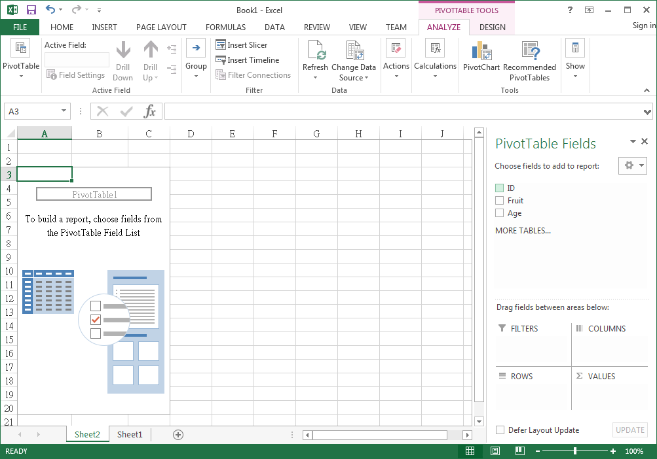
Created a New Worksheet

Slide 40
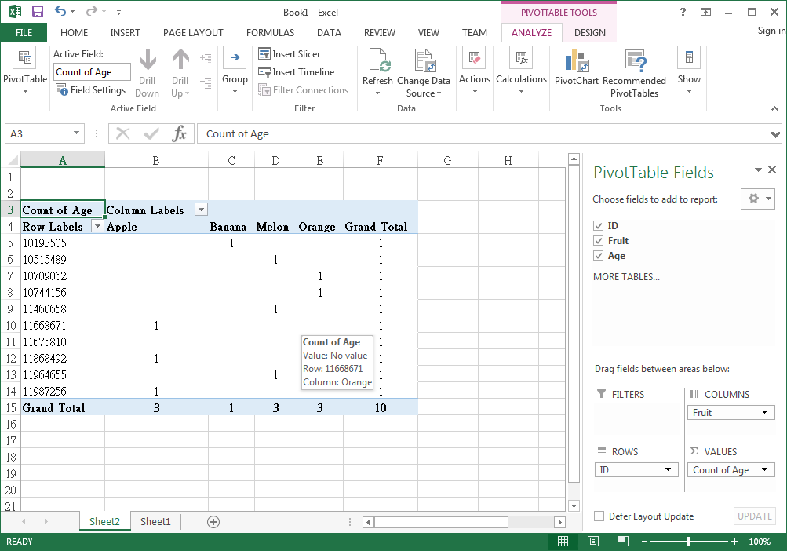
Choose/ Drag-and-Drop Fields
Refresh as needed
(when Sheet1 data has changed)
Change the labels as needed

Slide 41
Summary
Basic concepts of spreadsheet
Formulas
  Common useful functions
  Relative vs absolute addressing
Pivot Table and data analysis
Plotting Charts
Data Filtering and Sorting
Conditional Formatting
Appendix: a Bigger Example and Additional Useful Functions (see coming pages)

Slide 42
Appendix: A Bigger (and More Complicated) Example
Find the “window sum” of some given data
Data | 2-Window Sum | 4-Window Sum
58 | 58 + 47 = 105 | 58 + 47 + 16 + 20 = 141
47 | 47 + 16 = 63 | 47 + 16 + 20 + 77 = 160
16 | 16 + 20 = 36 | 16 + 20 + 77 + 80 = 193
20 | 20 + 77 = 97 | 20 + 77 + 80 + 98 = 275
77 | 77 + 80 = 157 | 77 + 80 + 98 + 90 = 345
80 | 80 + 98 = 178 | 80 + 98 + 90 + 46 = 314
98 | 98 + 90 = 188 | 98 + 90 + 46 + 63 = 297
90 | 90 + 46 = 136 | -
46 | 46 + 63 = 109 | -
63 | - | -
[Self-study]

Slide 43
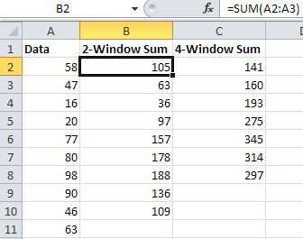
Easy?
What if we want to find k-window sum, where k is a value stored in another cell?
=sum(A2:A5)
=sum(A2:A3)
[Self-study]

Slide 44
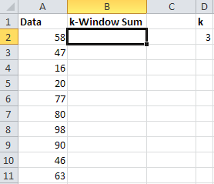
k-window Sum
When D2 is 3, compute 3-window sum.
When D2 is 4, compute 4-window sum.
…
Let’s start with the formula in B2
What is the row number of the last element in the sum?
[Self-study]

Slide 45
k-window Sum
The sum in B2 should run from row 2 to row 2+k-1
The sum in B3 should run from row 3 to row 3+k-1
So, the row in which the
sum ends is: row()+D2-1
k
So, the cell in which the sum ends is:
index(A1:A11, row()+D2-1, 1)
[Self-study]

Slide 46
k-window Sum
For B2, we need to sum from A2 to index(A1:A11, row()+D2-1, 1)
Type formula here:
=sum(A2:index(A1:A11, row()+D2-1, 1))
=
sum(
A2:
index(A1:A11, row()+D2-1, 1)
)
[Self-study]

Slide 47
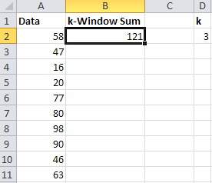

k-window Sum
So far so good. Try changing k to another value
=sum(A2:index(A1:A11, row()+D2-1, 1))
[Self-study]

Slide 48
To Wrap Up…
Simply copying B2 to B3, …, B11 does not work. (Why?)
We have to consider:
  Which cell addresses in the formula should not change upon “copy and paste”?
=sum(A2:index(A1:A11, row()+D2-1, 1))
=sum(A2:index(A$1:A$11, row()+D$2-1, 1))
[Self-study]

Slide 49
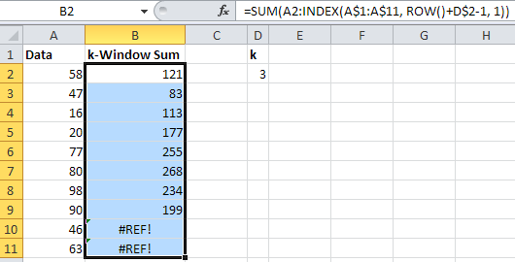
To Wrap Up…
After “copy and paste”
=sum(A2:index(A$1:A$11, row()+D$2-1, 1))
=sum(A5:index(A$1:A$11, row()+D$2-1, 1))
This is normal. (Why?)
[Self-study]

Slide 50
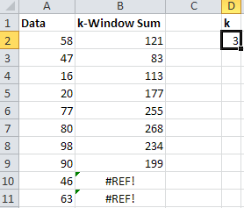

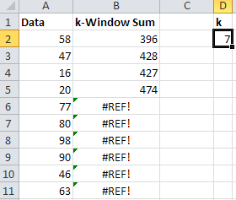
Testing
Try modifying D2 to other values to check if the results are correct
[Self-study]

Slide 51
Appendix: More Useful Functions
frequency(data, bins)
  data is a range of cells for which you want to count
  bins is another range of cells into which you want to group
  Calculates how often values occur within a range of values
This function returns more than one value!
[Self-study]
Detailed usage:
http://office.microsoft.com/en-us/starter-help/frequency-function-HP010342543.aspx

Slide 52
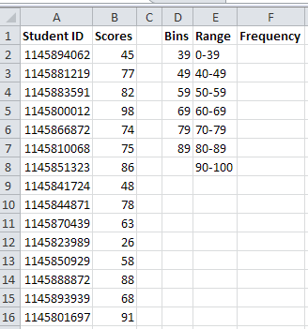
frequency(): Example
Step 1: Select cells F2 to F8
Step 2: Type
=frequency(B2:B16,D2:D7)
(without pressing ENTER)
Step 3: Ctrl+Shift+Enter
[Self-study]

Slide 53
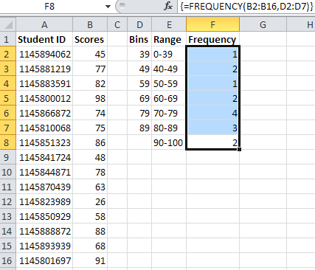
frequency(): Example
score ≤ 39: 1 time
39 < score ≤ 49: 2 times
49 < score ≤ 59: 1 time
59 < score ≤ 69: 2 times
69 < score ≤ 79: 4 times
79 < score ≤ 89: 3 times
89 < score: 2 times
[Self-study]

Slide 54
Appendix: More Useful Functions
row()
  Return the row number of a cell
column()
  Return the column number of a cell
Examples:
Cell | Formula | Result
C8 | =row() | 8
E10 | =column()^2 | 25
[Self-study]

Slide 55
Disclaimer
All company and product names are the trademarks of the respective companies
The copyright of all application screen shots belongs to the respective companies

