Slide 1
ENGG1000 IT Foundation
Introduction to Modern
Information Technologies

Slide 2
Overview
Digital computing
hardware, software, and peopleware
Data storage technologies
personal, institutional, and ubiquitous
Networking and communication systems
wired, wireless, and optical
Internet and the web
technologies, services, and applications
How IT change our lifestyle and the society

Slide 3
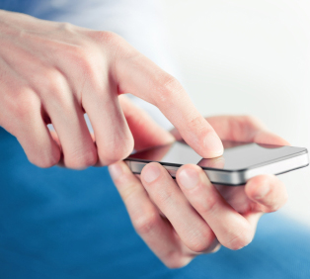
That’s IT, Part of our Lives!
Have you heard of suspected US president vote rigging through Facebook?
Can you survive a day without your Smartphone?
How would you compare those models on www.cuhk.edu.hk/price/special? Are you going to buy a notebook or tablet?
Notes:
References:
http://en.wikipedia.org/wiki/Edward_Snowden
http://www.octopus.com.hk/customer-service/octopus-service-point/en/index.html

Slide 4
New Opportunities and Living Style!
Food Delivery Platform
E.g. foodpanda, UberEat,..
Deepfakes software
Swapping faces!!
Crowdfunding - bring projects to life
https://www.foodpanda.com/
https://faceswap.dev
www.kickstarter.com

Slide 5
New Ideas and Applications
Doing reading comprehension for you!
https://www.pragnakalp.com/demos/BERT-NLP-QnA-Demo/
3D Scanning @ CUHK Library
http://www.lib.cuhk.edu.hk/en/use/facilities/3d-scan
3D Printing @ CUHK Library
http://www.lib.cuhk.edu.hk/en/use/facilities/3d-print

Slide 6
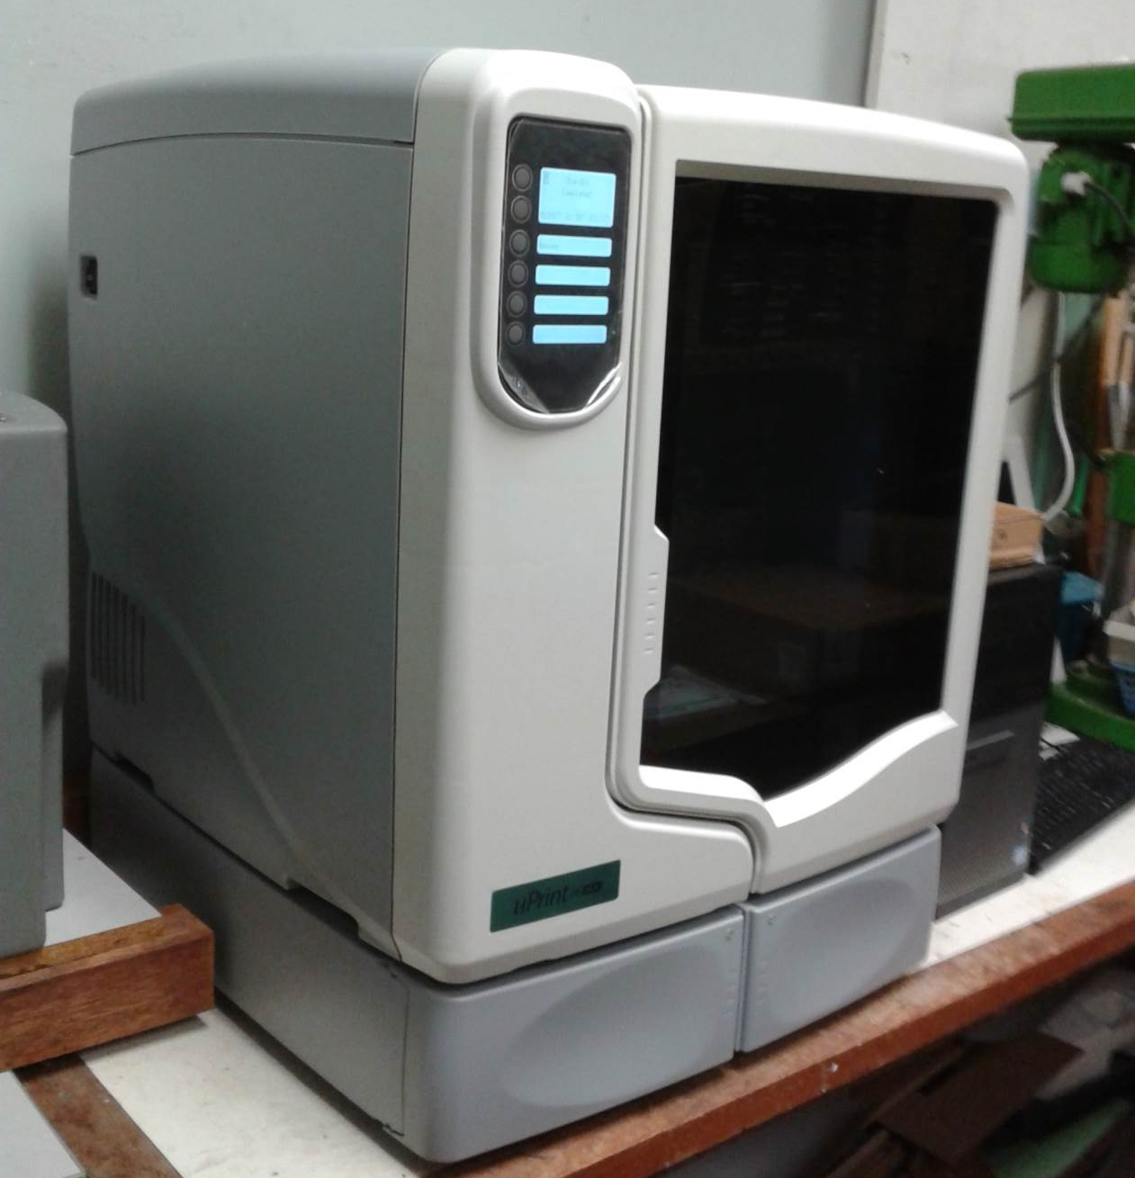
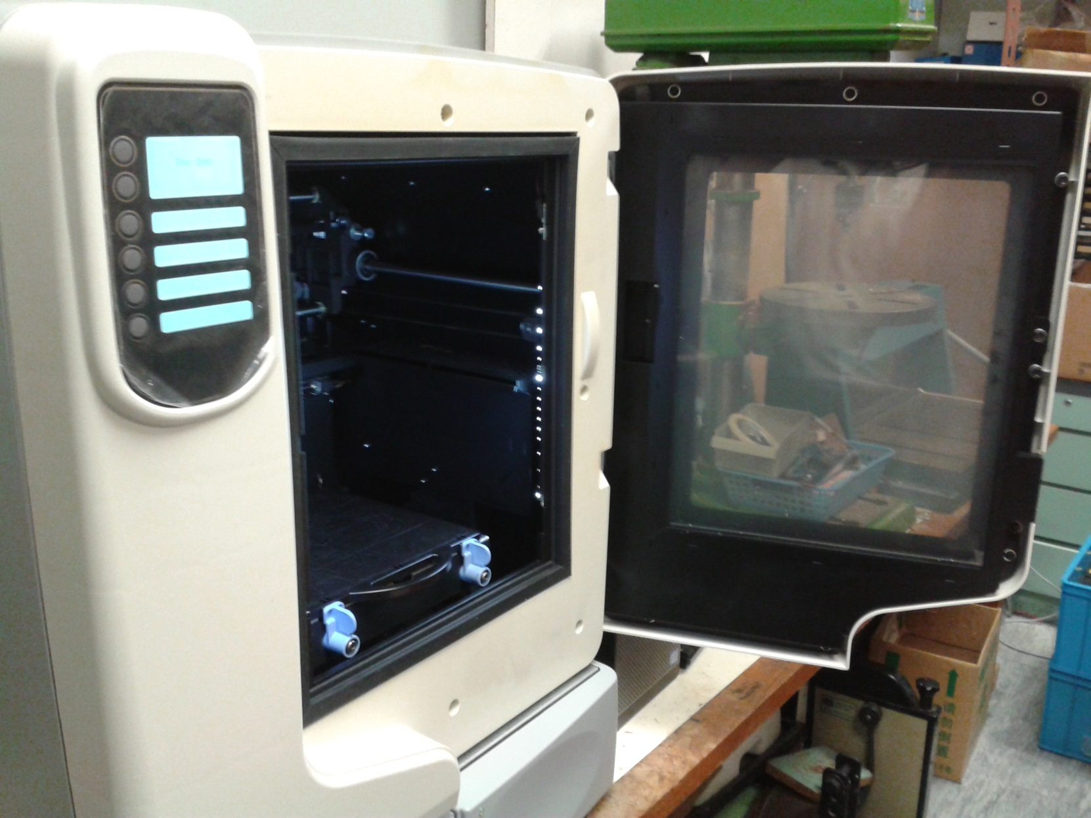
3D Printing @ CUHK Engineering
Notes:
Play a video clip showing the operation of the 3D printer.

Slide 7
They are Around us!
Uber HK
https://www.uber.com/cities/hong-kong
Airbnb
https://www.airbnb.com/hong-kong/stays
HKTV Mall
http://hktvmall.com/

Slide 8
Digital Computing
Prevailing digital technologies
History of the breakthroughs in digital technologies
We are living in the Digital Age, how and why has it been starting?
Understanding the Digital Age and Modern Information Technologies

Slide 9
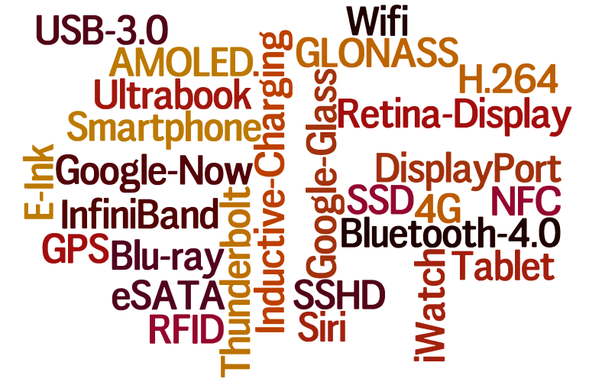
Contemporary Digital Technologies
* The above image is generated by http://www.wordle.net/create
Notes:
Mobile Tech
Video Tech
Audio Tech
Storage Tech
Interface Tech
Communication Tech
Computing Tech

Slide 10
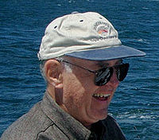
Moore’s Law: [Microprocessor] Transistor Count Grows Exponentially
“Transistor density on integrated circuits doubles about every two years.”
Proposed by Gordon E. Moore (Intel co-founder) in 1965
Doubling performance/ capacity every two years, well, 18 months!
Halving price every two years!
Click this link for an animation showing Moore’s Law
https://www.visualcapitalist.com/visualizing-moores-law-in-action-1971-2019/
* Quote from: “Moore’s Law: Raising the Bar” (Intel Corp. 2005)
* Image from: https://en.wikipedia.org/wiki/Moore%27s_law#/media/File:Gordon_Moore.jpg (CC BY 2.0)
* Image from: http://www.computerhistory.org

Slide 11
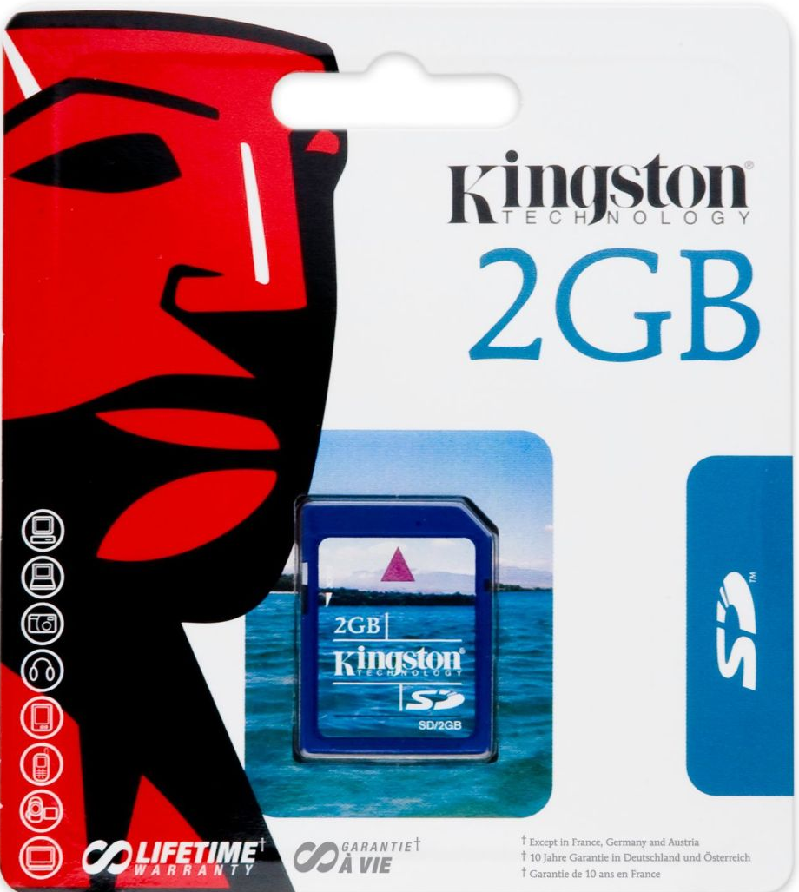
smaller; BIGGER; Cheaper
512MB
HK$500@2000
2GB
HK$30@2010
16GB SDHC Class 4
HK$40 @ 2015!!!

Slide 12
Breakthroughs in Information Technologies: from idea, to invention, to application
Data Storage | Usage | Desktop and Notebook Computer | Tablet and Smartphone | Camera and Set-top Box
Main Memory | Installed working area for transient use; “volatile”: contents need power to keep | Random Access Memory (RAM) | RAM | RAM
Secondary Storage | Storage for OS, apps, programs and data; “non-volatile”: semi-permanent storage | Hard-drives, Optical disks, Flash Memory drives & cards | “ROM”, Flash Memory cards | “ROM”, Flash Memory drives & cards
Tertiary Storage | Expandable backup and long-term storage of software and data | Removable media such as drives, disks and tapes | Computer Sync | ditto
Network and Cloud Storage | Sharing and backup of contents | LAN and Internet access to Web Services; NAS | Network and Cloud Services | Network and Cloud Services
Notes:
IBM Atomic Storage: http://www.ibm.com/smarterplanet/us/en/smarter_computing/article/atomic_scale_memory.html

Slide 13
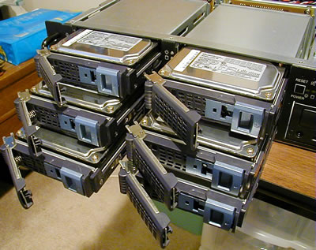
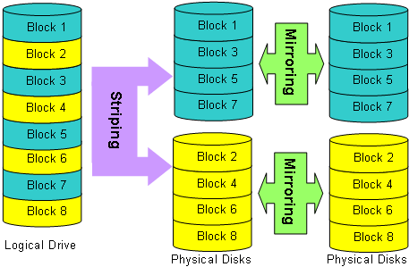
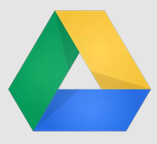
Breakthroughs in Information Technologies: from idea, to invention, to application
Advanced Storage Technologies
Redundant Array of Independent Disks (RAID)
Network-Attached Storage (NAS)
Cloud/ Online IT Services
Picasa / Youtube services
Dropbox / SkyDrive / Google Drives / iCloud
Online collaborative office tools
e.g. Microsoft Office 365 / Google Docs

Slide 14
Do You Know These Prefixes and Units? [Take-home Exercise]
Physical/ basic
μs →
ns →
nm →
bit → a binary digit
Byte → ___ bits
Data volume/ capacity
kb →
kB →
MiB →
GB →
TiB →
Data rate
bps → bit per sec
Bps →
kbps →
MBps →
Gbps →
Frequency: beat / sec
kHz →
GHz →
Daily life
Broadband data rate?
Mobile data volume?
Look up SI Prefixes
& Binary Prefixes
Notes:
https://en.wikipedia.org/wiki/Binary_prefix

Slide 15
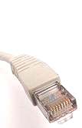
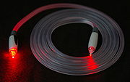
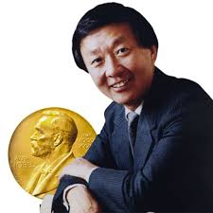
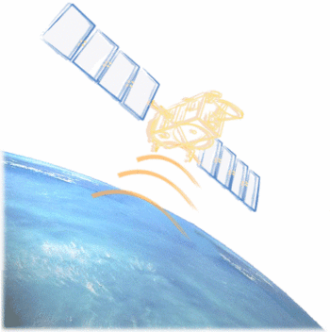
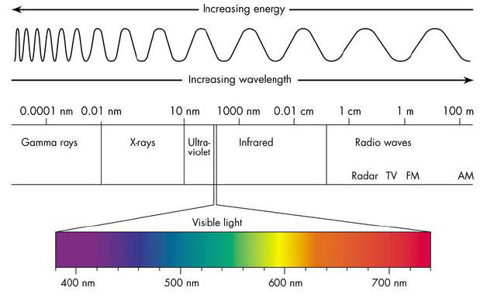
Breakthroughs in Information Technologies: from idea, to invention, to application
Wired Communication
Coaxial / Twisted-Pair Cable
Optical Fibre
Invented by Prof Charles K. Kao and George A. Hockham in 1965 光纖之父高錕教授 2009 Nobel Laureate VC of the CUHK (1987-1996)
Wireless Communication
Microwave Link (e.g. Satellite)
GSM, 4G, 5G and WiFi
Bluetooth (PAN) and Near-Field Communication (NFC)
E.g. Octopus, VISA PayWave, CU Link

Slide 16
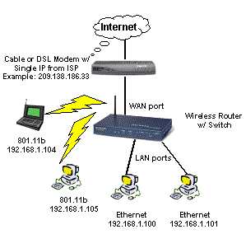
Breakthroughs in Information Technologies: from idea, to invention, to application
Communication Systems and Protocols
Ethernet (IEEE802.3 Standard)
Evolving standards: 100Mbps, 1Gbps, 10Gbps
Local Area Network (LAN) / Wide Area Network (WAN)
Internet Protocol (IP) packet switching
Host/device identification using IP address
Send and receive data packets with IP
An IPv4 address is 32-bit
Four numbers [0-255] separated by dots
e.g. 137.189.11.73
Newer standard IPv6 uses 128-bit addresses
More numbers separated by colons
e.g. 2405:3000:3:118::49

Slide 17
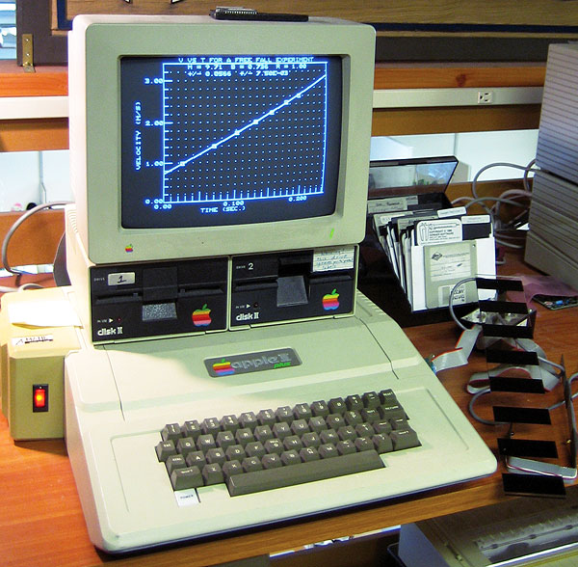
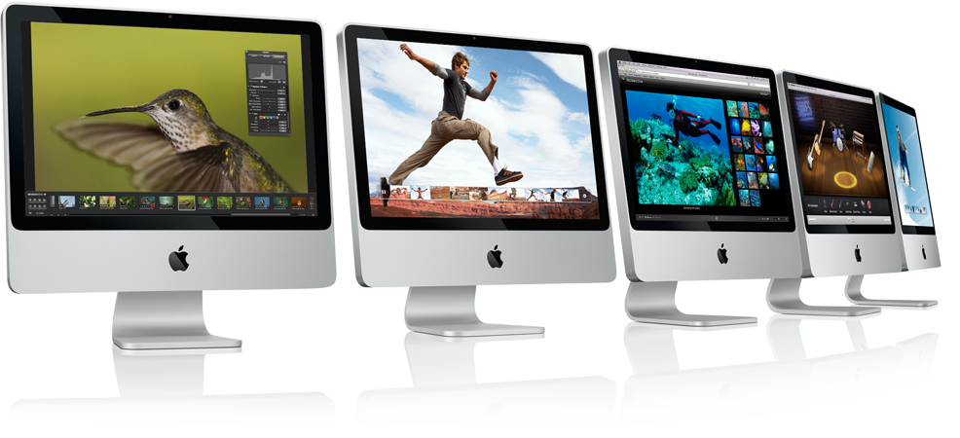
Breakthroughs in Information Technologies: from idea, to invention, to application
1980's Spread of Personal Computer (PC's)

Slide 18
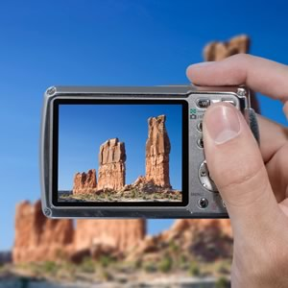
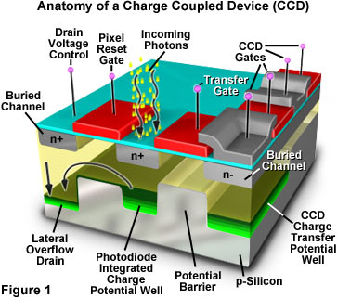
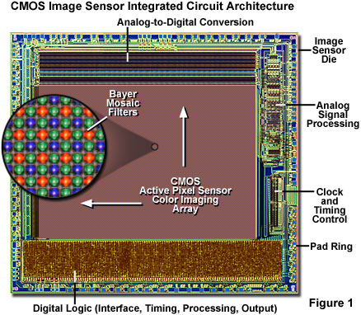
Breakthroughs in Information Technologies: from idea, to invention, to application
Imaging Technologies
Digital Cameras and Scanners
Trend: higher resolution, better colour space, higher fidelity, higher speed
Capturing aid: anti-shake, face detection, motion detection
Applications
Ubiquitous photo & video taking
QRCode scanning to obtain information and links – e.g. Google App Goggles
Notes:
http://www.micro.magnet.fsu.edu/primer/java/digitalimaging/ccd/virtual2/
http://www.micro.magnet.fsu.edu/primer/digitalimaging/cmosimagesensors.html

Slide 19
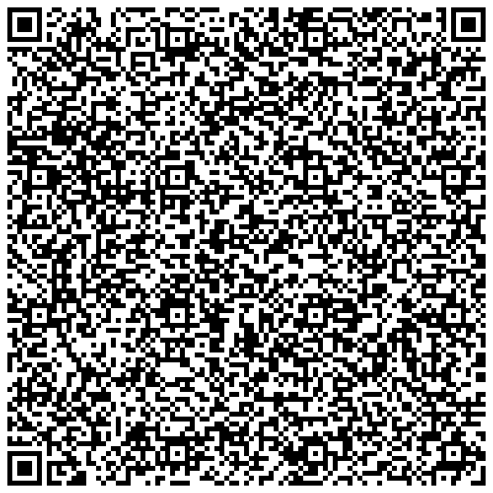
One Picture is Worth Many Words – QR Code (with LOVE)
For God so loved the world that he gave his one and only Son, that whoever believes in him shall not perish but have eternal life. For God did not send his Son into the world to condemn the world, but to save the world through him. Whoever believes in him is not condemned, but whoever does not believe stands condemned already because they have not believed in the name of God’s one and only Son. This is the verdict: Light has come into the world, but people loved darkness instead of light because their deeds were evil. Everyone who does evil hates the light, and will not come into the light for fear that their deeds will be exposed. But whoever lives by the truth comes into the light, so that it may be seen plainly that what they have done has been done in the sight of God. -- Bible NIV John 3:16-21

Slide 20
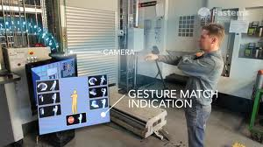
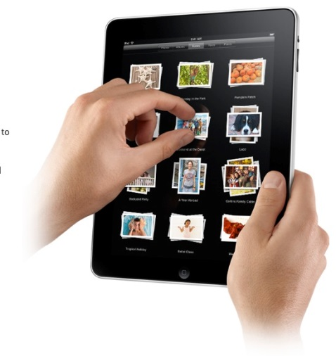
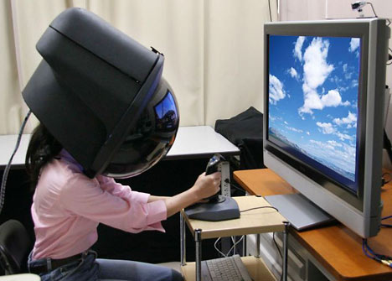
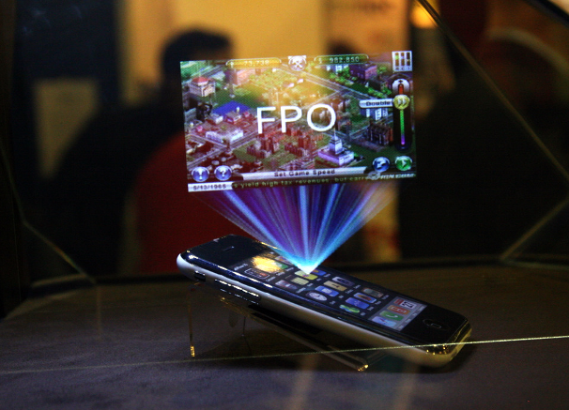
Breakthroughs in Information Technologies: from idea, to invention, to application
Human-Computer Interfacing (HCI)
Keyboard and Mouse!
Graphical User Interface
Motion Control
Multi-touch Control
Speech Recognition
Voice Synthesis
Sensors
Accelerometer
Gyroscope
Magnetometer
Light and Proximity
Finger-print

Slide 21
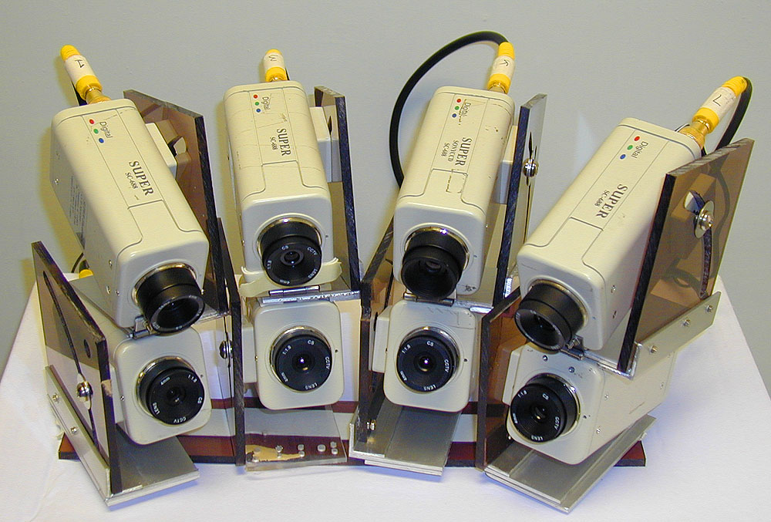
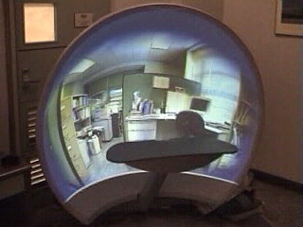
VR Lab @ CSE

Slide 22
The Power of Image, Voice and Text
Image and Voice Search
Web Cam and Mic Demo with Chrome
Google Web Speech and Translate API Demo (under Chrome)
Speech Recognition https://www.google.com/intl/en/chrome/demos/speech.html
Voice Synthesis (Text-To-Speech/ TTS) https://cloud.google.com/text-to-speech/
Translation https://translate.google.com/#en/zh-CN/Good%20morning!

Slide 23
Implication and Significance
Today, computers, imaging, recording and interactive devices are ubiquitous (無處不在), what are the issues and concerns?
Privacy?
Security?
Distraction on the road?
Implication on resources:
How many such gadgets do you have?
How often do you upgrade and backup?
How much power do they consume?
Have you ever used public charge service?

Slide 24
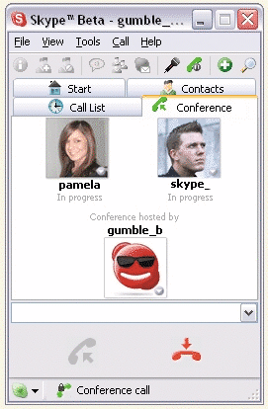
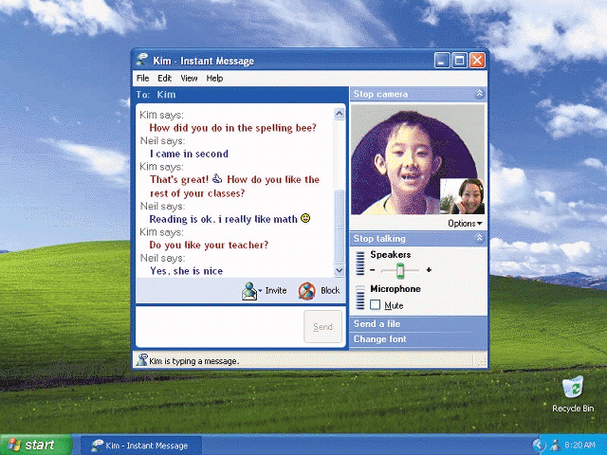
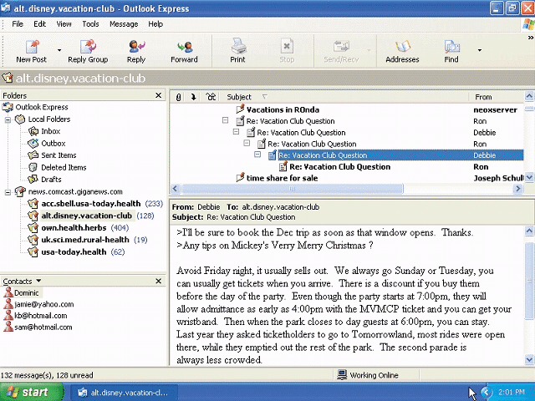
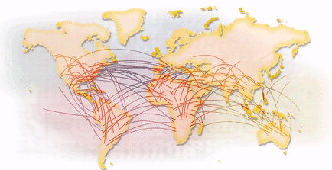
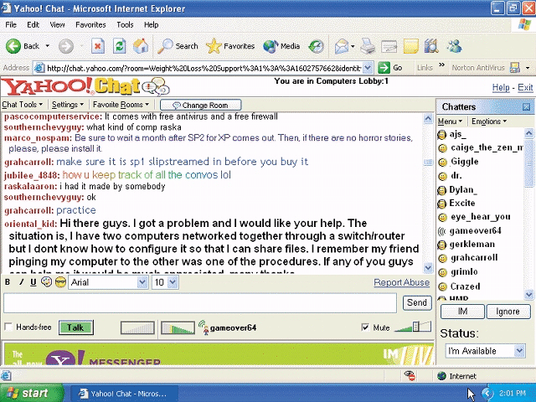
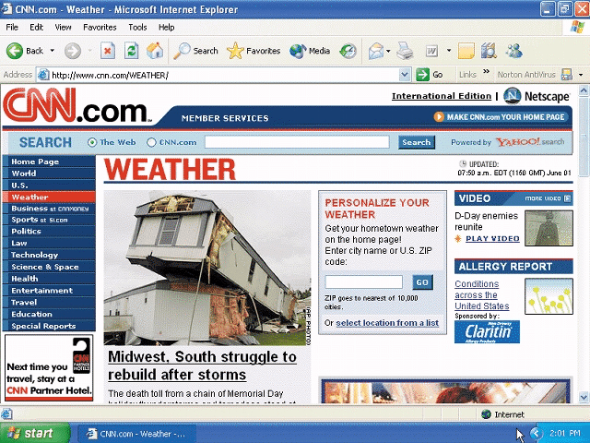
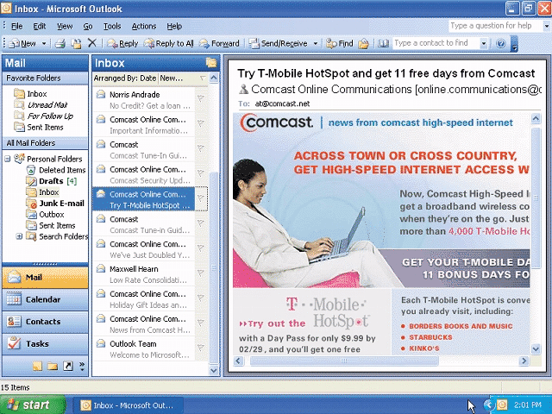
The Internet

Slide 25
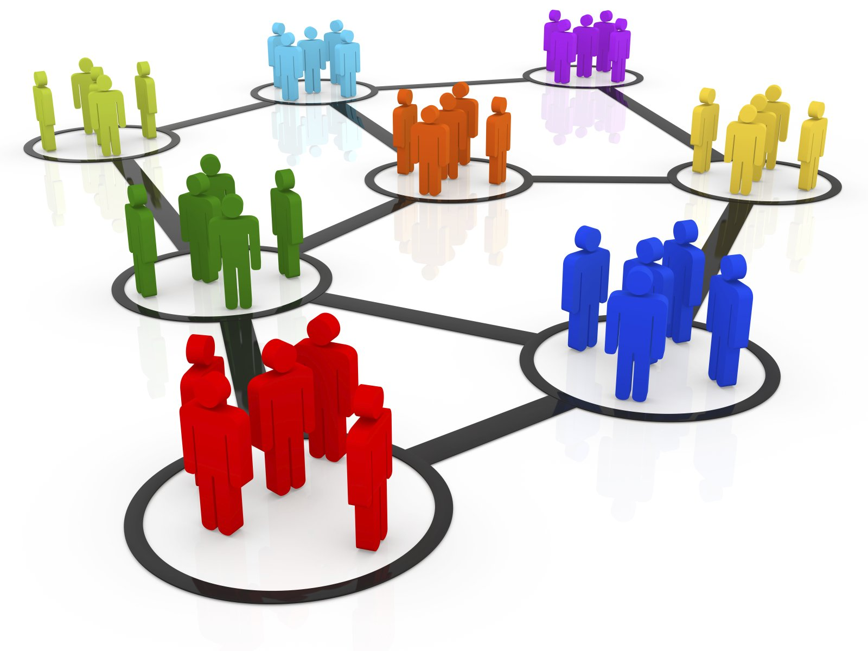
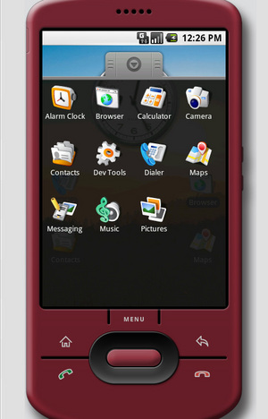
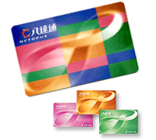
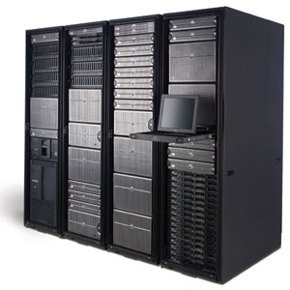
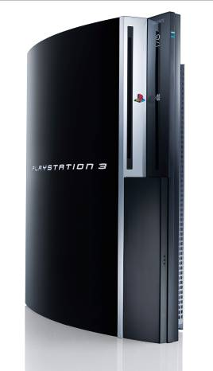
What are Connected?
Desktop computers
Servers and clusters
Mobile devices
Smart phones, tablets, e-books, etc.
Embedded systems and appliances
Set-top boxes, game consoles (Wii, PS4, Xbox One), etc.
Wearable gadgets
Intelligent watch, glasses, belts, gloves, etc.
Detachable or removable devices
USB devices, cards, RFIDs, Octopus!
People!

Slide 26
In Close Relation with Modern IT
Health & Safety
Environment & Sustainable Development
Economics
Societies, Social Life & Living Style

Slide 27
Questions to Ask
How reliable are these technologies?
What are the impacts?
What are the costs?
What are the risks?

Slide 28
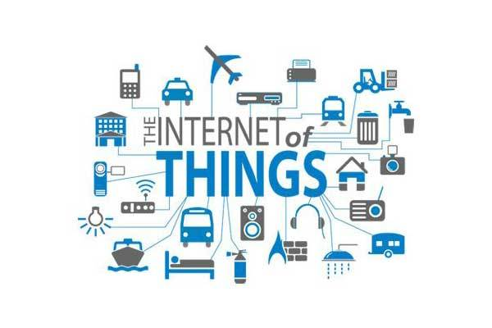
Possibilities and Applications
Internet of Things (IoT)
By connecting everything to the Internet, we will be able to do a lot of things
https://eurowatchers.com/2018/04/28/global-internet-of-things-iot-analytics-market-growth-is-expected-to-be-driven-majorly-by-revenue-contribution-by-asia-pacific-market/

Slide 29
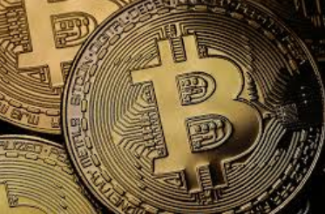
Possibilities and Applications
Blockchain
A distributed list of records, called blocks, which are linked and secured using cryptography.
Need consensus to store a record – irreversible and tamper-resistance transactions
1st Gen: transaction – Bitcoin
2nd Gen: Smart Contracts: logics & actions – Ethereum iOT applications

Slide 30
Living in the IT Era
"More time" means "More life"?
Is my digital information safe?
Are Information Technologies serving me or driving me?
What kind of freedom do we enjoy?
How do you think of the “Remembering” feature of FB?
Why and how do people care about the afterlife of a social account?

Slide 31
Contemporary Developments
Cloud Computing
Infrastructure, Platform, Software as a Service
Ref: http://en.wikipedia.org/wiki/Cloud_computing
Artificial Intelligence
Deep learning enables a lot of computer applications that previously can only be achieved by human
Big Data
Data mining and applications

Slide 32
References and Further Readings
Misty E. Vermaat and Susan L. Sebok, “Introducing Today’s Technologies: Computers, Devices, and the Web," Discovering Computers 2016: Tools, Apps, Devices, and the Impact of Technology, Course Technology, Shelly Cashman series, 2015.
Wikipedia contributors, "Internet," Wikipedia, The Free Encyclopedia,https://en.wikipedia.org/w/index.php?title=Internet&oldid=677501313 (accessed August 25, 2015).
Wikipedia contributors, "Charles K. Kao," Wikipedia, The Free Encyclopedia, https://en.wikipedia.org/w/index.php?title=Charles_K._Kao&oldid=674425768 (accessed August 25, 2015).

