Slide 1
MSC projects for 2016-7
To be supervised by Prof. KH Wong

Slide 2
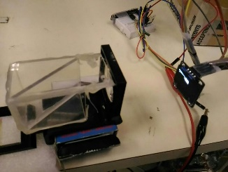
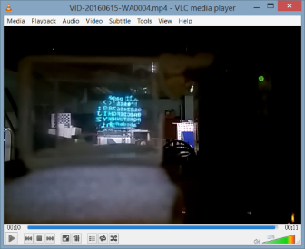
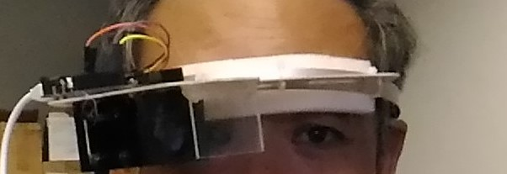
Msc-Khw-1601 : Smart wearable glasses development
Wearable glasses such as the google glass draw a lot of attention from the public because it provides novel applications to users. For example, it can display texts and information directly to users onto the glasses they are wearing. At CUHK, we designed a novel wearable glass hardware that enlarges the display area and can be built at low cost. The function is more versatile such that one can see through the display so that texts and graphics can be overlaid onto the real scene. This project is to develop software applications such as text recognition, language translation or face recognition applications that can be incorporated into our wearable glass system. The project is suitable for those who are interested in system development and the creation of new products and ideas. We expect the system has high commercial potential and can be turned into a successful commercial product in future. The hardware design of our system can be found at http://www.cse.cuhk.edu.hk/~khwong/proj/msc_khw_1617.pptx

Slide 3
Msc-khw-1602 : Artificial Neural Network research for 3D computer vision
Normally Artificial Neural Networks such as the Convolution or Deep Neural Networks can perform well in object recognition tasks, etc. We suggest we can use the networks for 3D reconstruction of models or camera pose tracking as well. The results can be useful in virtual reality systems and other applications such as automatic driving. Traditionally, a network takes the raw images as the input, our new idea is to feed the 2D feature tracking data to the network rather than the raw images to enable better results. We hope this can also enhance the efficiency of the network in terms of training and recognition. Our approach is not just preparing data for large scale training but rather to investigate ways to redesign a new network architecture for better performances. References are: http://deeplearning.net/tutorial/lenet.html , https://www.tensorflow.org/, http://www.cse.cuhk.edu.hk/~khwong/proj/msc_khw_1617.pptx

Slide 4
The design of smart glasses for VR applications The CU-GLASSES
KH Wong

Slide 5
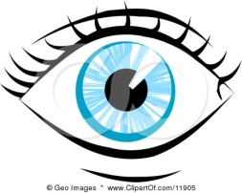
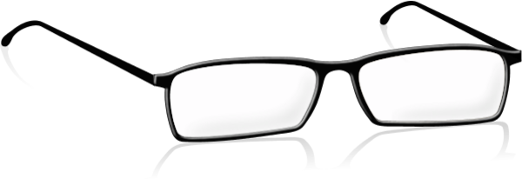
Introduction
Glass frame(no lens)
Be able to overlay images or text to our normal view
Simple, low cost and easy to build
Can duplicate for the 2nd eye
Close up
Lens
See through glass
CCD display
For text or graphics
The CU-GLASSES

Slide 6
The idea
Top down view
Eye
See through glass
CCD
display
Close up
Lens

Slide 7
Tests
Video link
https://youtu.be/i2lpo0DHaWA

Slide 8
Applications
Translation
Real time translate what you see into other languages
Education
Overlay more information to students when reading books

Slide 10
Extension
Add stereo display and cameras
Application
Gaming
Add 3D information to the scene

Slide 11
End
Q&A

